Slide 1
Network Applications:
HTTP/1.0/1.1/2
  Qiao Xiang, Congming Gao, Qiang Su
  https://sngroup.org.cn/courses/cnns-xmuf25/index.shtml
  09/30/2025
This deck of slides are heavily based on CPSC 433/533 at Yale University, by courtesy of Dr. Y. Richard Yang.

Slide 2
Outline
Admin. and recap
Network applications (continue)
  File transfer (FTP) and extension
  HTTP

Slide 3

Recap: FTP
FTP
user
interface
FTP
client
file transfer
FTP
server
user
at host
local file
system
remote file
system
Transfer files to/from remote host
Client/server model
  client: side that initiates transfer (either to/from remote)
  server: remote host
ftp: RFC 959
ftp server: port 21/20 (smtp 25, http 80)

Slide 4
FTP: A Client-Server Application with Separate Control, Data Connections
Two types of TCP connections opened:
  A control connection: exchange commands, responses between client, server.
    “out of band control”
  Data connections: each for file data to/from server
Discussion: why does FTP separate control/data connections?
Q: How to create a new data connection?
Notes:
A: someone (either server or client) needs to pick a new port

Slide 5
Traditional FTP: Client Specifies Port for Data Connection
FTP
client
FTP
server
TCP control connection
port 21 at server
PORT clientip:cport
RETR file.dat
Server initiates TCP data connection
server:20 clientip:cport

Slide 6
Problem of the Client PORT Approach
Many Internet hosts are behind NAT/firewalls that block connections initiated from outside
FTP
client
FTP
server
TCP control connection
port 21 at server
PORT clientip:cport
RETR file.dat
Server initiates TCP data connection
server:20 clientip:cport

Slide 7
FTP PASV: Server Specifies Data Port, Client Initiates Connection
FTP
client
FTP
server
FTP
client
FTP
server
TCP control connection
port 21 at server
TCP control connection
port 21 at server
PORT clientip:cport
PASV
serverip:sport
RETR file.dat
RETR file.dat
Server initiates TCP data connection
server:20 clientip:cport
Client initiates TCP data connection
of PASV returned serverip:sport

Slide 8
Outline
Admin. and recap
Network application programming
  UDP sockets
  TCP sockets
Network applications (continue)
  File transfer (FTP) and extension
  HTTP

Slide 9
From Opaque Files to Web Pages
Web page:
  authored in HTML
  addressed by a URL
    URL has two components:
      host name, port number and
      path name
Most Web pages consist of:
  base HTML page, and
  several referenced objects
    E.g., image
http request
User agent:
Explorer
http response
http://qiaoxiang.me:80/index.html
http request
Server
running
Apache Web
server
http response
User agent:
Firefox
The Web pages are requested through HTTP: hypertext transfer protocol

Slide 10
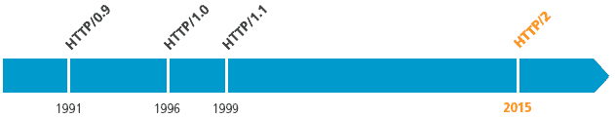
HTTP is Still Evolving
RFC 1945
RFC 2068
RFC 7540

Slide 11
HTTP 1.0 Message Flow
Server waits for requests from clients
Client initiates TCP connection (creates socket) to server, port 80
Client sends request for a document
Web server sends back the document
TCP connection closed
Client parses the document to find embedded objects (images)
  repeat above for each image

Slide 12
HTTP 1.0 Message Flow (more detail)
0. http server at host qiaoxiang.me waiting for TCP connection at port 80.
Suppose user enters URL
qiaoxiang.me/index.html
1a. http client initiates TCP connection to http server (process) at qiaoxiang.me. Port 80 is default for http server.
1b. server “accepts” connection, ack. client
2. http client sends http request message (containing URL) into TCP connection socket
3. http server receives request message, forms response message containing requested object (index.html), sends message into socket (the sending speed increases slowly, which is called slow-start)
time

Slide 13
HTTP 1.0 Message Flow (cont.)
4. http server closes TCP connection.
5. http client receives response message containing html file, parses html file, finds embedded image
time
6. Steps 1-5 repeated for each of the embedded images

Slide 14
Basic HTTP Server Workflow
Create ServerSocket(6789)
128.36.232.5
128.36.230.2
TCP socket space
state: listening
address: {*.6789, *.*}
completed connection queue:
sendbuf:
recvbuf:
connSocket = accept()
read request from connSocket
state: established
address: {128.36.232.5:6789, 198.69.10.10.1500}
sendbuf:
recvbuf:
Map URL to file
state: listening
address: {*.25, *.*}
completed connection queue:
sendbuf:
recvbuf:
Read from file/
write to connSocket
close connSocket

Slide 15
Example Code
See BasicWebServer.java
Try using telnet and real browser, and fetch
  file1.html
  index.html
  what difference in behavior?

Slide 16
Static -> Dynamic Content
Create ServerSocket(6789)
connSocket = accept()
It does not have to be a static file
read request from connSocket
Map URL to file
Read from file/
write to connSocket
close connSocket

Slide 17
Outline
Admin and recap
HTTP/1.0
  Basic design
  Dynamic content

Slide 18
Dynamic Content Pages
There are multiple approaches to make dynamic web pages:
  Embed code into pages (server side include)
    http server includes an interpreter for the type of pages
  Invoke external programs (http server is agnostic to the external program execution)
    E.g., Common Gateway Interface (CGI)
http://www.cs.yale.edu/index.shtml
http://www.cs.yale.edu/cgi-bin/ureserve.pl
http://www.google.com/search?q=Yale&sourceid=chrome

Slide 19
Example SSI
See programming/examples-java-socket/BasicWebServer/ssi/index.shtml, header.shtml, …
Notes:
https://httpd.apache.org/docs/2.2/howto/ssi.html

Slide 20
Example SSI
See programming/examples-java-socket/BasicWebServer/ssi/index.shtml, header.shtml, …
To enable ssi, need configuration to tell the web server (see conf/apache-htaccess)
  https://httpd.apache.org/docs/2.2/howto/htaccess.html (Server Side Includes example)
Notes:
https://httpd.apache.org/docs/2.2/howto/ssi.html

Slide 21
CGI: Invoking External Programs
Two issues
  Input: Pass HTTP request parameters to the external program
  Output: Redirect external program output to socket

Slide 22
Example: Typical CGI Implementation
Starts the executable as a child process
  Passes HTTP request as environment variables
    http://httpd.apache.org/docs/2.2/env.html
    CGI standard: http://www.ietf.org/rfc/rfc3875
  Redirects input/output of the child process to the socket

Slide 23
Example: CGI
Example:
  GET /search?q=Yale&sourceid=chrome HTTP/1.0
  setup environment variables, in particular
  $QUERY_STRING=q=Yale&sourceid=chrome
  start search and redirect its input/output
https://docs.oracle.com/javase/7/docs/api/java/lang/ProcessBuilder.html

Slide 24
Example
https://httpd.apache.org/docs/2.2/howto/htaccess.html
(CGI Example)
http://172.28.229.215/BasicWebServer/cgi/price.cgi?appl
#!/usr/bin/perl -w
$company = $ENV{'QUERY_STRING'};
print "Content-Type: text/html\r\n";
print "\r\n";
print "<html>";
print "<h1>Hello! The price is ";
if ($company =~ /appl/) {
my $var_rand = rand();
print 450 + 10 * $var_rand;
} else {
print "150";
}
print "</h1>";
print "</html>";
Notes:
https://httpd.apache.org/docs/2.2/howto/htaccess.html

Slide 25
Client Using Dynamic Pages
See ajax.html and wireshark for client code example
  http://172.28.229.215/BasicWebServer/cgi/ajax.html

Slide 26
Discussions
What features are missing in HTTP that we have covered so far?

Slide 27
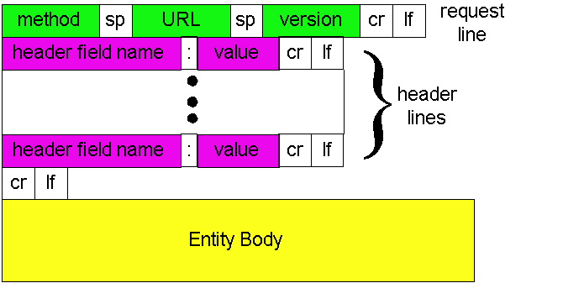
HTTP: POST
If an HTML page contains forms or parameter too large, they are sent using POST and encoded in message body

Slide 28
HTTP: POST Example
POST /path/script.cgi HTTP/1.0
User-Agent: MyAgent
Content-Type: application/x-www-form-urlencoded
Content-Length: 15
item1=A&item2=B
Example using nc:
programming/examples-java-socket/BasicWebServer/nc/

Slide 29
Stateful User-server Interaction: Cookies
client
server
Goal: no explicit application level session
Server sends “cookie” to client in response msg
  Set-cookie: 1678453
Client presents cookie in later requests
  Cookie: 1678453
Server matches presented-cookie with server-stored info
  authentication
  remembering user preferences, previous choices
usual http request msg
usual http response +
Set-cookie: #
usual http request msg
Cookie: #
cookie-
specific
action
usual http response msg
usual http request msg
Cookie: #
cookie-
specific
action
usual http response msg

Slide 30
Authentication of Client Request
client
server
Authentication goal: control access to server documents
stateless: client must present authorization in each request
authorization: typically name, password
  Authorization: header line in request
  if no authorization presented, server refuses access, sends
    WWW-authenticate:
    header line in response
usual http request msg
401: authorization req.
WWW-authenticate:
usual http request msg
+ Authorization:line
usual http response msg
usual http request msg
+ Authorization:line
usual http response msg
time
Browser caches name & password so
that user does not have to repeatedly enter it.

Slide 31
Example: Amazon S3
Amazon S3 API
  http://docs.aws.amazon.com/AmazonS3/latest/API/APIRest.html

Slide 32
HTTP as the Thin Waist
WebMail
WebApp…
HTTP
TCP
UDP
Ethernet
Wireless
Cable/DSL

Slide 33
Protocol Flow of Basic HTTP/1.0
>= 2 RTTs per object:
  TCP handshake --- 1 RTT
  client request and server
  responds --- at least 1 RTT
  (if object can be contained
  in one packet)
TCP SYN
TCP ACK
TCP/ACK; HTTP GET
base page
TCP SYN
TCP ACK
TCP/ACK; HTTP GET
image 1
Notes:
Typical approaches to reduce latency:
parallel TCP connections
persistent HTTP
cache and conditional GET

Slide 34
Outline
Admin and recap
HTTP/1.0
HTTP “acceleration”

Slide 35
Substantial Efforts to Speedup Basic HTTP/1.0
Reduce the number of objects fetched [Browser cache]
Reduce data volume [Compression of data]
Header compression [HTTP/2]
Reduce the latency to the server to fetch the content [Proxy cache]
Remove the extra RTTs to fetch an object [Persistent HTTP, aka HTTP/1.1]
Increase concurrency [Multiple TCP connections]
Asynchronous fetch (multiple streams) using a single TCP [HTTP/2]
Server push [HTTP/2]

Slide 36
Browser Cache and Conditional GET
client
server
Goal: don’t send object if client has up-to-date stored (cached) version
client: specify date of cached copy in http request
  If-modified-since: <date>
server: response contains no object if cached copy up-to-date:
  HTTP/1.0 304 Not Modified
http request msg
If-modified-since: <date>
object
not
modified
http response
HTTP/1.0
304 Not Modified
http request msg
If-modified-since: <date>
object
modified
http response
HTTP/1.1 200 OK
…
<data>

Slide 37
Web Caches (Proxy)
Goal: satisfy client request without involving origin server
origin
server
Proxy
server
http request
http request
client
http response
http response
http request
http request
http response
http response
client
origin
server

Slide 38
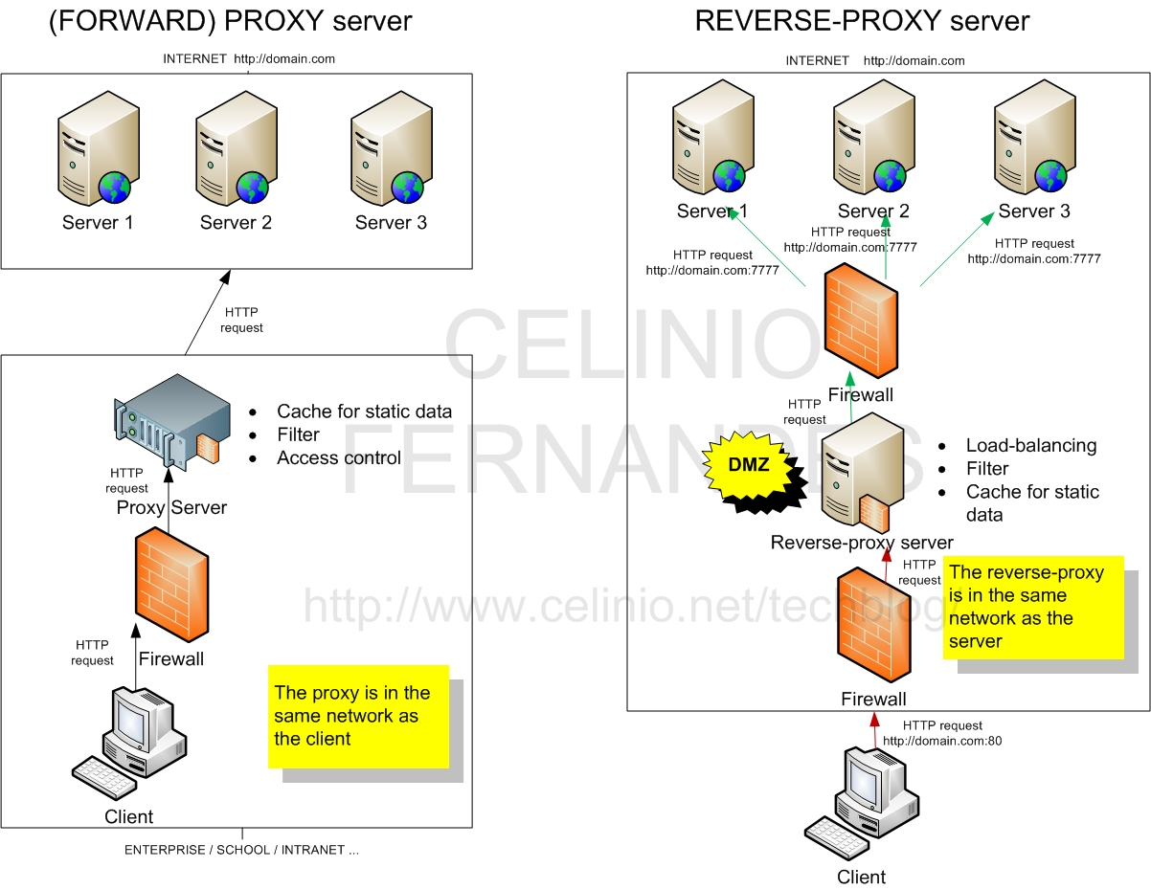
Two Types of Proxies
http://www.celinio.net/techblog/?p=1027
Typically
in the same network as
the client
    Typically in the same network as the server

Slide 39
Benefits of Forward Proxy
origin
servers
Assume: cache is “close” to client (e.g., in same network)
smaller response time: cache “closer” to client
decrease traffic to distant servers
  link out of institutional/local ISP network often is bottleneck
public
Internet
1.5 Mbps
access link
institutional
network
10 Mbps LAN
institutional
cache

Slide 40
No Free Lunch: Problems of Web Caching
The major issue of web caching is how to maintain consistency
Two ways
  pull
    Web caches periodically pull the web server to see if a document is modified
  push
    whenever a server gives a copy of a web page to a web cache, they sign a lease with an expiration time; if the web page is modified before the lease, the server notifies the cache

