Slide 1
Network Transport Layer: Overview; UDP; Stop-and-Wait ARQ
Qiao Xiang, Congming Gao, Qiang Su
https://sngroup.org.cn/courses/cnns-xmuf25/index.shtml
10/23/2025
This deck of slides are heavily based on CPSC 433/533 at Yale University, by courtesy of Dr. Y. Richard Yang.

Slide 2
Outline
Admin and recap
Overview of transport layer
UDP
Reliable data transfer, the stop-and-go protocols

Slide 3
Admin
Midterm exam on Oct. 28 (during lab class)
cover from introduction to application layer
15-16 subjective questions over 100 minutes
1-page cheat sheet allowed
Lab 3 due on Oct.29

Slide 4
Recap: Scalability of Server-Only Approaches
origin
DNS
edge. servers
C₀
client 1
client 2
client n
client 3

Slide 5
Server+Host (P2P) Content Distribution: Key Design Issues
Robustness
Resistant to churns and failures
Efficiency
A client has content that others need; otherwise, its upload capacity may not be utilized
Incentive: clients are willing to upload
Some real systems nearly 50% of all responses are returned by the top 1% of sharing hosts
servers
C₀
C₁
client 1
C_{n}
C₂
C₃
client 2
client n
client 3

Slide 6
Recap
Applications
Client-server applications
Single server
Multiple servers load balancing
Application overlays (distributed network applications) to
scale bandwidth/resource (BitTorrent)
distribute content lookup (Freenet, DHT, Chord) [optional]
distribute content verification (Block chain) [optional]
achieve anonymity (Tor) [optional]

Slide 7
Outline
Admin and recap
Overview of transport layer
UDP
Reliable data transfer, the stop-and-go protocols

Slide 8
Overview
Provide logical communication between app’ processes
Transport protocols run in end systems
send side: breaks app messages into segments, passes to network layer
rcv side: reassembles segments into messages, passes to app layer
Transport vs. network layer services:
Network layer: data transfer between end systems
Transport layer: data transfer between processes
relies on, enhances network layer services
application
transport
network
data link
physical
network
data link
physical
network
data link
physical
network
data link
physical
logical end-end transport
network
data link
physical
network
data link
physical
application
transport
network
data link
physical

Slide 9
Transport Layer Services and Protocols
Reliable, in-order delivery (TCP)
multiplexing
reliability and connection setup
congestion control
flow control
Unreliable, unordered delivery: UDP
multiplexing
Services not available:
delay guarantees
bandwidth guarantees
Notes:
https://www.ietf.org/proceedings/99/slides/slides-99-maprg-the-quic-transport-protocol-design-and-internet-scale-deployment-01.pdf

Slide 10
Transport Layer: Road Ahead
Class 1 (today):
transport layer services
connectionless transport: UDP
reliable data transfer using stop-and-wait/alternating-bit protocol
Class 2 (ready for lab assignment 4/part 1):
sliding window reliability
TCP reliability
overview of TCP
TCP RTT measurement
TCP connection management
Class 3 (ready for lab assignment 4/part 2 [optional]):
principles of congestion control
TCP congestion control; AIMD; TCP Reno
Class 4:
TCP Vegas, performance modeling; Nash Bargaining solution
Class 5:
primal-dual as a resource allocation and analysis framework
…

Slide 11
Outline
Admin and recap
Overview of transport layer
UDP and error checking
Reliable data transfer, the stop-and-go protocols

Slide 12
UDP: User Datagram Protocol [RFC 768]
Often used for streaming multimedia apps
loss tolerant
rate sensitive
Other UDP uses
DNS
SNMP
32 bits
Length, in
bytes of UDP segment,
including
header
source port #
dest port #
length
checksum
Application
data
(message)
UDP segment format

Slide 13
UDP Checksum
Goal: end-to-end detection of “errors” (e.g., flipped bits) in transmitted segment
Sender:
treat segment contents as sequence of 16-bit integers
checksum: addition of segment contents to be zero
sender puts checksum value into UDP checksum field
Receiver:
compute sum of segment and checksum; check if sum zero
NO - error detected
YES - no error detected. But maybe errors nonetheless?

Slide 14
One’s Complement Arithmetic
UDP checksum is based on one’s complement arithmetic
one’s complement was a common representation of signed numbers in early computers
One’s complement representation
bit-wise NOT for negative numbers
example: assume 8 bits
00000000: 0
00000001: 1
01111111: 127
10000000: ?
11111111: ?
addition: conventional binary addition except adding any resulting carry back into the resulting sum
Example: -1 + 2
Notes:
Two zeros turned out to be handy: +0 for no check sum, -0 for checksum
Add the carry back to the sum treats all bits “equally”

Slide 15
UDP Checksum: Algorithm
Example checksum:
1 1 1 1 0 0 1 1 0 0 1 1 0 0 1 1 0
1 1 1 0 1 0 1 0 1 0 1 0 1 0 1 0 1
1 1 0 1 1 1 0 1 1 1 0 1 1 1 0 1 1
1 1 0 1 1 1 0 1 1 1 0 1 1 1 1 0 0
0 1 0 0 0 1 0 0 0 1 0 0 0 0 1 1
wraparound
sum
checksum
- For fast implementation of computing UDP checksum, see http://www.faqs.org/rfcs/rfc1071.html
Notes:
Common among many early computers: PDP-1 and UNIVAC 1100/2200 series

Slide 16
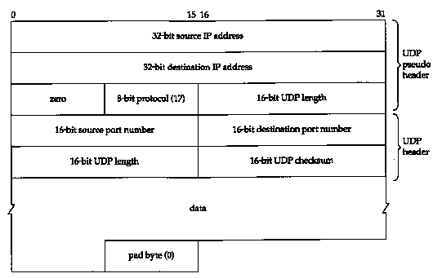
UDP Checksum: Coverage
Calculated over:
A pseudo-header
IP Source Address (4 bytes)
IP Destination Address (4 bytes)
Protocol (2 bytes)
UDP Length (2 bytes)
UDP header
UDP data
Notes:
Limitation: 2 string, same bit, each flip

Slide 17
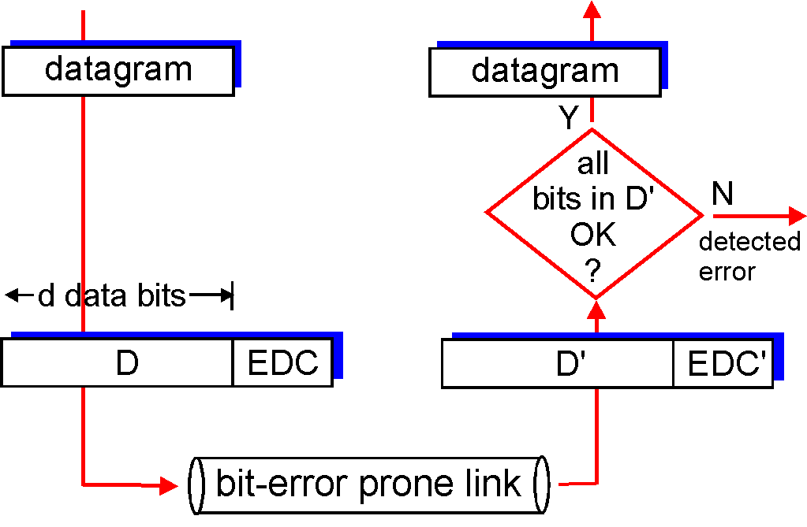
General Error Detection (Checksum)
‘
D = Data protected by error checking, may include header fields
ED = Error Detection bits (redundancy)
Error detection not 100% reliable!
a good error detector may miss some errors, but rarely
larger ED field generally yields better detection

Slide 18
Cyclic Redundancy Check: Background
Widely used in practice, e.g.,
Ethernet, DOCSIS (Cable Modem), FDDI, PKZIP, WinZip, PNG
For a given data D, consider it as a polynomial D(x)
consider the string of 0 and 1 as the coefficients of a polynomial
e.g. consider string 10011 as x⁴+x+1
addition and subtraction are modular 2, thus the same as xor
Choose generator polynomial G(x) with r+1 bits, where r is called the degree of G(x)

Slide 19
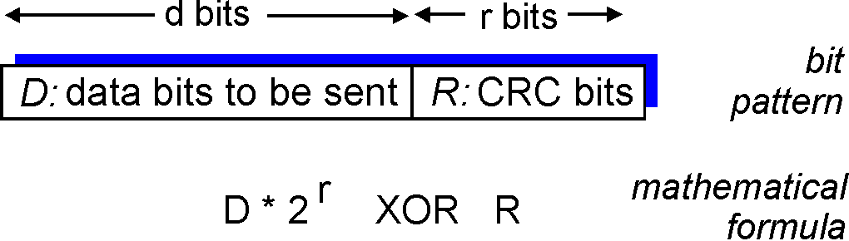
Cyclic Redundancy Check: Encode
Given data G(x) and D(x), choose R(x) with r bits, such that
D(x)x^{r}+R(x) is exactly divisible by G(x)
The bits correspond to D(x)x^{r}+R(x) are sent to the receiver
x
+

Slide 20
Cyclic Redundancy Check: Decode
Since G(x) is global, when the receiver receives the transmission T’(x), it divides T’(x) by G(x)
if non-zero remainder: error detected!
if zero remainder, assumes no error
Encode: CRC(G)
T = D(x)x^{r}+R(x)
T’
check
D

Slide 21
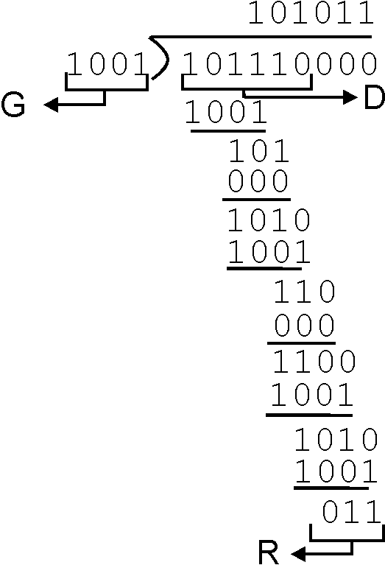
CRC: Steps and an Example
Suppose the degree of G(x) is r
Append r zero to D(x), i.e. consider D(x)x^{r}
Divide D(x)x^{r} by G(x). Let R(x) denote the reminder
Send <D, R> to the receiver

Slide 22
The Power of CRC
Let T(x) denote D(x)x^{r}+R(x), and E(x) the polynomial of the error bits
the received signal is T’(x) = T(x)+E(x)
Since T(x) is divisible by G(x), we only need to consider if E(x) is divisible by G(x)
Encode: CRC(G)
T = D(x)x^{r}+R(x)
T’
check
D

Slide 23
The Power of CRC
Detect a single-bit error: E(x) = x^{i}
if G(x) contains two or more terms, E(x) is not divisible by G(x)
Detect an odd number of errors: E(x) has an odd number of terms:
lemma: if E(x) has an odd number of terms, E(x) cannot be divisible by (x+1)
suppose E(x) = (x+1)F(x), let x=1, the left hand will be 1, while the right hand will be 0
thus if G(x) contains x+1 as a factor, E(x) will not be divided by G(x)
Many more errors can be detected by designing the right G(x)

Slide 24
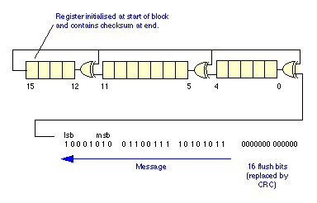
Example G(x)
16 bits CRC:
CRC-16: x¹⁶+x¹⁵+x²+1, CRC-CCITT: x¹⁶+x¹²+x⁵+1
both can catch
all single or double bit errors
all odd number of bit errors
all burst errors of length 16 or less
>99.99% of the 17 or 18 bits burst errors
CRC-16 hardware implementation
Using shift and XOR registers
http://en.wikipedia.org/wiki/CRC-32#Implementation

Slide 25



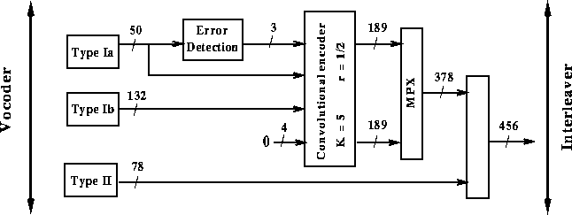
Example G(x)
32 bits CRC:
CRC32: x³² + x²⁶ + x²³ + x²² + x¹⁶ + x¹² + x¹¹ + x¹⁰ + x⁸ + x⁷ + x⁵ + x⁴ + x² + x + 1
used by Ethernet, FDDI, PKZIP, WinZip, and PNG
GSM phones
For more details see the link below and further links it contains:
http://en.wikipedia.org/wiki/Cyclic_redundancy_check
.

Slide 26
Outline
Admin and recap
Transport overview
UDP
Reliable data transfer

Slide 27
Principles of Reliable Data Transfer (RDT)
Important in app., transport, link layers
Foundation to other protocols
We use the development of RDT to also better appreciate understanding distributed protocols

Slide 28
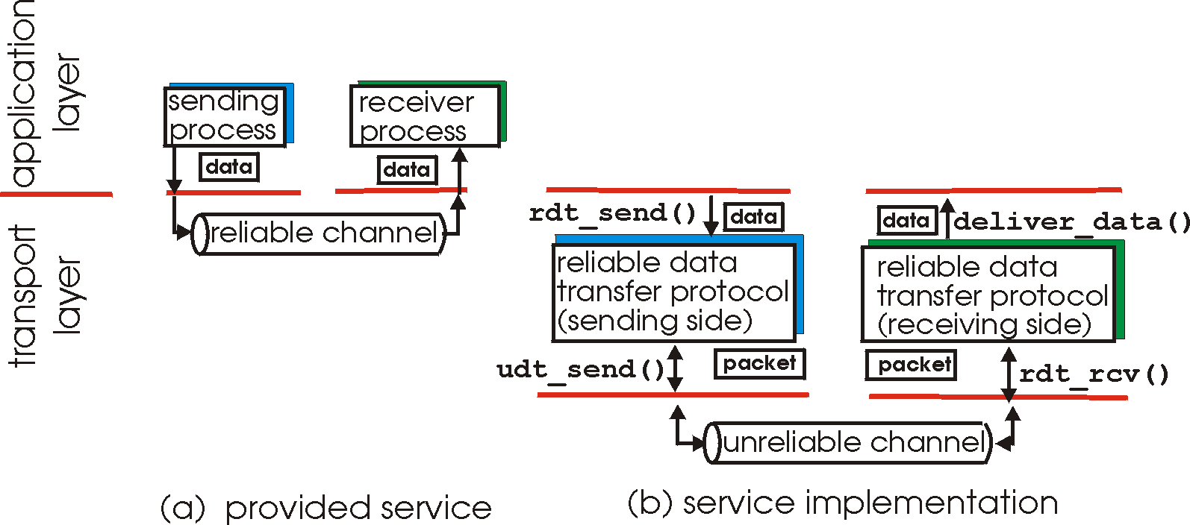
Reliable Data Transfer

Slide 29
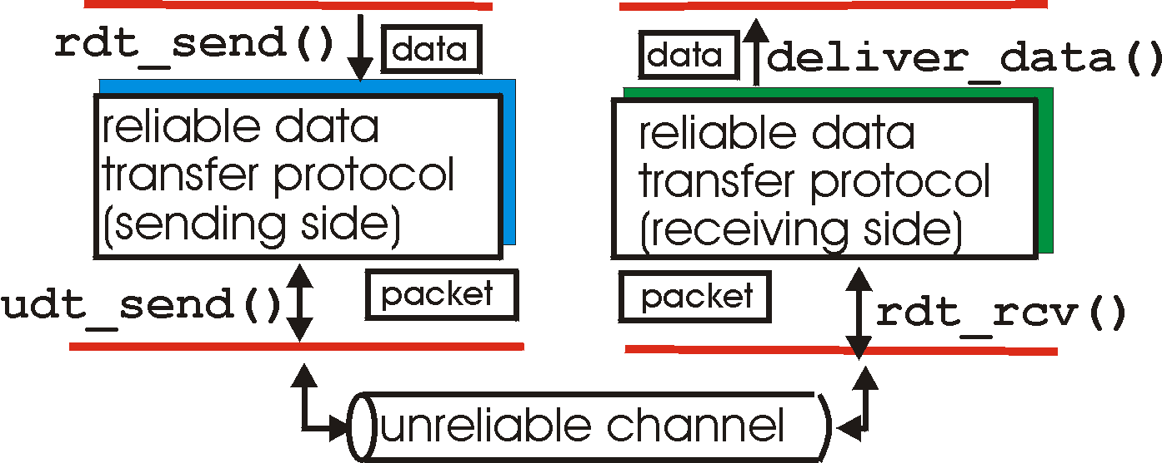
Reliable Data Transfer: Getting Started
rdt_send(): called from above, (e.g., by app.)
deliver_data(): called by rdt to deliver data to upper
send
side
receive
side
udt_send(): called by rdt,
to transfer packet over
unreliable channel to receiver
rdt_rcv(): called from below; when packet arrives on rcv-side of channel

Slide 30
Reliable Data Transfer: Getting Started
We’ll:
incrementally develop sender, receiver sides of reliable data transfer protocol (rdt)
consider only unidirectional data transfer
but control info will flow on both directions !
use finite state machines (FSM) to specify sender, receiver
event causing state transition
actions taken on state transition
state: when in this “state” next state uniquely determined by next event
state
1
state
2
event
actions

Slide 31
Outline
Admin and review
Overview of transport layer
UDP and error checking
Reliable data transfer
perfect channel

Slide 32
Rdt1.0: reliable transfer over a reliable channel
separate FSMs for sender, receiver:
sender sends data into underlying channel
receiver reads data from underlying channel
Wait for call from above
rdt_send(data)
Wait for call from below
rdt_rcv(packet)
extract (packet,data)
deliver_data(data)
packet = make_pkt(data)
udt_send(packet)
sender
receiver
Exercise: Prove correctness of Rdt1.0.
Correctness: for every single packet, one and only one copy is received by receiver correctly (no error) and in-order
Notes:
correctness: every single packet received correctly, received by one and only one at receiver, and received in-order

Slide 33
Potential Channel Errors
bit errors
loss (drop) of packets
reordering or duplication
Characteristics of unreliable channel will determine complexity of reliable data transfer protocol (rdt).

Slide 34
Outline
Admin and recap
Overview of transport layer
Reliable data transfer
perfect channel
channel with bit errors

Slide 35
rdt2.0: Channel With Bit Errors
Assume: Underlying channel may only flip bits in packet
Wait for call from above
rdt_send(data)
Wait for call from below
rdt_rcv(packet)
extract (packet,data)
deliver_data(data)
packet = make_pkt(data)
udt_send(packet)
sender
receiver
Exercise: What correctness requirement(s) rdt1.0 cannot provide?

Slide 36
rdt2.0: Channel With Bit Errors
New mechanisms in rdt2.0 (beyond rdt1.0):
receiver error detection: recall: UDP checksum/Ethernet CRC detects bit errors
receiver feedback: control msgs (ACK,NAK) rcvr->sender
acknowledgements (ACKs): receiver explicitly tells sender that pkt received OK
negative acknowledgements (NAKs): receiver explicitly tells sender that pkt had errors
sender retransmission
sender retransmits pkt on receipt of NAK

Slide 37
rdt2.0: FSM Specification
rdt_send(data)
sndpkt = make_pkt(data, checksum)
udt_send(sndpkt)
receiver
rdt_rcv(rcvpkt) &&
isNAK(rcvpkt)
Wait for data
Wait for ACK or NAK
rdt_rcv(rcvpkt) &&
corrupt(rcvpkt)
udt_send(sndpkt)
udt_send(NAK)
rdt_rcv(rcvpkt) && isACK(rcvpkt)
Λ
Wait for data
sender
rdt_rcv(rcvpkt) &&
notcorrupt(rcvpkt)
extract(rcvpkt,data)
deliver_data(data)
udt_send(ACK)

Slide 38
rdt2.0: Operation with No Errors
rdt_send(data)
snkpkt = make_pkt(data, checksum)
udt_send(sndpkt)
rdt_rcv(rcvpkt) &&
isNAK(rcvpkt)
Wait for data
Wait for ACK or NAK
rdt_rcv(rcvpkt) &&
corrupt(rcvpkt)
udt_send(sndpkt)
udt_send(NAK)
rdt_rcv(rcvpkt) && isACK(rcvpkt)
Wait for data
Λ
rdt_rcv(rcvpkt) &&
notcorrupt(rcvpkt)
extract(rcvpkt,data)
deliver_data(data)
udt_send(ACK)

Slide 39
rdt2.0: Error Scenario
rdt_send(data)
snkpkt = make_pkt(data, checksum)
udt_send(sndpkt)
rdt_rcv(rcvpkt) &&
isNAK(rcvpkt)
Wait for data
Wait for ACK or NAK
rdt_rcv(rcvpkt) &&
corrupt(rcvpkt)
udt_send(sndpkt)
udt_send(NAK)
rdt_rcv(rcvpkt) && isACK(rcvpkt)
Λ
Wait for data
rdt_rcv(rcvpkt) &&
notcorrupt(rcvpkt)
extract(rcvpkt,data)
deliver_data(data)
udt_send(ACK)

Slide 40
Rdt2.0 Analysis
sender
receiver
data (n)
Execution traces of rdt2.0: {data^ NACK}* data deliver ACK
waiting for N/ACK
NACK
data (n)
Analyzing set of all possible execution traces is a common technique to understand and analyze many types of distributed protocols.
ACK
waiting for data
data (n+1)

