Slide 1
Network Transport Layer:
TCP
  Qiao Xiang, Congming Gao, Qiang Su
  https://sngroup.org.cn/courses/cnns-xmuf25/index.shtml
  11/04/2025
This deck of slides are heavily based on CPSC 433/533 at Yale University, by courtesy of Dr. Y. Richard Yang.

Slide 2
Outline
Admin and recap
TCP

Slide 3
rdt3.0: Stop-and-Wait Performance
sender
receiver
first packet bit transmitted, t = 0
last packet bit transmitted, t = L / R
first packet bit arrives
RTT
last packet bit arrives, send ACK
ACK arrives, send next
packet, t = RTT + L / R
  What is U_{sender}: utilization – fraction of time link busy sending?
Assume: 1 Gbps link, 15 ms e-e prop. delay, 1KB packet
3

Slide 4
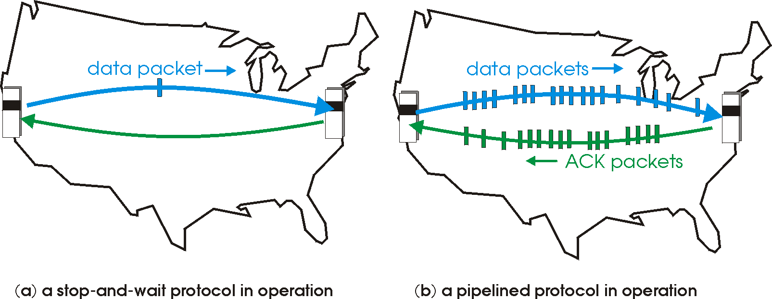
Recap: Reliable Transport
Basic structure: sliding window protocols
Realization: GBN or SR
General technique:
pipelining.

Slide 5
TCP Reliable Data Transfer
Connection-oriented:
  connection management
    setup (exchange of control msgs) init’s sender, receiver state before data exchange
    close
Full duplex data:
  bi-directional data flow in same connection
A sliding window protocol
  a combination of go-back-n and selective repeat:
    send & receive buffers
    cumulative acks
    TCP uses a single retransmission timer
    do not retransmit all packets upon timeout

Slide 6
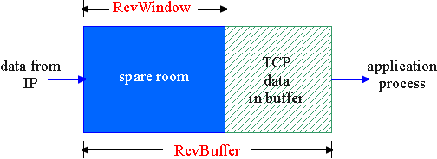
Flow Control
flow control
sender won’t overflow
receiver’s buffer by
transmitting too much,
too fast
receive side of a connection has a receive buffer:
speed-matching service: matching the send rate to the receiving app’s drain rate
app process may be slow at reading from buffer

Slide 7
TCP Flow Control: How it Works
source port #
dest port #
sequence number
acknowledgement number
head
len
not
used
U
A
rcvr window size
P
R
S
F
checksum
ptr urgent data
spare room in buffer
= RcvWindow
Options (variable length)
application
data
(variable length)

Slide 8
TCP Seq. #’s and ACKs
Seq. #’s:
  byte stream “number” of first byte in segment’s data
ACKs:
  seq # of next byte expected from other side
  cumulative ACK in standard header
  selective ACK in options
Host A
Host B
User
types
‘C’
Seq=42, ACK=79, data = ‘C’
host ACKs
receipt of
‘C’, echoes
back ‘C’
Seq=79, ACK=43, data = ‘C’
host ACKs
receipt
of echoed
‘C’
Seq=43, ACK=80
time
simple telnet scenario

Slide 9
TCP Send/Ack Optimizations
TCP includes many tune/optimizations, e.g.,
  the “small-packet problem”: sender sends a lot of small packets (e.g., telnet one char at a time)
    Nagle’s algorithm: do not send data if there is small amount of data in send buffer and there is an unack’d segment
  the ”ack inefficiency” problem: receiver sends too many ACKs, no chance of combing ACK with data
    Delayed ack to reduce # of ACKs/combine ACK with reply

Slide 10
TCP Receiver ACK Generation [RFC 1122, RFC 2581]
Event at Receiver
Arrival of in-order segment with
expected seq #. All data up to
expected seq # already ACKed
Arrival of in-order segment with
expected seq #. One other
segment has ACK pending
Arrival of out-of-order segment
higher-than-expect seq. # .
Gap detected
Arrival of segment that
partially or completely fills gap
TCP Receiver Action
Delayed ACK. Wait up to 500ms
for next segment. If no next segment,
send ACK
Immediately send single cumulative
ACK, ACKing both in-order segments
Immediately send duplicate ACK,
indicating seq. # of next expected byte
Immediate send ACK, provided that
segment starts at lower end of gap

Slide 11
Outline
Admin and Recap
Reliable data transfer
  perfect channel
  channel with bit errors
  channel with bit errors and losses
  sliding window: reliability with throughput
TCP reliability
  data seq#, ack, buffering
  timeout realization

Slide 12
TCP Reliable Data Transfer
Basic structure: sliding window protocol
Remaining issue: How to determine the “right” parameters?
  timeout value?
  sliding window size?

Slide 13
History
Key parameters for TCP in mid-1980s
  fixed window size W
  timeout value = 2 RTT
Network collapse in the mid-1980s
  UCB ←→ LBL throughput dropped by 1000X !
The intuition was that the collapse was caused by wrong parameters…

Slide 14
Timeout: Cost of Timeout Param
Why is good timeout value important?
too short
  premature timeout
  unnecessary retransmissions; many duplicates
too long
  slow reaction to segment loss
Q: Is it possible to set Timeout as a constant?
Q: Any problem w/ the early approach: Timeout = 2 RTT

Slide 15
Setting Timeout
Problem:
Ideally, we set timeout = RTT,
but RTT is not a fixed value
=>
using the average of RTT will generate
many timeouts due to network variations
Possibility: using the average/median of RTT
Issue: this will generate many timeouts due to network variations
Solution:
Set Timeout RTO = avg + “safety margin” based on variation
freq.
RTT
TCP approach:
Timeout = EstRTT + 4 * DevRTT

Slide 16
Compute EstRTT and DevRTT
Exponential weighted moving average (EWMA)
  influence of past sample decreases exponentially fast
EstRTT = (1-alpha)*EstRTT + alpha*SampleRTT
- SampleRTT: measured time
from segment transmission
until ACK receipt
- typical value: alpha = 0.125
DevRTT = (1-beta)*DevRTT + beta|SampleRTT-EstRTT|
(typically, beta = 0.25)

Slide 17
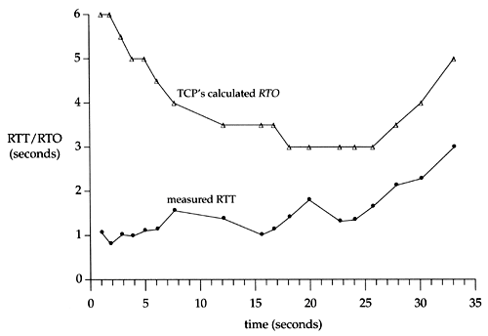
An Example TCP Session

Slide 18
Fast Retransmit
Issue: Timeout period often relatively long:
  long delay before resending lost packet
Question: Can we detect loss faster than RTT?
Detect lost segments via duplicate ACKs
  sender often sends many segments back-to-back
  if segment is lost, there will likely be many duplicate ACKs
If sender receives 3 ACKs for the same data, it supposes that segment after ACKed data was lost:
  resend segment before timer expires

Slide 19
Triple Duplicate Ack
Packets
1
2
3
4
5
6
7
Acknowledgements (waiting seq#)
2
3
4
4
4
4

Slide 20
Fast Retransmit:
event: ACK received, with ACK field value of y
if (y > SendBase) {
…
SendBase = y
if (there are currently not-yet-acknowledged segments)
start timer
…
}
else {
increment count of dup ACKs received for y
if (count of dup ACKs received for y = 3) {
resend segment with sequence number y
…
a duplicate ACK for
already ACKed segment
fast retransmit

Slide 21
TCP: reliable data transfer
00 sendbase = initial_sequence number agreed by TWH
01 nextseqnum = initial_sequence number by TWH
02 loop (forever) {
03 switch(event)
04 event: data received from application above
05 if (window allows send)
06 create TCP segment with sequence number nextseqnum
06 if (no timer) start timer
07 pass segment to IP
08 nextseqnum = nextseqnum + length(data)
else put packet in buffer
09 event: timer timeout for sendbase
10 retransmit segment
11 compute new timeout interval
12 restart timer
13 event: ACK received, with ACK field value of y
14 if (y > sendbase) { /* cumulative ACK of all data up to y */
15 cancel the timer for sendbase
sendbase = y
if (no timer and packet pending) start timer for new sendbase
while (there are segments and window allow)
sent a segment;
18 }
19 else { /* y==sendbase, duplicate ACK for already ACKed segment */
20 increment number of duplicate ACKs received for y
21 if (number of duplicate ACKS received for y == 3) {
22 /* TCP fast retransmit */
23 resend segment with sequence number y
24 restart timer for segment y
25 }
26 } /* end of loop forever */
Simplified
TCP
sender

Slide 22
Outline
Admin and Recap
Reliable data transfer
  perfect channel
  channel with bit errors
  channel with bit errors and losses
  sliding window: reliability with throughput
TCP reliability
  data seq#, ack, buffering
  timeout realization
  connection management

Slide 23
Why Connection Setup/When to Accept (Safely Deliver) First Packet?
sender
receiver
data 0
accept
ACK for 0

Slide 24
Why Connection Setup/When to Accept (Safely Deliver) First Packet?
sender
receiver
data 0 (transfer $1000 to B)
accept
ACK for 0 (n)
data 0 (transfer $1000 to B)
accept?
24
Notes:
a sender should not reuse a seq# before it is sure the packet has left the network

Slide 25
Transport “Safe-Setup” Principle
A general safety principle for a receiver R to accept a message from a sender S is the general “authentication” principle, which consists of two conditions:
  Transport authentication principle:
  [p1] Receiver can be sure that what Sender says is fresh
  [p2] Receiver receives something that only Sender can say
We first assume a secure setting: no malicious attacks.
Exercise: Techniques to allow a receiver to check for freshness
(e.g., add a time stamp)?

Slide 26
Generic Challenge-Response Structure Checking Freshness
sender
receiver
I have data to send
deliver
Challenge (nonce)
Demonstrate knowing nonce; data

Slide 27
Three Way Handshake (TWH) [Tomlinson 1975]
Host A
Host B
SYN(seq=x)
notify initial seq#. Accept?
ACK(seq=x), SYN(seq=y)
think of y as a challenge
ACK(seq=y)
accept data only after
verified y is bounced back
x is the init. seq
DATA(seq=x+1)
SYN: indicates connection setup
Notes:
Syn(seq=x) could be duplicate or malicious

Slide 28
Scenarios with Duplicate Request/SYN Attack
Host A
Host B
SYN(seq=x)
accept?
ACK(seq=x), SYN(seq=y)
no such
request
REJECT(seq=y)
reject

Slide 29
Scenarios with Duplicate Request/SYN Attack
Host A
Host B
SYN(seq=x)
accept?
ACK(seq=x), SYN(seq=y)
no such
request
ACK(seq=z)
reject
REJECT(seq=y)

Slide 30
Make “Challenge y” Robust
To avoid that “SYNC ACK y” comes from reordering and duplication
  for each connection (sender-receiver pair), ensuring that two identically numbered packets are never outstanding at the same time
    network bounds the life time of each packet
    a sender will not reuse a seq# before it is sure that all packets with the seq# are purged from the network
    seq. number space should be large enough to not limit transmission rate
Increasingly move to cryptographic challenge and response
Notes:
Add QUIC design: QUIC uses a cryptographic handshake
Servers
front-end servers, which collectively handle billions of requests a day from web browsers and mobile apps across a wide range of services.
On the client side, we have deployed QUIC in
Chrome,
our mobile video streaming YouTube app, and in the
Google Search app on Android
TCP connections commonly incur at least one round-trip delay of connection setup time before any application data can be sent, and TLS adds two round trips to this delay

Slide 31
Connection Close
Why connection close?
  so that each side can release resource and remove state about the connection (do not want dangling socket)
client
server
init. close
release
resource?
I am done. Are you done too?
close
I am done too. Goodbye!
release
resource?
close
release
resource?

Slide 32
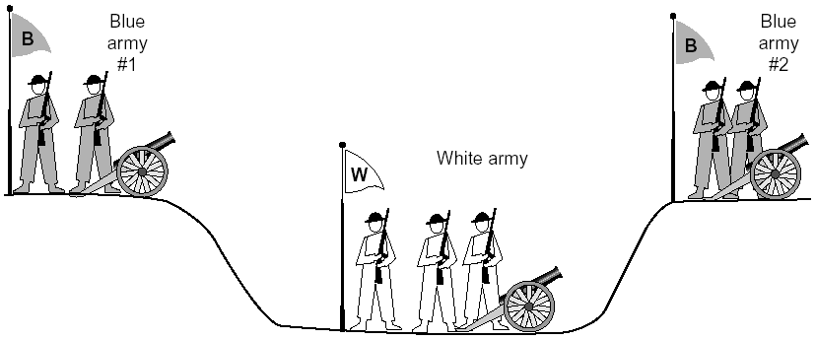
General Case: The Two-Army Problem
The gray (blue) armies need to agree on whether or not they will attack the white army. They achieve agreement by sending messengers to the other side. If they both agree, attack; otherwise, no. Note that a messenger can be captured!

Slide 33
Time_Wait
Generic technique: Timeout to “solve” infeasible problem
  Instead of message-driven state transition, use a timeout based transition; use timeout to handle error cases
client
server
init. close
release
resource?
I am done. Are you done too?
Working
Closed
close
I am done too. Goodbye!
release
resource?
close
Working
Time_Waiit
Closed
release
resource?

Slide 34
Time_Wait Design Options
Design 1 (initiator time wait)
Design 2 (receiver time wait)
Host A
Host B
Host A
Host B
close
FIN
close
FIN
Time = n x timeout
Time to retry FIN
after each timeout
Close after receive FIN
All states removed
ACK
Time to retransmit
ACK
Close after
first ACK
All states removed
ACK
All states removed
All states removed

Slide 35
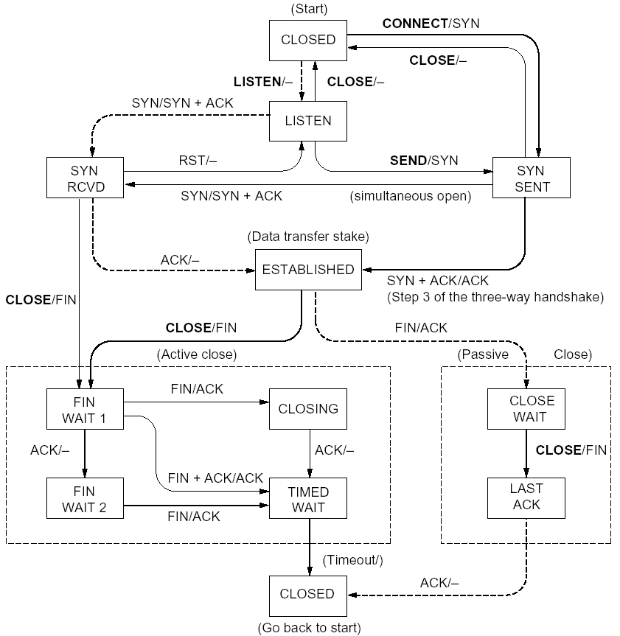
%netstat -t -a
CLOSED
SYN
SENT
CLOSED
SYN
LISTEN
SYN
RCVD
SYN/ACK
ESTABLSIHED
ACK
ESTABLSIHED
ESTABLSIHED
ESTABLSIHED
FIN
WAIT 1
FIN
CLOSE
WAIT
ACK
LAST
ACK
FIN
WAIT 2
FIN
TIME
WAIT
ACK

Slide 36
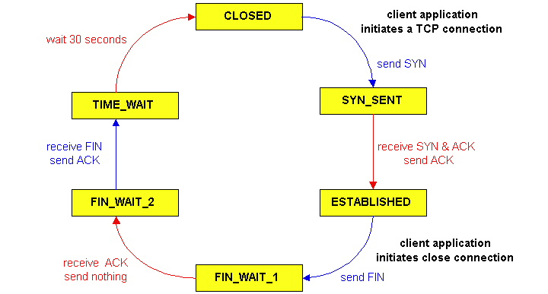
TCP Connection Management
CLOSED
SYN
SENT
CLOSED
TCP lifecycle: init SYN/FIN
SYN
SYN
RCVD
SYN/ACK
ESTABLSIHED
ACK
ESTABLSIHED
ESTABLSIHED
FIN
WAIT 1
FIN
CLOSE
WAIT
ACK
LAST
ACK
FIN
WAIT 2
FIN
TIME
WAIT
ACK
http://dsd.lbl.gov/TCP-tuning/ip-sysctl-2.6.txt

Slide 37
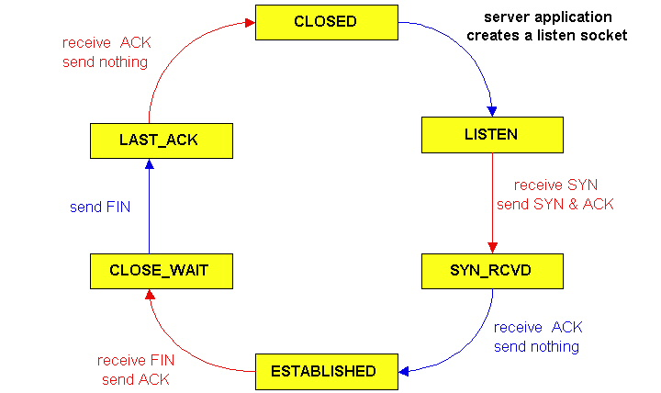
TCP Connection Management
CLOSED
SYN
SENT
CLOSED
SYN
TCP lifecycle: wait for SYN/FIN
SYN
RCVD
SYN/ACK
ESTABLSIHED
ACK
ESTABLSIHED
ESTABLSIHED
FIN
WAIT 1
FIN
CLOSE
WAIT
ACK
LAST
ACK
FIN
WAIT 2
FIN
TIME
WAIT
ACK

Slide 38
A Summary of Questions
Basic structure: sliding window protocols
How to determine the “right” parameters?
  timeout: mean + variation
  sliding window size?

Slide 39
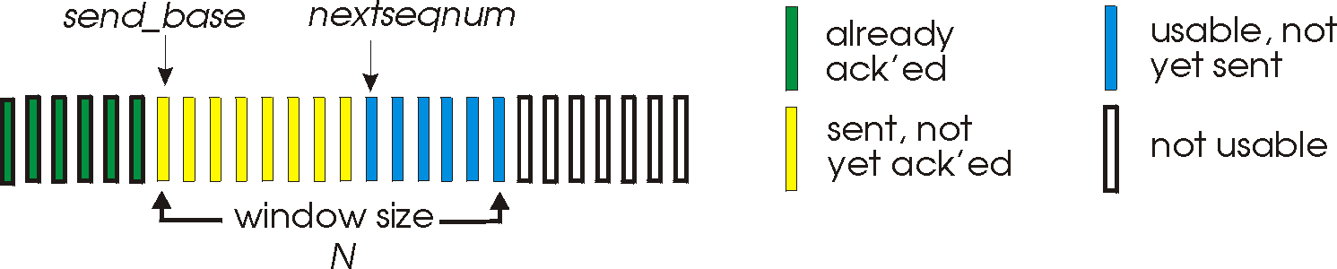
Sliding Window Size Function: Rate Control
Transmission rate determined by congestion window size, cwnd, over segments:
cwnd
cwnd segments, each with MSS bytes sent in one RTT:
cwnd * MSS
Rate =
Bytes/sec
RTT
Assume W is small enough. Ignore small details. MSS: Minimum Segment Size

Slide 40
Some General Questions
Big picture question:
How to determine a flow’s sending rate?
For better understanding, we need to look at a few basic questions:
What is congestion (cost of congestion)?
Why are desired properties of congestion control?

Slide 41
Roadmap
What is congestion
The basic CC alg
TCP/reno CC
TCP/Vegas
A unifying view of TCP/Reno and TCP/Vegas
Network wide resource allocation
  Framework
  Axiom derivation of network-wide objective function
  Derive distributed algorithm

Slide 42
Outline
Admin and recap
TCP Reliability
Transport congestion control
  what is congestion (cost of congestion)

Slide 43
Cause/Cost of Congestion: Single Bottleneck
flow 1
20 Mbps
5 Mbps
10 Mbps
flow 2 (5 Mbps)
20 Mbps
20 Mbps
router 1
router 2
- Flow 2 has a fixed sending rate of 5 Mbps
- We vary the sending rate of flow 1 from 0 to 20 Mbps
- Assume
  no retransmission; link from router 1 to router 2 has infinite buffer
throughput: e2e packets delivered in unit time
Delay?
throughput of
flow 1 & 2 (Mbps)
delay at central link
delay due to
randomness
10
sending rate
by flow 1 (Mbps)
sending rate
by flow 1 (Mbps)
5
0
5
5
0

Slide 44
Cause/Cost of Congestion: Single Bottleneck
router 3
router 5
flow 1
20 Mbps
5 Mbps
10 Mbps
flow 2 (5 Mbps)
20 Mbps
20 Mbps
router 1
router 2
router 4
router 6
Assume
  no retransmission
  the link from router 1 to router 2 has finite buffer
  throughput: e2e packets delivered in unit time
Zombie packet: a packet dropped at the link from router 2 to router 5; the upstream transmission from router 1 to router 2 used for that packet was wasted!
throughput of
flow 1 & 2 (Mbps)
10
sending rate
by flow 1 (Mbps)
5
x
0
5

Slide 45
Summary: The Cost of Congestion
When sources sending rate too high for the network to handle”:
Packet loss =>
  wasted upstream bandwidth when a pkt is discarded at downstream
  wasted bandwidth due to retransmission (a pkt goes through a link multiple times)
High delay
packet
loss
knee
cliff
Throughput
congestion
collapse
Load
Delay
Load

