Slide 1
Network Transport Layer: Network Resource Allocation Framework
Qiao Xiang, Congming Gao, Qiang Su
https://sngroup.org.cn/courses/cnns-xmuf25/index.shtml
11/11/2025
This deck of slides are heavily based on CPSC 433/533 at Yale University, by courtesy of Dr. Y. Richard Yang.

Slide 2
Outline
Admin and recap
Transport congestion control
what is congestion (cost of congestion)
basic congestion control alg.
TCP/Reno congestion control
TCP Cubic
TCP/Vegas
network wide resource allocation
general framework
objective function: axiom derivation of network-wide objective function
algorithm: general distributed algorithm framework
application: TCP/Reno TCP/Vegas revisited
2

Slide 3
congestion
x₀
x₀
a=0
b=1
efficiency
efficiency: distributed linear rule
a=0
b=1
x₀
x₀
fairness
intersection

Slide 4
no-congestion
x₀
x₀
efficiency
efficiency: distributed linear rule
x₀
x₀
fairness
convergence

Slide 5
TCP/Reno Full Alg
Initially:
cwnd = 1;
ssthresh = infinite (e.g., 64K);
For each newly ACKed segment:
if (cwnd < ssthresh) // slow start: MI
cwnd = cwnd + 1;
else
// congestion avoidance; AI cwnd += 1/cwnd;
Triple-duplicate ACKs:
// MD
cwnd = ssthresh = cwnd/2;
Timeout:
ssthresh = cwnd/2; // reset
cwnd = 1;
(if already timed out, double timeout value; this is called exponential backoff)

Slide 6
TCP/Reno: Big Picture
cwnd
TD
TD
TD
TO
ssthresh
ssthresh
ssthresh
ssthresh
Time
slow
start (MI)
congestion
avoidance (AIMD)
congestion
avoidance
congestion
avoidance
slow
start
congestion
avoidance
TD: Triple duplicate acknowledgements
TO: Timeout

Slide 7
Outline
Admin and recap
Transport congestion control
what is congestion (cost of congestion)
basic congestion control alg.
TCP/Reno congestion control
design
analysis

Slide 8
Objective
To understand
the throughput of TCP/Reno as a function of RTT (RTT), loss rate (p) and packet size
the underlying queue dynamics
We will analyze TCP/Reno under two different setups

Slide 9
TCP/Reno Throughput Analysis
Given mean packet loss rate p, mean round-trip time RTT, packet size S
Consider only the congestion avoidance mode (long flows such as large files)
Assume no timeout
Assume mean window size is W_{m} segments, each with S bytes sent in one RTT:
W_{m} * S
Throughput =
bytes/sec
RTT

Slide 10
Outline
Admin and recap
Transport congestion control
what is congestion (cost of congestion)
basic congestion control alg.
TCP/Reno congestion control
design
analysis
small fish in a big pond
loss rate given from the environment

Slide 11
TCP/Reno Throughput Modeling (Fixed, Given Loss Rate)
=>
=>
This is called the TCP throughput sqrt of loss rate law.

Slide 12
Exercise: Application of Analysis
State of art network link can reach 100 Gbps. Assume packet size 1250 bytes, RTT 100 ms, what is the highest packet loss rate to still reach 100 Gbps?
tcp-reno-tput.xlsx

Slide 13
Outline
Admin and recap
Transport congestion control
what is congestion (cost of congestion)
basic congestion control alg.
TCP/Reno congestion control
design
analysis
small fish in a big pond
big fish in small pond
growth causes losses

Slide 14
TCP/Reno Throughput Modeling: Relating W with Loss Rate p
cwnd
TD
W
ssthresh
W/2
Time
congestion
avoidance
Total packets sent per cycle = (W/2 + W)/2 * W/2 = 3W²/8
Assume one loss per cycle
=> p = 1/(3W²/8) = 8/(3W²)
=>

Slide 15
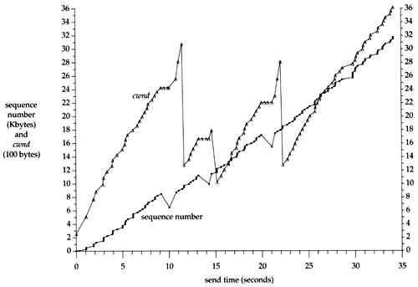
A Puzzle: cwnd and Rate of a TCP Session
Question: although cwnd fluctuates widely (i.e., cut to half), why can the sending rate stay relatively smooth?

Slide 16
TCP/Reno Queueing Dynamics
cwnd
filling buffer
TD
bottleneck
bandwidth
ssthresh
draining buffer
Time
congestion
avoidance
If the buffer at the bottleneck is large enough, the buffer is never empty (not idle), during the cut-to-half to “grow-back” process.
Exercise: How big should the buffer be to achieve full utilization?

Slide 17
Extreme: Zero Buffer
Assume
BW: 10 G
RTT: 100 ms
Packet: 1250 bytes
BDP (full window size): 100,000 packets
A loss can cut window size from 100,000 to 50,000 packets
To fully grow back
Need 50,000 RTTs => 5000 seconds, 1.4 hours
Q: What is the link utilization in one cycle?

Slide 18
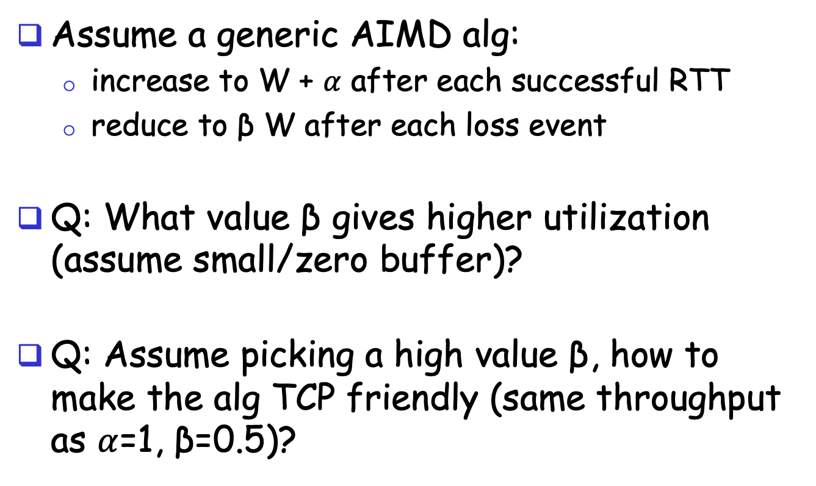
Design
Assume a generic AIMD alg:
increase to W + $α$ after each successful RTT
reduce to β W after each loss event
Q: What value β gives higher utilization (assume small/zero buffer)?
Q: Assume picking a high value β, how to make the alg TCP friendly (same throughput as $α$=1, β=0.5)?

Slide 19
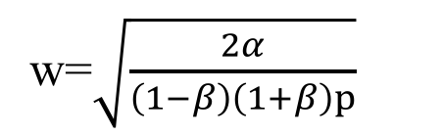

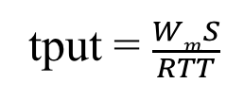
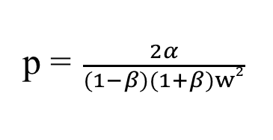

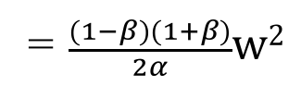
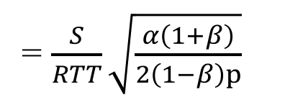

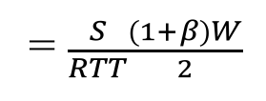
Generic AIMD and TCP Friendliness
cwnd
TD
W
ssthresh
βW
Time
congestion
avoidance
Total packets sent per cycle =
$$\frac{βW+W}{2}$$
$$\frac{(1−β)W}{α}$$
=$\frac{(1−β)(1+β)}{2α}w2$
w=$\sqrt{\frac{2α}{\left(1−β\right)\left(1+β\right)p}}$
Assume one loss per cycle
p =$\frac{2α}{(1−β)(1+β)w2}$
tput = $\frac{WmS}{RTT}$
= $\frac{S}{RTT}\sqrt{\frac{α\left(1+β\right)}{2\left(1−β\right)p}}$
= $\frac{S}{RTT}\frac{(1+β)W}{2}$
TCP friendly =>
$$α=3 \frac{1−β}{1+β}$$

Slide 20
Outline
Admin and recap
Transport congestion control
what is congestion (cost of congestion)
basic congestion control alg.
TCP/Reno congestion control
TCP Cubic

Slide 21
TCP Cubic
Designed in 2008
Default for Linux
Most sockets in MAC appear to use cubic as well
sw_vers
sysctl –a

Slide 22
TCP Cubic Goals
Improve TCP efficiency over fast, long-distance links
TCP friendliness
Fairness of flows w/ different RTTs
Smaller reduction, longer stay at BDP, faster than linear increase---cubic function
Follows TCP if TCP gives higher rate
Window growth depends on real-time (from congestion- epoch through synchronized losses)

Slide 23
TCP BIC Algorithm
cwnd
TD
TD
TD
TD
Wmax
W_{m}
Wmin
CA
CA
CA
CA
Time
Setting
W_{max} = cwnd size before reduction
Too big
W_{min} = β*W_{max} – just after reduction, where β is multiplicative decrease factor
Small
Basic idea
binary search between W_{max} and W_{min}

Slide 24
TCP BIC Algorithm: Issues
cwnd
TD
TD
TD
TD
Wmax
W_{m}
Wmin
CA
CA
CA
CA
Time
Pure binary search (jump from W_{min} to (W_{max} and W_{min})/2) may be too aggressive
Use a large step size Smax
What if you grow above W_{max}?
Use binary growth (slow start) to probe more

Slide 25
TCP BIC Algorithm
Max Probing
W_{max} + 3S_{max}
Packet loss event
W_{max} + 2S_{max}
W_{max} +S_{max}
W_{max} + S_{min}
W_{max} + S_{min}
W_{min}
(midpoint – W_{min})< S_{min}
W_{max}
W_{min}
midpoint = (W_{min} + W_{max})/2
W_{min} + S_{min}
midpoint = (W_{min} + W_{max})/2
midpoint = (W_{min} + W_{max})/2
W_{min} + S_{max}
W_{min}
W_{min} + S_{max}
midpoint – W_{min} > S_{max}
W_{min} = β*W_{max}
Additive Increase
Binary Search
Slow Start
Additive Inc.

Slide 26
TCP BIC Algorithm
while (cwnd < Wmax) {
if ( (midpoint - Wmin) > Smax )
cwnd = cwnd + Smax
else
if ((midpoint - Wmin) < Smin)
cwnd = Wmax
else
cwnd = midpoint
if (no packet loss)
Wmin = cwnd
else
Wmin = β*cwnd
Wmax = cwnd
midpoint = (Wmax + Wmin)/2
}
Additive Increase
Binary Search

Slide 27
TCP BIC Algorithm: Probe
while (cwnd >= W_{max}){
if (cwnd < W_{max} + S_{max})
cwnd = cwnd + S_{min}
else
cwnd = cwnd + S_{max}
if (packet loss)
W_{min} = β*cwnd
W_{max} = cwnd
}
Slow growth
Fast growth
Max Probing

Slide 28
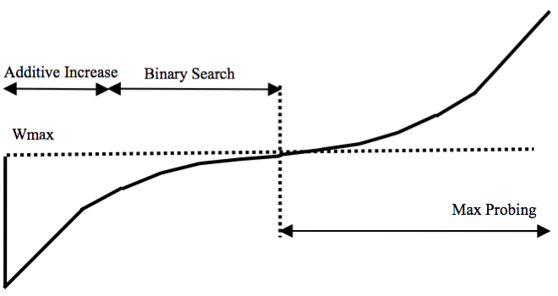
TCP BIC - Summary
Max Probing
+ S_{min}
+ S_{max}
Packet loss event
W_{max}
Time
+ S_{max}
jump to midpoint
Additive Increase
Binary Increase
Slow
Start
Additive Increase

Slide 29
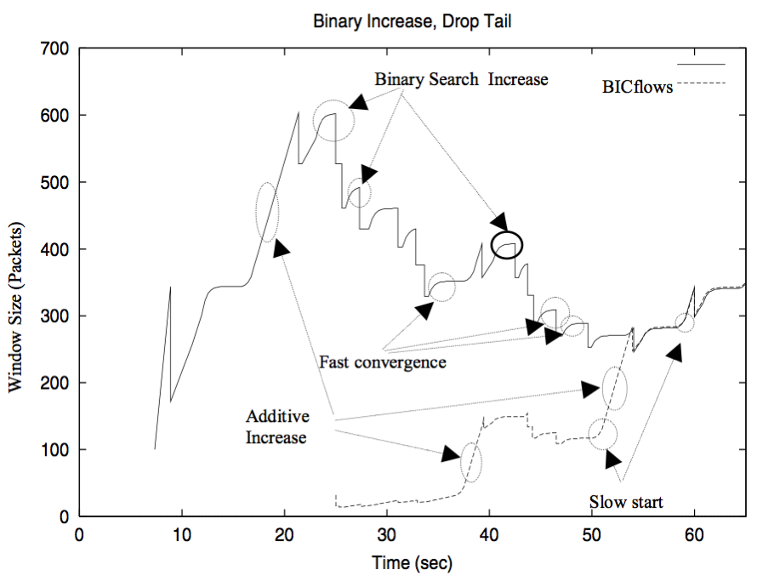
TCP BIC in Action

Slide 30
TCP BIC Analysis
Advantages
Faster convergence at large gap
Slower growth at convergence to avoid timeout
Issues
Still depend on RTT
Complex growth function
More details: http://www.land.ufrj.br/~classes/coppe-redes-2007/projeto/BIC-TCP-infocom-04.pdf

Slide 31
Cubic High-Level Structure
If (received ACK && state == cong avoid)
Compute W_{cubic}(t+RTT).
If cwnd < W_{TCP}
Cubic in TCP mode
If cwnd < Wmax
Cubic in concave region
If cwnd > Wmax
Cubic in convex region

Slide 32
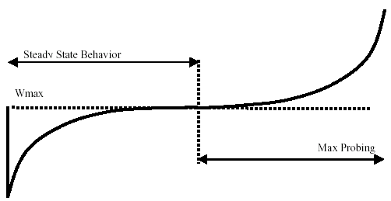


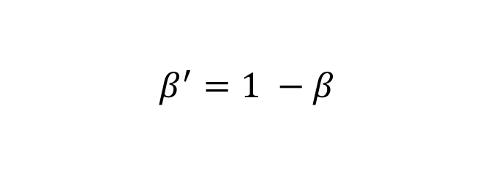
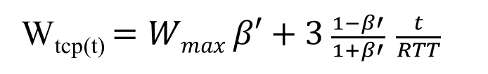
The Cubic function
$$β^{′}=1 −β$$
W_{tcp(t)} $=Wmax β′+3 \frac{1−β′}{1+β′} \frac{t}{RTT}$
convex region
slow down
concave region
where C is a scaling factor, t is the elapsed time from the last window reduction, and β is a constant multiplication decrease factor

Slide 33
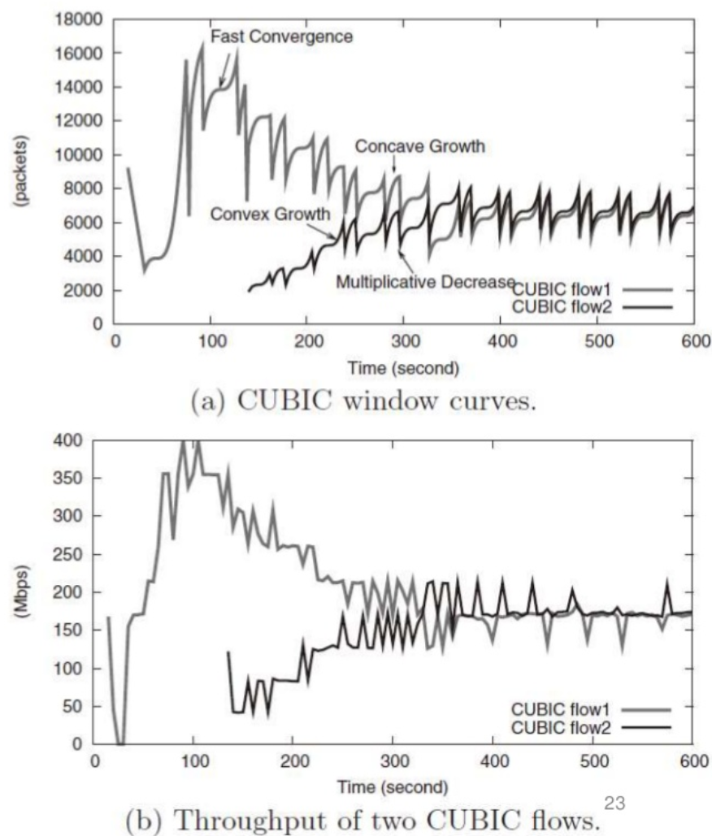

Slide 34
Outline
Admin and recap
Transport congestion control
what is congestion (cost of congestion)
basic congestion control alg.
TCP/Reno congestion control
TCP Cubic
TCP/Vegas

Slide 35
TCP/Vegas (Brakmo & Peterson 1994)
window
time
SS
CA
Idea: try to detect congestion by delay before loss
Objective: not to overflow the buffer; instead, try to maintain a constant number of packets in the bottleneck queue

Slide 36
TCP/Vegas: Key Question
How to estimate the number of packets queued in the bottleneck queue?
window
time
SS
CA

Slide 37

Recall: Little’s Law
For any system with no or (low) loss.
Assume
mean arrival rate X, mean service time T, and mean number of requests in the system W
Then relationship between W, X, and T:
T, W
X
Notes:
Proof of Little’s Law:

Slide 38
Estimating Number of Packets in the Queue

Slide 39
TCP/Vegas CA algorithm
T = T_{prop} + T_{queueing}
Applying Little’s Law:
x_{vegas} T = x_{vegas} T_{prop} + x_{vegas} T_{queueing}, where x_{vegas} = W / T is the sending rate
Then number of packets in the queue is x_{vegas} T_{queueing} = x_{vegas} T - x_{vegas} T_{prop}
= W – W/T T_{prop}

Slide 40
TCP/Vegas CA algorithm
window
maintain a constant number of packets in the bottleneck buffer
time
SS
CA
for every RTT
{ if W – W/RTT RTT_{min} < α then W ++
if W – W/RTT RTT_{min} > α then W -- }
for every loss
W := W/2
queue size

Slide 41
Discussions
If two flows, one TCP Vegas and one TCP reno run together, how may bandwidth partitioned among them?
Issues that limit Vegas deployment?

