Slide 1
Network Transport Layer:
Network Resource Allocation Framework
  Qiao Xiang, Congming Gao, Qiang Su
  https://sngroup.org.cn/courses/cnns-xmuf25/index.shtml
11/13/2025
This deck of slides are heavily based on CPSC 433/533 at Yale University, by courtesy of Dr. Y. Richard Yang.

Slide 2
Outline
Admin and recap
Transport congestion control
  what is congestion (cost of congestion)
  basic congestion control alg.
  TCP/Reno congestion control
  TCP Cubic
  TCP/Vegas
  network wide resource allocation
    general framework
    objective function: axiom derivation of network-wide objective function
    algorithm: general distributed algorithm framework
    application: TCP/Reno TCP/Vegas revisited
2

Slide 3
Recap: TCP/Reno Throughput Modeling
=>
=>
This is called the TCP throughput sqrt of loss rate law.
3

Slide 4
Recap: TCP/Reno Throughput Modeling
cwnd
TD
W
ssthresh
W/2
Time
congestion
avoidance
Total packets sent per cycle = (W/2 + W)/2 * W/2 = 3W²/8
Assume one loss per cycle
=> p = 1/(3W²/8) = 8/(3W²)
=>

Slide 5
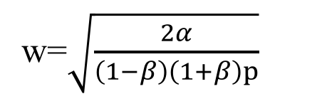

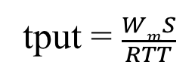
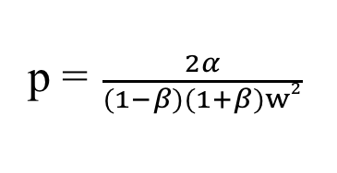

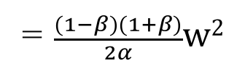
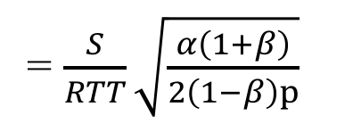

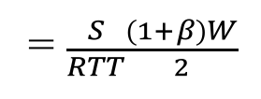
Recap: Generic AIMD and TCP Friendliness
cwnd
TD
W
ssthresh
βW
Time
congestion
avoidance
Total packets sent per cycle =
$$\frac{βW+W}{2}$$
$$\frac{(1−β)W}{α}$$
=$\frac{(1−β)(1+β)}{2α}w2$
w=$\sqrt{\frac{2α}{\left(1−β\right)\left(1+β\right)p}}$
Assume one loss per cycle
p =$\frac{2α}{(1−β)(1+β)w2}$
tput = $\frac{WmS}{RTT}$
= $\frac{S}{RTT}\sqrt{\frac{α\left(1+β\right)}{2\left(1−β\right)p}}$
= $\frac{S}{RTT}\frac{(1+β)W}{2}$
TCP friendly =>
$$α=3 \frac{1−β}{1+β}$$

Slide 6
TCP/Vegas (Brakmo & Peterson 1994)
window
time
SS
CA
Idea: try to detect congestion by delay before loss
Objective: not to overflow the buffer; instead, try to maintain a constant number of packets in the bottleneck queue

Slide 7
TCP/Vegas: Key Question
How to estimate the number of packets queued in the bottleneck queue?
window
time
SS
CA

Slide 8

Recall: Little’s Law
For any system with no
or (low) loss.
Assume
  mean arrival rate X, mean service
  time T, and mean number of requests in
  the system W
Then relationship between W, X, and T:
T, W
X
Notes:
Proof of Little’s Law:

Slide 9
TCP/Vegas CA algorithm
T = T_{prop} + T_{queueing}
Applying Little’s Law:
x_{vegas} T = x_{vegas} T_{prop} + x_{vegas} T_{queueing},
where x_{vegas} = W / T is the sending rate
Then number of packets in the queue is
x_{vegas} T_{queueing} = x_{vegas} T - x_{vegas} T_{prop}
= W – W/T T_{prop}

Slide 10
TCP/Vegas CA algorithm
window
maintain a constant number of packets in the bottleneck buffer
time
SS
CA
for every RTT
{ if W – W/RTT RTT_{min} < α then W ++
if W – W/RTT RTT_{min} > α then W -- }
for every loss
W := W/2
queue size

Slide 11
Discussions
If two flows, one TCP Vegas and one TCP reno run together, how may bandwidth partitioned among them?
Issues that limit Vegas deployment?

Slide 12
Outline
Admin and recap
Transport congestion control
  what is congestion (cost of congestion)
  basic congestion control alg.
  TCP/Reno congestion control
  TCP Cubic
  TCP/Vegas
  network wide resource allocation
    general framework
12

Slide 13
Motivation
So far our discussion is implicitly on a network with a single bottleneck link; this simplifies design and analysis:
  efficiency/optimality (high utilization)
    fully utilize the bandwidth of the link
  fairness (resource sharing)
    each flow receives an equal share of the link’s bandwidth

Slide 14
Network Resource Allocation
It is important to understand and design protocols for a general network topology
  how will TCP allocate resource in a general topology?
  how should resource be allocated in a general topology?

Slide 15
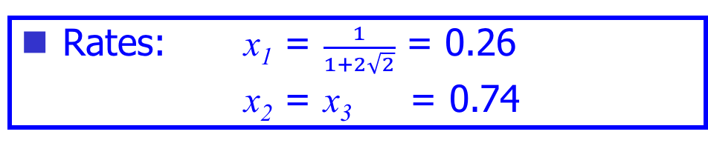
Example: TCP/Reno Rates
Rates: x₁ = $\frac{1}{1+2\sqrt{2}}$ = 0.26
x₂ = x₃ = 0.74
x₁
C= 1
C = 1
x₂
x₃

Slide 16
Example: TCP/Vegas Rates
Rates : x₁ = 1/3
x₂ = x₃ = 2/3
x₁
C= 1
C = 1
x₂
x₃

Slide 17

Example: Max-min Fairness
Max-min fairness: maximizes the throughput of the flow receiving the minimum (of resources)
    Justification: John Rawls, A Theory of Justice (1971)
      http://en.wikipedia.org/wiki/John_Rawls
    This is a resource allocation scheme used in ATM and some other network resource allocation proposals
17

Slide 18
Example: Max-Min
Rates: x₁ = x₂ = x₃ = 1/2
x₁
C= 1
C = 1
x₂
x₃

Slide 19
Framework: Network Resource Allocation
Using Utility Functions
A set of flows F
Let x_{f} be the rate of flow f, and the utility to flow f is U_{f}(x_{f}).
Maximize aggregate utility, subject to capacity constraints

Slide 20

Example: Maximize Throughput
$$Uf\left(xf\right)=xf$$
Optimal: x₁ = 0
x₂ = x₃ = 1
x₁
C= 1
C = 1
x₂
x₃

Slide 21
Example: Proportional Fairness
Optimal: x₁ = 1/3
x₂ = x₃ = 2/3
x₁
C= 1
C = 1
x₂
x₃

Slide 22
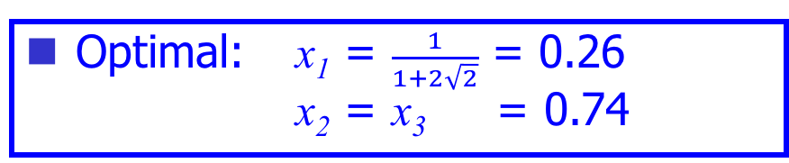
Example 3: a “Funny” Utility Function
Optimal: x₁ = $\frac{1}{1+2\sqrt{2}}$ = 0.26 x₂ = x₃ = 0.74
x₁
C= 1
C = 1
x₂
x₃

Slide 23
Summary: Allocations
Objective | Allocation (x1, x2, x3)
TCP/Reno | 0.26 | 0.74 | 0.74
TCP/Vegas | 1/3 | 2/3 | 2/3
Max Throughput | 0 | 1 | 1
Max-min | ½ | ½ | ½
Max sum log(x) | 1/3 | 2/3 | 2/3
Max sum of -1/(RTT² x) | 0.26 | 0.74 | 0.74
x₁
C= 1
C = 1
x₂
x₃

Slide 24
Questions
Forward engineering: systematically
  design objective function
  design distributed alg to achieve objective
Science/reverse engineering: what do TCP/Reno, TCP/Vegas achieve?
Objective | Allocation (x1, x2, x3)
TCP/Reno | 0.26 | 0.74 | 0.74
TCP/Vegas | 1/3 | 2/3 | 2/3
Max throughput | 0 | 1 | 1
Max-min | ½ | ½ | ½
Max sum log(x) | 1/3 | 2/3 | 2/3
Max sum of -1/(RTT² x) | 0.26 | 0.74 | 0.74

Slide 25
Outline
Admin and recap
Transport congestion control
  what is congestion (cost of congestion)
  basic congestion control alg.
  TCP/Reno congestion control
  TCP Cubic
  TCP/Vegas
  network wide resource allocation
    general framework
    objective function: an example of an axiom derivation of network-wide objective function
25

Slide 26
Network Bandwidth Allocation
Using Nash Bargain Solution (NBS)
High level picture
  given the feasible set of bandwidth allocation, we want to pick an allocation point that is efficient and fair
The determination of the allocation point should be based on “first principles” (axioms)

Slide 27
Network Bandwidth Allocation:
Feasible Region
x₁
x₂
x₃
x₁
C= 1
C = 1
x₂
x₃

Slide 28
Nash Bargain Solution (NBS)
Assume a finite, convex feasible set in the first quadrant
Axioms
x₂
R
s
x₁
Notes:
The second two enforce consistency across scenarios

Slide 29
Nash Bargain Solution (NBS)
Assume a finite, convex feasible set in the first quadrant
Axioms
  Pareto optimality
    impossibility of increasing the rate of one user without decreasing the rate of another
  symmetry
    a symmetric feasible set yields a symmetric outcome
  invariance of linear transformation
    the allocation must be invariant to linear transformations of users’ rates
  independence of irrelevant alternatives
    assume s is an allocation when feasible set is R, s ∈T ⊂ R, then s is also an allocation when the feasible set is T
x₂
R
s
T
x₁
Notes:
The second two enforce consistency across scenarios

Slide 30
Nash Bargain Solution (NBS)
Surprising result by John Nash (1951)
  the rate allocation point is the feasible point which maximizes
This is equivalent to maximize
In other words, assume each flow f has utility function log(x_{f})
I will give a proof for F = 2
  think about F > 2
x₂
R
x₁

Slide 31
Nash Bargain Solution
Assume s is the feasible point which maximizes
x1 * x2
Scale the feasible set so that s is at (1, 1)
  how?
x₂
x1 * x2
s
1
x₁
1

Slide 32
Nash Bargain Solution
x₂
P
x1 * x2 = 1
x1 = x2
Question: after the transformation, is there any feasible point with x1 + x2 > 2?
Q
1
s
R
x1 + x2 = 2
x₁
1

Slide 33
Nash Bargain Solution
Consider the symmetric rectangle U containing the now feasible set
-> According to symmetry and Pareto, s is the allocation when feasible set is U
According to independence of irrelevant alternatives, the allocation of R is s as well.
x₂
x1 * x2 = 1
x1 = x2
1
s
R
x1 + x2 = 2
x₁
1
U

Slide 34
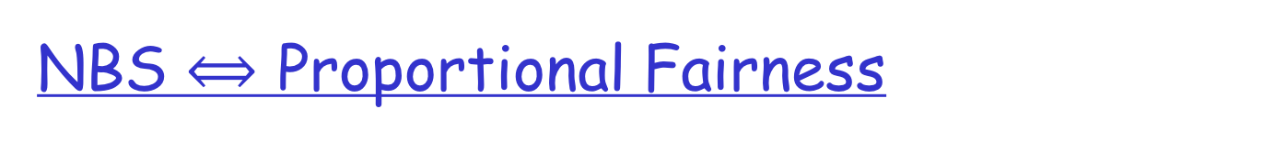
Allocation is proportionally fair if for any other allocation, aggregate of proportional changes is non-positive, e.g. if x_{f} is a proportional-fair allocation, and y_{f} is any other feasible allocation, then require

Slide 35
Questions to Think
Vary the axioms and see if you can derive any objective functions

Slide 36
Outline
Admin and recap
Transport congestion control
  what is congestion (cost of congestion)
  basic congestion control alg.
  TCP/Reno congestion control
  TCP Cubic
  TCP/Vegas
  network wide resource allocation
    general framework
    objective function: an example axiom derivation of network-wide objective function
    algorithm: general distributed algorithm framework
    application: TCP/Reno TCP/Vegas revisited
36

Slide 37
Recall: Resource Allocation Framework
The Resource-Allocation Problem:
Goal: Design a distributed alg to solve the problem.
Discussion：
  What are typical approaches to solve optimization, e.g.,?
  max U(x)
  Why is the Resource-Allocation problem hard to solve by a distributed algorithm?

Slide 38
A Two-Slide Summary of Constrained
Convex Optimization Theory
f(x) concave
g(x) linear
S is a convex set
q
f(x)
Map each x in S, to [g(x), f(x)]
S
q
Top contour of map is concave
Easy to read solution from contour
For each slope q (>=0), computes
f(x) – q g(x) of all mapped [f(x), g(x)]
g(x)
Notes:
The intersection w/ y-axis is f(x)-qg(x)
Important to draw the two cases of g(x)

Slide 39
A Two-Slide Summary of Constrained
Convex Optimization Theory
f(x) concave
g(x) linear
S is a convex set
f(x)
q₁
q₂
S
q₃
D(q) is called the dual;
q (>= 0) are called prices in economics
D(q) provides an upper bound on obj.
- According to optimization theory: when D(q) achieves minimum over all q (>= 0), then the optimization objective is achieved.
g(x)

Slide 40
x₁
Dual of the Primal
1
1
x₂
x₃

Slide 41
Dual of the Primal
x₁
1
1
x₂
x₃

Slide 42
Distributed Optimization: User Problem
Given p_{f} (=sum of dual var q_{l} along the path) flow f chooses rate x_{f} to maximize:
Using the price signals, the optimization problem of each user is independent of each other!

Slide 43
Distributed Optimization:
User Problem
How should flow f adjust x_{f} locally?
At equilibrium (i.e., at optimal), x_{f} satisfies:

Slide 44
Interpreting Congestion Measure
q_{l}(t)
q₂(t)
x_{f}(t)

Slide 45
Distributed Optimization:
Network Problem
The network (i.e., link l) adjusts the link signals q_{l} (assume after all flows have picked their optimal rates given congestion signal)

Slide 46
Distributed Optimization:
Network Problem
how should link l adjust q_{l} locally?

Slide 47
System Architecture
SYSTEM(U):
USER_{f}:
NETWORK:

Slide 48
Decomposition Theorem
There exist vectors p , w and x such that
  w_{f} = p_{f}x_{f} for f ∈ F
  w_{f} solves USER_{f}(U_{f}; p_{f})
  x solves NETWORK(w)
The vector x then also solves SYSTEM(U).

Slide 49
Outline
Admin and recap
Transport congestion control
  what is congestion (cost of congestion)
  basic congestion control alg.
  TCP/Reno congestion control
  TCP Cubic
  TCP/Vegas
  network wide resource allocation
    general framework
    objective function: an example axiom derivation of network-wide objective function
    algorithm: a general distributed algorithm framework
    application: TCP/Reno and TCP/Vegas revisited
49

Slide 50
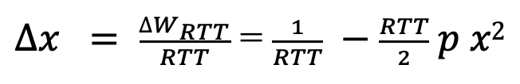
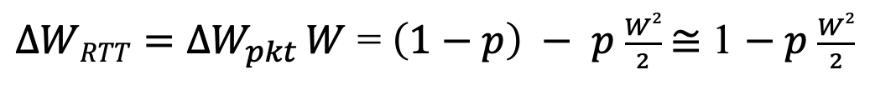

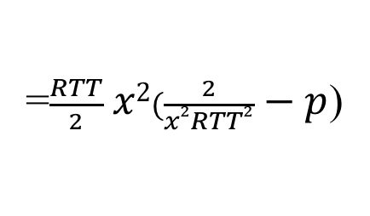
TCP/Reno Dynamics
$$∆Wpkt=\left(1−p\right)\frac{1}{W} −p \frac{W}{2}$$
$∆WRTT=∆W_{pkt} W$ = $\left(1−p\right) − p \frac{W2}{2} \text{≅}$ 1 $− p \frac{W2}{2}$
$∆x = \frac{∆W_{RTT}}{RTT}$ = $\frac{1}{RTT} −\frac{RTT}{2} p x2$
=$\frac{RTT}{2} x2(\frac{2}{x2RTT2} − p$)

Slide 51
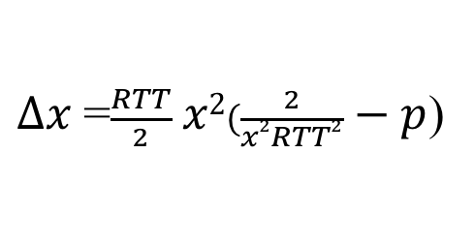
TCP/Reno Dynamics
$∆x$=$\frac{RTT}{2} x2(\frac{2}{x2RTT2} − p$)

Slide 52
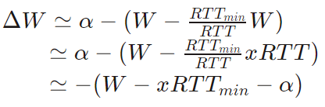
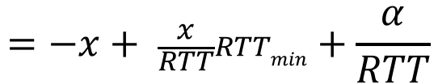
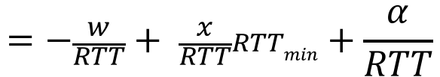
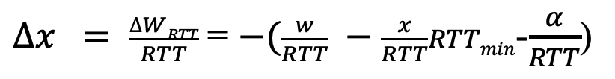
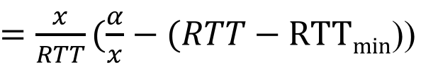
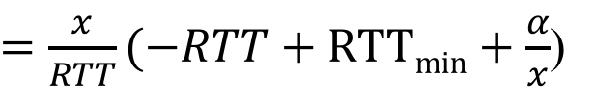
TCP/Vegas Dynamics
$∆x = \frac{∆WRTT}{RTT}$ = $−(\frac{w}{RTT} −\frac{x}{RTT}RTTmin$-$\frac{α}{RTT}$)
$$=−\frac{w}{RTT}+ \frac{x}{RTT}RTTmin+\frac{α}{RTT}$$
$$=−x+ \frac{x}{RTT}RTTmin+\frac{α}{RTT}$$
$=\frac{x}{RTT}(−RTT+RTTmin+\frac{α}{x}$)
$=\frac{x}{RTT}(\frac{α}{x}−(RTT−RTTmin$))

Slide 53
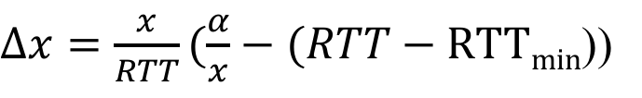
TCP/Vegas Dynamics
$∆x=\frac{x}{RTT}(\frac{α}{x}−(RTT−RTTmin$))

Slide 54
Summary: TCP/Vegas and TCP/Reno
Pricing signal is queueing delay T_{queueing}
Pricing signal is loss rate p

Slide 55
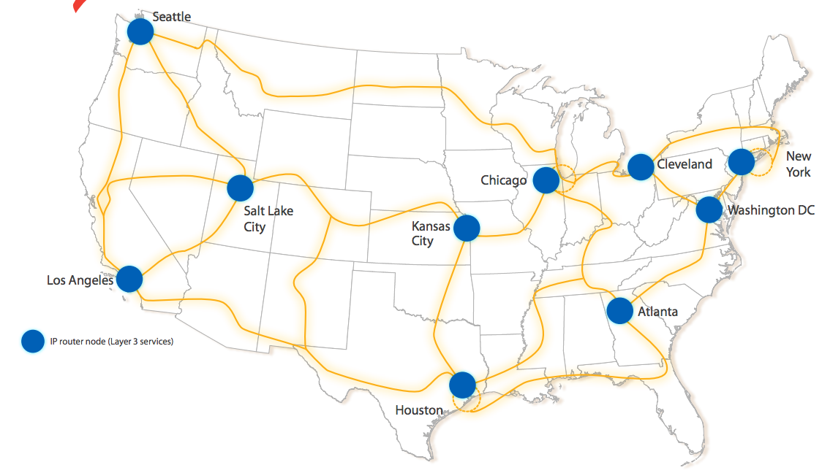
Discussion
Assume that you are given a set of flows deployed at a given network topology.
What is a simple way to predict TCP rate allocation?

Slide 56
Summary: Resource Allocation Frameworks
Forward (design) engineering:
  how to determine
  objective functions
  given objective, how
  to design
  effective alg
Reverse (understand) engineering:
  understand current protocols (what are the objectives of TCP/Reno, TCP/Vegas?)
Additional pointers:
  http://www.statslab.cam.ac.uk/~frank/pf/

