Slide 1
Network Layer:
Overview;
Distance Vector Protocols
  Qiao Xiang, Congming Gao, Qiang Su
  https://sngroup.org.cn/courses/cnns-xmuf25/index.shtml
11/18/2025
This deck of slides are heavily based on CPSC 433/533 at Yale University, by courtesy of Dr. Y. Richard Yang.

Slide 2
Outline
Admin and recap
Network overview
Network control-plane
  Routing

Slide 3
Recap: BW Allocation
Framework
Forward engineering: systematically design
  objective function
  distributed alg to achieve objective
Science/reverse engineering: what do TCP/Reno, TCP/Vegas achieve?
Objective | Allocation (x1, x2, x3)
TCP/Reno | 0.26 | 0.74 | 0.74
TCP/Vegas | 1/3 | 2/3 | 2/3
Max throughput | 0 | 1 | 1
Max-min | ½ | ½ | ½
Max sum log(x) | 1/3 | 2/3 | 2/3
Max sum of -1/(RTT² x) | 0.26 | 0.74 | 0.74

Slide 4
Recap: Derive Objective Function
NBS axioms
  Pareto optimality
  symmetry
  invariance of linear transformation
  independence of irrelevant alternatives
NBS solution
  the rate allocation point is the feasible point which maximizes
x₂
R
s
T
x₁
Notes:
The second two enforce consistency across scenarios

Slide 5
Recap: Primal-Dual Decomposition of Network-Wide Resource Allocation
SYSTEM(U):
USER_{f}:
NETWORK:

Slide 6
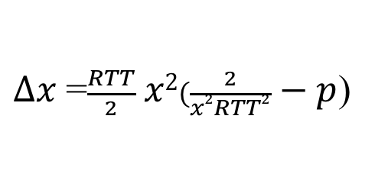
TCP/Reno Dynamics
$∆x$=$\frac{RTT}{2} x2(\frac{2}{x2RTT2} − p$)

Slide 7
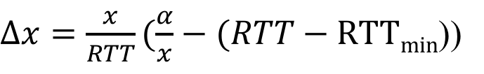
TCP/Vegas Dynamics
$∆x=\frac{x}{RTT}(\frac{α}{x}−(RTT−RTTmin$))

Slide 8
Outline
Admin and recap
Network overview

Slide 9
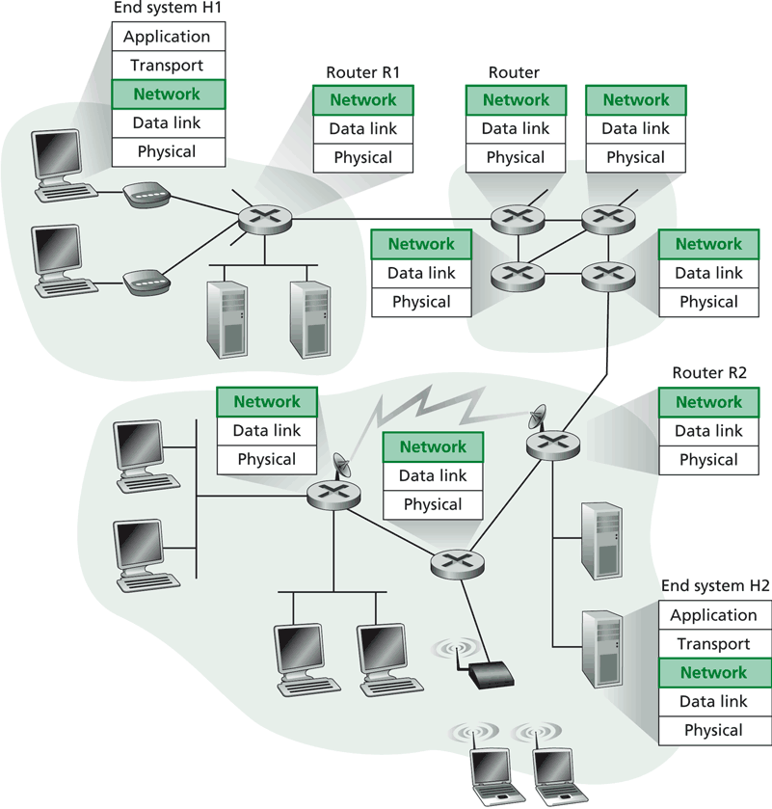
Network Layer
Transport packet from source to dest.
Network layer in every host, router
Basic functions:
inter-networking (e.g., fragmentation/assembly)
routing (determine route(s) taken by packets of a flow), and forwarding (move the packets along the route(s))

Slide 10
Current Internet Network Layer
Network layer functions:
Transport layer
Routing protocols
path selection
e.g., RIP, OSPF, BGP
Control protocols
error reporting
e.g. ICMP
Control protocols
- router “signaling”
e.g. RSVP
Network
layer
Network layer protocol (e.g., IP)
addressing conventions
packet format
packet handling conventions
forwarding
Link layer
physical layer

Slide 11
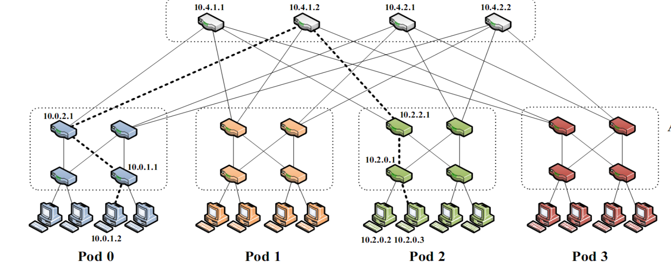
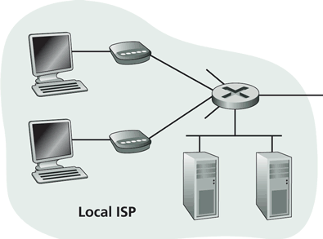
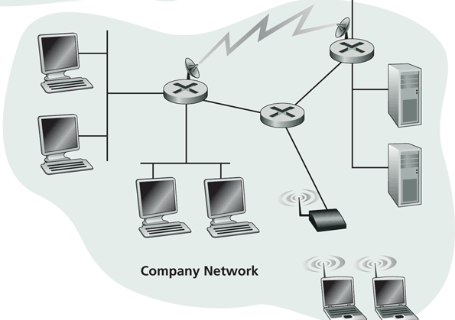
Our Focus: Global Routing System
Residential networks, e.g., cable, fiber, DSL, wireless, cellular
Backbone ISP
ISP
ISP
Campus networks, e.g.,
Ethernet, Wireless
data center
Discussion: What are the challenges/requirements of designing the global routing system?
Notes:
Scaling
Robustness
Decentralization

Slide 12
Global Routing Divide and Conquer:
Routing with Autonomous Systems
Global Internet routing is divided into intra-AS routing and inter-AS routing
  Intra-AS routing (also called intradomain routing)
    A protocol running insides an AS is called an Interior Gateway Protocol (IGP), each AS can choose its own protocol, such as RIP, E/IGRP, OSPF, IS-IS
  Inter-AS routing (also called interdomain routing)
    A protocol runs among autonomous systems is also called an Exterior Gateway Protocol (EGP)
    The de facto EGP protocol is BGP

Slide 13
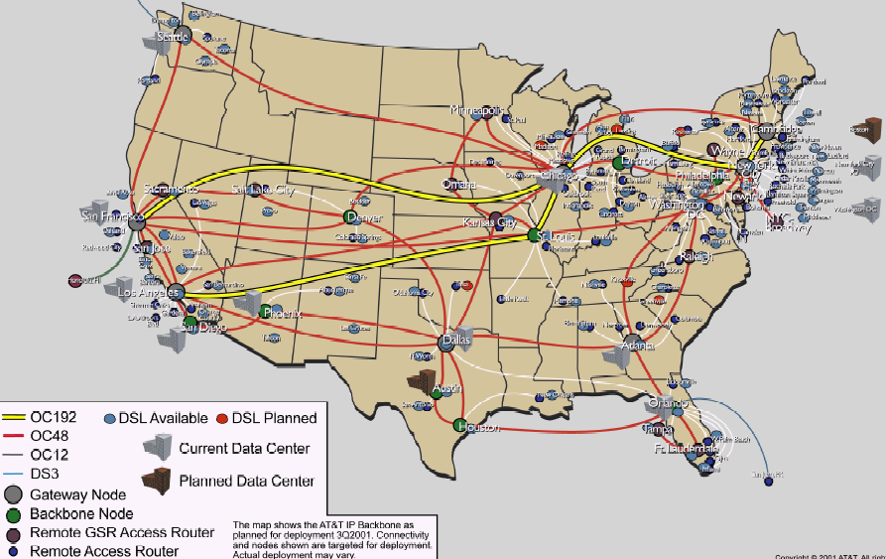
Routing: Overview
Routing
Goal: determine “good” paths
(sequences of routers) thru
networks from source to dest.
Graph abstraction for the routing problem:
graph nodes are routers
graph edges are physical links
  links have properties: delay, capacity, $ cost, policy
5
B
3
C
2
5
A
2
1
F
3
1
2
D
E
1

Slide 14
Network Layer: Complexity Factors/Objectives
For network providers
  efficiency of routes
  policy control on routes
  scalability
For users: quality of services
  guaranteed bandwidth?
  preservation of inter-packet timing (no jitter)?
  loss-free delivery?
  in-order delivery?
Users and network may interact

Slide 15
Network Layer Quality of Service
Network
Architecture
Internet
ATM
ATM
ATM
ATM
Service
Model
best effort
CBR
VBR
ABR
UBR
Guarantees ?
Congestion
feedback
no (inferred
via loss/delay)
no
congestion
no
congestion
yes
no
Bandwidth
none
constant
rate
guaranteed
rate
guaranteed
minimum
none
Loss
no
yes
yes
no
no
Order
no
yes
yes
yes
yes
Timing
no
yes
yes
no
no
Internet model being extended: Intserv, Diffserv
  multimedia networking
ATM: Asynchronous Transfer Mode; CBR: Constant Bit Rate; V: Variable; A: available; U: User

Slide 16
Routing Design Space
- Robustness
- Optimality
- Simplicity
Routing has a large design space
  who decides routing?
    source routing: end hosts make decision
    network routing: networks make decision
  how many paths from source s to destination d?
    multi-path routing
    single path routing
  what does routing compute?
    network cost minimization
    QoS aware
  will routing adapt to network traffic demand?
    adaptive routing
    static routing
  …

Slide 17
Routing Design Space:
User-based, Multipath, Adaptive
- Robustness
- Optimality
- Simplicity
Routing has a large design space
  who decides routing?
    source routing: end hosts make decision
    network routing: networks make decision
  how many paths from source s to destination d?
    multi-path routing
    single path routing
  what does routing compute?
    network cost minimization
    QoS aware
  will routing adapt to network traffic demand?
    adaptive routing
    static routing
  …

Slide 18
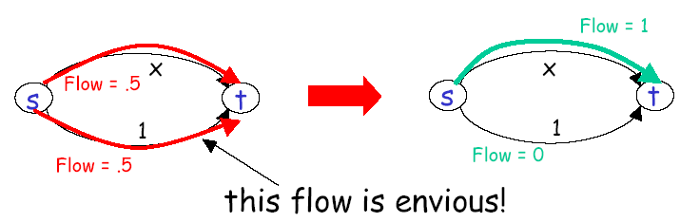
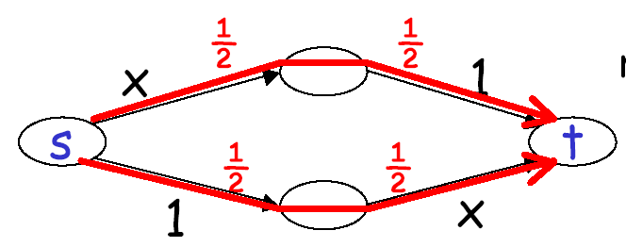
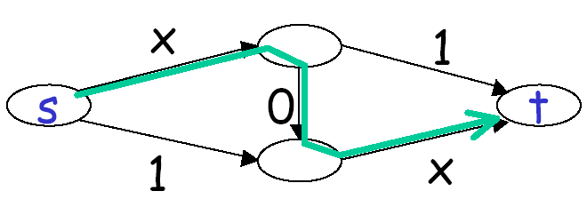
User Optimal, Multipath, Adaptive
User optimal: users pick the shortest routes (selfish routing)
Braess’s paradox

Slide 19
Price of Anarchy
For a network with linear latency functions
total latency of user (selfish) routing for given traffic demand
≤ 4/3
total latency of network optimal routing for the traffic demand

Slide 20
Price of Anarchy
For any network with continuous, non-decreasing latency functions →
total latency of user (selfish) routing
for given traffic demand
≤
total latency of network optimal routing for twice traffic demand

Slide 21
Routing Design Space:
Internet
- Robustness
- Optimality
- Simplicity
Routing has a large design space
  who decides routing?
    source routing: end hosts make decision
    network routing: networks make decision
      - (applications such as overlay and p2p are trying to bypass it)
  what does routing compute?
    network cost minimization (shortest path)
    QoS aware
  how many paths from source s to destination d?
    multi-path routing
    single path routing (with small amount of multipath)
  will routing adapt to network traffic demand?
    adaptive routing
    static routing (mostly static; adjust in larger timescale)
  …

Slide 22
Basic Formulation
Assign link weights
Compute shortest path
5
B
3
C
2
5
A
2
1
F
3
1
2
D
E
1

Slide 23
Assigning Link Weight: Dynamic Link Costs
Assign link costs to reflect current traffic
Link costs reflect current traffic intensity
0
D
0
0
D
0
A
1
1+e
2+e
0
0
C
A
1+e
1
C
0
e
0
0
B
B
1
1
D
e
t=1
t=0
D
D
A
C
0
0
0
2+e
A
2+e
C
A
0
0
C
1+e
1
1
B
1
0
e
1
B
1+e
B
e
t=3
t=2
Solution: Link costs are a combination of current traffic intensity (dynamic) and topology (static). To improve stability, the static topology part should be large. Thus less sensitive to traffic; thus non-adaptive.

Slide 24
Example: Cisco Proprietary Recommendation on Link Cost
Link metric:
  metric = [K1 * bandwidth⁻¹ + (K2 * bandwidth⁻¹) / (256 - load) + K3 * delay] * [K5 / (reliability + K4)] * 256
By default, k1=k3=1 and k2=k4=k5=0. The default composite metric for EIGRP, adjusted for scaling factors, is as follows:
BW_{min} is in kbps and the sum of delays are in 10s of microseconds.
EIGRP : Enhanced Interior Gateway Routing Protocol

Slide 25
Example: EIGRP Link Cost
The bandwidth and delay for an Ethernet interface are 10 Mbps and 1 ms, respectively.
The calculated EIGRP BW metric is as follows:
  256 × 10⁷/BW = 256 × 10⁷/10,000
  = 256 × 1000
  = 256,000
5
B
3
C
2
5
A
2
1
F
3
1
2
D
E
1

Slide 26
Outline
Admin and recap
Network overview
Network control plane
  Routing
    Link weights assignment
    Routing computation
      Distributed distance vector protocols

Slide 27
Distance Vector Routing
5
3
Setting: static (positive)
costs assigned to network links
    The static link costs may be
    adjusted in a longer time scale:
    this is called traffic engineering
Goal: distributed computing to compute the shortest path from a source to a destination
  Based on the Bellman-Ford algorithm (BFA)
  Conceptually, runs for each destination separately
Look ahead
  Although few (e.g., RIP) use basic distance vector, it is a foundation for many other protocols
  We also use the study to acquire another basic set of techniques to understand distributed protocols
B
C
2
5
A
2
1
F
3
1
2
D
E
1

Slide 28
Distance Vector Routing: Basic Idea
At node i, the basic update rule
where
- d_{i} denotes the distance
estimation from i to the
destination,
- N(i) is set of neighbors of
node i, and
- d_{ij} is the distance of
the direct link from i to j
destination
j
i

Slide 29
Outline
Admin and recap
Network overview
Network control plane
  Routing
    Link weights assignment
    Routing computation
      distributed distance vector protocols
        synchronous Bellman-Ford (SBF)

Slide 30
Synchronous Bellman-Ford (SBF)
7
B
1
C
A
8
2
10
Nodes update in rounds:
  there is a global clock;
  at the beginning of each round, each node sends its estimate to all of its neighbors;
  at the end of the round, updates its estimation
E
D
2
A
B
E
C
D

Slide 31
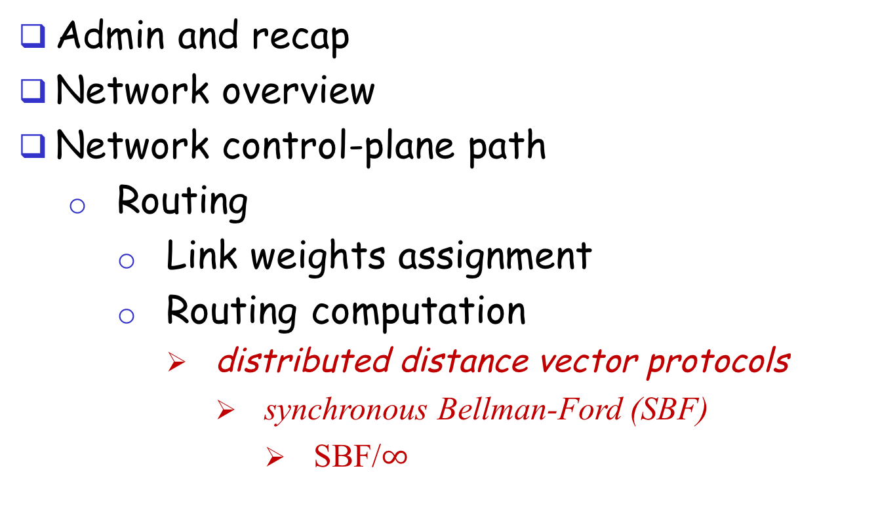
Outline
Admin and recap
Network overview
Network control-plane path
  Routing
    Link weights assignment
    Routing computation
      distributed distance vector protocols
        synchronous Bellman-Ford (SBF)
          SBF/$∞$

Slide 32
SBF/$∞$
7
B
1
C
A
8
2
10
E
D
2
Initialization (time 0):

Slide 33
Example
B
1
C
7
A
8
2
10
Consider D as destination; d(t) is a vector consisting of
estimation of each node at round t
E
D
2
A B C E D
d(0)
$∞$ $∞$ $∞$ $∞$ 0
d(1)
$∞$ $∞$ 2 2 0
d(2)
12 3 2 2 0
d(3)
10 3 2 2 0
d(4)
10 3 2 2 0
Observation: d(0) $≥$ d(1) $≥$d(2) $≥$d(3) $≥$ d(4) =d*

