Slide 1
Network Layer:
Distance Vector Protocols Variations
  Qiao Xiang, Congming Gao, Qiang Su
  https://sngroup.org.cn/courses/cnns-xmuf25/index.shtml
11/20/2025
This deck of slides are heavily based on CPSC 433/533 at Yale University, by courtesy of Dr. Y. Richard Yang.

Slide 2
Outline
Admin and recap
Network overview
Network control plane
  Routing
    Link weights assignment
    Routing computation
      Distance vector protocols (distributed computing)
      Link state protocols (distributed state synchronization)

Slide 3
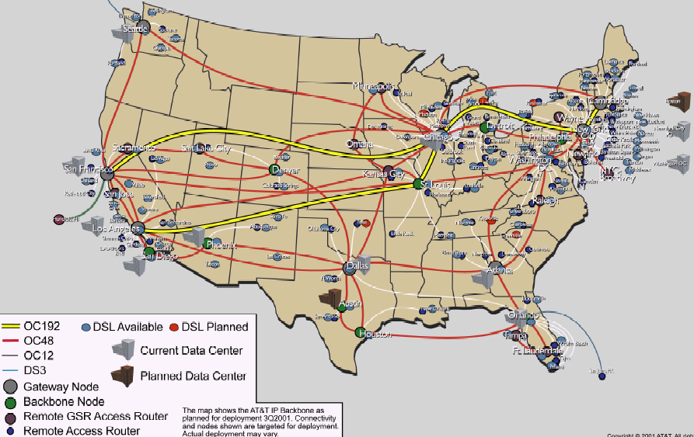
Recap: Routing Context
Routing
Goal: determine “good” paths
(sequences of routers) thru
networks from source to dest.
Often depends on a graph abstraction:
graph nodes are routers
graph edges are physical links
  links have properties: delay, capacity, $ cost, policy
5
B
3
C
2
5
A
2
1
F
3
1
2
D
E
1

Slide 4
Recap: Routing Design Space
Routing has a large design space
  who decides routing?
    source routing: end hosts make decision
    network routing: networks make decision
  how many paths from source s to destination d?
    multi-path routing
    single path routing
  what does routing compute?
    network cost minimization (shortest path routing)
    QoS aware
  will routing adapt to network
  traffic demand?
    adaptive routing
    static routing
  …
5
B
3
C
2
5
A
2
1
F
1
3
D
E
2
1

Slide 5
Recap: Distance Vector Routing: Basic Idea (Bellman-Ford Alg)
At node i, the basic update rule
where
- d_{i} denotes the distance
estimation from i to the
destination,
- N(i) is set of neighbors of
node i, and
- d_{ij} is the distance of
the direct link from i to j
destination
j
i

Slide 6
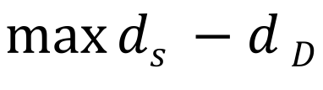
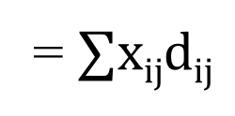
Understanding BFA and an Exercise of Primal-Dual
$$\max_{}{ds −d}D$$
$$for any edge i→j: di−dj≤dij$$
$$di≥0$$
D$ual:D\left(x\right)=\max{(ds −dD+∑xij\left(di−dj−dij\right))}$
= $∑xijdij$
x_{ij} is a flow from s to D
https://en.wikipedia.org/wiki/Shortest_path_problem#Linear_programming_formulation

Slide 7
Recap: Synchronous Bellman-Ford (SBF)
Nodes update in rounds:
  there is a global clock;
  at the beginning of each round, each node sends its estimate to all of its neighbors;
  at the end of the round, updates its estimation
A
B
E
C
D

Slide 8

Recap: SBF/$∞$
7
B
1
C
A
8
2
10
E
D
2
Initialization (time 0):

Slide 9
Example
B
1
C
7
A
8
2
10
Consider D as destination; d(t) is a vector consisting of
estimation of each node at round t
E
D
2
A B C E D
d(0)
$∞$ $∞$ $∞$ $∞$ 0
d(1)
$∞$ $∞$ 2 2 0
d(2)
12 3 2 2 0
d(3)
10 3 2 2 0
d(4)
10 3 2 2 0
Observation: d(0) $≥$ d(1) $≥$d(2) $≥$d(3) $≥$ d(4) =d*

Slide 10
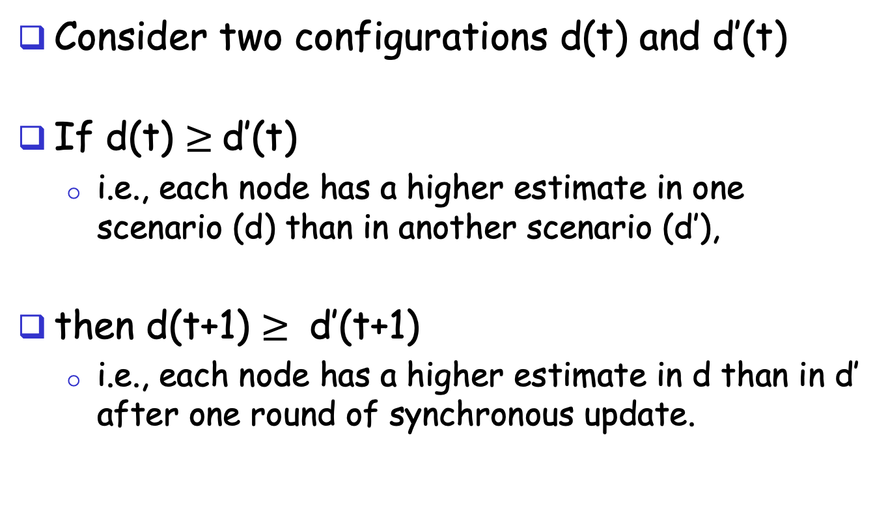
A Nice Property of SBF: Monotonicity
Consider two configurations d(t) and d’(t)
If d(t) $≥$d’(t)
  i.e., each node has a higher estimate in one scenario (d) than in another scenario (d’),
then d(t+1) $≥$ d’(t+1)
  i.e., each node has a higher estimate in d than in d’ after one round of synchronous update.

Slide 11
Correctness of SBF/$∞$
Claim: d_{i}(h) is the length L_{i}(h) of a shortest path from i to the destination using ≤ h hops
  base case: h = 0 is trivially true
  assume true for ≤ h,
  i.e., L_{i}(h)= d_{i}(h), L_{i}(h-1)= d_{i}(h-1), …

Slide 12
Correctness of SBF/$∞$
consider ≤ h+1 hops:
since d_{i}(h) ≤ d_{i}(h-1)

Slide 13
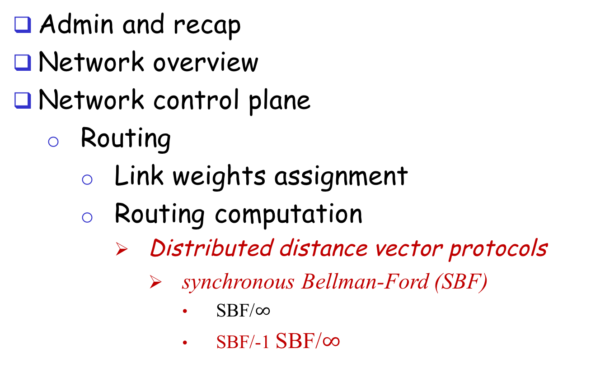
Outline
Admin and recap
Network overview
Network control plane
  Routing
    Link weights assignment
    Routing computation
      Distributed distance vector protocols
        synchronous Bellman-Ford (SBF)
          SBF/$∞$
          SBF/-1 SBF/$∞$

Slide 14
SBF at another
Initial Configuration: SBF/-1
7
B
1
C
A
8
2
10
E
D
2
Initialization (time 0):

Slide 15
Example
B
1
C
7
A
8
2
10
Consider D as destination
E
D
2
A B C E D
d(0)
-1 -1 -1 -1 0
d(1)
6 0 0 2 0
d(2)
7 1 1 2 0
d(3)
8 2 2 2 0
d(4)
9 3 3 2 0
d(5)
10 3 3 2 0
d(6)
10 3 3 2 0
Observation: d(0) $≤$d(1) $≤$d(2) $≤$d(3) $≤$ d(4) $≤$ d(5) = d(6) = d*

Slide 16
Correctness of SBF/-1
SBF/-1 converges due to monotonicity
Remaining question:
  Can we guarantee that SBF/-1 converges to shortest path?

Slide 17
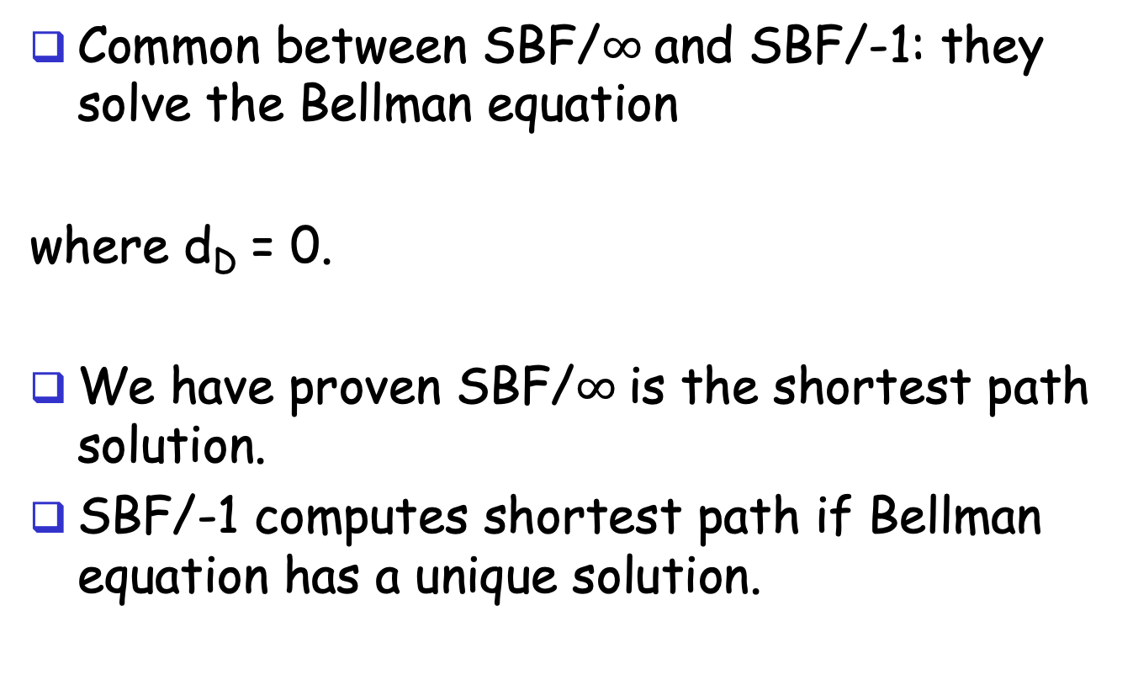
Correctness of SBF/-1
Common between SBF/$∞$and SBF/-1: they solve the Bellman equation
where d_{D} = 0.
We have proven SBF/$∞$is the shortest path solution.
SBF/-1 computes shortest path if Bellman equation has a unique solution.

Slide 18

Uniqueness of Solution to BE
Assume another solution d, we will show that d = d*
case 1: we show d $≥$d*
Since d is a solution to BE, we can construct
paths as follows: for each i, pick a j which
satisfies the equation; since d* is shortest, d $≥$ d*
3
2
7
B
1
C
10
A
8
2
10
E
D
2
2

Slide 19
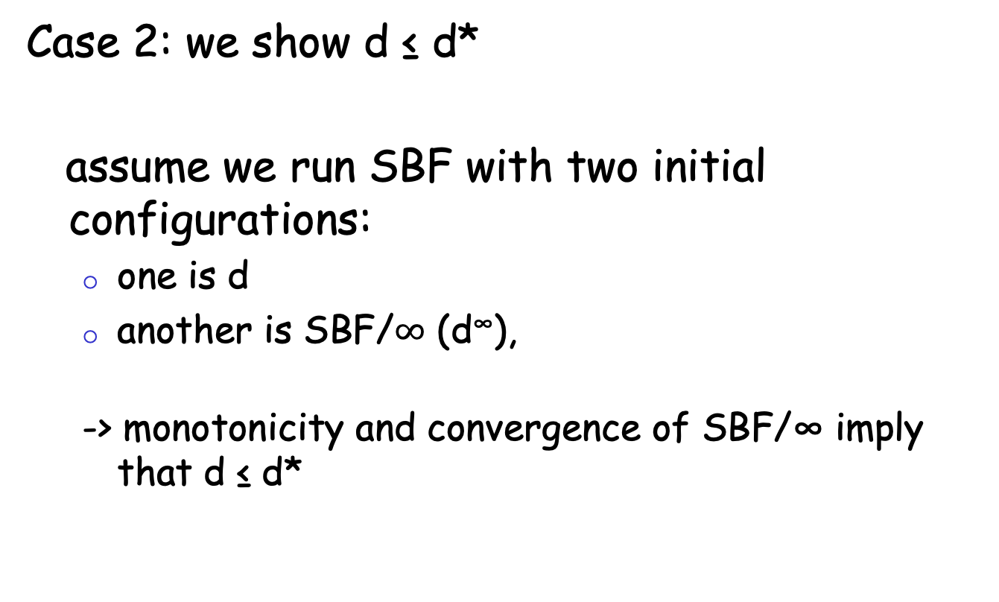
Uniqueness of Solution to BE
Case 2: we show d ≤ d*
assume we run SBF with two initial configurations:
  one is d
  another is SBF/$∞$ (d∞),
  -> monotonicity and convergence of SBF/∞ imply that d ≤ d*

Slide 20
Discussion
Will SBF converge under other non-negative initial conditions?
Problems of running synchronous BF?

Slide 21
Outline
Admin and recap
Network overview
Network control plane
  Routing
    Link weights assignment
    Routing computation
      Distributed distance vector protocols
        synchronous Bellman-Ford (SBF)
        asynchronous Bellman-Ford (ABF)

Slide 22
Asynchronous Bellman-Ford (ABF)
No notion of global iterations
  each node updates at its own pace
Asynchronously each node i computes
  using last received value d^{i}_{j} from neighbor j.
Asynchronously node j sends its estimate to its neighbor i:
  We assume that there is an upper bound on the delay of estimate packet
Notes:
Ti infinite
T^i_j infinite

Slide 23
ABF: Example
B
1
C
7
A
8
2
Below is just one step! The protocol repeats forever!
10
E
D
2
distance tables
from neighbors
computation
E’s
distance
table
distance
table E sends
to its neighbors
d ()
A
B
C
D
A B D
A B D
A: 10
B: 8
C: 4
D: 2
E: 0
E
0 7 $∞$
10 15 $∞$
A: 10
7 0 $∞$
17 8 $∞$
B: 8
destinations
$∞$ 1 2
$∞$ 9 4
D: 4
$∞ ∞$ 0
$∞ ∞$ 2
D: 2
10 8 2

Slide 24
Asynchronous Bellman-Ford (ABF)
ABF will eventually converge to the shortest path
  links can go down and come up – but if topology is stabilized after some time t and connected, ABF will eventually converge to the shortest path !

Slide 25
ABF Convergence Proof Complexity: Complex System State
j
i
What is system state?
Notes:
There are three types of distance estimates from node i:
d_i: current distance estimate at node i
- d^j_i: last d_i that neighbor j received
- d^j_i: d_i that are in transit to neighbor j

Slide 26
System State
three types of distance state from node j:
d_{j}: current distance estimate state at node j
- d^{i}_{j}: last d_{j} that neighbor i received
- d^{i}_{j}: those d_{j} that are still in transit to neighbor i
dj
d^{i}_{j}
d^{i}_{j}
d_{i}

Slide 27
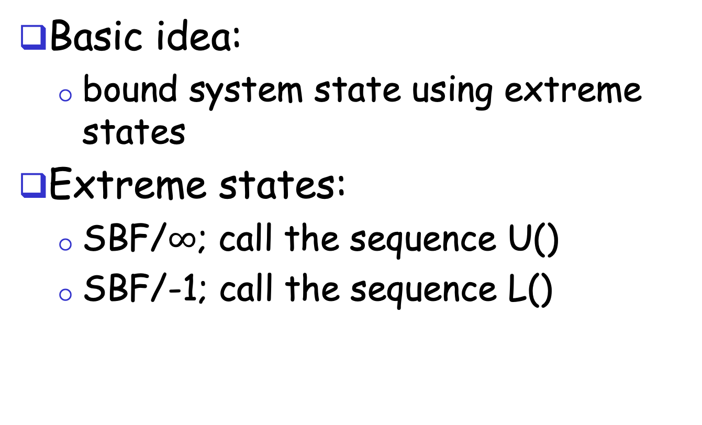
ABF Convergence Proof:
The Sandwich Technique
Basic idea:
  bound system state using extreme states
Extreme states:
  SBF/$∞$; call the sequence U()
  SBF/-1; call the sequence L()
Notes:
The state includes di, di_j, and messages containing di_j

Slide 28
ABF Convergence
Consider the time when the topology is stabilized as time 0
U(0) and L(0) provide upper and lower bounds at time 0 on all corresponding elements of states
  L_{j} (0) ≤ d_{j} ≤ U_{j} (0) for all d_{j} state at node j
  L_{j} (0) ≤ d^{i}_{j} ≤ U_{j} (0)
  L_{j} (0) ≤ update messages d^{i}_{j} ≤ U_{j} (0)
Notes:
The state includes di, di_j, and messages containing di_j

Slide 29
ABF Convergence
d_{j}
  after at least one
  update at node j:
  d_{j} falls between
  L_{j} (1) ≤ d_{j} ≤ U_{j} (1)
d^{i}_{j} :
  eventually all d^{i}_{j} that
  are only bounded by
  L_{j} (0) and U_{j} (0) are
  replaced with in
  L_{j}(1) and U_{j}(1)
dj
d^{i}_{j}
d^{i}_{j}
d_{i}
Notes:
The state includes di, di_j, and messages containing di_j

Slide 30
Asynchronous Bellman-Ford: Summary
Distributed
  each node communicates its routing table to its directly-attached neighbors
Iterative
  continues periodically or when link changes, e.g. detects a link failure
Asynchronous
  nodes need not exchange info/iterate in lock step!
Convergence
  in finite steps, independent of initial condition if network is connected

Slide 31
Summary: Distributed Distance-Vector
Tool box: a key technique for proving convergence (liveness) of distributed protocols: monotonicity and bounding-box (sandwich) design
  Consider two configurations d(t) and d’(t):
    if d(t) <= d’(t), then d(t+1) <= d’(t+1)
  Identify two extreme configurations to sandwich any real configurations

Slide 32
Outline
Admin and recap
Network control plane
  Routing
    Link weights assignment
    Routing computation
      Distance vector protocols (distributed computing)
        synchronous Bellman-Ford (SBF)
        asynchronous Bellman-Ford (ABF)
        properties of DV

Slide 33
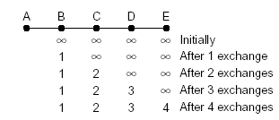
Properties of Distance-Vector Algorithms
Good news propagate fast

Slide 34
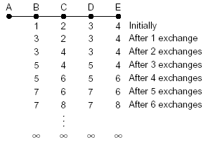
Properties of Distance-Vector Algorithms
Bad news propagate slowly
This is called the counting-to-infinity problem
Q: what causes counting-to-infinity?
A-B link down

Slide 35
Counting-To-Infinity is Because of Routing Loop
Counting-to-infinity is caused by a routing loop, which is a global state (consisting of the nodes’ local states) at a global moment (observed by an oracle) such that there exist nodes A, B, C, … E such that A (locally) thinks B as next hop, B thinks C as next hop, … E thinks A as next hop

Slide 36
Discussion
Why avoid routing loops is hard?
Any proposals to avoid routing loops?

Slide 37
Outline
Admin and recap
Network control plane
  Routing
    Link weights assignment
    Routing computation
      Distance vector protocols (distributed computing)
        synchronous Bellman-Ford (SBF)
        asynchronous Bellman-Ford (ABF)
        properties of DV
          DV w/ loop prevention
            reverse poison

Slide 38
The Reverse-Poison
(Split-horizon) Hack
B
1
C
7
A
8
2
If the path to dest is through neighbor h, report
∞ to neighbor h for dest.
1
E
D
2
distance tables
from neighbors
computation
E’s
distance
table
distance
table E sends
to its neighbors
E
D
$$∞$$
$$∞$$
4
2
D ()
A
B
C
D
A
0
7
$$∞$$
$$∞$$
1
c(E,A)
B
7
0
1
$$∞$$
8
c(E,B)
D
$$∞$$
$$∞$$
2
0
2
c(E,D)
A
1
8
$$∞$$
$$∞$$
B
15
8
9
$$∞$$
1, A
8, B
4, D
2, D
To A
A: $∞$
B: 8
C: 4
D: 2
E: 0
To B
A: 1
B: $∞$
C: 4
D: 2
E: 0
To D
A: 1
B: 8
C: $∞$
D: $∞$
E: 0
destinations
distance
through
neighbor
38

Slide 39
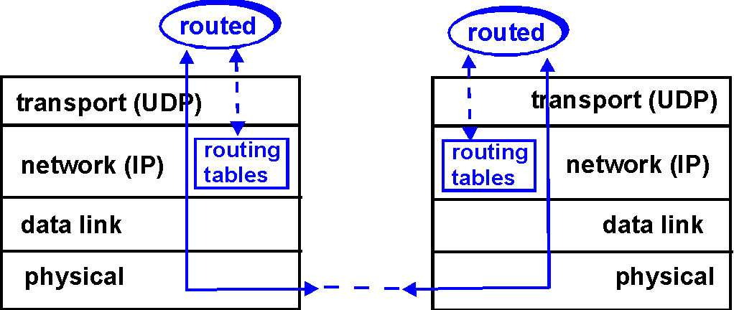
DV+RP => RIP
( Routing Information Protocol)
Included in BSD-UNIX
Distribution in 1982
Link cost: 1
Distance metric: # of
hops
Distance vectors
  exchanged every 30 sec via Response Message (also called advertisement) using UDP
  each advertisement: route to up to 25 destination nets
39

Slide 40
RIP: Link Failure and Recovery
If no advertisement heard after 180 sec --> neighbor/link declared dead
  routes via neighbor invalidated
  new advertisements sent to neighbors
  neighbors in turn send out new advertisements
  (if tables changed)
  link failure info quickly propagates to entire net
  reverse-poison used to prevent ping-pong loops
  set infinite distance = 16 hops (why?)
40

Slide 41
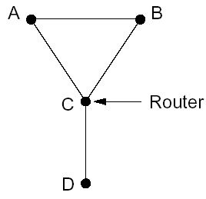
General Routing Loops and Reverse-poison
Exercise: Can Reverse-poison guarantee no loop for this network?

Slide 42
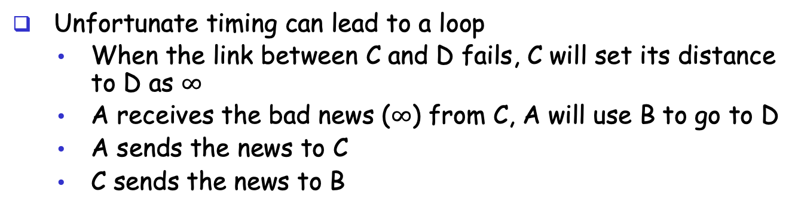
General Routing Loops and Reverse-poison
Reverse-poison removes two-node loops but may not remove more-node loops
I can reach
D w/ cost 3
Unfortunate timing can lead to a loop
  When the link between C and D fails, C will set its distance to D as $∞$
  A receives the bad news ($∞$) from C, A will use B to go to D
  A sends the news to C
  C sends the news to B

Slide 43
Outline
Admin and recap
Network control plane
  Routing
    Link weights assignment
    Routing computation
      Distance vector protocols (distributed computing)
        synchronous Bellman-Ford (SBF)
        asynchronous Bellman-Ford (ABF)
        properties of DV
          DV w/ loop prevention
            reverse poison
            destination-sequenced DV (DSDV)

Slide 44
Destination-Sequenced
Distance Vector protocol (DSDV)
Basic idea: use sequence numbers to partition computation
  tags each route with a sequence number
  each destination node D periodically advertises monotonically increasing even-numbered sequence numbers
  when a node realizes that the link it uses to reach destination D is broken, it advertises an infinite metric and a sequence number which is one greater than the previous route (i.e., an odd seq. number)
    the route is repaired by a later even-number advertisement from the destination

Slide 45
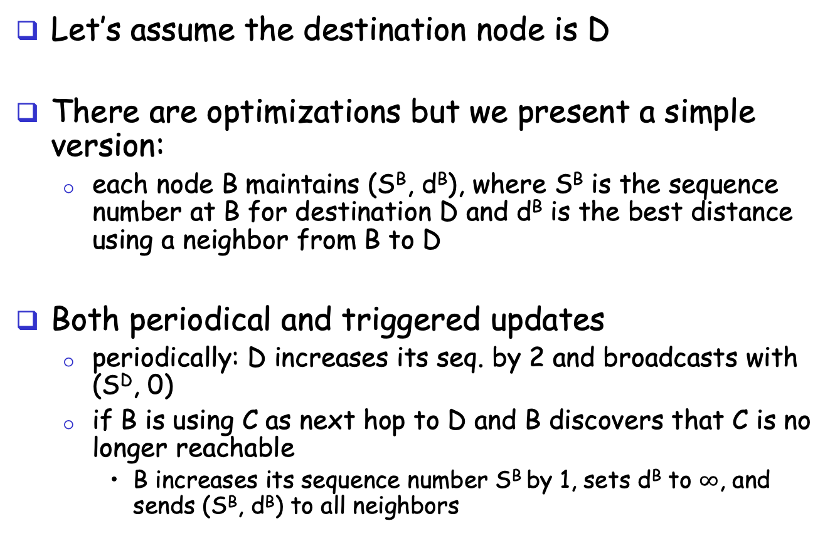
DSDV: More Detail
route update
A
B
Let’s assume the destination node is D
There are optimizations but we present a simple version:
  each node B maintains (S^{B}, d^{B}), where S^{B} is the sequence number at B for destination D and d^{B} is the best distance using a neighbor from B to D
Both periodical and triggered updates
  periodically: D increases its seq. by 2 and broadcasts with (S^{D}, 0)
  if B is using C as next hop to D and B discovers that C is no longer reachable
    B increases its sequence number S^{B} by 1, sets d^{B} to $∞$, and sends (S^{B}, d^{B}) to all neighbors
Notes:
The step if S^{A} > S^{B}, then update may not be good because it maybe a cross talk.

Slide 46
Example
1
5
X
1
1
Will this trigger an update?

Slide 47
Example
1
5
X
1
1
Will this trigger an update?

Slide 48
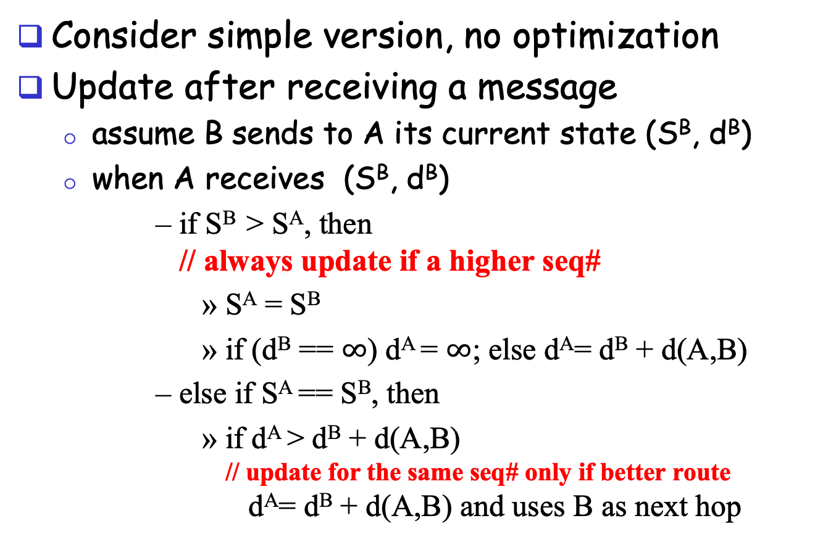
DSDV: Update Alg.
route update
A
B
Consider simple version, no optimization
Update after receiving a message
  assume B sends to A its current state (S^{B}, d^{B})
  when A receives (S^{B}, d^{B})
      if S^{B} > S^{A}, then
      // always update if a higher seq#
        S^{A} = S^{B}
        if (d^{B} == $∞$) d^{A} = $∞$; else d^{A}= d^{B} + d(A,B)
      else if S^{A} == S^{B}, then
        if d^{A} > d^{B} + d(A,B)
        // update for the same seq# only if better route
        d^{A}= d^{B} + d(A,B) and uses B as next hop
Notes:
The step if S^{A} > S^{B}, then update may not be good because it maybe a cross talk.

Slide 49
Example
1
5
1
1
Exercise: update process after D increases its seq# to next even number.

Slide 50
Claim: DSDV will NEVER Form a Loop
Initially no loop (no one has next hop so no loop)
Derive contradiction if a loop forms after a node processes an update,
  e.g., when A receives the
  update from B, A decides
  to use B as next hop and
  forms a loop
update
A
B

Slide 51
Technique: Global Invariants
Global Invariant is a very effective method in understanding safety of distributed asynchronous protocols
Invariants are defined over the states of the distributed nodes
Consider any node B.
Let’s identify some invariants over the state of node B, i.e., (S^{B}, d^{B}).

Slide 52
Invariants of a Single Node B
Some invariants about the state of a node B
  [I1] S^{B} is non-decreasing
  [I2] d^{B} is non-increasing
  for the same
  sequence number
time

Slide 53
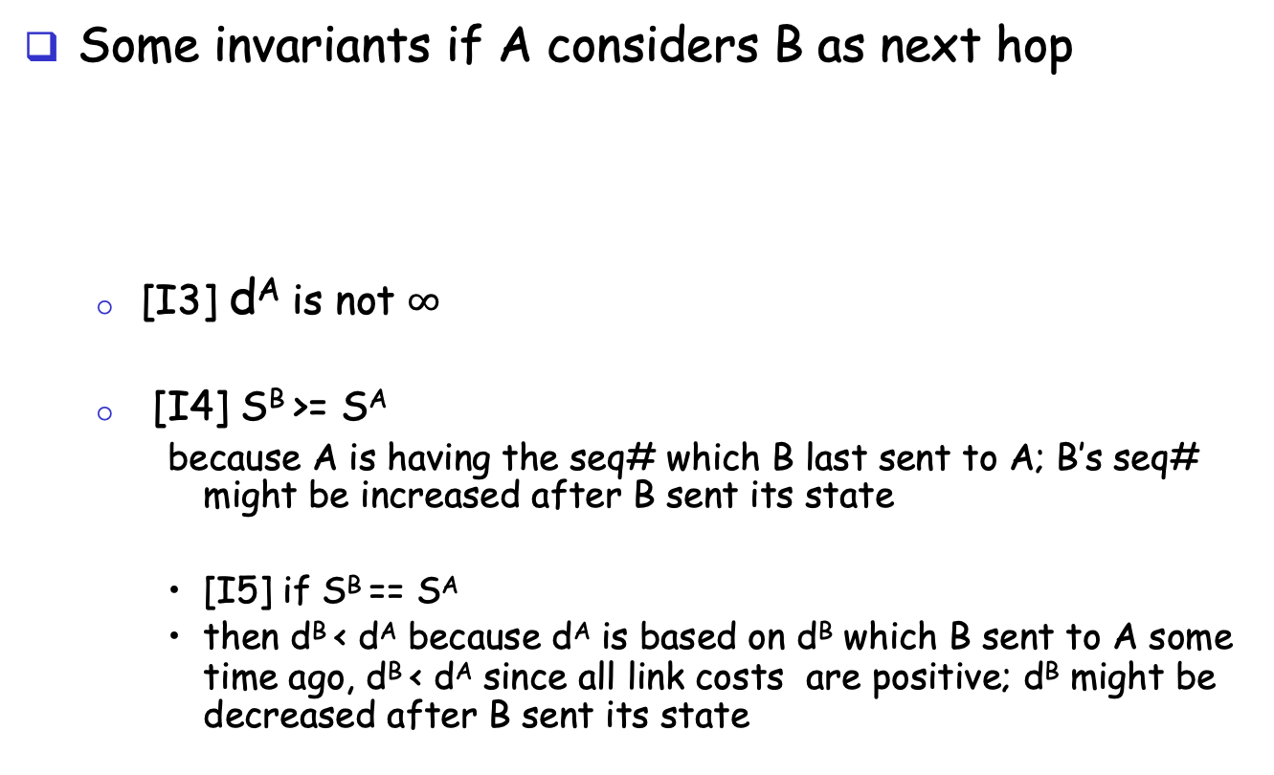
Invariants of if A Considers B as Next Hop
Some invariants if A considers B as next hop
  [I3] d^{A} is not $∞$
  [I4] S^{B} >= S^{A}
    because A is having the seq# which B last sent to A; B’s seq# might be increased after B sent its state
    [I5] if S^{B} == S^{A}
    then d^{B} < d^{A} because d^{A} is based on d^{B} which B sent to A some time ago, d^{B} < d^{A} since all link costs are positive; d^{B} might be decreased after B sent its state
A
B

Slide 54
Loop Freedom of DSDV
Consider a critical moment
  A starts to consider B as
  next hop, and we have a loop
According to invariant I4 for
each link in the loop
(X considers Y as next hop) :
S^{Y} >= S^{X}
Two cases:
  exists S^{Y} > S^{X}
    by transition along the
    loop S^{B} > S^{B}
  all nodes along the loop have the same sequence number
    apply I5, by transition along the loop d^{B} > d^{B}
update
A
B
X
Y

Slide 55
Issue of DSDV
1
5
X
1
1

Slide 56
Outline
Admin and recap
Network control plane
  Routing
    Link weights assignment
    Routing computation
      Distance vector protocols (distributed computing)
        synchronous Bellman-Ford (SBF)
        asynchronous Bellman-Ford (ABF)
        properties of DV
          DV w/ loop prevention
            reverse poison
            destination-sequenced DV (DSDV)
            diffusive update algorithm (DUAL) and EIGRP

Slide 57
Basic Idea
DSDV guarantees no loop, but at the price of not using any backup path before destination re-announces reachability.
Basic idea: Sufficient condition to guarantee no loop using backup paths (called switching)?

Slide 58
Key Idea: Feasible Successors
If the reported distance of a neighbor n is lower than the total distance using primary (current shortest), the neighbor n is a feasible successor
p
i
n

Slide 59
Intuition
Since the reported distance of B is lower than my total distance, B cannot be using me (along a path) to reach the destination
feasible successor
A
B
primary
D
Notes:
Before failure:
- dB < dA
- dB >= dC >= dD >= dE >= dA

Slide 60
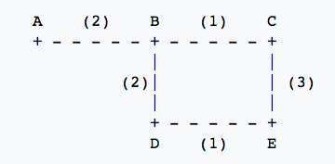
Example
Assume A is destination, consider E
 | Reported Dist. | Total Dist.
Neighbor C
Neighbor D
3
6
4
5

Slide 61
Example
1
5
1
1

Slide 62
Summary: Distance Vector Routing
Basic DV protocol
  take away: use monotonicity as a technique to understand liveness/convergence
    highly recommended reading of Bersekas/Gallager chapter
Fix counting-to-infinity problem
  DSDV
    Idea: uses sequence number to avoid routing loops
      seq# partitions routing updates from different outside events
      within same event, no loop so long each node only decreases its distance
    Analysis: use global invariants to understand/design safety/no routing loops
  EIRGP (DUAL)
    Idea: introduces a sufficient condition for local recovery
Notes:
Simplicity
churns before convergence
path exploration; counting-to-infinity
not enough information when making routing decision (only next-hops and their distance estimates)
While distance-vector protocols are appropriate for small internetworks, and require much less configuration and management
- IGRP was a significant improvement over RIP, which had a hop count restriction that limited the size of an internetwork. IGRP supports internetworks with up to 255 hops.
IGRP:
Upon router startup, IGRP broadcast request messages to other routers. Upon receipt of the message, router send their routing tables to the startup router. Routing tables contain entries for each of the networks that a router can reach. At regular intervals, routers automatically transmit their routing tables to other routers which in turn update their own routing tables if there are changes in the topology. A triggered update occurs if the network topology changes. Triggered updates allow quick responses to changes in the network. When routers add entries to routing tables, 1 is added to the hop count to account for the hop between the router and the neighbor from which it received the route information. When a route is entered into the routing table, a timer is set. As routing table updates arrive and a route entry is verified to still be valid, the timer is reset. If a known router fails to appear in an update and in subsequent updates, the timer will run out and the route entry will be purged.

Slide 63
Discussion: Distance Vector Routing
What do you like about distributed, distance vector routing?
What do you not like about distributed, distance vector routing?
Notes:
Simplicity
churns before convergence
path exploration; counting-to-infinity
not enough information when making routing decision (only next-hops and their distance estimates)
While distance-vector protocols are appropriate for small internetworks, and require much less configuration and management
- IGRP was a significant improvement over RIP, which had a hop count restriction that limited the size of an internetwork. IGRP supports internetworks with up to 255 hops.
IGRP:
Upon router startup, IGRP broadcast request messages to other routers. Upon receipt of the message, router send their routing tables to the startup router. Routing tables contain entries for each of the networks that a router can reach. At regular intervals, routers automatically transmit their routing tables to other routers which in turn update their own routing tables if there are changes in the topology. A triggered update occurs if the network topology changes. Triggered updates allow quick responses to changes in the network. When routers add entries to routing tables, 1 is added to the hop count to account for the hop between the router and the neighbor from which it received the route information. When a route is entered into the routing table, a timer is set. As routing table updates arrive and a route entry is verified to still be valid, the timer is reset. If a known router fails to appear in an update and in subsequent updates, the timer will run out and the route entry will be purged.

Slide 64
Churns of DV: One Example
Message sequences
Node 2 tells 3. Node 3 tells 4…Node N tells N+1. (N-1 messages)
Node N+1 tells N+2, N+2 tells N+3,…,2N. (N-1 messages)
Now node N-1 tells node N+1
Step 2 repeats
Now node N-2 tells node N+1
…
2N
Initially converged.
All links have cost 1
Event: Cost of 1->2 reduces to 0
…
N+3
N+2
N+1
A total of O(N²) messages
1
2
3
…
N-1
N

Slide 65
Outline
Admin and recap
Network control plane
  Routing
    Link weights assignment
    Routing computation
      Distance vector protocols (distributed computing)
      Link state protocols (distributed state synchronization)

Slide 66
Link-State Routing
Basic idea: Not distributed computing, only distributed state distribution
Net topology, link costs are distributed to all nodes
    all nodes have same info
    Each node computes its shortest paths from itself to all other nodes
      standard Dijkstra’s algorithm as path compute alg
      Allows multiple same-cost paths
      Multiple cost metrics per link (for type of service routing)
Most commonly used routing protocol (e.g., OSPF/ISIS) by most networks in Internet

Slide 67
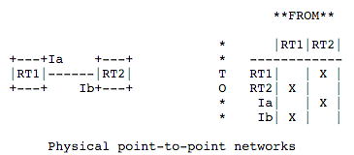
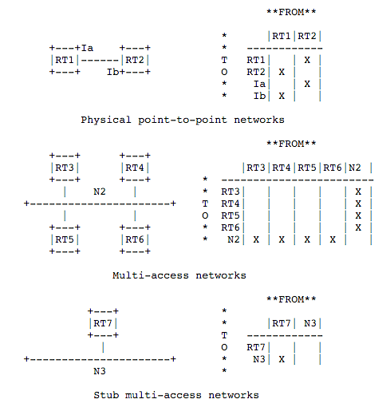
Example: Link State and Directed Graph (OSPFv2)
https://tools.ietf.org/html/rfc1583#page-12
Notes:
Need to setup order: Right after said a link is up, it became down
solution: sequence#
sequence# corruption: age
Partition: periodical rebroadcast
Failure

Slide 68
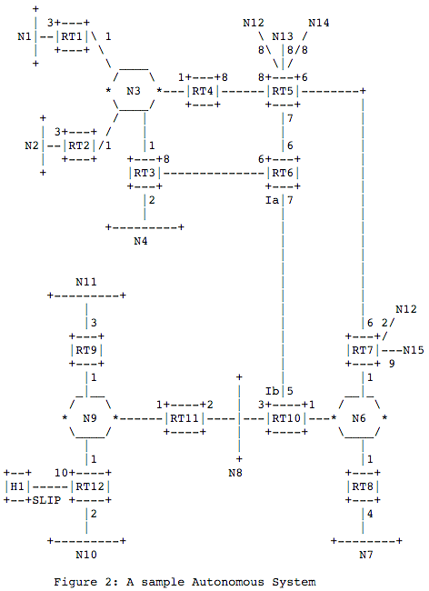
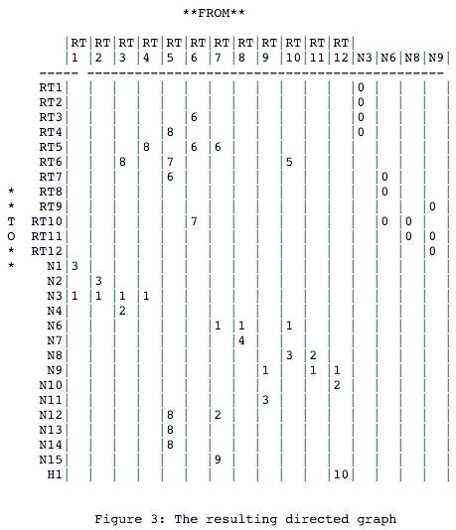
Example: Link State and Directed Graph (OSPFv2)
Notes:
Need to setup order: Right after said a link is up, it became down
solution: sequence#
sequence# corruption: age
Partition: periodical rebroadcast
Failure

Slide 69
Outline
Admin and recap
Network control plane
  Routing
    Link weights assignment
    Routing computation
      Distance vector protocols (distributed computing)
      Link state protocols (distributed state synchronization)
        data structure to be distributed
        state distribution protocol

Slide 70
Basic Link State Broadcast Protocol
Basic event structure at node n
  on initialization:
    broadcast LSA[e] for each link e connected to n
  on state change to a link e connected to n:
    broadcast LSA[e] = new status
  on receiving an LSA[e]:
    if (does not have LSA[e])
    forwards LSA[e] to all links except the incoming link
Notes:
Need to setup order: Right after said a link is up, it became down
solution: sequence#
ordering of events (link up and down)
network partitioning and then merge
sequence# corruption: age
Partition: periodical rebroadcast
Failure

Slide 71

Link State Broadcast
Node S updates link states connected to it.
S
E
F
B
C
M
L
J
A
G
H
D
K
I
N

Slide 72
Link State Broadcast
S
E
F
B
C
M
L
J
A
G
H
D
K
I
N
To avoid forwarding the same link state announcement (LSA) multiple times
(forming a loop), each node remembers the received LSAs.
- Second LSA[S] received by E from C is discarded
- Second LSA[S] received by C from E is discarded as well
- Node H receives LSA[S] from two neighbors, and will discard one of them

Slide 73
Discussion
Issues of the basic link state protocol?
  Recall: goal is to efficiently distribute to each node to a correct, complete link state map

Slide 74
Link State Broadcast: Issues
Problem: Out of order delivery
  link down and then up
  A node may receive up first and then down
Solution
  Each link update is given a sequence number: (initiator, seq#, link, status)
    the initiator should increase the seq# for each new update
  If the seq# of an update of a link is not higher than the highest seq# a router has seen, drop the update
  Otherwise, forward it to all links except the incoming link (real implementation using packet buffer)
  Problem of solution: seq# corruption
  Solution: age field (e.g., https://tools.ietf.org/html/rfc1583#page-102)

Slide 75
Link State Broadcast: Issues
Problem: network partition and then reconnect, how to sync across the reconnected components
Solution: updates are sent periodically

Slide 76
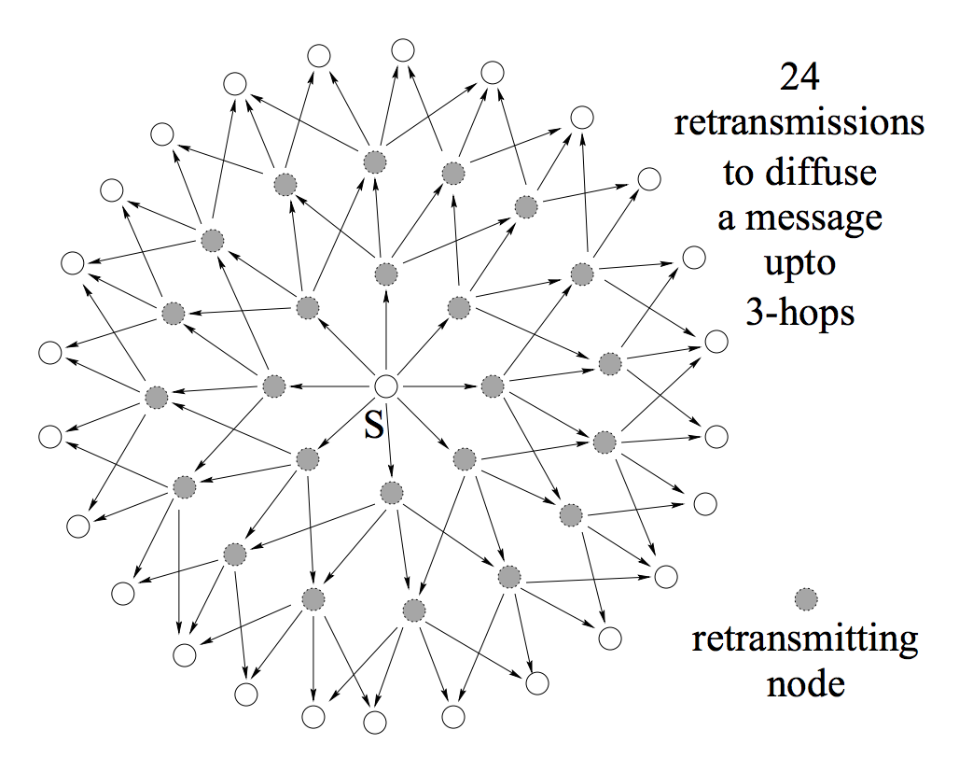
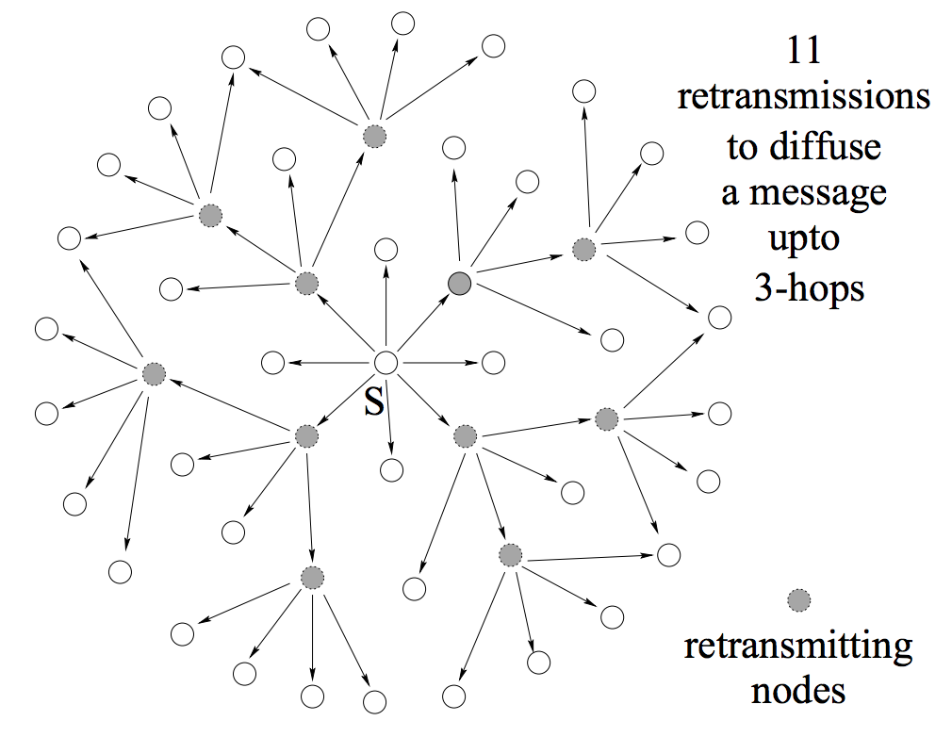
Link State Broadcast: Issues
Problem: Broadcast redundancy
https://hal.inria.fr/inria-00072756/document

Slide 77
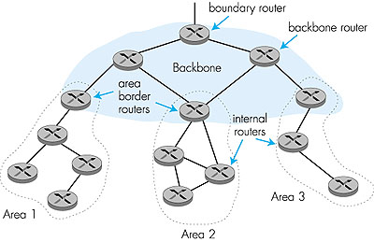
Hierarchical OSPF
“summarize” distances to nets in own area, advertise to other Area Border routers.
run OSPF routing limited to backbone.
  - Link-state advertisements only in area
  each nodes has detailed area topology;
  - only know direction (shortest path) to nets in other areas.
Two-level hierarchy: local area, backbone.

Slide 78
Summary: Link State
Basic LS protocol
  take away: instead of computing routing results using distributed computing, distributed computing is for only link state distribution (synchronization)
Link state distribution can still have much complexity, e.g., out of order delivery, partition and reconnect, scalability
Notes:
Simplicity
churns before convergence
path exploration; counting-to-infinity
not enough information when making routing decision (only next-hops and their distance estimates)
While distance-vector protocols are appropriate for small internetworks, and require much less configuration and management
- IGRP was a significant improvement over RIP, which had a hop count restriction that limited the size of an internetwork. IGRP supports internetworks with up to 255 hops.
IGRP:
Upon router startup, IGRP broadcast request messages to other routers. Upon receipt of the message, router send their routing tables to the startup router. Routing tables contain entries for each of the networks that a router can reach. At regular intervals, routers automatically transmit their routing tables to other routers which in turn update their own routing tables if there are changes in the topology. A triggered update occurs if the network topology changes. Triggered updates allow quick responses to changes in the network. When routers add entries to routing tables, 1 is added to the hop count to account for the hop between the router and the neighbor from which it received the route information. When a route is entered into the routing table, a timer is set. As routing table updates arrive and a route entry is verified to still be valid, the timer is reset. If a known router fails to appear in an update and in subsequent updates, the timer will run out and the route entry will be purged.

Slide 79
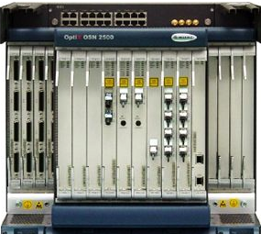
Roadmap: Routing Computation Architecture Spectrum
Dijkstra
Distributed Bellman Ford
Distributed Link State
Dijkstra
Datapath
Distributed Bellman Ford
Distributed Link State
Dijkstra
Datapath
Distributed Bellman Ford
Distributed Link State
Datapath
Notes:
RIP: 1988 RFC1058 OSFPv2: RFC2328

Slide 80
Outline
Admin and recap
Network control plane
  Routing
    Link weights assignment
    Routing computation
      Basic routing computation protocols
        Distance vector protocols (distributed computing)
        Link state protocols (distributed state synchronization)
      Global Internet routing

Slide 81
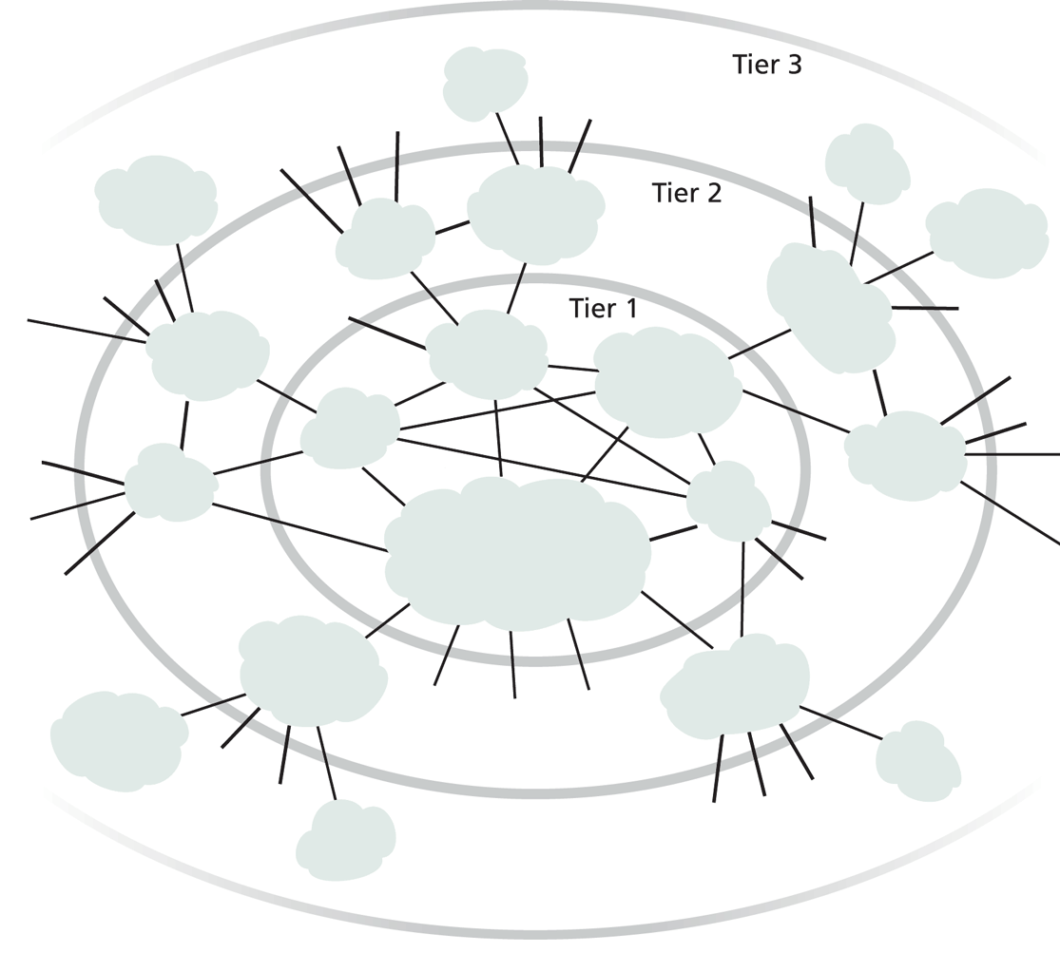
Exercise
Does it work to use DV or LS as we discussed for global Internet routing?
Notes:
DV: so many loops,
LS/DV: scalability

Slide 82
Requirements and Solution of Current Global Internet Routing
Scalability: handle network size (#devices) much higher than typical DV or LS can handle
  Solution: Introduce new abstraction to reduce network (graph) size
Autonomy: allow each network to have individual preference of routing (full control of its internal routing; control/preference of routing spanning multiple networks)
  Solution: hierarchical routing and policy routing
Notes:
Other than scale, what else?

Slide 83
New Abstraction: Autonomous Systems (AS)
Abstract each network as an autonomous system (AS), identified by an AS number (ASN)
Conceptually the global routing graph consists of only autonomous systems
as nodes
http://www.bgplookingglass.com/list-of-autonomous-system-numbers

Slide 84
Routing with Autonomous Systems
Internet routing is divided into intra-AS routing and inter-AS routing
  Intra-AS routing (also called intradomain routing)
    A protocol running insides an AS is called an Interior Gateway Protocol (IGP), each AS can choose its own protocol, such as RIP, E/IGRP, OSPF, IS-IS
  Inter-AS routing (also called interdomain routing)
    A protocol runs among autonomous systems is also called an Exterior Gateway Protocol (EGP)
    The de facto EGP protocol is BGP

