Slide 1
Network Layer:
Distance Vector Routing, Link State Routing
Global Internet Routing (Interdomain, BGP)
Qiao Xiang, Congming Gao, Qiang Su
  https://sngroup.org.cn/courses/cnns-xmuf25/index.shtml
11/25/2025
This deck of slides are heavily based on CPSC 433/533 at Yale University, by courtesy of Dr. Y. Richard Yang.

Slide 2
Outline
Admin and recap
Network control plane
  Routing
    Link weights assignment
    Routing computation
      Distance vector protocols (distributed computing)
        synchronous Bellman-Ford (SBF)
        asynchronous Bellman-Ford (ABF)
        properties of DV
          DV w/ loop prevention
            reverse poison
            destination-sequenced DV (DSDV)

Slide 3
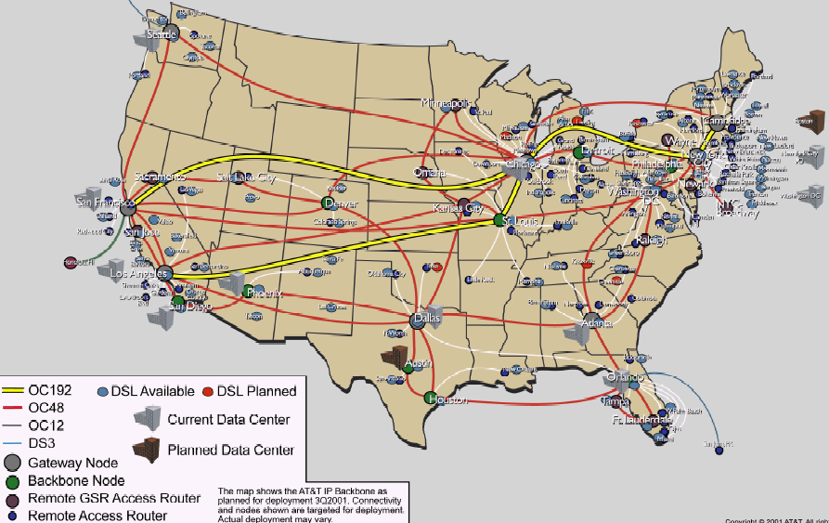
Recap: Routing Context
Routing
Goal: determine “good” paths
(sequences of routers) thru
networks from source to dest.
Often depends on a graph abstraction:
graph nodes are routers
graph edges are physical links
  links have properties: delay, capacity, $ cost, policy
5
B
3
C
2
5
A
2
1
F
3
1
2
D
E
1

Slide 4
Recap: Routing Computation using Distance Vector/Bellman-Ford Routing
Distributed computation:
At node i, computes
One way to understand BFA
is to consider it as a dynamic
programming alg, propagating from dest to other nodes
destination
j
i

Slide 5
Recap: Destination-Sequenced
Distance Vector protocol (DSDV)
Basic idea: use sequence numbers to partition computation
  tags each route with a sequence number
  each destination node D periodically advertises monotonically increasing even-numbered sequence numbers
  when a node realizes that the link it uses to reach destination D is broken, it advertises an infinite metric and a sequence number which is one greater than the previous route (i.e., an odd seq. number)
    the route is repaired by a later even-number advertisement from the destination

Slide 6
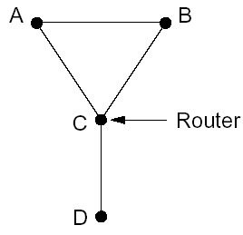
Recap: Example
1
5
X
1
1
Will this trigger an update?

Slide 7
Recap: Example
1
5
X
1
1
Will this trigger an update?

Slide 8
Outline
Admin and recap
Network control plane
  Routing
    Link weights assignment
    Routing computation
      Distance vector protocols (distributed computing)
        synchronous Bellman-Ford (SBF)
        asynchronous Bellman-Ford (ABF)
        properties of DV
          DV w/ loop prevention
            reverse poison
            destination-sequenced DV (DSDV)
            diffusive update algorithm (DUAL) and EIGRP

Slide 9
Basic Idea
DSDV guarantees no loop, but at the price of not using any backup path before destination re-announces reachability.
Basic idea: Sufficient condition to guarantee no loop using backup paths (called switching)?

Slide 10
Key Idea: Feasible Successors
If the reported distance of a neighbor n is lower than the total distance using primary (current shortest), the neighbor n is a feasible successor
p
i
n

Slide 11
Intuition
Since the reported distance of B is lower than my total distance, B cannot be using me (along a path) to reach the destination
feasible successor
A
B
primary
D
Notes:
Before failure:
- dB < dA
- dB >= dC >= dD >= dE >= dA

Slide 12
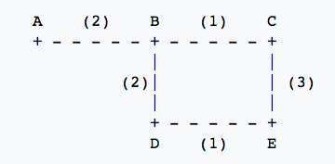
Example
Assume A is destination, consider E
 | Reported Dist. | Total Dist.
Neighbor C
Neighbor D
3
6
4
5

Slide 13
Example
1
5
1
1

Slide 14
Summary: Distance Vector Routing
Basic DV protocol
  take away: use monotonicity as a technique to understand liveness/convergence
    highly recommended reading of Bersekas/Gallager chapter
Fix counting-to-infinity problem
  DSDV
    Idea: uses sequence number to avoid routing loops
      seq# partitions routing updates from different outside events
      within same event, no loop so long each node only decreases its distance
    Analysis: use global invariants to understand/design safety/no routing loops
  EIRGP (DUAL)
    Idea: introduces a sufficient condition for local recovery
Notes:
Simplicity
churns before convergence
path exploration; counting-to-infinity
not enough information when making routing decision (only next-hops and their distance estimates)
While distance-vector protocols are appropriate for small internetworks, and require much less configuration and management
- IGRP was a significant improvement over RIP, which had a hop count restriction that limited the size of an internetwork. IGRP supports internetworks with up to 255 hops.
IGRP:
Upon router startup, IGRP broadcast request messages to other routers. Upon receipt of the message, router send their routing tables to the startup router. Routing tables contain entries for each of the networks that a router can reach. At regular intervals, routers automatically transmit their routing tables to other routers which in turn update their own routing tables if there are changes in the topology. A triggered update occurs if the network topology changes. Triggered updates allow quick responses to changes in the network. When routers add entries to routing tables, 1 is added to the hop count to account for the hop between the router and the neighbor from which it received the route information. When a route is entered into the routing table, a timer is set. As routing table updates arrive and a route entry is verified to still be valid, the timer is reset. If a known router fails to appear in an update and in subsequent updates, the timer will run out and the route entry will be purged.

Slide 15
Discussion: Distance Vector Routing
What do you like about distributed, distance vector routing?
What do you not like about distributed, distance vector routing?
Notes:
Simplicity
churns before convergence
path exploration; counting-to-infinity
not enough information when making routing decision (only next-hops and their distance estimates)
While distance-vector protocols are appropriate for small internetworks, and require much less configuration and management
- IGRP was a significant improvement over RIP, which had a hop count restriction that limited the size of an internetwork. IGRP supports internetworks with up to 255 hops.
IGRP:
Upon router startup, IGRP broadcast request messages to other routers. Upon receipt of the message, router send their routing tables to the startup router. Routing tables contain entries for each of the networks that a router can reach. At regular intervals, routers automatically transmit their routing tables to other routers which in turn update their own routing tables if there are changes in the topology. A triggered update occurs if the network topology changes. Triggered updates allow quick responses to changes in the network. When routers add entries to routing tables, 1 is added to the hop count to account for the hop between the router and the neighbor from which it received the route information. When a route is entered into the routing table, a timer is set. As routing table updates arrive and a route entry is verified to still be valid, the timer is reset. If a known router fails to appear in an update and in subsequent updates, the timer will run out and the route entry will be purged.

Slide 16
Churns of DV: One Example
Message sequences
Node 2 tells 3. Node 3 tells 4…Node N tells N+1. (N-1 messages)
Node N+1 tells N+2, N+2 tells N+3,…,2N. (N-1 messages)
Now node N-1 tells node N+1
Step 2 repeats
Now node N-2 tells node N+1
…
2N
Initially converged.
All links have cost 1
Event: Cost of 1->2 reduces to 0
…
N+3
N+2
N+1
A total of O(N²) messages
1
2
3
…
N-1
N

Slide 17
Outline
Admin and recap
Network control plane
  Routing
    Link weights assignment
    Routing computation
      Distance vector protocols (distributed computing)
      Link state protocols (distributed state synchronization)

Slide 18
Link-State Routing
Basic idea: Not distributed computing, only distributed state distribution
Net topology, link costs are distributed to all nodes
    all nodes have same info
    Each node computes its shortest paths from itself to all other nodes
      standard Dijkstra’s algorithm as path compute alg
      Allows multiple same-cost paths
      Multiple cost metrics per link (for type of service routing)
Most commonly used routing protocol (e.g., OSPF/ISIS) by most networks in Internet

Slide 19
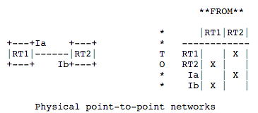
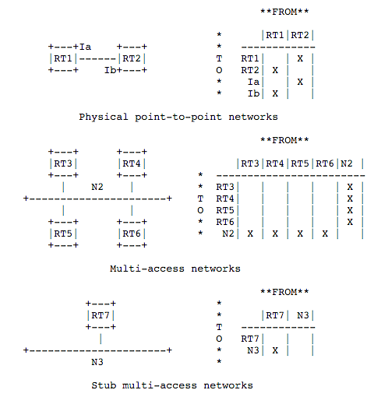
Example: Link State and Directed Graph (OSPFv2)
https://tools.ietf.org/html/rfc1583#page-12
Notes:
Need to setup order: Right after said a link is up, it became down
solution: sequence#
sequence# corruption: age
Partition: periodical rebroadcast
Failure

Slide 20
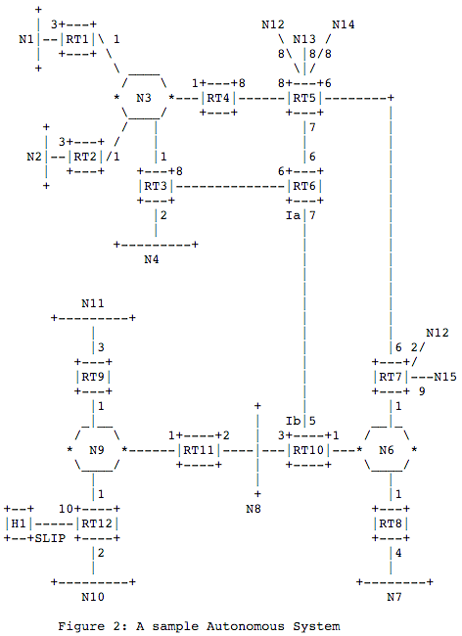
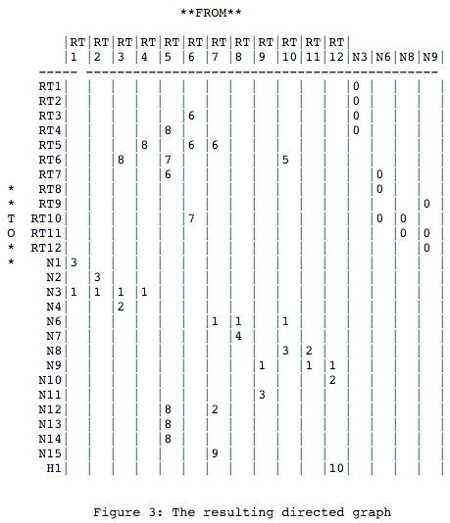
Example: Link State and Directed Graph (OSPFv2)
Notes:
Need to setup order: Right after said a link is up, it became down
solution: sequence#
sequence# corruption: age
Partition: periodical rebroadcast
Failure

Slide 21
Outline
Admin and recap
Network control plane
  Routing
    Link weights assignment
    Routing computation
      Distance vector protocols (distributed computing)
      Link state protocols (distributed state synchronization)
        data structure to be distributed
        state distribution protocol

Slide 22
Basic Link State Broadcast Protocol
Basic event structure at node n
  on initialization:
    broadcast LSA[e] for each link e connected to n
  on state change to a link e connected to n:
    broadcast LSA[e] = new status
  on receiving an LSA[e]:
    if (does not have LSA[e])
    forwards LSA[e] to all links except the incoming link
Notes:
Need to setup order: Right after said a link is up, it became down
solution: sequence#
ordering of events (link up and down)
network partitioning and then merge
sequence# corruption: age
Partition: periodical rebroadcast
Failure

Slide 23

Link State Broadcast
Node S updates link states connected to it.
S
E
F
B
C
M
L
J
A
G
H
D
K
I
N

Slide 24
Link State Broadcast
S
E
F
B
C
M
L
J
A
G
H
D
K
I
N
To avoid forwarding the same link state announcement (LSA) multiple times
(forming a loop), each node remembers the received LSAs.
- Second LSA[S] received by E from C is discarded
- Second LSA[S] received by C from E is discarded as well
- Node H receives LSA[S] from two neighbors, and will discard one of them

Slide 25
Discussion
Issues of the basic link state protocol?
  Recall: goal is to efficiently distribute to each node to a correct, complete link state map

Slide 26
Link State Broadcast: Issues
Problem: Out of order delivery
  link down and then up
  A node may receive up first and then down
Solution
  Each link update is given a sequence number: (initiator, seq#, link, status)
    the initiator should increase the seq# for each new update
  If the seq# of an update of a link is not higher than the highest seq# a router has seen, drop the update
  Otherwise, forward it to all links except the incoming link (real implementation using packet buffer)
  Problem of solution: seq# corruption
  Solution: age field (e.g., https://tools.ietf.org/html/rfc1583#page-102)

Slide 27
Link State Broadcast: Issues
Problem: network partition and then reconnect, how to sync across the reconnected components
Solution: updates are sent periodically

Slide 28
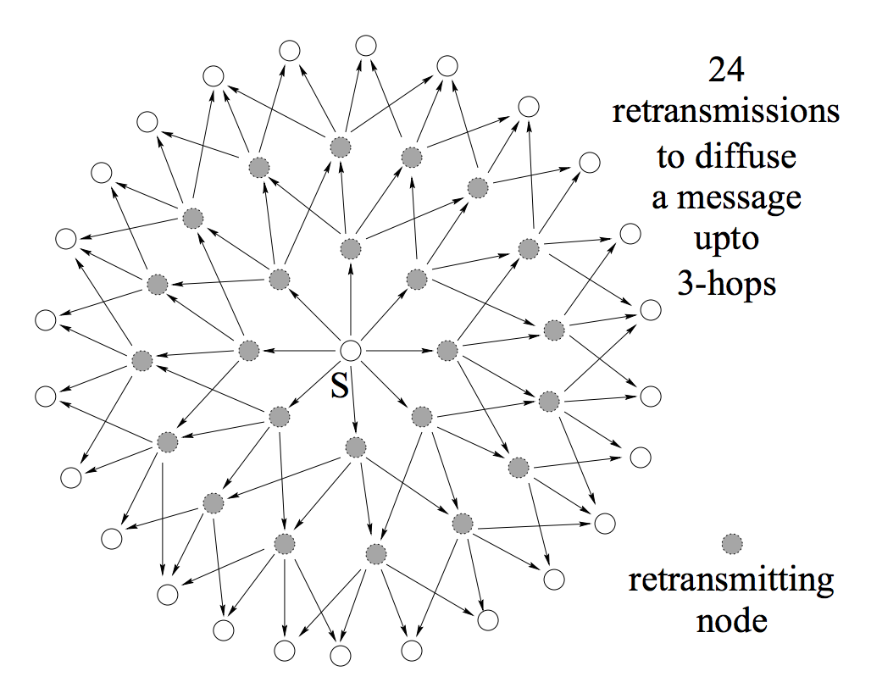
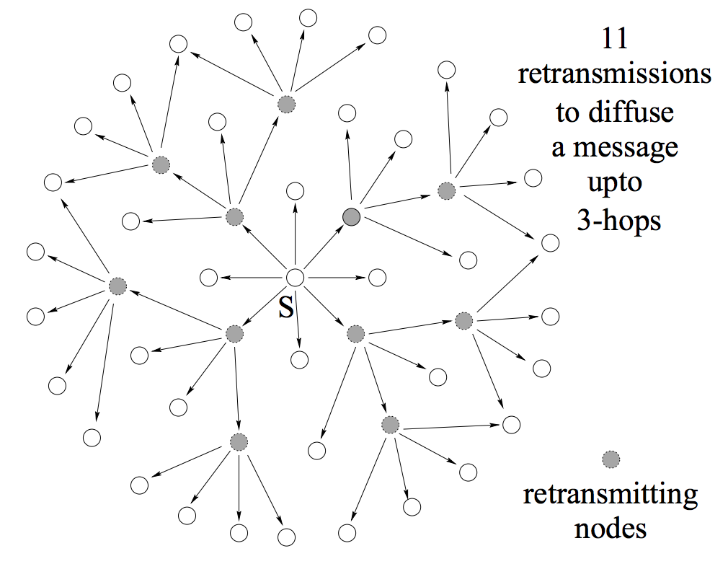
Link State Broadcast: Issues
Problem: Broadcast redundancy
https://hal.inria.fr/inria-00072756/document

Slide 29
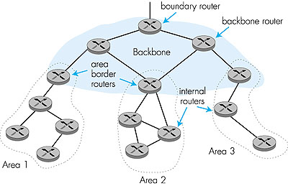
Hierarchical OSPF
“summarize” distances to nets in own area, advertise to other Area Border routers.
run OSPF routing limited to backbone.
  - Link-state advertisements only in area
  each nodes has detailed area topology;
  - only know direction (shortest path) to nets in other areas.
Two-level hierarchy: local area, backbone.

Slide 30
Summary: Link State
Basic LS protocol
  take away: instead of computing routing results using distributed computing, distributed computing is for only link state distribution (synchronization)
Link state distribution can still have much complexity, e.g., out of order delivery, partition and reconnect, scalability
Notes:
Simplicity
churns before convergence
path exploration; counting-to-infinity
not enough information when making routing decision (only next-hops and their distance estimates)
While distance-vector protocols are appropriate for small internetworks, and require much less configuration and management
- IGRP was a significant improvement over RIP, which had a hop count restriction that limited the size of an internetwork. IGRP supports internetworks with up to 255 hops.
IGRP:
Upon router startup, IGRP broadcast request messages to other routers. Upon receipt of the message, router send their routing tables to the startup router. Routing tables contain entries for each of the networks that a router can reach. At regular intervals, routers automatically transmit their routing tables to other routers which in turn update their own routing tables if there are changes in the topology. A triggered update occurs if the network topology changes. Triggered updates allow quick responses to changes in the network. When routers add entries to routing tables, 1 is added to the hop count to account for the hop between the router and the neighbor from which it received the route information. When a route is entered into the routing table, a timer is set. As routing table updates arrive and a route entry is verified to still be valid, the timer is reset. If a known router fails to appear in an update and in subsequent updates, the timer will run out and the route entry will be purged.

Slide 31
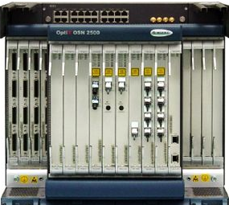
Roadmap: Routing Computation Architecture Spectrum
Dijkstra
Distributed Bellman Ford
Distributed Link State
Dijkstra
Datapath
Distributed Bellman Ford
Distributed Link State
Dijkstra
Datapath
Distributed Bellman Ford
Distributed Link State
Datapath
Notes:
RIP: 1988 RFC1058 OSFPv2: RFC2328

Slide 32
Outline
Admin and recap
Network control plane
  Routing
    Link weights assignment
    Routing computation
      Basic routing computation protocols
        Distance vector protocols (distributed computing)
        Link state protocols (distributed state synchronization)
      Global Internet routing

Slide 33
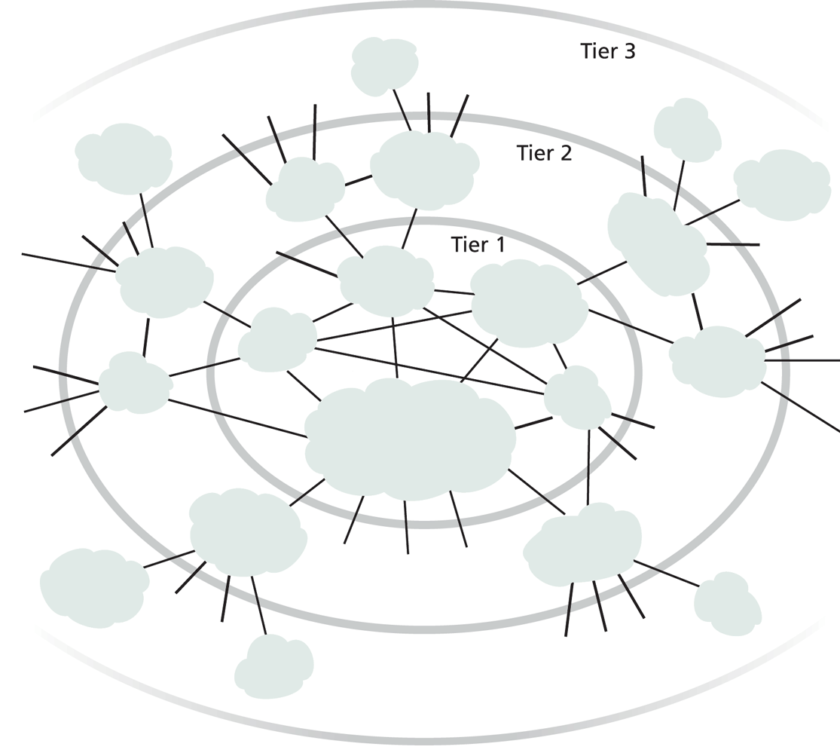
Exercise
Does it work to use DV or LS as we discussed for global Internet routing?
Notes:
DV: so many loops,
LS/DV: scalability

Slide 34
Requirements and Solution of Current Global Internet Routing
Scalability: handle network size (#devices) much higher than typical DV or LS can handle
  Solution: Introduce new abstraction to reduce network (graph) size
Autonomy: allow each network to have individual preference of routing (full control of its internal routing; control/preference of routing spanning multiple networks)
  Solution: hierarchical routing and policy routing
Notes:
Other than scale, what else?

Slide 35
New Abstraction: Autonomous Systems (AS)
Abstract each network as an autonomous system (AS), identified by an AS number (ASN)
Conceptually the global routing graph consists of only autonomous systems
as nodes
http://www.bgplookingglass.com/list-of-autonomous-system-numbers

Slide 36
Routing with Autonomous Systems
Internet routing is divided into intra-AS routing and inter-AS routing
  Intra-AS routing (also called intradomain routing)
    A protocol running insides an AS is called an Interior Gateway Protocol (IGP), each AS can choose its own protocol, such as RIP, E/IGRP, OSPF, IS-IS
  Inter-AS routing (also called interdomain routing)
    A protocol runs among autonomous systems is also called an Exterior Gateway Protocol (EGP)
    The de facto EGP protocol is BGP

Slide 37
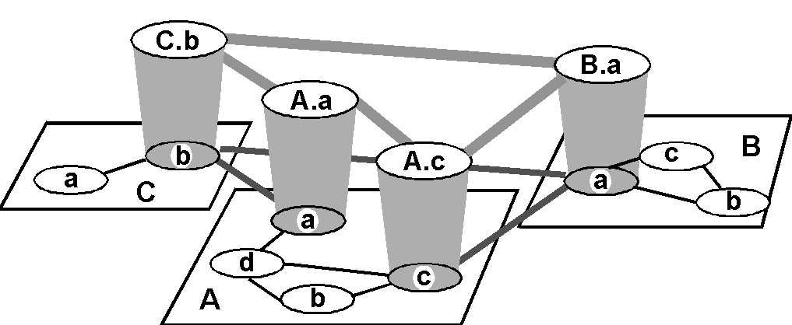
Routing with Autonomous Systems
Inter-AS routers form an overlay
Gateway routers participate in intradomain to learn internal routes.
Gateway routers of same AS share learned external
routes using iBGP.
AS C
(RIP intra
AS B
(OSPF intra
AS A
(OSPF intra
routing)
routing)
routing)
i
a
b
e
eBGP
iBGP
f
g
Gateway routers of diff. auto. systems exchange routes using eBGP
d
c
h

Slide 38
Routing with Autonomous Systems
border (exterior gateway) routers
C.b
B.a
A.a
b
A.c
c
a
C
a
b
a
B
d
c
A
b
interior (gateway) routers

Slide 39
Summary: Internet Routing Architecture
Autonomous systems have flexibility to choose their own intradomain routing protocols
  allows autonomy
Only a small # of routers (gateways) from each AS in the interdomain level
  improves scalability
Interdomain routing using AS topology instead of detailed topology
  improves scalability/privacy

Slide 40
Outline
Admin and recap
Network control plane
  Routing
    Link weights assignment
    Routing computation
      Basic routing computation protocols
      Global Internet routing
        Basic architecture
        BGP (Border Gateway Protocol): The de facto Inter-domain routing standard

Slide 41
BGP Basic Operations
BGP is a Path Vector protocol
  similar to Distance Vector protocol
  a border gateway sends to a neighbor entire path (i.e., a sequence of ASNs) to a destination, e.g.,
    gateway X sends to neighbor N its path to dest. Z:
path (X,Z) = X,Y1,Y2,Y3,…,Z
  if N selects path(X, Z) advertised by X, then:
  path (N,Z) = N, path (X,Z)
Z
N
X

Slide 42
BGP Basic Operations
Establish session on
TCP port 179
AS1
BGP session
Exchange all
active routes
AS2
while (connection is ALIVE)
exchange UPDATE message
select best available route
if route changes, export to neigh.
Exchange incremental
updates

Slide 43
BGP Messages
Four types of messages
  OPEN: opens TCP connection to peer and authenticates sender
  UPDATE: advertises new path (or withdraws old)
  KEEPALIVE keeps connection alive in absence of UPDATES; also ACKs OPEN request
  NOTIFICATION: reports errors in previous msg; also used to close connection

Slide 44
Outline
Admin and recap
Network control plane
  Routing
    Link weights assignment
    Routing computation
      Basic routing computation protocols
      Global Internet routing
        Basic architecture
        BGP (Border Gateway Protocol): The de facto Inter-domain routing standard
          Basic operations
          BGP as a policy routing framework (control interdomain routes)

Slide 45
BGP Policy Routing Framework: Decision Components
route selection policy: rank paths
1 3 0
1 0
routing cache
select best
path
export policy: which paths export to which neighbors
export path
to neighbors
AT&T
Qwest
Internet2
Yale
45

Slide 46
BGP Example (1)
AS D
d
E
AS A
(OSPF)
d->a2: I can reach
hosts in D; my path: D
Export to E: i->e: I can
reach hosts in D; path: IAD
a2
a2->a1: I can reach
hosts in D; path: D
a1->i: I can reach hosts
in D; my path: AD
a1
No export
to F (effect?)
i
F
AS C
Route selection policy:
- Shortest AS Path policy:
Choose AD using a1
i2->i: I can reach
hosts in D; path: BCD
b->i: I can reach hosts
in D; my path: BCD
AS B
(OSPF intra
Export policy
controls ingress, i.e.,
who can use I
routing)
i2
b
b->i2: I can reach hosts
in D; my path: BCD
AS I
Notes:
Choose

