Slide 1
Network Layer: Global Internet Routing (Interdomain, BGP); DHCP; Forwarding
Qiao Xiang, Congming Gao, Qiang Su
https://sngroup.org.cn/courses/cnns-xmuf25/index.shtml
11/27/2024
This deck of slides are heavily based on CPSC 433/533 at Yale University, by courtesy of Dr. Y. Richard Yang.

Slide 2
Outline
Admin and recap
Network control plane
Routing
Routing computation
Basic routing computation protocols
Distance vector protocols (distributed computing)
Link state protocols (distributed state synchronization)
Global Internet routing

Slide 3
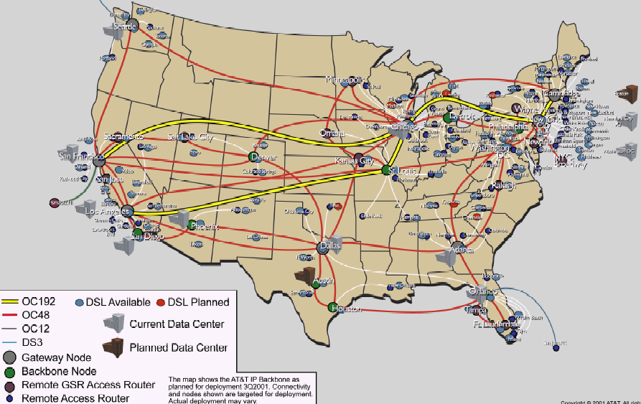
Recap: Routing Context
Routing
Goal: determine “good” paths
(sequences of routers) thru
networks from source to dest.
Often depends on a graph abstraction:
graph nodes are routers
graph edges are physical links
links have properties: delay, capacity, $ cost, policy
5
B
3
C
2
5
A
2
1
F
3
1
2
D
E
1

Slide 4
Recap: Link-State Routing
Basic idea: Not distributed computing, only distributed state distribution
Net topology, link costs are distributed to all nodes
all nodes have same info
Each node computes its shortest paths from itself to all other nodes
standard Dijkstra’s algorithm as path compute alg
Allows multiple same-cost paths
Multiple cost metrics per link (for type of service routing)
Most commonly used routing protocol (e.g., OSPF/ISIS) by most networks in Internet

Slide 5

Roadmap: Routing Computation Architecture Spectrum
Dijkstra
Distributed Bellman Ford
Distributed Link State
Dijkstra
Datapath
Distributed Bellman Ford
Distributed Link State
Dijkstra
Datapath
Distributed Bellman Ford
Distributed Link State
Datapath
Notes:
RIP: 1988 RFC1058 OSFPv2: RFC2328

Slide 6
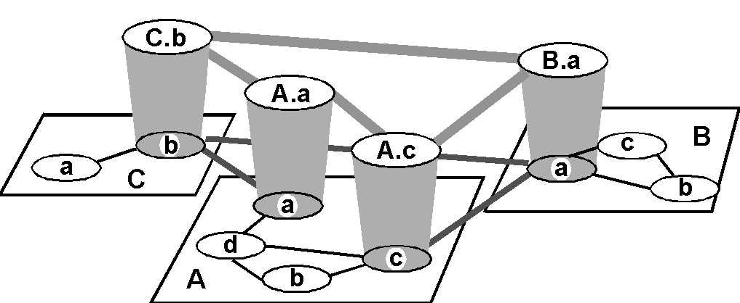
Recap: Routing with Autonomous Systems
Inter-AS routers form an overlay
Gateway routers participate in intradomain to learn internal routes.
Gateway routers of same AS share learned external routes using iBGP.
AS C
(RIP intra
AS B
(OSPF intra
AS A
(OSPF intra
routing)
routing)
routing)
i
a
b
e
eBGP
iBGP
f
g
Gateway routers of diff. auto. systems exchange routes using eBGP
d
c
h

Slide 7
Recap: BGP Basic Operations
BGP is a Path Vector protocol
similar to Distance Vector protocol
a border gateway sends to a neighbor entire path (i.e., a sequence of ASNs) to a destination, e.g.,
gateway X sends to neighbor N its path to dest. Z:
path (X,Z) = X,Y1,Y2,Y3,…,Z
if N selects path(X, Z) advertised by X, then: path (N,Z) = N, path (X,Z)
Z
N
X

Slide 8
Outline
Admin and recap
Network control plane
Routing
Link weights assignment
Routing computation
Basic routing computation protocols
Global Internet routing
Basic architecture
BGP (Border Gateway Protocol): The de facto Inter-domain routing standard
Basic operations
BGP as a policy routing framework (control interdomain routes)

Slide 9
BGP Policy Routing Framework: Decision Components
route selection policy: rank paths
1 3 0
1 0
routing cache
select best path
export policy: which paths export to which neighbors
export path to neighbors
AT&T
Qwest
Internet2
Yale
9

Slide 10
BGP Example (1)
AS D
d
E
AS A
(OSPF)
d->a2: I can reach
hosts in D; my path: D
Export to E: i->e: I can reach hosts in D; path: IAD
a2
a2->a1: I can reach
hosts in D; path: D
a1->i: I can reach hosts in D; my path: AD
a1
No export to F (effect?)
i
F
AS C
Route selection policy:
- Shortest AS Path policy:
Choose AD using a1
i2->i: I can reach hosts in D; path: BCD
b->i: I can reach hosts
in D; my path: BCD
AS B
(OSPF intra
Export policy controls ingress, i.e., who can use I
routing)
i2
b
b->i2: I can reach hosts
in D; my path: BCD
AS I
Notes:
Choose

Slide 11
BGP Example (2)
AS D
d
E
AS A
(OSPF)
d->a2: I can reach
hosts in D; my path: D
Export to E: i->e: I can reach hosts in D; path: IBCD
a2
a2->a1: I can reach
hosts in D; path: D
a1->i: I can reach hosts in D; my path: AD
a1
F
i
AS C
Selection policy: - Low local_pref for A
- Shortest AS Path
- Prefer eBGP
Called hot potato (why?)
i2->i: I can reach hosts in D; path: BCD
b->i: I can reach hosts
in D; my path: BCD
AS B
(OSPF intra
Outcome: Choose BCD using b
routing)
i2
b
b->i2: I can reach hosts
in D; my path: BCD
AS I
Notes:
Choose

Slide 12
BGP Example (3)
AS D
d
E
AS A
(OSPF)
d->a2: I can reach
hosts in D; my path: D
Export to E: i->e: I can reach hosts in D; path: IBCD
a2
a2->a1: I can reach
hosts in D; path: D
a1->i: I can reach hosts in D; my path: AD
a1
F
i
AS C
Selection policy: - Low local pref A
- Shortest AS Path
- Prefer iBGP
Called cold potato (why?)
i2->i: I can reach hosts in D; path: BCD
b->i: I can reach hosts
in D; my path: BCD
AS B
(OSPF intra
Outcome: Choose BCD using i2
routing)
i2
b
b->i2: I can reach hosts
in D; my path: BCD
AS I
Notes:
Choose

Slide 13
Observing BGP Paths
Using one of the looking glass servers: http://www.bgp4.as/looking-glasses
https://www.gin.ntt.net/looking-glass/

Slide 14
Outline
Admin and recap
Network control plane
Routing
Link weights assignment
Routing computation
Basic routing computation protocols
Global Internet routing
Basic architecture
BGP (Border Gateway Protocol): The de facto Inter-domain routing standard
Basic operations
BGP as a policy routing framework (control interdomain routes)
Policy/interdomain routing analysis

Slide 15
Motivation: Policy Routing Stability
A policy routing system can be considered as a system to aggregate local preferences, but aggregation may not be always successful.
The BAD GADGET example:
- 0 is the destination
- the route selection policy of each AS is to prefer its counter clock-wise neighbor
preferred
2 1 0
2 0
2
4
less
preferred
0
3 2 0
3 0
1 3 0
1 0
1
3
3
Policy (preferences) aggregation fails: routing instability !

Slide 16
General Framework of Preference Aggregation
Also called Social Choice
Given individual preferences, define a framework to aggregate individual preferences:
A set of choices: a, b, c, …
A set of voters 1, 2, …
Each voter has a preference (ranking) of all choices, e.g.,
voter 1: a > b > c
voter 2: a > c > b
voter 3: a > c > b
A well-specified aggregation rule (protocol) computes an aggregation of ranking, e.g.,
Society (network): a > b > c
For more details: see Semih Salihoglu (2007). Interdomain Routing as a Social Choice.
Notes:
https://en.wikipedia.org/wiki/Arrow%27s_impossibility_theorem

Slide 17
Example: Aggregation of Global Preference
A
S
D
B
Choices (for S->D route): SAD, SBD, SABD, SBAD
Voters S, A, B, D
Each voter has a preference, e.g.,
S: SAD > SBD > SABD > SBAD
…
Notes:
https://en.wikipedia.org/wiki/Arrow%27s_impossibility_theorem

Slide 18
Arrow’s Impossibility Theorem
Axioms:
Transitivity
if a > b & b > c, then a > c
Unanimity:
If all participants prefer a over b (a > b) => a > b
Independence of irrelevant alternatives (IIA)
Social ranking of a and b depends only on the relative ranking of a and b among all participants
Result:
Arrow’s Theorem: Any constitution that respects transitivity, unanimity and IIA is a dictatorship.
Notes:
https://en.wikipedia.org/wiki/Arrow%27s_impossibility_theorem

Slide 19
Proofs of Arrow’s Theorem
There are quite a few proofs, and the six-page paper linked on the Schedule page gives three simple proofs.
Below, I give the key insight of the proof using approach 1.

Slide 20
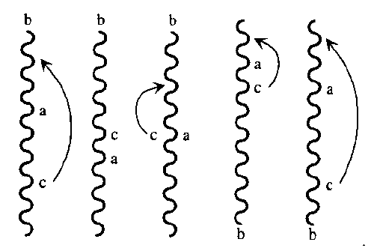
The Extremal Lemma
Let choice b be chosen arbitrarily. Assume that every voter puts b at the very top or the very bottom of his ranking. Then society must as well (even if half voters put b at the top and half at the bottom)
Proof: by contradiction.
Assume there exist a and c such that society has a >= b; b >= c.
By transitivity, a >= c
We can move c above a w/o changing ab or cb votes, leading to c > a
By unanimity, c > a

Slide 21
Step 1: Existence of Pivotal Voter
Let choice b be chosen arbitrarily. There exist a voter n* = n(b) who is extremely pivotal for b in the sense that by changing his vote at some profile, he can move b from the very bottom to the very top in the social ranking.
Proof:
Consider an extreme profile where b is at the bottom of each voter.
Consider voter from 1 to n, and we move b from bottom to top one-by-one.
The first voter whose change causes b to move to the top is n*
By unanimity, this change must happen at the latest when n*=n

Slide 22
Step 2: n*=n(b) is dictator of any pair ac not involving b
Proof
Consider a from ac pair. We show that if a >_{n*} c, then constitution protocol has a > c
Let profile before n* moves b to top as profile I
Let profile after n* moves b to top as profile II
Construct profile III from II by letting n* move a above b; all others can arrange ac as they want, but leave b in extreme position
a>b in profile I, and a,b is equivalent by IIA in profiles I and III
b>c in profile II, and bc is equivalent by IIA in profiles II and III
b
.
.
.
b
.
.
.
.
.
.
b
.
.
.
b
.
.
.
b
Profile I
Constitution protocol: b bottom
b
.
.
.
b
.
.
.
b
.
.
.
.
.
.
b
.
.
.
b
Profile II
Constitution protocol : b top
1 2 n* . N
b
.
.
.
b
.
.
.
a
b
.
c
.
.
.
b
.
.
.
b
Constitution protocol: a > b since ab same as I
Profile III
b > c since bc same as II

Slide 23
Step 3: n* is dictator for every pair ab
Consider c not equal to a or b
There exists n(c) who is a dictator of any pair not involving c, such as the pair ab, i.e.,
For any profile, if a >_{n(c)} > b, a > b in constitution protocol
n(c) must be n*
Assume not.
Consider Profile I and Profile II.
Since n(c) is not n*, n(c) ranking of ab does not change in Profile I and Profile II.
When n* changes ab ranking between Profile I and Profile II, the global ranking of ab changes.
Contradiction.

Slide 24
Outline
Admin and recap
Network control plane
Routing
Link weights assignment
Routing computation
Basic routing computation protocols
Global Internet routing
Basic architecture
BGP (Border Gateway Protocol): The de facto Inter-domain routing standard
Basic operations
BGP as a policy routing framework (control interdomain routes)
Policy/interdomain routing analysis
Global preference aggregation and Arrow’s Theorem [Optional]
Local preference aggregation

Slide 25
BGP w/ Local Preference
BGP preferences are typically local (only on paths start from itself)
Hence the preferences have dependency (priority)
The “closer” a node to the destination, the more “powerful” it may be
210
20
2
0
130
10
1
3
320
30
1 3 0
2 1 0
3 2 0
1 0
2 0
3 0
25

Slide 26
Complete Dependency: P-Graph
Complete dependency can be captured by a structure called P-graph
Nodes in P-graph are feasible paths
Edges represent priority (low to high)
A directed edge from path N₁P₁ to P₁
intuition: to let N₁ choose N₁P₁, P₁ must be chosen and exported to N₁
A directed edge from a lower ranked path to a higher ranked path
intuition: the higher ranked path should be considered first
210
20
2
0
130
10
1
3
320
30
1 3 0
2 1 0
3 2 0
1 0
2 0
3 0
Any observation on the P-graph?
26

Slide 27
P-Graph and BGP Convergence
If the P-graph of the networks has no loop, then policy routing converges.
intuition: choose the path node from the partial order graph with no out-going edge to non-fixed path nodes, fix the path node, eliminate all no longer feasible; continue
Example: suppose we swap the order of 30 and 320
210
20
2
1 3 0
2 1 0
3 0
0
130
10
1
3
30
320
1 0
2 0
3 2 0
27

Slide 28
Outline
Admin and recap
Network control plane
Routing
Link weights assignment
Routing computation
Basic routing computation protocols
Global Internet routing
Basic architecture
BGP (Border Gateway Protocol): The de facto Inter-domain routing standard
Basic operations
BGP as a policy routing framework (control interdomain routes)
Policy/interdomain routing analysis
Global preference aggregation and Arrow’s Theorem
Local preference aggregation
Economics and interdomain routing patterns

Slide 29
Internet Economy: Two Types of Business Relationship
Customer provider relationship
a provider is an AS that connects the customer to the rest of the Internet
customer pays the provider for the transit service
e.g., XMU is a customer of CERNET and China Telecom
Peer-to-peer relationship
mutually agree to exchange traffic between their respective customers only
there is no payment between peers
peer
peer
provider
provider
customer
provider to
customer
29

Slide 30
Route Selection Policies and Economics
Route selection (ranking) policy:
the typical route selection policy is to prefer customers over peers/providers to reach a destination, i.e., Customer > pEer/Provider
provider
customer
peer
30

Slide 31
Export Policies and Economics
case 1: routes learned from customer
provider
customer
Routes learned from a customer are sent to all other neighbors
customer
peer
case 2: routes learned from provider
case 3: routes learned from peer
provider
provider
provider
peer
customer
customer
Routes learned from a provider are sent only to customers
peer
Routes learned from a peer are sent only to customers
peer
31

Slide 32
Example: Typical Export -> No-Valley Routing
P₁
P₂
A advertises path to C, but not P₂
A advertises path to C, but not P₁
A learns paths to C, P1, P2
A
A advertises to C paths to P₁ and P₂
C
IP traffic
Suppose P₁ and P₂ are providers of A; A is a provider of C
32

Slide 33
Typical Export Policies Route Patterns
Assume a BGP path SABCD to destination AS D. Consider the business relationship between each pair:
Three types of business relationships:
PC (provider-customer)
CP (customer-provider)
PP (peer-peer)
S A B C D

Slide 34
Typical Export Policies Route Patterns
Invariant 1 of valid BGP routes (with labels representing business relationship)
P C
P C
P C
P C
?
Dest
Reasoning: only route learned from customer is sent to provider; thus
after a PC, it is always PC to the destination
Notes:
If PC, then PC all the way to destination
If CP/PP, all preceding is CP

Slide 35
Typical Export Policies Route Patterns
Invariant 2 of valid BGP routes (with labels representing business relationship)
CP
?
CP
CP
/PP
······
Dest
Reasoning: routes learned from peer or provider are sent to only customers; thus all relationship before is CP.
Notes:
If PC, then PC all the way to destination
If CP/PP, all preceding is CP

Slide 36
Stability of BGP Policy Routing
Suppose
there is no loop formed by provider-customer relationship in the Internet
each AS uses typical route selection policy:
C > E/P
each AS uses the typical export policies
Then policy routing always converges (i.e., is stable).

Slide 37
Case 1: A Link is PC
Proof by contradiction. Assume a loop in P-graph. Consider a fixed link. in the loop
AS 1
AS 2
AS 3
AS 4
PC
PC
PC

Slide 38
Case 2: Link is CP/PP
AS 1
AS 2
AS 3
AS 4
CP
CP
CP/PP
CP/PP
CP/PP

Slide 39
Summary: BGP Policy Routing
Advantage
satisfies current demand
Issues
policy dispute can lead to instability
current Internet economy provides a stability framework, but if the framework changes, we may see instability
Hierarchical routing can be inefficient
AS 4
AS 3
AS 2
AS 1

Slide 40
Routing: Remaining Issue
AS D
d1
d
E
d2
AS A
(OSPF)
a2
a1->i: I can reach
hosts in D; my path: AD
F
i
a1
AS C
Naïve design is to send individual host D’s IP. Can we do better?
AS B
(OSPF intra
routing)
b
AS I
Notes:
How to specify hosts in D

Slide 41
Outline
Admin and recap
Network control plane
Routing
Link weights assignment
Routing computation
Basic routing computation protocols
Global Internet routing
Basic architecture
BGP (Border Gateway Protocol): The de facto Inter-domain routing standard
Basic operations
BGP as a policy routing framework (control interdomain routes)
Policy/interdomain routing analysis
Global preference aggregation and Arrow’s Theorem
Local preference aggregation
Economics and interdomain routing patterns
IP addresses for Interdomain routing

Slide 42
IP Addressing Scheme: Requirements
Uniqueness: We need an address to uniquely identify each destination
Aggregability : Routing scalability needs flexibility in aggregation of destination addresses
we want to aggregate as a large set of destinations as possible in BGP announcements
Current: the unit of routing in the Internet is a classless interdomain routing (CIDR) address

Slide 43
IP Address: Uniqueness
IPv4 address: A 32-bit unique identifier for an interface
interface:
routers typically have multiple interfaces
host may have multiple interfaces
%/sbin/ifconfig -a
223.1.1.1
223.1.2.1
223.1.1.2
223.1.1.4
223.1.2.9
223.1.2.2
223.1.1.3
223.1.3.27
223.1.3.1
223.1.3.2
223.1.3.2 = 11011111 00000001 00000011 00000010
223
1
3
2
e.g., /etc/sysconfig/network-scripts/ifcfg-enp0s25
%ifup

Slide 44
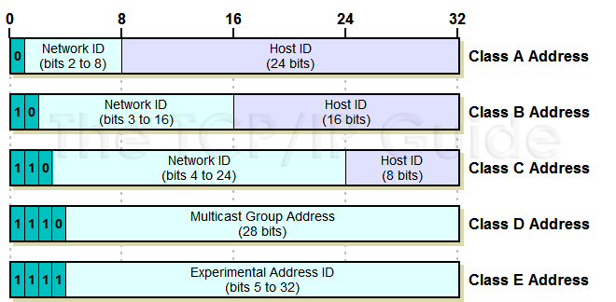
IP Addressing: Class-ful Addressing
given notion of “network”, let’s re-examine IP addresses:
“class-ful” addressing in the original IP design:
1.0.0.0 to
127.255.255.255
128.0.0.0 to
191.255.255.255
192.0.0.0 to
223.255.255.255
224.0.0.0 to
239.255.255.255
240.0.0.0 to
255.255.255.255

Slide 45
Classless InterDomain Routing (CIDR) Address: Aggregation
A CIDR address partitions an IP address into two parts
A prefix representing the network portion, and the rest (host part)
address format: a.b.c.d/x, where x is # bits in network portion of address
network
part
host
part
11001000 00010111 00010000 00000000
200.23.16.0/23
Some systems use mask (1’s to indicate network bits), instead of the /x format

Slide 46
CIDR Aggregation in BGP
AS D
d1
d
AS A
(OSPF)
a2
130.132.0.0/24
i->a1: I can reach
130.132.0/22; my path: I
130.132.1.0/24
i
a1
intradomain routing uses /24
130.132.2.0/24
130.132.3.0/24
AS I
Notes:
Does not have to be 24; some can be, say 22.

