Slide 1
Network Layer:
Forwarding; Link Layer
Qiao Xiang, Congming Gao, Qiang Su
  https://sngroup.org.cn/courses/cnns-xmuf25/index.shtml
12/2/2025
This deck of slides are heavily based on CPSC 433/533 at Yale University, by courtesy of Dr. Y. Richard Yang.

Slide 2
Admin
Assignment 5: Due Dec 16, 2025

Slide 3
Recap: Policy Routing Stability
A policy routing system can be considered as a system to aggregate local preferences, but aggregation may not be always successful.
The BAD GADGET example:
- 0 is the destination
- the route selection policy of each AS is to prefer its counter clock-wise neighbor
preferred
2 1 0
2 0
2
4
less
preferred
0
3 2 0
3 0
1 3 0
1 0
1
3
3
Policy (preferences) aggregation fails: routing instability !

Slide 4
Recap: Complete Dependency: P-Graph
Complete dependency can be captured by a structure
called P-graph
Nodes in P-graph are feasible paths
Edges represent priority
(low to high)
  A directed edge from
  path N₁P₁ to P₁
    intuition: to let N₁ choose N₁P₁,
    P₁ must be chosen and exported to N₁
  A directed edge from a lower ranked path to a higher ranked path
    intuition: the higher ranked path should be considered first
210
20
2
0
130
10
1
3
320
30
1 3 0
2 1 0
3 2 0
1 0
2 0
3 0
Any observation on the P-graph?
4

Slide 5
Recap: P-Graph and BGP Convergence
If the P-graph of the networks has no loop, then policy routing converges.
  intuition: choose the path node from the partial order graph with no out-going edge to non-fixed path nodes, fix the path node, eliminate all no longer feasible; continue
Example: suppose we swap the order of 30 and 320
210
20
2
1 3 0
2 1 0
3 0
0
130
10
1
3
30
320
1 0
2 0
3 2 0
5

Slide 6
Recap: Internet Economy: Two Types of Business Relationship
Customer provider relationship
  a provider is an AS that connects the customer to the rest of the Internet
  customer pays the provider for the transit service
  e.g., XMU is a customer of CERNET and China Telecom
Peer-to-peer relationship
  mutually agree to exchange traffic between their respective customers only
  there is no payment between peers
peer
peer
provider
provider
customer
provider to
customer
6

Slide 7
Recap: Export Policies and Economics
case 1: routes learned from customer
provider
customer
Routes learned from a
customer are sent to
all other neighbors
customer
peer
case 2: routes learned from provider
case 3: routes learned from peer
provider
provider
provider
peer
customer
customer
Routes learned from
a provider are sent
only to customers
peer
Routes learned from
a peer are sent only
to customers
peer
7

Slide 8
Outline
Admin and recap
Network control plane
  Routing
    Link weights assignment
    Routing computation
      Basic routing computation protocols
      Global Internet routing
        Basic architecture
        BGP (Border Gateway Protocol): The de facto Inter-domain routing standard
          Basic operations
          BGP as a policy routing framework (control interdomain routes)
          Policy/interdomain routing analysis
            Global preference aggregation and Arrow’s Theorem
            Local preference aggregation
            Economics and interdomain routing patterns
          IP addresses for Interdomain routing

Slide 9
IP Addressing Scheme: Requirements
Uniqueness: We need an address to uniquely identify each destination
Aggregability : Routing scalability needs flexibility in aggregation of destination addresses
  we want to aggregate as a large set of destinations as possible in BGP announcements
Current: the unit of routing in the Internet is a classless interdomain routing (CIDR) address

Slide 10
IP Address: Uniqueness
IPv4 address: A 32-bit unique identifier for an interface
interface:
  routers typically have multiple interfaces
  host may have multiple interfaces
  %/sbin/ifconfig -a
223.1.1.1
223.1.2.1
223.1.1.2
223.1.1.4
223.1.2.9
223.1.2.2
223.1.1.3
223.1.3.27
223.1.3.1
223.1.3.2
223.1.3.2 = 11011111 00000001 00000011 00000010
223
1
3
2
e.g., /etc/sysconfig/network-scripts/ifcfg-enp0s25
%ifup

Slide 11
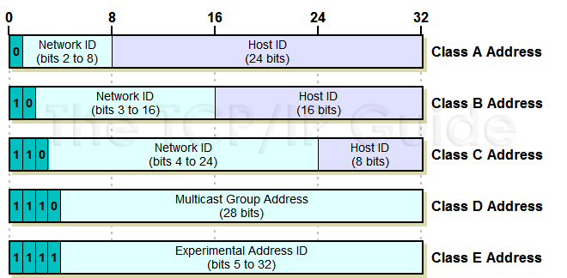
IP Addressing: Class-ful Addressing
given notion of “network”, let’s re-examine IP addresses:
“class-ful” addressing in the original IP design:
1.0.0.0 to
127.255.255.255
128.0.0.0 to
191.255.255.255
192.0.0.0 to
223.255.255.255
224.0.0.0 to
239.255.255.255
240.0.0.0 to
255.255.255.255

Slide 12
Classless InterDomain Routing
(CIDR) Address: Aggregation
A CIDR address partitions an IP address into two parts
  A prefix representing the network portion, and the rest (host part)
  address format: a.b.c.d/x, where x is # bits in network portion of address
network
part
host
part
11001000 00010111 00010000 00000000
200.23.16.0/23
Some systems use mask (1’s to indicate network bits), instead of the /x format

Slide 13
CIDR Aggregation in BGP
AS D
d1
d
AS A
(OSPF)
a2
130.132.0.0/24
i->a1: I can reach
130.132.0/22; my path: I
130.132.1.0/24
i
a1
intradomain routing uses /24
130.132.2.0/24
130.132.3.0/24
AS I
Notes:
Does not have to be 24; some can be, say 22.

Slide 14
CIDR Aggregation in BGP
S
B
x/22: A
x00/24: B
A
x01/24: C
C
x11/24: GF
x10/24: E
E
x11/24: F
G
x11/24: F
F
F
Problem at S：
Overlapping routing entries.
Solution：
Longest prefix matching (LPM)

Slide 15
Routing Table Size of BGP (number of globally advertised, aggregated entries)
Active BGP Entries (http://bgp.potaroo.net/as1221/bgp-active.html)
Internet Growth
(http://www.caida.org/research/topology/as_core_network/historical.xml)

Slide 16
IP Addressing: How to Get One?
Q: How does an ISP get its block of addresses?
A: Local Internet Registry (LIR) or National Internet Registry (NIR)
https://www.iana.org/numbers
https://www.iana.org/assignments/ipv4-address-space/ipv4-address-space.xhtml
Use
%whois <IP address>
to check who is allocated the given address.

Slide 17
IP addresses: How to Get One?
Q: How does a host get an IP address?
A:
  Static configured
    unix:
    %/sbin/ifconfig eth0 inet 192.168.0.10 netmask 255.255.255.0
  DHCP: Dynamic Host Configuration Protocol (RFC2131): dynamically get address from a DHCP server

Slide 18
DHCP Goal and History
Goal: allow host to dynamically obtain its IP address from network server when it joins network
History
  1984 Reverse ARP (RFC903): obtain IP address, but at link layer, and hence requires a server at each network link
  1985 Bootstrap Protocol (BOOTP; RFC951): introduces the concept of a relay agent to forward across networks
  1993 DHCP (RFC1531): based on BOOTP but can dynamically allocate and reclaim IP addresses in a pool, as well as delivery of other parameters
  1993 Errors in editorials led to immediate reissue as RFC1541
  1997 DHCP (RFC2131): add DHCPINFORM

Slide 19
Exercise
DHCP wireshark example

Slide 20
DHCP: Dynamic Host Configuration Protocol
The often used DORA model (4 messages)
  host broadcasts “DHCP discover” msg
  DHCP server responds with “DHCP offer” msg
  host requests IP address: “DHCP request” msg
  DHCP server sends address: “DHCP ack” msg

Slide 21
Outline
Admin and recap
Network layer
  Overview
  Routing
  Forwarding (put it together)

Slide 22
Network Forwarding: Putting it Together
Forwarding is also called the fast path (upon receiving each packet)
Slow path: not per packet
  Get IP address (DHCP, or static)
  Setup/compute routing table

Slide 23
Forwarding: Example 1
src
dst
misc
fields
223.1.1.1
223.1.1.3
data
Setting: Host A network layer receives a packet above.
Action:
  Host A looks up destination in routing table
    Exercise: Suppose A uses DHCP to obtain its address, how can A construct its routing table (routing information base, RIB)?
A
To Internet
223.1.1.1
223.1.4.1
223.1.2.1
223.1.1.2
223.1.1.4
223.1.2.9
223.1.2.2
223.1.1.3
223.1.3.27
223.1.3.1
223.1.3.2

Slide 24
Host Routing Table Example: Zoo
Zoo
  ifconfig –a
  netstat –rn (man netstat to see description)
[yry3@cicada ~]$ netstat -rn
Kernel IP routing table
Destination Gateway Genmask Flags MSS Window irtt Iface
0.0.0.0 128.36.232.1 0.0.0.0 UG 0 0 0 enp0s25
128.36.232.0 0.0.0.0 255.255.255.0 U 0 0 0 enp0s25
130.132.1.57 128.36.232.1 255.255.255.255 UGH 0 0 0 enp0s25
192.168.122.0 0.0.0.0 255.255.255.0 U 0 0 0 virbr0

Slide 25
Host Routing Table Example: my Mac
Mac
  ifconfig –a
  netstat –rn (man netstat to see description)
Routing tables
Internet:
Destination Gateway Flags Refs Use Netif Expire
default 172.27.16.1 UGSc 1470 0 en0
127 127.0.0.1 UCS 1 0 lo0
127.0.0.1 127.0.0.1 UH 4 3788 lo0
169.254 link#4 UCS 106 0 en0
169.254.1.229 link#4 UHLSW 1 0 en0
169.254.5.209 f0:99:bf:1e:6f:de UHLSW 1 0 en0 989
169.254.8.254 link#4 UHLSW 1 0 en0
169.254.11.96 0:cd:fe:75:59:75 UHLSW 1 0 en0 1009
169.254.13.89 64:9a:be:af:34:53 UHLSW 1 0 en0 1145
169.254.16.49 link#4 UHLSW 1 0 en0
169.254.19.58 link#4 UHLSW 1 0 en0
169.254.19.82 link#4 UHLSW 1 0 en0
169.254.21.198 link#4 UHLSW 1 0 en0
169.254.22.67 0:23:12:12:bc:39 UHLSW 1 0 en0 31
169.254.23.4 link#4 UHLSW 1 0 en0
...

Slide 26
CIDR Forwarding Look Up: Software
default: -
# prefix interface
a) 00001
0
1
b) 00010
a
c) 00011
d) 001
g
e) 0101
f) 011
f
d
h
g) 10
h) 100
i) 1010
i
e
j
k
j) 1011
k) 1100
The RIB are represented by
a decision tree, e.g., a Patricia Trie to look for the longest match of the destination address
a
b
c

Slide 27
Putting it Together: Example 1: A->B
src
dst
forwarding table in A
misc
fields
Dest. Net. next router Nhops
223.1.1.1
223.1.1.3
data
223.1.1/24 1
223.1.2/24 223.1.1.4 2
Setting: Host A network layer receives a packet above.
Action:
  Host A looks up destination in routing table (on same subnet)
  Hand datagram to link layer to send inside a link-layer frame
    Key step: need to map B’s IP address 223.1.1.3 to B’s MAC address
223.1.3/24 223.1.1.4 2
0.0.0.0/0 223.1.1.4 -
A
To Internet
223.1.1.1
223.1.4.1
223.1.2.1
223.1.1.2
223.1.1.4
223.1.2.9
B
223.1.2.2
223.1.1.3
223.1.3.27
223.1.3.1
223.1.3.2

Slide 28
Comparison of IP address and MAC Address
IP address is locator
  address depends on network to which an interface is attached
    NOT portable
  introduces features (e.g., CIDR) for routing scalability
IP address needs to be globally unique (if no NAT)
MAC address is an identifier
  dedicated to a device
    portable
  flat
MAC address does not need to be globally unique, but the current assignment ensures uniqueness

Slide 29
Issue
A finds the MAC address of B to construct
A
223.1.1.1
223.1.2.1
223.1.1.2
223.1.1.4
223.1.2.9
B
223.1.1.3
223.1.3.27
223.1.2.2
223.1.3.1
223.1.3.2
frame source,
dest address
datagram source,
dest address
B’s MAC
addr
A’s MAC
addr
A’s IP
addr
B’s IP
addr
IP payload
datagram
frame

Slide 30
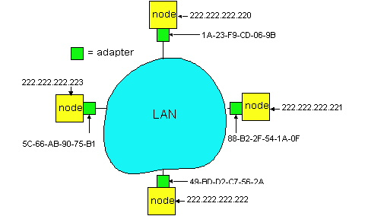
Recall: Address Resolution Table
Each IP node (Host, Router) on LAN has ARP table
ARP Table: IP/MAC address mappings for some LAN nodes
< IP address; MAC address; TTL>
  TTL (Time To Live): time after which address mapping will be forgotten (typically 20 min)
  [yry3@cicada yry3]$ /sbin/arp
  Address HWtype HWaddress Flags Mask Iface
  zoo-gatew.cs.yale.edu ether AA:00:04:00:20:D4 C eth0
  artemis.zoo.cs.yale.edu ether 00:06:5B:3F:6E:21 C eth0
  lab.zoo.cs.yale.edu ether 00:B0:D0:F3:C7:A5 C eth0

Slide 31
Recall: ARP Protocol
ARP table by the ARP Protocol, which is a “plug-and-play” protocol
  nodes create their ARP tables without intervention from net administrator
A broadcast protocol:
  source broadcasts query frame, containing queried IP address
    all machines on LAN receive ARP query
  destination D receives ARP frame, replies
    frame sent to A’s MAC address (unicast)

Slide 32
Putting it Together: Example 2 (Different Networks): A-> E
forwarding table in A
misc
fields
223.1.1.1
223.1.2.3
data
Dest. Net. next router Nhops
Setting: Host A network layer receives a packet above.
Action:
  Host A looks up destination in routing table
    Find next hop should be 223.1.1.4
  Hand datagram to link layer to send inside a link-layer frame
223.1.1/24 1
223.1.2/24 223.1.1.4 2
223.1.3/24 223.1.1.4 2
0.0.0.0/0 223.1.1.4 -
A
To Internet
223.1.1.1
223.1.4.1
223.1.2.1
223.1.1.2
223.1.1.4
223.1.2.9
frame
dst, src addr
datagram source,
dest address
B
C
223.1.2.3
223.1.1.3
223.1.3.27
E
C’s MAC
addr
A’s MAC
addr
A’s IP
addr
E’s IP
addr
IP payload
223.1.3.1
223.1.3.2
datagram
frame

Slide 33
Exercise: Actions at a Router
Source: https://nmap.org/book/tcpip-ref.html

Slide 34
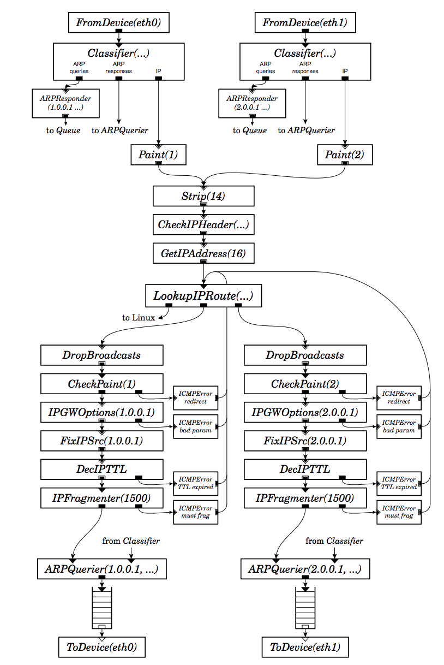
Router Actions
Routing
  Look up
  Prevent loops (TTL--)
  Notify host better routers (ICMP redirect)
Handle IPGW options
  (e.g., record routes)
Handle fragmentation
Error checking and reporting using ICMP
Scheduling (e.g., linux tc)
34

Slide 36
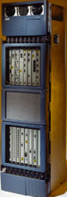
What A Router Looks Like: Outside

Slide 37
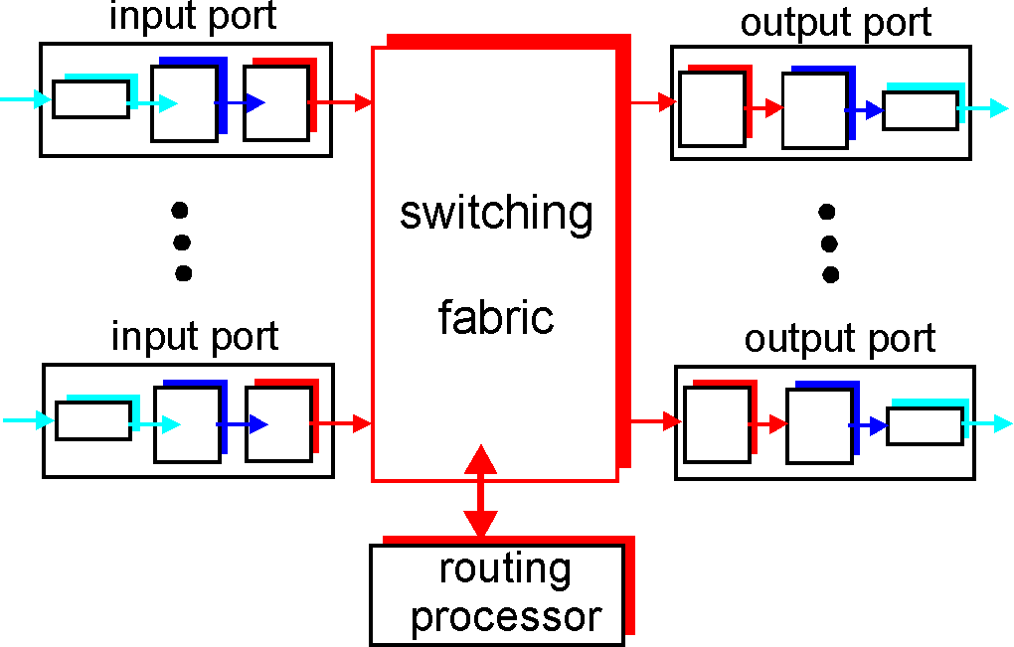
Look Inside a Router

Slide 38
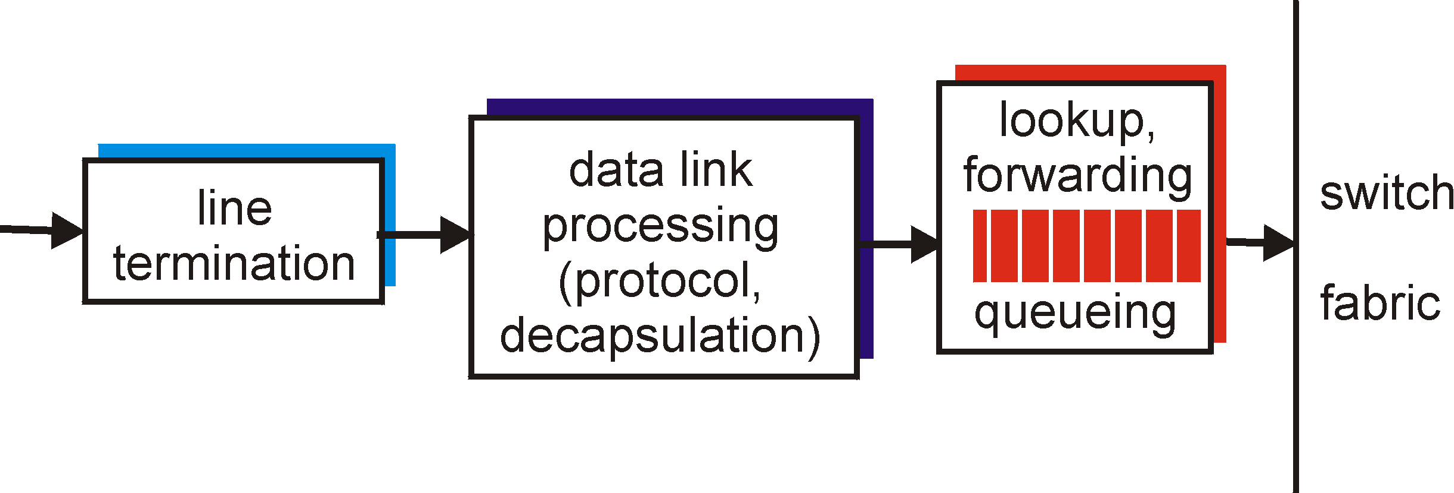
Look Inside a Router: Input Port
physical layer:
bit-level reception
data link layer:
e.g., Ethernet
network layer:
lookup output port using forwarding table

Slide 39
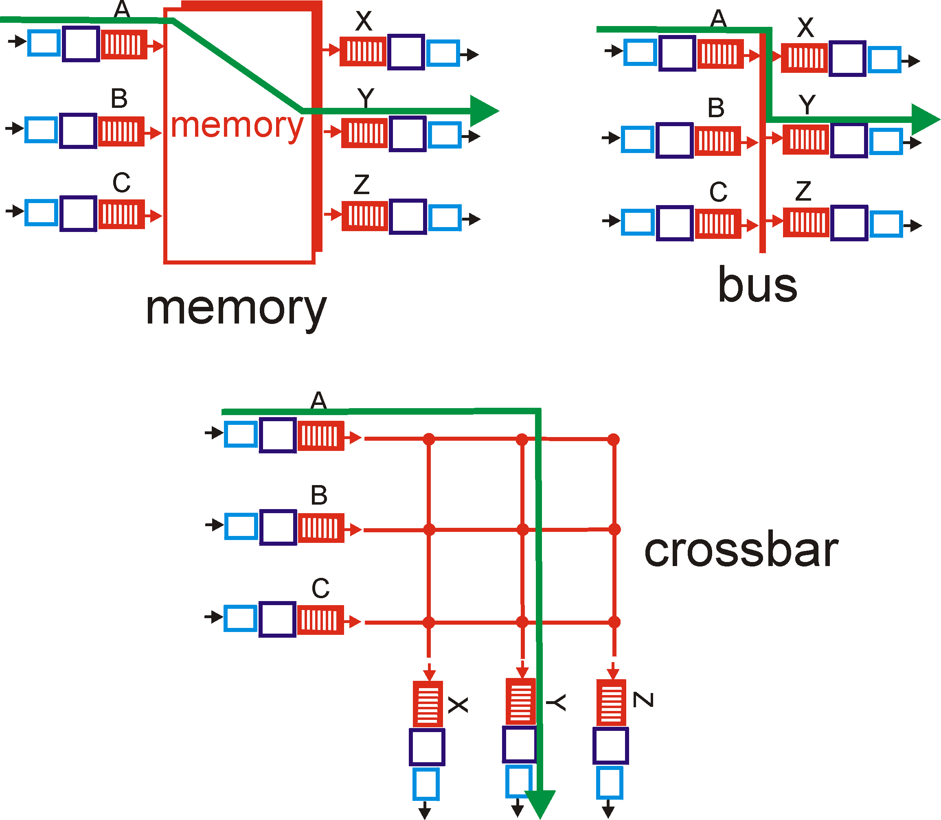
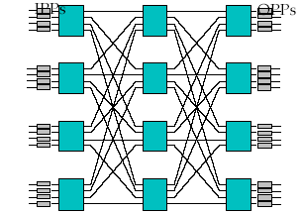
Look Inside a Router: Switching Fabric
Low
End
High
End
Banyan

Slide 40
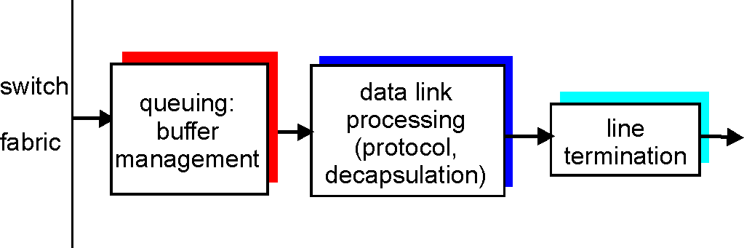
Look Inside a Router: Output Port
Buffering required when datagrams arrive from fabric faster than the transmission rate
Queueing (delay) and loss due to output port buffer overflow !
Scheduling and queue/buffer management choose among queued datagrams for transmission

Slide 41
Putting it Together: Example 2 (Different Networks): A-> E
forwarding table in router
misc
fields
223.1.1.1
223.1.2.3
data
Dest. Net router Nhops interface
Setting: Packet above arrives at Router C’s network layer.
Action:
  Router C conducts standard router actions
    Assume packet correct, find next hop should be 223.1.2.9
  Hand datagram to link layer to send inside a link-layer frame
223.1.1/24 - 1 223.1.1.4
223.1.2/24 - 1 223.1.2.9
223.1.3/24 - 1 223.1.3.27
0.0.0.0/0 - - 223.1.4.1
A
To Internet
223.1.1.1
223.1.4.1
223.1.2.1
223.1.1.2
223.1.1.4
223.1.2.9
frame
dst, src addr
datagram source,
dest address
B
C
223.1.2.3
223.1.1.3
223.1.3.27
E
E’s MAC
addr
C’s MAC
addr
A’s IP
addr
E’s IP
addr
IP payload
223.1.3.1
223.1.3.2
datagram
frame
datagram arrives at 223.1.2.3!! (hooray!)

Slide 42

Summary of Network Layer
We have covered the very basics of the network layer
  routing and basic forwarding
There are multiple other topics that we did not cover
  Multicast/anycast
  QoS
  slides as backup
  just in case you need
  reading in the winter

Slide 43
Roadmap: The Hourglass Architecture of the Internet
Telnet
Email
FTP
WWW
TCP
UDP
IP
Ethernet
Wireless
FDDI
ADSL
CableDOCSIS

Slide 44
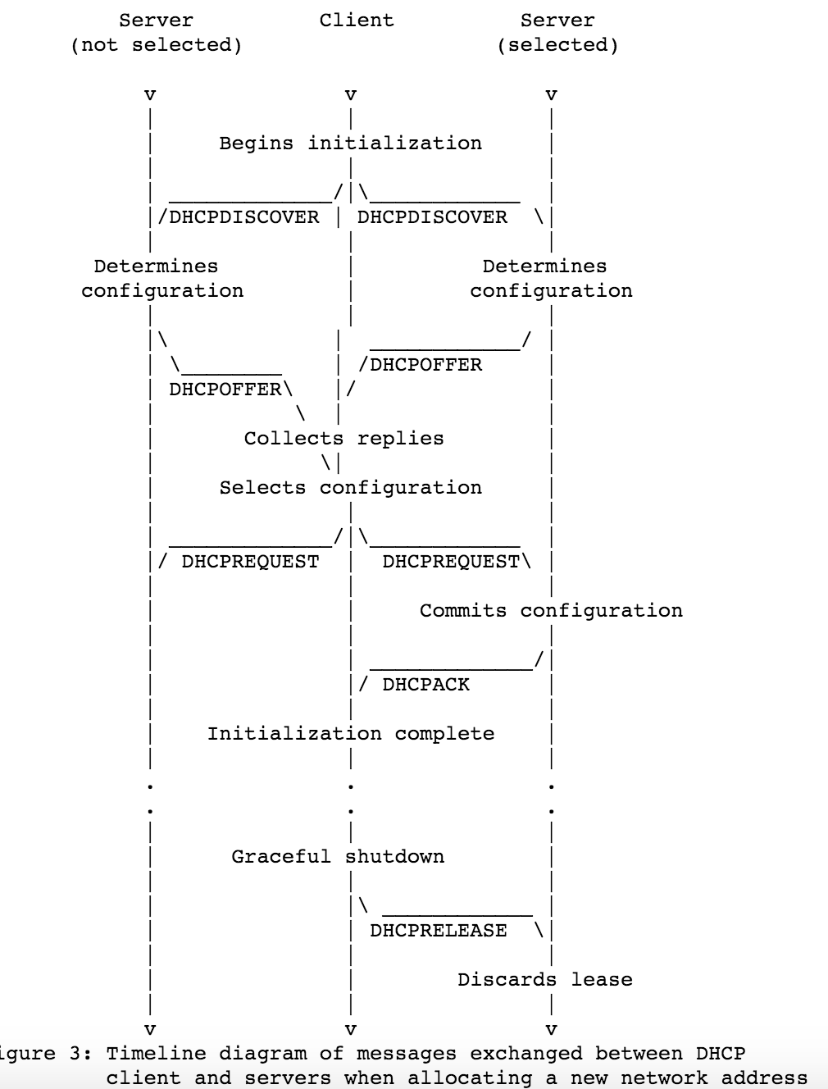
https://www.ietf.org/rfc/rfc2131.txt

Slide 45
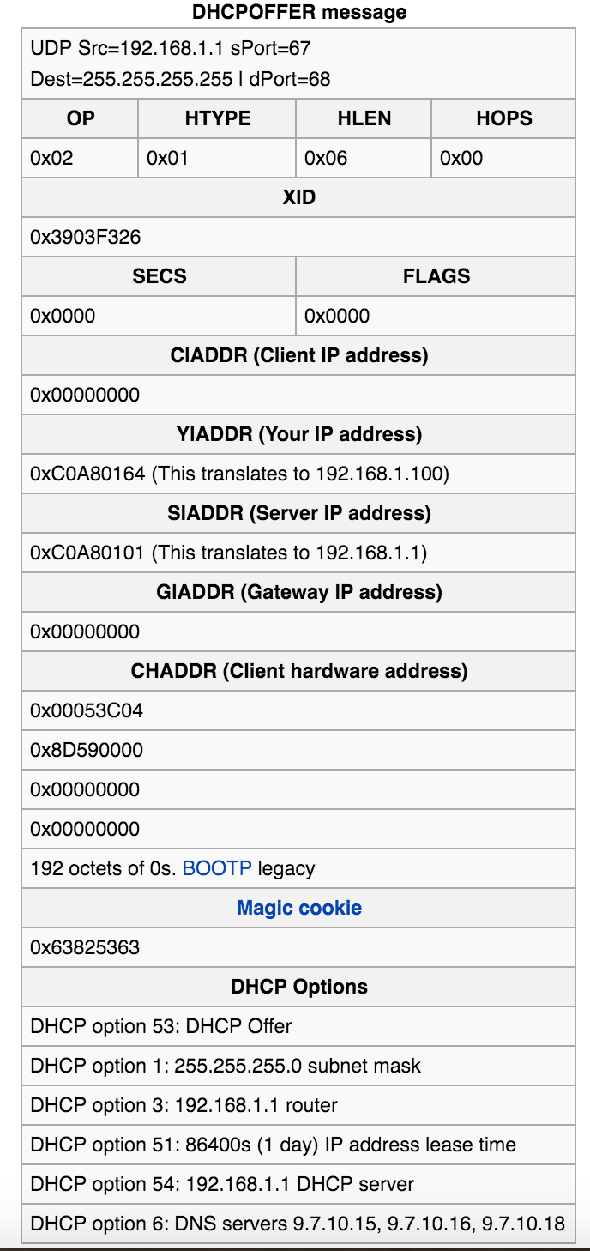
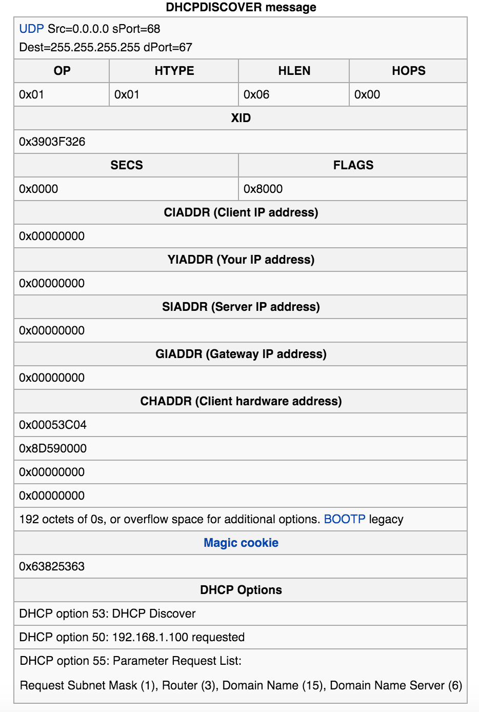

Slide 46
Exercise
DHCP lease renew

Slide 47
Link Layer Services
Framing
  encapsulate datagram into frame, adding header, trailer and error detection/correction
Multiplexing/demultiplexing
  frame headers to identify src, dest
Reliable delivery between adjacent nodes
  we learned how to do this already !
  seldom used on low bit error link (fiber, some twisted pair)
  common for wireless links: high error rates
Media access control
Forwarding/switching with a link-layer (Layer 2) domain

Slide 48
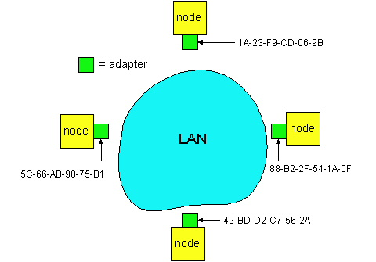
Adaptors Communicating
datagram
link layer protocol
receiving
node
sending
node
frame
frame
adapter
adapter
link layer typically implemented in “adaptor” (aka NIC)
  Ethernet card, modem, 802.11 card, cloud virtual switch
adapter is semi-autonomous, implementing link & physical layers
in most link-layer, each adapter has a unique link layer address (also called MAC address)

