Slide 1
Network Applications: DNS; Network Programming: UDP,TCP
Qiao Xiang, Congming Gao, Qiang Su
https://sngroup.org.cn/courses/cnns-xmuf25/index.shtml
09/18/2025
This deck of slides are heavily based on CPSC 433/533 at Yale University, by courtesy of Dr. Y. Richard Yang.

Slide 2
Outline
Admin. and recap
Basic network applications
Email
DNS
Java in a Nutshell
Network application programming

Slide 3
Admin
Assignment Two to be posted by Friday

Slide 4
DNS Message Flow: Two Types of Queries
Recursive query:
The contacted name server resolves the name completely
Iterated query:
Contacted server replies with name of server to contact
“I don’t know this name, but ask this server”

Slide 5

Two Extreme DNS Message Flows
root name server
root name server
Iterative query
Recursive query
1
1
2
2
6
client
TLD name server
client
5
TLD name server
3
4
5
4
3
6
A: ALL the load has to go through the root server!
Q: Issues of the two approaches?
authoritative name server
authoritative name server
informatics.xmu.edu.cn
informatics.xmu.edu.cn

Slide 6
Typical DNS Message Flow: The Hybrid Case
root name server
Host knows only local name server
Local name server is learned from DHCP, or configured, e.g. /etc/resolv.conf
Local DNS server helps clients resolve DNS names
2
iterated query
3
4
7
local name server
130.132.1.9
TLD name server
6
5
1
8
authoritative name server
dns.cs.umass.edu
requesting host
cyndra.cs.yale.edu
gaia.cs.umass.edu

Slide 7
Typical DNS Message Flow: The Hybrid Case
root name server
Host knows only local name server
Local name server is learned from DHCP, or configured, e.g. /etc/resolv.conf
Local DNS server helps clients resolve DNS names
Benefits of local name servers (often called resolvers)
simplifies client
caches/reuses results
2
iterated query
3
4
7
local name server
TLD name server
6
5
1
8
authoritative name server
dns.cs.umass.edu
requesting host
harvard.edu
gaia.cs.umass.edu

Slide 8
Outline
Admin. and recap
DNS
High-level design
Details

Slide 9
DNS Message Format?
Basic encoding decisions: UDP/TCP, how to encode domain name, how to encode answers…
DNS
DNS
TCP
UDP
TCP
UDP
IP
IP
Ethernet
Wireless
Cable/DSL
Ethernet
Wireless
Cable/DSL
9
Notes:
Basic questions: how to encode domain name; how to do compression…

Slide 10
Observing DNS Messages
Capture the messages
DNS server is at port 53
Display and clear DNS cache
MacOS: https://support.apple.com/en-us/HT202516 sudo killall -HUP mDNSResponder
Ubuntu:
sudo systemd-resolve --flush-caches
sudo systemd-resolve --statistics
Try to load the dns-capture file from class Schedule page, if you do not want live capture

Slide 11
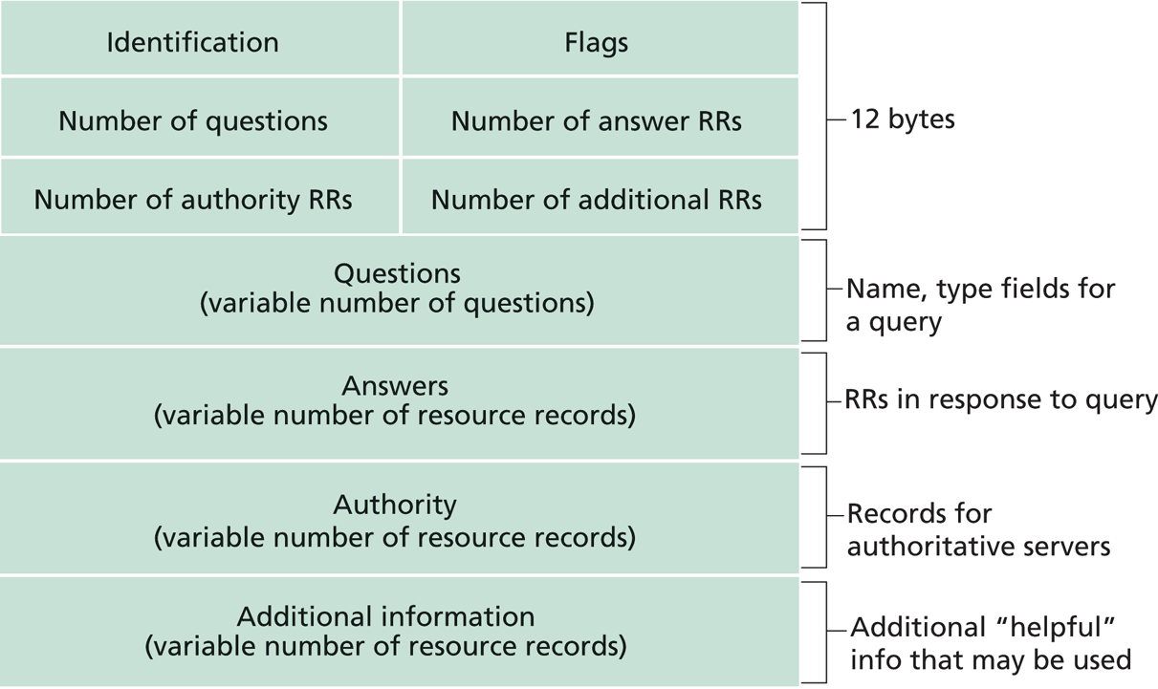
DNS Protocol, Messages
https://www.ietf.org/rfc/rfc1035.txt
DNS protocol : typically over UDP (can use TCP); query and reply messages, both with the same message format

Slide 12
DNS Details
Header (Sec. 4.1.1 of https://www.ietf.org/rfc/rfc1035.txt)
Encoding of questions (Sec. 4.1.2):
[Label-length label-chars]
Encoding of answers (Sec. 4.1.3)
Pointer format (http://www.iana.org/assignments/dns-parameters/dns-parameters.xhtml)
See example DNS packets

Slide 13
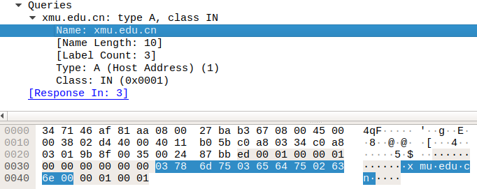
Name Encoding
cn
xmu
edu
length

Slide 14
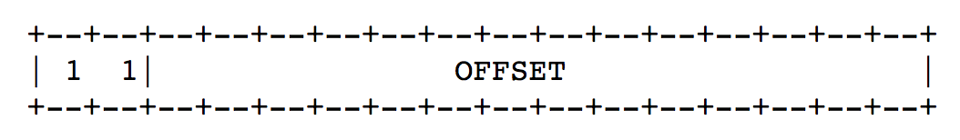
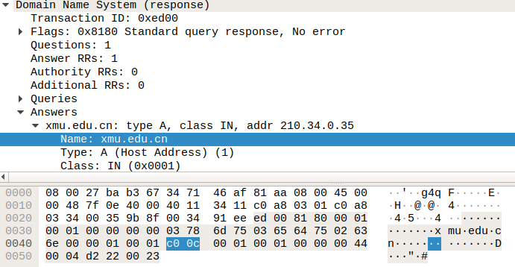
Message Compression (Label Pointer)
question
DNS start
Answer: offset 12

Slide 15
Recap: DNS Protocol, Messages
https://www.ietf.org/rfc/rfc1035.txt
Many features: typically over UDP (can use TCP); query and reply messages with the same message format; length/content encoding of names; simple compression; additional info as server push

Slide 16
What DNS did Right?
Hierarchical delegation avoids central control, improving manageability and scalability
Redundant servers improve robustness
see http://www.internetnews.com/dev-news/article.php/1486981 for DDoS attack on root servers in Oct. 2002 (9 of the 13 root servers were crippled, but only slowed the network)
Caching reduces workload and improves robustness
Proactive answers reduce # queries on server and latency on client

Slide 17
Problems of DNS
Simple query model, relatively static resource values and types make it harder to implement generic service discovery
e.g., service discovery of all printers
Although theoretically you can update the values of the records, it is rarely enabled
Early binding (separation of DNS query from application query) does not work well in mobile, dynamic environments
e.g., load balancing, locate the nearest printer
Each local domain needs servers, but an ad hoc domain may not have a DNS server

Slide 18
Outline
Admin. and recap
DNS
High-level design
Details
Extensions/alternatives

Slide 19
Discussions
What extension(s) to standard DNS operations do we need to allow service discovery, say to implement Bonjour (discover all local printers)?
each printer needs to provide the following info: host, port, printer info (e.g., support postscript)

Slide 20

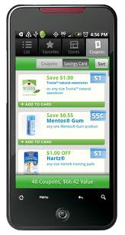
DNS-Service Discovery
Leverage DNS message format, but each node can announce its own services
169.254.1.219
Printer
Network
169.254.10.29
169.254.4.51

Slide 21
Realizing DNS-SD without Central DNS Server: mDNS
Multicast in a small world
no central address server
each node is a responder
link-local addressing
send to multicast address: 224.0.0.251
169.254.1.219
Printer
Network
169.254.10.29
169.254.4.51

Slide 22
Example
Use the avahi-publish-service command on Ubuntu as example
Advertise (register) an LPR printer on port 515 avahi-publish-service test _printer._tcp . 515 pdl=application/postscript
port
Name of instance providing the service
<type_service>. <transport>
Txt for additional data
22

Slide 23
Example
Use the dns-sd command on Mac as example
Advertise (register) an LPR printer on port 515 dns-sd -R "test" _printer._tcp . 515 pdl=application/postscript
port
Name of instance providing the service
domain (. means default, which is local
<type_service>. <transport>
Txt for additional data
23

Slide 24
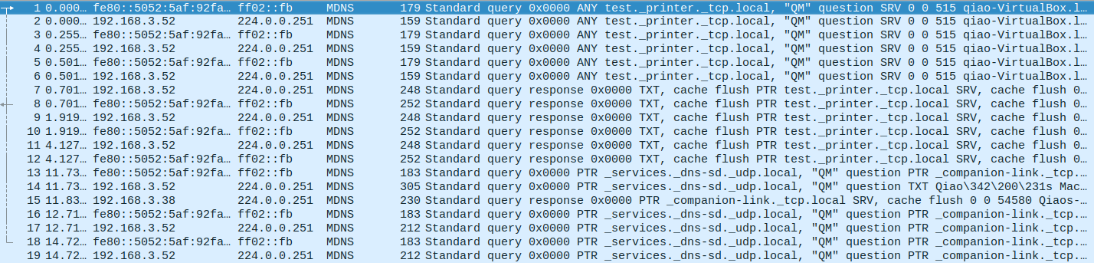

Slide 25
Offline Exercise
Use the dns-sd /avahi-publish-service command as example
Advertise (register) a web page on local machine dns-sd -R "My Test" _http._tcp . 80 path=/path-to-page.html
25

Slide 26
Issue: How to Query
Query needs a back pointer, PTR records
Exercise: Use the dns-sd / avahi-service-publish command as example
Browse web pages on local machines dns-sd -B _http._tcp
avahi-browse –rt _http._tcp

Slide 27
Network Service Discovery in Android
Based on DNS-SD/mDNS
Foundation for peer-to-peer/Wi-Fi Direct in Android
See https://developer.android.com/training/connect-devices-wirelessly/nsd.html for programming using nsd

Slide 28
Outline
Admin. and recap
Basic network applications
Email
DNS
Java in a Nutshell

Slide 29
High-level Picture
C/C++
Prog 1
Prog 2
Prog 1; Arch 1
Prog 1; Arch n
Prog 2; Arch 1
Prog 2; Arch n’

Slide 30
Java Virtual Machine
To be platform independent, Java designers introduced Java Virtual Machine (JVM), a machine different from any physical platform, but a virtual machine
The language of the virtual machine is referred to as bytecode
Thus Java actually has two programming languages
A Java compiler translates Java source code (.java files) into bytecode (in .class files)
Each Java software program needs to be compiled only once: from the Java source code to bytecode
Other languages (e.g., Jruby, Jython, Scala) may also compile to bytecode

Slide 31
Java Execution
To execute a Java program, another piece of software called an interpreter, translates between bytecode and the actual machine
an interpreter is specific to a specific platform
the interpreter understands java bytecode, and then issues instructions in the specific platform for which it is written
we also say that an interpreter provides a java virtual machine (JVM)

Slide 32
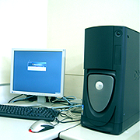
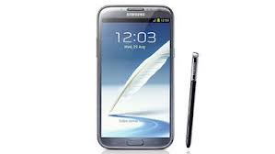


Java Translation and Execution
Java source code
Java compiler
Java bytecode
bytecode interpreter
for Windows
bytecode interpreter
for Mac
bytecode interpreter
for Android
bytecode interpreter
for Linux

Slide 33
Comparing Traditional (e.g., C/C++) and Java Software Development
Traditional, e.g., C/C++
Java
A developer writes a program in C/C++
The C/C++ source code is generally considered proprietary, and not released
The developer compiles the C/C++ program for each platform it intends to support, and distributes one version for each platform
thus each program has multiple compiled versions
each compiled version can run by itself
Platform dependency handled by each software developer
A developer writes a program in Java
The Java source code is generally considered proprietary, and not released
The developer compiles the Java program to bytecode, and distributes the bytecode version
thus each program has only one compiled version
the compiled bytecode needs an interpreter for each platform
Platform dependency handled by platform vendor

Slide 34
High-level Picture
C/C++
Prog 1
Prog 2
Prog 1; Arch 1
Prog 1; Arch n
Prog 2; Arch 1
Prog 2; Arch n’
Java
Prog 1
Prog 2
Prog 1/bytecode
Prog 2/bytecode
Interp; Arch 1
Interp; Arch n

Slide 35


Recall: Java Programming Steps
Programming in Java consists of 3 simple steps
Create and edit “Java source code” (.java files)
Compile into “Java bytecode” (.class files)
Execute bytecode with a “Java interpreter”
source code
byte code
compile
run
output
35

Slide 36
Programming in Java (Step 1): Create/Edit
The basic way is to use a text editor
Example editors: vim, sublime, Notepad, TextEdit (Format/Make Plain Text) etc.
Note: MS Word is NOT a text editor
The key is that your .java file cannot include any markup or stylistic formatting; just text.
You enter your Java code following Java Language syntax (more soon).
36
Notes:
36
:syntax on
~/.vimrc

Slide 37
Programming in Java (Step 2): Compile
Compile a Java program $ javac HelloWorld.java
Take a look to see that HelloWorld.class is generated $ ls HelloWorld.java HelloWorld.class
37
Notes:
37

Slide 38
Programming in Java (Step 3): Execute
Run Java interpreter
$ java HelloWorld
38
Notes:
38

Slide 39
First Java Program
/*************************************
* Prints “Hello World”
* Everyone’s first Java program.
*************************************/
public class Hello {
public static void main(String[] args) {
System.out.println("Hello, world!");
}
}

Slide 40
Another Java Program
public class Hello2 {
public static void main(String[] args) {
System.out.println("Hello, world!");
System.out.println();
System.out.println("This program produces");
System.out.println("four lines of output");
}
}

Slide 41
Programming in Java: Method 2
Another way is to use an Integrated Development Environment (IDE)
Example IDEs: Eclipse, IDEA, DrJava, etc.
An IDE usually presents the user with a space for text (like an editor) but layers additional features on top of the text for the user's benefit.
Note: The underlying file contains pure text, just like a text editor.
These features can be very useful and save time.
Example features are GUI compile, GUI execution, code completion, and syntax highlighting.
IDEs take more time to get started than a simple text editor, e.g.,
set up where to find the “java” and “javac” programs
find out where does the IDE save my file
41
Notes:
41

Slide 42
Java Syntax Structure: A Top-Down View
A class:
has a name, defined in a file with same name Convention we follow: capitalize each English word
starts with {, and ends with }
includes a group of methods
public class <class name> {
public static void main(String[] args) {
<statement>;
<statement>;
...
<statement>;
}
}
A method:
has a name Convention we follow: lowercase first word, capital following
starts with {, and ends with }
includes a group of statements
statement:
a command to be executed
end with ;
Notes:
The book as a program analogy: need to write chapter name, paragraph name, before you can write a sentence.

Slide 43
The System.out.println statement
A statement that prints a line of output on the console.
pronounced "print-linn”
Two ways to use System.out.println :
System.out.println(<string>);
Prints the given message <string> as output.
System.out.println();
Prints a blank line of output.
Notes:
43

Slide 44
Java program structure
A top-down view
A bottom-up view

Slide 45
Java Syntax: A Bottom-Up View
// Comment 1: A Java program
/* Comment 2: a long comment
*********************************/
public class Hello {
public static void main(String[] args) {
System.out.println("Hello, world!");
System.out.println();
System.out.println("This program produces");
System.out.println("four lines of output");
}
}
Notes:
The top-down view is good because we can read at the bigger picture. Hence small details do not change our understanding. For example, removing ; {
Computers are stupid and hence read without a bigger picture. You can think we read in 2D and computer in 1D (scan sequentially)

Slide 46
Java Syntax: A Bottom-Up View
// Comment 1: A Java program
/* Comment 2: a long comment
*********************************/
public class Hello {
public static void main(String[] args) {
System.out.println("Hello, world!");
System.out.println();
System.out.println("This program produces");
System.out.println("four lines of output");
}
}
Basic Java syntax units
white space and comments
identifiers (words)
symbols: { } “ ( ) < > [ ] ; = …
strings
numbers
Notes:
The top-down view is good because we can read at the bigger picture. Hence small details do not change our understanding. For example, removing ; {
Computers are stupid and hence read without a bigger picture. You can think we read in 2D and computer in 1D (scan sequentially)

Slide 47
Syntax: White Space
White space
includes spaces, new line characters, tabs
white space is used to separate other entities
extra white space is ignored
White space allows a Java program to be formatted in many ways, and should be formatted to enhance readability
the usage of white space forms part of programming style
47
Notes:
47

Slide 48
Syntax: Comments
comment: A note written in source code by the programmer to describe or clarify the code.
Comments are ignored by the compiler
Useful for other people (and yourself!) to understand your code
Two types of comments in Java
single-line comments use //…
// this comment runs to the end of the line
multi-lines comments use /* … */
/* this is a very long
multi-line comment */
48
Notes:
48

Slide 49
Syntax: Identifier
Identifier: A name given to an item in a program.
Syntax requirement on identifier:
must start with a letter or _ or $
subsequent characters can be any of those or a number
Important: Java is case sensitive:
Hello and hello are different identifiers

Slide 50
Three Types of Identifiers
1. Identifiers chosen by ourselves when writing a program (such as HelloWorld)
2. Identifiers chosen by another programmer, so we use the identifiers that they chose (e.g., System, out, println, main)
public class HelloWorld
{
public static void main(String[] args)
{
System.out.println(“Hello World!”);
}
}

Slide 51
Three Types of Identifiers
3. Special identifiers called keywords or reserved words: A keyword has a special meaning in Java.
abstract default if private this
boolean do implements protected throw
break double import public throws
byte else instanceof return transient
case extends int short try
catch final interface static void
char finally long strictfp volatile
class float native super while
const for new switch
continue goto package synchronized
Java reserved words: they are all lowercase!

Slide 52
Syntax: Strings
string: A sequence of characters that starts and ends with a " (quotation mark character).
The quotes do not appear in the output.
Examples: "hello" "This is a string. It is very long!”
Restrictions:
May not span multiple lines "This is not a legal String."
Notes:
52

Slide 53
Examples
Which of the following are legal strings in Java?
"This is a string. It’s very long!"
"This cool string spans two lines. "
"It is a great thing when children cry, "I want my mommy"! "
Notes:
53

Slide 54
Escape Sequences
escape sequence: A special sequence of characters used to represent certain special characters in a string.
\b backspace
\t tab character
\n new line character
\" quotation mark character
\\ backslash character
Example: System.out.println("\\hello\nhow\tare \"you\"?\\\\");
Output: \hello how are "you"?\\

Slide 55
Comment on syntax errors
A syntax/compile error: A problem in the structure of a program that causes the compiler to fail, e.g.,
Missing semicolon
Too many or too few { } braces
Class and file names do not match
…
Compilers can’t (DO not) read minds.
Compilers don’t make mistakes.
If the program is not doing what you want, do NOT blame the computer---it’s YOU who made a mistake.

Slide 56
Outline
Admin. and recap
Basic network applications
Email
DNS
Java in a Nutshell
Network application programming

Slide 57
Socket Programming
Socket API
introduced in BSD4.1 UNIX, 1981
Two types of sockets
connectionless (UDP)
connection-oriented (TCP)
socket
an interface (a “door”) into which one
application process can both send and
receive messages to/from another (remote or
local) application process

Slide 58
Services Provided by Transport
User data protocol (UDP)
multiplexing/demultiplexing
Transmission control protocol (TCP)
multiplexing/demultiplexing
reliable data transfer
rate control: flow control
and congestion control
Host A
Host B
Hello
I am ready
DATA
ACK

Slide 59
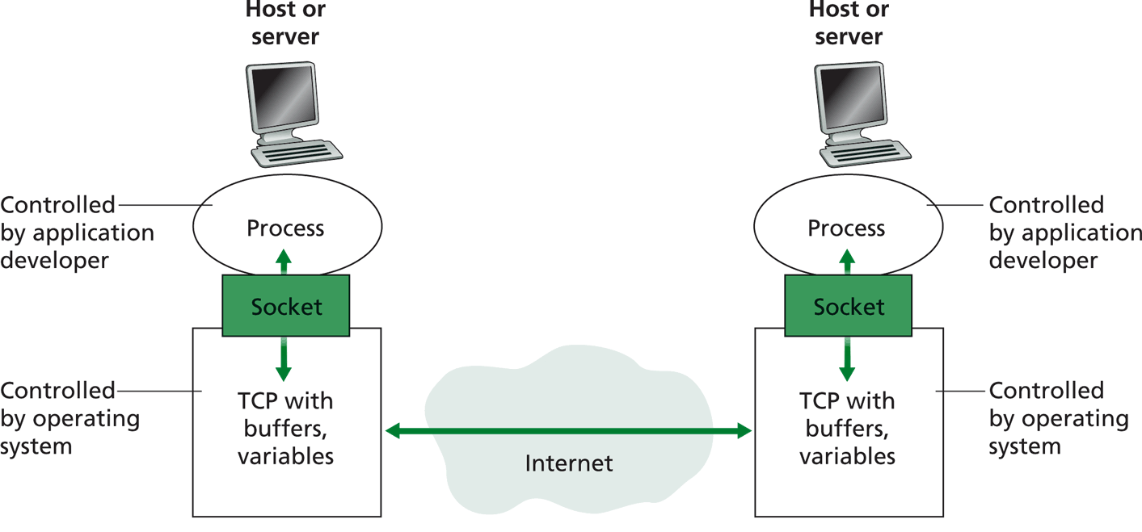
Big Picture: Socket
buffers,
states
buffers,
states

