Slide 1
Network Applications: Network Programming: UDP,TCP
Qiao Xiang, Congming Gao, Qiang Su
https://sngroup.org.cn/courses/cnns-xmuf25/index.shtml
09/23/2025
This deck of slides are heavily based on CPSC 433/533 at Yale University, by courtesy of Dr. Y. Richard Yang.

Slide 2
Outline
Admin. and recap
Network application programming

Slide 3
Admin
Assignment One posted last Saturday
Due on Sep. 30
Assignment Two to be posted this week

Slide 4
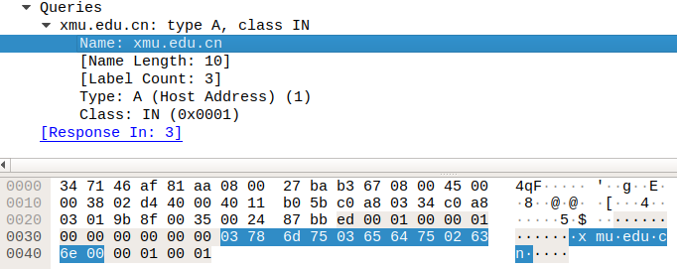
Recap: DNS Name Encoding
cn
xmu
edu
length

Slide 5
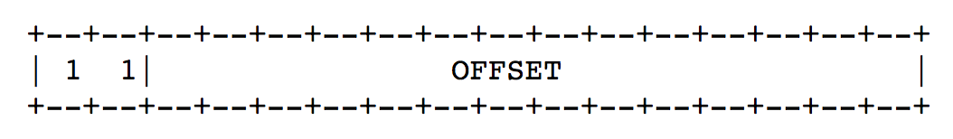
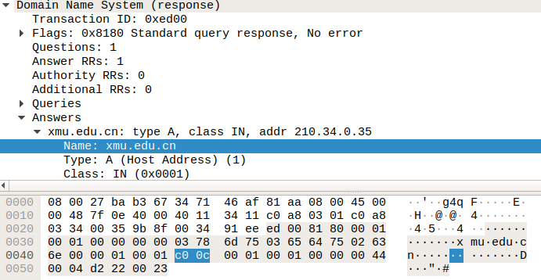
Message Compression (Label Pointer)
question
DNS start
Answer: offset 12

Slide 6
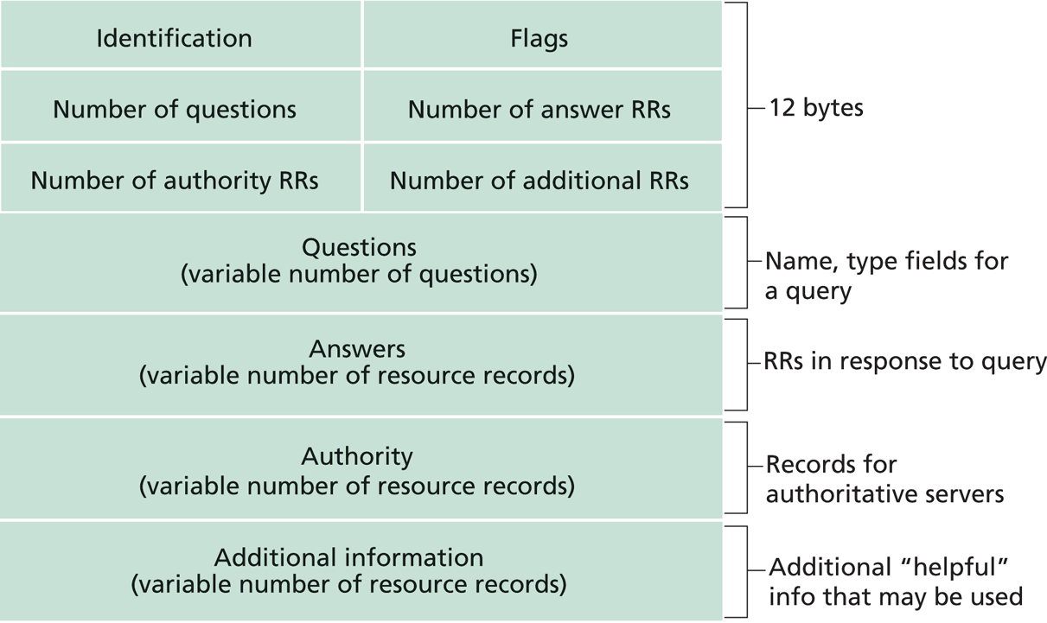
Recap: DNS Protocol, Messages
https://www.ietf.org/rfc/rfc1035.txt
Many features: typically over UDP (can use TCP); query and reply messages with the same message format; length/content encoding of names; simple compression; additional info as server push

Slide 7
What DNS did Right?
Hierarchical delegation avoids central control, improving manageability and scalability
Redundant servers improve robustness
see http://www.internetnews.com/dev-news/article.php/1486981 for DDoS attack on root servers in Oct. 2002 (9 of the 13 root servers were crippled, but only slowed the network)
Caching reduces workload and improves robustness
Proactive answers reduce # queries on server and latency on client

Slide 8
Problems of DNS
Simple query model, relatively static resource values and types make it harder to implement generic service discovery
e.g., service discovery of all printers
Although theoretically you can update the values of the records, it is rarely enabled
Early binding (separation of DNS query from application query) does not work well in mobile, dynamic environments
e.g., load balancing, locate the nearest printer
Each local domain needs servers, but an ad hoc domain may not have a DNS server

Slide 9
Outline
Admin. and recap
Network application programming

Slide 10
Socket Programming
Socket API
introduced in BSD4.1 UNIX, 1981
Two types of sockets
connectionless (UDP)
connection-oriented (TCP)
socket
an interface (a “door”) into which one
application process can both send and
receive messages to/from another (remote or
local) application process

Slide 11
Services Provided by Transport
User data protocol (UDP)
multiplexing/demultiplexing
Transmission control protocol (TCP)
multiplexing/demultiplexing
reliable data transfer
rate control: flow control
and congestion control
Host A
Host B
Hello
I am ready
DATA
ACK

Slide 12
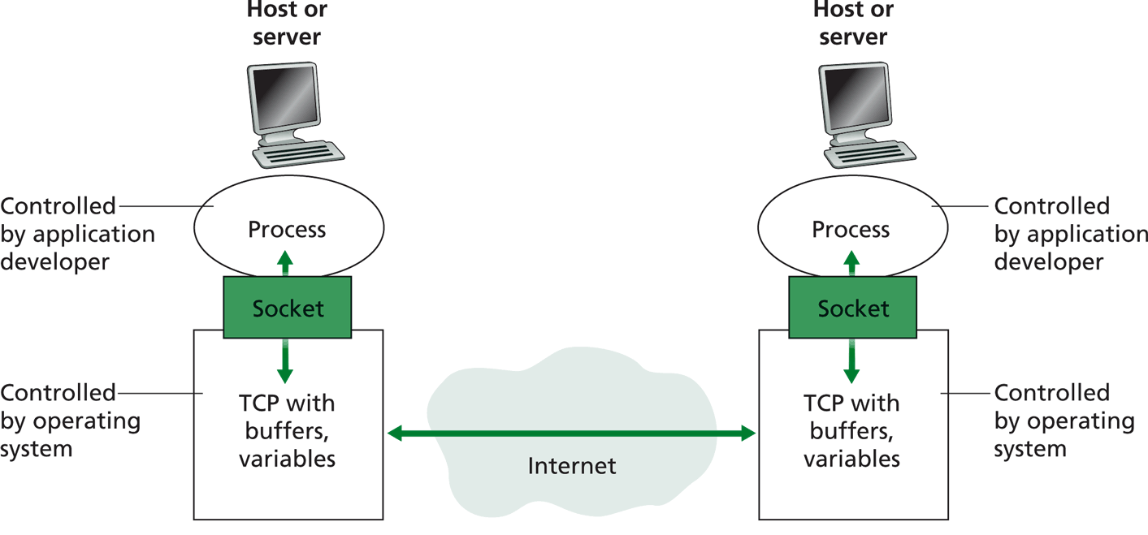
Big Picture: Socket
buffers,
states
buffers,
states

Slide 13
Outline
Admin. and recap
Basic network application programming
Overview
UDP (Datagram Socket)

Slide 14
DatagramSocket(Java) (Basic)
DatagramSocket()
constructs a datagram socket and binds it to any available port on the local host
DatagramSocket(int lport)
constructs a datagram socket and binds it to the specified port on the local host machine.
DatagramPacket(byte[] buf, int length)
constructs a DatagramPacket for receiving packets of length length.
DatagramPacket(byte[] buf, int length, InetAddress address, int port)
constructs a datagram packet for sending packets of length length to the specified port number on the specified host.
receive(DatagramPacket p)
receives a datagram packet from this socket.
send(DatagramPacket p)
sends a datagram packet from this socket.
close()
closes this datagram socket.

Slide 15
Connectionless UDP: Big Picture (Java version)
Server (running on serv)
Client
create socket,
port=x, for
incoming request:
create socket,
clientSocket =
DatagramSocket()
serverSocket =
DatagramSocket( x )
Create datagram using (serv, x) as (dest addr. port), send request using clientSocket
read request from
serverSocket
generate reply, create datagram using client
host address, port number
write reply to
serverSocket
read reply from
clientSocket
close
clientSocket

Slide 16
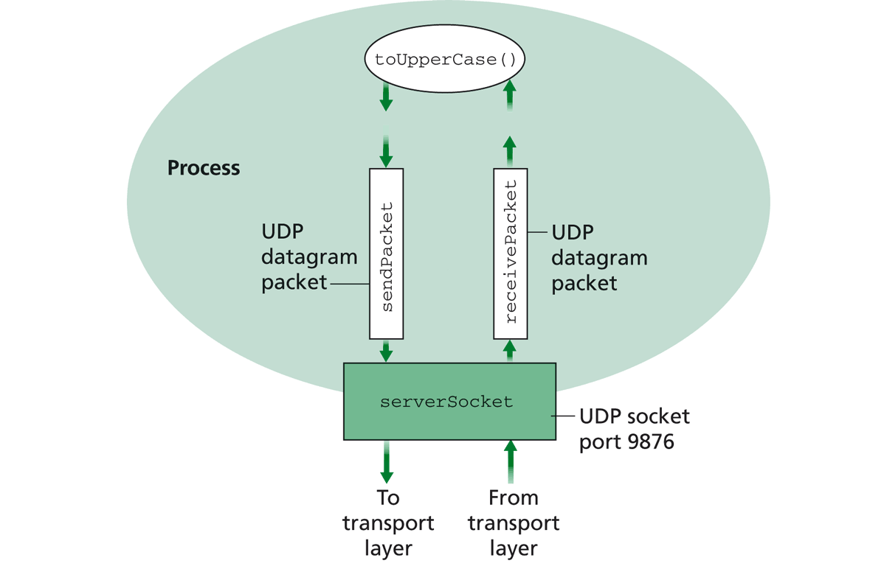
Example: UDPServer.java
A simple UDP server which changes any received sentence to upper case.

Slide 17
Java Server (UDP): Create Socket
import java.io.*;
import java.net.*;
class UDPServer {
public static void main(String args[]) throws Exception
{
DatagramSocket serverSocket = new DatagramSocket(9876);
Create
datagram socket
bind at port 9876
Check socket state:
%netstat –a –u –n

Slide 18
System State after the Call
server
128.36.232.5 128.36.230.2
UDP socket space
“*” indicates that the socket binds to all IP addresses of the machine: % ifconfig -a
address: {*:9876}
snd/recv buf:
local port
local address why shown as “*”?
address: {128.36.232.5:53}
snd/recv buf:

Slide 19
Binding to Specific IP Addresses
server
Public address: 128.36.59.2 Local address: 127.0.0.1
UDP socket space
InetAddress sIP1 =
InetAddress.getByName(“localhost”);
DatagramSocket ssock1 = new DatagramSocket(9876, sIP1);
InetAddress sIP2 = InetAddress.getByName(“128.36.59.2”);
DatagramSocket ssock2 = new DatagramSocket(9876,sIP2);
DatagramSocket serverSocket = new DatagramSocket(6789);
address: {127.0.0.1:9876}
snd/recv buf:
address: {128.36.59.2:9876}
snd/recv buf:
address: {*:6789}
snd/recv buf:
address: {128.36.232.5:53}
snd/recv buf:

Slide 20
UDP Demultiplexing
client
on server
server
P1
SP: x
Public address: 128.36.59.2 Local address: 127.0.0.1
DP: 9876
UDP socket space
S-IP: A
address: {127.0.0.1:9876}
snd/recv buf:
D-IP: 127.0.0.1
address: {128.36.59.2:9876}
snd/recv buf:
P2
SP: y
DP: 9876
S-IP: B
D-IP: 128.36.59.2
address: {128.36.232.5:53}
snd/recv buf:
client
IP: B
UDP demutiplexing is based on matching (dst address, dst port)

Slide 21
UDP Demultiplexing
Client
on server
server
P1
SP: x
Public address: 128.36.59.2 Local address: 127.0.0.1
DP: 9876
UDP socket space
S-IP: A
address: {127.0.0.1:9876}
snd/recv buf:
D-IP: 127.0.0.1
address: {128.36.59.2:9876}
snd/recv buf:
P3
address: {*:6789}
snd/recv buf:
SP: y
DP: 6789
S-IP: C
D-IP: 128.36.59.2
address: {128.36.232.5:53}
snd/recv buf:
client
IP: C
UDP demutiplexing is based on matching (dst address, dst port)

Slide 22
Per Socket State
Each Datagram socket has a set of states:
local address
send buffer size
receive buffer size
timeout
traffic class
See http://download.java.net/jdk7/archive/b123/docs/api/java/net/DatagramSocket.html
Example: socket state after clients sent msgs to the server

Slide 23
Java Server (UDP): Receiving
import java.io.*;
import java.net.*;
class UDPServer {
public static void main(String args[]) throws Exception
{
DatagramSocket serverSocket = new DatagramSocket(9876);
byte[] receiveData = new byte[1024];
byte[] sendData = null;
while(true)
{
DatagramPacket receivePacket =
new DatagramPacket(receiveData, receiveData.length);
serverSocket.receive(receivePacket);
Create space for
received datagram
Receive
datagram

Slide 24
DatagramPacket
Receiving
DatagramPacket(byte[] buf, int length)
constructs a DatagramPacket for receiving packets of length length.
DatagramPacket(byte[] buf, int offset, int length)
constructs a DatagramPacket for receiving packets starting at offset, length length.
Sending
DatagramPacket(byte[] buf, int length, InetAddress address, int port) constructs a datagram packet for sending packets of length length to the specified port number on the specified host.
DatagramPacket(byte[] buf, int offset, int length, InetAddress address, int port)

Slide 25
Java Server (UDP): Processing
getData() returns a pointer to an underlying buffer array; for efficiency, don’t assume receive() will reset the rest of the array
import java.io.*;
import java.net.*;
class UDPServer {
public static void main(String args[]) throws Exception {
…
// process data
String sentence = new String(receivePacket.getData(), 0, receivePacket.getLength());
String capitalizedSentence = sentence.toUpperCase();
sendData = capitalizedSentence.getBytes();
getLength() returns how much data is valid.

Slide 26
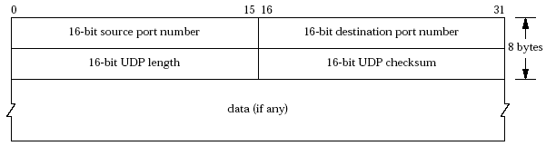
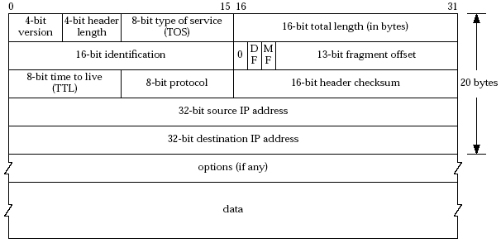
Java Server (UDP): Response
Java DatagramPacket:
getAddress()/getPort() returns the source address/port

Slide 27
Java server (UDP): Reply
InetAddress IPAddress = receivePacket.getAddress();
int port = receivePacket.getPort();
DatagramPacket sendPacket =
new DatagramPacket(sendData, sendData.length, IPAddress, port);
serverSocket.send(sendPacket);
}
}
}
Get IP addr
port #, of
sender
Create datagram
to send to client
Write out
datagram
to socket
End of while loop,
loop back and wait for
another datagram

Slide 28
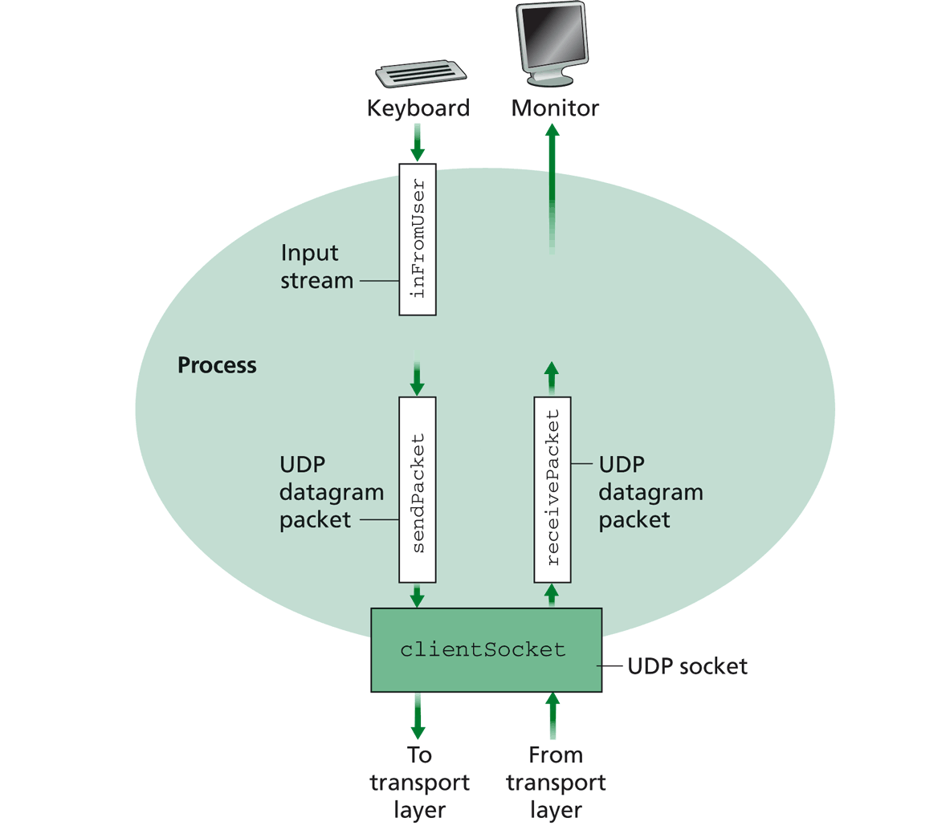
Example: UDPClient.java
A simple UDP client which reads input from keyboard, sends the input to server, and reads the reply back from the server.

Slide 29
Example: Java client (UDP)
import java.io.*;
import java.net.*;
class UDPClient {
public static void main(String args[]) throws Exception
{
BufferedReader inFromUser =
new BufferedReader(new InputStreamReader(System.in));
String sentence = inFromUser.readLine(); byte[] sendData = sentence.getBytes();
DatagramSocket clientSocket = new DatagramSocket();
InetAddress sIPAddress = InetAddress.getByName(“servname");
Create
input stream
Create
client socket
Translate
hostname to IP
address using DNS

Slide 30
Example: Java client (UDP), cont.
Create datagram with data-to-send,
length, IP addr, port
DatagramPacket sendPacket =
new DatagramPacket(sendData, sendData.length, sIPAddress, 9876);
clientSocket.send(sendPacket);
byte[] receiveData = new byte[1024];
DatagramPacket receivePacket =
new DatagramPacket(receiveData, receiveData.length);
clientSocket.receive(receivePacket);
String modifiedSentence =
new String(receivePacket.getData());
System.out.println("FROM SERVER:" + modifiedSentence);
clientSocket.close();
}
}
Send datagram
to server
Read datagram
from server

Slide 31
Demo
%ubuntu: java UDPServer
%netstat to see buffer
%ubuntu: java UDPClient <server>
%wireshark to capture traffic
Notes:
netstat -a -p udp -n | grep "9876" System.out.println(clientSocket.getLocalAddress());
System.out.println(clientSocket.getLocalPort());
System.out.println(clientSocket.getReceiveBufferSize());
System.out.println(clientSocket.getSendBufferSize());
System.out.println(clientSocket.getSoTimeout());
System.out.println( java.nio.charset.Charset.defaultCharset() );

Slide 32
Discussion on Example Code
A simple upper-case UDP echo service is among the simplest network service.
Are there any problems with the program?
Notes:
System.out.println(clientSocket.getLocalAddress());
System.out.println(clientSocket.getLocalPort());
System.out.println(clientSocket.getReceiveBufferSize());
System.out.println(clientSocket.getSendBufferSize());
System.out.println(clientSocket.getSoTimeout());
System.out.println( java.nio.charset.Charset.defaultCharset() );

