Slide 1
Introduction to Computational Thinking
Inheritance and object construction;
Method Overriding; Object Hierarchy; Event-Driven Programming
Qiao Xiang, Qingyu Song
https://sngroup.org.cn/courses/ct-xmuf25/index.shtml
12/20/2025
This deck of slides are heavily based on cs112 at Yale University and cs101 at UCAS, respectively,
by courtesy of Dr. Y. Richard Yang and Dr. Zhiwei Xu.

Slide 2

Coordination

Slide 3

Coordinating Critter Exercise: Hipster (潮人)
A group of hipster critters want to hangout together
Each hipster can suddenly become inspired and choose a random board location called an edgy (前卫) bar
A hipster go north until reaches edgy bar’s horizontal, then east until reaching the bar

Slide 4
Solution 1 (See Hipster.java)
public class Hipster extends Critter {
private Random rand;
private int edgyBarX, edgyBarY;
private int nextT, t;
private final int FLASH_INTERVAL = 200;
public Hipster() {
rand = new Random();
t = 0; nextT = rand.nextInt(FLASH_INTERVAL);
}
public Direction getMove(String[][] grid) {
t ++;
if (t == nextT) {
edgyBarX = rand.nextInt( getWidth() );
edgyBarY = rand.nextInt( getHeight() );
t = 0; nextT = rand.nextInt(FLASH_INTERVAL);
}
if (getY() != edgyBarY) {
return Direction.NORTH;
} else if (getX() != edgyBarX) {
return Direction.EAST;
} else {
return Direction.CENTER;
}
}
public String toString() {
return "H(" + edgyBarX + "," +edgyBarY + ")”; }

Slide 5
Solution 1 (See Hipster.java)
public class Hipster extends Critter {
private Random rand;
private int edgyBarX, edgyBarY;
private int nextT, t;
private final int FLASH_INTERVAL = 200;
public Hipster() {
rand = new Random();
t = 0; nextT = rand.nextInt(FLASH_INTERVAL);
}
public Direction getMove(String[][] grid) {
t ++;
if (t == nextT) {
edgyBarX = rand.nextInt( getWidth() );
edgyBarY = rand.nextInt( getHeight() );
t = 0; nextT = rand.nextInt(FLASH_INTERVAL);
}
if (getY() != edgyBarY) {
return Direction.NORTH;
} else if (getX() != edgyBarX) {
return Direction.EAST;
} else {
return Direction.CENTER;
}
}
public String toString() {
return "H(" + edgyBarX + "," +edgyBarY + ")”; }
Problem: Each hipster goes to a different bar. We want all hipsters to share the same bar location.

Slide 6
Solution 1 (See Hipster.java)
public class Hipster extends Critter {
private Random rand;
private static int edgyBarX, edgyBarY;
private int nextT, t;
private final int FLASH_INTERVAL = 200;
public Hipster() {
rand = new Random();
t = 0; nextT = rand.nextInt(FLASH_INTERVAL);
}
public Direction getMove(String[][] grid) {
t ++;
if (t == nextT) {
edgyBarX = rand.nextInt( getWidth() );
edgyBarY = rand.nextInt( getHeight() );
t = 0; nextT = rand.nextInt(FLASH_INTERVAL);
}
if (getY() != edgyBarY) {
return Direction.NORTH;
} else if (getX() != edgyBarX) {
return Direction.EAST;
} else {
return Direction.CENTER;
}
}
public String toString() {
return "H(" + edgyBarX + "," +edgyBarY + ")”; }

Slide 7
Recall: Static members
static: Part of a class, rather than part of an object.
Object classes can have static methods and fields.
Not copied into each object; shared by all objects of that class.
class
state: private static int staticFieldA private static String staticFieldB
behavior: public static void someStaticMethodC() public static void someStaticMethodD()
object #1
state: int field1 double field2
behavior: public void method3() public int method4() public void method5()
object #2
state: int field1 double field2
behavior: public void method3() public int method4() public void method5()
object #3
state: int field1 double field2
behavior: public void method3() public int method4() public void method5()

Slide 8
Accessing static fields
From inside the class where the field was declared:
fieldName // get the value
fieldName = value; // set the value
From another class (if the field is public):
ClassName.fieldName // get the value
ClassName.fieldName = value; // set the value
generally static fields are not public unless they are final

Slide 9

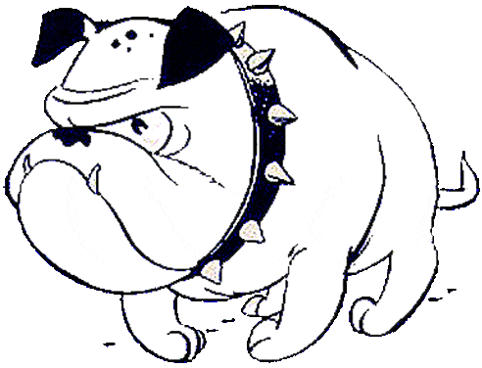
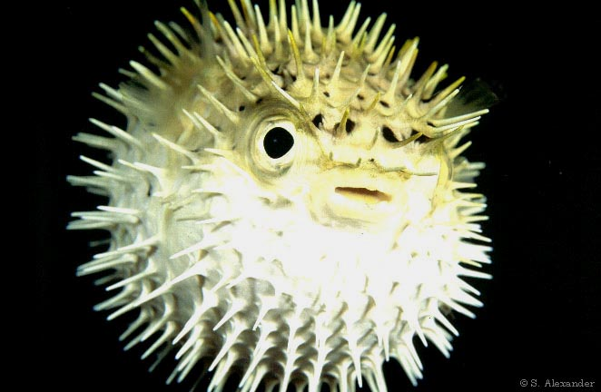
Designing Bulldog
Be open minded
Think about strategies, e.g.,
How much state do your bulldogs keep and probe state?
When do your bulldogs eat/mate?
Is there an “optimal” fight strategy for a specific type of opponent?
Do your bulldogs play disguise(伪装)?
Does your strategy change with time?
Do your bulldogs coordinate their behaviors to form some kind of patterns?

