Slide 1
Introduction to
Computational Thinking
Encapsulation
Qiao Xiang, Qingyu Song
https://sngroup.org.cn/courses/ct-xmuf25/index.shtml
12/6/2025
This deck of slides are heavily based on cs112 at Yale University and cs101 at UCAS, respectively,
by courtesy of Dr. Y. Richard Yang and Dr. Zhiwei Xu.

Slide 2
Outline
The encapsulation(封装) principle

Slide 3
Two Views of an Object
You can take one of two views of an object:
  external (API) - the interaction of the object with its users
  internal (implementation) - the structure of its data, the algorithms used by its methods
Notes:
对象的用户或客户端不应该了解状态的内部表示或算法的细节——对象应该是一个封装的实体（一个黑盒），而不泄露实现。

Slide 4
The Encapsulation Principle
Methods
User
User can see only the external API (state and behaviors)
Data/state
User should not see the internal state or behaviors
Notes:
封装的目的

Slide 5


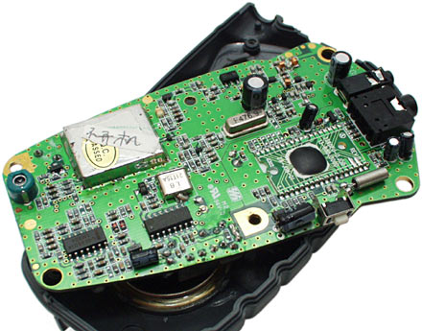
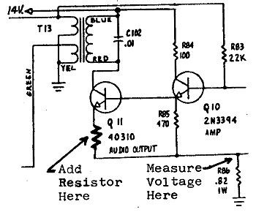
Encapsulation Analogy
Client
API
Implementation
client needs to know
how to use API
implementation needs to know
what API to implement

Slide 6
Encapsulation Analogy
As a user, you don't understand the inner details of iPhone, and you don't need to.
Apple does not want to commit to any internal details so that Apple can continuously update the internal

Slide 7
Examples
What are some risks of allowing others to view/access the internal state of a class?
  The Coin class
  The Ball class
  The Point class
  The BankAccount class
Notes:
大家思考，银行账户，如果知道细节就危险了

Slide 8
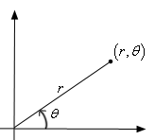
Why Encapsulating Data
Consistency: so that we make it impossible for others to "reach in" and directly alter another object's state
  Protect object from unwanted access
    Example: Can't fraudulently increase an BankAccount balance.
  Maintain state invariants
    Example: Only allow BankAccounts with non-negative balance.
    Example: Only allow Dates with a month from 1-12.
Flexibility: so that you can change the state representation later without worrying about breaking others’ code
  Example: Point could be rewritten in polar
  coordinates (r, θ) so long you provide translation in the interface, clients will not see difference.
Notes:
两个方面

Slide 9
Accomplish Encapsulation:
Access Modifiers
In Java, we accomplish encapsulation through the appropriate use of access modifiers(修饰符)
An access modifier is a Java reserved word that specifies the accessibility of a method, data field, or class
  we will discuss two access modifiers: public, private
  we will discuss the other modifier (protected) later
Notes:
access modifiers：访问修饰符

Slide 10
The public and private Access Modifiers
access modifiers enforce encapsulation
  public members (data and methods): can be accessed from anywhere
  private members: can be accessed from a method defined in the same class
  Members without an access modifier: default private accessibility, i.e., accessible in the same package; otherwise, not accessible.

Slide 11
Using Access Modifiers to Implement Encapsulation: Methods
Only service methods should be made public
Support or helper methods created simply to assist service methods should be declared private
Notes:
Service解释一下

Slide 12
The Effects of Public and Private Accessibility
public
private
violate
Encapsulation
Use Caution
enforce
encapsulation
variables
provide services
to clients
support other
methods in the
class
methods

