Slide 1
Introduction to Computational Thinking
Lecture #1: Introduction
Qiao Xiang, Qingyu Song
https://sngroup.org.cn/courses/ct-xmuf25/index.shtml
9/24/2025
This deck of slides are heavily based on cs112 at Yale University and cs101 at UCAS, respectively, by courtesy of Dr. Y. Richard Yang and Dr. Zhiwei Xu.

Slide 2
Outline
What is Computer Science?
What is Programming?
Administrative trivia’s
Summary

Slide 3
What are CS and CT?
Computer science (CS) is the study of computational processes
  for problem solving and creative expression
  that are correct, smart, and practical
CS combines
  logic, algorithmic, systems thinking, and network thinking
Computational thinking (CT) is the way of thinking underlying the computer science discipline

Slide 4
ALGORITHMIC THINKING?
Late lonely nights in front of computers?
Computers?
ALGORITHMIC THINKING
al·go·rithm:
a step-by-step procedure for solving a problem or accomplishing some end, especially by computers.
Notes:
No more lonely nights: http://www.youtube.com/watch?v=tGI9CUbqNSQ

Slide 5
Fields of Computer Science
Artificial intelligence
Databases
Graphics and multimedia
Mobile computing
Systems/networks
Theory
...
Notes:
How is CS112 related?
A broad, programming-centric introduction to computer science and its applications

Slide 6

Algorithm Example: Phonebook
Problem: How to look up a name in the telephone directory?
Src: http://www.123rf.com/photo_3534051_phone-directory-on-isolated-white-background.html

Slide 7
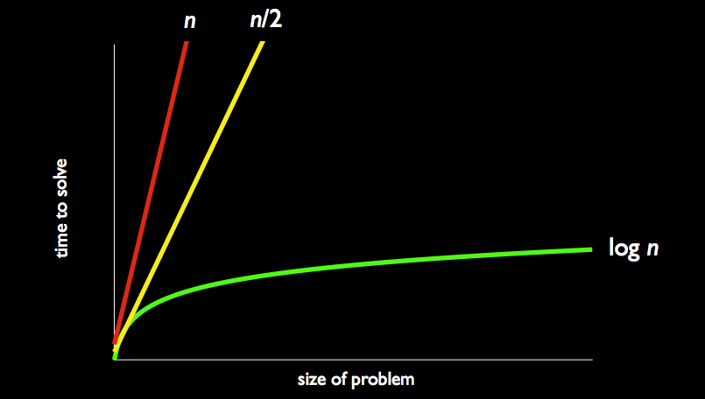
Comparison of Complexity
http://d2o9nyf4hwsci4.cloudfront.net/2013/fall/lectures/0/w/notes0w/notes0w.html

Slide 8
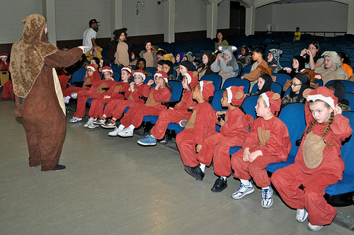
Algorithm Example: Counting
Problem: How to count the number of students in a classroom?
Src: http://www.flickr.com/photos/usag-yongsan/5587562543/

Slide 9


Google’s Map-Reduce Scheme
Initialize all inputs
Repeat until no input to process
  Map: partition inputs into buckets
  Reduce: process the inputs in the same bucket

Slide 10
A Map-Reduce Counting Algorithm
Initialize inputs
  every student finds a piece of paper, writes 1 on it, and stands up
Repeat
  Map:
    Pairing standing-up students
  Reduce:
    For each pair, one student gives his/her number to the other and sits down; The other student updates its number to be the sum and remains standing up
Q: How long does the alg run?

Slide 11
Comparison of Complexity
http://d2o9nyf4hwsci4.cloudfront.net/2013/fall/lectures/0/w/notes0w/notes0w.html

Slide 12
Outline
What is Computer Science?
What is Programming?
Administrative trivia’s
Summary

Slide 13

What is Programming?
Programming: Design algorithms
and express algorithms precisely in programs
Program: A set of instructions
written in a computer language
to be carried out by a computer.
  We will be focusing on computer
  languages including Java and JS
Program execution: The act of
carrying out the instructions
contained in a program.

Slide 14
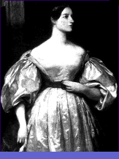
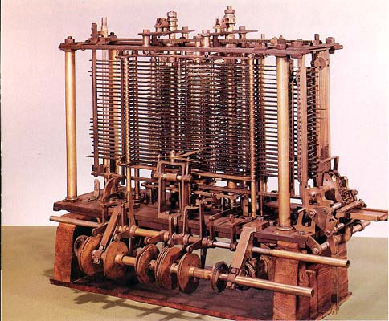
Why Programming?
Avoid programming: using prepackaged software solutions.
Programming: Enables you to make
a computer do much more.
Ada Lovelace
Analytic Engine
Notes:
Programming is like writing.
Ada Lovelace is "first computer programmer." Worked with Charles Babbage on a mechanical machine known as the Analytic Engine (which existed only on paper, unlike his Difference Engine, not built due to funding problems). Described how, in principle, it could be programmed using punch cards to carry out any arithmetic calculations (computing Bernouilli numbers). Anticipated much of 20th century computers. Daughter of romantic poet Lord Byron.
" In her article, published in 1843, Lady Lovelace's prescient comments included her predictions that such a machine might be used to compose complex music, to produce graphics, and would be used for both practical and scientific use. She was correct."
Note: some controversy surrounding extent her contributions vs. Babbage's

Slide 15
Why Programming?

Slide 16
Learning a Programming Language
16
Just like learning any new language
  syntax: “new words”
  grammar: how to put them together
  programming: telling a coherent story
  library: use plots already written
Initially needs efforts, but pays off in the end !
Notes:
16

Slide 17
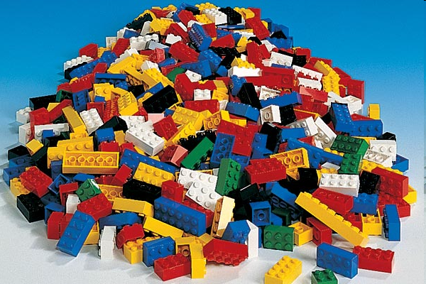
Programming is like Legos…

Slide 18
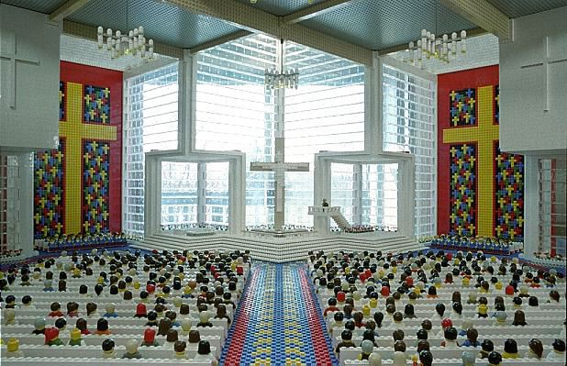

Slide 19
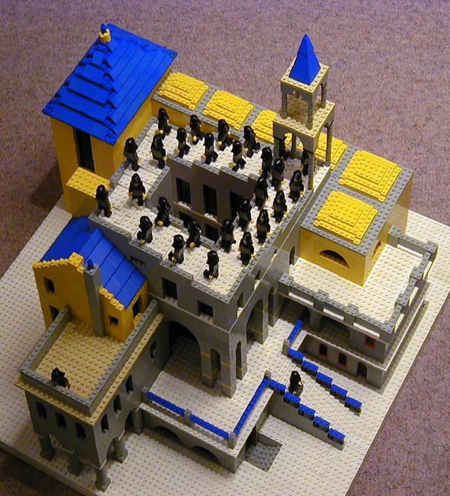

Slide 20
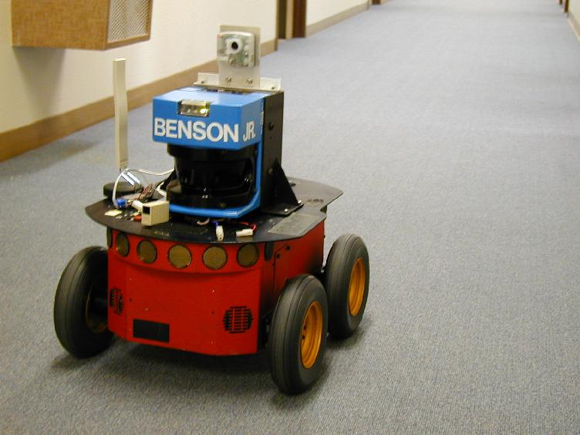
20

Slide 21
Programming Languages are Easier than Natural Languages
Programming languages have simpler structure
Programming languages do not have ambiguities
  Kids Make Nutritious Snacks.
  Local High School Dropouts Cut in Half.
  Police Squad Helps Dog Bite Victim.
  Red Tape Holds Up New Bridge.
[ real newspaper headlines, compiled by Rich Pattis ]

Slide 22
Comment on Course Eval
“We only work with java, but honestly the class isn't about learning a language so much as it is learning how to think like a programmer. This class was great for that purpose, indeed, I would argue that such a class is actually what a QR requirement should be -- not merely quantitative reasoning but thinking in terms of a formal system and how to translate complex tasks into simple tasks that can be accomplished with formal statements.”

Slide 23
What Kind of Class is This?
Sort of foreign language (how to communicate with a computer effectively)
Sort of engineering (building things that realize a desired objective)
Sort of philosophy (formal logic, deductive systems and semantics, model of world)
Sort of psychology (given some output behavior, what is going on internally?)
Notes:
Philosophy, Psychology, Foreign Language, Engineering, Politics, Sociology, Biology, Physics, and Business rolled into one!

Slide 24
Comment on Course Eval
“Econ major? History? English? Political Science? It matters not, my friend! You use a computer. Now is the time to take the reigns and truly control that machine that captures your attention for 35% of your day.”

Slide 25
What are learned in this course
Learn the elementary and the way of thinking
  Overview of the CS discipline and the IT field
  Ability to create computer applications
    Not just use computer applications
  Principles of computational thinking
    Logic thinking, algorithmic thinking, systems thinking
    Network thinking

Slide 26
Topics of this course
Intended mainly as your first CS and programming course !
program problem solving techniques:
  how to model real world and manage complexity, e.g.,
    structural programming: top-down vs. bottom-up vs. stepwise refinement
    recursive programming
    object-oriented programming: abstraction and modularization
    event-driven programming
  how to solve a problem efficiently, elegantly
  debugging: figure out why the computer did not do what you wanted
good programming style, e.g.,
  robust, efficient program, readable code; documentation
use important libraries and data structures, e.g.,
  Multimedia, GUI, Android, Google App Engine, thread
programming tools
  Java/Javascript/Web programming language and supporting tools

Slide 27
Outline
What is Computer Science?
What is Programming?
Administrative trivia’s
Summary

Slide 28
Course Personnel: Instructor
Instructor
  Qiao Xiang, qiaoxiang@xmu.edu.cn
    office hours： by appointment
  Qingyu Song, qingyusong@xmu.edu.cn
Teaching assistant
  Mengqi Fu, fumengqi0725@gmail.com
  Ziheng Zhang, ziheng.zhang.xmu@outlook.com

Slide 29

Instructor: Qiao Xiang
Joined XMU as a professor in January 2021
Research: Computer Networks and Systems
Previously,
  Research assistant professor, Yale University, US., 2019-2020
  Postdoctoral fellow, Yale University, US. 2016-2018
  Postdoctoral fellow, McGill University, Canada, 2014-2015
  Ph.D. in Computer Science, Wayne State University, US, 2014
  B.E. in Information Security and B.Econ., NKU, 2007

Slide 30
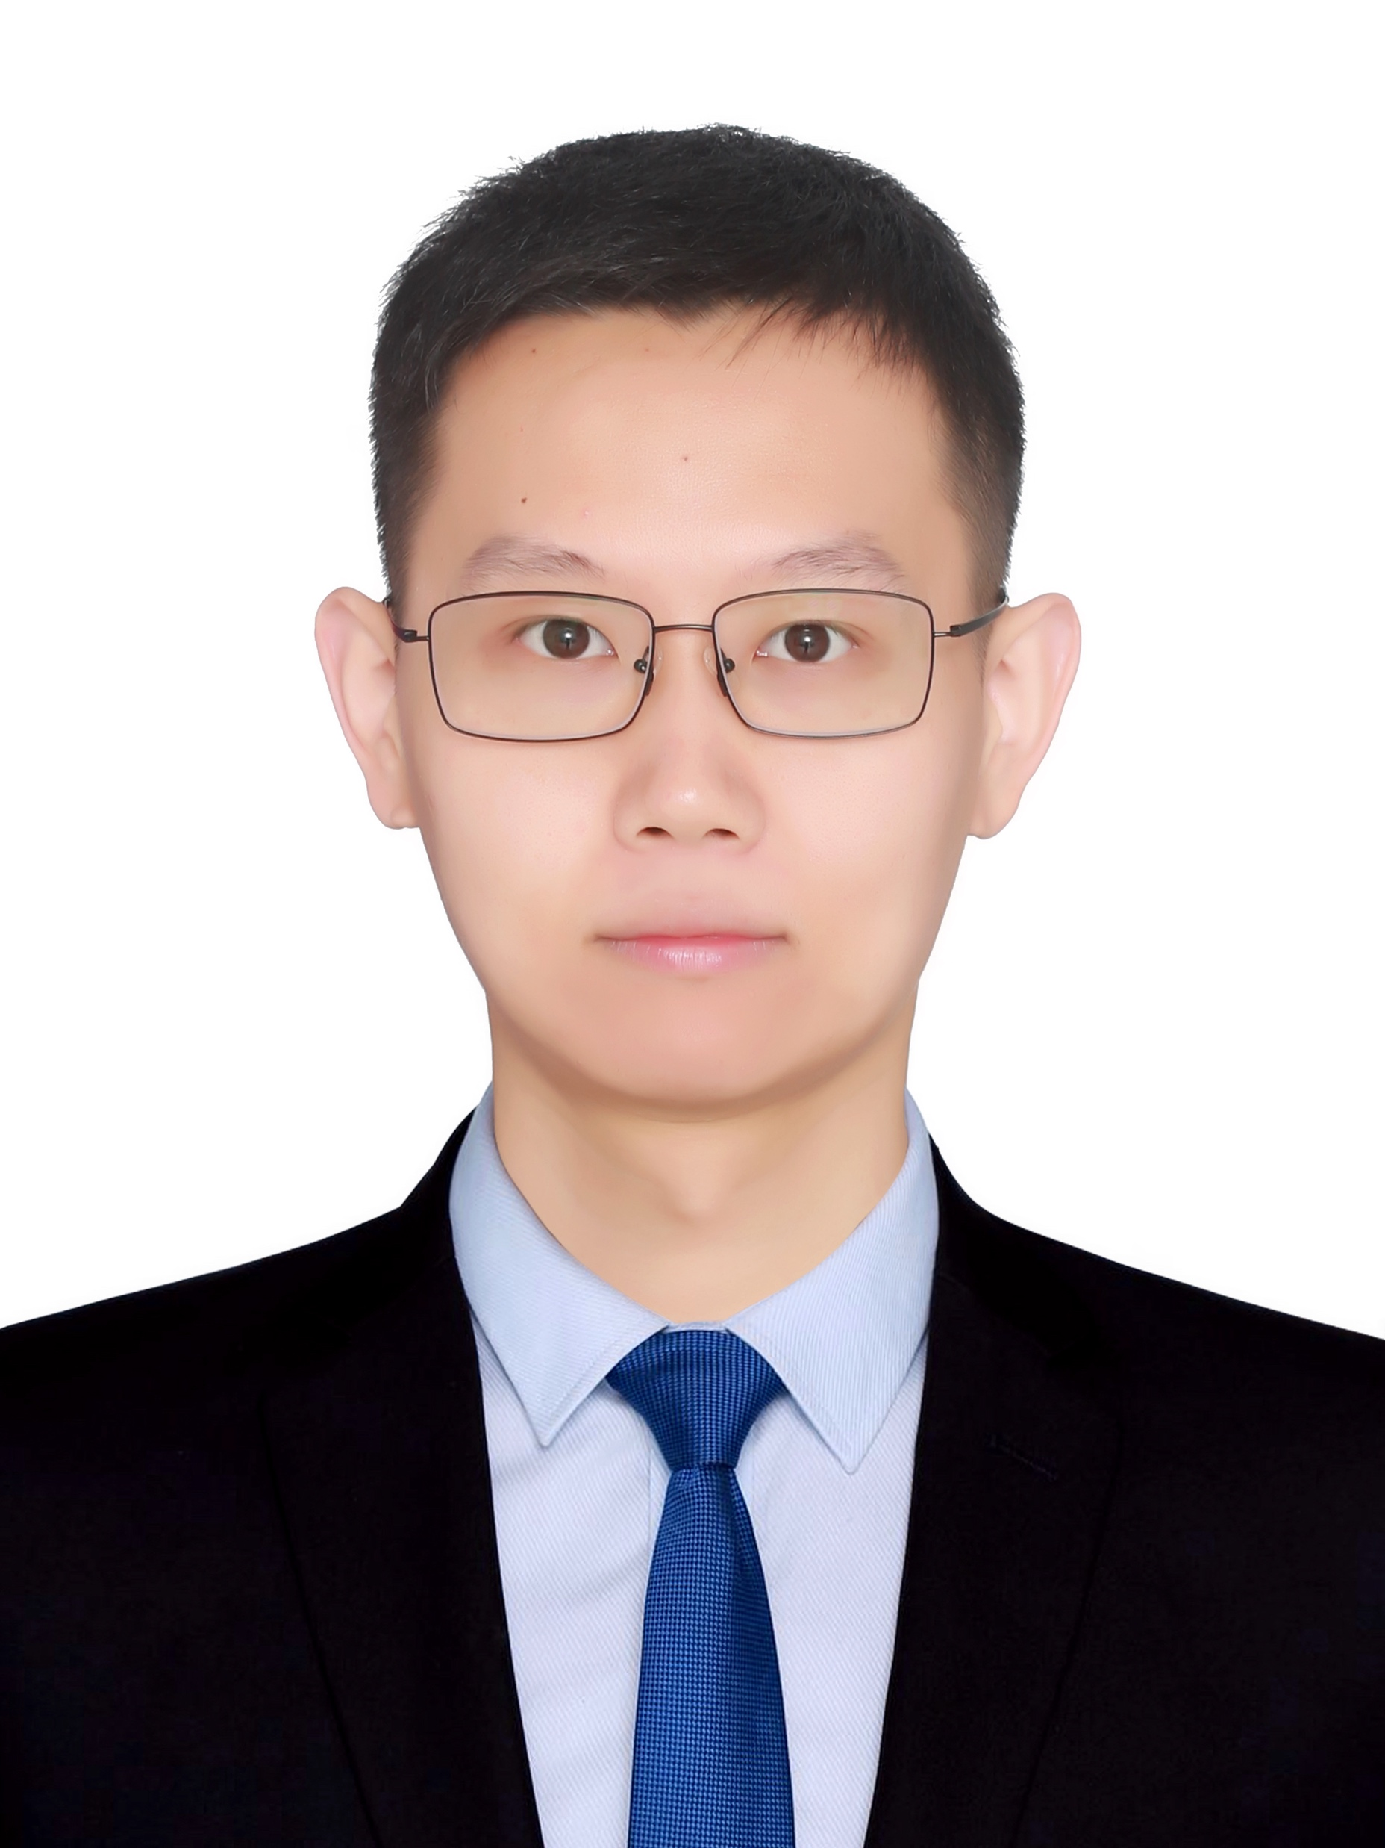
Instructor: Qingyu Song
Joined XMU as an assistant professor September 2025
Research: Computer Network + AI
Previously,
  Ph.D. in Computer Science & Engineering, CUHK, 2025
  Research Intern, Huawei HK, Hong Kong SAR. 2025
  Visiting Research Intern, Huawei HK, Hong Kong SAR. 2023
  M.E. in Control Engineering, THU, 2021
  B.E. in Software Engineering, HITWH, 2018

Slide 31
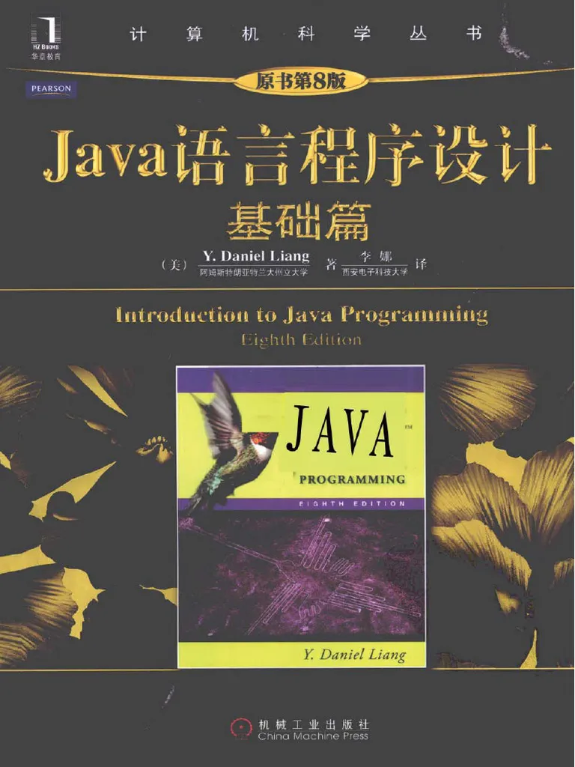

Textbook Information
Java语言程序设计（基础篇）
计算机科学导论——以计算思维为舟
Other recommended readings listed online
Information, lecture notes, & assignments are available on class server
  we won’t use much paper !
  please read online information at least once every two days !

Slide 32
Course Workload
Participant 10%
A one-hour exams (20%)
    one exam == 1.5 assignments
Others (70%) :
  Assignments: 8 -- 9 in all
      all assignments are posted online (no paper handout)
      all assignments must be submitted online
      due on the date specified in the schedule page
      grace period policies
  One or two bonus [optional] assignments to replace lowest grades
  Final project (== 2 assignments)?

Slide 33
Assignments (pset)
All assignments are programming assignments
You learn more from doing the assignments
  we learn [Dr. William Glasser]
    10% of what we read
    20% of what we hear
    50% of what we read and hear
    70% of what we discuss
    80% of what we experience personally
    95% of what we teach others
http://principalcowart.blogspot.com/2009/02/how-we-learn-william-glasser.html

Slide 34
Assignments (pset)
Assignments start small and easy, and then turn large and more interesting
Each assignment intends to
  introduce one key programming concept
  demonstrate the application of computer programming to diverse fields (text, graphics, audio, problem solving, scientific computation)

Slide 35
Example Past Assignments (pset): Processing Texts
Generate (simple) poems
Madlib
Hangman

Slide 36
Example Past Assignments (pset): Media
Recursive graphics (static image)
Bouncing animation (dynamic image)
Countdown
Generating illustration
Guitar hero (music + visualization)
  demo/ps8-guitar/

Slide 37
Example Past Assignments (pset): Problem Solving
Sudoku (ps7)
  http://mrt-sudokusolver.appspot.com/
Critter tournament (ps8)

Slide 38
Example Past Assignments (pset): Scientific Computation
N-body
  demo/ps5-nbody/

Slide 39
Assignments this Semester
We are still finalizing the programming assignments for this semester: expect both overlapping and new assignments

Slide 40
Assignments Workload
Time spent on assignments reported by students

Slide 41
Comment on Course Eval
“[The problem sets] often take 6-7 hours to complete (especially a few towards the end of the semester). The final project […] took me at least 12 hours to get right, but the feeling of accomplishment after making a working program is like none other.”

Slide 42
Comment on Course Eval
“Basically, programming is just problem solving. If you think you're someone who likes to solve problems, then definitely take this class. […] I do have to warn you about the problem sets, though. They start out very easy, but get pretty hard because you have to build on your prior knowledge.
Debugging your program can be the most annoying thing in the world, since hitting the shift key while typing the equals sign can cost you about 5 hours' worth of time looking for it (personal experience). So start on the problem sets early, and don't hesitate to ask the TA's or help--you'll probably need it at least once, such as on the last problem set.”

Slide 43
How to do well in this course
Keep up with the assignments
  The course material is cumulative
  From a former student: “Procrastination will eventually come around to bite you in the ass!”
If you don’t understand something, ask questions (especially “WHY?”).
  “There’s no such thing as a dumb question.”
  Computers are neither magical nor mysterious. Everything can be explained!
Discuss your design with others

Slide 44
Should you Take this Course?
  “I hate computers.”
  “I like fuzzy solutions.”
    Programming forces you to solve problem precisely.
  “I refuse to think logically.”
  “I want to take an easy class.”
    Hard for those who find difficulty in logical thinking and who don’t pay attention to precision.
Answer: No

Slide 45
Should you Take this Course?
  “I want free gourmet meals and to make lots of money by working for Facebook/Google/LinkedIn/Apple”
  “World of Warcraft rocks hardcore!”
  “Everyone, look at my Facebook farm!”
Answer: Yes/no

Slide 46
Should you Take this Course?
  “I have to take this class.”
  “Computers and robots are going to take over the world. I want to befriend them so that my life will be spared.”
  “I know that 65% of us will have to talk to software developers on a regular basis in whatever profession I choose after I graduate, I need to communicate with them.”
  “I like to solve problems.”
  “I like to learn new perspectives on how to solve problems.”
  …
Answer: Yes

Slide 47

Questions for You
Please return the class survey at the end of the class

Slide 48
Questions?

