Slide 1
Introduction to
Computational Thinking
Lecture #2:
Computational Thinking Overview & Java Program Structure
Qiao Xiang, Qingyu Song
https://sngroup.org.cn/courses/ct-xmuf25/index.shtml
10/11/2025
This deck of slides are heavily based on cs112 at Yale University and cs101 at UCAS, respectively,
by courtesy of Dr. Y. Richard Yang and Dr. Zhiwei Xu.

Slide 2
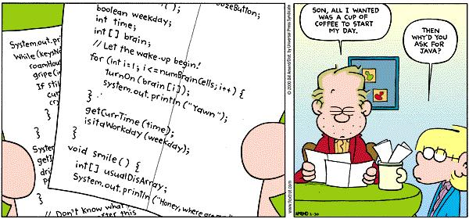

Slide 3
Outline
Admin. and recap
Computational process and development
Java: the programming language
Programming levels
Java programming steps
Java program structure

Slide 4
Admin
pset 1 to be posted

Slide 5

Questions for You
Please return the class survey at the end of the class

Slide 6
Recap
Computer science (CS) is the study of computational processes
  for problem solving and creative expression
  that are correct, smart, and practical
CS combines
  logic, algorithmic, systems thinking, and
  network thinking
Computational thinking (CT) is the way of thinking underlying the computer science discipline

Slide 7
Recap
Programming is to apply algorithmic thinking to design computer programs to solve problems
  Describe each step in a computer language
    Algorithms represent imperative knowledge vs declarative knowledge
  Figure out why the computer did not follow the instructions as you expected

Slide 8
Outline
Admin. and recap
Computational process and development

Slide 9
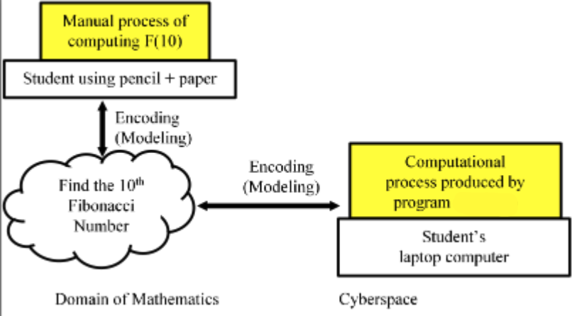
Computational process
A step-by-step process of information transformation
  A sequence of symbol manipulation steps
  Can be done manually or automatically
Compute Fibonacci number F(10)
    Given definition
    F(0)=0, F(1)=1,
    F(n)=F(n-1)+F(n-2)
    when n>1,
    Find F(10).
Manual
    Tedious
    Impractical for large n
Computer
    Automatic after
    encoding into cyberspace
    Practical even for
    n = 1 billion

Slide 10
2. ABC features
Automatic execution
Bit accuracy
Constructive abstraction

Slide 11
Automatic execution
Computational processes are automatically executed step-by-step on computers.
Automatic execution is common when looking inside or from outside
    Step-by-step mechanic automatic execution of digital symbol manipulation is the most fundamental characteristic of computational thinking, both without and within.
    It underlies all the other understandings.
    CS studies logic that is automatic executable logic, algorithms that are automatic executed algorithms, abstractions that are automatic executed abstractions.
It partially answers the question
    Why and how trillions of instructions can be automatically executed in a fraction of a second, sometimes across the globe, to produce correct computational results?

Slide 12
Bit accuracy
Other sciences pursue their own scientific rigor
    Experiments results are statistically significant when the p-value is less than 0.05
Computer science uses binary values of 0s and 1s
  One binary digit is called a bit
Computer science pursues bit accuracy
    A computational process is accurate and precise up to every bit
    Any practical computer has finite memory
      Cannot represent real numbers of arbitrary precision

Slide 13
Constructive abstraction
Computer science is about digital abstractions
    constructive, automatically executed abstractions of information transformation
Three layers of meaning
    Abstraction from concrete instances to the general concept
    Constructive: a step-by-step integration of more primitive symbols and operations
    Smart construction, not ad hoc, arbitrary actions or processes
      Although may use brute-force actions (e.g., exhaustive enumeration) and
      seemingly arbitrary random operations (e.g., randomly picking a number)

Slide 14
How to develop a computational process?
Data + Program

Slide 15
What are Data & Program?
Data is a group of bits.
A bit is a binary digit with a value of 0 or 1.
A digital symbol is any notation that is representable as one or more bits, to denote any concrete or abstract entity.
Manipulation is a sequence of operation steps on digital symbols, where the length can be one or many.
A program is an algorithm written in a computer language.
Code is a fraction (segment) of a program.

Slide 16

What is a digital symbol
A notation
  Representable as one or more bits
    Discrete, not continuous
    Finite, not infinite many bits
  Denoting any concrete or abstract entity
    Number, character, string, image, audio, video
    Idea, program code, human genome sequence
Manipulation is
  Any sequence of operation on symbols
    Find (look up), read, write, transport (send), modify
A WeChat QR code
https://www.ncbi.nlm.nih.gov/nuccore/LR991581

Slide 17
Data are digital symbols
Analog vs. digital values
  Analog: Continuous
  Digital: Discrete
Binary-decimal conversion
Representations
  ASCII： American Standard Code for Information Interchange
  uses 8 bits to encode English characters
Month
You will learn details in another course!
Month |  | Jan | Feb | Mar | Apr | May | Jun | Jul | Aug | Sep | Oct | Nov | Dec
Temperature °C | Decimal | 0 | 0 | 20 | 20 | 30 | 30 | 30 | 30 | 30 | 20 | 10 | 0
 | Binary | 00 | 00 | 10 | 10 | 11 | 11 | 11 | 11 | 11 | 10 | 01 | 00

Slide 18
Program:Digital symbol manipulation
Computer science studies computational processes
A computational process is a process of information transformation,
which is a sequence of steps of digital symbol manipulation
  Process = a sequence of steps
  Information transformation = digital symbol manipulation
Process of information transformation
a sequence of steps digital symbol manipulation

Slide 19
Take away
Data as Symbols
Programs to manipulate symbols

Slide 20
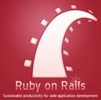


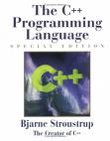


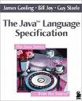





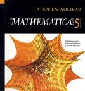

Programming Language Choices

Slide 21
Outline
Admin. and recap
Computational process and development
Java: the programming language

Slide 22
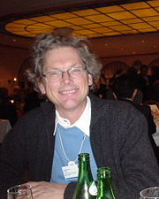
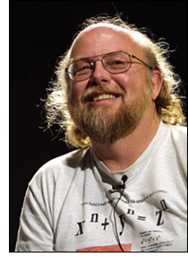

Java Programming Language: Key Designers
Bill Joy
    BSD Unix guy from UC Berkeley
    co-founder of Sun Microsystems (1982)
    focus on “the network is the computer”, targeting workstation market
    failure: focusing on network was ahead of its time, but missed the boat on PC revolution
James Gosling
    early fame as the author of “Gosling Emacs”
      killed by open GNU emacs
    then onto Sun’s “NeWS” windows system
      killed by open X-windows
    failure: keeping things proprietary led to “kiss of death”
Notes:
retreated to Aspen, Colorado
Why the future does not need us: http://www.wired.com/wired/archive/8.04/joy.html

Slide 23
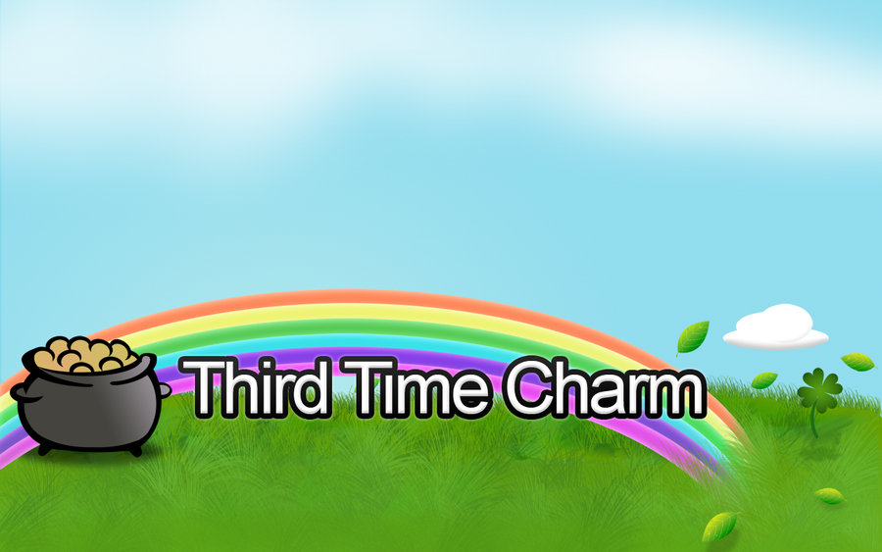
Java Programming Language: History
Joy and Gosling joined force: Sun subsidiary, FirstPerson, Inc. (1992)
  target consumer electronics: PDAs, appliances, phones, all with cheap infra-red kinds of networks
  need a language that’s safe, portable, secure, wired
    started working on C++--
    soon gave up hope, decided to start from scratch
  a little ahead of time (again): PDAs died with the demise of Apple Newton
  switched to interactive TV (ITV)
    the resulting language was called “Oak”
  a little ahead of time (yet again): ITV died too
Third time’s the charm
  the Web exploded
  Oak became Java

Slide 24
Java Features
Java is a modern, elegant, object-oriented programming language
    simpler than other object-oriented languages [e.g., C++]
    Java is the basis of other modern programming languages [e.g., Microsoft C#]
Java is (largely) portable --- write once run everywhere
    Java supports multiple platforms (Unix, Windows, Mac), multiple types of devices (desktops, phones, embedded devices)
Java has rich libraries and good support
    good multimedia, graphics packages
    good client-server and network support
    good, free Integrated Development Environments (IDE)
Notes:
http://www.tiobe.com/index.php/content/paperinfo/tpci/index.html

Slide 25
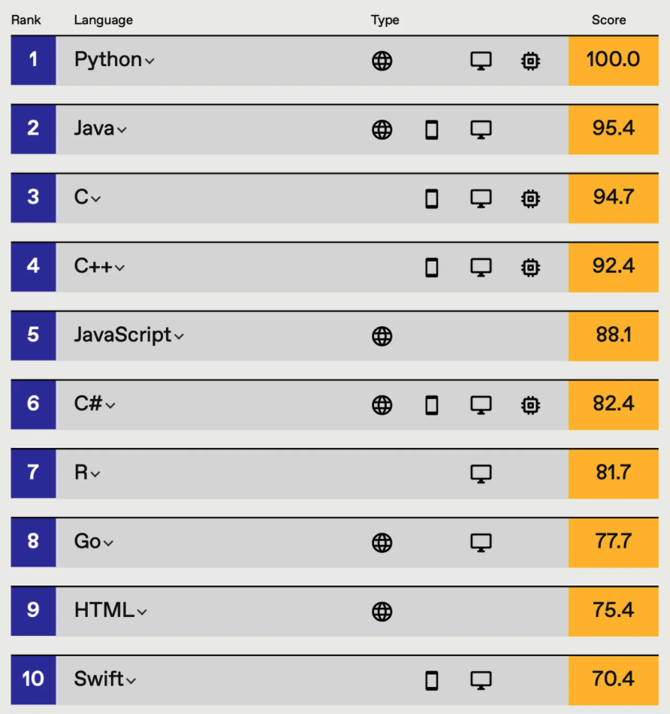
Language “Beauty Contest”
https://spectrum.ieee.org/top-programming-languages-2021

Slide 26
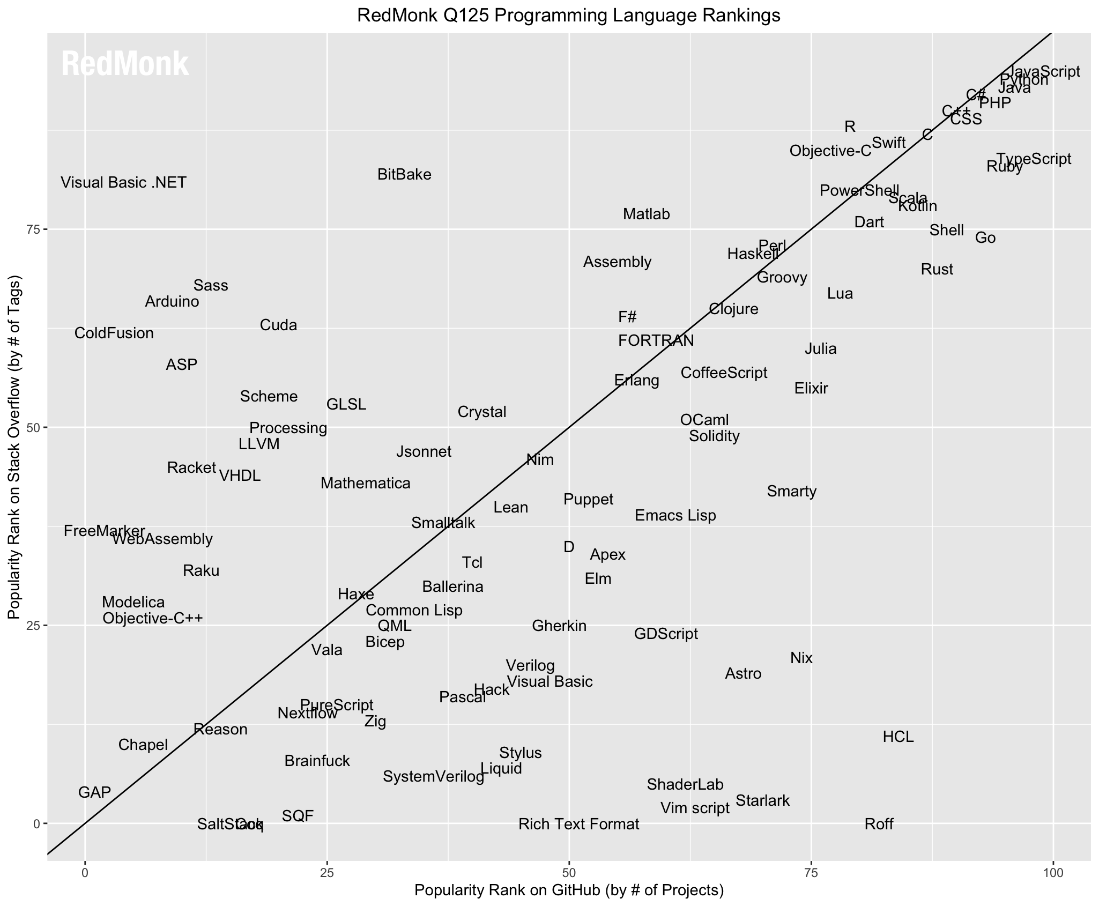
Language popularity
https://redmonk.com/sogrady/files/2025/06/lang.rank_.125.wm_.png

Slide 27
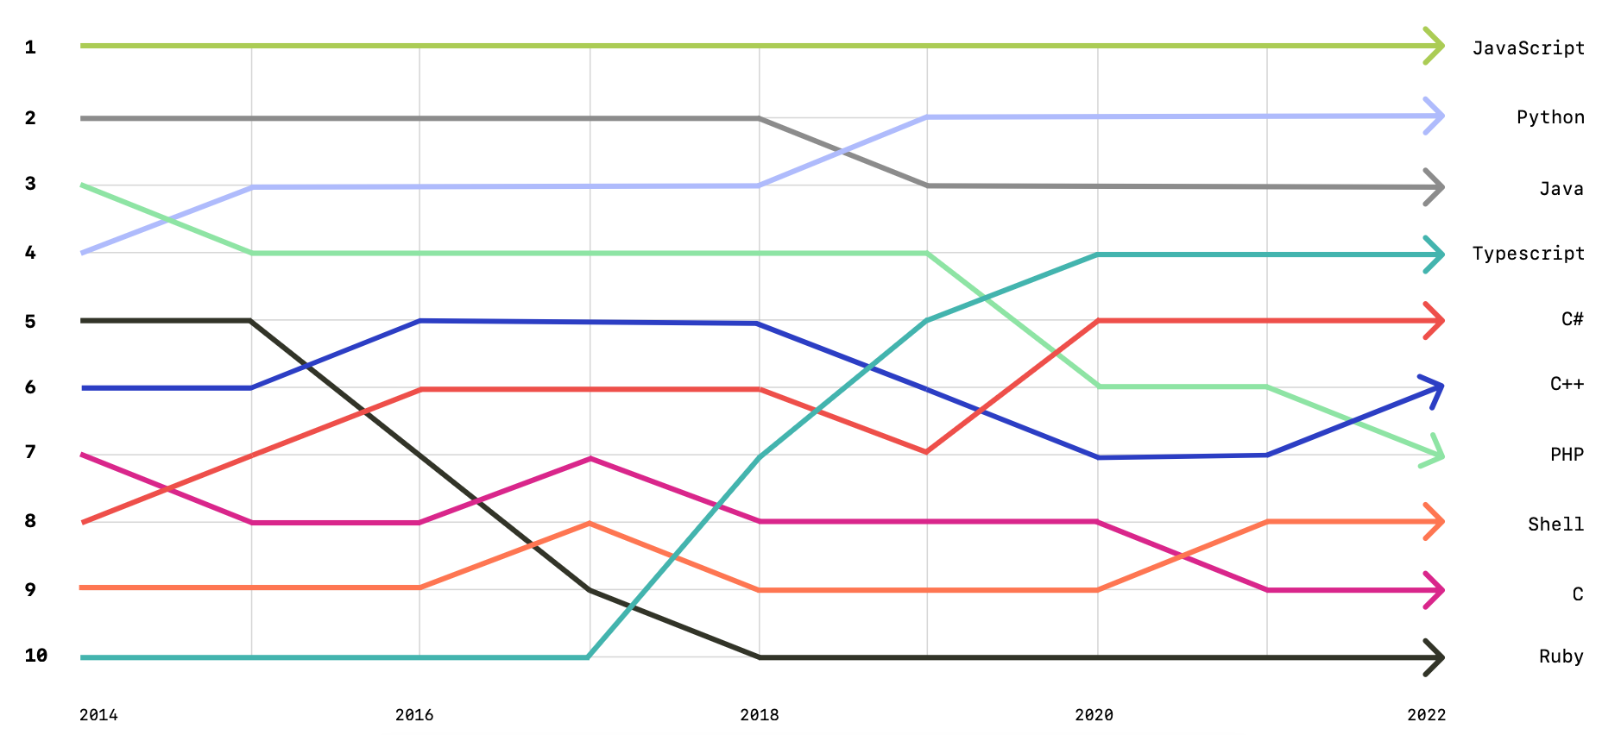
Language popularity
https://octoverse.github.com/2022/top-programming-languages

Slide 28
Java is Still Evolving
Version | Year | Important New Features
1.0 | 1996
5 | 2004 | Generic classes, enhanced for loop, auto-boxing, enumerations
10 | 2018 | Local-Variable Type Inference
15 | 2020 | Dynamic class-file constants, HTTP client (standard)
20 | 2023 | Enhancing concurrent programming and developer productivity
25 | 2025 | Aid in the development of AI applications
- New features added by following the Java Community Process
- Others extend Java to other settings: Google Android uses Java on mobile devices

Slide 29
Outline
Admin. and recap
Computational process and development
Java: the programming language
Programming levels

Slide 30

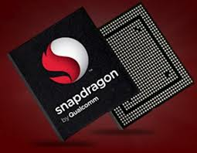
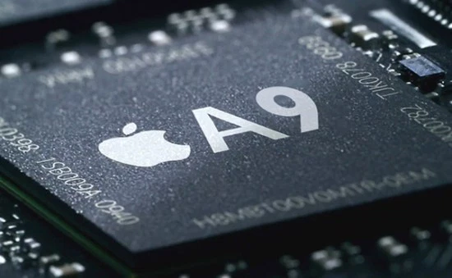
Machine Language
The “brain” of a computer is its
Central Processing Unit (CPU)
A CPU can understand only
very basic instructions
  - e.g., store a given value at a memory location; do some arithmetic operations; compare two values; start to execute the instruction at another location
The instruction set of a CPU forms the machine language of the CPU
Different machines understand different machine languages
MacBookPro
Qualcomm S4
Nexus 4,
Samsung Galaxy
A9
iPhone 6s
Notes:
For example, see x86 instruction set: http://en.wikipedia.org/wiki/X86_instruction_listings

Slide 31
High-Level Programming Languages
A high-level programming language enables a programmer to specify, in a high level (close to natural language), what data a computer will act upon, how these data will be stored, and what actions to take under various circumstances
The syntax and grammar of a high-level language is independent of CPU
celsiusTemperature = 32;
fahrenheitTemperature=
celsiusTemperature * 9 / 5 + 32;
if (fahrenheitTemperature > 100)
hot = true;
else
hot = false;
Example Higher-level Source Code fragment

Slide 32
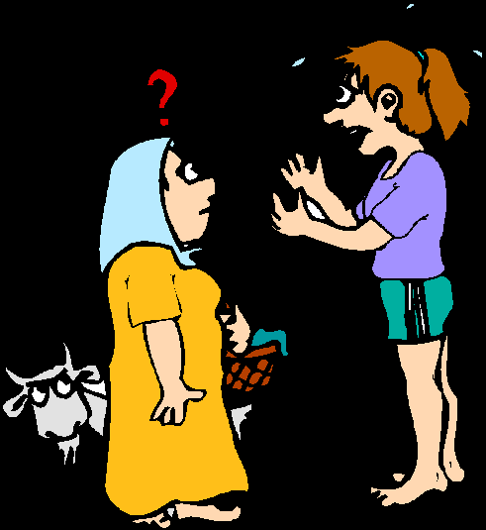
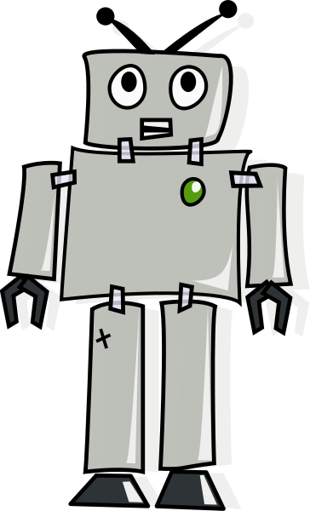
Problem
Language barrier
  Computers: understand machine platform languages---to build efficient hardware
  Programmers: want more readable high-level languages---to be more productive

Slide 33
Hire a Translator: Compiler
A program written in a high-level language must be translated into the language of a particular platform (type of CPU and operating system) before execution
A compiler is a program which translates source code into a specific target platform (CPU + OS)
source
code
machine
code
compiler
source code
intel x86 +Win8

Slide 34
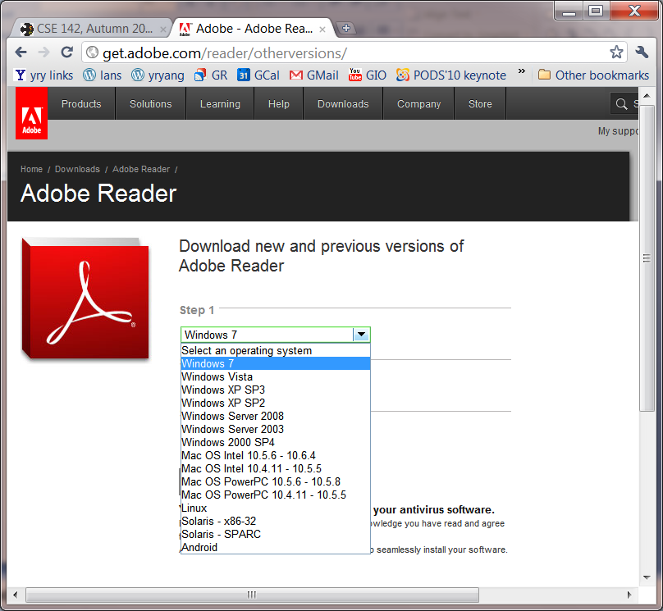
Problems of Compiling to Each Specific Computer Platform
Multiple versions of the same software

Slide 35
High-level Picture
C/C++
Prog 1
Prog 2
Prog 1; Arch 1
Prog 1; Arch n
Prog 2; Arch 1
Prog 2; Arch n’

Slide 36
Java Virtual Machine
To be platform independent, Java designers introduced Java Virtual Machine (JVM), a machine different from any physical platform, but a virtual machine
  The language of the virtual machine is referred to as bytecode
  Thus Java actually has two programming languages
A Java compiler translates Java source code (.java files) into bytecode (in .class files)
  Each Java software program needs to be compiled only once: from the Java source code to bytecode
Other languages (e.g., Jruby, Jython, Scala) may also compile to bytecode

Slide 37
Java Execution
To execute a Java program, another piece of software called an interpreter, translates between bytecode and the actual machine
  an interpreter is specific to a specific platform
  the interpreter understands java bytecode, and then issues instructions in the specific platform for which it is written
  we also say that an interpreter provides a java virtual machine (JVM)

Slide 38
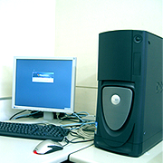
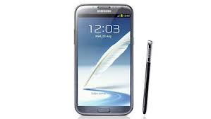


Java Translation and Execution
Java source code
Java compiler
Java bytecode
bytecode interpreter
for Windows
bytecode interpreter
for Mac
bytecode interpreter
for Android
bytecode interpreter
for Linux

Slide 39
Comparing Traditional (e.g., C/C++) and Java Software Development
Traditional, e.g., C/C++
Java
A developer writes a program in C/C++
The C/C++ source code is generally considered proprietary, and not released
The developer compiles the C/C++ program for each platform it intends to support, and distributes one version for each platform
  thus each program has multiple compiled versions
  each compiled version can run by itself
Platform dependency handled by each software developer
A developer writes a program in Java
The Java source code is generally considered proprietary, and not released
The developer compiles the Java program to bytecode, and distributes the bytecode version
  thus each program has only one compiled version
  the compiled bytecode needs an interpreter for each platform
Platform dependency handled by platform vendor

Slide 40
High-level Picture
C/C++
Prog 1
Prog 2
Prog 1; Arch 1
Prog 1; Arch n
Prog 2; Arch 1
Prog 2; Arch n’
Java
Prog 1
Prog 2
Prog 1/bytecode
Prog 2/bytecode
Interp; Arch 1
Interp; Arch n

Slide 41
Outline
Admin. and recap
Computational process and development
Java: the programming language
Programming levels
Java programming steps

Slide 42


Recall: Java Programming Steps
Programming in Java consists of 3 simple steps
  Create and edit “Java source code” (.java files)
  Compile into “Java bytecode” (.class files)
  Execute bytecode with a “Java interpreter”
source code
byte code
compile
run
output
42

Slide 43
Programming in Java (Step 1): Create/Edit
The basic way is to use a text editor
  Example editors: vim, sublime, Notepad, TextEdit (Format/Make Plain Text) etc.
    Note: MS Word is NOT a text editor
  The key is that your .java file cannot include any markup or stylistic formatting; just text.
  You enter your Java code following Java Language syntax (more soon).
43
Notes:
43
:syntax on
~/.vimrc

Slide 44
Programming in Java (Step 2): Compile
Compile a Java program
$ javac HelloWorld.java
Take a look to see that HelloWorld.class is generated
$ ls
HelloWorld.java HelloWorld.class
44
Notes:
44

Slide 45
Programming in Java (Step 3): Execute
Run Java interpreter
$ java HelloWorld
45
Notes:
45

Slide 46
First Java Program
/*************************************
* Prints “Hello World”
* Everyone’s first Java program.
*************************************/
public class Hello {
public static void main(String[] args) {
System.out.println("Hello, world!");
}
}

Slide 47
Another Java Program
public class Hello2 {
public static void main(String[] args) {
System.out.println("Hello, world!");
System.out.println();
System.out.println("This program produces");
System.out.println("four lines of output");
}
}

Slide 48
Programming in Java: Method 2
Another way is to use an Integrated Development Environment (IDE)
  Example IDEs: Eclipse, DrJava, etc.
  An IDE usually presents the user with a space for text (like an editor) but layers additional features on top of the text for the user's benefit.
    Note: The underlying file contains pure text, just like a text editor.
  These features can be very useful and save time.
    Example features are GUI compile, GUI execution, code completion, and syntax highlighting.
  IDEs take more time to get started than a simple text editor, e.g.,
    set up where to find the “java” and “javac” programs
    find out where does the IDE save my file
48
Notes:
48

Slide 49
Outline
Admin. and recap
Computational process and development
Java: the programming language
Programming levels
Java programming steps
Java program (syntax) structure

Slide 50
Java Syntax Structure: A Top-Down View
A class:
has a name, defined in a file with same name
Convention we follow: capitalize each English word
starts with {, and ends with }
includes a group of methods
public class <class name> {
public static void main(String[] args) {
<statement>;
<statement>;
...
<statement>;
}
}
A method:
has a name
Convention we follow: lowercase first
word, capital following
starts with {, and ends with }
includes a group of statements
statement:
a command to be executed
end with ;
Notes:
The book as a program analogy: need to write chapter name, paragraph name, before you can write a sentence.

Slide 51
The System.out.println statement
A statement that prints a line of output on the console.
  pronounced "print-linn”
Two ways to use System.out.println :
  System.out.println(<string>);
  Prints the given message <string> as output.
  System.out.println();
  Prints a blank line of output.
Notes:
51

Slide 52
Outline
Admin. and recap
Computational process and development
Java: the programming language
Programming levels
Java programming steps
Java program structure
  A top-down view
  A bottom-up view

Slide 53
Java Syntax: A Bottom-Up View
// Comment 1: A Java program
/* Comment 2: a long comment
*********************************/
public class Hello {
public static void main(String[] args) {
System.out.println("Hello, world!");
System.out.println();
System.out.println("This program produces");
System.out.println("four lines of output");
}
}
Notes:
The top-down view is good because we can read at the bigger picture. Hence small details do not change our understanding. For example, removing ; {
Computers are stupid and hence read without a bigger picture. You can think we read in 2D and computer in 1D (scan sequentially)

Slide 54
Java Syntax: A Bottom-Up View
// Comment 1: A Java program
/* Comment 2: a long comment
*********************************/
public class Hello {
public static void main(String[] args) {
System.out.println("Hello, world!");
System.out.println();
System.out.println("This program produces");
System.out.println("four lines of output");
}
}
Basic Java syntax units
  white space and comments
  identifiers (words)
  symbols: { } “ ( ) < > [ ] ; = …
  strings
  numbers
Notes:
The top-down view is good because we can read at the bigger picture. Hence small details do not change our understanding. For example, removing ; {
Computers are stupid and hence read without a bigger picture. You can think we read in 2D and computer in 1D (scan sequentially)

Slide 55
Syntax: White Space
White space
  includes spaces, new line characters, tabs
  white space is used to separate other entities
  extra white space is ignored
White space allows a Java program to be formatted in many ways, and should be formatted to enhance readability
  the usage of white space forms part of programming style
55
Notes:
55

Slide 56
Syntax: Comments
comment: A note written in source code by the programmer to describe or clarify the code.
  Comments are ignored by the compiler
  Useful for other people (and yourself!) to understand your code
Two types of comments in Java
    single-line comments use //…
    // this comment runs to the end of the line
    multi-lines comments use /* … */
/* this is a very long
multi-line comment */
56
Notes:
56

Slide 57
Syntax: Identifier
Identifier: A name given to an item in a program.
Syntax requirement on identifier:
  must start with a letter or _ or $
  subsequent characters can be any of those or a number
  Important: Java is case sensitive:
    Hello and hello are different identifiers

Slide 58
Three Types of Identifiers
1. Identifiers chosen by ourselves when writing a program (such as HelloWorld)
2. Identifiers chosen by another programmer, so we use the identifiers that they chose (e.g., System, out, println, main)
    public class HelloWorld
    {
    public static void main(String[] args)
    {
    System.out.println(“Hello World!”);
    }
    }

Slide 59
Three Types of Identifiers
3. Special identifiers called keywords or reserved words: A keyword has a special meaning in Java.
abstract default if private this
boolean do implements protected throw
break double import public throws
byte else instanceof return transient
case extends int short try
catch final interface static void
char finally long strictfp volatile
class float native super while
const for new switch
continue goto package synchronized
Java reserved words: they are all lowercase!

Slide 60
Examples
Which of the following are legal non reserved-word identifiers?
  Greeting1
  g
  class
  101dalmatians
  _101dalmatians
  Hello, World
  <greeting>

Slide 61
Syntax: Strings
string: A sequence of characters that starts and ends with a " (quotation mark character).
    The quotes do not appear in the output.
  Examples:
  "hello"
  "This is a string. It is very long!”
Restrictions:
  May not span multiple lines
  "This is not
  a legal String."
Notes:
61

Slide 62
Examples
Which of the following are legal strings in Java?
  "This is a string. It’s very long!"
  "This cool string spans
  two lines. "
  "It is a great thing when children cry, "I want my mommy"! "
Notes:
62

Slide 63
Escape Sequences
escape sequence: A special sequence of characters used to represent certain special characters in a string.
  \b backspace
  \t tab character
  \n new line character
  \" quotation mark character
  \\ backslash character
  Example:
  System.out.println("\\hello\nhow\tare \"you\"?\\\\");
  Output:
  \hello
  how are "you"?\\

Slide 64
Comment on syntax errors
A syntax/compile error: A problem in the structure of a program that causes the compiler to fail, e.g.,
  Missing semicolon
  Too many or too few { } braces
  Class and file names do not match
  …
Compilers can’t (DO not) read minds.
Compilers don’t make mistakes.
If the program is not doing what you want, do NOT blame the computer---it’s YOU who made a mistake.

Slide 65
Outline
Admin.
von Neumann Model: a Symbol Manipulation Platform
Java methods

Slide 66
Recap: Java Programming Steps
Programming in Java consists of three tasks
  edit java source code (.java files)
  compile java source code to generate bytecode (.class files)
  execute/run/test bytecode using an interpreter
source code
byte code
compile
run
output

Slide 67
Recap: Top-Down Java Syntax Structure
A class:
has a name, defined in a file with same name
Convention we follow: capitalize each English word
starts with {, and ends with }
includes a group of methods
public class <class name> {
public static void main(String[] args) {
<statement>;
<statement>;
...
<statement>;
}
}
A method:
has a name
Convention we follow: lowercase first
word, capital following
starts with {, and ends with }
includes a group of statements
statement:
a command to be executed
end with ;

Slide 68
Recap: The System.out.println Statement
Two ways to use the statement:
  System.out.println(“string”);
    You may need to use escape sequences in strings
  System.out.println();
A related statement is System.out.print(“string”);
It does not print a newline

Slide 69
Java Syntax: A Bottom-Up Look
Basic Java syntax units
  white space and comments
  identifiers (words)
  symbols: { } “ ( ) < > [ ] ; = …
  strings
  numbers
// This is a one-line comment
public class Hello {
public static void main(String[] args) {
System.out.println("Hello, world!");
System.out.println();
System.out.println("This program produces");
System.out.println("four lines of output");
}
}

Slide 70
Java Syntax: A Bottom-Up Look
Basic Java syntax units
  white space and comments
  identifiers (words)
  symbols: { } “ ( ) < > [ ] ; = …
  strings
  numbers
Java depends on the identifiers and symbols to understand your program
public class Hello {
public static void main(String[] args) {
System.out.println("Hello, world!");
System.out.println();
System.out.println("This program produces");
System.out.println("four lines of output");
}
}

Slide 71
Syntax Error: Example
1 public class Hello {
2 pooblic static void main(String[] args) {
3 System.owt.println("Hello, world!")_
4 }
5 }
Compiler output:
Hello.java:2: <identifier> expected
pooblic static void main(String[] args) {
^
Hello.java:3: ';' expected
}
^
2 errors
  The compiler shows the line number where it found the error.
  The error messages sometimes can be tough to understand:
    Why can’t the computer just say “You misspelled ‘public’”?
    Since the computer knows that a “;” is missing, can’t it just fix it??

Slide 72
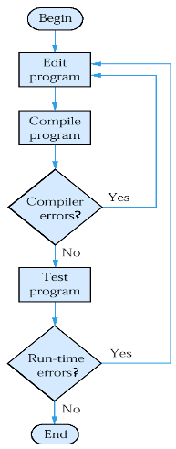
Java Programming Steps and Errors
Compile-time errors
  the compiler may find problems with syntax and other basic issues
  if compile-time errors exist, an executable version of the program is not created
Run-time errors
  a problem can occur during program execution, such as trying to divide by zero, which causes a program to terminate abnormally (crash)
Logical errors
  a program may run, but produce incorrect results

Slide 73
Programming in Java: IDE
Professional programmers typically use an Integrated Development Environment (IDE)
  Example IDEs: Eclipse, IntelliJ, DrJava, etc.
  An IDE usually presents the user with a space for text (like an editor) but layers additional features on top of the text for the user's benefit.
    Note: The underlying file contains pure text, just like a text editor.
  These features can be very useful and save time.
    Example features are GUI compile, GUI execution, code completion, and syntax highlighting.
  IDEs take more time to get started than a simple text editor, and we will arrange sessions to review how to use the Eclipse IDE
73
Notes:
73

Slide 74
Roadmap
any program you might want to write
objects
methods and classes
graphics, sound, and image I/O
arrays
conditionals and loops
math
text I/O
primitive data types
assignment statements

Slide 75
Reading and Practice Slides (Out of Class)

Slide 76
Questions
What is the output of the following println statements?
  System.out.println("\ta\tb\tc");
  System.out.println("\\\\");
  System.out.println("'");
  System.out.println("\"\"\"");
  System.out.println("C:\nin\the downward spiral");
Write a println statement to produce this output:
  / \ // \\ /// \\\

Slide 77
Answers
Output of each println statement:
  a b c
  \\
  '
  """
  C:
  in he downward spiral
println statement to produce the line of output:
  System.out.println("/ \\ // \\\\ /// \\\\\\");

Slide 78
Questions
What println statements will generate this output?
  This program prints a
  quote from the Gettysburg Address.
  "Four score and seven years ago,
  our 'fore fathers' brought forth on
  this continent a new nation."
What println statements will generate this output?
  A "quoted" String is
  'much' better if you learn
  the rules of "escape sequences."
  Also, "" represents an empty String.
  Don't forget: use \" instead of " !
  '' is not the same as "

Slide 79
Answers
println statements to generate the output:
  System.out.println("This program prints a");
  System.out.println("quote from the Gettysburg Address.");
  System.out.println();
  System.out.println("\"Four score and seven years ago,");
  System.out.println("our 'fore fathers' brought forth on");
  System.out.println("this continent a new nation.\"");
println statements to generate the output:
  System.out.println("A \"quoted\" String is");
  System.out.println("'much' better if you learn");
  System.out.println("the rules of \"escape sequences.\"");
  System.out.println();
  System.out.println("Also, \"\" represents an empty String.");
  System.out.println("Don't forget: use \\\" instead of \" !");
  System.out.println("'' is not the same as \"");

Slide 80
Questions
What println statements will generate this output?
  This quote is from
  Irish poet Oscar Wilde:
  "Music makes one feel so romantic
  - at least it always gets on one's nerves –
  which is the same thing nowadays."
What println statements will generate this output?
  A "quoted" String is
  'much' better if you learn
  the rules of "escape sequences."
  Also, "" represents an empty String.
  Don't forget: use \" instead of " !
  '' is not the same as "

Slide 81
Answers
println statements to generate the output:
  System.out.println("This quote is from");
  System.out.println("Irish poet Oscar Wilde:”);
  System.out.println();
  System.out.println("\"Music makes one feel so romantic");
  System.out.println("- at least it always gets on one's nerves -");
  System.out.println("which is the same thing nowadays.\"");
println statements to generate the output:
  System.out.println("A \"quoted\" String is");
  System.out.println("'much' better if you learn");
  System.out.println("the rules of \"escape sequences.\"");
  System.out.println();
  System.out.println("Also, \"\" represents an empty String.");
  System.out.println("Don't forget: use \\\" instead of \" !");
  System.out.println("'' is not the same as \"");

Slide 82
Syntax and Semantics
The syntax rules of a language define how we can put characters together to make a valid program
The semantics of a program define what a program does
  a program that is syntactically correct is not necessarily logically (semantically) correct
  This is similar in natural language, e.g.,
    “Yale University has no dining halls.”
    “Harvard can beat Yale.”
At the very beginning, the challenge is to resolve syntax issues; but quickly, we will focus on the semantics—let a program do what we want

Slide 83
Some Common Compile/Syntax Errors
A syntax/compile error: A problem in the structure of a program that causes the compiler to fail, e.g.,
  Missing semicolon
  Too many or too few { } braces
  Class and file names do not match
  …

Slide 84
Syntax Error: Example
1 public class Hello {
2 pooblic static void main(String[] args) {
3 System.owt.println("Hello, world!")_
4 }
5 }

Slide 85
Syntax Error: Example
1 public class Hello {
2 pooblic static void main(String[] args) {
3 System.owt.println("Hello, world!")_
4 }
5 }
Compiler output:
Hello.java:2: <identifier> expected
pooblic static void main(String[] args) {
^
Hello.java:3: ';' expected
}
^
2 errors
  The compiler shows the line number where it found the error.
  The error messages sometimes can be tough to understand:
    Why can’t the computer just say “You misspelled ‘public’”?
    Since the computer knows that a “;” is missing, can’t it just fix it??

Slide 86
End Outside Slides

Slide 87
Backup Slides

Slide 88
Assembly Languages
Assembly language or simply assembly is a human-readable notation for the machine language
it’s much easier to remember:
movl %al, 97
than
10110000 01100001
movl (%edx,%eax), %ecx
movl 12(%ebp), %eax
leal 0(,%eax,4), %edx
movl $nodes, %eax
movl (%edx,%eax), %eax
fldl (%ecx)
fsubl (%eax)
movl 8(%ebp), %eax
leal 0(,%eax,4), %edx
movl $nodes, %eax
movl (%edx,%eax), %ecx
movl 12(%ebp), %eax
leal 0(,%eax,4), %edx
movl $nodes, %eax
Example assembly code fragment

Slide 89
Some Major Types of High-Level Languages
Procedural languages: programs are a series of commands
  Pascal (1970): designed for education
  C (1972): low-level operating systems and device drivers
Functional programming: functions map inputs to outputs
  Lisp (1958) / Scheme (1975), ML (1973), Haskell (1990)
Object-oriented languages: programs use interacting "objects"
  Smalltalk (1980): first major object-oriented language
  C++ (1985): "object-oriented" improvements to C
    successful in industry; used to build major OSes such as Windows
  Java (1995): designed for embedded systems, web apps/servers
    Runs on many platforms (Windows, Mac, Linux, cell phones...)

