Slide 1
Introduction to Computational Thinking
Lecture #3:
Java Methods &
Primitive Data Types
Qiao Xiang, Qingyu Song
https://sngroup.org.cn/courses/ct-xmuf25/index.shtml
10/15/2025
This deck of slides are heavily based on cs112 at Yale University and cs101 at UCAS, respectively,
by courtesy of Dr. Y. Richard Yang and Dr. Zhiwei Xu.

Slide 2
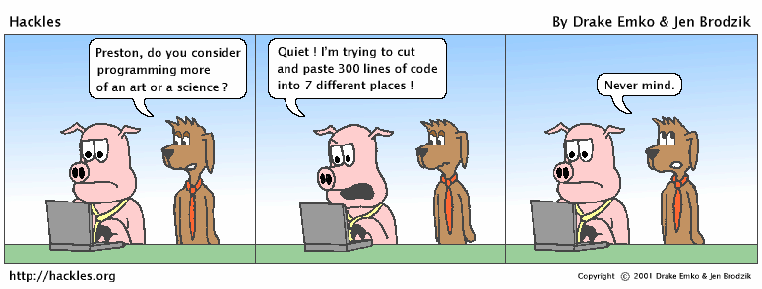

Slide 3
Outline
Admin.
Java methods

Slide 4
Admin
Practice Slides at the end of slides for Lecture 2
Office hours have been posted
PS1
You have 9 discretionary late days across the semester, but can use at most 3 days per PSET

Slide 5
Recap
What are digital symbol manipulations?
Data are digital symbols
Programs are digital symbols manipulation

Slide 6


Recap: Java Programming Steps
Programming in Java consists of three tasks
edit java source code (.java files)
compile java source code to generate bytecode (.class files)
execute/run/test bytecode using an interpreter
source code
byte code
compile
run
output

Slide 7
Recap: Top-Down Java Syntax Structure
A class:
has a name, defined in a file with same name Convention we follow: capitalize each English word
starts with {, and ends with }
includes a group of methods
public class <class name> {
public static void main(String[] args) {
<statement>;
<statement>;
...
<statement>;
}
}
A method:
has a name Convention we follow: lowercase first word, capital following
starts with {, and ends with }
includes a group of statements
statement:
a command to be executed
end with ;

Slide 8
Recap: The System.out.println Statement
Two ways to use the statement:
System.out.println(“string”);
You may need to use escape sequences in strings
System.out.println();
A related statement is System.out.print(“string”); It does not print a newline

Slide 9
Java Syntax: A Bottom-Up Look
Basic Java syntax units
white space and comments
identifiers (words)
symbols: { } “ ( ) < > [ ] ; = …
strings
numbers
// This is a one-line comment
public class Hello {
public static void main(String[] args) {
System.out.println("Hello, world!");
System.out.println();
System.out.println("This program produces");
System.out.println("four lines of output");
}
}

Slide 10
Java Syntax: A Bottom-Up Look
Basic Java syntax units
white space and comments
identifiers (words)
symbols: { } “ ( ) < > [ ] ; = …
strings
numbers
Java depends on the identifiers and symbols to understand your program
public class Hello {
public static void main(String[] args) {
System.out.println("Hello, world!");
System.out.println();
System.out.println("This program produces");
System.out.println("four lines of output");
}
}

Slide 11
Syntax Error: Example
1 public class Hello {
2 pooblic static void main(String[] args) {
3 System.owt.println("Hello, world!")_
4 }
5 }
Compiler output:
Hello.java:2: <identifier> expected
pooblic static void main(String[] args) {
^
Hello.java:3: ';' expected
}
^
2 errors
The compiler shows the line number where it found the error.
The error messages sometimes can be tough to understand:
Why can’t the computer just say “You misspelled ‘public’”?
Since the computer knows that a “;” is missing, can’t it just fix it??

Slide 12
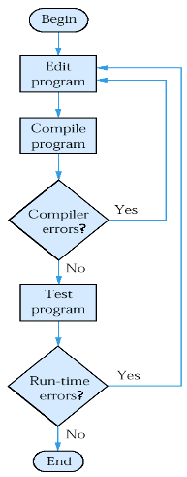
Java Programming Steps and Errors
Compile-time errors
the compiler may find problems with syntax and other basic issues
if compile-time errors exist, an executable version of the program is not created
Run-time errors
a problem can occur during program execution, such as trying to divide by zero, which causes a program to terminate abnormally (crash)
Logical errors
a program may run, but produce incorrect results

Slide 13
Roadmap
any program you might want to write
objects
methods and classes
graphics, sound, and image I/O
arrays
conditionals and loops
math
text I/O
primitive data types
assignment statements

Slide 14
Outline
Admin.
von Neumann Model: a Symbol Manipulation Platform
Java methods
Motivation: why methods?

Slide 15
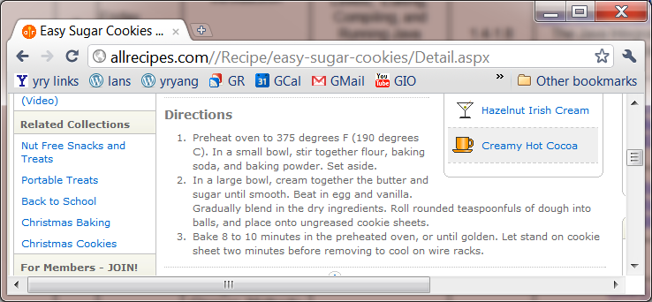
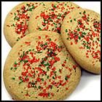
Algorithms
Algorithm: A list of steps for solving a problem.
An example algorithm (recipe): "Bake sugar cookies”

Slide 16
An Example Algorithm Spec: "Bake two batches of sugar cookies"
Preheat oven temperature to 375F.
Mix the dry ingredients.
Cream the butter and sugar.
Beat in the eggs.
Stir in the dry ingredients.
Set the timer for 8 min.
Place 1st batch of cookies to oven.
Allow the cookies to bake.
Set the timer for 8 min.
Place 2nd batch of cookies to oven.
Allow the cookies to bake.
Mix ingredients for frosting.
Spread frosting and sprinkles.
Readability of the specification?

Slide 17

Problem 1: Lack of Structure
Lack of structure: Many tiny steps; tough to remember.
A human being typically can only manage seven (plus or minus 2) pieces of information at one time
http://www.michaeljemery.com/nlp/your-conscious-minds-capacity-seven-plus-or-minus-two-chunks-of-information/

Slide 18
Problem 2: Redundancy
Redundancy: unnecessary repeat
Preheat oven temperature to 375F.
Mix the dry ingredients.
Cream the butter and sugar.
Beat in the eggs.
Stir in the dry ingredients.
Set the timer for 8 min.
Place the first batch of cookies into the oven.
Allow the cookies to bake.
Set the timer for 8 min.
Place the second batch of cookies into the oven.
Allow the cookies to bake.
Mix ingredients for frosting.
Spread frosting and sprinkles.

Slide 19
Fix: Structured Algorithms
Structured algorithm: Split into coherent tasks.
1 Preheat oven.
Set oven to 375 degrees
2 Make the cookie batter.
Mix the dry ingredients.
Cream the butter and sugar.
Beat in the eggs.
Stir in the dry ingredients.
3 Bake the cookies.
Set the timer for 8 min.
Place the cookies into the oven.
Allow the cookies to bake.
4 Decorate the cookies.
Mix the ingredients for the frosting.
Spread frosting and sprinkles onto the cookies.

Slide 20
Structured Algorithm?
// This program displays a delicious recipe for baking cookies.
public class BakeCookies2 {
public static void main(String[] args) {
// Step 1: preheat oven
System.out.println(“Preheat oven to 375F.");
// Step 2: Make the cookie batter.
System.out.println("Mix the dry ingredients.");
System.out.println("Cream the butter and sugar.");
System.out.println("Beat in the eggs.");
System.out.println("Stir in the dry ingredients.");
// Step 3a: Bake cookies (first batch).
System.out.println("Set the timer for 8 min.");
System.out.println("Place a batch of cookies into the oven.");
System.out.println("Allow the cookies to bake.");
// Step 3b: Bake cookies (second batch).
System.out.println("Set the timer for 8 min.");
System.out.println("Place a batch of cookies into the oven.");
System.out.println("Allow the cookies to bake.");
// Step 4: Decorate the cookies.
System.out.println("Mix ingredients for frosting.");
System.out.println("Spread frosting and sprinkles.");
}
}

Slide 21
Structured Algorithms
Structured algorithm provides abstraction (hide/ignore the right details at the right time)
1 Preheat oven.
Set oven to 375 degrees
2 Make the cookie batter.
Mix the dry ingredients.
Cream the butter and sugar.
Beat in the eggs.
Stir in the dry ingredients.
3 Bake the cookies.
Set the timer.
Place the cookies into the oven.
Allow the cookies to bake.
4 Decorate the cookies.
Mix the ingredients for the frosting.
Spread frosting and sprinkles onto the cookies.
Notes:
hide (or ignore) the right details at the right time

Slide 22
Structured Algorithms
Structured algorithm provides abstraction (hide/ignore the right details at the right time)
1 Preheat oven.
Set oven to 375 degrees
2 Make the cookie batter.
Mix the dry ingredients.
Cream the butter and sugar.
Beat in the eggs.
Stir in the dry ingredients.
3 Bake the cookies.
Set the timer.
Place the cookies into the oven.
Allow the cookies to bake.
4 Decorate the cookies.
Mix the ingredients for the frosting.
Spread frosting and sprinkles onto the cookies.
Notes:
hide (or ignore) the right details at the right time

Slide 23
Removing Redundancy
A well-structured algorithm can describe repeated tasks with less redundancy.
1 Preheat oven.
2 Make the cookie batter.
3a Bake the cookies (first batch).
3b Bake the cookies (second batch).
4 Decorate the cookies.

Slide 24
Outline
Admin.
Java methods
Motivation
Syntax: declaring method

Slide 25
Static Methods
Arrange statements into groups and give each group a name.
Each such named group of statements is a static method
Writing a static method is like adding a new command to Java.
class
method A
statement
statement
statement
method B
statement
statement
method C
statement
statement
statement

Slide 26
Declaring a Method
Gives your method a name so it can be referred to.
Syntax: public static void <name>() { <statement>; <statement>; ... <statement>; }
Example: public static void printWarning() { System.out.println("This product causes cancer"); System.out.println("in lab rats and humans."); }

Slide 27
Calling a Method
Executes the method's code
Syntax:
<name>();
You can call the same method many times if you like.
Example:
printWarning();
Output:
This product causes cancer
in lab rats and humans.

Slide 28
Example
public class FreshPrince {
public static void main(String[] args) {
rap(); // Calling (running) the rap method
System.out.println();
rap(); // Calling the rap method again
}
// This method prints the lyrics to my favorite song.
public static void rap() {
System.out.println("Now this is the story all about how");
System.out.println("My life got flipped turned upside-down");
}
}

Slide 29
Example
public class FreshPrince {
public static void main(String[] args) {
rap(); // Calling (running) the rap method
System.out.println();
rap(); // Calling the rap method again
}
// This method prints the lyrics to my favorite song.
public static void rap() {
System.out.println("Now this is the story all about how");
System.out.println("My life got flipped turned upside-down");
}
}
Output:
Now this is the story all about how
My life got flipped turned upside-down
Now this is the story all about how
My life got flipped turned upside-down

Slide 30
Final Cookie Program
// This program displays a delicious recipe for baking cookies.
public class BakeCookies3 {
public static void main(String[] args) {
preheatOven();
makeBatter();
bake(); // 1st batch
bake(); // 2nd batch
decorate();
}
// Step 1: Preheat oven
public static void preheatOven() {
System.out.println(“Preheat Oven to 375F.");
}
// Step 2: Make the cake batter.
public static void makeBatter() {
System.out.println("Mix the dry ingredients.");
System.out.println("Cream the butter and sugar.");
System.out.println("Beat in the eggs.");
System.out.println("Stir in the dry ingredients.");
}
// Step 3: Bake a batch of cookies.
public static void bake() {
System.out.println("Set the timer for 8 min.");
System.out.println("Place a batch of cookies into the oven.");
System.out.println("Allow the cookies to bake.");
}
// Step 4: Decorate the cookies.
public static void decorate() {
System.out.println("Mix ingredients for frosting.");
System.out.println("Spread frosting and sprinkles.");
}
}

Slide 31
Examples: Modifying BakeCookies
Bake three batches
Change timer from 8 to 10 min

Slide 32
Summary: Why Methods?
Capture structure of the program
main should be a good summary of the program
public static void main(String[] args) {
}
public static void main(String[] args) {
}
public static ... (...) {
}
public static ... (...) {
}
Notes:
Longer code does not mean worse code.

Slide 33
Summary: Why Methods?
Eliminate redundancy
public static void main(String[] args) {
}
public static void main(String[] args) {
}
public static ... (...) {
}

Slide 34
Outline
Admin.
Java methods
Motivations
Syntax: declaring method
Method control flow

Slide 35
Method Calling Flow
When a method A calls another method B, the program's execution...
"jumps" into method B, executing its statements, then
"jumps" back to method A at the point where the method was called.

Slide 36
Methods Calling Methods
public class MethodsExample {
public static void main(String[] args) {
message1();
message2();
System.out.println("Done with main.");
}
public static void message1() {
System.out.println("This is message1.");
}
public static void message2() {
System.out.println("This is message2.");
message1();
System.out.println("Done with message2.");
}
}

Slide 37
Methods Calling Methods
public class MethodsExample {
public static void main(String[] args) {
message1();
message2();
System.out.println("Done with main.");
}
public static void message1() {
System.out.println("This is message1.");
}
public static void message2() {
System.out.println("This is message2.");
message1();
System.out.println("Done with message2.");
}
}
Output:
This is message1.
This is message2.
This is message1.
Done with message2.
Done with main.

Slide 38
Methods Calling Methods
public class MethodsExample {
public static void main(String[] args) {
message1();
message2();
System.out.println("Done with main.");
}
...
}
public static void message1() {
System.out.println("This is message1.");
}
public static void message2() {
System.out.println("This is message2.");
message1();
System.out.println("Done with message2.");
}
public static void message1() {
System.out.println("This is message1.");
}

Slide 39
Methods Calling Methods
Example: What is the output of Lullaby?

Slide 40
Outline
Admin. and recap
Java methods
Why methods?
Syntax: declaring method
Method control flow
Designing methods

Slide 41
Example
Write a program to print these figures using methods.
______
/ \
/ \
\ /
\______/
\ /
\______/
+--------+
______
/ \
/ \
| STOP |
\ /
\______/
______
/ \
/ \
+--------+

Slide 42
Program version 1
public class Figures1 {
public static void main(String[] args) {
System.out.println(" ______");
System.out.println(" / \\");
System.out.println("/ \\");
System.out.println("\\ /");
System.out.println(" \\______/");
System.out.println();
System.out.println("\\ /");
System.out.println(" \\______/");
System.out.println("+--------+");
System.out.println();
System.out.println(" ______");
System.out.println(" / \\");
System.out.println("/ \\");
System.out.println("| STOP |");
System.out.println("\\ /");
System.out.println(" \\______/");
System.out.println();
System.out.println(" ______");
System.out.println(" / \\");
System.out.println("/ \\");
System.out.println("+--------+");
}
}
The code does not reflect structure.
It has redundancy.

Slide 43
Method Design Techniques
A basic approach of designing methods, with consideration of structure and removing redundancy, is called top-down decomposition
dividing a problem into sub problems to be solved using methods

Slide 44
Top-Down Decomposition
______
/ \
/ \
\ /
\______/
\ /
\______/
+--------+
______
/ \
/ \
| STOP |
\ /
\______/
______
/ \
/ \
+--------+
main
egg
teaCup
stopSign
hat

Slide 45
Top-Down Decomposition (egg)
______
/ \
/ \
\ /
\______/
\ /
\______/
+--------+
______
/ \
/ \
| STOP |
\ /
\______/
______
/ \
/ \
+--------+
main
egg
teaCup
stopSign
hat
eggTop
eggBottom

Slide 46
Top-Down Decomposition (teaCup)
______
/ \
/ \
\ /
\______/
\ /
\______/
+--------+
______
/ \
/ \
| STOP |
\ /
\______/
______
/ \
/ \
+--------+
main
egg
teaCup
stopSign
hat
eggTop
eggBottom
line

Slide 47
Top-Down Decomposition (stopSign)
______
/ \
/ \
\ /
\______/
\ /
\______/
+--------+
______
/ \
/ \
| STOP |
\ /
\______/
______
/ \
/ \
+--------+
main
egg
teaCup
stopSign
hat
eggTop
eggBottom
line
stopLine

Slide 48
Top-Down Decomposition (hat)
______
/ \
/ \
\ /
\______/
\ /
\______/
+--------+
______
/ \
/ \
| STOP |
\ /
\______/
______
/ \
/ \
+--------+
main
egg
teaCup
stopSign
hat
eggTop
eggBottom
line
stopLine
Q: What is a good order to implement/test the methods?

Slide 49
Structured Program version
// Prints several figures, with methods
// for structure and redundancy.
public class Figures3 {
public static void main(String[] args) {
egg();
teaCup();
stopSign();
hat();
}
// Draws the top half of an an egg figure.
public static void eggTop() {
System.out.println(" ______");
System.out.println(" / \\");
System.out.println("/ \\");
}
// Draws the bottom half of an egg figure.
public static void eggBottom() {
System.out.println("\\ /");
System.out.println(" \\______/");
}
// Draws a complete egg figure.
public static void egg() {
eggTop();
eggBottom();
System.out.println();
}
...

Slide 50
Program version 3, cont'd.
...
// Draws a line of dashes.
public static void line() {
System.out.println("+--------+");
}
// Draws a teacup figure.
public static void teaCup() {
eggBottom();
line();
System.out.println();
}
// Draws a stop sign figure.
public static void stopSign() {
eggTop();
System.out.println("| STOP |");
eggBottom();
System.out.println();
}
// Draws a figure that looks sort of like a hat.
public static void hat() {
eggTop();
line();
}
}

Slide 51
A Word about Style
Structure your code properly
Eliminate redundant code
Use comments to describe code behavior
Use spaces judiciously and consistently
Indent properly
Follow the naming conventions

Slide 52
Why Style?
Programmers build on top of other’s code all the time.
You shouldn’t waste time deciphering what a method does.
You should spend time on thinking or coding. You should NOT be wasting time looking for that missing closing brace.
So code with style!

Slide 53

Foundational Programming Concepts
any program you might want to write
objects
methods and classes
graphics, sound, and image I/O
arrays
conditionals and loops
Math
text I/O
primitive data types
assignment statements

Slide 54
Outline
Admin and recap
Java methods
Primitive data types
why data types

Slide 55
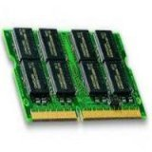
Memory
Primary storage area for programs and data
Also called RAM
RAM is divided into many cells; each cell can be identified by a numeric address
Main
Memory
Each memory cell has a set number of bits (usually 8 bits, or one byte); a bit can represent 2 values of 0 or 1)
9278
9279
9280
9281
9282
9283
9284
9285
9286
00110000
- how many possible values can a byte represent?
A computer can use multiple cells ( e.g., 2 bytes) to store a value
- how many possible values can 2 bytes represent?
Notes:
http://www.ascii-code.com/

Slide 56
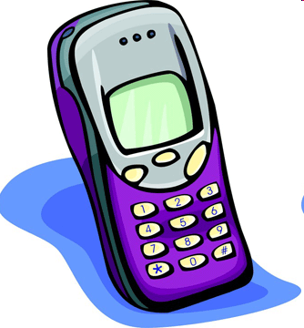
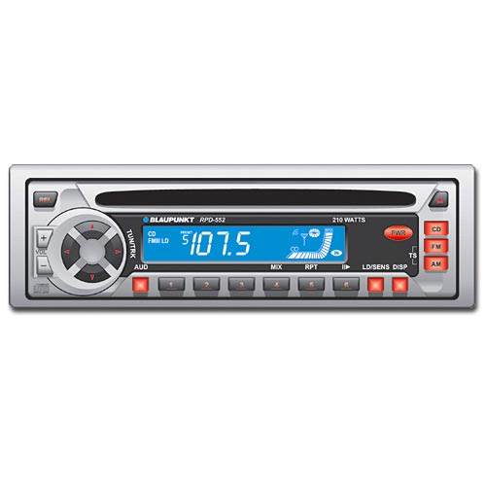
Variable
RAM is divided into many cells; each cell can be identified by a numeric address
In high-level programming, instead of a numerical address, you can refer to a memory location by a name, say x. This is called a variable.
9278
9279
9280
9281
9282
9283
9284
9285
9286
00110000
Notes:
http://www.ascii-code.com/

Slide 57
Problem
Main
Memory
What does the number (combination) stored at a given memory location represent?
00110000

Slide 58
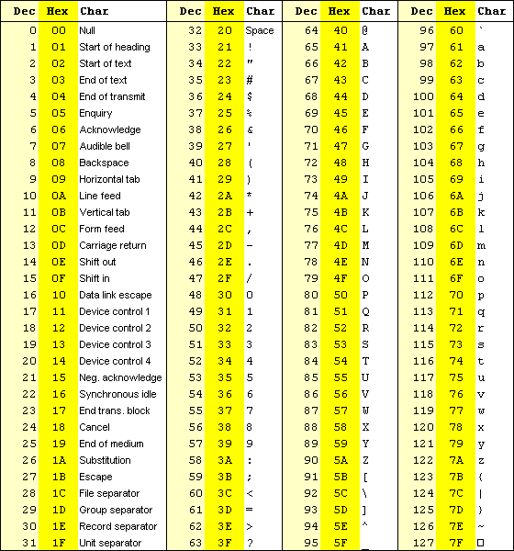
Two Example Possibilities
Main
Memory
00110000 → number 48
00110000 → character ‘0‘
Problem: How can the computer tell what 00110000 stands for: a character 0 or num 48?
00110000

Slide 59
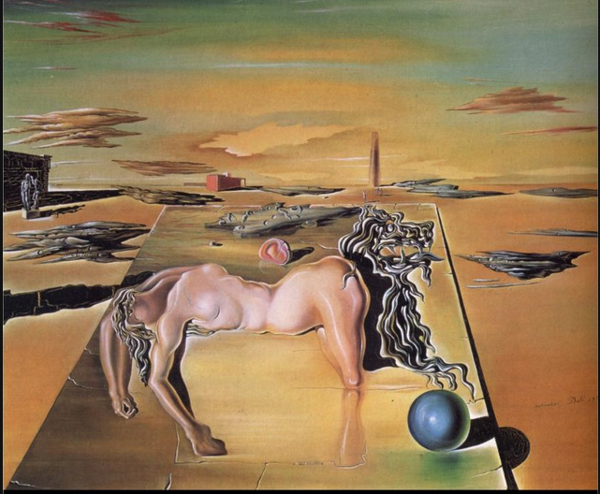
http://www.wikipaintings.org/en/salvador-dali/invisible-sleeping-woman-horse-lion-1930

Slide 60
Type System
Main
Memory
type: A category or set of values and operations defined on those values.
By specifying the type of a memory location, we know what the values represent
Many languages ask the programmer to specify types
Examples: integer, real number, character
0110100

Slide 61
Variable and Type
Variable: A piece of the computer's memory that is given a name and a type to store value of the type.
Steps for using a variable:
Declare it - state its name and type
Assign value - initialize or update its value
Use it - print it or use it as part of an expression
Notes:
61

Slide 62
Primitive Data Types
There are eight (simple) primitive data types in Java
six numerical types (e.g., int, double)
for mathematical calculation
characters
for text processing
Boolean (logical) values
for decision making
Notes:
We're basically going to manipulate letters and numbers.

Slide 63
Declaration
Variable declaration: Sets aside memory for storing a value.
Variables must be declared before they can be used.
Syntax:
<type> <name>;
int x;
double myGPA;
x
myGPA

Slide 64
Assignment
x | 3
myGPA | 3.25
A variable can only store a value of its own type.
Assignment: Stores a value into a variable.
The value can be an expression; the variable stores its result.
Syntax:
<name> = <expression>;
int x; x = 3;
double myGPA; myGPA = 1.0 + 2.25;

Slide 65
Outline
Admin and recap
Java methods
Primitive data types
why data types?
storage and representation

Slide 66
Numeric Primitive Data Types
numbers
integer numbers
real (floating) numbers
byte
short
int
long
float
double
The differences among the various numeric primitive types are their storage sizes and representation format, and hence the ranges & precision of the values they can store
Notes:
Why does Java separate int and double? Why not use one combined type called number?
We make the integer / real number distinction in English as well. We don't ask, "How many do you weigh?" or, "How much sisters do you have?”
Part of the int/double split is related to how a computer processor crunches numbers. A CPU does integer computations and a Floating Point Unit (FPU) does real number computations.

Slide 67
Integer Numeric Data Types
Different integer numeric data types have different ranges and precision
Type
byte
short
int
long
Storage
1 byte
2 bytes
4 bytes
8 bytes
Min Value
-128
-32,768
-2,147,483,648
< -9 x 10¹⁸
Max Value
127
32,767
2,147,483,647
> 9 x 10¹⁸
numbers with no fractional part

Slide 68
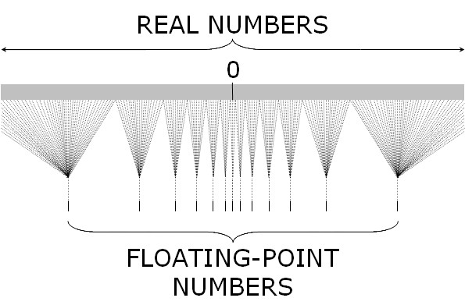
Real Numeric Data Types
Question: can computer store all real numbers in a range?
Represented using the IEEE 754 format
with limited # of precision bits
See Precision.java
Notes:
The output is 0.30000000000000004!

Slide 69
All Numeric Data Types
Different integer numeric data types have different ranges and precision
Type
byte
short
int
long
float
double
Storage
1 byte
2 bytes
4 bytes
8 bytes
4 bytes
8 bytes
Min Value
-128
-32,768
-2,147,483,648
< -9 x 10¹⁸
+/- 3.4 x 10³⁸ with 7 significant digits
+/- 1.7 x 10³⁰⁸ with 15 significant digits
Max Value
127
32,767
2,147,483,647
> 9 x 10¹⁸
numbers with no fractional part
IEEE 754 format

Slide 70
Java Numerical Value and Type
Java is a strongly typed language, i.e., every data item has a type
An integer literal is by default of type int
that is, a literal number 4 in Java is of type int
to say that the number 4 is of type long, write 4l or 4L (4L is preferred over 4l since lower case “l” is hard to distinguish from 1)
A real (floating point) literal (e.g., -1.23 6.12e23) is by default of type double
to say that the number 0.1 is of type float, write 0.1f or 0.1F
Notes:
e.g., we want miles / gallons to be treated as floating point
int miles;
int gallons;
System.out.print( miles / gallons );
e.g., total number of classes you taken, and the total grade points; when compute GPA we need division

Slide 71
Questions
byte; short; int; long; float; double
Question: to represent the number of students at Xiamen University, which numeric data type variable do you use?
Question: to represent the world population, which numeric data type variable do you use?
Question: to represent your GPA, which numeric data type variable do you use?
Question: to represent a person’s height in meters, which numeric data type variable do you use?
Question: to represent pi as 3.14159265359, which numeric data type variable do you use?

Slide 72
Real Life Example: Ariane 5
Historical example: Ariane 5 explosion in 1996 (http://www.youtube.com/watch?v=kYUrqdUyEpI; http://www.ima.umn.edu/~arnold/disasters/ariane.html)

Slide 73


Real Life Example: Ariane 5
Historical example: Ariane 5 explosion in 1996 (http://www.youtube.com/watch?v=kYUrqdUyEpI; http://www.ima.umn.edu/~arnold/disasters/ariane.html)

Slide 74
Real Life Example: Ariane 5
Historical example: Ariane 5 explosion in 1996 (http://www.youtube.com/watch?v=kYUrqdUyEpI; http://www.ima.umn.edu/~arnold/disasters/ariane.html)
Reason: range error
trying to store a 64-bit real number (a double) to a 16-bit integer led to the crash

Slide 75
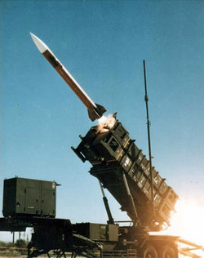
Real Life Example: Patriot Failure
The Patriot Missile Failure in 1991
Perfect detection of a Scud missile, but the intercepting Patriot missed the target
Reason: precision error
a computer cannot represent 0.1 precisely; for a 24-bit floating point number they used, it is off by 0.000000095.
After 100 hours in operation, it is off by 0.34 seconds (=0.000000095*100 hours * 60 min/hour * 60 sec/min * 10), leading to an error of about 600 meters (http://www.ima.umn.edu/~arnold/disasters/patriot.html)
Notes:
Off by about 0.34 seconds, leading to an error of 600 meters for the detected Scud missile.

Slide 76

In the Movie
http://www.youtube.com/watch?v=G_wiXgRWrIU
Notes:
e.g., we want miles / gallons to be treated as floating point
int miles;
int gallons;
System.out.print( miles / gallons );
e.g., total number of classes you taken, and the total grade points; when compute GPA we need division

Slide 77
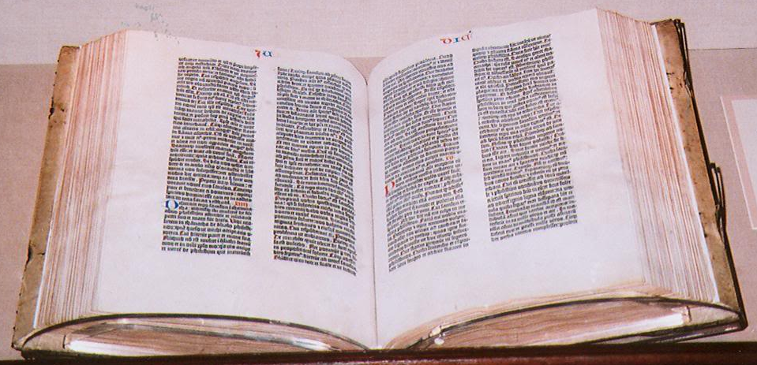
Characters
A char is a single character from a character set
A character set is an ordered list of characters; each character is given a unique number
Character literals are represented in a program by delimiting with single quotes:
’a’ ’X’ '7' ’$’ ',' '\n'

Slide 78
Java Character Set
Java uses the Unicode character set, a superset of ASCII
uses sixteen bits (2 bytes) per character, allowing for 65,536 unique characters
it is an international character set, containing symbols and characters from many languages
code chart can be found at:
http://www.unicode.org/charts/

Slide 79
Boolean
A boolean value represents logical value: true or false
The keywords true and false are the only valid values for a boolean type
A boolean can also be used to represent any two states, such as a light bulb being on or off

Slide 80
Outline
Admin and recap
Java Methods
Primitive data types
why data types?
storage and representation
operations

Slide 81
Data Type and Operations
A type defines not only the storage/representation but also the allowed and meaning (semantics) of operations
Discussions: reasonable operations that can be performed on two operands
Integers: i1 ? i2
Strings: s1 ? s2
Characters: c1 ? c2

Slide 82
Data Type and Operations
type
set of values
literal values
operations
char
characters
'A'
'@'
compare (more details later on +-)
String
sequences of characters
"Hello"
”112 is fun"
concatenate +
int
integers
17
12345
compare add +, sub -, multiply *, divide /, modulus %
double
floating-point numbers
3.1415
6.022e23
compare add +, sub -, multiply *, divide /, modulus %
boolean
truth values
true
false
==, !=, and &&, or ||, not !

Slide 83
Data Type and Operations
Most operations (+, -, *, /) are intuitive and similar to our daily-life use
Perhaps a first major surprise in learning programming is that the result of an operation depends on the data type
3 + 5 v.s. “3” + “5”
3 / 5 v.s. 3.0 / 5.0
See TypeDep.java

Slide 84
Interpretation
You should think that there are multiple versions of the same operator, each for a type, e.g.,
+int +string …
/int /double …

Slide 85
Integer Division with /
6
0
1
When we divide integers, the result is an integer (the fractional part is discarded)
14 / 4 is 3, not 3.5
3 4
4 ) 14 10 ) 45
12 40
2 5
More examples:
32 / 5 is
8 / 10 is
156 / 100 is
Dividing by 0 causes an error when your program runs.

Slide 86
Integer Remainder with %
The % operator computes the remainder from integer division.
14 % 4 is 2
218 % 5 is 3 3 43 4 ) 14 5 ) 218 12 20 2 18 15 3
Practice (offline):
45 % 6
2 % 2
8 % 20
11 % 0
Obtain last digit of a number:
230857 % 10 is 7
Obtain last 4 digits:
230857 % 10000 is 857
See whether a number is odd:
7 % 2 is 1, 42 % 2 is 0
Notes:
86
What is 8 % 20? It's 8, but students often say 0.

Slide 87
Outline
Admin and recap
Primitive data types
why data types?
storage and representation
operations
expressions

Slide 88
Evaluating Arithmetic Expression
Arithmetic operators can be combined into complex arithmetic expressions
(7 + 2) * 6 / 3
The evaluation order of the operators in an arithmetic expression is determined by a well-defined precedence order
Remember?
Pretty Please My Dear Aunt Sally

Slide 89
Operator Precedence Rules
Generally operators evaluate left-to-right. 1 - 2 - 3 is (1 - 2) - 3 which is -4
But * / % have a higher level of precedence than + - 1 - 3 * 4 is -11
Parentheses can force a certain order of evaluation: (1 + 3) * 4 is 16
Spacing does not affect order of evaluation 1+3 * 4-2 is 11

