Slide 1
Introduction to Computational Thinking
Lecture #5:
Java Graphics
Qiao Xiang, Qingyu Song
https://sngroup.org.cn/courses/ct-xmuf25/index.shtml
10/29/2025
This deck of slides are heavily based on cs112 at Yale University and cs101 at UCAS, respectively,
by courtesy of Dr. Y. Richard Yang and Dr. Zhiwei Xu.

Slide 2
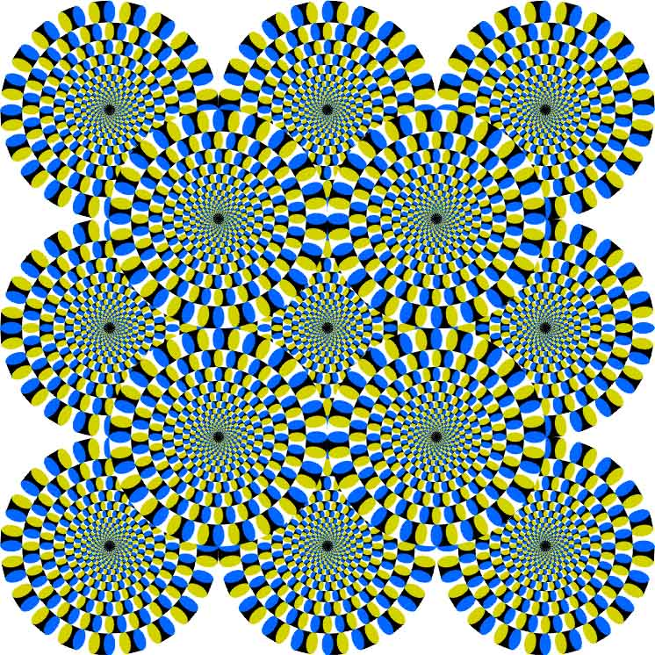

Slide 3
Outline
Admin and recap
Java graphics (StdDraw)
Parameterized graphics methods and loops

Slide 4
Recap: DrawX
1. Bound
== , 2S – 4 spaces, ==
2. for line = 1 to S -1
line spaces
\
2 S – 2 – 2 * line spaces
/
3. for line = 1 to S – 1
S – line spaces
/
(line – 1) * 2 spaces
\
4. Bound
== ==
1 \ /
2 \ /
3 \/
1 /\
2 / \
3 / \
== ==

Slide 5
Recap: Identify Subtasks (Methods)
1. Bound
== , 2S – 4 spaces, ==
2. for line = 1 to S -1
line spaces
\
2 S – 2 – 2 * line spaces
/
3. for line = 1 to S – 1
S – line spaces
/
(line – 1) * 2 spaces
\
4. Bound
main
bound
drawV
drawUV
bound
spaces
Drawing spaces is a reusable function, but need parameter to be reusable.

Slide 6
Method w/ Parameters
Why: Redundancy removal/abstraction through generalization
General: a method can accept multiple parameters. (separate by , )
When calling it, you must pass values for each parameter.
Declaration:
public static void <name>(<type> <name>, ..., <type> <name>) {
<statement>(s);
}
Call:
<name>(<exp>, <exp>, ..., <exp>);

Slide 7
Multiple Parameters Example
public static void main(String[] args) {
printNumber(4, 9);
printNumber(17, 6);
printNumber(8, 0);
printNumber(0, 8);
}
public static void printNumber(int number, int count) {
for (int i = 1; i <= count; i++) {
System.out.print(number);
}
System.out.println();
}
Output:
444444444
171717171717
00000000

Slide 8
Multiple Parameter Invocation
Corresponding actual argument in the invocation is copied into the corresponding formal argument
printNumber(1+3, 1+1);
public static void printNumber(int number, int count)
{
for (int i = 1; i <= count; i++) {
System.out.print(number);
}
System.out.println();
}
// equiv: number = 4; count = 2;

Slide 9
Exercise
Define displayChars to display a char ch count times
Implement spaces by calling displayChars

Slide 10
Foundational Programming Concepts
any program you might want to write
objects
methods and classes
graphics, sound, and image I/O
arrays
conditionals and loops
math
text I/O
primitive data types
assignment statements

Slide 11
Java Graphics
Java provides a large number of methods for graphics
A graphical method may need to use a large number of parameters
E.g., draw a line: line color, stroke width, stoke pattern, init pos, end pos
To avoid specifying a large of parameters in each method call, Java native graphics uses an object-oriented design: state parameters are contained (encapsulated) in entities called objects
We will cover objects in more details later

Slide 12
Java Graphics Wrapper Classes
To simplify the usage of Java native graphics, wrapper graphics classes are provided
Back to Basics Textbook: defines class DrawingPanel, which is still an object-oriented design
Sedgewick & Wayne book: avoids objects, by defining a class called StdDraw, which contains many static (non-object-oriented) graphics methods:
http://introcs.cs.princeton.edu/java/stdlib/javadoc/StdDraw.html
To access a static method defined in a class, use <class-name>.<method-name>(…), for example,
StdDraw.line (0, 0, 10, 10);
DrawingPanel and StdDraw are good examples that method designers may differ substantially in their designs, although for very similar functions

Slide 13
DrawingPanel Design (Back to Basics Textbook)
Coordinate system
Each (x, y) position is pixel ("picture element") position
Position (0, 0) is at the window's top-left corner.
x increases rightward and the y increases downward.
Example method rectangle:
DrawingPanel: rect (int x0, int y0, int width, int height),
e.g., rect(0, 0, 200, 100)
(0, 0)
x+
(200, 100)
y+

Slide 14
StdDraw (The One we will use)
Coordinate system
You still set canvas size using numbers of pixels: setCanvasSize(int w, int h)
But (x, y) position is the coordinate in a normalized coordinate system
[0, 1] as default
setXScale(double x0, double x1) to set x range
setYScale(double y0, double y1)
Position (0, 0) is at the window's lower-left corner.
x increases rightward and the y increases upward.
Example method rectangle:
rectangle(double cx, double cy, double halfWidth, double halfHeight);
y+
(200, 100)
(0, 0)
x+
StdDraw.setCanvasSize(500, 500);
StdDraw.setXScale(0, 500);
StdDraw.setYScale(0, 500);
StdDraw.rectangle(100, 450, 100, 50);

Slide 15
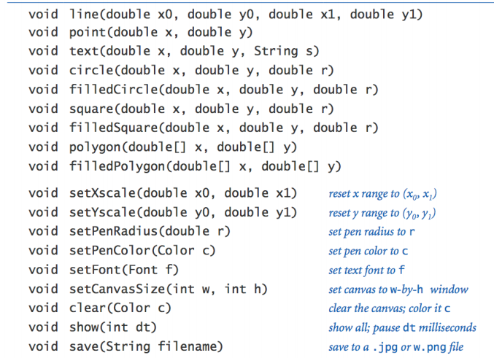
Example StdDraw Methods
Complete list at: helpdoc/doc_StdDraw/

Slide 16
Example: StdDraw X
Implement SimpleStdDrawX.java to draw an X using StdDraw
Try two approaches:
Use the normalized coordinate system (0,0) -> (1,1)
Set the Xscale and and Yscale

Slide 17
Example: StdDraw Loops
You may use loop (nested loop) to produce more “complex” patterns.
See SimpleStdDrawLoop.java and predict its display

Slide 18
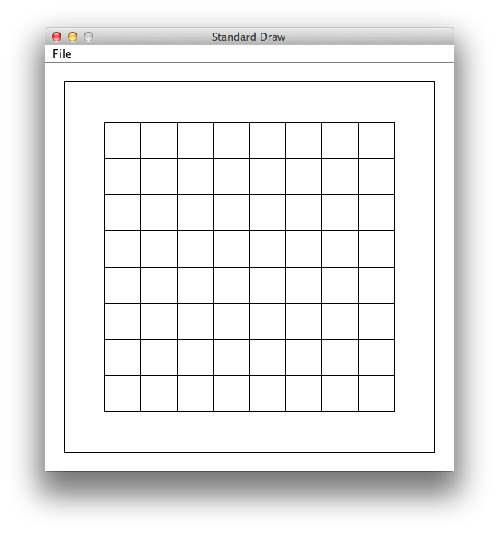
Example: Draw using Loops

Slide 19
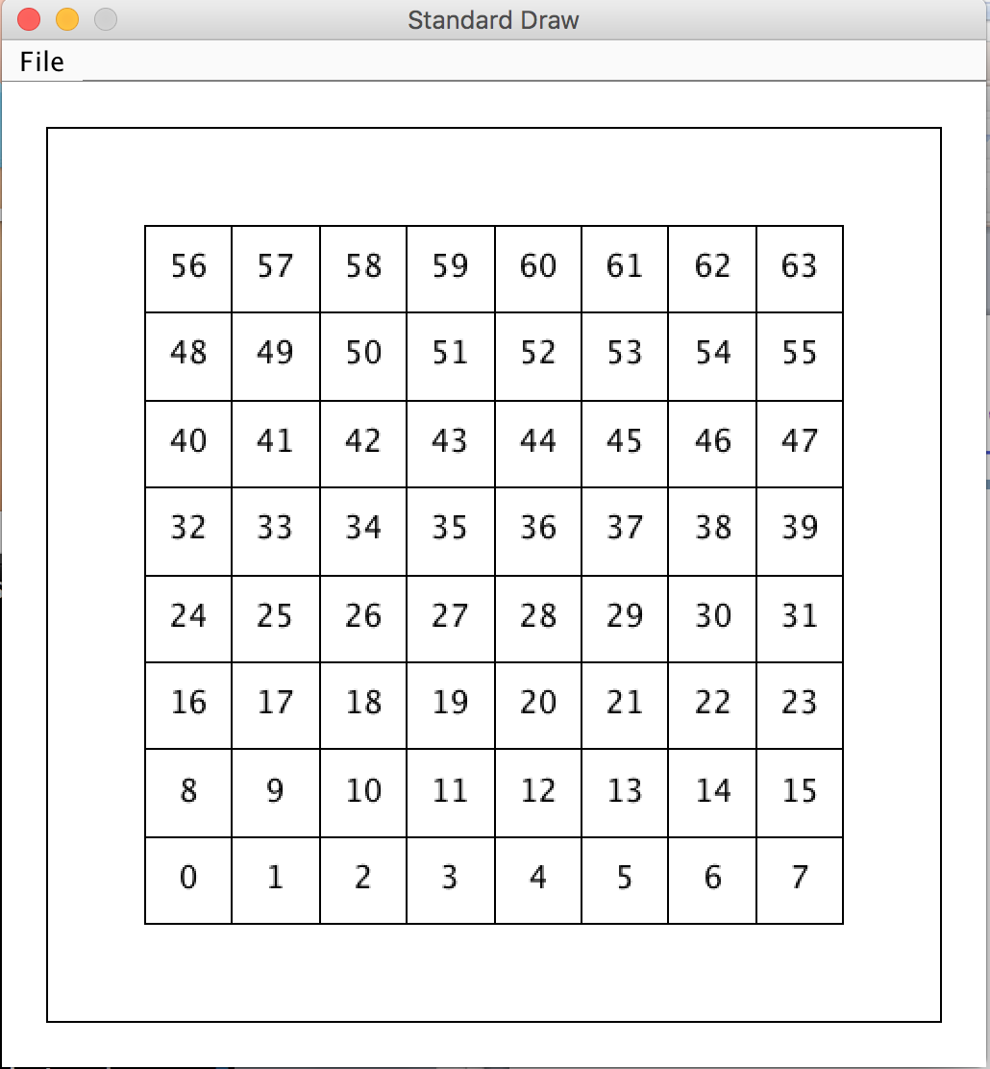
Example: Modify SimpleStdDrawLoop to Label a Number for each Cell

Slide 20
Outline
Admin and recap
Java graphics
Coordinate system and basic shape
Drawing w/ color

Slide 21
Example: Draw with Color
What if we want to draw the X in red?
StdDraw has two methods to set pen color
StdDraw.setPenColor(R, G, B);
StdDraw.setPenColor(Color);
predefined class constants defined in the Color class

Slide 22
Exercise: SimpleStdDrawXColor
Modify SimpleStdDrawX to use setPenColor(R, G, B) to draw the lines red

Slide 23
Class Constants
class constant: A static class variable with a fixed value
value can be set only at declaration; cannot be reassigned
Syntax:
public static final type name = value; // in class scope
name is usually in ALL_UPPER_CASE
Examples:
public static final int DAYS_IN_WEEK = 7;
public static final double INTEREST_RATE = 3.5;
public static final int SSN = 658234569;

Slide 24

Color
Java predefines many class constants in the Color class:
Color.CONSTANT_NAME
where CONSTANT_NAME is one of:
BLACK, BLUE, CYAN, DARK_GRAY, GRAY, GREEN, LIGHT_GRAY, MAGENTA, ORANGE, PINK, RED, WHITE, YELLOW
http://download.oracle.com/javase/8/docs/api/java/awt/Color.html

Slide 25
Complexity of Using the Color Class: Class Library
The Color class is part of Java standard class library
A class library is a collection of classes that one can use when developing programs
libraries are not part of the Java language per se, but using them is essential to achieve productive programming
A big advantage of Java is that it provides a quite large standard class library

Slide 26
Library and Packages
The classes in a library are organized into packages
think of packages as folders, which help you to get organized
Some of the packages in the standard class library are:
Color belongs to a package named java.awt
Package
java.lang
java.applet
java.awt
javax.swing
java.net
java.util
java.text
Purpose
General support, e.g., Math, String, System
Creating applets for the web
Graphics and graphical user interfaces
Additional graphics capabilities and components
Network communication
Utilities
Text processing
http://download.oracle.com/javase/7/docs/api/

Slide 27
The import Declaration
When you want to use a class from a package, you could use its fully qualified class name, e.g., java.awt.Color color;
Or you can import the class, then just use the class name // put this at the very top of your program import java.awt.Color;
To import all classes in a particular package, you can use the * wildcard character
// put this at the very top of your program
import java.awt.*;

Slide 28
Example: Using Colors
Pass a Color to StdDraw's setPenColor method
Subsequent shapes will be drawn in the new color. import java.awt.Color;
StdDraw.setPenColor(Color.BLUE);
StdDraw.line(20, 0, 10, 30);
StdDraw.setPenColor(Color.RED);
StdDraw.line(20, 0, 10, 30);

Slide 29
Exercise: SimpleStdDrawX
Modify SimpleStdDrawX to draw the lines red using Color.RED

Slide 30
Outline
Admin and recap
Java graphics
Coordinate system and basic shape
Drawing w/ color
Parameterized drawing examples

Slide 31
Exercise: Parameterized Drawing
Write method drawCar(x0, y0, size):
Center: (x0 + 0.5 size, y0 + 0.25 size)
Size: 0.5 size, .25 size
size=100
30
50
20
Center: (x0 + (1.00-.30/2) size, y0+.50/2 size)
Size: .15 size, .10 size
15
(x0, y0)
r=10
Center: (x0 + (.15 + .10) size, y0)
Radius: .10 size
Center: (x0 + (1.00-.15-.10) size, y0)
Radius: .10 size
Car.java

Slide 32
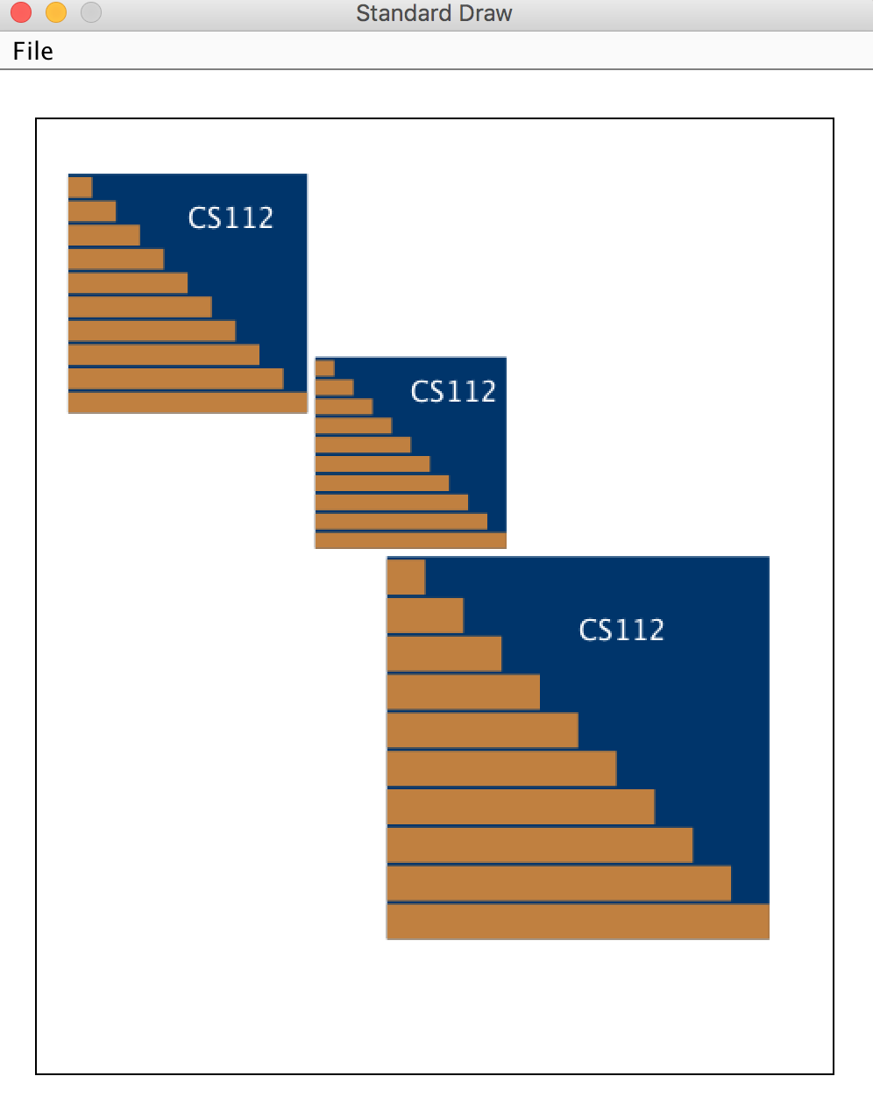
Exercise: Book Cover (Color and Loop)
White 500x600 drawing panel
Three components at
(20, 415), (165, 330), (220, 85) with sizes 150, 120, and 240
Each component
XMU blue background
white “CT-F25" text left @ 1/2 horizontal, 4/5 vertical
10 brown (red=192, green=128, blue=64) “bricks”
2 pixel between two adjacent bricks
BookCover.java

Slide 33
Outline
Admin and recap
Animations

Slide 34
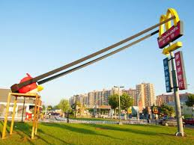
Question: Car Launch
Two cars launching from different heights, at diff speed, compute their positions in the initial 10 sec.
Car 1: One World Trade Center * initial height: 541 m * speed (210 km/h), with horizontal speed: 50 m/sec vertical speed: 30 m/sec
Car 2: Empire State * initial height: 381 m * speed (114 km/h), with horizontal speed: 30 m/sec vertical speed: 10 m/sec

Slide 35
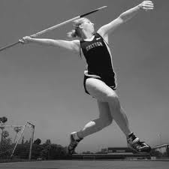
Background: Physics
In physics, for each dimension (x or y), given initial velocity v₀ in m/s, acceleration a in m/s², and elapsed time t in s
the speed of the moving body at time t:
V = v0 + a t
The displacement of the moving body at time t:
Displacement = v₀ t + ½ a t ²
The position of the moving body at time t:
Pos = initial position + displacement

Slide 36
Position
p₀ + v₀ t + ½ a t²
Horizontal (x):
v_{x0} * t
Vertical (y):
g ≅ 9.81 m/s², downward
h₀ + v_{y0} t - ½ g t ²

Slide 37
CarLaunch: Initial Version
// You must have StdAudio.java and race-car.wav in the
// same directory and first compile StdAudio.java.
StdAudio.loop("race-car.wav");
// set up the initial state of the two cars
int h1 = 541, v1x = 50, v1y = 30;
int h2 = 381, v2x = 30, v2y = 10;
// Simulate time from 0 to 10 sec.
for (double t = 0; t < 10; t += 0.1) {
// Compute car 1's position
double x1 = v1x * t;
double y1 = h1 + v1y * t - 0.5 * 9.81 * t * t;
// Compute car 2's position
double x2 = v2x * t;
double y2 = h2 + v2y * t - 0.5 * 9.81 * t * t;
// Use the method defined in Car.java
StdDraw.picture(x1, y1, "angry-bird-b.png”);
Car.drawCar(x2, y2, CAR2_SIZE);
} // end of for
You can use StdAudio to add sound
One can mix param. drawing and fixed image file

Slide 38
CarLaunch: No Trace
// You must have StdAudio.java and race-car.wav in the
// same directory and first compile StdAudio.java.
StdAudio.loop("race-car.wav");
// set up the initial state of the two cars
int h1 = 541, v1x = 50, v1y = 30;
int h2 = 381, v2x = 30, v2y = 10;
// Simulate time from 0 to 10 sec.
for (double t = 0; t < 10; t += 0.1) {
// Compute car 1's position
double x1 = v1x * t;
double y1 = h1 + v1y * t - 0.5 * 9.81 * t * t;
// Compute car 2's position
double x2 = v2x * t;
double y2 = h2 + v2y * t - 0.5 * 9.81 * t * t;
// Use the method defined in Car.java
Car.drawCar(x1, y2, CAR1_SIZE);
Car.drawCar(x2, y2, CAR2_SIZE;
StdDraw.clear();
} // end of for
Removes all content from display

Slide 39
CarLaunch: using StdDraw.show(t) for Timing
// FRAME_T = 60;
int h1 = 541, v1x = 50, v1y = 30;
int h2 = 381, v2x = 30, v2y = 10;
for (double t = 0; t < 10; t += FRAME_T/1000.0 ) {
double x1 = v1x * t;
double x2 = v2x * t;
double y1 = h1 + v1y * t - 9.81 * t * t / 2;
double y2 = h2 + v2y * t - 9.81 * t * t / 2;
Car.drawCar(x1, y1, CAR1_SIZE);
Car.drawCar(x2, y2, CAR2_SIZE);
StdDraw.show(FRAME_T); // hold image for 60 ms
StdDraw.clear(); // now clear up
}

Slide 40
StdDraw.show(t) and Animation
StdDraw.show is overloaded
StdDraw.show(int t)
Display on screen, pause for t milliseconds, and turn on animation mode: subsequent calls to drawing methods such as line(), circle(), and square() will not be displayed on screen until the next call to StdDraw.show.
StdDraw.show()
Display on-screen and turn off animation mode: subsequent calls to drawing methods such as line(), circle(), and square() will be displayed on screen when called.

Slide 41
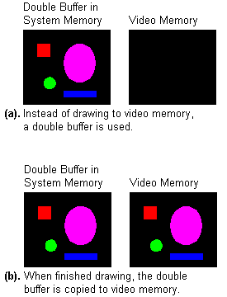
On-Screen
The display of your computer is just a mirror of the content of the Video Memory
http://www.brackeen.com/vga/unchain.html

Slide 42

On-Screen (Video Memory) and (Double) Buffer
In animation mode, drawing is in the (double) buffer
Next show(t) statement copies to screen
http://www.brackeen.com/vga/unchain.html

Slide 43
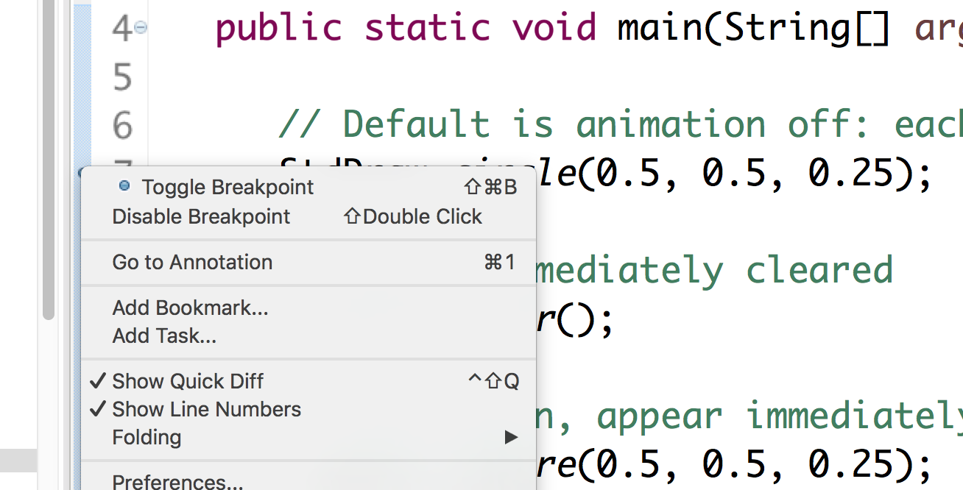
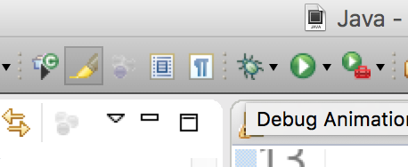
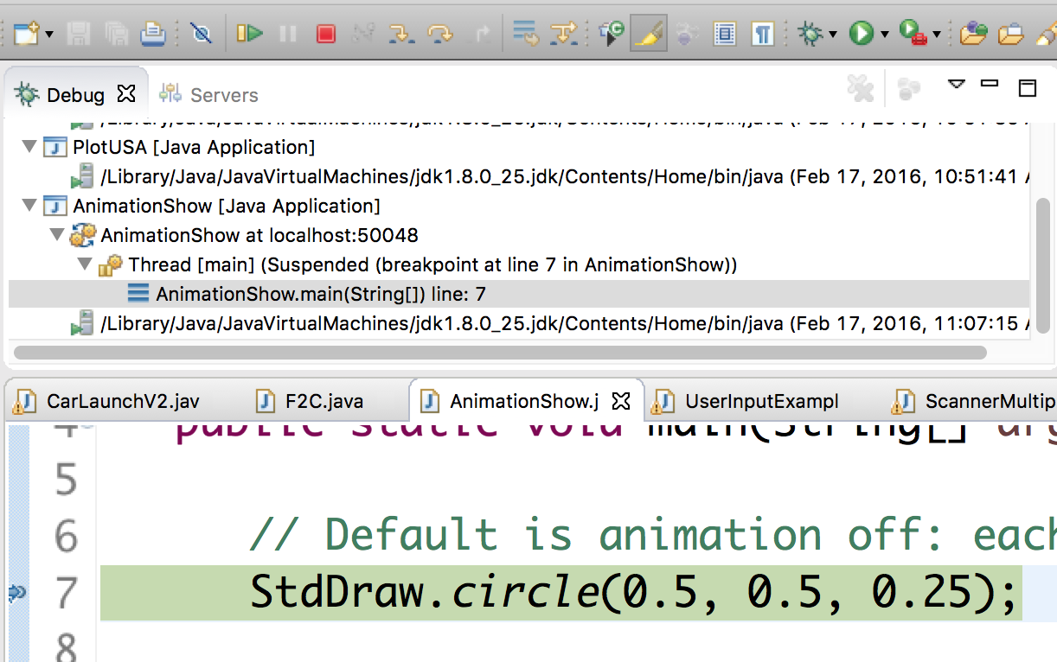
Example: AnimationShow.java
Try running the example in Debug mode
Right click first line and toggle breakpoint
Execute in Debug mode
Execute (step over) each statement

Slide 44
Exercise: Add a Countdown Scene
Count down from 10 to 0 and then start the race

Slide 45
Exercise: Add a Countdown Scene
Count down from 10 to 0 and then start the race
public static void sceneStart(int h1, int h2) {
for (int t = 10; t>= 0; t--) {
Car.drawCar(0, h1, CAR1_SIZE);
Car.drawCar(0, h2, CAR2_SIZE);
StdDraw.text( WIDTH/2, HEIGHT/2, ""+t );
StdDraw.show( 1000 );
StdDraw.clear();
}
}

