Slide 1
Introduction to Computational Thinking
Lecture #6 (Offline):
Text Input/Output (Scanner); Object (briefly);
Boolean Expressions; Nested if/else;
Qiao Xiang, Qingyu Song
https://sngroup.org.cn/courses/ct-xmuf25/index.shtml
11/7/2025
This deck of slides are heavily based on cs112 at Yale University and cs101 at UCAS, respectively,
by courtesy of Dr. Y. Richard Yang and Dr. Zhiwei Xu.

Slide 2
Outline
Admin and recap
Method w/ return
Summary of method definition and invocation rules
overloaded methods
formal arguments are local variables
primitive types use value semantics
Text I/O
Input: basic Scanner input
Output: basic printf and String.format
Notes:
方法结束 -> 文本输入输出

Slide 3
Recap: Defining a Method Returning a Value
return
type
properties
method
name
parameter list
public static type name( parameters ) {
statements;
...
return expression;
}

Slide 4
Recap: Method Definition, Invocation, Formal Arguments (Parameters)
Definition rule
You can define multiple methods with the same name in a class. This is called method overloading.
These methods must have different signatures.
Invocation
Compiler picks the best match, allowed by implicit conversion
Values of actual arguments are copied to formal arguments, which are local variables
All primitive variables are value variables, with value semantics

Slide 5
Recap: Value-Variable Assignment and Value Semantics
int a = 100; double x = 45.12; int aa; aa = a;
a = 200;
a
100
200
x
45.12
aa
100
Change the value of one value variable will not change the other.

Slide 6
Exercise: “Parameter Mystery”
public static void strange(int x) {
x = x + 1;
System.out.println("1. x = " + x);
}
public static void main(String[] args) {
int x = 23;
strange(x);
System.out.println("2. x = " + x);
...
}
Output:
1. x = 24
2. x = 23

Slide 7
Explanation: main() start
public static void main(String[] args) {
int x = 23;
strange(x);
System.out.println("2. x = " + x);
}
args
x
23

Slide 8
Explanation: Invocation
public static void main(String[] args) {
int x = 23;
strange(x);
System.out.println("2. x = " + x);
}
args
x
23
public static void strange(int x) {
x = x + 1;
System.out.println("1. x = " + x);
}
x
23
compiler declares formal argument x and copies value from the actual argument

Slide 9
Explanation: Local update
public static void main(String[] args) {
int x = 23;
strange(x);
System.out.println("2. x = " + x);
}
args
x
23
public static void strange(int x) {
x = x + 1;
System.out.println("1. x = " + x);
}
23
x
24

Slide 10
Explanation: Method return
public static void main(String[] args) {
int x = 23;
strange(x);
System.out.println("2. x = " + x);
}
args
x
23
public static void strange(int x) {
x = x + 1;
System.out.println("1. x = " + x);
}
x
24
compiler un-declares formal argument

Slide 11
Explanation: Method return
public static void main(String[] args) {
int x = 23;
strange(x);
System.out.println("2. x = " + x);
}
args
x
23

Slide 12
Foundational Programming Concepts
any program you might want to write
objects
methods and classes
graphics, sound, and image I/O
arrays
conditionals and loops
math
text I/O
primitive data types
assignment statements

Slide 13
(Some Potentially Confusing) Scanner Details
The OS will not send input to Scanner constructed using System.in until user hits enter (reason?)
nextInt(), nextDouble(), next() are token based scanning methods
skip whitespace (spaces, tabs, new lines) until find first non-white space, collect input into a token until a whitespace, send token to the method to interpret; the following white space remains
How many tokens appear on the following line of input?
23 John Smith 42.0 "Hello world" $2.50 " 19”
nextLine() collects any input character into a string until the first new line and discards the new line
Notes:
强调
Token： 令牌/标记
答案是23，因为23后面有个whitespace

Slide 14

Exercise: nextInt, nextLine
int i1 = console.nextInt();
String s1 = console.nextLine();
2018↵
result: i1 = 2018 s1 = “”
Lets have a try
☐2018☐☐a☐↵
result: i1 = 2018 s1 = “☐☐a☐”
First read ScannerTokenDiff.java to guess behaviors, then try.
Notes:
做演示：
注意这里是同时使用的nextInt和nextLine

Slide 15
Exercise: nextInt, next
int i1 = console.nextInt();
String s1 = console.next();
2018↵
result: i1 = 2018 program hangs, waiting for non-whitespace
2018☐☐a☐↵
Lets have a try
result: i1 = 2018 s1 = “a”
First read ScannerTokenDiff.java to guess behaviors, then try.

Slide 16
Exercise: nextLine or next?
System.out.print(“A number: “);
int i1 = console.nextInt();
System.out.print(“File name: “); String fileName = console._____();
Lets have a try
First read ScannerInputExample2.java to guess behaviors, then try.
Notes:
答案是next，不然没有block，直接接受“”（空）

Slide 17
(Offline) Practice: Scanner Fun
Please try out ScannerFun.java
ScannerFun.java

Slide 18
Input from File
There are two approaches
Create a scanner with src as a file (more shortly)
Redirect: a concept in computer science, which allows the operating system to send a file’s content as if it is typed in by keyboard: (Use command line: Terminal -> to working directory) %java Plot < USA.txt
Plot.java USA.txt

Slide 19
Exercise: Plot a Geo Data File
File format:
xmin ymin xmax ymax npoints
x, y
…
Plot.java USA.txt

Slide 20
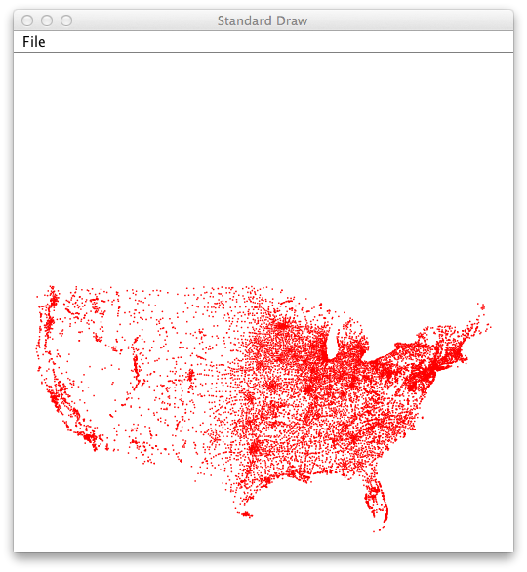
Input from File
PlotUSA.java USA.txt

Slide 21
Exercise
What if you do not want to see the loading process (e.g., see all display at once, not one point at a time)?
Find solution from StdDraw.java
Plot.java USA.txt
Notes:
Find solution from StdDraw.java

Slide 22

Design Issue
What value to return when a token is not the type the scanner expects
System.out.print("Which year will you graduate? ");
Int year = console.nextInt();
Output:
Which year will you graduate? Timmy

Slide 23

Token and Exception
When a token is not the type that the scanner expects, since no reasonable (non-ambiguous) return value, Scanner throws an exception (panic)
System.out.print("Which year will you graduate? ");
int year = console.nextInt();
Output:
Which year will you graduate? Timmy
java.util.InputMismatchException
at java.util.Scanner.next(Unknown Source)
at java.util.Scanner.nextInt(Unknown Source)
...

Slide 24
Issue: How to avoid crash when user may give wrong type of input?
System.out.print("Which year will you graduate? ");
int year = console.nextInt();
Output:
Which year will you graduate? Timmy

Slide 25
Approach 1: Test before Proceed
System.out.print("Which year will you graduate? ");
int year = console.nextInt();
Output:
Which year will you graduate? Timmy
Robust design
Add a test method to check whether the input has the expected type
if the test failed, report error

Slide 26
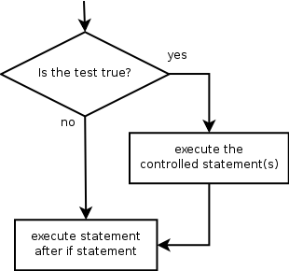
The if statement
Executes a block of statements only if a test is true
if (test) {
statement;
...
statement;
}
Example:
double gpa = console.nextDouble();
if (gpa >= 3.9)
System.out.println("Welcome to XMU!");

Slide 27
The if/else Statement
An else clause can be added to an if statement to make it an if-else statement:
if ( test ) {
statement1; }
else {
statement2;
}
If the condition is true, statement1 is executed; if the condition is false, statement2 is executed
One or the other will be executed, but not both
Notes:
Clause 条款

Slide 28
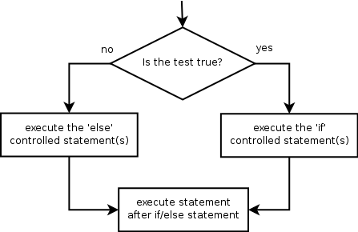
The if/else Statement
Example:
if (gpa >= 3.8) {
System.out.println("Welcome to XMU!");
} else {
System.out.println(”We recommend Harvard.");
}

Slide 29
Outline
Admin and recap
Text I/O
Input: basic Scanner input
Output: basic printf and String.format
Program flow of control
Boolean expressions

Slide 30
Recap: Scanner
Basic Scanner methods:
Design methodology: Java uses an object to remember the state (e.g., source) of a scanner
Method | Description
nextInt() | Returns an int from source
nextDouble() | Returns a double from source
next() | Returns a one-word String from source
nextLine() | Returns a one-line String from source
Scanner console = new Scanner(System.in);
console.nextInt();

Slide 31
Recap: Scanning Details
nextLine() collects any input character into a string until the first new line and discards the new line
nextInt(), nextDouble(), next() are token based scanning methods
ignore leading white space characters
collect non-white space chars into a token
interpret the token as an int/double for nextInt/nextDouble
Design issue: What if the token is not in the correct format?

Slide 32
Token and Exception
When a token is not the type that the scanner expects, since no reasonable (non-ambiguous) return value, Scanner throws an exception (panic)
System.out.print("Which year will you graduate? ");
int year = console.nextInt();
Output:
Which year will you graduate? Timmy
java.util.InputMismatchException
at java.util.Scanner.next(Unknown Source)
at java.util.Scanner.nextInt(Unknown Source)
...

Slide 33

Exceptions
Exception: a programming language mechanism to represent a runtime error, e.g.,
dividing an integer by 0
trying to read the wrong type of value from a Scanner
trying to read a file that does not exist
Java has defined a set of exceptions, each with a name, e.g., ArithmeticException, InputMisMatchException, FileNotFoundException

Slide 34
Why Not a “Smarter” nextInt()
For example, continue to scan the input to find the integer?
Design principle: design of basic methods should KISS (Keep It Simple and Stupid)
Higher level programs handle the case in their specific settings

Slide 35
Design Methodology: How to Handle Potential Exceptions?
Two basic approaches
Test before proceed
Proceed and clean up (try/catch)

Slide 36
Robust Input Approach 1: Test Before Proceed
Design pattern
if ( <ExceptionConditionFalse> ) {
proceed;
}
else {
System.out.println(“Error message.”);
}
return type of hasNextInt() is boolean, indicating a logical condition.
System.out.print("Which year will you graduate? ");
if ( console.hasNextInt() ) {
year = console.nextInt();
}
else {
System.out.println(“Wrong type; please give int.”);
}

Slide 37
Robust Input Approach 2: try and catch
try/catch: if an exception happens, program execution jumps to the catch statement, skipping the rest in the try block.
try {
potentially dangerous statements
} catch (ExceptionName e) {
handle exception, such as print an error message
} // end of catch

Slide 38
Robust Input Approach 2: Example
import java.util.Scanner; // for Scanner
public class ScannerInputExampleTry {
public static void main(String[] args) {
Scanner console = new Scanner( System.in );
try {
System.out.print("Which year will you graduate? ");
int year = console.nextInt();
System.out.println(“Your give “ + year); } catch (InputMisMatchException e) {
// print an error message
System.out.println(“You give a wrong input type.”);
} // end of catch
} // end of main
}

Slide 39
File as Scanner Source
import java.io.File; // for File
import java.util.Scanner; // for Scanner
public class PlotFile {
public static void main(String[] args) {
File f = new File(“USA.txt”);
Scanner input = new Scanner( f );
…
} // end of main
}
Compilation fails with the following error:
PlotFile.java:9: unreported exception java.io.FileNotFoundException;
must be caught or declared to be thrown
Scanner input = new Scanner( f );

Slide 40
What Happened: the throws Clause
throws clause: Keyword on a method's header to state that it may generate an exception (and will not handle it) and those using it must handle it (called a checked exception; nextInt does not declare it).
Syntax:
public static <type> <name>(...) throws <type> {
Example: http://docs.oracle.com/javase/7/docs/api/java/util/Scanner.html#Scanner(java.io.File)
Notes:
analogy: A throws clause is like the legal waiver you sign before you go bungee jumping. "I understand that I am taking a risk, and I promise not to sue!”
Throws：可能跑出异常，调用时候必须处理
Clause：条款

Slide 41
Scanner File Input
import java.io.File; // for File
import java.util.Scanner; // for Scanner
public class PlotFile {
public static void main(String[] args) {
try {
File f = new File(“USA.txt”);
Scanner input = new Scanner( f );
… } catch (FileNotFoundException e) {
// print an error message
System.out.println(“File not found exception”);
} // end of catch
} // end of main
}

Slide 42
Outline
Admin and recap
Text I/O
Input: Scanner input
Scanner using object to remember state
Scanner input with exceptions (run time errors)
Output: basic printf and String.format

Slide 43
A Tiny Bit History of Java Text Formatting
Before Java 1.5, Java provides formatting classes such as NumberFormat and DecimalFormat classes as part of the java.text package
But many programmers like the more flexible method signature of printf() starting from the C programming language
Starting from Java 1.5, printf/formatr is added and typically preferred by many programmers

Slide 44
Discussion
Text output formatting as of now
String concatenation without ability to specify per variable format ….
Notes:
目前文本输出格式
字符串连接无法为每个变量指定格式……

Slide 45
Printf/Format Design
System.out.printf("format string", parameters);
Output with placeholders to insert parameters, e.g.,
%d integer
%f real number
%s string
these placeholders are used instead of + concatenation
Example:
int x = 3;
int y = -17;
System.out.printf("x is %d and y is %d!\n", x, y);
printf does not drop to the next line unless you write \n
// x is 3 and y is -17!
https://docs.oracle.com/javase/8/docs/api/java/util/Formatter.html

Slide 46
Printf/Format Design and Language Support
System.out.printf("format string", parameters);
In the most general case, Java allows flexible (variable) method signature, e.g.,
Number and type of parameters determined by the first parameter. We will not learn how to define such methods, but will use some: printf() and format()
public static type name( <type1> param1, <type2>… param2)

Slide 47
printf Width
%Wd integer, W characters wide, right-aligned
%-Wd integer, W characters wide, left-aligned
%Wf real number, W characters wide, right-aligned
...
for (int i = 1; i <= 3; i++) {
for (int j = 1; j <= 10; j++) {
System.out.printf("%4d", (i * j));
}
System.out.println(); // to end the line
}
Output:
1 2 3 4 5 6 7 8 9 10
2 4 6 8 10 12 14 16 18 20
3 6 9 12 15 18 21 24 27 30

Slide 48
printf Precision
%.Df real number, rounded to D digits after decimal
%W.Df real number, W chars wide, D digits after decimal
%-W.Df real number, W wide (left-align), D after decimal
double gpa = 3.253764;
System.out.printf("your GPA is %.1f\n", gpa);
System.out.printf("more precisely: %8.3f\n", gpa);
Output:
your GPA is 3.3
more precisely: 3.254
3
8

Slide 49
printf Formatting
Many more formatting control options supported by printf, e.g., using the comma (,) to display numbers with thousands separator
System.out.printf("%,d\n", 58625);
System.out.printf("%,.2f\n", 12345678.9);
Output:
58,625
12,345,678.90

Slide 50
System.out.printf and String.format
String.format has the same formatting capability as printf, except that printf outputs and String.format returns:
System.out.printf("%,.2f\n", 12345678.9);
String s = String.format("%,.2f\n", 12345678.9);
System.out.print( s );
Output:
12,345,678.90
12,345,678.90

Slide 51
Exercise: F2C
Revise F2C to print 2 decimal digits.

Slide 52
Foundational Programming Concepts
any program you might want to write
objects
methods and classes
graphics, sound, and image I/O
arrays
conditionals and loops
math
text I/O
primitive data types
assignment statements
Notes:
最后呢，我们为条件分支或者叫条件判断开一个头

Slide 53
Program Flow of Control
Java has three types of program flow of control:
decision statements, or conditional statements: decide whether or not to execute a particular statement
repetition statements, or loop statements: perform a statement over and over repetitively
exceptions: to handle run-time errors (atypical)
The foundation of conditional/loop program flow of control is the logical condition, which should be a boolean expression

Slide 54

Basic Boolean Condition: Relational Comparison
A basic Boolean expression is to compare two values using a relational operator :
Note the difference between the equality operator (==) and the assignment operator (=)
Operator | Meaning | Example | Value
== | equals | 1 + 1 == 2 | true
!= | does not equal | 3.2 != 2.5 | true
< | less than | 10 < 5 | false
> | greater than | 10 > 5 | true
<= | less than or equal to | 126 <= 100 | false
>= | greater than or equal to | 5.0 >= 5.0 | true

Slide 55
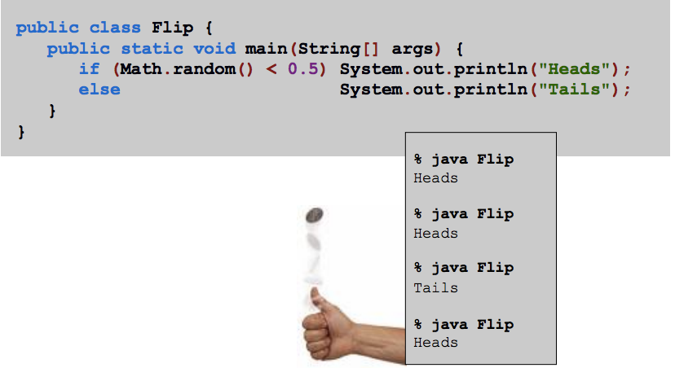
Example: Basic Boolean Expression
Flip.java

Slide 56
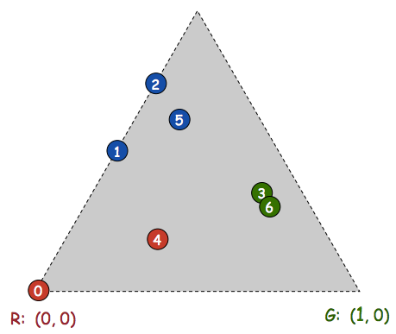
(Offline) Example: Chaos Game
Play on equilateral triangle, with vertices R (node 0), G (node 1), B (node 2)
Start at R
Repeat N times
Pick a random vertex
Move halfway between current point and vertex
Draw a point in color of chosen vertex
B
Chaos.java
Notes:
Vertex 顶点

Slide 57
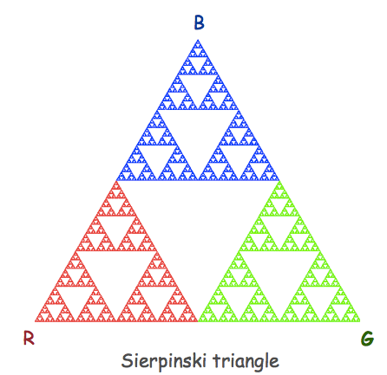

(Offline) Example: Chaos Game

