Slide 1
Introduction to Computational Thinking
Encryption/Decryption
Basic Arrays
Indefinite Loops: Motivation; while/do-while Statements;
Program analysis; Loop pattern: Sentinel input/Fencepost loops
Qiao Xiang, Qingyu Song
https://sngroup.org.cn/courses/ct-xmuf25/index.shtml
11/19/2025
This deck of slides are heavily based on cs112 at Yale University and cs101 at UCAS, respectively,
by courtesy of Dr. Y. Richard Yang and Dr. Zhiwei Xu.

Slide 2
Roadmap: String Processing
Access methods, e.g.,
length, substring, charAt, indexOf
String generator methods (string->string), e.g.
toLowerCase, toUpperCase, replace, split (string->strings)
Conversion from String, e.g.,
Integer.parseInt, Double.parseDouble
Input processing, e.g.,
Scanner.next, Scanner.nextLine
Output formatting: format string
System.out.printf, String.format
Boolean methods, e.g.,
equals, equalsIgnoreCase, startsWith, endsWith, contains, matches

Slide 3
Recap: char vs. String
 | String | char
Store | An object w/ a sequence of chars | A primitive value storing a unicode index
Methods | .length, .toUpperCase, … | No methods
==, != | Compare reference, not value | Compare value
<, <=, >, >= | Not defined. Use compareTo(anotherString) method | Lexicographic order
.equals method | Compare content | Not defined
https://en.wikipedia.org/wiki/List_of_Unicode_characters
Notes:
3

Slide 4
Outline
Arrays
Motivation
Basic syntax
declare arrays, access array elements, OOB
array initializer list

Slide 5

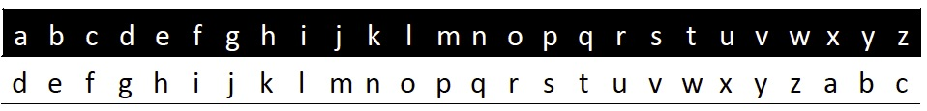
Caesar Cipher
Plaintext
Ciphertext
attack said zeus προσβάλλω
dwwdfn vdlg chxv
στςφείξξό
Notes:
Cipher 密码
中间是例子
下面是密码表，相当于整体向一个方向偏移，例如，（注意最后三个的对应关系）最开始的abc表示了xyz

Slide 6

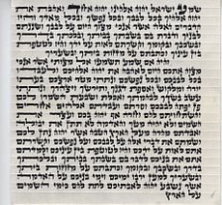

Additional Caesar-Style Cipher
Augustus
Right shift 1 without rotate, with AA for Z
Mezuzah
Shift of one to encrypt the names of God
Vigenere (a variant) was used by the Confederacy during Civil War
Mafia boss Provenzano (2006): A (4), …
Notes:
其他密码的例子，快速过掉

Slide 7
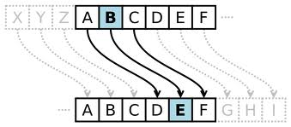
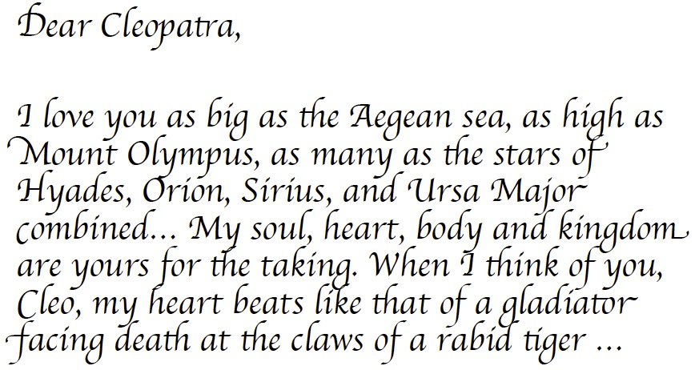
Why Programming?
Notes:
以这个为例，如果要编码这段话，手动的话很麻烦，
答案：简化流程

Slide 8
Caesar Cipher Encoding (Design 1)
Letter | a | b | c | d | ... | … | w | x | y | z
Orig | 97 | 98 | 99 | 100 | ... | … | 119 | 120 | 121 | 122
Shift (+3) | 100 | 101 | 102 | 103 |  |  | 122 | 123 | 124 | 125
Cipher | 100 | 101 | 102 | 103 |  |  | 122 | 97 | 98 | 99
int cipher = ch + key;
if (cipher > ‘z’) cipher -= 26;
ch = (char)cipher;
Q: What if key is 100?
Notes:
我们的需求：在下面的编码表
如果key是100，这段代码问题是什么？
直接加100，超过97-122范围，得放缩到这个范围

Slide 9
Caesar Cipher: Encoding (Design 2)
Letter | a | b | c | d | ... | … | w | x | y | z
Orig | 0 | 1 | 2 | 3 | ... | … | 22 | 23 | 24 | 25
Shift (+3) | 3 | 4 | 5 | 6 |  |  | 25 | 26 | 27 | 28
Cipher (% 26) | 3 | 4 | 5 | 6 |  |  | 25 | 0 | 1 | 2
int cipherInt = (origInt + key) % 26
Assumption: a-z mapped to 0 to 25.
How to map a char in a-z to 0 to 25?
char – ‘a’
Notes:
另一种设计方法，我们知道一共只有26个
我们可以用一个运算来实现这个放缩，问大家？

Slide 10
Caesar Cipher Encoding
Letter | a | b | c | d | ... | … | w | x | y | z
Orig | 0 | 1 | 2 | 3 | ... | … | 22 | 23 | 24 | 25
Shift (+3) | 3 | 4 | 5 | 6 |  |  | 25 | 26 | 27 | 28
Cipher (% 26) | 3 | 4 | 5 | 6 |  |  | 25 | 0 | 1 | 2
int chRelativeIndex = ch – ‘a’;
int cipherRelInd = (chRelativeIndex + key) % 26;
ch = (char)(cipherRelInd + ‘a’);

Slide 11
CaesarFile using a for Loop
public class ReadFile {
public static void main(String[] args) {
try {
Scanner input = new Scanner(new File(”data.txt"));
encode(input, 3); } catch (FileNotFoundException e) {
// print an error message
System.out.println(“File not found exception”);
} // end of catch
} // end of main
}
public static void encode(Scanner scan, int key) {
for (int line = 0; line < NLINES; line ++ ) { String text = scan.nextLine();
String result = Caesar.encode(text, key);
System.out.println( result );
}
}

Slide 12
Think: How to Decode?

Slide 13
Caesar Cipher: Decoding
Letter | a | b | c | d | ... | … | w | x | y | z
Orig | 0 | 1 | 2 | 3 | ... | … | 22 | 23 | 24 | 25
Shift (+3) | 3 | 4 | 5 | 6 |  |  | 25 | 26 | 27 | 28
Cipher (% 26) | 3 | 4 | 5 | 6 |  |  | 25 | 0 | 1 | 2
Back (-3) | 0 | 1 | 2 | 3 |  |  | 22 | -3 | -2 | -1
Range (+26%26) | 0 | 1 | 2 | 3 |  |  | 22 | 23 | 24 | 25
Notes:
相同的思路，相同的平移方向，这次平移的距离：26-key

Slide 14
Unifying Design
int cipherInt = (origInt + key) % 26
int origInt = (cipherInt – key + 26) % 26
A single encode method with parameter key
To encode
encode(key)
To decode
encode(26 – key)
Caesar.java

Slide 15
Unifying Design
Encode using key
Decode using key
int chRelativeIndex = ch – ‘a’;
int cipherRelInd = (chRelativeIndex + key) % 26;
ch = (char)(cipherRelInd + ‘a’);
int chRelativeIndex = ch – ‘a’;
int cipherRelInd = (chRelativeIndex – key + 26) % 26;
ch = (char)(cipherRelInd + ‘a’);
decode(key) = encode(26 – key)
Caesar.java

Slide 16

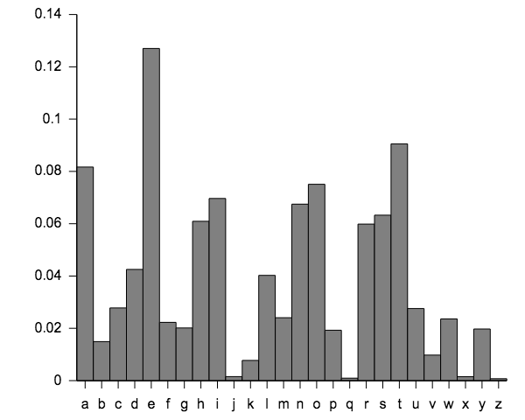
Exercise: Breaking Caesar Encryption
How to count frequency of letters?
Caesar encryption (or permutation ciphers in general) is easy to break because it does not change the frequency of letters.
Notes:
Permutation： 排列

Slide 17
Frequency Analysis Code (Attempt 1)
int nA = 0, nB = 0, nC = 0, nD = 0, nE = 0,
nF = 0, nG = 0, … nZ = 0;
for (int line = 0; line < NLINES; line ++ ) {
String text = scan.nextLine();
for (int i = 0; i < text.length(); i++) {
char ch = line.charAt( i );
if ( ch == ‘a’ )
nA ++;
else if ( ch == ‘b’ )
nB ++;
else if ( ch == ‘c’ )
nC ++;
…
}
print nA, nB, ….

Slide 18
Improving Attempt 1
We need a way to declare many variables in one step.
We need an effective scheme to refer to the variables
The objective of arrays is to provide these

Slide 19
Outline
Arrays
Motivation
Basic syntax
declare arrays, access array elements, OOB
array initializer list

Slide 20
Arrays
index | 0 | 1 | 2 | 3 | 4 | 5 | 6 | 7 | 8 | 9
value | 12 | 49 | -2 | 26 | 5 | 17 | -6 | 84 | 72 | 3
element 0
element 4
element 9
array: an object that stores many values of the same type.
element: one value in an array.
index: array element referred to by position number starting from 0

Slide 21
Array Declaration
After declaration, all elements of an int array are initialized to 0.
index | 0 | 1 | 2 | 3 | 4 | 5 | 6 | 7 | 8 | 9
value | 0 | 0 | 0 | 0 | 0 | 0 | 0 | 0 | 0 | 0
The length in declaration can be any non-negative integer expression, e.g.,
int m = 3;
int d = 31;
double[] data = new double[m * d +1];
// arr w/ 94 elem
<type>[] <name> = new <type>[<length>];
Example:
int[] numbers = new int[10];
Notes:
强调跟C的区别：
1. 初始全是0而不是随机数值
2. 声明长度可以是一个可变变量，不非要真值整数

Slide 22
Accessing Array Elements
<name>[<index>] // access
<name>[<index>] = <value>; // modify
numbers[ 0 ]
85
numbers[ 1 ]
60
numbers[ 2 ]
100
int[] numbers = new int[10];
numbers[ 3 ]
72
numbers[ 4 ]
54
numbers[ 5 ]
89
numbers
position number (index or subscript) of the element within array numbers
numbers[ 6 ]
90
numbers[ 7 ]
62
numbers[ 8]
93
numbers[ 9 ]
81
BasicArrays.java
Notes:
都跟C一致

Slide 23
Accessing Elements: Example
int[] numbers = new int[10]; // create an int array
numbers[1] = 3;
numbers[4] = 99;
numbers[6] = 2;
System.out.println(numbers[2-1]);
if (numbers[4] > 10) {
System.out.println(”numbers[4] > 10.");
}
index | 0 | 1 | 2 | 3 | 4 | 5 | 6 | 7 | 8 | 9
value | 0 | 3 | 0 | 0 | 99 | 0 | 2 | 0 | 0 | 0
numbers

Slide 24
Accessing Elements: Example
What does this code segment do?
int[] numbers = new int[8];
numbers[0] = 1; numbers[1] = 1;
for (int i = 2; i < 8; i++) {
numbers[i] = numbers[i-1] + numbers[i-2];
}
index | 0 | 1 | 2 | 3 | 4 | 5 | 6 | 7
value | 1 | 1 | 2 | 3 | 5 | 8 | 13 | 21

Slide 25
Array length field
Java provides a length field for each array to store the number of elements
It does not use parentheses like a String's .length()
length holds the number of elements, not the largest index
Reference length using the array variable’s name:
<name>.length
int[] numbers = new int[8];
System.out.println ( numbers.length ); // 8
What expressions refer to the index of (by .length):
the last element of any array?
the middle element (assume odd number of elements)?
Notes:
C语言没有

Slide 26
Out-of-bounds (OOB)
// okay
// okay
// error: OOB
// error: OOB
index | 0 | 1 | 2 | 3 | 4 | 5 | 6 | 7 | 8 | 9
value | 0 | 0 | 0 | 0 | 0 | 0 | 0 | 0 | 0 | 0
Reading or writing any index outside of range will throw an ArrayIndexOutOfBoundsException.
Example (which line(s) will cause OOB):
int[] data = new int[10];
System.out.println(data[0]); // okay
System.out.println(data[9]); // okay
System.out.println(data[-1]); // OOB
System.out.println(data[data.length]); // OOB
Notes:
跟C一致

Slide 27
Outline
Admin and recap
Arrays
Motivation
Basic syntax
declare arrays, access array elements, OOB
array initializer list

Slide 28
Quick Array Initialization
An initializer list can be used to instantiate and initialize an array in one step
<type>[] <name> = {<value>, <value>, … <value>};
Examples:
int[] numbers = {12, 49, -2, 26, 5, 17, -6};
char[] letterGrades = {'A', 'B', 'C', 'D', 'F'};
String[] wordList = {“cs112“, “computer", “television"};
The values are delimited by braces and separated by commas
The new operator is not used
The compiler
figures out the size by counting the values in the initializer list
initializes the values of the elements with those in the initializer list
Notes:
跟C一样

Slide 29
Example: Implement Month2Word
// map number of 1-12 to English word
public static String month2Word(int num)
{
final String[] map = {“Jan”, “Feb”, “Mar”, “Apr”, “May”, “Jun”, “Jul”, “Aug”, “Sep”, “Oct”, “Nov”, “Dec” };
if (num < 1 || num > 12) // for robust programming
return “Error”;
else
return map[num-1];
}

Slide 30
Outline
Admin and recap
Arrays
Motivation
Basic syntax
declare arrays, access array elements, OOB
array initializer list
array as method parameter/return

Slide 31
Array as Parameter (Declare)
See Arrays class for many useful array methods
https://docs.oracle.com/javase/7/docs/api/java/util/Arrays.html
public static <type> <method>(<type>[] <name>) {
Example:
// Returns the average of the given array of numbers.
public static double max(int[] numbers) {
int max = Integer.MIN_VALUE;
for (int i = 0; i < numbers.length; i++) {
if (numbers[i] > max) max = numbers[i];
}
return max;
}
Notes:
跟C语言一样

Slide 32
Array as Parameter (Call)
<methodName>(<arrayName>);
Example:
public class MyProgram {
public static void main(String[] args) {
// figure out the average TA IQ
int[] iq = {126, 109, 149, 167, 125};
int maxIQ = max(iq);
System.out.println(”Highest IQ = " + maxIQ);
}
...
Notice that you don't write the [] when passing the array.
Notes:
跟C一致

Slide 33
Example: Command-Line Arguments
The signature of the main method indicates that it takes an array of String as a parameter
These values come from command-line arguments that are provided when the interpreter is invoked
For example, the following invocation of the interpreter passes an array of three String objects into main method:
> java Calc 3 + 5
The strings “3”, “+”, “5”, are stored at indexes 0-2 of the String array args
Exercise: Implement a simple command-line calculator: <num1> +|-|*|- <num2>
See Calc.java
Notes:
课上看代码练习

Slide 34
Example: Command-Line Arguments
Modify CaesarFile to take command, key, and file in commandline % java CaesarFileCL <enc|dec> <file> <key>

Slide 35
Outline
Admin and recap
Arrays
Motivation
Basic syntax
declare arrays, access array elements, OOB
array initializer list
array as method parameter/return
Using arrays
basic array loops to process array elements

Slide 36
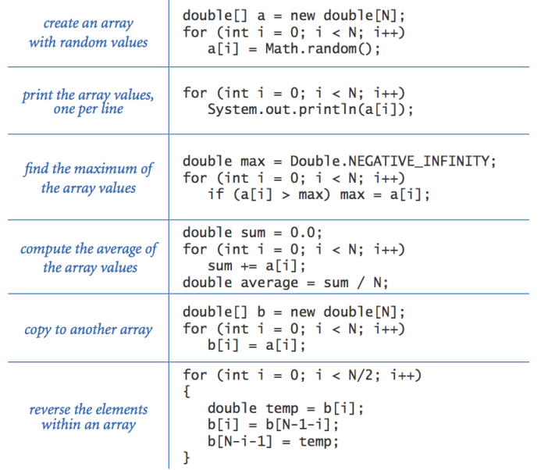
Array and Loops Examples
Notes:
简单过掉，跟C类似

Slide 37
Outline
Admin and recap
Arrays
Motivation
Basic syntax
declare arrays, access array elements, OOB
array initializer list
array as method parameter/return
Using arrays
basic array loops
using array as counters/accumulators

Slide 38
Example Array Use Pattern: Array Elements as Counters/Accumulators
Create an array equal to the size of the number of categories
Loop over each input
map input’s value to array index
increase the array element at index
Display result
map each array index back to input to display
Notes:
给出思路

Slide 39
Grade Histogram Question
Given a file of integer exam scores, where a score is between 0 and 100, e.g.,
82
66
79
63
83
Write a program that will print a histogram of stars
indicating the number of students who earned each unique
exam score.
85: *****
86: ************
87: ***
88: *
91: ****
Notes:
Curve the scores; add a fixed number to each score. (But don't allow a curved score to exceed the max of 100.)
Histogram：直方图

Slide 40
Example Array Use Pattern: Array Elements as Counters/Accumulators
Create an array equal to the size of the number of categories
Q: how many categories?
Loop over each input
map input’s value to array index
increase the array element at index
Display result
map each array index back to input to display
int[] counters = new int[101];
grade is the index

Slide 41
Grade Histogram
// Reads a file of test scores and shows a histogram of the score distribution.
import java.io.*;
import java.util.*;
public class GradeHistogram {
public static void main(String[] args) throws FileNotFoundException {
Scanner input = new Scanner(new File("midterm.txt"));
int[] counts = new int[101]; // counters of test scores 0 - 100
for (int i = 0; i < NSTUDENTS; i++) { // read file into counts array
int grade= input.nextInt();
counts[grade]++; // if gradeis 87, then counts[87]++
}
for (int i = 0; i < counts.length; i++) { // print star histogram
if (counts[i] > 0) {
System.out.printf(“%3d: ”, i);
for (int j = 0; j < counts[i]; j++) {
System.out.print("*");
}
System.out.println();
}
}
}
}

Slide 42
Revision
How about a bucket for every 5 points:
00-04:
05-09:
..
90-94:
95-99:
100:

Slide 43
Example Array Use Pattern: Array Elements as Counters/Accumulators
Create an array equal to the size of the number of categories
Q: how many categories?
Loop over each input
map input’s value to array index
increase the array element at index
Display result
map each array index back to input to display
int[] counters = new int[100/5+1];
grade -> index is grade/5
[index * 5, index*5+4] before 100
Notes:
整数除法
多少种类别？
怎么把不同的分数映射到相应的类别？

Slide 44
(Offline Exercise) Revision
How about the following buckets:
00-59:
60-64:
65-69:
70-74:
…
90-94:
95-99:
100:

Slide 45
Example Array Use Pattern: Array Elements as Counters/Accumulators
Create an array equal to the size of the number of categories
Q: how many categories?
Loop over each input
map input’s value to array index
increase the array element at index
Display result
map each array index back to input to display
int[] counters = new int[1+(100-60)/5+1];
if (grade < 60)
index = 0;
else
index = (grade-60) / 5 + 1;

Slide 46
(Offline Exercise/Hard): Excel Style
Buckets specified in an array
[59, 75, 85, 90] =>
0 – 59 bucket 1
60 – 75 bucket 2
76 – 85 bucket 3
86 – 90 bucket 4
91 and above bucket 5

Slide 47
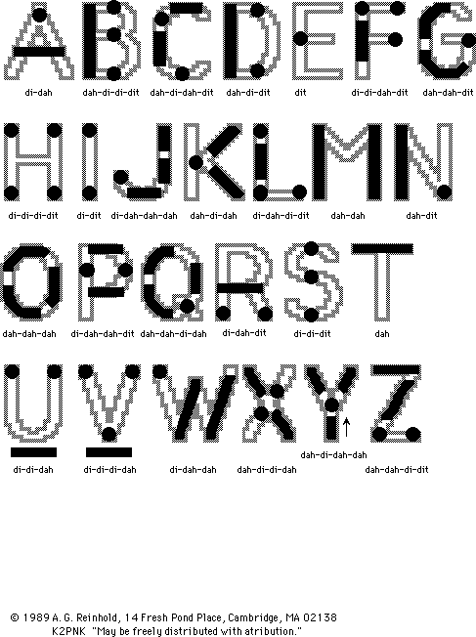
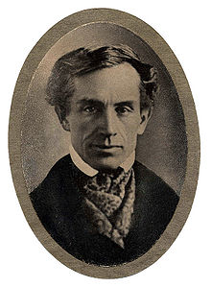
Letter Frequency Counting
Objective: Count the frequency of letters a to z in a text file.
The inventor of Morse code, Samuel Morse (1791-1872), counted letter frequencies to assign the simpler codes to the more frequently used letters. The counters he obtained:
E: 12000
T: 9000
A: 8000
…
X: 400
Z: 200
Freq. counting is also the foundation of code breaking
47

Slide 48
Using Array as Counters/Accumulators
Create an array equal to the size of the number of categories
Q: how many categories?
Loop over each input
map input’s value to array index
increase the array element at index
Display result
map each array index back to input to display
int[] counters = new int[26];
ch -> array index is ch-’a’
index -> (char)(‘a’+ index)

Slide 49
Array Elements as Counters
Count the number of characters in a line: int[] counts = new int[26]; String line = scan.nextLine(); for (int i = 0; i < line.length(); i++) { char ch = line.charAt(i); if (‘a’ <= ch && ch <= ‘z’) { counts[ch-’a’]++; }
}
Mapping data to index

Slide 50
Array Index to Display
public static void histogram(int[] counts) {
for (int i = 0; i < counts.length; i++) {
if (counts[i] > 0) {
System.out.print( (char)('a' + i) + ": ");
int h = counts[i];
for (int j = 0; j < h; j++) {
System.out.print("*");
}
System.out.println();
}
}
} // end of histogram
Mapping index to data for better display
LetterHistogram.java

Slide 51
Exercise: Decode cipher.txt

Slide 52
Outline
Admin and recap
Indefinite loops
Motivation
Program statements (for/while/do-while)

Slide 53
Motivation
CaesarFile reads a file with a fixed number of lines. What if the file can contain an arbitrary number of lines of text?

Slide 54
Motivation
CaesarFile reads a file with a fixed number of lines. What if the file can contain an arbitrary number of lines of text?
If there are more lines than the constant used in the loop, the remaining lines are not processed.
If there are fewer lines than the constant, program will crash

Slide 55
Outline
Admin and recap
Indefinite loops
Motivation
Program statements (for/while/do-while)

Slide 56
Indefinite Loops
Number of times of a loop is not a simple number, but rather a logical condition
Indefinite loops are common in programming design, e.g.,
Read from user until input is a non-negative number.
Repeat until the user has typed "q" to quit.
Print random numbers until a prime number is printed.
Search for a solution in a set.
A key to define an indefinite loop is to identify the loop’s test condition.
Notes:
带大家回顾一下
不定长循环有很多作用，比如
那么实现不定长数组的关键就是，对于循环判定条件的特殊处理

Slide 57
Scanner Test for Input Status
These methods of the Scanner do not consume input; they just give information about what the next input will be.
Method | Description
hasNext() | returns true if there is a next token
hasNextInt() | returns true if there is a next token and it can be read as an int
hasNextDouble() | returns true if there is a next token and it can be read as a double
hasNextLine() | returns true if there is a next line.
Notes:
以Scanner为例

Slide 58
CaesarFile using for Loop
public static void encode(Scanner scan, int key) {
for ( ; scan.hasNextLine(); )
String text = scan.nextLine();
String result = Caesar.encode(text, key);
System.out.println( result );
}
}
reads ugly
Notes:
for 循环的判定条件在中间

Slide 59
Java Repetition /Loop Statements
Java has three kinds of loop statements:
the for loop
the while loop,
the do loop, and
They have the same expressive power
Which loop statements to use will depend on the context: pick the one that is more intuitive to read
Notes:
回顾，大家学过

Slide 60
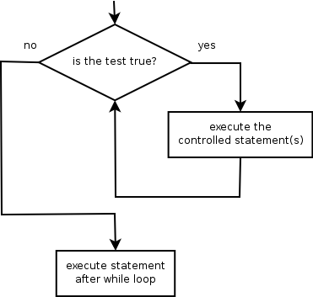
The while loop
while loop: Repeatedly executes its body as long as a logical test is true.
while (<test>) {
<statement(s)>;
}
Example:
int num = 1; // initialization
while (num <= 10) { // test
System.out.print(num + " ");
num = num * 2; // update
}
// output: 1 2 4 8
while is a
keyword

Slide 61
The do/while loop
do/while loop: Similar to while, except move test at the end:
do {
<statement(s)>;
} while (<test>);
Example:
int num = 1; // initialization
do {
System.out.print(num + " ");
num = num * 2; // update
} while (num <= 10); // test
// output: 1 2 4 8

Slide 62
CaesarFile using a while Loop
public static void encode(Scanner scan, int key) {
while ( scan.hasNextLine() ) {
String text = scan.nextLine();
String result = Caesar.encode(text, key);
System.out.println( result );
}
}

Slide 63
Summary: CaesarFile using Loop
public static void encode(Scanner scan, int key) {
for ( ; scan.hasNextLine(); )
String text = scan.nextLine();
String result = Caesar.encode(text, key);
System.out.println( result );
}}
reads ugly
public static void encode(Scanner scan, int key) {
while ( scan.hasNextLine() ) {
String text = scan.nextLine();
String result = Caesar.encode(text, key);
System.out.println( result );
}
}

Slide 64
Summary: Flow Control Statements
Loop statements
for
while
do/while
Choosing the loop control structure depends on the specific situation and personal taste
for ( initialization ; condition ; increment ) {
statement list;
}
while ( condition ) {
statement list;
}
do {
statement list;
} while ( condition );

Slide 65
Summary: for loop
typically used in sequential iteration
for loop is easy to read, since it provides visual aid to recognize the four components
If complex or empty initialization, increment, or condition, a for loop may not read as well as a while or do/while loop
for ( initialization ; condition ; increment ) {
statement list;
}

Slide 66
Summary: while, do/while loop
The choice between do/while and while depends on the logic of the program:
first check condition or first execute statement
while ( condition ) {
statement list;
}
do {
statement list;
} while ( condition );

Slide 67
(Offline Exercise): Coupon Collector
Write a program to simulate the number of coupons to collect before collecting at least one of each N distinct coupons
CouponCollector.java
Notes:
Check是否有示例代码
Coupon：优惠券

Slide 68
Roadmap: Program Flow Control
We have covered all syntax of program flow control
Mastering program control structure is among the most important in terms of fully mastering computer programming
Program control structure may involve complex logical analysis
Program control structure often has substantial flexibility and hence depends on personal style
multiple types of conditional statements
if/else; switch; conditional operator
multiple types of loop statements
for, while, do/while
break/return in the middle of a loop

Slide 69
How to Grasp Program Flow Control
Learn common loop patterns
Conduct program analysis
Read and practice
Try out the offline exercises
Read sample programs

Slide 70
Outline
Admin and recap
Indefinite loops
Motivation
Program statements (for/while/do/while)
Common indefinite loop pattern: search loop

Slide 71
Example
Design a method isInt: returns true if all chars of a string are numbers, e.g.,
isInt(“4822116”) returns true
isInt(“2016Mar3”) returns false
Design questions:
for, while, or do while loop?
At each loop iteration (over a char), what conclusion can we have?
if the char is not a number
false; An evidence that is enough to draw conclusion; need to break (return)
if the char is a number
not enough evidence, need to continue
Notes:
问大家，如何实现是否是数字的检查？

Slide 72
Boolean Return Answer
public static boolean isInt(String word) {
for (int i = 0; i < word.length(); i++) {
if (! isDigit( word.charAt(i) ) {
return false;
}
} // end of for
return true;
}
public static boolean isDigit(char ch) {
return '0' <= ch && ch <= '9‘;
}

Slide 73
Alternative Design
public static boolean isInt(String word) {
for (int i = 0; i < word.length(); i++) {
if (! isDigit( word.charAt(i) ) {
return false;
}
} // end of for
return true;
}
Multiple exit points
Some programmers do not like a method having multiple exit (return) points. Objective: design a single exit point.

Slide 74
Analysis
public static boolean isInt(String word) {
for (int i = 0; i < word.length(); i++) {
if (! isDigit( word.charAt(i) ) {
return false;
}
} // end of for
return true;
}
Question: logical conditions that the for loop should exit?
i >= word.length || !isDigit(i)
Condition to continue the loop:
!( i >= word.length || ! isDigit(i) )

Slide 75
De Morgan's Law
De Morgan's Law: Rules used to negate boolean tests.
Useful when you want the opposite of an existing test.
Original Expression | Negate | EquivalentNegate
a && b | !(a && b) | !a || !b
a || b | !(a || b) | !a && !b
!( i >= word.length || ! isDigit(i) )
( i < word.length ) && isDigit(i)

Slide 76
Alternative Version
public static boolean isInt(String word) {
for (int i = 0; i < word.length(); i++) {
if (! isDigit( word.charAt(i) ) {
return false;
}
} // end of for
return true;
}
public static boolean isInt(String word) {
for (int i = 0; i < word.length() && isDigit(word.charAt(i));
i++) { }
// ??? return;
}
Notes:
yry: really depends on using the shortcircuit

Slide 77
Alternative Version (any issues?)
public static boolean isInt(String word) {
for (int i = 0; i < word.length() && isDigit(word.charAt(i));
i++) { }
// ??? return;
}
public static boolean isInt(String word) {
for (int i = 0; i < word.length() && isDigit(word.charAt(i));
i++) { }
if (i < word.length())
return false;
else return true;
}
Notes:
yry: really depends on using the shortcircuit

Slide 78
Alternative Version
public static boolean isInt(String word) {
int i = 0;
for (; i < word.length() && isDigit(word.charAt(i));
i++) { }
return i >= word.length();
}
Notes:
yry: really depends on using the shortcircuit

Slide 79
Alternative Version
public static boolean isInt(String word) {
int i = 0;
for (; i < word.length() && isDigit(word.charAt(i);
i++) { }
return i >= word.length();
}
public static boolean isInt(String word) {
int i = 0;
while (i < word.length() && isDigit(word.charAt(i)) {
i++;
}
return i >= word.length() ;
}
Notes:
yry: really depends on using the shortcircuit

Slide 80
(Offline) Exercise
Design a method hasAnOddDigit : returns true if any digit of an integer n is odd, e.g.,
hasAnOddDigit(4822116) returns true
hasAnOddDigit(2448) returns false
Design questions:
How do we loop over each digit from n
How do we stop
If the digit we just saw is odd, can we draw any conclusion?
If the digit is even, can we draw any conclusion?
When do we know we have seen all digits?
digit = n % 10;
n = n / 10;
Yes. We found an evidence, return true
No, unless we have seen all digits.
Notes:
注意我们这里的要求，是存在 any
Odd 奇数

Slide 81
Boolean Return Answer
public static boolean hasAnOddDigit(int n) {
while (n != 0) {
int digit = n % 10;
if (digit % 2 != 0) { // find an example,
// enough to draw conclusion
return true;
}
n = n / 10;
}
return false; // if we reach here, no
// evidence of odd, return false
}
public static boolean hasAnOddDigit(int n) {
while (n != 0) {
if (n % 2 != 0) { // find an example,
// enough to draw conclusion
return true;
}
n = n / 10;
}
return false; // if we reach here, no
// evidence of odd, return false
}

Slide 82
(Offline) Exercise
Designs method allDigitsOdd : returns true if every digit of an integer is odd.
allDigitsOdd(135319) returns true
allDigitsOdd(9174529) returns false
Notes:
Every 要求每一个

Slide 83
Boolean Return Answer
public static boolean allDigitsOdd(int n) {
while (n != 0) {
if (n % 2 == 0) { // find a counter example,
// enough to draw conclusion
return false;
}
n = n / 10;
}
return true; // if we reach here, no
// evidence of counter example, // return true
}

Slide 84
Offline Slides

Slide 85

Example: MatchDB
Design a program to query a match-making database
database (file) format:
line 1: number of candidates
each line represents a candidate: name age and then a sequence of words (tags) each describing a character
user commands
list: display each candidate
match <a list of tag words> // print all matching
match1 <a list of tag words> // print first matching

Slide 86
match1
public static void match1 (String[] matchTags){
for (int i = 0; i < N; i++ ) { if ( checkMatch(matchTags, i) ) {
System.out.println(“Find ” + name[i]);
}
} // end of for }
Problem: Loop does not stop after matching first.

Slide 87
Alternatives
public static void match1(String[] mTags){
for (int i = 0; i < N; i++ ) { if ( match(mTags, i) ) {
System.out.println(“Find ” + name[i]);
return;
}
}}
public static void match1(String[] mTags){
int i;
for (i = 0;
i < N && !match(mTags, i) ;
i++ ) { } // end of for
if (i < N) System.out.println(“Find ” + name[i]);
public static void match1(String[] mTags){
int i = 0;
while (i < N && !match(mTags, i) ) {
i++; }
if (i < N) System.out.println(“Find ” + name[i]);
Notes:
yry: really depends on using the shortcircuit

Slide 88
(Offline) Practice
Implement match command that limits at most <maxNumberMatches> results: matchN <maxNumberMatches> <tags>

Slide 89
(Offline) Practice
Implement matchOr command that matches if any one of the search tags matches: matchOr <searchtags>

Slide 90
Foundational Programming Concepts
any program you might want to write
objects
methods and classes
graphics, sound, and image I/O
arrays
conditionals and loops
math
text I/O
primitive data types
assignment statements

Slide 91
Recap: Program Flow Control
We have covered all program flow control statements
Conditional statements
if, switch, conditional operator
Break of flow statements
break, return
Loop statements
for, while, do/while
Program flow control is among the most challenging and also most important in mastering computer programming
it may involve complex logical analysis
it often has substantial flexibility and hence depends on personal style
for ( initialization ; condition ; increment ) {
statement list;
}
while ( condition ) {
statement list;
}
do {
statement list;
} while ( condition );

Slide 92
Recap: Search
public static boolean isInt(String word) {
for (int i = 0; i < word.length(); i++) {
if (! isDigit( word.charAt(i) ) {
return false;
}
} // end of for
return true;
}
public static boolean isInt(String word) {
int i = 0;
while (i < word.length() && isDigit(word.charAt(i)) {
i++;
}
return i >= word.length() ;
}
Notes:
yry: really depends on using the shortcircuit

Slide 93
Offline Exercise
Implement strCmp(String s1, String s2), which returns
0, if they have the same content
< 0, if s1 appears before s2 in dictionary order (e.g., “computer” is before “science”, “a” before “an”)
> 0, if s1 after s2

Slide 94
How to Grasp Program Flow Control
Learn common loop patterns
Read and practice
Try out the offline exercises
Read sample programs
Conduct program analysis

Slide 95
Outline
Admin and recap
Indefinite loops
Motivation
Program statements (for/while/do-while)
Common indefinite loop pattern: search loop
Program analysis

Slide 96

Program Analysis
A useful tool to understand flow control
Requirements
Program
Program analysis to check if program satisfies requirements

Slide 97
Foundation of Program Analysis: Logical Assertions
(depends on the value of x)
Assertion: A statement that we focus on whether it is true, false, or sometime true/sometime false (unknown).
Examples:
Yale was founded in 1701.
The capital of Connecticut is New Haven.
Prof. Yang met a donkey this morning.
int x; … x = x+10; x divided by 2 equals 7.

Slide 98
Logical Assertions on Program Variables
One can make assertions on program variables at each point of a program
For example, right after a variable is initialized, its value is known, and we can make true/false statement:
int x = 3;
// is x > 0?
A common confusion: An assertion is not part of your program; it is an external claim/property of your program
True
Notes:
断言不是你的程序的一部分，是我们对程序的理解

Slide 99
Difficulty of Making Assertions
The value of a variable may become unknown after certain operations (hence leading to ”unknown/sometimes” assertions), e.g.,
reading from a Scanner
assigned a number from a random number
a parameter's initial value to a method
public static void mystery(int a, int b) {
// is a == 10? UNKNOWN

Slide 100
Control Structure Establishes Assertions
A key function of a control structure (e.g., if, while, break)is that it establishes assertions:
public static void mystery(int a, int b) {
if (a < 0) {
// is a == 10?
...
}
}
FALSE
We know a < 0, which implies a != any positive number.

Slide 101
Assertions and Controls
At the start of an if or loop's body, the <test> or what can be implied by the <test> must be true, e.g.,
while (y < 10) {
// is y < 10?
...
}
In the else or after a loop w/o break, the <test> must be false:
while (y < 10) {
...
}
// is y < 10?
Note: Inside a loop's body, the loop's test may become false:
while (y < 10) {
y++;
// is y < 10?
// if y < 12
}
TRUE
FALSE
UNKNOWN
TRUE
Notes:
根据while内部y的进入条件，判断

Slide 102
Using Assertions to Understand Program
public static double getNonNegDouble(Scanner console) {
System.out.print("Type a nonnegative number: ");
double number = console.nextDouble();
while (number < 0.0) {
System.out.print(“Error: Negative; try again: ");
number = console.nextDouble();
}
return number;
}
// ASSERTION: number < 0
// ASSERTION: number >= 0.0
Is the following statement about the program above correct:
it prints an error message only if user number is negative
it returns number only if non-negative

Slide 103
Outline
Admin and recap
Indefinite loops
Motivation
Program statements (for/while/do/while)
Common indefinite loop pattern: search loop
Program analysis
Common indefinite loop pattern: sentinel user input processing

Slide 104



User Input Protocol
Two input styles
Header control protocol
User first specifies the number of data items (e.g., TaskMan)
In-band control protocol
User finishes input by entering a sentinel value
e.g., -1 to signal the end of input grades; “quit” to finish the program
Why in-band sentinel: flexibility.
Complexity of in-band sentinel: a data item just read can be either a real data item or the signaling sentinel
N
data 1
data N
data || control

Slide 105
Sentinel Values
sentinel: A value that signals the end of user input.
sentinel loop: Repeats until a sentinel value is seen.
Example: Write a program that prompts the user for exam grade until the user types -1, then outputs the average grade.
(In this case, the value -1 is the sentinel value.)
Type a grade (-1 to exit): 100 Type a grade (-1 to exit): 90 Type a grade (-1 to exit): -1 The average is 95.
Design question: for, while, or do loop?
Notes:
Sentinel：哨兵

Slide 106
Potential Solution
Scanner console = new Scanner(System.in);
int sum = 0, count = 0;
int grade;
do {
System.out.print("Type a grade (-1 to exit): ");
grade = console.nextInt();
sum += grade; count ++;
} while (grade != -1);
System.out.println(”The average is “ + (count > 0? sum /count : 0) );

Slide 107
Potential Solution: Test
Scanner console = new Scanner(System.in);
int sum = 0, count = 0;
int grade;
do {
System.out.print("Type a grade (-1 to exit): ");
grade = console.nextInt();
sum += grade; count ++;
} while (grade != -1);
System.out.println(”The average is “ + (count > 0? sum /count : 0) );
Type a grade (-1 to exit): 100
Type a grade (-1 to exit): 90
Type a grade (-1 to exit): -1
Output:
The average is 63
The output is incorrect!

Slide 108
Program Analysis
Requirements
Program
Derive assertions to check if program satisfies requirements

Slide 109


Requirements Specification
The program reads in a sequence of grades, adds each non-sentinel grade to sum/count, stops when sees sentinel.
reads in a non-sentinel grade
=> add it to sum/count
reads in sentinel grade
=> not add to sum/count; read loop must stop
Equivalent cond for safety:
add to sum/count
=> grade is not sentinel
Notes:
If user gives -1 -2, the method returns -2

Slide 110
Program Analysis
Scanner console = new Scanner(System.in);
int sum = 0, count = 0;
int grade;
do {
System.out.print("Type a grade (-1 to exit): ");
grade = console.nextInt();
sum += grade; count ++;
} while (grade != -1);
System.out.println(”The average is “ + (count > 0? sum /count : 0) );
// assertion grade != -1 must be established
Condition to guarantee safety:
add to sum and count => grade != -1

Slide 111
Program Revision to Establish Assertion
Scanner console = new Scanner(System.in);
int sum = 0, count = 0;
int grade;
do {
System.out.print("Type a grade (-1 to exit): ");
grade = console.nextInt();
sum += grade; count ++;
} while (grade != -1);
System.out.println(”The average is “ + (count > 0? sum /count : 0) );
if (grade != -1) {
}

Slide 112
Version 2: do/while -> while
Scanner console = new Scanner(System.in);
int sum = 0, count = 0;
int grade;
while (grade != -1) {
System.out.print("Type a grade (-1 to exit): ");
grade = console.nextInt();
sum += grade; count ++;
}
System.out.println(”The average is “ + (count > 0? sum /count : 0) );
if (grade != -1) {
}

Slide 113
Final Version 2: do/while -> while
Scanner console = new Scanner(System.in);
int sum = 0, count = 0;
int grade = 0; // any value other than sentinel
while (grade != -1) {
System.out.print("Type a grade (-1 to exit): ");
grade = console.nextInt();
sum += grade; count ++;
}
System.out.println(”The average is “ + (count > 0? sum /count : 0) );
if (grade != -1) {
}

Slide 114
Outline
Admin and recap
Indefinite loops
Motivation
Program statements (for/while/do/while)
Common indefinite loop pattern: search loop
Program analysis
Common indefinite loop pattern: sentinel user input processing
Basic design using assertion to view and fix bug
An alternative view of the bug: a design pattern

Slide 115
A “Simpler” Problem...
Revisit the countDown method that prints from a given maximum (>=1) to 1, separated by commas. For example, the call:
countDown(5)
should print:
5, 4, 3, 2, 1

Slide 116
Previous “Solution”
5, 4, 3, 2, 1
public static void countDown(int max) {
for (int i = max; i >= 1; i--) {
System.out.print(i + ", ");
}
System.out.println(); // to end the line of output
}
Output from countDown(5):
5, 4, 3, 2, 1,

Slide 117
Previous “Solution”
5, 4, 3, 2, 1
public static void countDown(int max) {
for (int i = max; i >= 1; i--) {
System.out.print(i + ", ");
}
System.out.println(); // to end the line of output
}
Output from countDown(5):
public static void countDown(int max) {
for (int i = max; i >= 1; i--) {
System.out.print(", " + i);
}
System.out.println(); // to end the line of output
}
Output from countDown(5): , 5, 4, 3, 2, 1
5, 4, 3, 2, 1,

Slide 118
Problem: Fence Post Analogy
We print n numbers but need only n - 1 commas.
If we use a loop algorithm that repeatedly places a post + wire, the last post will have an extra dangling wire.
loop (length of fence-wire pair) {
place a post. // e.g., <number>
place some wire. // e.g., ,
}
5 , 4 , 3 , 2 , 1 ,
Notes:
Fence：栅栏
这一类问题呢，可以类比为安装栅栏
这里例子里面，逗号是栅栏柱之间的铁丝

Slide 119
Problem: Fence Post Analogy
The sentinel input loop pattern is also a fencepost problem: Must read N grades, but sum/count only the first N-1.
read a number
update sum/count
Notes:
Fencepost：栅栏柱

Slide 120
Problem: Fence Post Analogy
The sentinel input loop pattern is also a fencepost problem: Must read N grades, but sum/count only the first N-1.
Scanner console = new Scanner(System.in);
int sum = 0, count = 0;
int grade;
do {
System.out.print("Type a grade (-1 to exit): ");
grade = console.nextInt();
sum += grade; count ++;
} while (grade != -1);
System.out.println(”The average is “ + count > 0? sum /count : 0);
Notes:
获取的输入是栅栏
执行的后续操作是铁丝

Slide 121
Solve the Fencepost Problem: Design I
Detect if it is the last post in the loop, if it is, do not place the wire
loop (length of fence) {
place a post.
if (! last post)
place a wire.
}
Notes:
检查是否是最后一个，是，就不用装铁丝了

Slide 122
Revisit Previous Program
We test grade != -1 twice
int sum = 0;
int grade = 0;
while ( grade != -1 ) {
System.out.print("Enter a number (-1 to quit): ");
grade = console.nextInt();
if ( grade != -1 ) {
sum = sum + grade;
}
}
Q: What does the if() do?
Notes:
注意初始的grade声明

Slide 123
Alternative: Sentinel Loop with break
Scanner console = new Scanner(System.in);
int sum = 0, count = 0;
int grade;
do {
System.out.print("Type a grade (-1 to exit): ");
grade = console.nextInt();
if (grade == -1)
break; // break stops the containing loop
sum += grade; count ++;
} while (grade != -1);
System.out.println(”The average is “ + (count > 0? sum /count : 0) );
// Do we have assertion grade != -1?
Notes:
Sentinel：哨兵

Slide 124
Design Pattern II
Add a statement outside the loop to place the initial "post.” Also called a "loop-and-a-half" solution.
place first post.
loop (length of fence - 1) {
place some wire.
place a post.
}
Notes:
另一种方法：先给一个初始

Slide 125
Fencepost Method Solution
public static void countDown(int max) {
System.out.print(max); // first post
for (int i = max-1; i >= 1; i--) {
System.out.print(", " + i); // wire + post
}
System.out.println(); // to end the line
}
Alternate solution: Either first or last "post" can be taken out:
public static void countDown(int max) {
for (int i = max; i >= 2; i--) {
System.out.print(i + ", "); // post + wire
}
System.out.println(1); // last post
}

Slide 126
Fencepost Sentinel Loop: Grade
public static final int SENTINEL = -1;
public static final String PROMPT = "Type a grade (" + SENTINEL + ” to exit): “;
public static GradeAnalyzer() {
Scanner console = new Scanner(System.in);
int sum = 0; int count = 0;
// pull one prompt/read ("post") out of the loop
int grade = getInt(PROMPT, console);
while ( grade != SENTINEL ) {
sum += grade; count++; // wire
grade = getInt(PROMPT, console); // post
}
if (count > 0) System.out.println(”Avg: ” 1.0 * sum / count);
}
public static String getInt(String prompt, Scanner console)
{ System.out.print(prompt);
return console.nextInt();
}
// Do we have assertion grade != -1 before updates?

Slide 127
Comparison
int sum = 0;
System.out.print("Enter a number (-1 to quit): ");
int grade = console.nextInt();
while ( grade != -1 ) {
sum = sum + grade;
System.out.print("Enter a number (-1 to quit): ");
grade = console.nextInt();
}
Duplicated code
int sum = 0;
int grade = 0;
while ( grade != -1 ) {
System.out.print("Enter a number (-1 to quit): ");
grade = console.nextInt();
if ( grade != -1 ) { // detect the last post
sum = sum + grade;
}
}
Duplicated code
Duplicate execution

Slide 128
Offline Exercise
Design loops without duplicates

Slide 129
Offline Slides: A More Detailed Example of Program Analysis

Slide 130
Program Analysis
Informal specification:
write a method to read a non-negative number from user; if the user input is negative, output an error message and try again.
Program:
public static double getNonNegativeNumber(Scanner console) {
System.out.print("Type a nonnegative number: ");
double number = console.nextDouble();
while (number < 0.0) {
System.out.print(“Error: Negative; try again: ");
number = console.nextDouble();
}
return number;
}

Slide 131
From Informal to Precise Requirements Specification
Requirement on returning number:
return number
=> it is non-negative
reads in a non-negative number
=> return it
Requirement on error message:
if print error message
=> user input negative
if user input negative
=> print error message
Notes:
If user gives -1 -2, the method returns -2

Slide 132
Program Analysis: Returning Number
public static double getNonNegativeNumber(Scanner console) {
System.out.print("Type a nonnegative number: ");
double number = console.nextDouble();
while (number < 0.0) {
System.out.print(“Error: Negative; try again: ");
number = console.nextDouble();
}
return number;
}
look where we get number, make sure we return if non-negative
Precise requirement on returning number:
reads in a non-negative number => return it
return number => it is non-negative

Slide 133
Program Analysis: Returning Number
public static double getNonNegativeNumber(Scanner console) {
System.out.print("Type a nonnegative number: ");
double number = console.nextDouble();
while (number < 0.0) {
System.out.print(“Error: Negative; try again: ");
number = console.nextDouble();
}
return number;
}
number is non-negative because it is right after the while loop.
look where we return number; check precondition (TRUE assertion) to make sure non-negative
Precise requirement on returning number:
reads in a non-negative number => return it
return number => it is non-negative

Slide 134
Using Assertions to Understand Program (II)
public static double getNonNegativeNumber(Scanner console) {
System.out.print("Type a nonnegative number: ");
double number = console.nextDouble();
while (number < 0.0) {
System.out.print(“Error: Negative; try again: ");
number = console.nextDouble();
}
return number;
}
look where we get number, make sure we print error if negative
Precise requirement on error message:
if user input negative => print error message
if print error message => user input negative

Slide 135
Using Assertions to Understand Program (II)
public static double getNonNegativeNumber(Scanner console) {
System.out.print("Type a nonnegative number: ");
double number = console.nextDouble();
while (number < 0.0) {
System.out.print(“Error: Negative; try again: ");
number = console.nextDouble();
}
return number;
}
number is negative because it is right after we check
look where we print error; check precondition (TRUE assertion) to make sure user input is negative
Precise requirement on error message:
if user input negative => print error message
if print error message => user input negative

Slide 136
Summary: Program Analysis
public static double getNonNegDouble(Scanner console) {
System.out.print("Type a nonnegative number: ");
double number = console.nextDouble();
while (number < 0.0) {
System.out.print(“Error: Negative; try again: ");
number = console.nextDouble();
}
return number;
}
// ASSERTION: number < 0
// ASSERTION: number >= 0.0
Requirements
print an error message only if user number is negative
return number only if non-negative
return the first non-negative number
print error message for every negative user input number

Slide 137
Practice: Use Program Analysis to see if Two Programs Give the Same Result
// set initial value of month so that the while
// condition below is true initially to force a loop
int month = -1;
while (month < 1 || month > 12) {
month = getInt( console, “Enter a month (1 to 12): “);
}
// set initial value of month so that the while
// condition below is true initially to force a loop
int month = -1;
do {
month = getInt( console, “Enter a month (1 to 12): “);
} while (month < 1 || month > 12);

