Slide 1
Introduction to Computational Thinking
Indefinite Loops: Examples
Arrays
Qiao Xiang, Qingyu Song
https://sngroup.org.cn/courses/ct-xmuf25/index.shtml
11/26/2025
This deck of slides are heavily based on cs112 at Yale University and cs101 at UCAS, respectively,
by courtesy of Dr. Y. Richard Yang and Dr. Zhiwei Xu.

Slide 2
Recap: Program Analysis
Program analysis is a useful tool to understand the flow control structure of a program
Key idea is to
derive assertions on program statements
compare assertions with requirements
Requirements
Program
Derive assertions to check if program satisfies requirements

Slide 3
Recap: Control Statements and Assertions
Control statement (e.g., if, while, break) establishes assertions
At the start of an if or loop's body, the <test> and what can be implied by the <test> must be true, e.g.,
while (y < 10) {
// (y < 10) must be true
...
}
In the else or after a loop w/o break, the <test> must be false, e.g.,
while (y < 10) {
...
}
// (y < 10) must be false

Slide 4
Recap: Using Assertion to View and Fix Program Bug
Grade Analyzer, sentinel input
Scanner console = new Scanner(System.in);
int sum = 0, count = 0;
int grade;
do {
System.out.print("Type a grade (-1 to exit): ");
grade = console.nextInt();
sum += grade; count ++;
} while (grade != -1);
System.out.println(”The average is “ + (count > 0? sum /count : 0) );
if (grade != -1) {
}

Slide 5
Recap: Another View of the Sentinel Bug: The Fencepost Problem
The sentinel input loop pattern is a fencepost problem: Must read N grades, but sum/count only the first N-1. The buggy version did not handle it correct.
Scanner console = new Scanner(System.in);
int sum = 0, count = 0;
int grade;
do {
System.out.print("Type a grade (-1 to exit): ");
grade = console.nextInt();
sum += grade; count ++;
} while (grade != -1);
System.out.println(”The average is “ + (count > 0? sum /count : 0) );
read a number
update sum/count
Fencepost 栅栏安置

Slide 6
Recap: Fencepost Loop Solutions
place a post
loop (length of post-1) {
place a wire.
place a post
}
Detect if it is the last post in the loop, if it is, do not place the wire
loop (length of post) {
place a post.
if (! last post)
place a wire.
}

Slide 7
Comparison
int sum = 0;
System.out.print("Enter a number (-1 to quit): ");
int grade = console.nextInt();
while ( grade != -1 ) {
sum = sum + grade;
System.out.print("Enter a number (-1 to quit): ");
grade = console.nextInt();
}
place a post
loop (length of post-1) {
place a wire.
place a post
}
int sum = 0;
int grade = 0;
do {
System.out.print("Enter a number (-1 to quit): ");
grade = console.nextInt();
if ( grade != -1 ) { // detect the last post
sum = sum + grade;
}
} while ( grade != -1 );
loop (length of post)
{
place a post.
if (! last post)
place a wire.
}

Slide 8
Comparison
int sum = 0;
System.out.print("Enter a number (-1 to quit): ");
int grade = console.nextInt();
while ( grade != -1 ) {
sum = sum + grade;
System.out.print("Enter a number (-1 to quit): ");
grade = console.nextInt();
}
place a post
loop (length of post-1) {
place a wire.
place a post
}
int sum = 0;
int grade = 0;
while ( grade != -1 ) {
System.out.print("Enter a number (-1 to quit): ");
grade = console.nextInt();
if ( grade != -1 ) { // detect the last post
sum = sum + grade;
}
};
loop (length of post)
{
place a post.
if (! last post)
place a wire.
}

Slide 9
Exercise: Remove a Test
So that we can exit the loop
int sum = 0;
int grade = 0;
while ( grade != -1 ) {
System.out.print("Enter a number (-1 to quit): ");
grade = console.nextInt();
if ( grade != -1 ) { // detect the last post
sum = sum + grade;
}
}
So that we don’t have an extra wire
Q: Can we remove one of the tests?

Slide 10
Remove a Test
So that we can exit the loop
int sum = 0;
int grade = 0;
while ( true ) {
System.out.print("Enter a number (-1 to quit): ");
grade = console.nextInt();
if ( grade != -1 ) { // detect the last post
sum = sum + grade;
}
}
So that we don’t have an extra wire

Slide 11
Remove a Test
int sum = 0;
int grade = 0;
while ( true ) {
System.out.print("Enter a number (-1 to quit): ");
grade = console.nextInt();
if ( grade == -1 ) { // detect the last post
break;
}
sum = sum + grade;
}
Two functions: (1) stop loop; (2) avoid last wire
This pattern is called infinite loop with sentinel break.

Slide 12
Remove a Test
int sum = 0;
int grade = 0;
do {
System.out.print("Enter a number (-1 to quit): ");
grade = console.nextInt();
if ( grade == -1 ) { // detect the last post
break;
}
sum = sum + grade;
} while ( true );
Two functions: (1) stop loop; (2) avoid last wire
For such infinite pattern, either while or do/while works.

Slide 13
Outline
Admin and recap
Indefinite loops
Motivation
Program statements (for/while/do/while)
Common indefinite loop pattern: search loop
Program analysis
Common indefinite loop pattern: sentinel user input processing
Examples
Robust grade analyzer

Slide 14
Robust Grade Analyzer
Q: Is the program robust (i.e., against bad user input)?
int sum = 0;
System.out.print( PROMPT );
int grade = console.nextInt();
while ( grade != -1 ) {
sum = sum + grade;
System.out.print( PROMPT );
grade = console.nextInt();
}
// Cannot establish assertion: console.hasNextInt
A: No. The program will crash if user input is not an integer.

Slide 15
Exercise
Convert
to a robust method
Loop show user the prompt show error msg skip for bad input, until user gives an integer
System.out.print( PROMPT );
int grade = console.nextInt();
public static int getInt(Scanner console, String prompt);
Notes:
通过这个联系来感受如何设计程序

Slide 16
Design Questions
Is the loop better controlled by
for or while/do/while?
Indeterminate logical condition (console.hasNextInt) -> more likely a while or do/while loop
How many times may the loop execute, at least once?
at least once => we may try a do/while loop
Indeterminate不确定

Slide 17
getInt() as a Fencsepost
// Progress: If there is a valid int, the loop finishes
public static int getInt(Scanner console, String prompt) {
System.out.print(prompt); // post
while ( !console.hasNextInt() ) { // check last post
// skip/print error only if next token is not int
console.next(); // wire
System.out.println("That is not an integer. " +
"Please try again.");
System.out.print(prompt); // post
}
// safety: next token should be an int before nextInt
return console.nextInt();
}

Slide 18
Offline Exercise: Robust Grade Analyzer with Valid Range
Check not only if input is an integer, but also if the number is in the good range (59-100, or -1)

Slide 19
getGrade()
public static int getGrade(Scanner console, String prompt) {
int grade = getInt(console, prompt); // post
while ( !(grade == -1 || 59 <= grade && grade <=100) ) {
System.out.println(“Invalid grade."); // wire
grade = getInt(console, prompt); // post
}
return grade;
}
Notes:
转换逻辑运算，更加好理解

Slide 20


A More User-Friendly Version
int grade;
boolean foundProblem; // loop flag
do {
grade = getInt( console, prompt );
foundProblem = false; // assume innocent
if (grade != -1 && grade < 59) {
System.out.println(“Grade cannot < 59 unless -1.”);
foundProblem = true;
} else if (grade > 100) {
System.out.println(“Grade cannot be higher than 100.”);
foundProblem = true;
}
} while ( foundProblem );

Slide 21
Programming Pattern
boolean foundProblem; // loop flag
do {
get user input;
foundProblem = false; // assume innocent
validate user input using a set of rules
if (violating rule x) // guilty
output that rule x is violated
foundProblem = true;
// check rule y …
} while ( foundProblem );

Slide 22
Outline
Admin and recap
Indefinite loops
Motivation
Program statements (for/while/do/while)
Common indefinite loop pattern: search loop
Program analysis
Common indefinite loop pattern: sentinel user input processing
Examples
Robust grade analyzer
MathAdding game

Slide 23
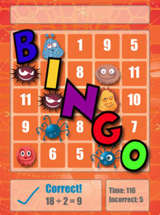
Exercise: MathAdding Game
Write a program that plays an adding game.
Ask user to solve random adding problems with n (2-5) numbers.
The user gets n-1 points for an addition with n numbers, 0 for incorrect.
A user has 3 lives (3 chances) to make mistakes.
4 + 10 + 3 + 10 = 27
9 + 2 = 11
8 + 6 + 7 + 9 = 25
Wrong! The answer was 30
5 + 9 = 13
Wrong! The answer was 14
4 + 9 + 9 = 22
3 + 1 + 7 + 2 = 13
4 + 2 + 10 + 9 + 7 = 42
Wrong! The answer was 32
You earned 9 total points.

Slide 24
Design Questions
Is the loop better controlled by for or while/do/while?
Indeterminate logical condition (cumulate 3 errors) -> more likely a while or do/while loop
How many times may the loop execute, at least once?
at least once => we may try a do/while loop

Slide 25
MathAddingGame Structure
Design question: we design a method playOneRound, what should the return be?
The user gets n-1 points for an addition with n numbers, 0 for incorrect.
// Asks the user to do adding problems and scores them.
import java.util.*;
public class MathAddingGame {
public static void main(String[] args) {
Scanner console = new Scanner(System.in);
// init. state
int totalPoints = 0;
int nChances = 3;
do {
// play a round; // update state: nChances, totalPoints
} while (nChances > 0);
System.out.println("You earned " + totalPoints + " total points.");
}

Slide 26
playOneRound Requirement
// play a round:
// return the # of points earned;
// 0 means user made a mistake
static int playOneRound()

Slide 27
playOneRound Structure
1 + 2 + 3 + 4 + 5 = 15
4 + 10 + 3 + 10 = 27
4 + 9 + 9 = 22
9 + 2 = 11
structure:
pick n = # of operands to be added (2-5)
build problem string
output problem to user
compute points to return

Slide 28
playOneRound
...
// Builds one addition problem and presents it to the user.
// Returns # of points earned.
public static int playOneRound(Scanner console) {
// print the operands being added, and sum them
int nOperands = randInt(2, 5);
int sum = 0;
int n = randInt(1, 10);
String question = “” + n; // post
for (int i = 2; i <= nOperands; i++) {
n = randInt(1, 10);
question += " + " + n; // wire + post
sum += n;
}
question += " = ";
// read user's guess
int guess = getInt( console, question );
if (guess == sum)
return nOperands - 1;
else
return 0;
} // end of playOneRound
Notes:
演示代码

Slide 29
MathAddingGame Program
// Asks the user to do adding problems and scores them.
import java.util.*;
public class MathAddingGame {
public static void main(String[] args) {
Scanner console = new Scanner(System.in);
// play until user gets 3 wrong
int totalPoints = 0;
int nChances = 3;
do {
int roundPoints = playOneRound(console);
totalPoints += roundPoints;
if ( roundPoints == 0) {
nChances--;
}
} while (nChances > 0);
System.out.println("You earned " + totalPoints + " total points.");
}

Slide 30
Roadmap: Foundational Programming Concepts
any program you might want to write
objects
methods and classes
graphics, sound, and image I/O
arrays
conditionals and loops
math
text I/O
primitive data types
assignment statements

Slide 31
Outline
Arrays
Array reviews
Arrays and reference semantics

Slide 32
Recap: Arrays
Arrays are similar to primitives in most ways, e.g.,
Pass arrays as parameters, e.g., public static double average(int[] numbers)
Differences between arrays and primitives e.g.,
Declare and initialize int[] numbers = new int[10]; char[] letterGrades = {'A', 'B', 'C', 'D', 'F'};
Syntax to access array elements, e.g.,
numbers[1] = 3;
numbers[2] = 2;
numbers[ numbers[2] ] = 42;
Reference vs value semantics

Slide 33
Outline
Arrays
Array reviews

Slide 34

Coupon-Collector Problem
Given N different types of chocolates, and you get one random type each day. Simulate how many days you need in order to have (at least) one of each type.
Coupon优惠券

Slide 35
Coupon-Collector Problem: Pseudo Code
How?
// assume items are numbered 0 to N - 1
repeat when not collected all distinct items
pick a random item
if item is new
record new item

Slide 36
Coupon-Collector Problem: Pseudo Code
// assume items are numbered 0 to N – 1
int distinct = 0;
while distinct < N
pick a random item
if item is new
record new item
distinct ++;
How?

Slide 37
Coupon-Collector Problem: Pseudo Code
// assume items are numbered 0 to N – 1
int distinct = 0;
boolean[] has = new boolean[N];
while distinct < N
pick a random item
if item is new
has[item] = true; // record new item
distinct ++;

Slide 38
Coupon-Collector Problem
public class CouponCollector {
public static void main(String[] args) {
int N = Integer.parseInt(args[0]);
int cnt = 0; // number of received collected
int distinctCnt = 0; // number of distinct
boolean[] has = new boolean[N]; // array keeping state
while (distinctCnt < N) {
int val = rand(0, N-1);
cnt++;
if (!has[val]) { // find state var
distinctCnt++;
has[val] = true; // update state var
}
}
// all N distinct cards found
System.out.println(cnt);
}}
Notes:
演示

Slide 39
For Those Who are Curious
# 1:
pick a new one with prob. 1
# 2
pick a new one with prob. (N-1)/N, and hence needs ~N/(N-1) for a new one
# 3
pick a new one with prob. (N-2)/N, and hence needs N/(N-2)
=> N (1 + 1/2 + 1/3 + … + 1/N) ~ N ln N.
N = 30 chocolate types. Expect to wait ≈ 120 days.

Slide 40
Array Merge Question
Write a method merge that accepts two arrays of integers and returns a new array containing all elements of the first array followed by all elements of the second.
int[] a1 = {12, 34, 56};
int[] a2 = {7, 8, 9, 10};
int[] a3 = merge(a1, a2);
System.out.println( Arrays.toString(a3) );
// [12, 34, 56, 7, 8, 9, 10]

Slide 41
Array Merge
// Returns a new array containing all elements of a1
// followed by all elements of a2.
public static int[] merge(int[] a1, int[] a2) {
int[] result = new int[a1.length + a2.length];
for (int i = 0; i < a1.length; i++) {
result[i] = a1[i];
}
for (int i = 0; i < a2.length; i++) {
result[a1.length + i] = a2[i];
}
return result;
}

Slide 42
Array Merge 3 Question
Write a method merge3 that merges 3 arrays similarly.
int[] a1 = {12, 34, 56};
int[] a2 = {7, 8, 9, 10};
int[] a3 = {444, 222, -1};
int[] a4 = merge3(a1, a2, a3);
System.out.println( Arrays.toString(a4) );
// [12, 34, 56, 7, 8, 9, 10, 444, 222, -1]
Notes:
I probably won't reach this in lecture; it's here just in case.

Slide 43
Array Merge 3
// Returns a new array containing all elements of a1,a2,a3.
public static int[] merge3(int[] a1, int[] a2, int[] a3) {
int[] a4 = new int[a1.length + a2.length + a3.length];
for (int i = 0; i < a1.length; i++) {
a4[i] = a1[i];
}
for (int i = 0; i < a2.length; i++) {
a4[a1.length + i] = a2[i];
}
for (int i = 0; i < a3.length; i++) {
a4[a1.length + a2.length + i] = a3[i];
}
return a4;
}
// Shorter version that calls merge.
public static int[] merge3(int[] a1, int[] a2, int[] a3) {
return merge(merge(a1, a2), a3);
}
Discussion: Which version do you use?

Slide 44
Complexity Analysis
V1
Creation of array (static complexity)
One array of size N1 + N2 + N3
Copy values (dynamic)
N1 + N2 + N3 values
V2
Creation of array
First size N1 + N2; second size (N1 + N2) + N3
Copy values
First N1 + N2
Then N1 + N2 + N3

Slide 45
Outline
Arrays
Array reviews
Arrays and reference semantics

Slide 46
Motivation: Primitive swap
public static void main(String[] args) {
int a = 1;
int b = 2;
System.out.println(a + " " + b); // ?
swap(a, b);
System.out.println(a + " " + b); // ?
}
public static void swap(int a, int b) {
// swap a and b’s values
int temp = a;
a = b;
b = temp;
System.out.println(a + " " + b); // ?
}
Notes:
It's basically not possible to write a swap method that accepts two ints.
swap can't escape from itself to modify the outside world.

Slide 47
Motivation: Array Reversal
public static void main(String[] args) {
int[] a = {1, 2};
System.out.println( Arrays.toString(a) );
reverse(a);
System.out.println( Arrays.toString(a) );
}
public static void reverse(int[] a) {
for (int i = 0; i < a.length / 2; i++) {
int temp = a[i];
a[i] = a[a.length-1-i];
a[a.length-1-i] = temp;
}
}
Notes:
演示

Slide 48
Value Semantics and Reference Semantics
Primitive data types use value semantics: variable stores value
Non primitive data types (e.g., arrays and objects) use reference semantics: variable stores reference address
int x = 5;
x | 5
Reference 引用
int[] a = {1, 2, 3};
1
See printVariable() of ArrayAsRef.java
2
Address of an array
3
a
Notes:
演示

Slide 49
References
Why reference variables
Efficiency. Copying large objects/arrays slows down a program
Sharing. It's useful to share an object/array's data among methods

Slide 50
Value/Reference Semantics and Assignment
When variable a is assigned to variable b: b = a it is always that the content of a is copied to b
if a value type, then it is the value that is copied
if a reference type, then it is the reference that is copied, b becomes an alias of a

Slide 51
Example: Value Assignment
Modifying the value of one value variable does not affect others.
int x = 5;
int y = x; // x = 5, y = 5
y = 17; // x = 5, y = 17
x = 8; // x = 8, y = 17
x | 5
x | 8
y | 17
y | 5

Slide 52
Example: Reference Assignment
Modifying an object/array through one reference variable changes the object/array and hence all references to the same object/array see the changes.
int[] a1 = {1, 2, 3};
int[] a2 = a1; // same array
Address of array object 1
a1
1
Content copied, but content is address
2
3
Address of array object 1
a2
a2[1] = 4;

Slide 53
Example: Reference Assignment
Modifying an object/array through one reference variable changes the object/array and hence all references to the same object/array see the changes.
int[] a1 = {1, 2, 3};
int[] a2 = a1; // same array
Address of array object 1
a1
1
Content copied, but content is address
4
3
Address of array object 1
a2
a2[1] = 4;

Slide 54
Special Case: Value/Reference Semantics and Parameter Passing
Each time a method is called, the actual argument in the invocation is copied into the corresponding formal argument => if a parameter is a reference type, then the actual argument and the formal argument now refer to the same object
Notes:
读一下

Slide 55
Example
public static void main(String[] args) {
int[] iq = {120, 160, 95};
doubleArray(iq);
System.out.println(Arrays.toString(iq));
}
static void doubleArray (int[] iqp)
{
for (int i = 0; i < iqp.length; i++) iqp[i] *= 2; }

Slide 56
Example: Illustration
public static void main(String[] args) {
int[] iq = {120, 160, 95};
doubleArray(iq);
System.out.println(Arrays.toString(iq));
}
iq
120
240
160
320
95
190
static void doubleArray (int[] iqp)
iqp
{
for (int i = 0; i < iqp.length; i++) iqp[i] *= 2; }
i

Slide 57
Exercise
Write a method swapTwo that accepts an array of integers and two indexes and swaps the elements at those indexes.
int[] a1 = {12, 34, 56};
swapTwo(a1, 1, 2);
System.out.println(Arrays.toString(a1)); // [12, 56, 34]
// Swaps the values at the given two indexes.
public static void swapTwo(int[] a, int i, int j) {
int temp = a[i];
a[i] = a[j];
a[j] = temp;
}

Slide 58
Exercise
Write a method swapAll that accepts two same-size arrays of integers as parameters and swaps their entire contents.
int[] a1 = {10, 11, 12};
int[] a2 = {20, 21, 22};
swapAll(a1, a2);
System.out.println(Arrays.toString(a1)); // [20, 21, 22]
System.out.println(Arrays.toString(a2)); // [10, 11, 12]
// Does this method swap the entire contents of
// a1 with those of a2?
public static void swapAll1(int[] a1, int[] a2) {
int[] temp = a1;
a1 = a2;
a2 = temp;
}
Notes:
No

Slide 59
Why it does not work? Init.
public static void main(String[] args) {
int[] a1 = {10, 11, 12};
int[] a2 = {20, 21, 22};
}
120
a1
10
160
11
95
12
120
a2
20
160
21
95
22

Slide 60
Why it does not work? Invoke
public static void main(String[] args) {
int[] a1 = {10, 11, 12};
int[] a2 = {20, 21, 22};
swapAll (a1, a2);
}
120
a1
10
160
11
95
12
120
a2
20
160
21
95
22

Slide 61
Why it does not work? Invoke
public static void main(String[] args) {
int[] a1 = {10, 11, 12};
int[] a2 = {20, 21, 22};
swapAll (a1, a2);
}
120
a1
10
160
11
95
12
120
a2
20
160
21
95
22
static void swapAll(int[] a1, int[] a2)
{
}
a1
a2

Slide 62
Why it does not work? Swap (temp = a1)
public static void main(String[] args) {
int[] a1 = {10, 11, 12};
int[] a2 = {20, 21, 22};
swapAll (a1, a2);
}
120
a1
10
160
11
95
12
120
a2
20
160
21
95
22
static void swapAll(int[] a1, int[] a2)
{
int[] temp = a1;
}
a1
temp
a2

Slide 63
Why it does not work? Swap (a1 = a2)
public static void main(String[] args) {
int[] a1 = {10, 11, 12};
int[] a2 = {20, 21, 22};
swapAll (a1, a2);
}
120
a1
10
160
11
95
12
120
a2
20
160
21
95
22
static void swapAll(int[] a1, int[] a2)
{
int[] temp = a1;
a1 = a2;
}
a1
temp
a2

Slide 64
Why it does not work? Swap (a2 = temp)
public static void main(String[] args) {
int[] a1 = {10, 11, 12};
int[] a2 = {20, 21, 22};
swapAll (a1, a2);
}
120
a1
10
160
11
95
12
120
a2
20
160
21
95
22
static void swapAll(int[] a1, int[] a2)
{
int[] temp = a1;
a1 = a2;
a2 = temp; }
a1
temp
a2

Slide 65
Why it does not work? After swapAll
public static void main(String[] args) {
int[] a1 = {10, 11, 12};
int[] a2 = {20, 21, 22};
swapAll (a1, a2);
}
120
a1
10
160
11
95
12
120
a2
20
160
21
95
22

Slide 66
Solution
// Swaps the entire contents of a1 with those of a2.
public static void swapAll(int[] a1, int[] a2) {
for (int i = 0; i < a1.length; i++) {
int temp = a1[i];
a1[i] = a2[i];
a2[i] = temp;
}
}

Slide 67
Outline
Arrays
Array reviews
Arrays and reference semantics
Arrays and digital audio

Slide 68
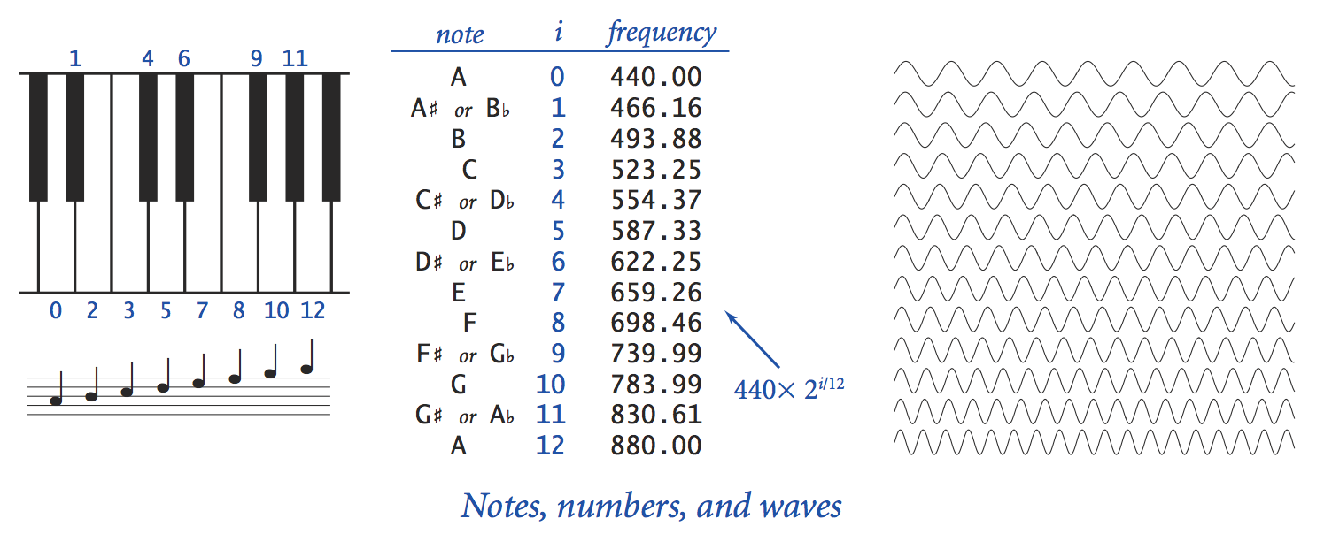
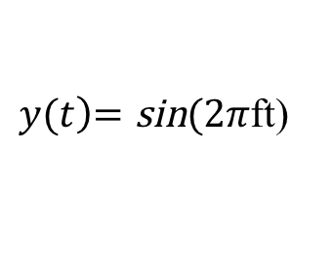
Sound
Sound is the perception of vibrations in our eardrums.
Perception 感知
Vibrations震动
Eardrums 耳膜
$y(t\left)=\text{sin}\right.(2π$ft)
Notes:
11/29/25
68
68

Slide 69
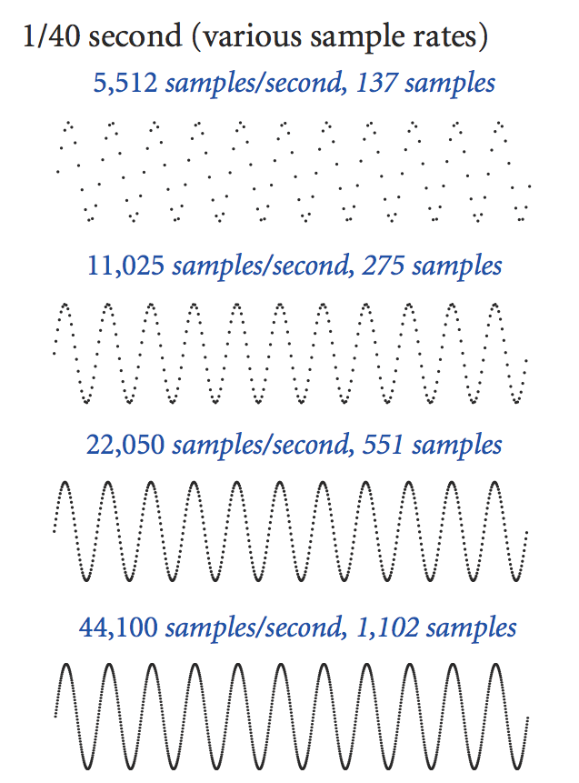
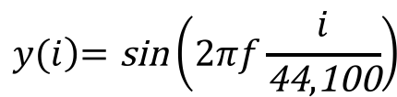
Digital Audio
Computer represents audio as a sequence of samples (how?)
When these samples are played in succession, it approximates the continuous sound
Audio CD
$$y(i\left)=\text{sin}\right.\left(2πf\frac{i}{\text{44},\text{100}}\right)$$
in succession 陆续
$y(t\left)=\text{sin}\right.(2π$ft)
Notes:
11/29/25
69
69
一系列散点

Slide 70
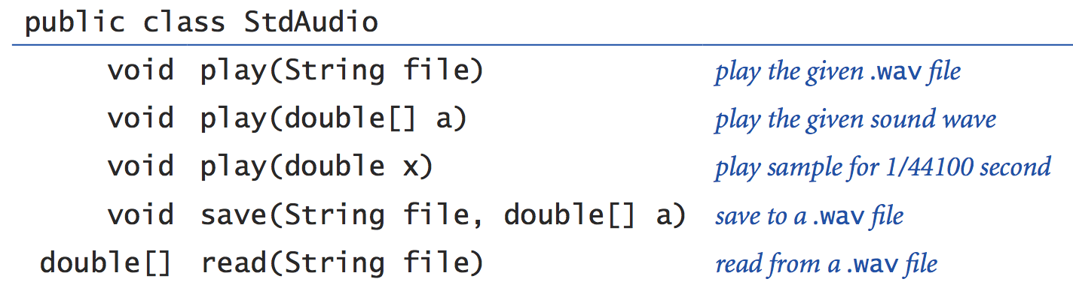
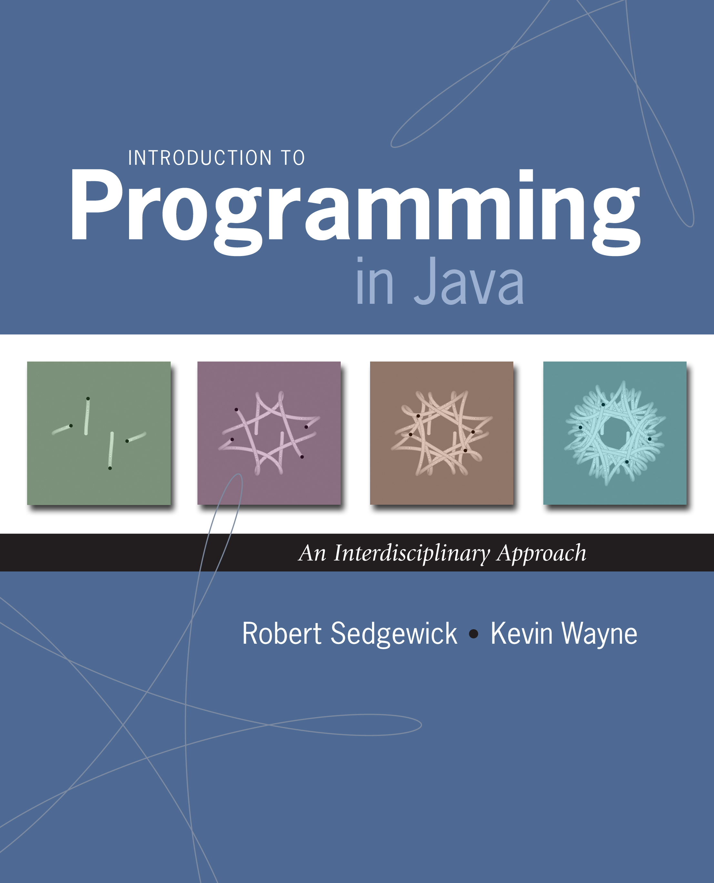
Use Digital Audio
Java has a complex digital audio system
We use the StdAudio library for playing and saving sound
Typical use: generate a sequence of samples, each for 1/44100 sec.
library developed from book:
70
Notes:
11/29/25
70
70

Slide 71

Example: Generate Musical Tone
Play Concert A (440hz) for 1.5 seconds using StdAudio.
a$(i\left)=\text{sin}\right.\left(2πf\frac{i}{\text{44},\text{100}}\right)$
final double hz = 440.0;
final double seconds = 1.5;
final int SAMPLE_RATE = 44100;
int N = (int) (seconds * SAMPLE_RATE);
double[] a = new double[N];
for (int i = 0; i < N; i++) {
a[i] = Math.sin(2 * Math.PI * hz * i / SAMPLE_RATE);
}
StdAudio.play(a);

Slide 72
Exercise: Generate Musical Tone from Array
Gen a tone from multiple frequencies

Slide 73
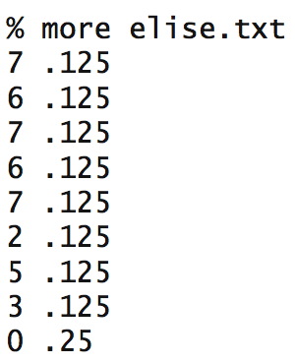
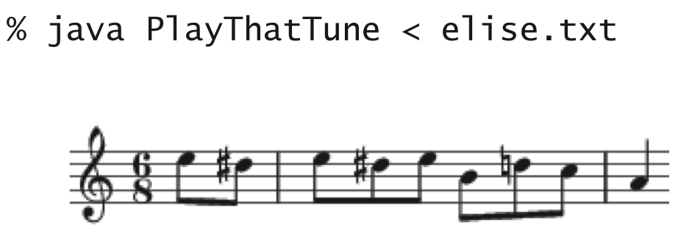
Example: PlayThatTune
Read in pitches and durations from standard input and sonify with StdAudio.
Notes:
11/29/25
73
73

Slide 74
PlayThatTune
public class PlayThatTune {
public static void main(String[] args) {
Scanner console = new Scanner( System.in );
while (console.hasNextInt()) {
int pitch = console.nextInt();
double seconds = console.nextDouble();
double hz = 440.0 * Math.pow(2, pitch / 12.0);
int SAMPLE_RATE = 44100;
int N = (int) (seconds * SAMPLE_RATE);
double[] a = new double[N];
for (int i = 0; i < N; i++) {
a[i] = Math.sin(2 * Math.PI * hz * i / SAMPLE_RATE);
}
StdAudio.play(a);
}
}
}
Same as before
Notes:
11/29/25
74
74
Pow: 第一个参数的第二个参数次方。

Slide 75
Outline
Arrays
Array reviews
Arrays and reference semantics
Arrays and digital audio
Multidimensional arrays

Slide 76
Motivation
Arrays are used in many settings, e.g.,
1d array in sound
2d in image processing, graph processing

Slide 77
Understanding Two Dimensional Array: An Array of Arrays
int[][] table = new int[3][4];
for (int i = 0; i < 3; i++) for (int j = 0; j < 4; j++)
table[i][j] = i + j;
table[ 0 ]
ref to array 0
table[ 1 ]
ref to array 1
table[ 2 ]
ref to array 2
table

Slide 78
Outline
Admin
Arrays
Array exercises
Arrays and reference semantics
Arrays and digital audio
Multidimensional arrays
Regular 2D arrays

Slide 79
Using 2-Dimensional Arrays
In most cases, you deal with regular 2D arrays, and hence no need to worry about the internal storage structure of 2-D arrays
final int NROWS = 3;
final int NCOLUMNS = 4;
int[][] table = new int[NROWS][NCOLUMNS];
for (int i = 0; i < NROWS; i++) for (int j = 0; j < NCOLUMNS; j++)
table[i][j] = i + j;

Slide 80
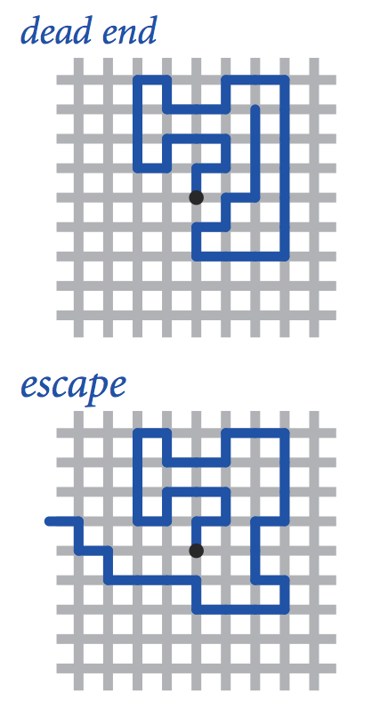
Example: Simulate Self-Avoiding Walk
Model.
N-by-N lattice(格子).
Start in the middle.
Each step randomly moves to a neighboring intersection, if a previously moved intersections, no move.
Two possible outcomes:
dead end and escape.

Slide 81
Key Design Points
How to represent the state of the visited status of the N-by-N lattice?
How to detect if (x,y) is a terminating state:
dead end (trap):
escape
boolean[][] visited = new boolean[N][N];
visited[x+1][y] && visited[x-1][y] && visited[x][y-1] && visited[x][y+1]
x == 0 || x == N-1 || y == 0 || y == N-1

Slide 82
Self-Avoiding Random Walk
// read in lattice size N as command-line argument.
// read in number of trials T as command-line argument.
// repeat T times:
// initialize (x, y) to center of N-by-N grid.
// repeat as long as (x, y) is not escape or trap
// mark (x, y) as visited.
// take a random step, updating (x, y).
// if not escape
increase #deadEnds
// print fraction of dead ends.
how to implement?

Slide 83
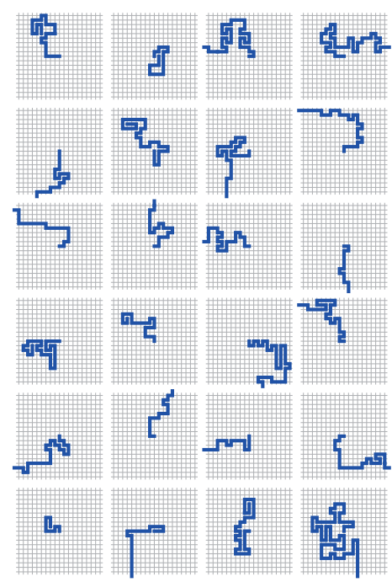
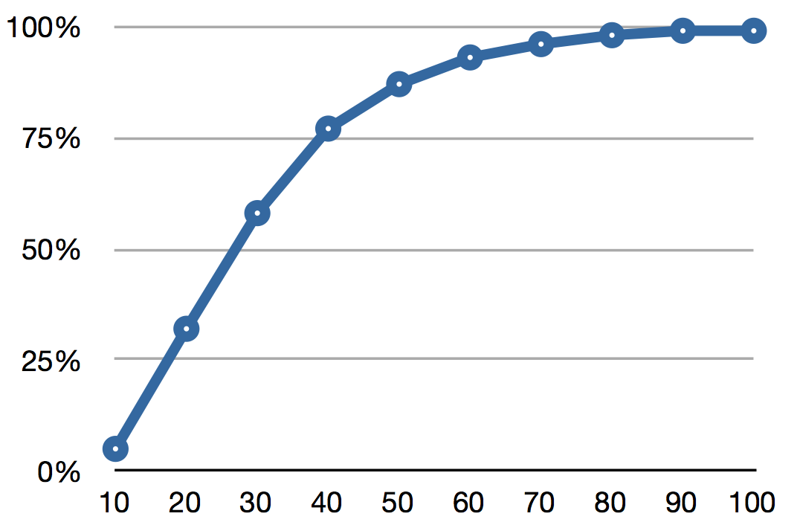
% java SelfAvoidingWalks 4 100000
0% dead ends
% java SelfAvoidingWalks 8 100000
1% dead ends
% java SelfAvoidingWalks 16 100000
20% dead ends
…
% java SelfAvoidingWalks 64 100000
94% dead ends
83

Slide 84
Outline
Admin
Arrays
Array exercises
Arrays and reference semantics
Arrays and digital audio
Multidimensional arrays
Regular 2D arrays
Irregular 2D arrays

Slide 85
Irregular Two-Dimensional Array
int[][] table = { {1, 2, 3, 4}, {5, 6, 7}, {8, 9}, {0} };
1
2
3
4
table[ 0 ]
ref to array 0
table[ 1 ]
ref to array 1
5
table[ 2 ]
ref to array 2
6
table[ 3 ]
ref to array 3
7
table
8
9
0

Slide 86
Irregular Two-Dimensional Array
int[][] table = { {1, 2, 3, 4}, {5, 6, 7}, {8, 9}, {0} };
1
2
3
int[][] table = new int[4][];
int[] temp0 = {1, 2, 3, 4};
table[0] = temp0;
int[] temp1 = {5, 6, 7};
table[1] = temp1;
int[] temp2 = {8, 9};
table[2] = temp2;
int[] temp3 = {0};
table[3] = temp3;
4
5
6
7
table[ 0 ]
ref to array 0
8
table[ 1 ]
ref to array 1
9
table[ 2 ]
ref to array 2
table
table[ 3 ]
ref to array 3
0

Slide 87
Access Irregular 2D Arrays
public class Test2DArray { public static void main(String[] args) { int[][] days = { {1, 2, 3, 4}, {5, 6, 7}, {8, 9}, {0} };
for (int i = 0; i < days.length; i++) { for (int j = 0; j < days[i].length; j++) System.out.print( days[i][j] ); System.out.println (); } } // end of main } // end of class

Slide 88
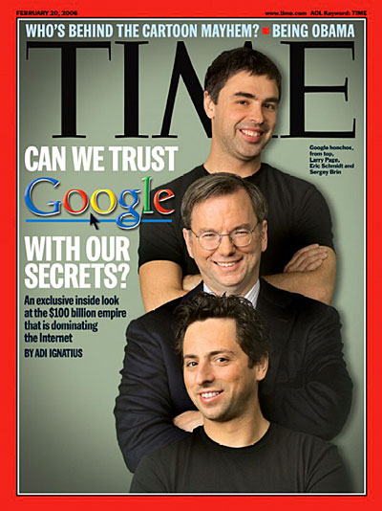
PageRank [Sergey Brin and Larry Page, 1998]
Problem: many Web pages may contain the searched key word (e.g., Yale), how to rank the pages when displaying search results?

Slide 89
PageRank [Sergey Brin and Larry Page, 1998]
Problem: many Web pages may contain the searched key word (e.g., Yale), how to rank the pages when displaying search results?
Basic PageRank™ idea
The 10-90 rule
10% of the time surfer(冲浪者) types a random page
90% of the time surfer clicks (follows) a random link on a given page
PageRank ranks pages according to frequencies (we call the pageranks) surfer visits the pages

Slide 90
Offline Exercise
Think about how to implement pagerank.

