Slide 1
Introduction to Computational Thinking
User-Defined Data Types Object-oriented programming
Qiao Xiang, Qingyu Song
https://sngroup.org.cn/courses/ct-xmuf25/index.shtml
12/3/2025
This deck of slides are heavily based on cs112 at Yale University and cs101 at UCAS, respectively,
by courtesy of Dr. Y. Richard Yang and Dr. Zhiwei Xu.

Slide 2
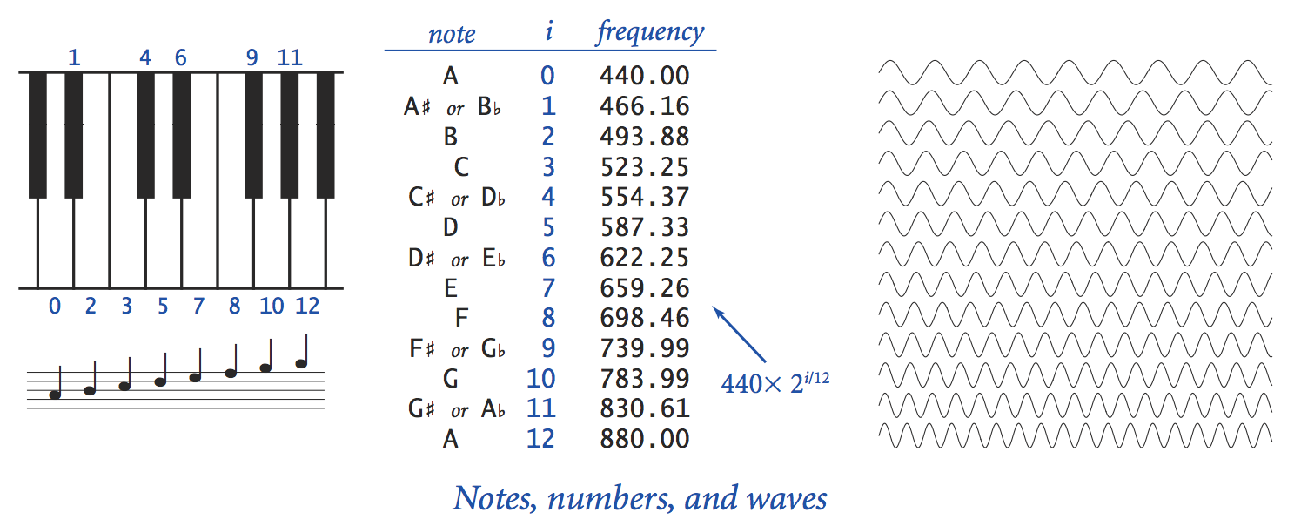
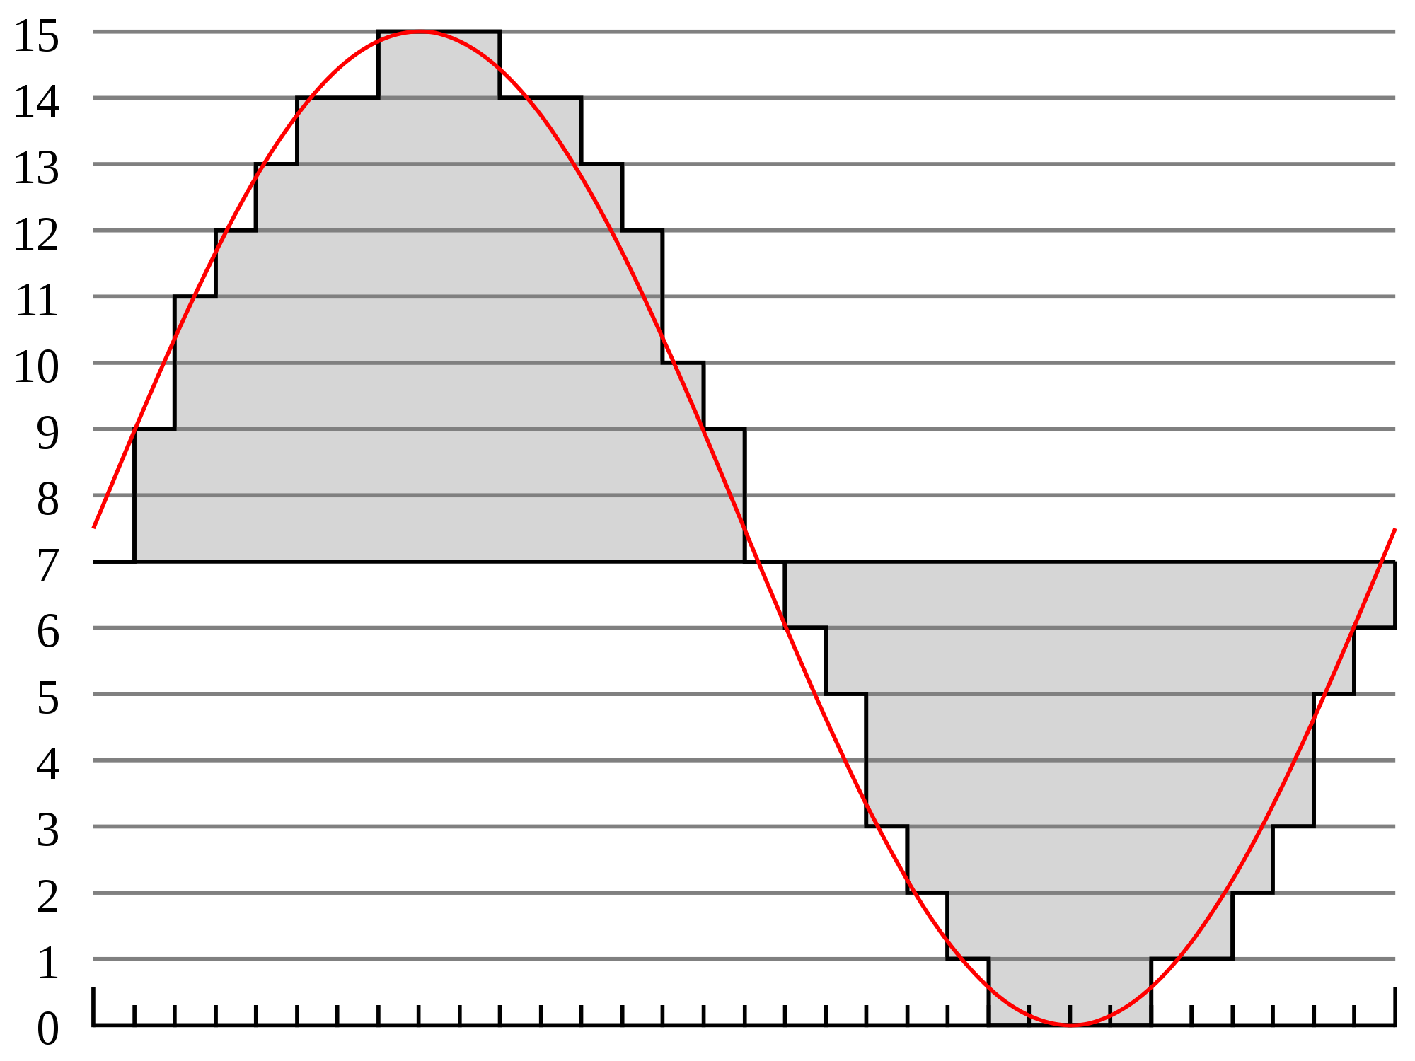
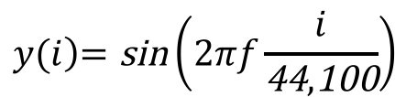
Recap: Digital Audio and Arrays
Audio is a composition of sin waves
Digital audio is samples of audio waves
$$y(i\left)=\text{sin}\right.\left(2πf\frac{i}{\text{44},\text{100}}\right)$$

Slide 3
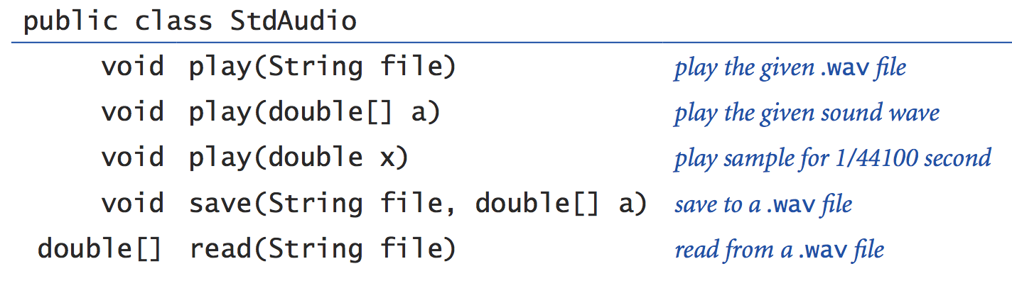
Recap: Digital Audio and Arrays
Audio synthesis is to generate the sin waves and send to the speaker ( StdAudio.play() )
StdAudio plays/saves audio samples
final double hz = 440.0;
final double seconds = 1.5;
final int SAMPLE_RATE = 44100;
int N = (int) (seconds * SAMPLE_RATE);
double[] a = new double[N];
for (int i = 0; i < N; i++) {
a[i] = Math.sin(2 * Math.PI * hz * i / SAMPLE_RATE);
}
StdAudio.play(a);

Slide 4
Recap: Multidimensional Arrays
int[][] table = { {1, 2, 3, 4}, {5, 6, 7}, {8, 9}, {0} };
1
2
3
4
table[ 0 ]
ref to array 0
table[ 1 ]
ref to array 1
5
table[ 2 ]
ref to array 2
6
table[ 3 ]
ref to array 3
7
table
8
9
0

Slide 5
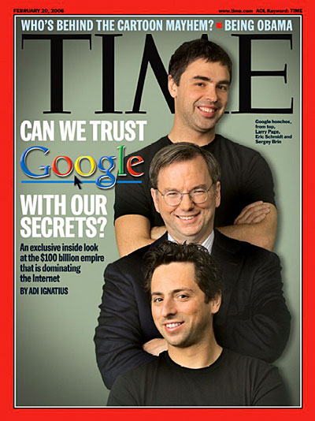
PageRank [Sergey Brin and Larry Page, 1998]
Problem: many Web pages may contain the searched key word (e.g., XMU), how to rank the pages when displaying search results?
Basic PageRank™ idea
The 10-90 rule
10% of the time, user types a random page
90% of the time, user clicks (follows) a random link on a given page
PageRank ranks pages according to frequencies (we call the pageranks) user visits the pages

Slide 6
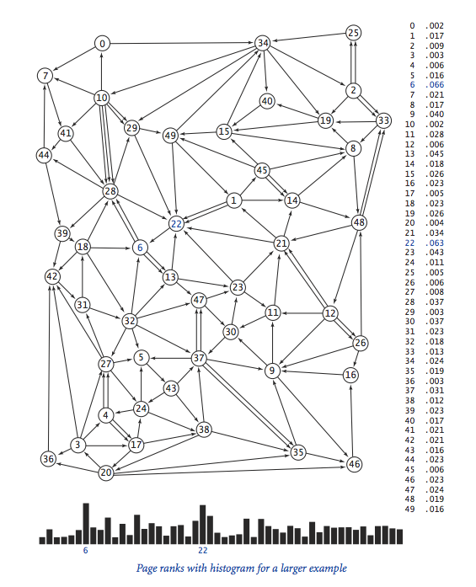
PageRank
Notes:
统计点击次数和总数，算频率

Slide 7
High-Level Structure of Google PageRank System
Obtain Web Graph
Compute Pagerank
Notes:
接下来看实现

Slide 8
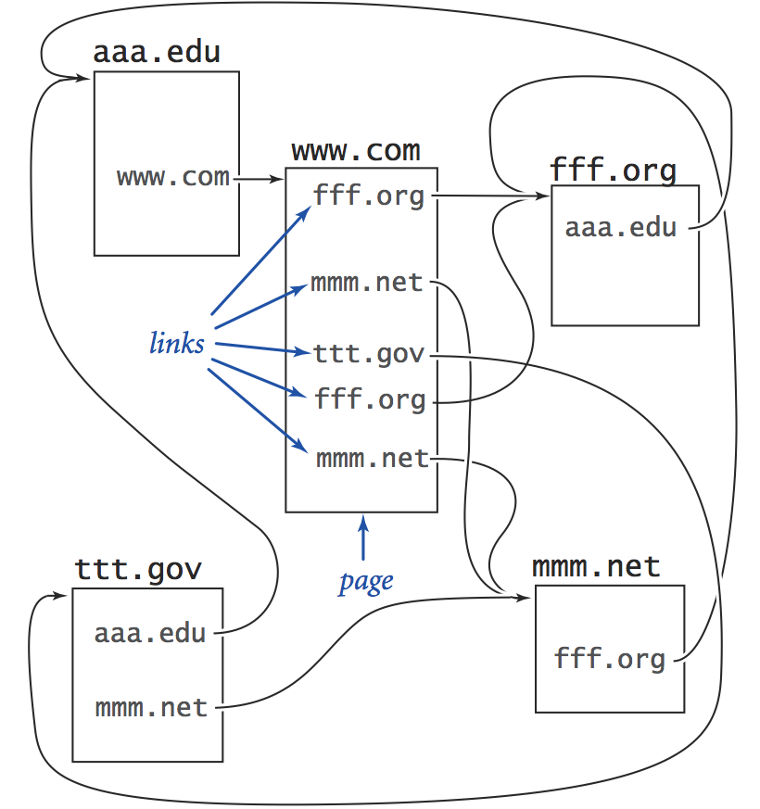
Obtain Web Graph
Crawl the Web to obtain Web pages
Parse pages to obtain links among pages
Notes:
Crawl 爬

Slide 9
Storing Web Graph
Number pages 0 to N – 1
Approach 1: a regular array storing connectivity matrix
conn[i][j] = 1 if page i links to page j; 0 otherwise
Q: How big is the array?
Most are 0

Slide 10
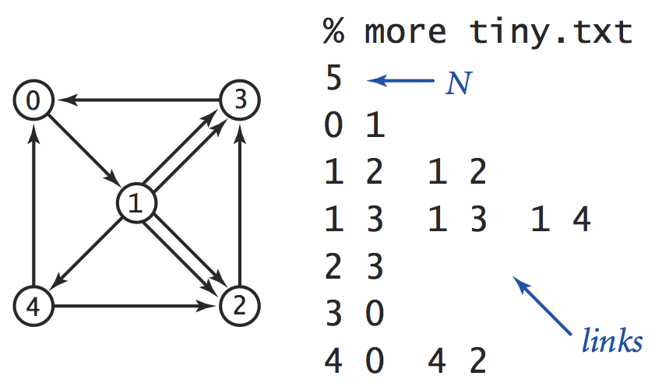
Storing Web Graph
Number pages 0 to N – 1
Approach 2: adjacent list
edges[i]: stores the pages that page i links to

Slide 11
Storing Web Graph: Adjacent List
#pages; allow 1-pass read
5
1
2 2 3 3 4
3
0
0 2
page 0 has 1 outgoing link to page 1
page 1 has four 5 outgoing links to pages 2, 2, 3, 3, 4
Outgoing adjacency List:
Each line for one page
Stores the links contained in this page
Notes:
第一个列出了有多少网页

Slide 12
PageRank: Load Web Graph
5
1
2 2 3 3 4
3
0
0 2
Scanner input = new Scanner(new File("tiny-web.txt"));
// First read N, the number of pages
int N = Integer.parseInt(input.nextLine());
// An irregular 2D array to keep track of outgoing links
int[][] outgoingLinks = new int[N][];
// read in graph one line at a time
for (int i = 0; i < N; i++) {
String line = input.nextLine(); // read outgoing links of i
String[] links = line.split(" ");
outgoingLinks[i] = new int[links.length];
for (int j = 0; j < links.length; j++) {
outgoingLinks[i][j] = Integer.parseInt(links[j]);
}
}
Notes:
tiny-web.txt 在右上角

Slide 13
Approach 1: Simulating Random Walk among Web Pages
// assume N pages
node = init position of user at a node visited[node] ++;
Loop
pick a random number to decide restart or follow links
if random chooses restart (10% chances)
node = choose random 0, N-1
else // follow links
nLinks = #outgoing links of node
outIndex = choose random 0, nLinks-1;
node = links[node][outIndex]
visited[node] ++
Sort visited array
Notes:
下一步，实现前面描述的点击过程？
读伪码

Slide 14
Approach 2: (Large-Popultion) Round-Based Visit Distribution
Assume current round page rank (frequency, #visitors) of page p_{i} is PR_{c}(p_{i})
Next round page rank
Each page gets 1/N of the 0.1 of total visitors
Each page distributes its 90% of its current-round frequency (visitors) equally among its outgoing hyperlinks
45=100*.9/2
100
p₁
45
60
x
60=200*.9/3
200
p₂
…
60
p_{n}
Distributes 散步
Notes:
看示例

Slide 15
Round-Based PageRank
Initialize arbitrary page ranks
Iterative algorithm to simulate visit redistribution
Assume current round page rank of page p_{i} is PR_{c}(p_{i})
Update next round
p₁
PR_{pre}(): outbound links to p_{i}.
C(): count of outbound links.
x
p₂
…
p_{n}
https://www.mlpod.com/36.html
Notes:
解释公式

Slide 16
PageRank: Compute Rank
double[] pr = new double[N];
pr[0] = 1; // initialize to assume start at web page 0
// or Arrays.fill(pr, 1.0 / N);
for (int t = 0; t < 20; t++) {
double[] newpr = new double[N]; // init newpr
Arrays.fill(newpr, 0.1 / N);
// loop over the node to redistribute the frequencies
for (int i = 0; i < N; i++) { // redistribute node i
for (int j = 0; j < outgoingLinks[i].length; j++) {
int to = outgoingLinks[i][j];
newpr[to] += 0.9 * pr[i] / outgoingLinks[i].length;
}
}
pr = newpr; // swap newpr to be pr
System.out.printf("pr[%2d] = %s\n", t, Arrays.toString(pr) );
}
Notes:
看演示代码

Slide 17
Comment
In real life, since the number of pages is too large for a single machine to compute, Google uses its MapReduce framework to do the updates using multiple machines
We will touch upon Hadoop (open source implementation of MapReduce) and Spark later in the course

Slide 18
Roadmap: Foundational Programming Concepts
any program you might want to write
objects
methods and classes
graphics, sound, and image I/O
arrays
conditionals and loops
math
text I/O
primitive data types
assignment statements

Slide 19
Programming Organizing Structure
Method and class are concepts for programming organization
Method provides an abstraction to group a sequence of statements
abstraction: we can use it without knowing its details
Class
So far our usage is to group similar methods (such as a folder) together, e.g., the Math class pre-defined by Java
A general, important functionality of class is to organize both data and behaviors

Slide 20
Road Ahead: Object Oriented Programming
Four steps
Struct data type (organize data together)
Object-oriented programming (organize data and code)
Class inheritance (reuse code)
Polymorphism (reuse code, allowing adaptation)
Inheritance 继承
Polymorphism 多态

Slide 21
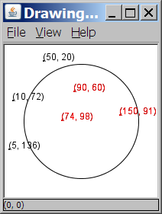
A Programming Problem
Given a file of cities' (x, y) coordinates, which begins with the number of cities:
6
50 20
90 60
10 72
74 98
5 136
150 91
Write a program to draw the cities and then drop a center point and turn all cities that are within a given radius red :
Center site x? 100
Center site y? 100
Radius? 75

Slide 22
Solution We Can Do So Far
Scanner input = new Scanner(new File("cities.txt"));
int cityCount = input.nextInt();
int[] xCoords = new int[cityCount];
int[] yCoords = new int[cityCount];
Scanner console = new Scanner( System.in );
int xCenter = console.nextInt();
int yCenter = console.nextInt();
for (int i = 0; i < cityCount; i++) {
xCoords[i] = input.nextInt(); yCoords[i] = input.nextInt();
if (distance(xCoords[i], yCoords[i], xCenter, yCenter ) < THRESHOLD) { // draw red
} else …
}
Parallel arrays: 2 arrays with related data at same indexes.
Conceptually, we should have just a single array of points.
Notes:
通过一个例子引出类的作用

Slide 23
A Conceptual Design
Scanner input = new Scanner(new File("cities.txt"));
int cityCount = input.nextInt();
Point[] points = new Point[cityCount];
Point pointCenter = readPointFromUser();
for (int i = 0; i < cityCount; i++) {
points[i] = readPoint(input);
if ( distance(points[i], pointCenter) < THRESHOLD) { // draw red
}
}
...
By introducing the concept of Point, we abstract away the details of the coordinate system
Notes:
红字是修改的部分

Slide 24
Summary: Complex Data Type Motivation
2 parallel arrays
2 parallel arrays
2 parallel arrays
Scanner input = new Scanner(new File("cities.txt"));
int cityCount = input.nextInt();
int[] xCoords = new int[cityCount];
int[] yCoords = new int[cityCount];
for (int i = 0; i < cityCount; i++) { xCoords[i] = input.nextInt(); yCoords[i] = input.nextInt();
if (distance(xCoords[i], yCoords[i], xCenter, yCenter ) < THRESHOLD) { // draw red
}
}
points
points
point abstraction
Scanner input = new Scanner(new File("cities.txt"));
int cityCount = input.nextInt();
Point[] points = new Point[cityCount];
for (int i = 0; i < cityCount; i++) { points[i] = readPoint(input); if ( distance(points[i], pointCenter) < THRESHOLD) { // draw red
}
}

Slide 25
Language Support: Defining Point
Need a language structure to specify that each point is defined by two data components:
The x coordinate
The y coordinate
public class Point {
int x;
int y;
}
Save this code into a file named Point.java.
The above code creates a new user-defined type (class) named Point.
The Point class definition serves as a template for creating Point objects.

Slide 26
A Class and its client
Point.java is not, by itself, a runnable program.
A class can be used by multiple client programs.
Point.java (class of objects)
public class Point {
int x;
int y;
}
PointMain1.java (client program)
public class PointMain1 {
main(String args) {
Point p1 = new Point();
p1.x = 50;
p1.y = 27;
Point p2 = new Point();
p2.x = 98;
p2.y = 53;
}
}
x | 50 | y | 27
x | 98 | y | 53
Notes:
介绍定义的类和调用它的位置的关系

Slide 27
User-Defined Type Term: Fields
public class Point {
int x;
int y;
}
x or y is called a field (字段)
A non-static, class scope variable defined inside a class (new type)
A field is also called an instance variable, or an attribute
A field is part of the descriptive characteristics (state) of an object
Each object has its own copy of each field
More example:
public class BankAccount {
String acctName;
int acctNumber;
double balance;
}

Slide 28
Summary of Important Concepts: Class, Object, Variable, Field
public class Point {
int x;
int y;
}
The Point class definition serves as a template for creating Point objects.
A field (also called instance variable, attribute) is a class-scope, non-static variable describing characteristics of each object. Each object has its own copy of each field
A Point variable stores a reference to a Point object

Slide 29
Summary: Class, Object, Variable, Field
Object variables (references)
fields
class
objects
Point.java (class of objects)
public class Point {
int x;
int y;
}
PointMain.java (client program)
public class PointMain {
main(String args) {
Point p1 = new Point();
p1.x = 50;
p1.y = 27;
Point p2 = p1;
Point p3 = new Point();
p3.x = 98;
p3.y = 53;
...
}
}
x | 50 | y | 27
x | 98 | y | 53

Slide 30
Historical Note
Before object-oriented programming, traditional languages (e.g. C) already have a language structure called struct to allow user to define data types combining multiple data fields
Object-oriented languages go one step further to organize both data and methods together

Slide 31
Outline
Admin
Defining classes
Data encapsulation (struct)
Data+behavior encapsulation
Encapsulation 封装

Slide 32
Object Oriented Programming Overview
OOP philosophy. Software is a simulation of the real world.
We know (approximately) how the real world works.
Design software to model the real world.
Procedural(过程式) programming. [verb-oriented]
Tell the computer to do this or that.
Objected oriented programming (OOP). [noun-oriented]
Programming paradigm based on data types.
Identify objects that are part of the problem domain or solution.
Identity: objects are distinguished from other objects (references).
State: objects know things (instance variables).
Behavior: objects do things (methods).

Slide 33
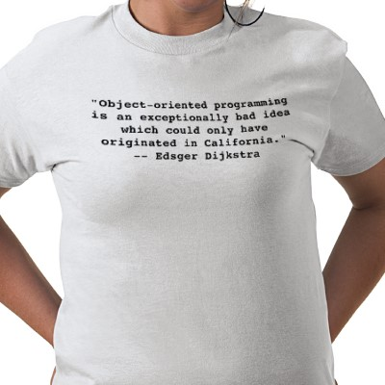
Object Oriented Programming

Slide 34


Alan Kay: Father of OOP
Alan Kay. [Xerox PARC 1970s]
Invented Smalltalk programming language.
Conceived (构思) Dynabook portable computer.
Ideas led to: laptop, modern GUI, OOP.
“ The computer revolution hasn't started yet. ”
“ The best way to predict the future is to invent it. ”
“ If you don't fail at least 90 per cent of the time, you're not aiming high enough. ”
— Alan Kay
Alan Kay
2003 Turing Award
Xerox PARC is research and development center in the US.
Notes:
http://www.sdsuniverse.info/Upload/Alan-Curtis-Kay.jpg
Kay was a computer science visionary. Motivated by deep interest in children and education.
Much of what you do everyday on a computer can be traced back to Alan Kay's ideas at Xerox PARC
The commercial computer is now about 50 years old and is still imitating the paper culture that came before it, just as the printing press did with the manuscript culture it gradually replaced. No media revolution can be said to have happened without a general establishment of "literacy:" fluent "reading" and "writing" at the highest level of ideas that the medium can represent.
"Java is the most distressing thing to hit computing since MS-DOS."

Slide 35
Motivation: Drawing Points
The client program PointMain1 draws Point objects:
// draw each city
Point p1 = new Point();
p1.x = 15;
p1.y = 37;
StdDraw.filledCircle(p1.x, p1.y, 3);
StdDraw.textLeft(p1.x, p1.y,
"(" + p1.x + ", " + p1.y + ")” );
Point p2 = new Point();
p2.x = 120;
p2.y = 140;
StdDraw.filledCircle(p2.x, p2.y, 3);
StdDraw.textLeft(p2.x, p2.y,
"(" + p2.x + ", " + p2.y + ")” );
Notes:
通过method简化代码

Slide 36
Eliminating Redundancy, v1
We can eliminate the redundancy with a static method:
// Draws the given point using StdDraw
public static void draw(Point p) {
StdDraw.filledCircle(p.x, p.y, 3);
StdDraw.textLeft(p.x, p.y, "(" + p.x + ", " + p.y + ")” );
}
Question: where is a natural class (Point or PointMain1) to define the method draw(Point p)?
Notes:
大家讨论，说出观点。
答案在之后的分析

Slide 37
Where do we Define draw(p): Attempt (意图) 1: in Point as a Static Method
public class Point {
int x;
int y;
public static void draw(Point p) {
StdDraw.filledCircle(p.x, p.y, 3);
StdDraw.textLeft(p.x, p.y, "(" + p.x + ", " + p.y + ")” );
}
}
Point p1 = new Point();
p1.x = 7; p1.y = 2;
Point.draw(p1);
Point p2 = new Point();
p2.x = 4; p2.y = 3;
Point.draw(p2);

Slide 38
Consistent Data Access and Method Access
Accessing point p’s x attribute
Point p = new Point();
p.x = 10;
p.y = 5;
Point.draw(p);
Accessing point p’s draw
behavior
p.draw();

Slide 39
Instance Methods
instance method (or object method): Exists inside each object of a class and gives behavior to each object.
public type name(parameters) {
statements;
}
same syntax as static methods, but without static keyword
Example:
public void shout() {
System.out.println("HELLO THERE!");
}
Notes:
不带static的方法
有些语义跟static一样

Slide 40
Instance Method example
Instance method (or object method) can access all class scope variables
public class Point {
int x;
int y;
// Draws this Point object with the given pen.
public void draw() {
StdDraw.filledCircle(x, y, 3);
StdDraw.textLeft(x, y,
"(" + x + ", " + y + ")”); }
}
}
The draw method no longer has a Point p parameter.
How will the method know which point’s x/y to draw?
p1: Point
x = 50
y = 27
p2: Point
x = 98
y = 53
Notes:
Instance method可以访问对象内部的属性

Slide 41
Invoking Instance Method
Format <obj>.<instance method>(…)
The <obj> provides an implicit parameter
Notes:
调用对象方法的原理

Slide 42
The Implicit Parameter
During the call p1.draw(); the object referred to by p1 is the implicit parameter.
During the call p2.draw(); the object referred to by p2 is the implicit parameter.
p1.draw()
draw(p1)
p2.draw()
draw(p2)
In an instance method, when we refer to a field, we are referring to the field of the implicit parameter.
We say that it executes in the context of a particular object.

Slide 43
Summary: Defining Related Method and Data in the Same Class: Instance Method
public class Point {
int x;
int y;
public static void draw(Point p) {
StdDraw.filledCircle(p.x, p.y, 3);
StdDraw.textLeft(p.x, p.y,
"(" + p.x + ", " + p.y + ")”);
}
}
p1 provides the implicit parameter: The x and y in draw() are those of the object referenced by p1.
Point p1 = new Point();
p1.x = 7; p1.y = 2;
p1.draw(); // Point.draw(p1);
Point p2 = new Point();
p2.x = 4; p2.y = 3;
p2.draw(); // Point.draw(p2);
p2 provides the implicit parameter: The x and y in draw() are those of the object referenced by p2.
Notes:
从static method instance method是什么使用的

Slide 44
Point objects w/ method
Each Point object has its own copy of the draw method, which operates on that object's state:
Point p1 = new Point();
p1.x = 7;
p1.y = 2;
Point p2 = new Point();
p2.x = 4;
p2.y = 3;
p1.draw();
p2.draw();
p1
public void draw() {
// this code can see p1's x and y
}
x | 7 | y | 2
public void draw() {
// this code can see p2's x and y
}
x | 4 | y | 3
p2
Notes:
两个方法访问属性是各自的类

Slide 45
Static Method vs Instance Method
public class Point {
int x;
int y;
public static void draw(Point p) {
StdDraw.filledCircle(p.x, p.y, 3, 3);
StdDraw.textLeft(p.x, p.y, "(" + p.x + ", " + p.y + ")” );
}
}
public class Point {
int x;
int y;
public static void draw(Point p) {
StdDraw.filledCircle(p.x, p.y, 3, 3);
StdDraw.textLeft(p.x, p.y, "(" + p.x + ", " + p.y + ")”);
}
}
Notes:
对比

Slide 46
Benefit of Instance Method
Point p = new Point();
p.x = 10;
p.y = 5;
p.draw();
Consistent (same) syntax(语法) accessing data and behaviors: a class is an abstraction for a collection of objects with common
data fields (attributes)
behaviors/services (i.e., what such objects can do or be done to them)
Notes:
类的含义

Slide 47
Instance Method questions
Write an instance method toString to generate string (x, y)
Write an instance method translate that changes a Point's location by a given dx, dy amount.
Write an instance method distanceFrom that returns the distance between the Point and another point
Use the formula:

