Slide 1
Outline
OOP analysis examples
Random objects vs Math.random
DrawingPanel objects vs StdDraw

Slide 2
StdDraw
Java graphics by nature is OOP
StdDraw is a library to hide OOP programming complexity (No objects)
Just as Math.random is a delegation to a single Random object StdDraw is a delegation to a graphics window

Slide 3
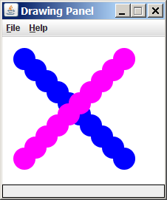
DrawingPanel Design
Developed for the Back to Basics Textbook, using an OOP approach. Two key classes (types of objects):
DrawingPanel: A window on the screen.
Not part of Java; provided by the textbook.
Graphics: A "pen" to draw shapes and lines on a window.
from Java standard class library

Slide 4
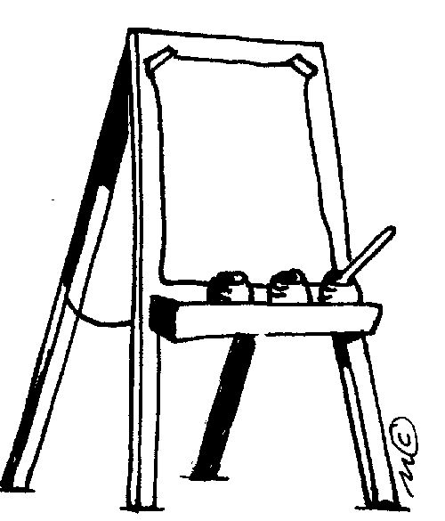
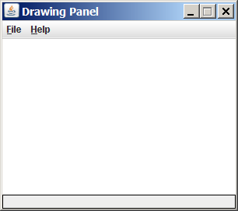
DrawingPanel
A "Canvas" object that represents windows/drawing surfaces
To create a window:
DrawingPanel name = new DrawingPanel(width, height);
Example:
DrawingPanel panel = new DrawingPanel(300, 200);
See SimplePanels.java

Slide 5

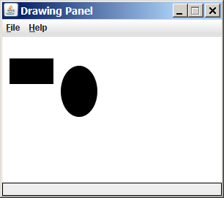
Graphics
DrawingPanel draws shapes / lines /characters /imagines using another object of type Graphics.
Graphics: Your painting toolset: "Pen" or "paint brush" objects to remember state and draw lines and shapes; fonts for character, …
Access it by calling getGraphics on a DrawingPanel object.
Graphics g = panel.getGraphics();
Draw shapes by calling methods on the Graphics object.
g.setColor(Color.BLACK);
g.fillRect(10, 30, 60, 35);
g.fillOval(80, 40, 50, 70);

Slide 6
Graphics Coordinate System
Each (x, y) position is a pixel ("picture element").
Position (0, 0) is at the window's top-left corner.
x increases rightward and the y increases downward.
A rectangle from (0, 0) to (200, 100) looks like this:
(0, 0) x+
(200, 100)
y+

Slide 7
Some Graphics Methods
Method name | Description
g.setColor(Color); | set Graphics to paint any following shapes in the given color
g.drawLine(x1, y1, x2, y2); | line between points (x1, y1), (x2, y2)
g.drawOval(x, y, width, height); | outline largest oval that fits in a box of size width * height with top-left at (x, y)
g.drawRect(x, y, width, height); | outline of rectangle of size width * height with top-left at (x, y)
g.drawString(text, x, y); | text with bottom-left at (x, y)
g.fillOval(x, y, width, height); | fill largest oval that fits in a box of size width * height with top-left at (x, y)
g.fillRect(x, y, width, height); | fill rectangle of size width * height with top-left at (x, y)
See SimplePanels.java
http://download.oracle.com/javase/6/docs/api/java/awt/Graphics.html

Slide 8
Outline
OOP analysis examples
Random objects vs Math.random
Complex numbers and fractal graphics
Notes:
fractal graphics 分形图形

Slide 9

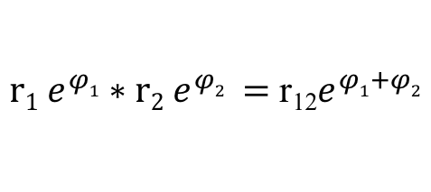

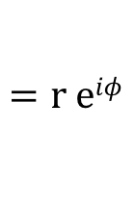
Complex Numbers
A complex number (a + bi) is a quintessential mathematical abstraction
(a + bi) + (c + di) = a + c + (b + d) i
(a + bi) x (c + di) = ac - bd + (ad + bc)i
A main power of complex numbers comes from Euler’s formula
a = 3 + 4i, b = -2 + 3i
a + b = 1 + 7i
a ∗ b = -18 + i
| a | = 5
r $[\cos\left(φ\right)+\sin\left(φ\right)i]$
$$=r eiφ$$
$r1 e^{φ1}∗r2 e^{φ2} =$ r₁₂$e^{φ1+φ2}$
$$φ$$

Slide 10
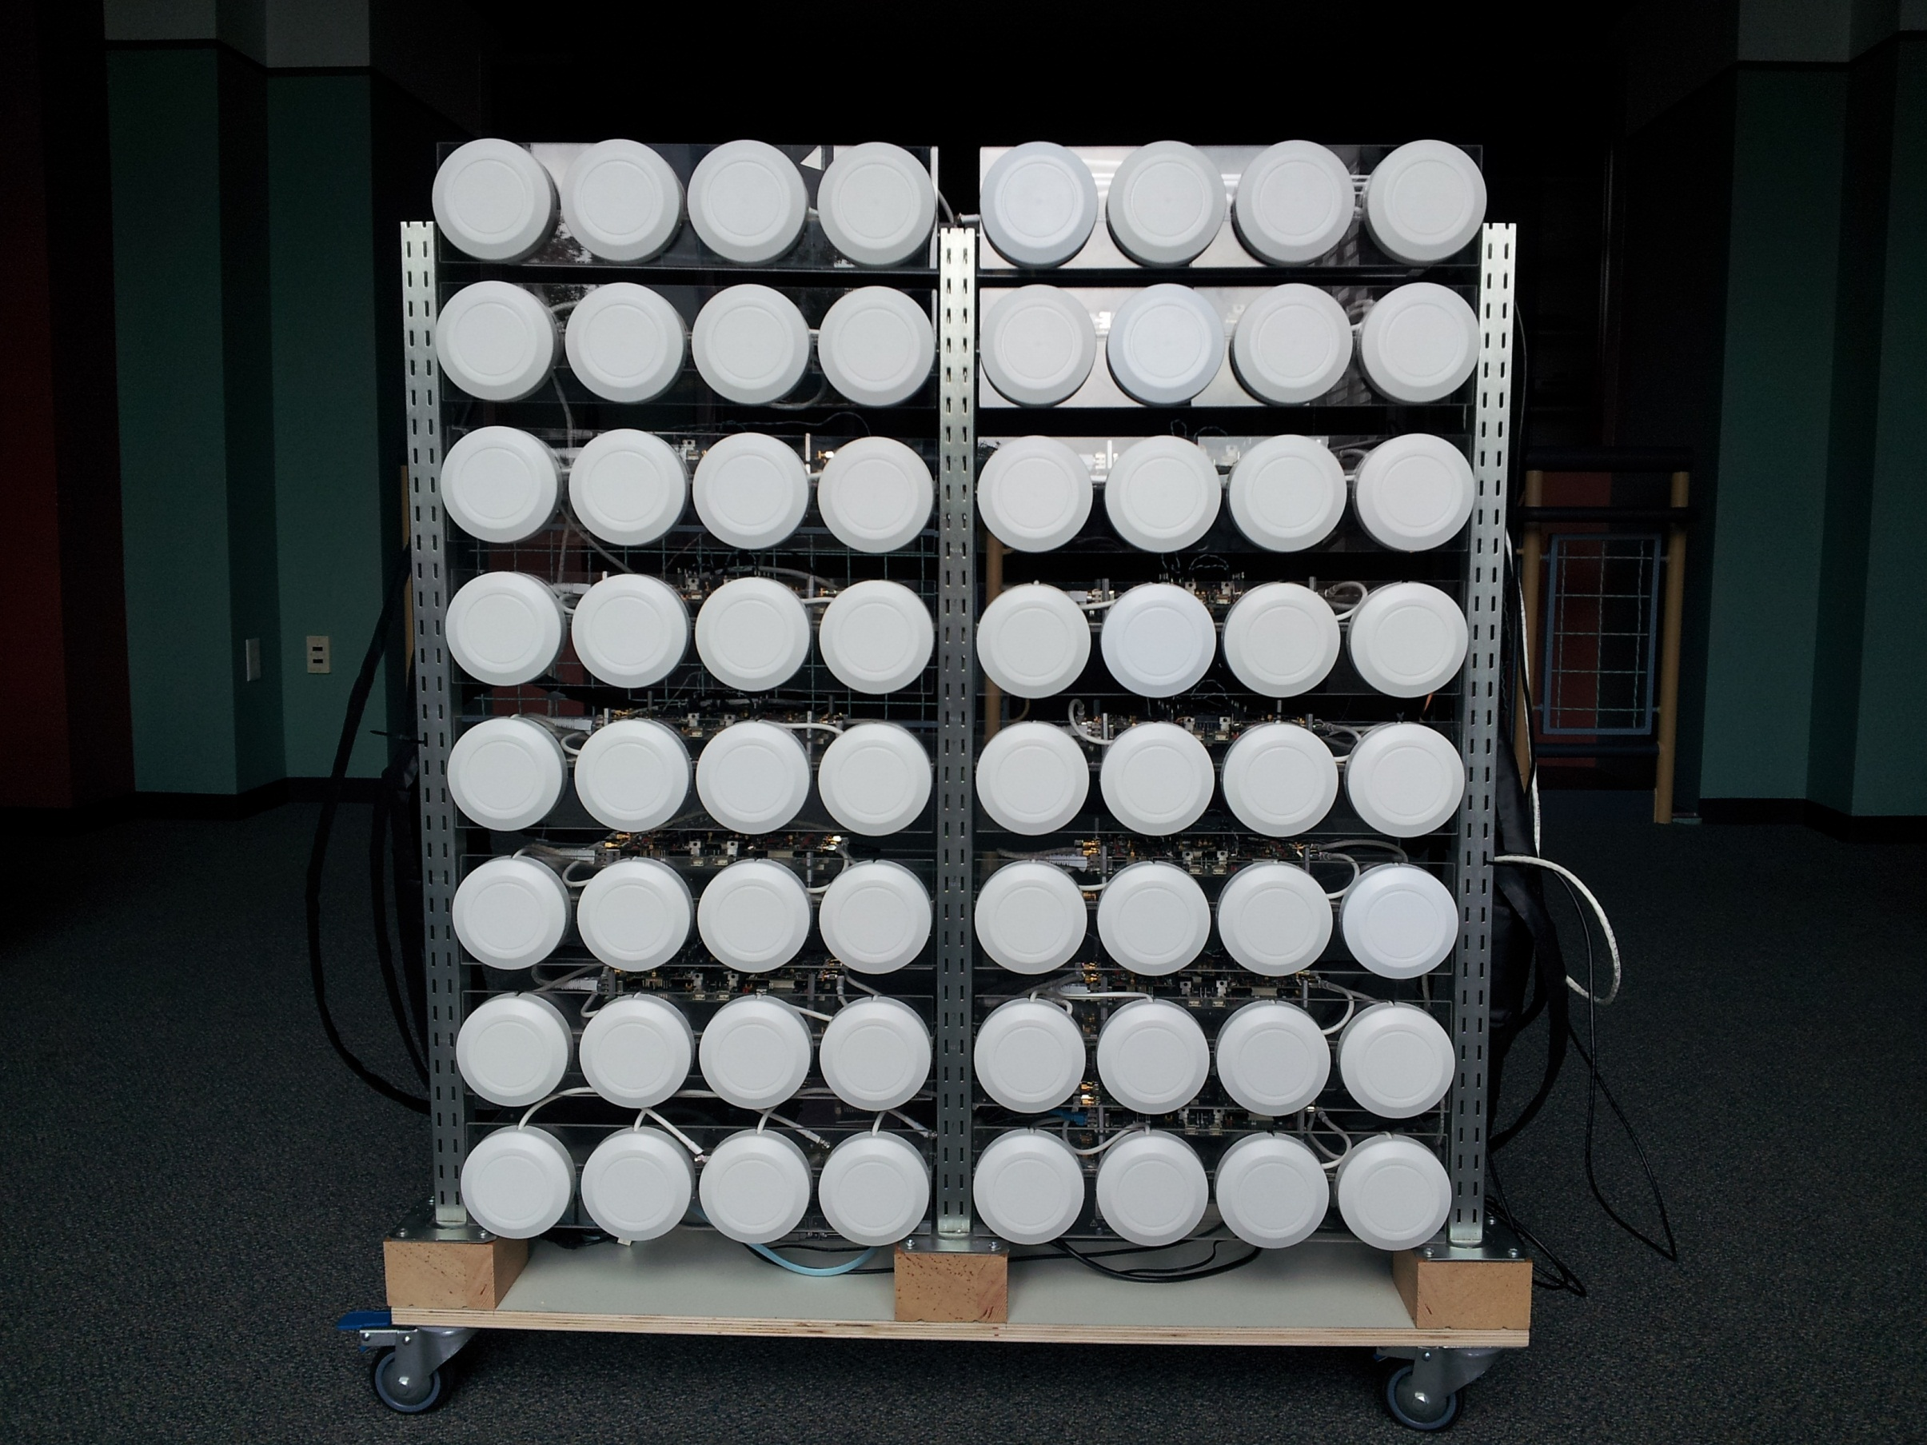
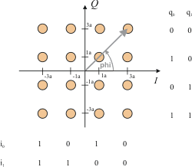
Complex Numbers are Widely Used
Control theory and Laplace transforms
Quantum mechanics and Hilbert spaces
Fractals
Signal processing and Fourier analysis
Antennas

Slide 11

A Complex Class
Design questions:
State: what field(s) do we need to represent the state of a complex number?
Design 1
re, a number representing the real part
im, a number representing the imaginary part
Design 2
r, a number representing the distance to origin
theta, a number representing the angle
$$φ$$

Slide 12
A Complex Class
Design questions:
Behaviors: what are some common behaviors of a complex number?
a Complex constructor, to set up the object
A abs method, to return the distance (magnitude)
a toString method: Return a string description of a complex number
Mathematical operations such as +, -, *
a plus method: Add current complex number with another complex number
a times method: Multiply current complex number with another complex number
…

Slide 13
The Complex Class: Design Question
public class Complex {
private double re;
private double im;
public Complex(double real, double imag) {
re = real;
im = imag;
}
public ?? plus(Complex b) {
…
}
…
What is the return type of plus?
Should plus change the state of the number, e.g., Complex c1 = new Complex(1, 1); Complex c2 = new Complex(2, 1); c1.plus(c2); // c1 changes to (3, 2)?

Slide 14
The Consistency (Familiarity) Design Principle
Basic idea when Defining the behaviors of a type A:
Think if there is a well-known type B. If so, make A’s behaviors consistent w/ B
Suppose a, b, and c are standard numbers (Complex numbers are numbers after all)
Does a + b (think a.+(b) ) change a?
no
What is the return of a + b (think a.+(b))?
The value of a + b so that we can write a + b + c
Complex.plus behavior design:
public Complex plus(Complex b) {
double real = re + b.re;
double imag = im + b.im;
return new Complex(real, imag);
}

Slide 15
Complex.java
public class Complex {
private double re;
private double im;
public Complex(double real, double imag) {
re = real;
im = imag;
}
public String toString() { return re + " + " + im + "i"; }
public double abs() { return Math.sqrt(re*re + im*im); }
public Complex plus(Complex b) {
double real = re + b.re;
double imag = im + b.im;
return new Complex(real, imag);
}
public Complex times(Complex b) {
double real = re * b.re – im * b.im;
double imag = re * b.im + im * b.re;
return new Complex(real, imag);
}
}
instance variables
constructor
refers to b's instance variable
creates a Complex object, and returns a reference to it
methods

Slide 16
Immutability: Advantages and Disadvantages
Consistency w/ primitive types leads to immutable data types: object's state does not change once constructed.
Example: Complex object, String.
Advantages.
Easier for debugging.
Avoid aliasing bugs.
Safety:
Limits scope of code that can change values.
Pass objects around without worrying about modification.
Disadvantage.
New object must be created for every value.

Slide 17
A Simple Client
public static void main(String[] args) {
Complex a = new Complex( 3.0, 4.0);
Complex b = new Complex(-2.0, 3.0);
Complex c = a.times(b);
System.out.println("a = " + a.toString() );
System.out.println("b = " + b.toString() );
System.out.println("c = " + c.toString() );
}
% java TestClient
a = 3.0 + 4.0i
b = -2.0 + 3.0i
c = -18.0 + 1.0i

Slide 18
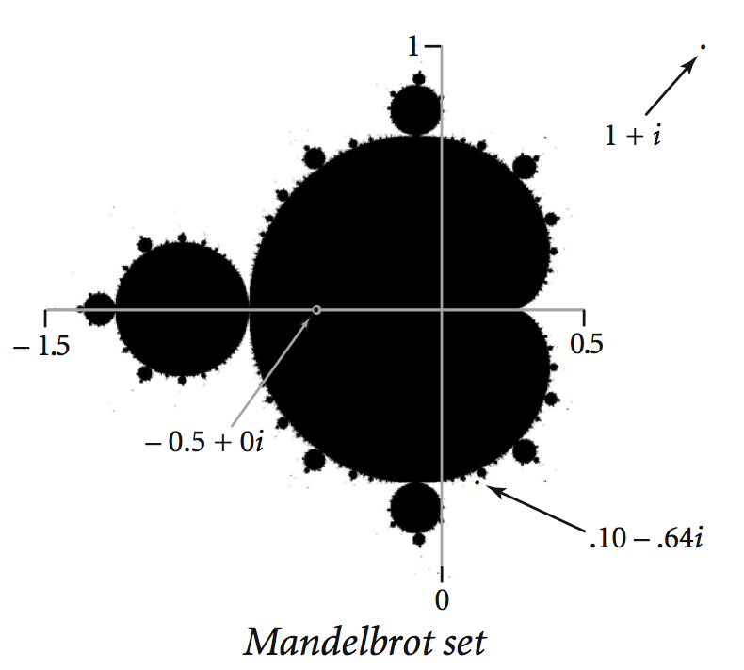
A Complex Client: Mandelbrot Set
Mandelbrot set. A set of complex numbers.
Plot.
Plot (x, y) black if z = x + y i is in the set, and white otherwise.
Can be used to model complex rugged shapes such as uneven clouds, contours of mountains, winding riverbeds, arts, …
http://users.math.yale.edu/mandelbrot/

Slide 19
A Complex Client: Mandelbrot Set
Mandelbrot set. Is complex number z₀ in the set?
Iterate z_{t + 1} = (z_{t} )² + z₀.
If | z_{t} | diverges to infinity, then z₀ is not in set; otherwise z₀ is in set.
t
z_{t}
t
z_{t}
0
-1/2 + 0i
0
1 + i
1
-1/4 + 0i
1
1 + 3i
2
-7/16 + 0i
2
-7 + 7i
3
-79/256 + 0i
3
1 - 97i
4
-26527/65536 + 0i
4
-9407 – 193i
5
-1443801919/4294967296 + 0i
5
88454401 + 3631103i
z = -1/2 is in Mandelbrot set
z = 1 + i not in Mandelbrot set

Slide 20
Testing Point in Mandelbrot Set
Practical issues.
Cannot iterate infinitely many times.
Approximate solution.
Fact: if | z_{t} | > 2 for any t, then z not in Mandelbrot set.
Pseudo-fact: if | z₂₅₅ | < 2 then z "likely" in Mandelbrot set.

Slide 21
Testing Point in Mandelbrot Set
Our Mandelbrot test:
Returns the number of iterations to check if z0 is in Mandelbrot
public static int mand(Complex z0) {
final int max = 255;
Complex z = z0;
for (int t = 0; t < max; t++) {
if (z.abs() > 2.0) return t;
z = z.times(z).plus(z0);
}
return max;
}
z = z² + z₀

Slide 22
Plotting Mandelbrot Set
Practical issues.
Cannot plot infinitely many points.
Display technique.
User specifies center, size
Program maps the points on the N-by-N drawing panel to center, size
x_{c}+ y_{c}i
Each grid has length size/N
(x_{c}-size/2) + (y_{c}-size/2) i

Slide 23
Plotting Mandelbrot Set (DrawingPanel)
Plot the Mandelbrot set in gray scale.
MandelbrotDrawingPanel.java
public static void main(String[] args) {
double xc = Double.parseDouble(args[0]);
double yc = Double.parseDouble(args[1]);
double size = Double.parseDouble(args[2]);
DrawingPanel panel = new DrawingPanel(N, N);
Graphics g = panel.getGrahics();
for (int i = 0; i < N; i++) {
for (int j = 0; j < N; j++) {
double x0 = xc - size/2 + size*i/N;
double y0 = yc - size/2 + size*j/N;
Complex z0 = new Complex(x0, y0);
int gray = mand(z0);
Color color = new Color(gray, gray, gray);
g.setColor( color );
g.drawLine(i, N-1-j, i, N – 1 - j);
} // end of for
} // end of for
}
(0, 0) is upper left

Slide 24
Mandelbrot Set
% java MandelbrotDrawingPanel –.5 0 2
% java MandelbrotDrawingPanel .1045 -.637 .01

Slide 25
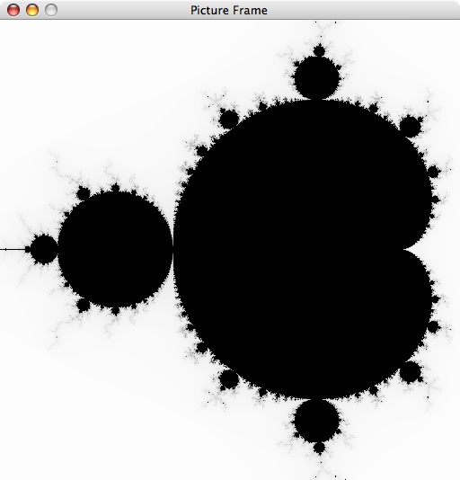
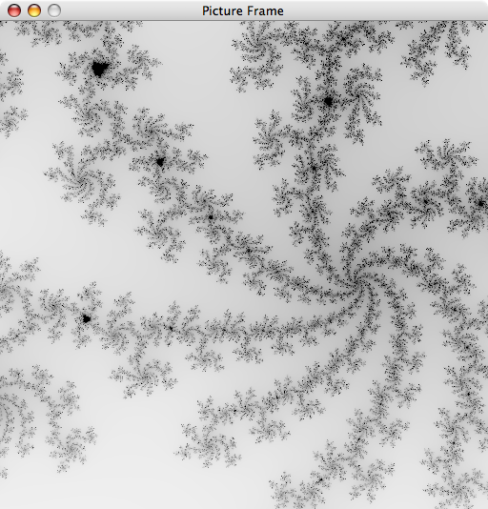
Mandelbrot Set
% java MandelbrotDrawingPanel –.5 0 2
% java MandelbrotDrawingPanel .1045 -.637 .01

Slide 26
Mandelbrot Set
Plot the Mandelbrot set in color using a color mapping table.
% java MandelbrotDrawingPanelColor –.5 0 2

Slide 27
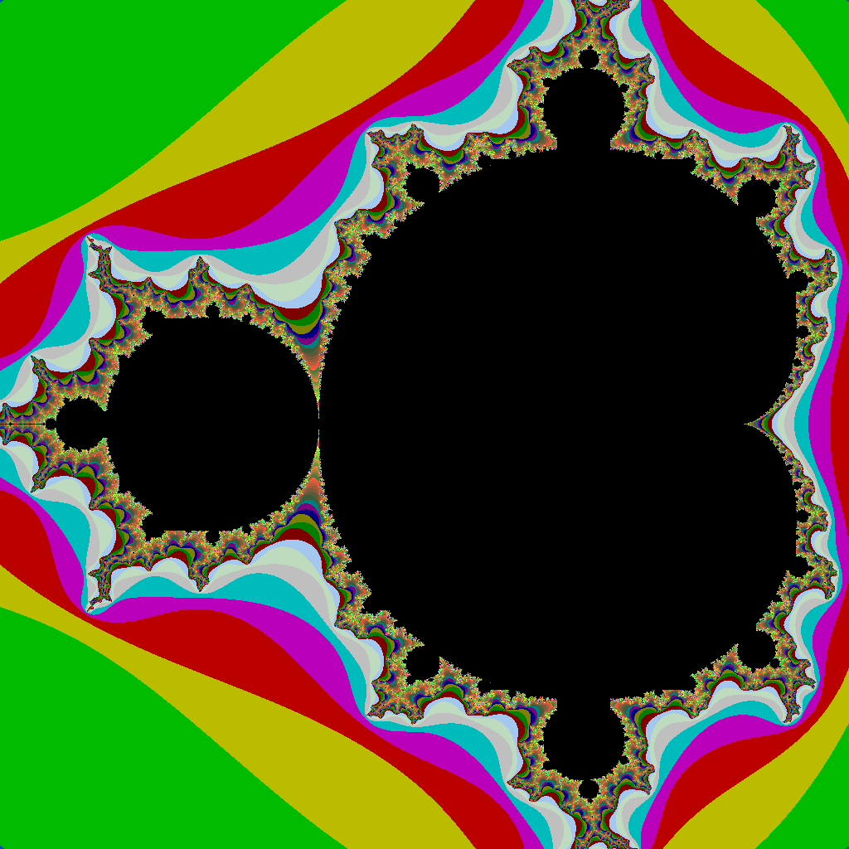
Mandelbrot Set
Plot the Mandelbrot set in color using a color mapping table.
% java MandelbrotDrawingPanelColor –.5 0 2

Slide 28


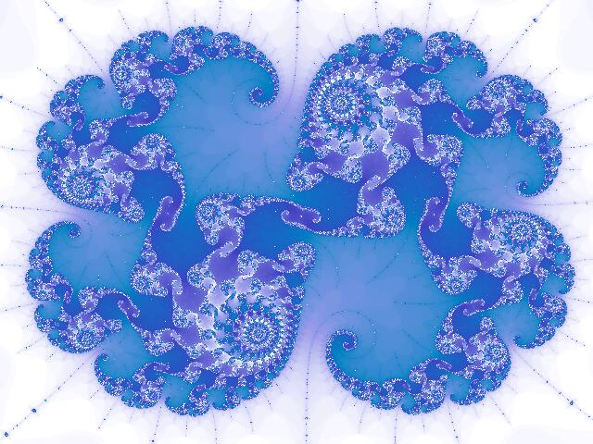


Slide 29

Mandelbrot Set
(-1.5, -1)
Notes:
Zoomed in on part of the Mandelbrot set. Can see little tiny "copies" of Mandelbrot set.
Someone used this image as the cover to their self-published book!

Slide 30
Mandelbrot Set
See video
https://www.bilibili.com/video/BV1ci4y1G7D2/?vd_source=4a5effc51fa44df6d45b104296de32eb

Slide 31
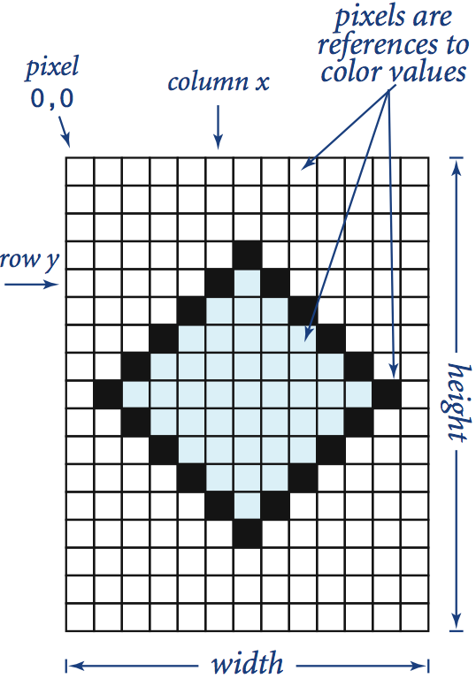
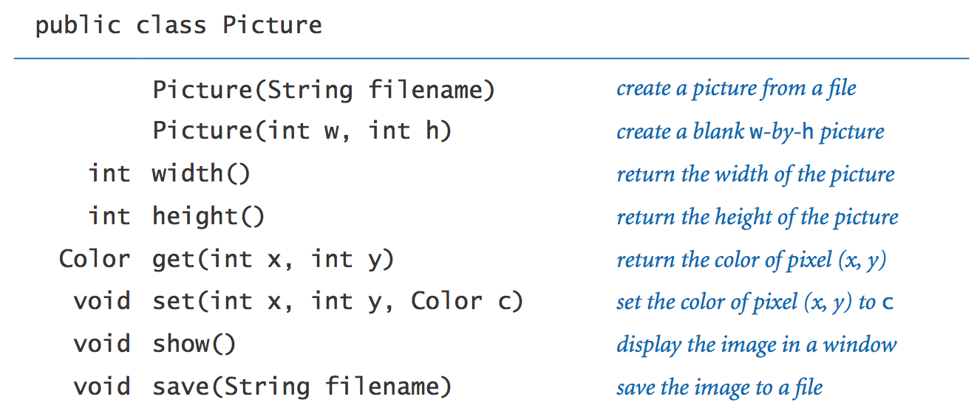
Picture Data Type
Raster graphics. Basis for image processing.
Set of values. 2D array of Color objects (pixels).
API.
Notes:
more complicated data type (Picture) composed from simpler data type (Color) composed from primitive data type (int).
Library developed for this course.

Slide 32
Plotting Mandelbrot Set (Picture)
Plot the Mandelbrot set in gray scale using Picture.
MandelbrotPicture.java
public static void main(String[] args) {
double xc = Double.parseDouble(args[0]);
double yc = Double.parseDouble(args[1]);
double size = Double.parseDouble(args[2]);
Picture pic = new Picture(N, N); // NxN picture
for (int i = 0; i < N; i++) {
for (int j = 0; j < N; j++) {
double x0 = xc - size/2 + size*i/N;
double y0 = yc - size/2 + size*j/N;
Complex z0 = new Complex(x0, y0);
int gray = mand(z0);
Color color = new Color(gray, gray, gray);
pic.set(i, N-1-j, color);
} // end of for
} // end of for
}
scale to screen coordinates
(0, 0) is upper left

