Slide 1
Introduction to Computational Thinking
Object-oriented programming
Qiao Xiang, Qingyu Song
https://sngroup.org.cn/courses/ct-xmuf25/index.shtml
12/10/2025
This deck of slides are heavily based on cs112 at Yale University and cs101 at UCAS, respectively,
by courtesy of Dr. Y. Richard Yang and Dr. Zhiwei Xu.

Slide 2
Recap: Class, Object, Variable, Field
Object variables (references)
fields
class
objects
Point.java (class of objects)
public class Point {
int x;
int y;
}
PointMain.java (client program)
public class PointMain {
main(String args) {
Point p1 = new Point();
p1.x = 50;
p1.y = 27;
Point p2 = p1;
Point p3 = new Point();
p3.x = 98;
p3.y = 53;
...
}
}
x | 50 | y | 27
x | 98 | y | 53

Slide 3
Recap: Static Method vs Instance Method
public class Point {
int x;
int y;
public static void draw(Point p) {
StdDraw.filledCircle(p.x, p.y, 3, 3);
StdDraw.textLeft(p.x, p.y, "(" + p.x + ", " + p.y + ")” );
}
}
public class Point {
int x;
int y;
public static void draw(Point p) {
StdDraw.filledCircle(p.x, p.y, 3, 3);
StdDraw.textLeft(p.x, p.y, "(" + p.x + ", " + p.y + ")”);
}
}
Notes:
对比

Slide 4
Recap: Defining Related Method and Data in the Same Class: Instance Method
public class Point {
int x;
int y;
public static void draw(Point p) {
StdDraw.filledCircle(p.x, p.y, 3);
StdDraw.textLeft(p.x, p.y,
"(" + p.x + ", " + p.y + ")”);
}
}
p1 provides the implicit parameter: The x and y in draw() are those of the object referenced by p1.
Point p1 = new Point();
p1.x = 7; p1.y = 2;
p1.draw(); // Point.draw(p1);
Point p2 = new Point();
p2.x = 4; p2.y = 3;
p2.draw(); // Point.draw(p2);
p2 provides the implicit parameter: The x and y in draw() are those of the object referenced by p2.
Notes:
从static method instance method是什么使用的

Slide 5
Outline
Defining classes
Data encapsulation (struct)
Data+behavior encapsulation
instance methods
constructors
Notes:
举例：衣柜

Slide 6
Initializing objects
Currently it takes 3 lines to create a Point and initialize it:
Point p = new Point();
p.x = 3;
p.y = 8; // tedious（乏味）
We'd rather specify the fields' initial values at the start:
Point p = new Point(3, 8); // better!
We are able to do this with most types of objects in Java.

Slide 7
Constructors
constructor: a special method to initialize the state of new objects.
public type(parameters) {
statements;
}
runs when the client uses the new keyword
no return type should be specified; it implicitly "returns" the new object being created
If a class has no constructor, Java gives it a default constructor with no parameters that sets all fields to zero-equivalent values.
Notes:
构造方法：初始化属性
三点注意：
注意特定的结构
注意不能有返回值
如果没有默认全为0

Slide 8
Constructor example
public class Point {
int x;
int y;
// Constructs a Point at the given x/y location.
public Point(int initialX, int initialY) {
x = initialX;
y = initialY;
}
public void translate(int dx, int dy) {
x = x + dx;
y = y + dy;
}
...
}

Slide 9
Client (User) code
public class PointMain3 {
public static void main(String[] args) {
// create two Point objects
Point p1 = new Point(5, 2);
Point p2 = new Point(4, 3);
// print each point
System.out.println("p1: (" + p1.x + ", " + p1.y + ")");
System.out.println("p2: (" + p2.x + ", " + p2.y + ")");
// move p2 and then print it again
p2.translate(2, 4);
System.out.println("p2: (" + p2.x + ", " + p2.y + ")");
}
}

Slide 10
Multiple Constructors
A class can have multiple constructors.
Each one must accept a unique set of parameters (same rule of method overloading).
Notes:
重载构造函数

Slide 11
Common Constructor Issues
1. By accidentally giving the constructor a return type.
Not a constructor, but a method named Point
public void Point(int initialX, int initialY) {
x = initialX;
y = initialY;
}
2. Declare a local variable with the same name as a field.
Rather than storing value into the field, the param is passed to local variable. The field remains 0.
public class Point {
int x;
int y;
public Point(int initialX, int initialY) {
int x = initialX;
int y = initialY;
}
}
Notes:
几类常犯的错误：
1. 不小心置顶了返回值，就不是构造方法了

Slide 12
Common Constructor Issues
“shadowing”: 2 variables with same name in same scope.
Normally illegal, except when one variable is a field
public class Point {
int x;
int y;
...
public Point(int x, int y) {
System.out.println(“x = “ + x);// para x
}
In most of the class, x and y refer to the fields.
In Point(int x, int y), x and y refer to the method's parameters.
Notes:
第三类：
构造方法定义的形式参数跟类的属性一样

Slide 13
The this keyword: Access Fields/Methods within Class
this : Refers to the implicit parameter inside your class.
(a variable that stores the object on which a method is called)
Refer to a field: this.field
Call a method: this.method(parameters);
Notes:
为了区分

Slide 14
Fixing “Shadowing” with this
To refer to the data field x: this.x
To refer to the parameter x: x
public class Point {
int x;
int y;
...
public Point(int x, int y) {
this.x = x;
this.y = y;
}
public void setLocation(int x, int y) {
this.x = x;
this.y = y;
}
}

Slide 15
Calling another constructor
public class Point {
private int x;
private int y;
public Point() {
this(0, 0); // calls (x, y) constructor
}
public Point(int x, int y) {
this.x = x;
this.y = y;
}
...
}
Avoids redundancy between constructors
Only a constructor (not a method) can call another constructor

Slide 16
Summary: Class Definition Components
Variables
fields (instance variables per object)
static variables (shared by all objects)
Methods
static methods (method usable with or without objects)
Can access only static variables
instance methods (can be used only on objects; can access both static and instance variables)
Constructors
Accessors (do not change object state)
Mutators (modify object state)

Slide 17
Outline
Admin and recap
Defining classes
Data encapsulation (struct)
Data+behavior encapsulation (OOP)
OOP design methodology

Slide 18
Example: Procedural vs OOP Design
Function-oriented
Object-oriented
public class DrawRocket{
public static void main(String args[]){
for (int size = 3; size < 10; size++){
drawRocket(size);
}
}
public static void drawRocket(int scale){
printCap(scale);
...
}
...
public static void printCap(int scale){
...
}
}
public class RocketDrawing{
public static void main(String args[]){
for (int size = 3; size < 10; size++){
Rocket curRocket = new Rocket(size);
curRocket.draw();
}
}
}
public class Rocket{
public int rocketSize;
public Rocket(int rocketSize){
this.rocketSize = rocketSize;
}
public void draw(){
printCap();
...
}
...
public void printCap(){
...
}
}
Notes:
以第三次作业作为例子，认识一下什么是OOP设计
左边：火箭数据和画火箭在一起
右边：分开，我们可以拿来画任意的火箭

Slide 19

Recap: Design and Implementation Methodology: Procedural Based
Design (goal oriented)
top-down stepwise goal-driven method decomposition
methods designed are those needed for the current goal
verb driven
Program implementation and testing
bottom-up

Slide 20
Design and Implementation Methodology: Object-Oriented
Design
Identify objects that are part of the problem domain or solution
Each object has state (variables)
Each object has behaviors (methods)
Often do not consider one specific goal, but rather a context (problem domain), to lead to more reusable, extensible software
noun driven

Slide 21
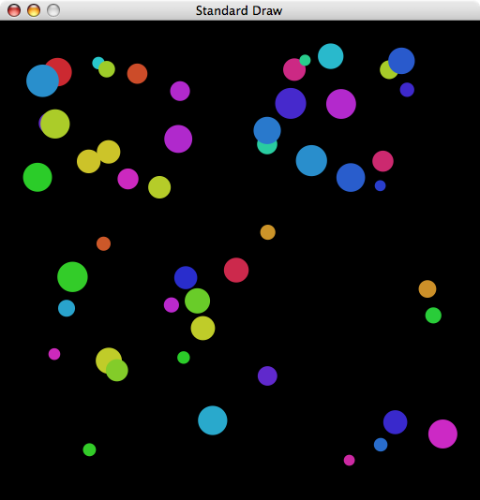
Example: The Ball Class
We define a Ball class to model self-bouncing balls

Slide 22
The Ball Class
Design questions:
State: what field(s) do we need to represent the state of a self-bouncing ball?
rx, ry, current position
radius: radius
vx, vy, speed
color, current color
left, right, bottom, top: cage (boundaries)
Behaviors/operations: what are some common behaviors of a self-bouncing ball?
A default constructor, to set up a random ball in unit square
A constructor, to set up a ball with given parameters
A move method, to update position
A draw method, to display
See Ball.java, BouncingBalls.java

Slide 23
Bouncing Ball in Unit Square
public class Ball {
double rx, ry;
double vx, vy;
double radius;
public Ball() {
rx = ry = 0.5;
vx = 0.015 - Math.random() * 0.03;
vy = 0.015 - Math.random() * 0.03;
radius = 0.01 + Math.random() * 0.01;
}
public void move() {
if ((rx + vx > 1.0) || (rx + vx < 0.0)) vx = -vx;
if ((ry + vy > 1.0) || (ry + vy < 0.0)) vy = -vy;
rx = rx + vx;
ry = ry + vy;
}
public void draw() {
StdDraw.filledCircle(rx, ry, radius);
}
}
Ball.java
instance variables
constructor
Bounce反弹
methods
Notes:
注意move方法

Slide 24
An Array of Objects
It is common that we create an array of objects
Use new to invoke constructor and create each one.
public class BouncingBalls {
public static void main(String[] args) {
int N = Integer.parseInt(args[0]);
Ball balls[] = new Ball[N];
for (int i = 0; i < N; i++)
balls[i] = new Ball();
while(true) {
StdDraw.clear();
for (int i = 0; i < N; i++) {
balls[i].move();
balls[i].draw();
}
StdDraw.show(20);
}
}
}
create and initialize N objects
animation loop
Notes:
原理：一直move，一直画
演示 java BouncingBalls 10 （后面传入小球数量）

Slide 25
Outline
Admin and recap
Defining classes
Data encapsulation (struct)
Data+behavior encapsulation (OOP)
OOP design methodology
Objects and reference semantics

Slide 26
Object References
Recall: non-primitive variables store references
Reference: essentially machine address (pointer).
addr
value
100
0
101
0
Ball b1 = new Ball();
b1.move();
b1.move();
Ball b2 = new Ball();
b2.move();
b2 = b1;
b2.move();
102
0
103
0
104
0
105
0
106
0
107
0
108
0
109
0
110
0
111
0
112
0
main memory (64-bit machine)
Notes:
Main memory (on 64-bit machine since double is 64 bits).

Slide 27
Object References
addr
value
Recall: non-primitive variables store references
Reference: essentially machine address (pointer).
100
0
0.50
rx
101
0
0.50
ry
102
0
Ball b1 = new Ball();
b1.move();
b1.move();
Ball b2 = new Ball();
b2.move();
b2 = b1;
b2.move();
b1
0.05
vx
103
0.01
100
0
vy
104
0.03
radius
0
105
0
106
0
107
0
108
0
109
0
110
0
111
0
112
0
main memory (64-bit machine)
Notes:
Main memory (on 64-bit machine since double is 64 bits).

Slide 28
Object References
addr
value
Recall: non-primitive variables store references
Reference: essentially machine address (pointer).
100
0.50
0.55
rx
101
0.50
0.51
ry
Ball b1 = new Ball();
b1.move();
b1.move();
Ball b2 = new Ball();
b2.move();
b2 = b1;
b2.move();
b1
102
0.05
vx
100
103
0.01
vy
104
0.03
radius
105
0
106
0
107
0
108
0
109
0
110
0
111
0
112
0
registers
main memory (64-bit machine)
Notes:
Main memory (on 64-bit machine since double is 64 bits).

Slide 29
Object References
addr
value
Recall: non-primitive variables store references
Reference: essentially machine address (pointer).
100
0.55
0.60
rx
101
0.51
0.52
ry
Ball b1 = new Ball();
b1.move();
b1.move();
Ball b2 = new Ball();
b2.move();
b2 = b1;
b2.move();
b1
102
0.05
vx
100
103
0.01
vy
104
0.03
radius
105
0
106
0
107
0
108
0
109
0
110
0
111
0
112
0
registers
main memory (64-bit machine)
Notes:
Main memory (on 64-bit machine since double is 64 bits).

Slide 30
Object References
addr
value
Recall: non-primitive variables store references
Reference: essentially machine address (pointer).
100
0.60
rx
101
0.52
ry
Ball b1 = new Ball();
b1.move();
b1.move();
Ball b2 = new Ball();
b2.move();
b2 = b1;
b2.move();
b1
102
0.05
vx
100
103
0.01
vy
104
0.03
radius
105
0
b2
106
0
107
107
0
0.50
rx
108
0.50
0
ry
109
0.07
vx
0
110
0.04
vy
0
111
0
radius
0.04
112
0
registers
main memory (64-bit machine)
Notes:
Main memory (on 64-bit machine since double is 64 bits).

Slide 31
Object References
addr
value
Recall: non-primitive variables store references
Reference: essentially machine address (pointer).
100
0.60
rx
101
0.52
ry
Ball b1 = new Ball();
b1.move();
b1.move();
Ball b2 = new Ball();
b2.move();
b2 = b1;
b2.move();
b1
102
0.05
vx
100
103
0.01
vy
104
0.03
radius
105
0
b2
106
0
107
107
0.57
0.50
rx
108
0.50
0.54
ry
109
0.07
vx
110
0.04
vy
111
0.04
radius
112
0
registers
main memory (64-bit machine)
Notes:
Main memory (on 64-bit machine since double is 64 bits).

Slide 32
Object References
addr
value
Recall: non-primitive variables store references
Reference: essentially machine address (pointer).
100
0.60
rx
101
0.52
ry
Ball b1 = new Ball();
b1.move();
b1.move();
Ball b2 = new Ball();
b2.move();
b2 = b1;
b2.move();
b1
102
0.05
vx
100
103
0.01
vy
104
0.03
radius
105
0
b2
106
0
100
107
0.57
rx
108
0.54
ry
109
0.07
vx
110
0.04
vy
Data stored in 107 – 111 for bit recycler (garbage collection).
111
0.04
radius
112
0
registers
main memory (64-bit machine)
Notes:
bit recycler = garbage collector

Slide 33
Object References
addr
value
Recall: non-primitive variables store references
Reference: essentially machine address (pointer).
100
0.60
0.65
rx
101
0.52
0.53
ry
Ball b1 = new Ball();
b1.move();
b1.move();
Ball b2 = new Ball();
b2.move();
b2 = b1;
b2.move();
b1
102
0.05
vx
100
103
0.01
vy
104
0.03
radius
105
0
b2
106
0
100
107
0.57
rx
108
0.54
ry
109
0.07
vx
110
0.04
vy
111
0.04
radius
Moving b2 also moves b1 since they are aliases that reference the same object.
112
0
registers
main memory (64-bit machine)
Notes:
Main memory (on 64-bit machine since double is 64 bits).

Slide 34
Outline
Admin and recap
Defining classes
Data encapsulation (struct)
Data+behavior encapsulation (OOP)
OOP design methodology
Objects and reference semantics
OOP design examples

Slide 35
Design and Implementation Methodology: Object-Oriented
Design
Identify objects that are part of the problem domain or solution
Each object has state (variables)
Each object has behaviors (methods)
Constructors, accessors, mutators(修改器)
Often do not consider one specific goal, but rather a context
noun driven

Slide 36
Example: The BankAccount Class
We define an BankAccount class to model a bank account
Design questions:
State: what field(s) do we need to represent the state of a bank acct?
acctNumber,an integer
acctName, a string
balance, an integer
Behaviors/operations: what are some common behaviors of a bank account in a simple banking context?
A constructor, to set up the object
Accessors
a getBalance method, to return balance
a toString method, to return a string description of the current state
Mutators
a withdraw method, to withdraw from the account
a deposit method, to deposit into the account
a addInterest method, to add interest
See BankAccount.java, Transactions.java
Notes:
如果还有半小时，讲这部分

Slide 37
Example: Account and Transactions
public class BankAccount {
final double RATE = 0.035;
long acctNumber;
String acctName;
double balance;
public BankAccount (String owner, long account, double initial) {
acctName = owner;
acctNumber = account;
balance = initial;
}
public double deposit (double amount) {
if (amount > ) balance = balance + amount;
return balance;
}
…
}
public static void main (String[] args) {
BankAccount aliceAcct = new BankAccount (“Alice", 11111, 100.00);
BankAccount bobAcct = new BankAccount (“Bob", 22222, 200.00);
BankAccount charlesAcct = new BankAccount (“Charles", 33333, 300.00);
bobAcct.deposit (30.00);
…
}

Slide 38
Example: The Three BankAccount Objects in Transactions
aliceAcct: BankAccount
aliceAcct: BankAccount
acctNumber = 11111
acctName = “Alice”
balance = 100.00
acctNumber = 11111
acctName = “Alice”
balance = 100.00
bobAcct: BankAccount
bobAcct: BankAccount
acctNumber = 22222
acctName = “Bob”
balance = 200.00
acctNumber = 22222
acctName = “Bob”
balance = 230.00
charlesAcct: BankAccount
charlesAcct: BankAccount
acctNumber = 33333
acctName = “Charles”
balance = 300.00
acctNumber = 33333
acctName = “Charles”
balance = 300.00
After bobAcct.deposit (30.00);

Slide 39
Outline
Admin and recap
Defining classes
Data encapsulation (struct)
Data+behavior encapsulation (OOP)
OOP design methodology
Objects and reference semantics
Simple examples
The encapsulation(封装) principle
Notes:
我们已经学习了data和behavior的封装，那么

Slide 40
Two Views of an Object
You can take one of two views of an object:
external (API) - the interaction of the object with its users
internal (implementation) - the structure of its data, the algorithms used by its methods
Notes:
对象的用户或客户端不应该了解状态的内部表示或算法的细节——对象应该是一个封装的实体（一个黑盒），而不泄露实现。

Slide 41
The Encapsulation Principle
Methods
Client
Client can see only the external API (state and behaviors)
Data/state
Client should not see the internal state or behaviors
Notes:
封装的目的

Slide 42


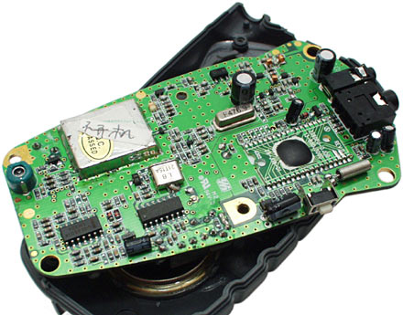
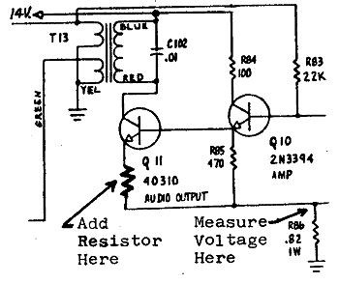
Encapsulation Analogy
Client
API
Implementation
client needs to know how to use API
implementation needs to know what API to implement

Slide 43

Encapsulation Analogy
As a client, you don't understand the inner details of iPhone, and you don't need to.
Apple does not want to commit to any internal details so that Apple can continuously update the internal

Slide 44
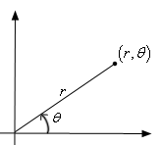
Why Encapsulating Data
Consistency: prevent "reach in" and directly alter object's state
Protect object from unwanted access
Example: BankAccount balance.
Maintain state invariants
Example: Only allow BankAccounts with non-negative balance.
Example: Only allow Dates with a month from 1-12.
Flexibility: internally modify state without worrying about breaking others’code
Example: Point could be rewritten in polar, clients will not see difference.
Notes:
两个方面

Slide 45
Accomplish Encapsulation: Access Modifiers
In Java, we accomplish encapsulation through the appropriate use of access modifiers(修饰符)
An access modifier is a Java reserved word that specifies the accessibility of a method, data field, or class
we will discuss two access modifiers: public, private
we will discuss the other modifier (protected) later
Notes:
access modifiers：访问修饰符

Slide 46
The public and private Access Modifiers
access modifiers enforce encapsulation
public members (data and methods): can be accessed from anywhere
private members: can be accessed from a method defined in the same class
Members without an access modifier: default private accessibility,

Slide 47
Using Access Modifiers to Implement Encapsulation: Methods
Only service methods should be made public
Support or helper methods created simply to assist service methods should be declared private
Notes:
Service解释一下

Slide 48
The Effects of Public and Private Accessibility
public
private
violate
Encapsulation
Use Caution
enforce
encapsulation
variables
provide services
to clients
support other
methods in the
class
methods

Slide 49
Examples: Set the Access Modifiers
Coin
Ball
BankAccount
Point

Slide 50
Class Diagram
Coin
class name
- face : int
attributes
+ flip() : void
+ isHeads() : boolean
+ toString() : String
methods
Above is a class diagram representing the Coin class.
“-” indicates private data or method
“+” indicates public data or method

Slide 51
Outline
Defining classes
Motivation and basic syntax
Simple examples
The encapsulation principle
OOP analysis examples
Random objects vs Math.random

Slide 52
Static Math.random() method vs Random Objects

Slide 53
Recall: Math.random()
public static double random()
Returns a random number between 0 and 1
Since computer is deterministic (given the same input parameter, gives the same output), how can Math.random() return a different number each time?

Slide 54
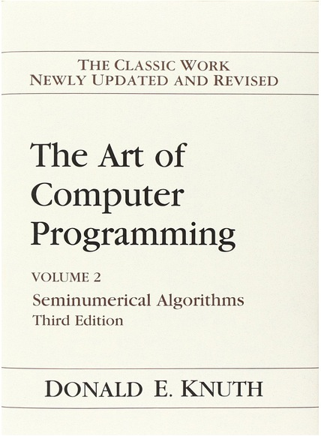
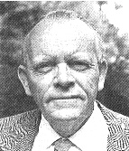
A Little Peek into Random Number Generation
The random numbers generated by Java are actually pseudo-random numbers
Suppose you get a random number R_{n}, the next time you call it to get R_{n+1}, it returns:
R_{n+1} = (R_{n} * 25214903917 + 11) (mod m)
it then converts to the right range to you !
This method is proposed by D. H. Lehmer
in mathematical jargon, Java uses a type of linear congruential pseudorandom number generator
Implication: the previously returned random number must be remembered
random method need to have memory (state)
Notes:
http://docs.oracle.com/javase/7/docs/api/java/lang/Math.html#random()
linear congruential pseudorandom number generator 线性同余伪随机数生成器

Slide 55
The Random class
OOP design is perfect for implementing random numbers: a Random object has
a state variable
a next method: computes next state based on current state, returns the new state
Class Random is found in the java.util package.
import java.util.Random;
Method name | Description
Random(long seed) | Create a random number using a seed (R₀)
Random() | Create a random number using a seed derived from time
setSeed(seed) | Initialize the random number generator
nextInt(<max>) | Returns a random integer in the range [0, max) in other words, 0 to max-1 inclusive
nextDouble() | Returns a random real number in [0.0, 1.0)

Slide 56
Using Random Number Objects
Random rand = new Random(); // Default, seed by time
get a random number from 0 to 9 inclusive:
int n = rand.nextInt(10); // 0-9
get a random number from 1 to 20 inclusive
int n = rand.nextInt(20) + 1; // 1-20 inclusive
get a random number in arbitrary range [min, max] inclusive:
int n = rand.nextInt(<size of range>) + <min>
where <size of range> is (<max> - <min> + 1)

Slide 57
How May Math.random()be Implemented Directly?
public class Math {
private static int R = 0;
public static double random() {
R = R * 25214903917 + 11;
// result = convert to the right range
return result;
}
..
}

Slide 58
How May Math.random()be Implemented using Random class?
A static variable, also called a singleton(单例).
public class Math {
private static Random rand;
public static double random() {
if (rand == null)
rand = new Random();
return rand.nextDouble();
}
..
}
A delegation (委托) implementation pattern.
Notes:
Delegation： 委托

Slide 59
Advantage and Issue of Using Math.random()
Advantage
Hide object-oriented programming, simplifying programming (shorter program, no need to know seeds)
Disadvantage
Without the ability to realize and control the state of the random variable
In testing, we want to repeat the same sequence of random numbers, but the Math.random design cannot provide this capability.

Slide 60
Outline
Admin and recap
Defining classes
Motivation and basic syntax
Simple examples
The encapsulation principle
Object examples
Random objects vs Math.random
Object-oriented analysis

Slide 61
Discussion
A quite helpful tool in OO analysis is object relationship analysis. What are some basic object relationships?

Slide 62
Outline
Admin and recap
Defining classes
Motivation and basic syntax
Simple examples
The encapsulation principle
Object examples
Random objects vs Math.random
Object-oriented analysis
Composition (has)/association relationship

Slide 63
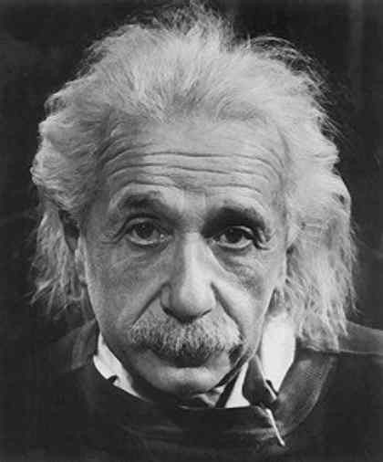
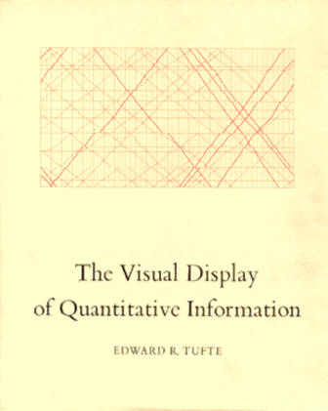

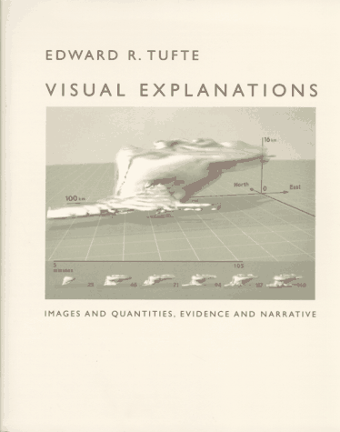

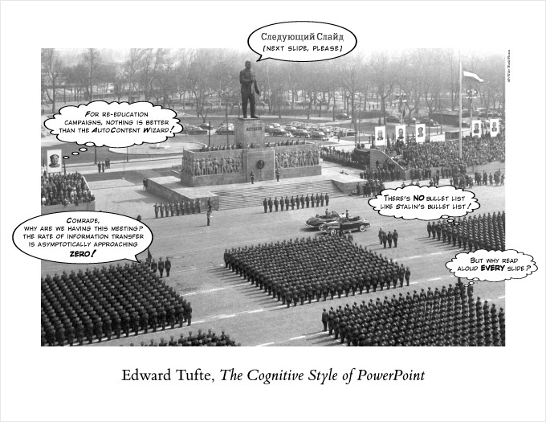
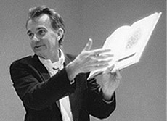
Domain: Data Visualization
“ If I can't picture it, I can't understand it. ”
— Albert Einstein
Edward Tufte (美国统计学家) Create charts with high data density that tell the truth.

Slide 64

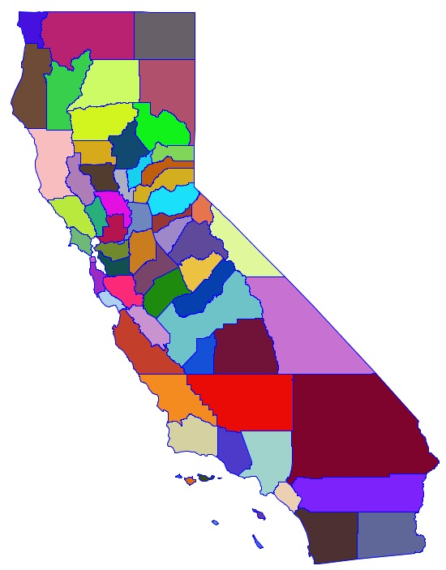
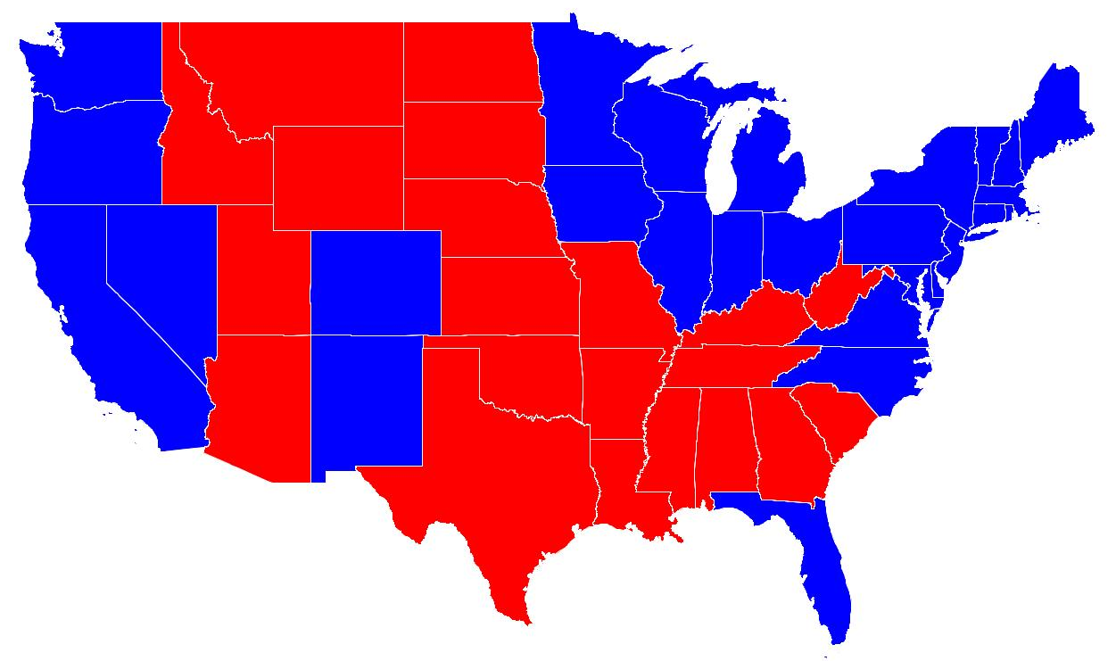
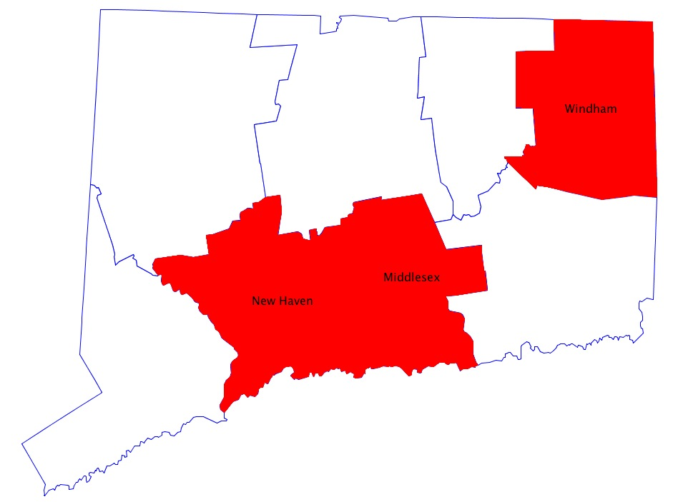
Domain: Visualization of Geographical Regions

Slide 65
Example Use Cases
GeoMap.java
RandomColorMap.java
RedBlueMap.java
ClickColorMap.java

Slide 66
Example Domain: Visualization of Geographical Regions
Classes and their relationships?
Notes:
思考用什么方法实现，

Slide 67
Major Classes and Relationship
1
m
m
2
GeoMap
Region
Color
1
1
A composition relationship
An association relationship
Polygon
1
m
Point
Polygon 多边形

Slide 68
Major Classes and Relationship
GeoMap
Region
…
Region
String
Color
Color
Polygon
Point
…
Point

Slide 69
Major Classes and Relationship
1
m
m
2
GeoMap
Region
Color
1
1
A composition relationship
An association relationship
Polygon
1
m
Design question:
- What is the basic controller structure?
Point

Slide 70
Coloring Controller Structure
Retrieve(检索) region (standard)
Batch: retrieve a list containing all regions
Specific: retrieve one specific region (e.g., the one being clicked)
Coloring (customized)
Map properties of each region to a color

Slide 71
Major Classes and Relationship
1
m
m
2
GeoMap
Region
Color
1
1
A composition relationship
An association relationship
Polygon
1
m
Discussion:
Public methods (API) of Point for the domain
Point

Slide 72
Major Classes and Relationship
1
m
m
2
GeoMap
Region
Color
1
1
A composition relationship
An association relationship
Polygon
1
m
Discussion:
Public methods (API) of Polygon for the domain
Point

Slide 73
Polygon
public class Polygon {
private final int N; // number of boundary points
private final Point[] points; // the points
// read from input stream
public Polygon(Scanner input) {
N = input.nextInt();
points = new Point[N+1];
for (int i = 0; i < N; i++) {
points[i] = new Point ( input );
}
points[N] = points[0];
}
…
public void draw() { … }
public void fill() { … }
public boolean contains(Point p) { … }
public Point centroid() { … }
…
}
Notes:
Final 字段可以通过构造方法初始化

Slide 74
Major Classes and Relationship
1
m
m
2
GeoMap
Region
Color
1
1
A composition relationship
An association relationship
Polygon
1
m
Discussion:
Public methods (API) of Region
Point

Slide 75
Region
Q: Should Region have a method that returns its internal Polygon?
public class Region {
private final String regionName; // name of region
private final String mapName;
private final Polygon poly; // polygonal boundary
private Color fillColor, drawColor;
public Region(String mName, String rName, Polygon poly) {
regionName = rName;
mapName = mName;
this.poly = poly;
setDefaultColor();
}
public void setDrawColor (Color c) { drawColor = c; }
public void draw() { setDrawColor(); poly.draw (); }
public void fill() { … }
public boolean contains(Point p) {
return poly.contains(p);
}
public Point centroid() { return poly.centroid() }
…
}
Even though most complexity is in Polygon, Polygon is not exposed. Region delegates (委托) tasks internally to Polygon.
Notes:
input values are in (latitude, longitude)
Consider using a Location ADT instead that computes distances according to great circle

Slide 76
Example Controllers
GeoMap.java
RandomColorMap.java
ClickColorMap.java
RedBlueMap.java

Slide 77
Cartograms
Cartogram. Area of state proportional to number of electoral votes.
Michael Gastner, Cosma Shalizi, and Mark Newman
http://www-personal.umich.edu/~mejn/election/2016/

Slide 78
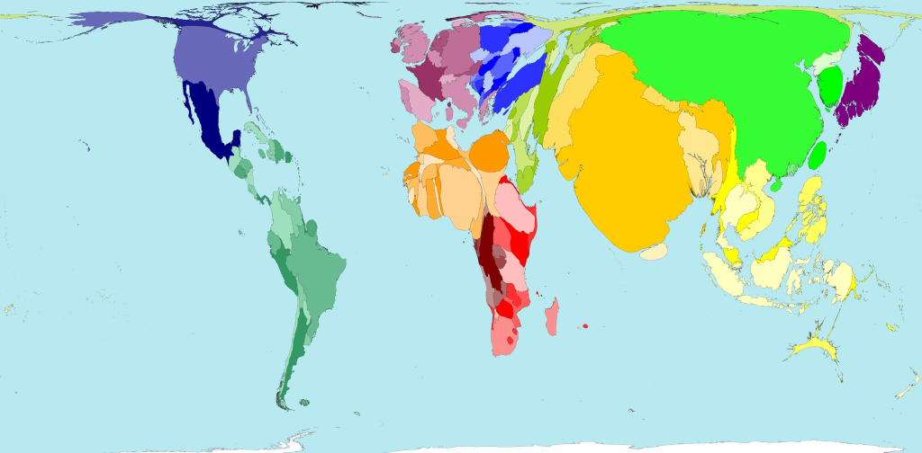
Cartograms
Cartogram. Area of country proportional to population.

Slide 79
Outline
Admin and recap
Defining classes
Object-oriented design
Composition (has)/association relationship and geo visualization
Inheritance(继承) relationship

Slide 80
Inheritance
Inheritance: Reuse classes by deriving a new class from an existing one
The existing class is called the parent class, or superclass, or base class
The derived class is called the child class or subclass.
As the name implies, the child inherits characteristics of the parent
The child class inherits every method and every data field defined for the parent class

Slide 81
Visualize Inheritance
The child class inherits all methods and data defined for the parent class
an animal object
Animal
- weight : int
weight = 120 getWeight()
+ getWeight() : int
a bird object
Bird
weight = 100
flySpeed = 30 getWeight()
fly()
- flySpeed : int
+ fly() : void

