Slide 1
Introduction to Computational Thinking
Inheritance and object construction;
Method Overriding; Object Hierarchy; Event-Driven Programming
Qiao Xiang, Qingyu Song
https://sngroup.org.cn/courses/ct-xmuf25/index.shtml
12/17/2025
This deck of slides are heavily based on cs112 at Yale University and cs101 at UCAS, respectively,
by courtesy of Dr. Y. Richard Yang and Dr. Zhiwei Xu.

Slide 2

Outline
Admin and recap
Final Exam: 2025-12-30 10:30-12:30 学武楼（1号楼）A206
Object-oriented design
Inheritance(继承) relationship

Slide 3
Recap: The GeoVisualization Domain and OO Composition/Association Relationships
1
m
m
2
GeoMap
Region
Color
1
1
A composition relationship
An association relationship
Polygon
1
m
Point

Slide 4
Inheritance
Inheritance: Reuse classes by deriving a new class from an existing one
The existing class is called the parent class, or superclass, or base class
The derived class is called the child class or subclass.
As the name implies, the child inherits characteristics of the parent
The child class inherits every method and every data field defined for the parent class

Slide 5
Deriving Subclasses: Syntax
public class <name> extends <superclass> {
}
For example: class Animal {
// class contents
private int weight;
public int getWeight() {…}
}
class Bird extends Animal {
private int flySpeed;
public void fly() {…};
}

Slide 6
Visualize Inheritance
The child class inherits all methods and data defined for the parent class
an animal object
Animal
- weight : int
weight = 120 getWeight()
+ getWeight() : int
a bird object
Bird
weight = 100
flySpeed = 30 getWeight()
fly()
- flySpeed : int
+ fly() : void

Slide 7
Visualize Inheritance
Shown graphically in a class diagram, with the arrow pointing to the parent class
Animal
- weight : int
+ getWeight() : int
Inheritance should create an is-a relationship:
the child is a more specific version of the parent
Bird
- flySpeed : int
+ fly() : void

Slide 8

Example: The Law Firm(律师事务所)
The firm has 5 types of employees
Standard employee
Secretary
prepare ordinary documents
Legal secretary
prepare both documents and legal documents. ordinary
Marketer
advertise
Lawyer
sue(起诉)
Notes:
律师事务所人力

Slide 9
The Law Firm
Work time policy: Employees work 40 hours / week.
Pay policy: Employees, base salary of $50,000 per year, except that
legal secretaries: 10% extra over base per year,
marketers: 20% extra over base per year,
lawyers who reach partner level get bonus.
Vacation policy: Employees have 2 weeks of paid vacation leave per year, except that
lawyers: an extra week on top of base,
employees: use a yellow form to apply for leave, except for lawyers who use a pink form.

Slide 10
The Employee class
public class Employee {
public int hours() {
return 40; // works 40 hours / week
}
public double pay() {
return 50000.0; // $50,000.00 / year
}
public int vacationDays() {
return 10; // 2 weeks' paid vacation
}
public String vacationForm() {
return "yellow"; // use the yellow form
}
public String toString() {
String result = "Hours: " + hours() + "\n";
result += "Pay: " + pay() + "\n";
result += "Vacation days: " + vacationDays() + "\n";
result += "Vacation Form: " + vacationForm() + "\n";
return result;
} }

Slide 11
Secretary without Reuse
public class Secretary {
public int hours() {
return 40; // works 40 hours / week
}
public double pay() {
return 50000.0; // $50,000.00 / year
}
public int vacationDays() {
return 10; // 2 weeks' paid vacation
}
public String vacationForm() {
return "yellow"; // use the yellow form
}
public String toString() {
String result += "Hours: " + hours() + "\n";
result += "Pay: ” + pay() + "\n";
result += "Vacation days: " + vacationDays() + "\n"; result += "Vacation Form: " + vacationForm() + "\n";
return result;
}
public void prepareDoc(String text) {
System.out.println(“Working on Document: " + text);
}
}

Slide 12
Improved Secretary code
// A class to represent secretaries.
public class Secretary extends Employee {
public void prepareDoc(String text) {
System.out.println(“Working on document: " + text);
}
}
By extending Employee, each Secretary object now:
receives methods hours, pay, vacationDays, vacationForm, toString from Employee’s definition automatically
can be treated as an Employee by client code (seen later)
Now we only write the parts unique to each type.

Slide 13
Outline
Class inheritance
why and how?
inheritance and object construction

Slide 14
Object Construction Example
public class Secretary extends Employee {
public Secretary() { System.out.println(“In Secretary()”);
}
…
}
public class Employee {
public Employee() { System.out.println(“In Employee()”);
}
…
}
public static void main(String[] args) {
Secretary seth = new Secretary();
}
Output:
In Employee()
In Secretary()

Slide 15
Object Construction Example
public class Secretary extends Employee {
public Secretary() {
System.out.println(“In Secretary()”);
}
…
}
public class Employee {
private String name;
public Employee(String name) { System.out.println(“In Employee()”);
this.name = name;
}
public Employee() { System.out.println(“In Employee()”);
}
…
}
Puzzle: This program will not compile.
Notes:
答案在后面，基于Java中继承以及构造方法的规则

Slide 16
Inheritance and Constructor
Java object construction can appear to be complex
Rules:
When an object is created, the constructor identified by new is invoked.
If a class does not define any constructor, Java automatically defines a default constructor (class name w/o any parameters).
Constructors are not inherited.
In a child class, the constructor of the parent class is first called. If the programmer does not invoke the parent’s constructor, Java automatically inserts a call to the parent’s default constructor.
public class Secretary extends Employee {
public Secretary () { // super() is automatically inserted
System.out.println(“In Secretary()”);
}
…}

Slide 17
Object Construction Example
public class Secretary extends Employee {
public Secretary() {
System.out.println(“In Secretary()”);
}
…
}
public class Employee {
private String name;
public Employee(String name) { System.out.println(“In Employee()”);
this.name = name;
}
…
}
// super() is automatically inserted, but not defined
Notes:
调用了没有

Slide 18
super and Constructor
If you insert super(…)as the first statement in child’s constructor, Java will not insert the default parent constructor:
public class Secretary extends Employee {
public Secretary(String name) { super(name); System.out.println(“In Secretary()”);
}
…
}
public class Employee {
private String name;
public Employee(String name) { System.out.println(“In Employee()”);
this.name = name;
}
…
}
Notes:
显式调用

Slide 19
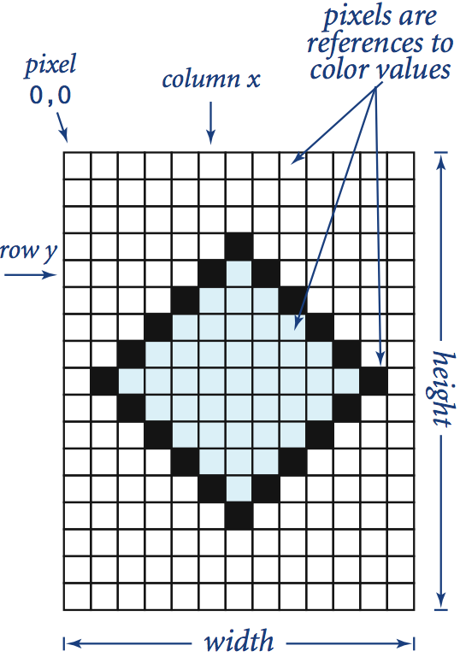
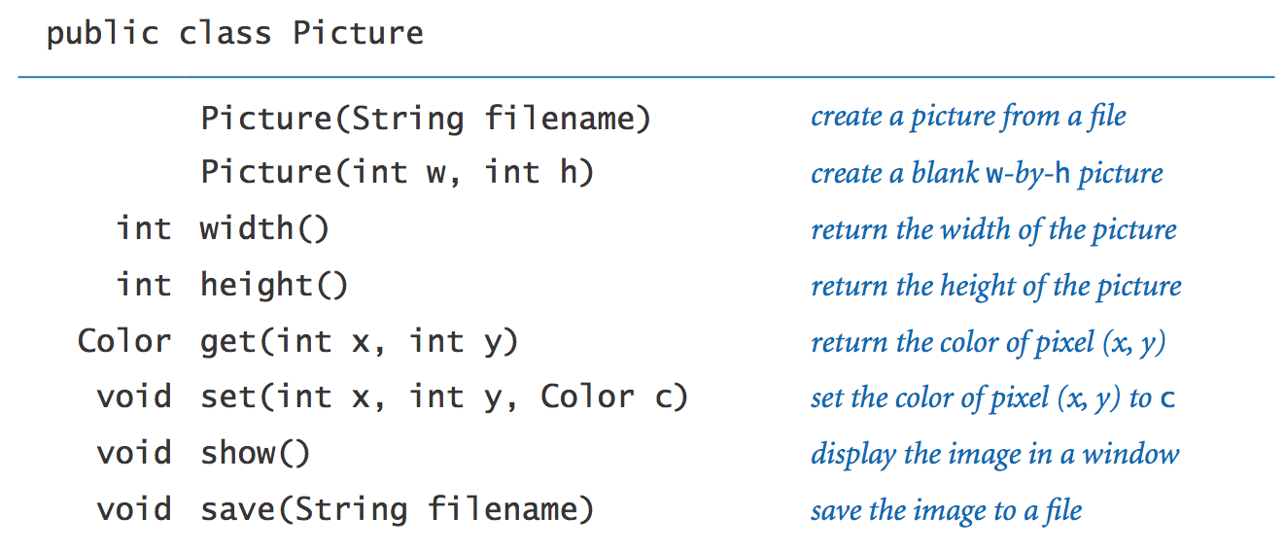
Exercise: Reuse Existing Class
Assume you find a Picture class (assume no source file, only .class file)
Assume you want to have a Picture class w/ more functions, such as converting to gray. What are your design options?
Notes:
more complicated data type (Picture) composed from simpler data type (Color) composed from primitive data type (int).
Library developed for this course.

Slide 20
Two Options to Reuse an Existing Code
Wrapper (delegation design)
public class BtrPicture {
private Picture p;
public BtrPicture(String file Name) { p = new Picture( fileName ); }
public int width() { return p.width();}
..
public BtrPicture gray() {
// create a new picture as gray
}
}
Inheritance design
public class BtrPicture extends Picture {
public BtrPicture(String file Name) { super( fileName ); }
..
public BtrPicture gray() {
// create a new picture as gray
}
}
Both designs have pros (positive) and cons (Negative) in terms of amount of coding, control.

Slide 21
Outline
Admin and recap
Class inheritance
why and how?
inheritance and object construction
inheritance and “mutation” (overriding)

Slide 22

Motivation: Implementing the Lawyer class: Attempt 1
// A class to represent lawyers.
public class Lawyer extends Employee {
public Lawyer(String name) { super(name); }
public void sue() {
System.out.println("I'll see you in court!");
}
}
public static void main(String[] args) {
Lawyer larry = new Lawyer("larry");
System.out.println ( larry.vacationDays() );
}
Does the design work?

Slide 23
Motivation: Implementing the Lawyer class: Attempt 1
// A class to represent lawyers.
public class Lawyer extends Employee {
public Lawyer(String name) { super(name); }
public void sue() {
System.out.println("I'll see you in court!");
}
}
public static void main(String[] args) {
Lawyer larry = new Lawyer("larry");
System.out.println ( larry.vacationDays() );
}
// 10 not 15
Does the design work?

Slide 24
Problem
We want lawyers to inherit most behaviors from employee, but we want to replace parts with new behavior:
Lawyers get an extra week of paid vacation over base vacation (a total of 3).
Lawyers use a pink form when applying for vacation leave.

Slide 25
Defining Methods in the Child Class: Overriding Methods
A child class can (have the option to) override the definition of an inherited method in favor of its own
that is, a child can redefine a method that it inherits from its parent
the new method must have the same signature as the parent's method, but can have different code in the body
The method invoked is always the one defined in the child class, if the child class refines (overrides) a method

Slide 26
Lawyer class
// A class to represent lawyers.
public class Lawyer extends Employee {
public Lawyer(String name) { super(name); }
// overrides getVacationDays from Employee class
public int vacationDays() {
return 15; // one more week vacation
}
// overrides getVacationForm from Employee class
public String vacationForm() {
return "pink";
}
public void sue() {
System.out.println("I'll see you in court!");
}
}

Slide 27
Overriding and the @Override annotation
// A class to represent lawyers.
public class Lawyer extends Employee {
public Lawyer(String name) { super(name); }
@Override // optional hint to compiler to check spelling
public int vacationDays() {
return 15; // one more week vacation
}
@Override
public String vacationForm() {
return "pink";
}
public void sue() {
System.out.println("I'll see you in court!");
}
}

Slide 28
Overloading vs. Overriding
Overloading deals with multiple methods in the same class with the same name but different signatures
Overloading lets you define a similar operation in different ways for different data
Overriding deals with two methods, one in a parent class and one in a child class, that have the same signature
Overriding lets you define a similar operation in different ways for different object types

Slide 29
Outline
Admin and recap
Class inheritance
why and how?
inheritance and object construction
inheritance and “mutation” (overriding)
Good overriding design

Slide 30
Marketer class
// A class to represent marketers.
public class Marketer extends Employee {
public Marketer(String name) { super(name); }
public void advertise() {
System.out.println("Act while supplies last!");
}
// override
public double pay() {
return 60000.0; // $60,000 = +20% of 50,000
}
}
Anything you do not like about the design?

Slide 31
A Problem
public class Marketer extends Employee {
public double pay() {
return 60000.0;
}
...
}
Problem: The policy is that Marketer‘s salaries are based on the Employee’s base salary (20% more than base), but the pay code does not reflect this.

Slide 32
Motivation: Changes to Common Behavior
Imagine a company-wide change affecting all employees.
Example: Everyone is given a $10,000 raise due to inflation.
The base employee salary is now $60,000.
We modify Employee’s pay method to reflect this policy change.

Slide 33
Modifying the superclass
// A class to represent employees in general (20-page manual).
public class Employee {
public int hours() {
return 40; // works 40 hours / week
}
public double pay() {
return 60000.0; // $60,000.00 / year
}
...
}
Issue: the Marketer subclass is still incorrect.
It has overridden pay to return another value.
Good design: derived behavior is based on base behavior

Slide 34
Calling overridden methods
Subclasses can call overridden methods with super
super.<method>(<parameters>)
Exercise: Modify Marketer to derive pay for marketers from base pay.

Slide 35
Improved subclasses
public class Marketer extends Employee {
public void advertise() {
System.out.println("Act now while supplies last!");
}
// override and invoke the parent’s version
public double pay() {
return super.pay() * 1.2;
}
…
}

Slide 36
Outline
Admin and recap
Class inheritance
why and how?
inheritance and object construction
inheritance and “mutation” (overriding)
inheritance and field access

Slide 37

Inheritance and Fields
Setting: To retain their lawyers, the firm changes pay policy so that a lawyer gets the base and $5000 for each year in the firm
public class Lawyer extends Employee {
…
public double pay() { return super.pay() + 5000 * years;
}
…
}
// years is a private field in Employee.
https://encrypted-tbn0.gstatic.com/images?q=tbn:ANd9GcR3InPYVkDuRLOzveTXxW0YyTTZi1b5Uo0pD8_Jkodow0IIPY9a

Slide 38
Problem
Fields declared private cannot be accessed from subclasses
Reason: subclassing cannot break encapsulation
Q: how to get around this limitation?

Slide 39
Solution 1
Add an accessor for any field needed by the subclass
public class Employee {
private String name; private int years;
public Employee(String name, int initialYears) {
this.name = name; years = initialYears;
}
public int getYears() {
return years;
}
...
}
public class Lawyer extends Employee {
public Lawyer(String name, int years) {
super(name, years);
}
public double pay() {
return super.pay() + 5000 * getYears();
}
...
}

Slide 40
Solution 2
Java provides a third visibility modifier to denote fields/methods to be accessible by only child classes: protected
public class Employee {
private String name;
protect int years;
public Employee(String name, int years) {
this.name = name;
this.years = years;
}
…
}

Slide 41
Discussion
How to choose between the two designs?
Design 1: Add public getYear()
Design 2: make year protected
Use Design 1, unless the method is an implementation method (not accessable, not service method)
Adding public getYear() makes it available to not only child class, but also all other classes.
If you do not want this, use Design 2

Slide 42
Outline
Admin and recap
Class inheritance
why and how?
inheritance and object construction
inheritance and “mutation” (overriding)
inheritance and field access
inheritance hierarchy

Slide 43
Levels of inheritance
Multiple levels of inheritance in a hierarchy are allowed.
Example: A legal secretary is the same as a regular secretary but makes more money (10% more) and can file legal briefs.
Exercise: Implement the LegalSecretary class.

Slide 44
Example: LegalSecretary class
// A class to represent legal secretaries.
public class LegalSecretary extends Secretary {
public void fileLegalBriefs() {
System.out.println("I could file all day!");
}
public double pay() {
return super.pay() * 1.1 ;
}
}

Slide 45

Example: Partner class
Partner is a senior lawyer that can get bonus. Thus it supports: awardBonus(double bonus)

Slide 46
Example: Partner class
// A class to represent partner.
public class Partner extends Lawyer { private double bonus;
public void awardBonus(double bonus) {
this.bonus = bonus;
}
public double pay() {
return super.pay() + bonus ;
}
}

Slide 47
Class Hierarchies
Many large-scale software systems define class hierarchies, where the root defines the common behaviors
Employee
Secretary
Lawyer
Marketer
LegalSecretary
Partner

Slide 48
Class Hierarchies: Another Example
Animal
Reptile
Bird
Mammal
Snake
Lizard
Parrot
Horse
Bat
Reptile爬行动物
Lizard蜥蜴
Parrot鹦鹉
Mammal哺乳动物
Notes:
Reptile爬行动物
Lizard蜥蜴
Parrot鹦鹉
Mammal哺乳动物
Bat蝙蝠

Slide 49
Outline
Admin and recap
Class inheritance
why and how?
inheritance and object construction
inheritance and “mutation” (overriding)
inheritance and field access
inheritance hierarchy
inheritance hierarchy of Critters and event-driven programming
Notes:
Critters小动物

Slide 50
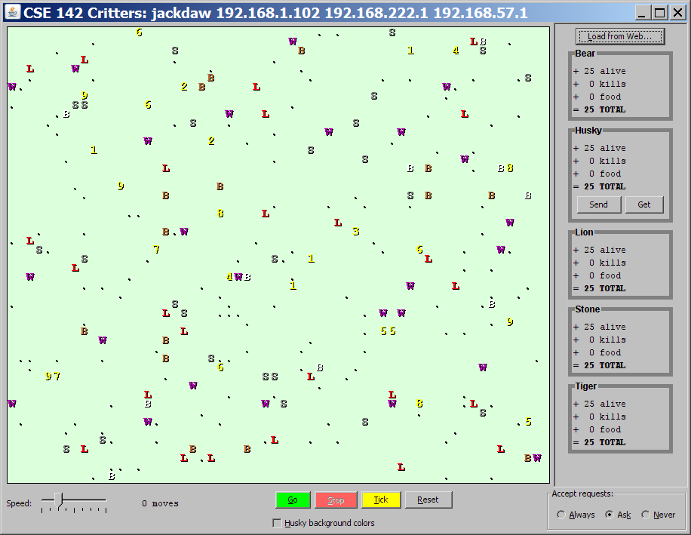
Critters
A simulation (game) world of animal objects (e.g., Ants, Birds, Cougars) with common behaviors such as
eat eating food
fight animal fighting
getColor color to display
getMove movement
toString letter to display
Notes:
Cougars美洲狮

Slide 51
The Critter Class
// abstract class means not implement every method
public abstract class Critter {
public boolean eat()
public Attack fight(String opponent)
// ROAR, POUNCE, SCRATCH, FORFEIT
public Color getColor()
public Direction getMove(String[][] grid)
// NORTH, SOUTH, EAST, WEST, CENTER
public String toString()
…
// read the class for other methods available
}

Slide 52
Defining a Critter subclass
public class name extends Critter {
...
}
extends Critter tells the simulator your class is a critter
an example of inheritance
Override methods to give each new type of animal distinct behaviors.

Slide 53
Example Critter World Class Hierarchy
Critter
Ant
Bird
Hippo
Bulldog
Vulture
Vulture秃鹫
Hippo河马
Bulldog斗牛犬

Slide 54

The Simulator (Controller)
Next move?
The simulator is in CritterMain.java
It searches local dir for all critters types
The simulator creates an array of critters
"Go" → loop, e.g.,
move each animal (getMove)
if two collide(碰撞), call each’s fight method on its behavior
if is over food, call eat
%

Slide 55
Simulator Pseudo-code
Critter[] critters = new Critter[N];
critters[0] = new Ant();
critters[1] = new Bird();
…
loop
foreach critter i in critters
call getMove of critter i if it can move
foreach critter i in critters
if new pos of critter i results in fight
ask how critter i will fight
else if new pos finds food
ask critter i whether it will eat
else if new pos results in mate possibility
ask if critter i will mate
compute new state of critters

Slide 56
Critter Example: Stone
import java.awt.*;
public class Stone extends Critter {
public Attack fight(String opponent) {
return Attack.ROAR; // ROAR(咆哮)... nothing beats that!
}
public Color getColor() {
return Color.GRAY; // stones are gray in color
}
public String toString() {
return "St"; // the game displays a stone
}
}

Slide 57
Event-Driven Programming
Key concept: The simulator is in control, NOT your animal.
Example: getMove can return only one move at a time. getMove can't use loops to return a sequence of moves.
It wouldn't be fair to let one animal make many moves in one turn!
Your animal must keep state (as fields) so that it can make a single move, and know what moves to make later.
We say that you focus on writing the callback functions of objects

Slide 58

Critter exercise: Cougar
Write a critter class Cougar (among the dumbest of all animals):
Method | Behavior
constructor | public Cougar()
eat | Always eats.
fight | Always roars.
getColor | Blue if the Cougar has never fought; red if he has.
getMove | Walks west until he finds food; then walks east until he finds food; then goes west and repeats.
toString | "C"
Implement Cougar’s eat, fight, toString.

Slide 59
getMove
How can a critter move west until it finds food and then moves to east until find food and repeat?
public Direction getMove(String[][] grid) {
initial currentDirect = WEST
loop
if (eat) {
reverse currentDirect;
print currentDirection;
}
Notes:
我们是遍历所有的Critter

Slide 60
getMove for Cougar
State machine
How to remember the state?
a boolean instance variable: boolean west
What is initial state and where to set it?
In constructor: west = true;
Who/when updates the state?
In eat(): reverse state
eat()
Move West
Move East
eat()

Slide 61
getColor for Cougar
Blue if the Cougar has never fought; red if he has.
State machine
How to remember the state?
A boolean instance variable: boolean fought
What is initial state and where to set it?
In constructor: fought = false;
Who/when updates the state?
In fight(): fought = true
fight()
! Has fought
Has fought

Slide 62
Cougar solution
import java.awt.*; // for Color
public class Cougar extends Critter {
private boolean west;
private boolean fought;
public Cougar() {
west = true;
fought = false;
}
public boolean eat() {
west = !west;
return true;
}
public Attack fight(String opponent) {
fought = true;
return Attack.POUNCE;
}
...

Slide 63
Cougar solution
...
public Color getColor() {
if (fought) {
return Color.RED;
} else {
return Color.BLUE;
}
}
public Direction getMove(String[][] grid) {
if (west) {
return Direction.WEST;
} else {
return Direction.EAST;
}
}
public String toString() {
return "C";
}
}

Slide 64
Comment: PS10 Development Strategy
Do one species at a time
in ABC order from easier to harder
debug printlns
Simulator helps you debug
smaller width/height
fewer animals
"Tick" instead of "Go"
"Debug" checkbox
drag/drop to move animals

Slide 65
Testing critters
Focus on one specific critter of one specific type
Only spawn 1 of each animal, for debugging
Make sure your fields update properly
Use println statements to see field values
Look at the behavior one step at a time
Use "Tick" rather than "Go"

Slide 66
Recap: Field/Method Access
Access Modifier | Who can access
private | Only within the defining class
public | Everywhere
protected | The defining class and its descendent classes
- | With the same package
Two approaches to access a field/method defined in parent class
Parent class defines it as public
Parent class defines it as protected

Slide 67
Recap: The Critter Class Hierarchy
Critter
Ant
Bird
Hippo
Bulldog
Vulture
// abstract class means not implement every method
public abstract class Critter {
public boolean eat()
public Attack fight(String opponent)
// ROAR, POUNCE, SCRATCH, FORFEIT
public Color getColor()
public Direction getMove(String[][] grid)
// NORTH, SOUTH, EAST, WEST, CENTER
public String toString()
…
// read the class for other methods available
}

Slide 68
Critters and Event-Driven Programming
Key concepts:
The simulator is in control, NOT an animal.
An animal must keep state (as fields) so that it can make a single move, and know what moves to make later.
We say that event-driven programming (EDP) focuses on writing the callback functions of objects
We will discuss how an EDP framework is designed.
Next move?
%

Slide 69
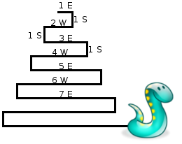
Critter : Snake
Method | Behavior
constructor | public Snake()
eat | Never eats
fight | random pounce(猛扑) or roar
getColor | Color(20, 50, 128)
getMove | 1 E, 1 S; 2 W, 1 S; 3 E, 1 S; 4 W, 1 S; 5 E, ...
toString | "S"

Slide 70
EDP for getMove
Variables that determine the state for getMove?
Length of current cycle (east-west)
Number of moves made in current cycle
What is the initial state?
cycleLength = 1
steps = 0

Slide 71
Non-EDP Version
A non-event driven version
cycleLength = 1; steps = 0;
do {
while (steps < cycleLength)
if cycleLength % 2 == 1 go East
else
go West
steps ++;
go South
cycleLength ++; steps = 0;
} while (true);

Slide 72

Non-EDP-> EDP: Guarding Condition
Technique: determine the guarding condition (using state variables) on action statements
steps < cycleLength
cycleLength = 1; steps = 0;
do {
while (steps < cycleLength)
if cycleLength % 2 == 1 go East
else
go West
steps ++;
go South
cycleLength ++; steps = 0;
} while (true);
if (cycleLength % 2 == 1) go East
else
go West
steps++;
steps == cycleLength
go South
cycleLength ++
steps=0;

Slide 73
Snake solution
import java.awt.*; // for Color
public class Snake extends Critter {
private int cycleLength; // # steps in curr. Horiz. cycle
private int steps; // # of cycle's steps already taken
public Snake() {
cycleLength = 1;
steps = 0;
}
public Direction getMove() {
if (steps < cycleLength) {
steps++;
if (cycleLength % 2 == 1) {
return Direction.EAST;
} else {
return Direction.WEST;
}
} else {
steps = 0;
cycleLength ++;
return Direction.SOUTH;
}
}
public String toString() {
return "S";
}
}
steps < cycleLength
if (cycleLength % 2 == 1) go East
else
go West
steps++;
steps == cycleLength
Go South
cycleLength ++
steps=0;

Slide 74
Comment: States
Counting is helpful:
How many total moves has this animal made?
How many times has it eaten? Fought?
Remembering recent actions in fields may be helpful:
Which direction did the animal move last?
How many times has it moved that way?
Did the animal eat the last time it was asked?
How many steps has the animal taken since last eating?
How many fights has the animal been in since last eating?

