Slide 1
Introduction to Computational Thinking
Polymorphism; Event-Driven Programming
Qiao Xiang, Qingyu Song
https://sngroup.org.cn/courses/ct-xmuf25/index.shtml
12/24/2025
This deck of slides are heavily based on cs112 at Yale University and cs101 at UCAS, respectively,
by courtesy of Dr. Y. Richard Yang and Dr. Zhiwei Xu.

Slide 2
Final Exam
One double-sided A4 page cheating sheet
Date, location: 10:30 AM - 12:30 PM, Dec 30, 2025, Xuewu Building 1, A206
Coverage: https://sngroup.org.cn/courses/ct-xmuf25/exam-coverage.html

Slide 3
Outline
Critters and objects coordination
Polymorphism 多态

Slide 4
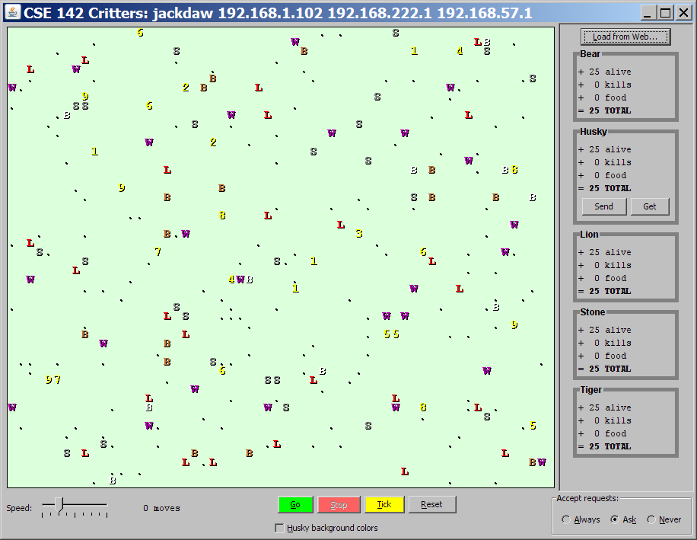

Recap: Critters and Event-Driven Programming
Key concepts:
The simulator is in control, NOT an animal.
An animal must keep state (as fields) so that it can make a single move, and know what moves to make later.
We say that event-driven programming (EDP) focuses on writing the callback functions of objects
Next move?
%

Slide 5
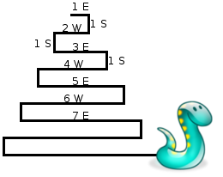
Recap: Critter : Snake
Method | Behavior
constructor | public Snake()
eat | Never eats
fight | random pounce(猛扑) or roar
getColor | Color(20, 50, 128)
getMove | 1 E, 1 S; 2 W, 1 S; 3 E, 1 S; 4 W, 1 S; 5 E, ...
toString | "S"

Slide 6
Recap: EDP for getMove
Variables that determine the state for getMove?
Length of current cycle (east-west)
Number of moves made in current cycle
What is the initial state?
cycleLength = 1
steps = 0

Slide 7
Recap: Non-EDP Version
A non-event driven version
cycleLength = 1; steps = 0;
do {
while (steps < cycleLength)
if cycleLength % 2 == 1 go East
else
go West
steps ++;
go South
cycleLength ++; steps = 0;
} while (true);

Slide 8

Recap: Non-EDP-> EDP: Guarding Condition
Technique: determine the guarding condition (using state variables) on action statements
steps < cycleLength
cycleLength = 1; steps = 0;
do {
while (steps < cycleLength)
if cycleLength % 2 == 1 go East
else
go West
steps ++;
go South
cycleLength ++; steps = 0;
} while (true);
if (cycleLength % 2 == 1) go East
else
go West
steps++;
steps == cycleLength
go South
cycleLength ++
steps=0;

Slide 9
Snake solution
import java.awt.*; // for Color
public class Snake extends Critter {
private int cycleLength; // # steps in curr. Horiz. cycle
private int steps; // # of cycle's steps already taken
public Snake() {
cycleLength = 1;
steps = 0;
}
public Direction getMove() {
if (steps < cycleLength) {
steps++;
if (cycleLength % 2 == 1) {
return Direction.EAST;
} else {
return Direction.WEST;
}
} else {
steps = 0;
cycleLength ++;
return Direction.SOUTH;
}
}
public String toString() {
return "S";
}
}
steps < cycleLength
if (cycleLength % 2 == 1) go East
else
go West
steps++;
steps == cycleLength
Go South
cycleLength ++
steps=0;

Slide 10
Comment: States
Counting is helpful:
How many total moves has this animal made?
How many times has it eaten? Fought?
Remembering recent actions in fields may be helpful:
Which direction did the animal move last?
How many times has it moved that way?
Did the animal eat the last time it was asked?
How many steps has the animal taken since last eating?
How many fights has the animal been in since last eating?

Slide 11
Outline
Critters and objects coordination
Polymorphism 多态

Slide 12
Motivation
Next move?
The controller implemented in CritterMain.java works on all critters objects, even of critter types defined in the future.
How does one write such a highly reusable, extensible program?
%

Slide 13
What is Polymorphism?
polymorphism: Ability for the same code to be used with different types of objects and behave differently according to the types of objects.
The foundation of polymorphism is dynamic typing: the method invoked is always determined by the object, not the class.

Slide 14
Recap: Reference Variables
Interaction with an object occurs through object reference variables
An object reference variable holds the reference (address, the location) of an object
ChessPiece bishop1 = new ChessPiece();
bishop1

Slide 15
Recap: Object Reference Variable
Object reference variable assignment copies address, creating aliases
bishop2 = bishop1;
Before
After
bishop1
bishop2
bishop1
bishop2

Slide 16
Requirements on Polymorphic Code
x can point to different types of objects
X x;
…
x.method();
…
x.method();
method() exists in these different objects
method() exists in these different obejcts
method() exists in these different obejcts
method() behaves differently
polymorphism: Ability for the same code to be used with different types of objects and behave differently according to the types of objects.

Slide 17
Polymorphism through Inheritance
Same reference points to different types of objects
A variable of type T can hold an object of class T or descendent(后代) of T, e.g.,
Employee emp = new Employee(“Ed”);
emp = new Lawyer(“Larry”); emp = new LegalSecretary(“Lisa”);
The method used exists in all the objects
If the method is defined in the base class
The method may behave differently
The child class can override the method

Slide 18
Polymorphism through Inheritance
You can call any methods defined in the based class T (e.g., Employee) class on polymorphic reference of type T (e.g., emp)
When you invoke a method through a polymorphic reference variable, it is the type of the object being referenced, not the reference type, that determines which method is invoked.
Careful use of polymorphic references can lead to elegant, robust, highly extensible software designs

Slide 19
Example: Polymorphic Variable
Employee emp; // base type
emp = new Lawyer("Larry");
System.out.println ( emp.vacationDays() );
// OUTPUT: 15
System.out.println ( emp.vacationForm() );
// OUTPUT: pink
emp = new LegalSecretary(“Lisa");
System.out.println ( emp.vacationDays() );
// OUTPUT: 10
System.out.println ( emp.vacationForm() );
// OUTPUT: yellow

Slide 20


Example: Polymorphic Variable
Object type: Lawyer
Reference variable type
emp.vacationDays()
// 15
Employee emp
Object type: Secretary
emp.vacationDays()
// 10

Slide 21
Example: Polymorphic Method
Define a method that can apply to all objects of a base type or its derived types.
This is how print in PrintStream is defined: void print(Object obj) { // all objects have the toString() method // convert to string and then output }

Slide 22
Example: Polymorphic Method
public class EmployeeMain {
public static void main(String[] args) {
Lawyer lisa = new Lawyer(“Lisa”);
Secretary steve = new Secretary(“Steve”);
printInfo(lisa);
printInfo(steve);
}
public static void printInfo(Employee empl) {
System.out.println("salary: " + empl.pay());
System.out.println("v.days: " + empl.vacationDays());
System.out.println("v.form: " + empl.vacationForm());
System.out.println();
}
}
OUTPUT:
salary: 50000.0 salary: 50000.0
v.days: 15 v.days: 10
v.form: pink v.form: yellow

Slide 23
Polymorphic Arrays
A common usage of polymorphism is to define an array of a base type, but different entries refer to different types of objects
To handle a heterogeneous population of objects with uniformity, achieving generic programming

Slide 24
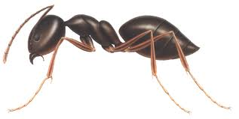


Example: CritterMain Internal
Critter[] critters = { new Ant(),
new Cougar(),
new Snake(),
new Bulldog()
};
while (true)
for (i=0; i<critters.length; i++)
newPos = critters[i].getMove();
disp = critters[i].toString();
… draw disp at pos
index | 0 | 1 | 2 | 3
Not dependent on any specific critters but only the generic Critter concept

Slide 25
Example: Polymorphic Array on Firm
public class Staff {
private Employee[] staffList;
public Staff() {
staffList = new Employee[4];
staffList[0] = new Lawyer("Lisa");
staffList[1] = new Secretary("Sally");
staffList[2] = new Marketer("Mike");
staffList[3] = new LegalSecretary("Lynne");
}
public void payday() {
for (int count = 0; count < staffList.length; count++) {
System.out.printf("%-10s:", staffList[count].name());
System.out.printf("$%.2f\n", staffList[count].pay());
System.out.println("-----------------------------------");
}
}
}
Works on any mix of Employee objects

Slide 26
Example: Extending the Program: Hourly
Include a new type of secretary who works variable number of hours and is paid by the hours.

Slide 27
Extending the Program: Hourly
public class Hourly extends Secretary {
private double payRate;
private int hours;
public Hourly(String name, double payRate)
super(name);
this.payRate = payRate;
hours = 0;
}
public void addHours(int hours) { this.hours += hours;
}
public int hours() { return hours; }
public double pay() {return hours() * payRate;}
}

Slide 28
Polymorphic Array Handles Changes
public class Staff {
private Employee[] staffList;
public Staff() {
staffList = new Employee[5];
staffList[0] = new Lawyer("Lisa");
staffList[1] = new Secretary("Sally");
staffList[2] = new Marketer("Mike");
staffList[3] = new LegalSecretary("Lynne");
Hourly holly = new Hourly(“Holly"); holly.addHours(10);
staffList[4] = holly;
}
public void payday() {
for (int count = 0; count < staffList.length; count++) {
System.out.printf("%-10s:", staffList[count].name());
System.out.printf("$%.2f\n", staffList[count].pay());
System.out.println("-----------------------------------");
}
}
}
No need to change the payday method at all.

Slide 29
Payroll
The pay-roll of a firm
+ main (args : String[]) : void
Staff
Employee
# name : String
- staffList : Employee[]
- staffList: staffMemeber[]
+ payday() : void
+ toString() : String
+ pay() : double
Hourly
Lawyer
- payRate: double
+ pay() : double
+ toString() : String
+ pay() : double
Partner
- bonus : double
+ awardBonus(bonus : double) : void
+ pay() : double

Slide 30
Comment: Variable Type and Method
Through a given type of reference variable, we can invoke only the methods defined in that type
class Employee{ public double pay() {…} }
class Lawyer extends Employee {
public void sue() {…}
}
Employee ed = new Lawyer(“Larry”);
Can we do the following statements:
ed.pay();
ed.sue();
Notes:
答案是不行

Slide 31
Comment: Variable Type and Method
We can “promote” an object back to its original type through an explicit narrowing cast:
staffList = new Employee[5];
staffList[0] = new Lawyer("Lisa");
staffList[1] = new Secretary("Sally");
staffList[2] = new Marketer("Mike");
staffList[3] = new LegalSecretary("Lynne");
staffList[4] = new Hourly(“Holly");
Hourly holly = (Hourly)staffList[4];
holly.addHours (5);
If the type of object referred to by staff[4] is not Hourly, program error.

Slide 32
Summary: Polymorphism
polymorphism: Ability for the same code to be used with different types of objects and behave differently with each.
CritterMain can interact with any type of critter.
Each one moves, fights, etc. in its own way.
Firm can use one method to pay for any type of Employee.
Each one is paid in its own way.
Print
Notes:
36 end

Slide 33
Outline
Class inheritance
polymorphism, and polymorphism through inheritance
Interface as an alternative of inheritance
motivation
syntax

Slide 34
Interface Syntax
An interface is a collection of constants and abstract methods
abstract method: a method header without a method body; we declare an abstract method using the modifier abstract
since all methods in an interface are abstract, the abstract modifier is usually left off

Slide 35
Interface: Example
interface is a reserved word
public interface Movable {
public double getSpeed();
public void setSpeed(double speed);
public void setDirection(int direction);
public int getDirection();
}
This interface describes the behaviors common to all movable things. (Every Movable thing should have these methods.)
A semicolon follows each method header
immediately
No method in an
interface has a definition (body)

Slide 36
Implementing an interface
general syntax:
public class <name> implements <interface names> {
...
}
Example:
public class Bicycle implements Movable {
...
}
(What must be true about the Bicycle class for it to compile?)
36

Slide 37
Interface Implementation
If we write a class that claims to be an interface (e.g., Movable) , but doesn't implement all of the methods defined in the interface, it will not compile.
Example:
public class Bicycle implements Movable {
}
The compiler error message:
Bicycle.java:1: Bicycle is not abstract and does not override abstract method getSpeed() in Movable
37

Slide 38
Example: Shape interface
An interface for shapes:
public interface Shape {
public double area();
}
This interface describes the common features that all shapes should have in your design. (Every shape has an area.)
38

Slide 39
Example: Circle class
// Represents circles.
public class Circle implements Shape {
private double radius;
// Constructs a new circle with the given radius.
public Circle(double radius) {
this.radius = radius;
}
// Returns the area of this circle.
public double area() {
return Math.PI * radius * radius;
}
}
39

Slide 40
Example: Rectangle class
// Represents person.
public class Person implements Shape {
private double weight;
private double height;
…
public Person(double weight, double height) {
this.weight = weight;
this.height = height;
}
// Returns the area of a person using Du Bois formula
public double area() {
return 0.007184 * Math.power(weight, 0.425) * Math.power(height, 0.725);
}
// other methods
}
40

Slide 41
Summary: Interfaces
interface: A list of methods that classes can promise to implement.
Analogous to non-programming idea of roles or certifications
"I'm certified as a CPA accountant.”
interface vs inheritance
inheritance gives an is-a relationship and code-sharing.
A Lawyer object can be treated as an Employee, and Lawyer inherits Employee's code.
interface gives an is-a relationship without code sharing.

Slide 42
Outline
Admin and recap
Class inheritance
polymorphism, and polymorphism through inheritance
Interface as an alternative of inheritance
motivation
syntax
polymorphism through inheritance

Slide 43
Satisfy Polymorphism Requirements using Interface
Same reference points to different types of objects
A variable of interface type T can hold an object of any class implementing T.
Movable mobj = new Bicyle();
The method used exists in all the objects
Using an interface reference, you can only invoke the methods defined in the interface;
A class must implement the methods defined in the interface
The method may behave differently
Different class can implement the method differently

Slide 44
Interface Polymorphism: Example
public static void printShapeInfo(Shape s) {
System.out.println("area : " + s.area());
System.out.println();
}
Any object that implements the interface may be passed as the parameter to the above method.
Circle circ = new Circle(12.0);
Person john = new Person(60, 175);
printShapeInfo(circ);
printShapeInfo(john);
Notes:
假设有个Shape接口

Slide 45
Interface Polymorphism: Example
We can create an array of an interface type, and store any object implementing that interface as an element.
Circle circ = new Circle(12.0);
Person john = new John(60, 175);
YaleStudent nicole = new YaleStudent();
Shape[] shapes = {circ, john, nicole};
for (int i = 0; i < shapes.length; i++) {
printShapeInfo(shapes[i]);
}
Each element of the array executes the appropriate behavior for its object when it is passed to the printShapeInfo method

Slide 46
Interface
An interface provides an abstraction to write reusable, general programs
Instead of writing a program for a single class (hierarchy) of objects, we want to write a program to handle all classes with a given set of behaviors/properties
An interface is an abstraction for the common behaviors of these behaviors
Often interface represents abstract concepts

Slide 47
Summary: Using Interface for General Programming
When defining a class or method (e.g., sorting), think about the essence (most general) properties/behaviors of the objects you require
Define those properties in an interface
Implement the class/method for the interface only so that your design is the most general !

