Slide 1
Discrete Mathematics and Its Applications
Introductory Lecture
Copyright © McGraw-Hill Education. All rights reserved. No reproduction or distribution without the prior written consent of McGraw-Hill Education.

Slide 2
What is Discrete Mathematics?
Discrete mathematics is the part of mathematics devoted to the study of discrete (as opposed to continuous) objects.
Calculus deals with continuous objects and is not part of discrete mathematics.
Examples of discrete objects: integers, steps taken by a computer program, distinct paths to travel from point A to point B on a map along a road network, ways to pick a winning set of numbers in a lottery.
A course in discrete mathematics provides the mathematical background needed for all subsequent courses in computer science and for all subsequent courses in the many branches of discrete mathematics.

Slide 3
Kinds of Problems Solved Using Discrete Mathematics
How many ways can a password be chosen following specific rules?
How many valid Internet addresses are there?
What is the probability of winning a particular lottery?
Is there a link between two computers in a network?
How can I identify spam email messages?
How can I encrypt a message so that no unintended recipient can read it?
How can we build a circuit that adds two integers?

Slide 4
Kinds of Problems Solved Using Discrete Mathematics
What is the shortest path between two cities using a transportation system?
Find the shortest tour that visits each of a group of cities only once and then ends in the starting city.
How can we represent English sentences so that a computer can reason with them?
How can we prove that there are infinitely many prime numbers?
How can a list of integers be sorted so that the integers are in increasing order?
How many steps are required to do such a sorting?
How can it be proved that a sorting algorithm always correctly sorts a list?

Slide 5
Goals of a Course in Discrete Mathematics
Mathematical Reasoning: Ability to read, understand, and construct mathematical arguments and proofs.
Combinatorial Analysis: Techniques for counting objects of different kinds.
Discrete Structures: Abstract mathematical structures that represent objects and the relationships between them. Examples are sets, permutations, relations, graphs, trees, and finite state machines.

Slide 6
Goals of a Course in Discrete Mathematics
Algorithmic Thinking: One way to solve many problems is to specify an algorithm. An algorithm is a sequence of steps that can be followed to solve any instance of a particular problem. Algorithmic thinking involves specifying algorithms, analyzing the memory and time required by an execution of the algorithm, and verifying that the algorithm will produce the correct answer.
Applications and Modeling: It is important to appreciate and understand the wide range of applications of the topics in discrete mathematics and develop the ability to develop new models in various domains. Concepts from discrete mathematics have not only been used to address problems in computing, but have been applied to solve problems in many areas such as chemistry, biology, linguistics, geography, business, etc.

Slide 7
Discrete Mathematics is a Gateway Course
Topics in discrete mathematics will be important in many courses that you will take in the future:
  Computer Science: Computer Architecture, Data Structures, Algorithms, Programming Languages, Compilers, Computer Security, Databases, Artificial Intelligence, Networking, Graphics, Game Design, Theory of Computation, ……
  Mathematics: Logic, Set Theory, Probability, Number Theory, Abstract Algebra, Combinatorics, Graph Theory, Game Theory, Network Optimization, …
    The concepts learned will also be helpful in continuous areas of mathematics.
  Other Disciplines: You may find concepts learned here useful in courses in philosophy, economics, linguistics, and other departments.

Slide 8
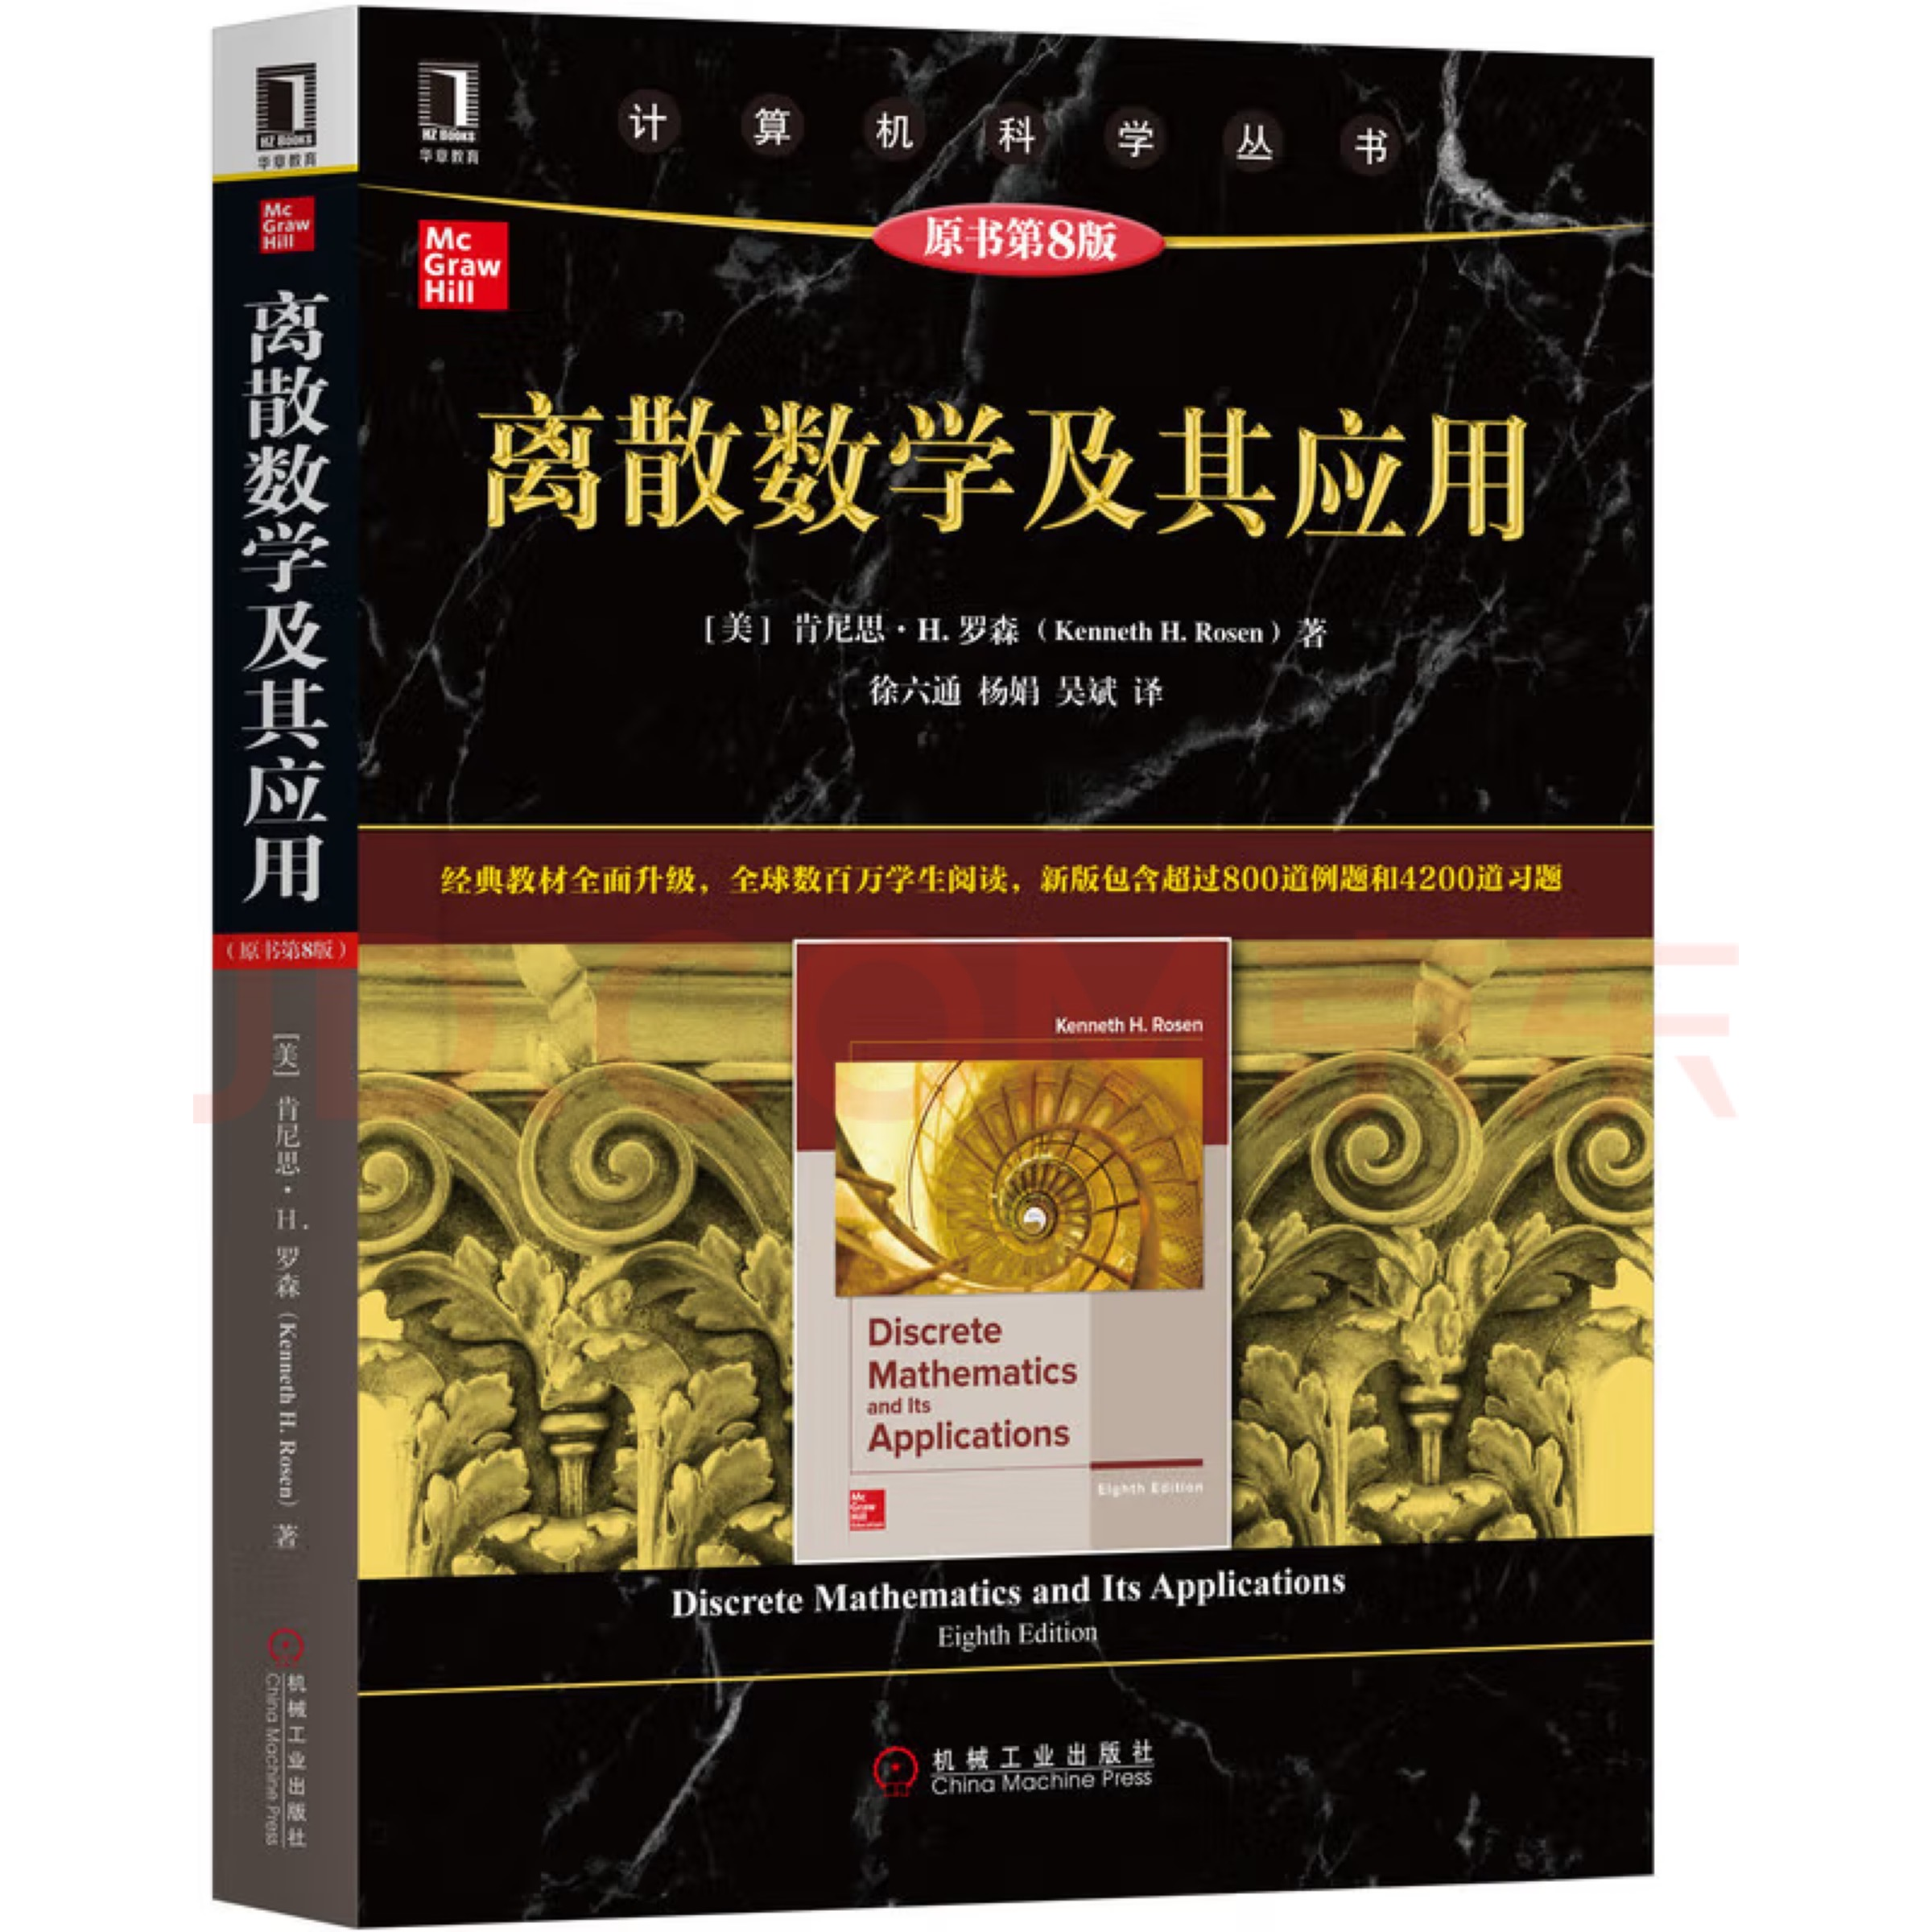
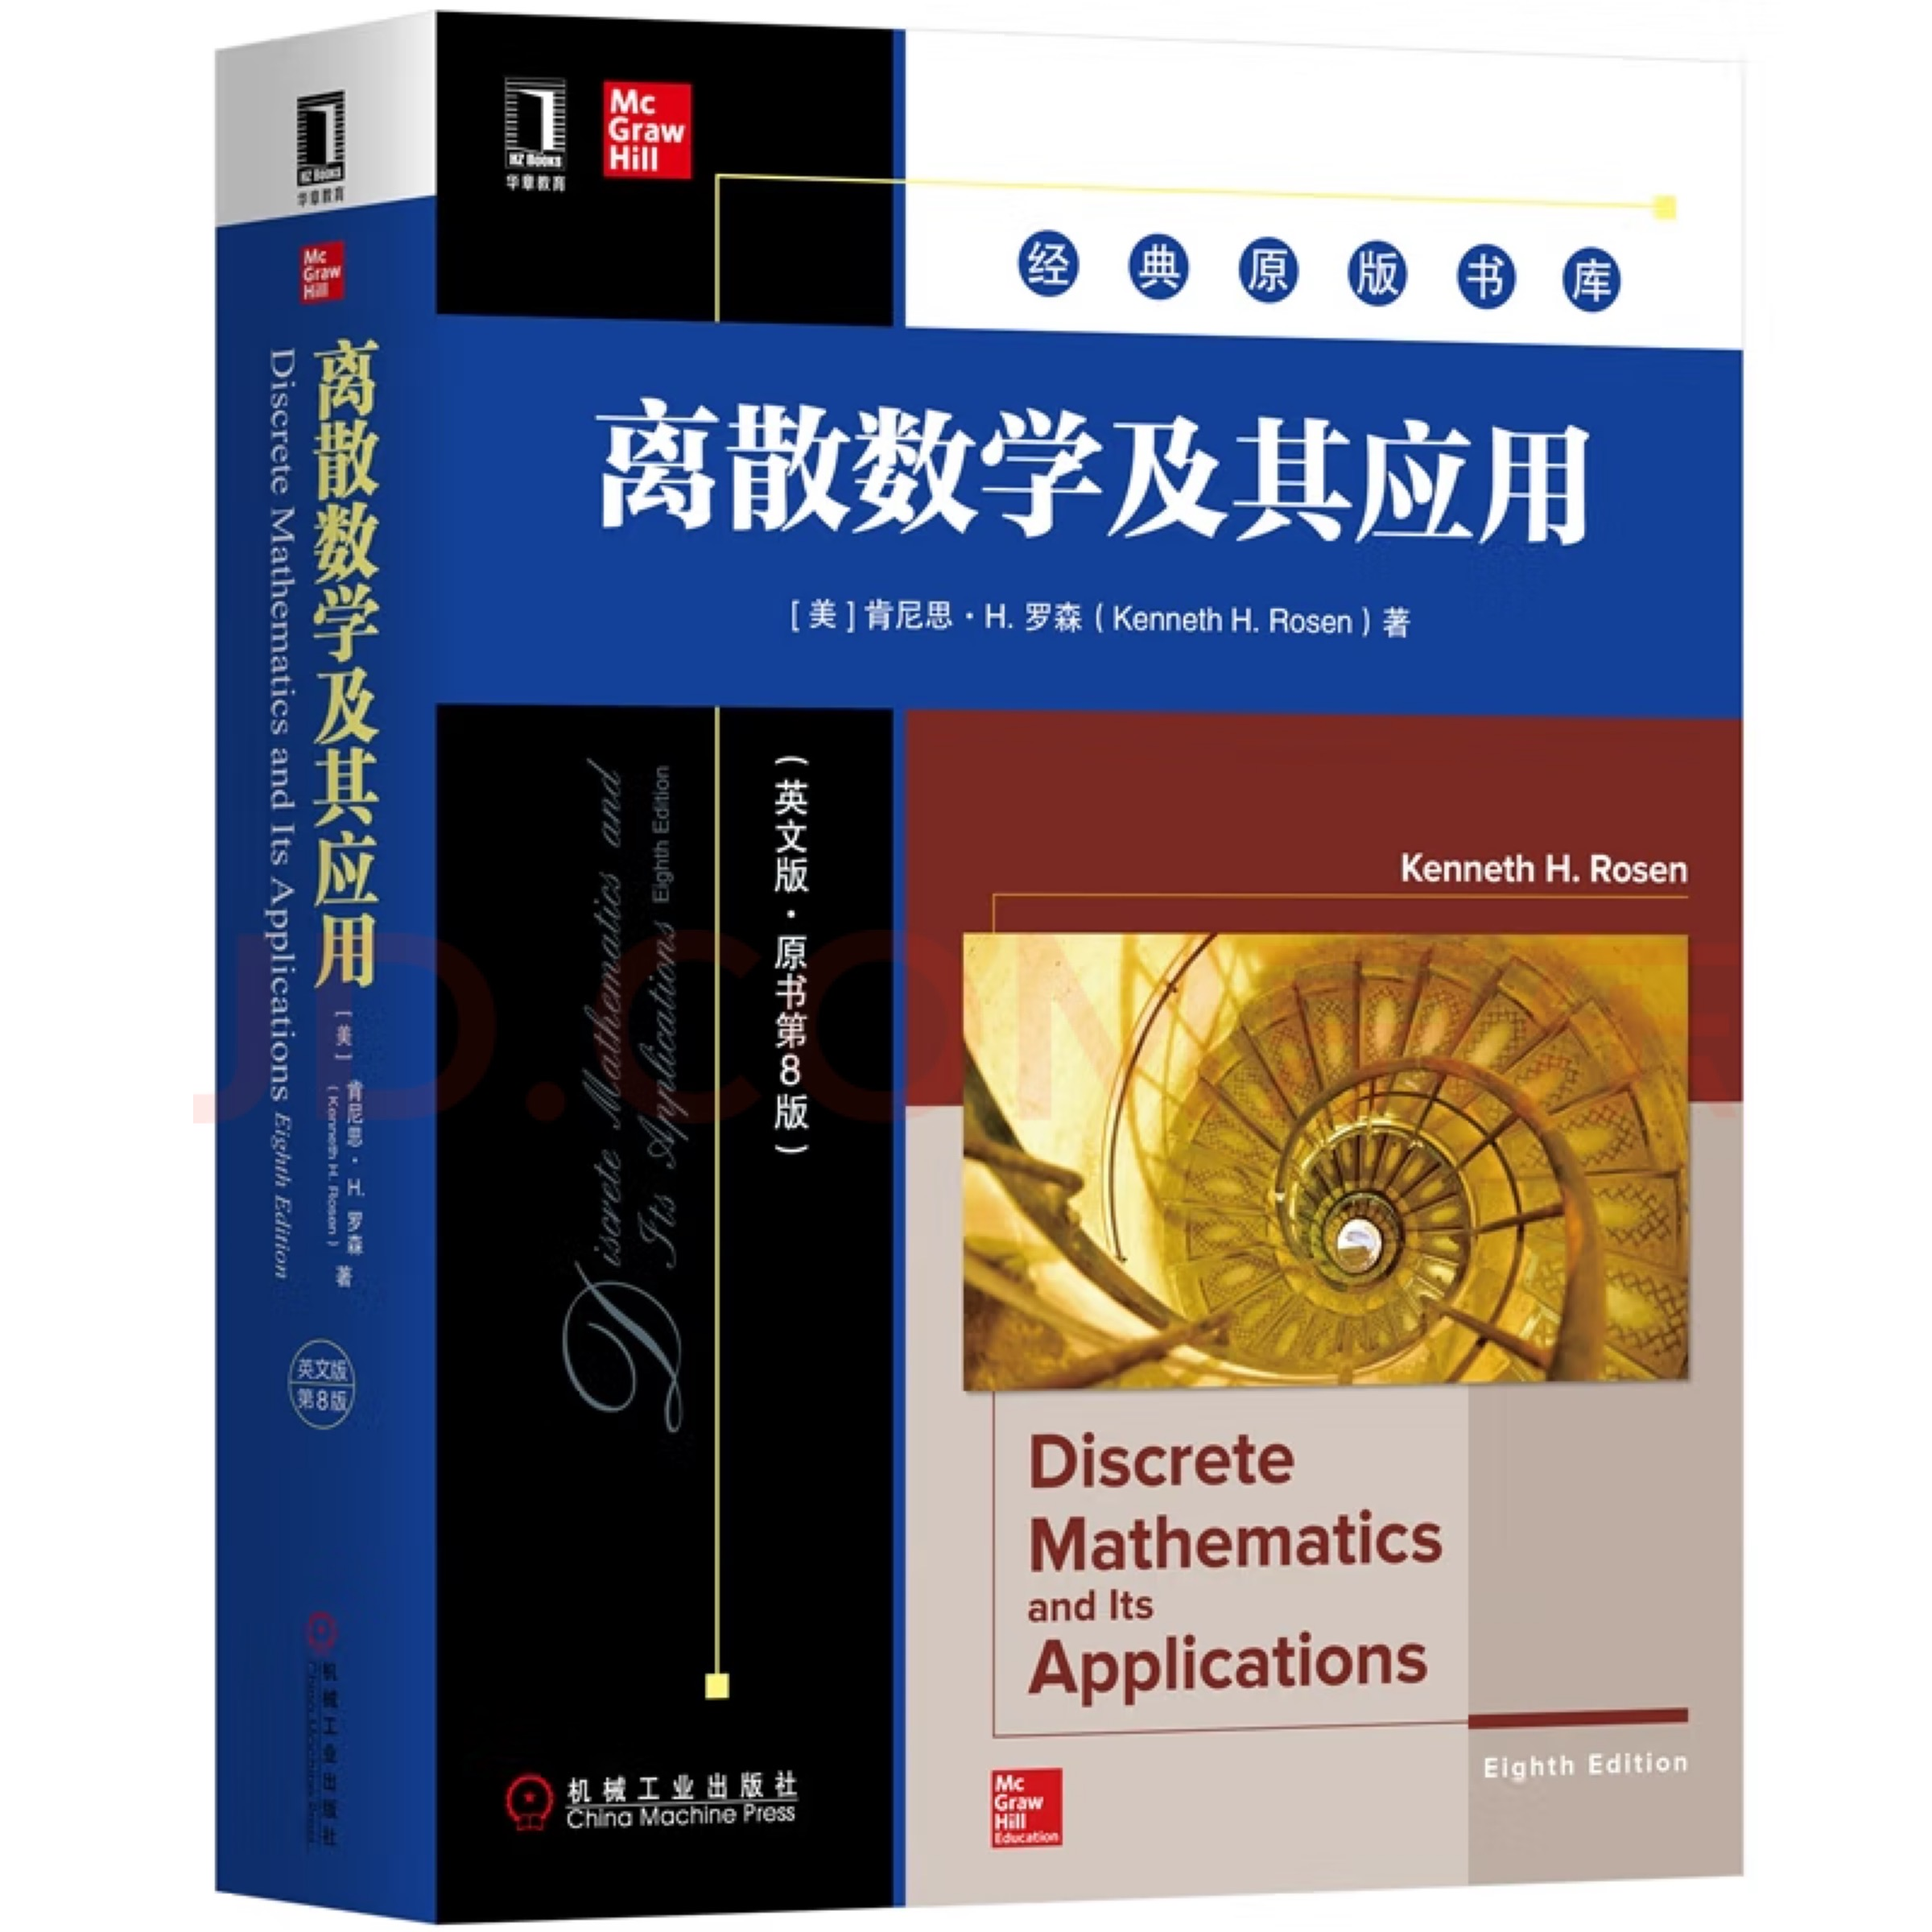
Textbook

Slide 9







Instructors
Qiao Xiang
Congming Gao
Zhirong Shen
Yaobin Shen
Xiaoli Wang
Rongxin Wu
Lu Tang

Slide 10
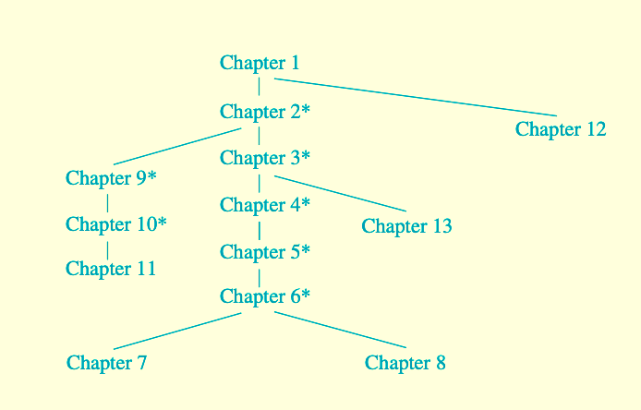
（逻辑）向乔
（集合论）
高聪明
（布尔代数）向乔
（关系代数）
沈志荣
（算法复杂度）
沈志荣
（数论/密码）
沈耀斌
（文法与自动机）
吴荣鑫
（图）
王晓黎
（树）
王晓黎
（数学归纳法）
唐璐
（组合数学I）
沈耀斌
（概率论）
高聪明
（组合数学II）
唐璐

Slide 11
Workload
One assignment per chapter (50%)
  Expect to spend 1-3 hours on every assignment
One mid-term exam (20%)
  Chapters 1, 2, 3, 4, 5, and 12
One final exam (30%)
  Chapters 6, 7, 8, 9, 10, 11, 13

Slide 12
The Foundations: Logic and Proofs
Chapter 1, Part I: Propositional Logic
With Question/Answer Animations
Copyright © McGraw-Hill Education. All rights reserved. No reproduction or distribution without the prior written consent of McGraw-Hill Education.

Slide 13
Chapter Summary
Propositional Logic
  The Language of Propositions
  Applications
  Logical Equivalences
Predicate Logic
  The Language of Quantifiers
  Logical Equivalences
  Nested Quantifiers
Proofs
  Rules of Inference
  Proof Methods
  Proof Strategy

Slide 14
Propositional Logic Summary
The Language of Propositions
  Connectives
  Truth Values
  Truth Tables
Applications
  Translating English Sentences
  System Specifications
  Logic Puzzles
  Logic Circuits
Logical Equivalences
  Important Equivalences
  Showing Equivalence
  Satisfiability

Slide 15
Propositional Logic
Section 1.1

Slide 16
Section Summary
Propositions
Connectives
  Negation
  Conjunction
  Disjunction
  Implication; contrapositive, inverse, converse
  Biconditional
Truth Tables

Slide 17
Propositions
A proposition is a declarative sentence that is either true or false.
Examples of propositions:
  The Moon is made of green cheese.
  Trenton is the capital of New Jersey.
  Toronto is the capital of Canada.
  1 + 0 = 1
  0 + 0 = 2
Examples that are not propositions.
  Sit down!
  What time is it?
  x + 1 = 2
  x + y = z
proposition 命题

Slide 18
Propositional Logic
Constructing Propositions
  Propositional Variables: p, q, r, s, …
  The proposition that is always true is denoted by T and the proposition that is always false is denoted by F.
  Compound Propositions; constructed from logical connectives and other propositions
    Negation ¬
    Conjunction ∧
    Disjunction ∨
    Implication →
    Biconditional ↔
Negation 否定
Conjunction 合取
Disjunction 析取
Implication 蕴含
Biconditional 双条件

Slide 19
Compound Propositions: Negation
  The negation of a proposition p is denoted by ¬p and has this truth table:
Example: If p denotes “The earth is round.”, then ¬p denotes “It is not the case that the earth is round,” or more simply “The earth is not round.”
p | ¬p
T | F
F | T

Slide 20
Conjunction
The conjunction of propositions p and q is denoted by p ∧ q and has this truth table:
Example: If p denotes “I am at home.” and q denotes “It is raining.” then p ∧q denotes “I am at home and it is raining.”
p | q | p ∧ q
T | T | T
T | F | F
F | T | F
F | F | F

Slide 21
Disjunction
The disjunction of propositions p and q is denoted by p ∨q and has this truth table:
Example: If p denotes “I am at home.” and q denotes “It is raining.” then p ∨q denotes “I am at home or it is raining.”
p | q | p ∨q
T | T | T
T | F | T
F | T | T
F | F | F

Slide 22
The Connective Or in English
In English “or” has two distinct meanings.
  “Inclusive Or” - In the sentence “Students who have taken CS202 or Math120 may take this class,” we assume that students need to have taken one of the prerequisites, but may have taken both. This is the meaning of disjunction. For p ∨q to be true, either one or both of p and q must be true.
  “Exclusive Or” - When reading the sentence “Soup or salad comes with this entrée,” we do not expect to be able to get both soup and salad. This is the meaning of Exclusive Or (Xor). In p ⊕ q , one of p and q must be true, but not both. The truth table for ⊕ is:
p | q | p ⊕q
T | T | F
T | F | T
F | T | T
F | F | F
Inclusive Or 兼或
Exclusive Or 异或

Slide 23
Implication
If p and q are propositions, then p →q is a conditional statement or implication which is read as “if p, then q ” and has this truth table:
Example: If p denotes “I am at home.” and q denotes “It is raining.” then p →q denotes “If I am at home then it is raining.”
In p →q , p is the hypothesis (antecedent or premise) and q is the conclusion (or consequence).
p | q | p →q
T | T | T
T | F | F
F | T | T
F | F | T
hypothesis 假设
antecedent 前件
premise 前提
conclusion 结论
consequence 后件

Slide 24
Understanding Implication
  In p →q there does not need to be any connection between the antecedent or the consequent. The “meaning” of p →q depends only on the truth values of p and q.
These implications are perfectly fine, but would not be used in ordinary English.
  “If the moon is made of green cheese, then I have more money than Bill Gates. ”
  “If the moon is made of green cheese then I’m on welfare.”
  “If 1 + 1 = 3, then your grandma wears combat boots.”

Slide 25
Understanding Implication (cont)
One way to view the logical conditional is to think of an obligation or contract.
  “If I am elected, then I will lower taxes.”
  “If you get 100% on the final, then you will get an A.”
If the politician is elected and does not lower taxes, then the voters can say that he or she has broken the campaign pledge. Something similar holds for the professor. This corresponds to the case where p is true and q is false.

Slide 26
Different Ways of Expressing p →q
if p, then q p implies q
if p, q p only if q
q unless ¬p q when p
q if p
q whenever p p is sufficient for q
q follows from p q is necessary for p
a necessary condition for p is q
a sufficient condition for q is p

Slide 27
Converse, Contrapositive, and Inverse
From p →q we can form new conditional statements .
  q →p is the converse of p →q
  ¬q → ¬ p is the contrapositive of p →q
  ¬ p → ¬ q is the inverse of p →q
Example: Find the converse, inverse, and contrapositive of “It raining is a sufficient condition for my not going to town.”
Solution:
  converse: If I do not go to town, then it is raining.
  inverse: If it is not raining, then I will go to town.
  contrapositive: If I go to town, then it is not raining.
converse 逆命题
contrapositive 逆否命题
inverse 反命题

Slide 28
Biconditional
If p and q are propositions, then we can form the biconditional proposition p ↔q , read as “p if and only if q .” The biconditional p ↔q denotes the proposition with this truth table:
If p denotes “I am at home.” and q denotes “It is raining.” then p ↔q denotes “I am at home if and only if it is raining.”
p | q | p ↔q
T | T | T
T | F | F
F | T | F
F | F | T

Slide 29
Expressing the Biconditional
Some alternative ways “p if and only if q” is expressed in English:
  p is necessary and sufficient for q
  if p then q , and conversely
  p iff q

Slide 30
Truth Tables For Compound Propositions
Construction of a truth table:
Rows
  Need a row for every possible combination of values for the atomic propositions.
Columns
  Need a column for the compound proposition (usually at far right)
  Need a column for the truth value of each expression that occurs in the compound proposition as it is built up.
    This includes the atomic propositions

Slide 31
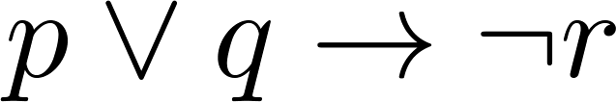
Example Truth Table
Construct a truth table for
p | q | r | ¬r | p ∨ q | p ∨ q → ¬r
T | T | T | F | T | F
T | T | F | T | T | T
T | F | T | F | T | F
T | F | F | T | T | T
F | T | T | F | T | F
F | T | F | T | T | T
F | F | T | F | F | T
F | F | F | T | F | T

Slide 32
Equivalent Propositions
Two propositions are equivalent if they always have the same truth value.
Example: Show using a truth table that the conditional is equivalent to the contrapositive.
Solution:
p | q | ¬ p | ¬ q | p →q | ¬q → ¬ p
T | T | F | F | T | T
T | F | F | T | F | F
F | T | T | F | T | T
F | F | T | T | T | T
equivalent 等价

Slide 33
Using a Truth Table to Show Non-Equivalence
Example: Show using truth tables that neither the converse nor inverse of an implication are not equivalent to the implication.
Solution:
p | q | ¬ p | ¬ q | p →q | ¬ p →¬ q | q → p
T | T | F | F | T | T | T
T | F | F | T | F | T | T
F | T | T | F | T | F | F
F | F | T | T | T | T | T

Slide 34
Problem
How many rows are there in a truth table with n propositional variables?
Solution: 2^{n} We will see how to do this in Chapter 6.
Note that this means that with n propositional variables, we can construct 2^{n} distinct (i.e., not equivalent) propositions.

Slide 35
Precedence of Logical Operators
Operator | Precedence
¬ | 1
∧ ∨ | 2 3
→ ↔ | 4 5
p ∨q → ¬r is equivalent to (p ∨q) → ¬r
If the intended meaning is p ∨(q → ¬r )
then parentheses must be used.
precedence 优先级
parentheses 括号

Slide 36
Applications of Propositional Logic
Section 1.2

Slide 37
Applications of Propositional Logic: Summary
Translating English to Propositional Logic
System Specifications
Boolean Searching
Logic Puzzles
Logic Circuits
AI Diagnosis Method (Optional)

Slide 38
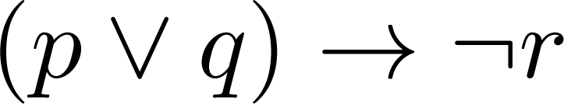
Translating English Sentences
Steps to convert an English sentence to a statement in propositional logic
  Identify atomic propositions and represent using propositional variables.
  Determine appropriate logical connectives
“If I go to Harry’s or to the country, I will not go shopping.”
  p: I go to Harry’s
  q: I go to the country.
  r: I will go shopping.
If p or q then not r.

Slide 39
Example
Problem: Translate the following sentence into propositional logic:
“You can access the Internet from campus only if you are a computer science major or you are not a freshman.”
One Solution: Let a, c, and f represent respectively “You can access the internet from campus,” “You are a computer science major,” and “You are a freshman.”
a→ (c ∨ ¬ f )

Slide 40
System Specifications
System and Software engineers take requirements in English and express them in a precise specification language based on logic.
Example: Express in propositional logic:
“The automated reply cannot be sent when the file system is full”
Solution: One possible solution: Let p denote “The automated reply can be sent” and q denote “The file system is full.”
q→ ¬ p

Slide 41
Consistent System Specifications
Definition: A list of propositions is consistent if it is possible to assign truth values to the proposition variables so that each proposition is true.
Exercise: Are these specifications consistent?
  “The diagnostic message is stored in the buffer or it is retransmitted.”
  “The diagnostic message is not stored in the buffer.”
  “If the diagnostic message is stored in the buffer, then it is retransmitted.”
Solution: Let p denote “The diagnostic message is stored in the buffer.” Let q denote “The diagnostic message is retransmitted” The specification can be written as: p ∨ q, ¬p, p → q. When p is false and q is true all three statements are true. So the specification is consistent.
  What if “The diagnostic message is not retransmitted is added.”
  Solution: Now we are adding ¬q and there is no satisfying assignment. So the specification is not consistent.
consistent 一致的

Slide 42
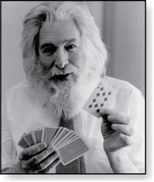
Logic Puzzles
Raymond Smullyan
(Born 1919)
An island has two kinds of inhabitants, knights, who always tell the truth, and knaves, who always lie.
You go to the island and meet A and B.
  A says “B is a knight.”
  B says “The two of us are of opposite types.”
Example: What are the types of A and B?
Solution: Let p and q be the statements that A is a knight and B is a knight, respectively. So, then ¬p represents the proposition that A is a knave and ¬q that B is a knave.
  If A is a knight, then p is true. Since knights tell the truth, q must also be true. Then (p ∧ ¬ q)∨ (¬ p ∧ q) would have to be true, but it is not. So, A is not a knight and therefore ¬p must be true.
  If A is a knave, then B must not be a knight since knaves always lie. So, then both ¬p and ¬q hold since both are knaves.
knaves 无赖

Slide 43
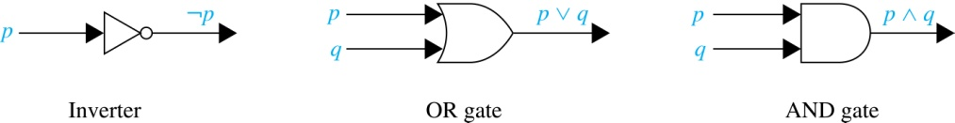
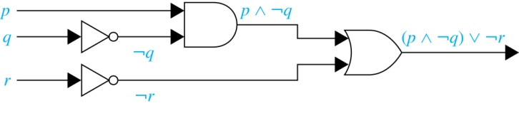
Logic Circuits
(Studied in depth in Chapter 12)
Electronic circuits; each input/output signal can be viewed as a 0 or 1.
  0 represents False
  1 represents True
Complicated circuits are constructed from three basic circuits called gates.
  The inverter (NOT gate)takes an input bit and produces the negation of that bit.
  The OR gate takes two input bits and produces the value equivalent to the disjunction of the two bits.
  The AND gate takes two input bits and produces the value equivalent to the conjunction of the two bits.
More complicated digital circuits can be constructed by combining these basic circuits to produce the desired output given the input signals by building a circuit for each piece of the output expression and then combining them. For example:

Slide 44
Propositional Equivalences
Section 1.3

Slide 45
Section Summary
Tautologies, Contradictions, and Contingencies.
Logical Equivalence
  Important Logical Equivalences
  Showing Logical Equivalence
Normal Forms (optional, covered in exercises in text)
  Disjunctive Normal Form
  Conjunctive Normal Form
Propositional Satisfiability
  Sudoku Example

Slide 46
Tautologies, Contradictions, and Contingencies
A tautology is a proposition which is always true.
  Example: p ∨¬p
A contradiction is a proposition which is always false.
  Example: p ∧¬p
A contingency is a proposition which is neither a tautology nor a contradiction, such as p
P | ¬p | p ∨¬p | p ∧¬p
T | F | T | F
F | T | T | F
tautology 永真式
contradiction 矛盾式
contingency 可能式

Slide 47
Logically Equivalent
Two compound propositions p and q are logically equivalent if p↔q is a tautology.
We write this as p⇔q or as p≡q where p and q are compound propositions.
Two compound propositions p and q are equivalent if and only if the columns in a truth table giving their truth values agree.
This truth table shows that ¬p ∨ q is equivalent to p → q.
p | q | ¬p | ¬p ∨ q | p→ q
T | T | F | T | T
T | F | F | F | F
F | T | T | T | T
F | F | T | T | T

Slide 48
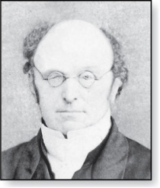
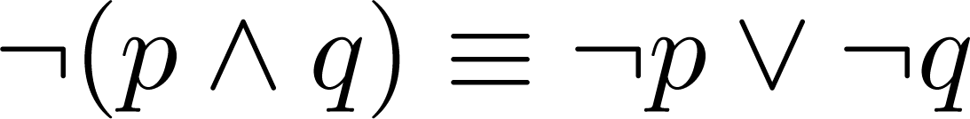
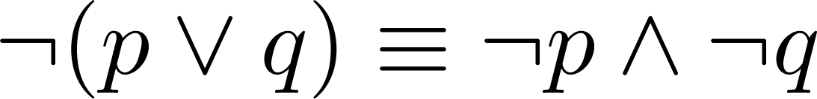
De Morgan’s Laws
Augustus De Morgan
1806-1871
This truth table shows that De Morgan’s Second Law holds.
p | q | ¬p | ¬q | (p∨q) | ¬(p∨q) | ¬p∧¬q
T | T | F | F | T | F | F
T | F | F | T | T | F | F
F | T | T | F | T | F | F
F | F | T | T | F | T | T

Slide 49
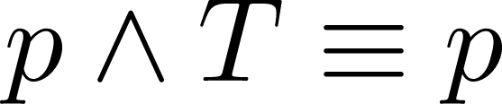
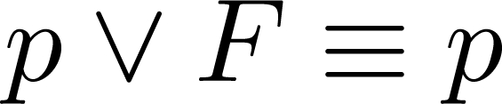
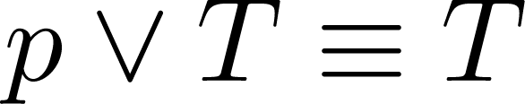
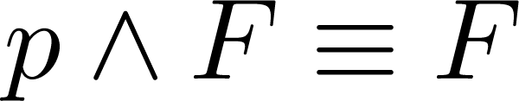
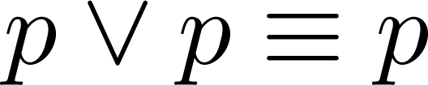
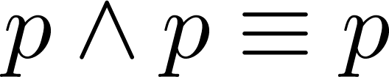
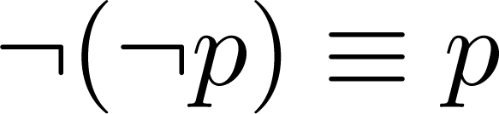
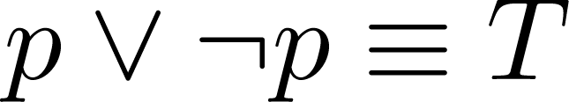
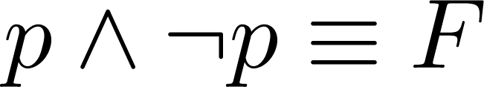
Key Logical Equivalences
Identity Laws(恒等律): ,
Domination Laws(支配律): ,
Idempotent Laws(幂等律): ,
Double Negation Law(双重否定律):
Negation Laws(否定律): ,

Slide 50
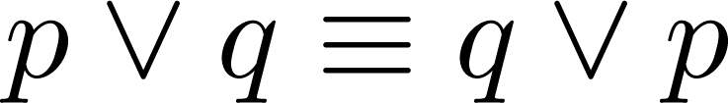
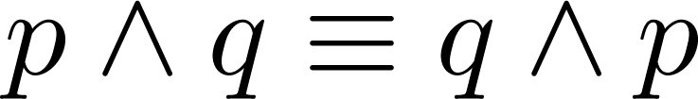
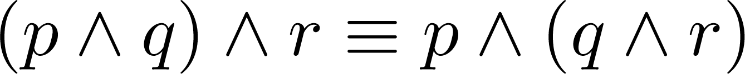
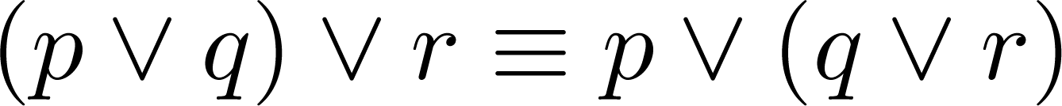
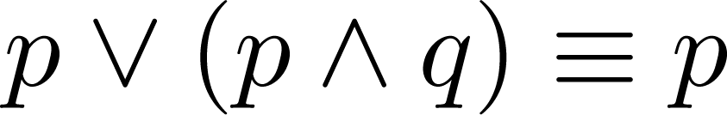
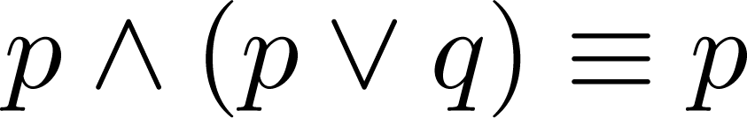
Key Logical Equivalences (cont)
Commutative Laws: ,
Associative Laws:
Distributive Laws:
Absorption Laws:
(交换律)
(结合律)
(分配律)
(吸收律)

Slide 51
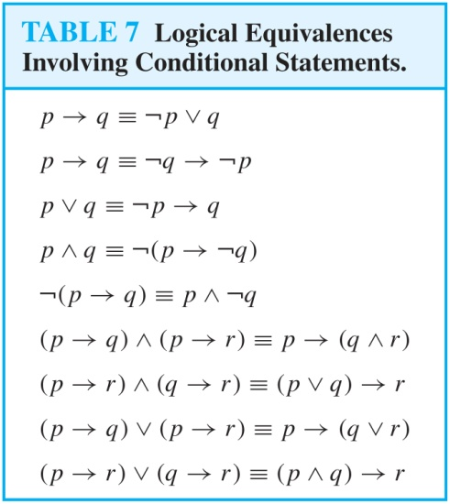
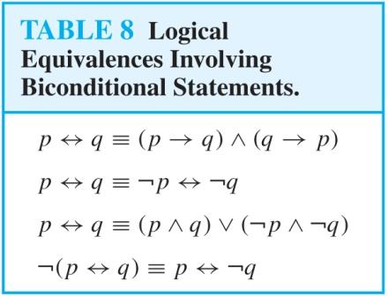
More Logical Equivalences

Slide 52


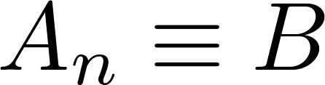
Constructing New Logical Equivalences
We can show that two expressions are logically equivalent by developing a series of logically equivalent statements.
To prove that we produce a series of equivalences beginning with A and ending with B.
Keep in mind that whenever a proposition (represented by a propositional variable) occurs in the equivalences listed earlier, it may be replaced by an arbitrarily complex compound proposition.

Slide 53
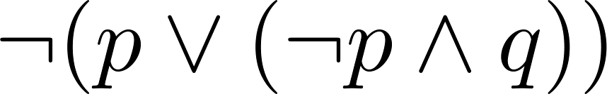
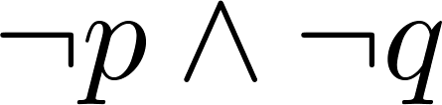
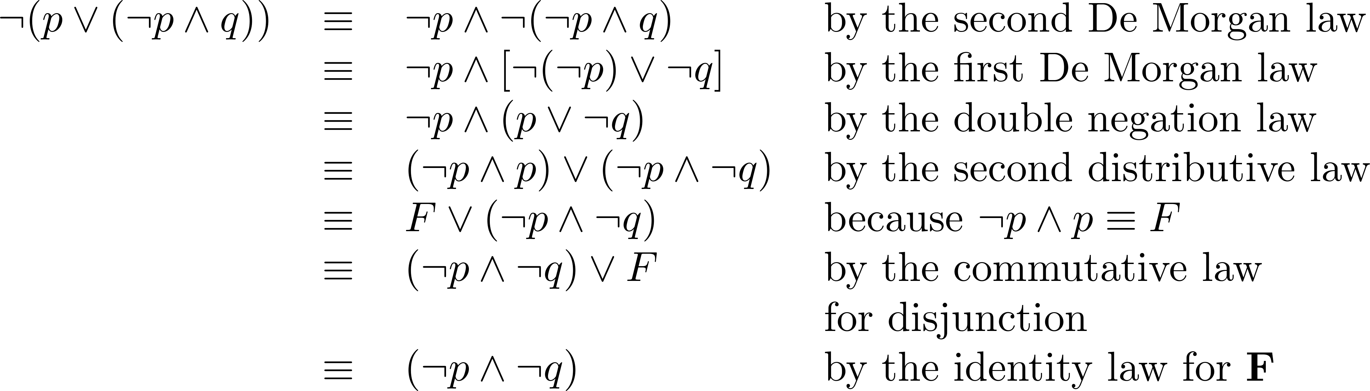
Equivalence Proofs
Example: Show that
is logically equivalent to
Solution:

Slide 54
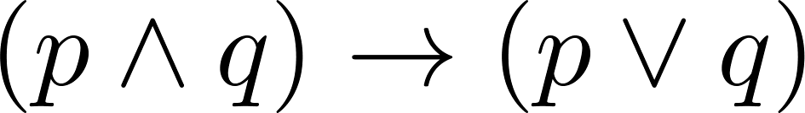
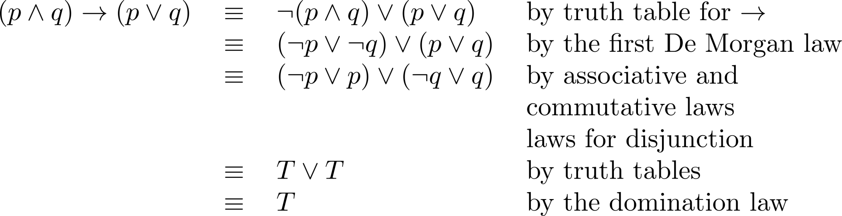
Equivalence Proofs
Example: Show that
is a tautology.
Solution:

Slide 55
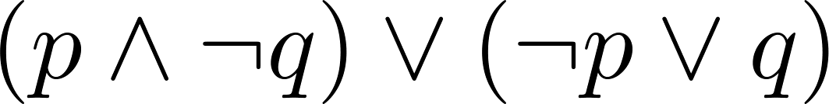
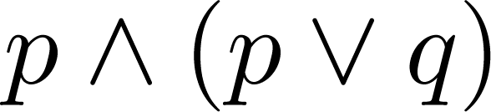
Disjunctive Normal Form (optional)
A propositional formula is in disjunctive normal form if it consists of a disjunction of (1, … ,n) disjuncts where each disjunct consists of a conjunction of (1, …, m) atomic formulas or the negation of an atomic formula.
  Yes
  No
Disjunctive Normal Form is important for the circuit design methods discussed in Chapter 12.
disjunctive Normal Form 析取范式

Slide 56
Disjunctive Normal Form (optional)
Example: Show that every compound proposition can be put in disjunctive normal form.
Solution: Construct the truth table for the proposition. Then an equivalent proposition is the disjunction with n disjuncts (where n is the number of rows for which the formula evaluates to T). Each disjunct has m conjuncts where m is the number of distinct propositional variables. Each conjunct includes the positive form of the propositional variable if the variable is assigned T in that row and the negated form if the variable is assigned F in that row. This proposition is in disjunctive normal from.

Slide 57
Disjunctive Normal Form (optional)
Example: Find the Disjunctive Normal Form (DNF) of
(p∨q)→¬r
Solution: This proposition is true when r is false or when both p and q are false.
(¬ p∧ ¬ q) ∨ ¬r

Slide 58
Conjunctive Normal Form (optional)
A compound proposition is in Conjunctive Normal Form (CNF) if it is a conjunction of disjunctions.
Every proposition can be put in an equivalent CNF.
Conjunctive Normal Form (CNF) can be obtained by eliminating implications, moving negation inwards and using the distributive and associative laws.
Important in resolution theorem proving used in artificial Intelligence (AI).
A compound proposition can be put in conjunctive normal form through repeated application of the logical equivalences covered earlier.
Conjunctive Normal Form 合取范式

Slide 59
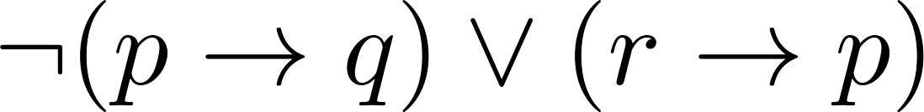
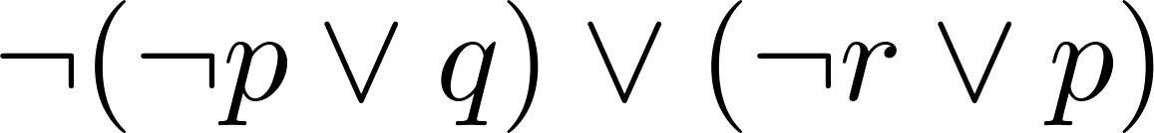
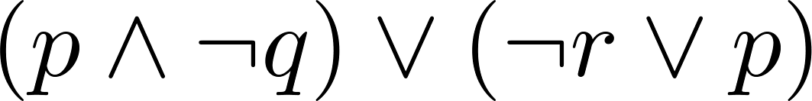
Conjunctive Normal Form (optional)
Example: Put the following into CNF:
Solution:
  Eliminate implication signs:
  Move negation inwards; eliminate double negation:
  Convert to CNF using associative/distributive laws

