Slide 1
The Foundations: Logic and Proofs
Chapter 1, Part II: Predicate Logic
With Question/Answer Animations
Copyright © McGraw-Hill Education. All rights reserved. No reproduction or distribution without the prior written consent of McGraw-Hill Education.

Slide 2
Recap: Propositional Logic Summary
The Language of Propositions
Connectives
Truth Values
Truth Tables
Applications
Translating English Sentences
System Specifications
Logic Puzzles
Logic Circuits
Logical Equivalences
Important Equivalences
Showing Equivalence
Satisfiability

Slide 3
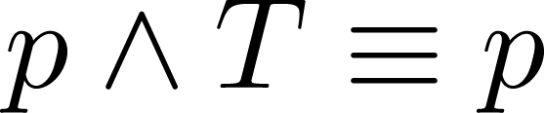
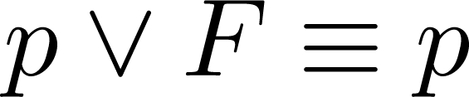
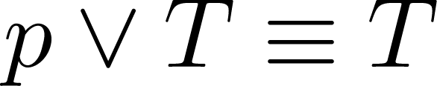
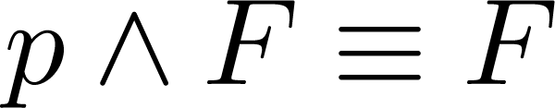
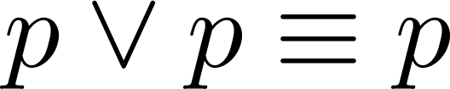
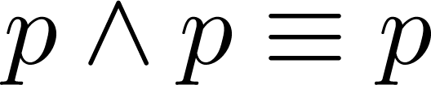
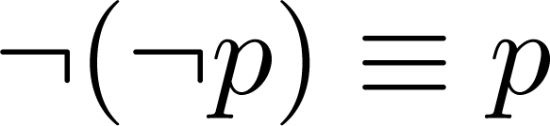
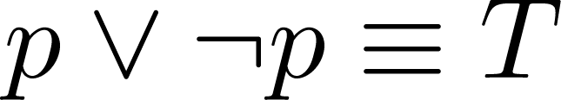
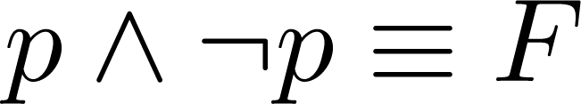
Key Logical Equivalences
Identity Laws(恒等律): ,
Domination Laws(支配律): ,
Idempotent Laws(幂等律): ,
Double Negation Law(双重否定律):
Negation Laws(否定律): ,

Slide 4
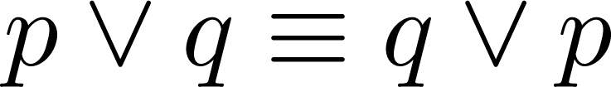
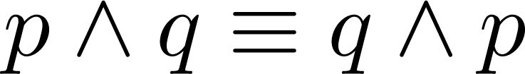
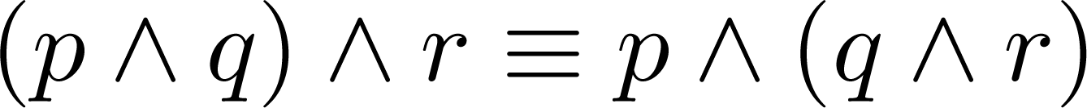
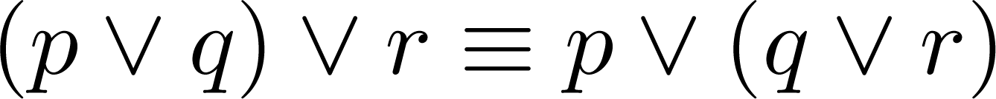
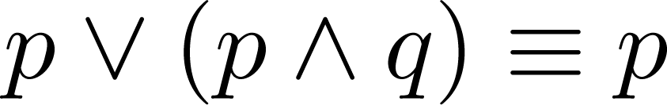
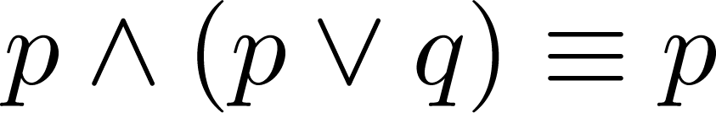
Key Logical Equivalences (cont)
Commutative Laws: ,
Associative Laws:
Distributive Laws:
Absorption Laws:
(交换律)
(结合律)
(分配律)
(吸收律)

Slide 5
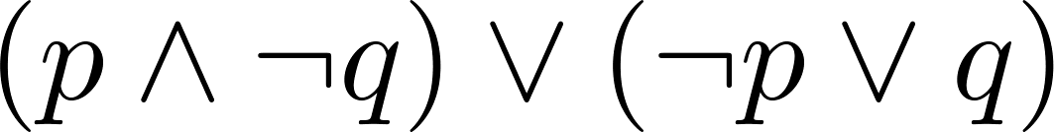
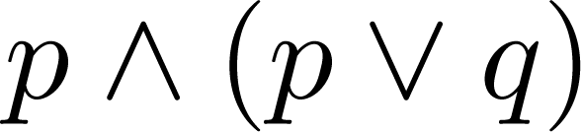
Disjunctive Normal Form (optional)
A propositional formula is in disjunctive normal form if it consists of a disjunction of (1, … ,n) disjuncts where each disjunct consists of a conjunction of (1, …, m) atomic formulas or the negation of an atomic formula.
Yes
No
Disjunctive Normal Form is important for the circuit design methods discussed in Chapter 12.
disjunctive Normal Form 析取范式

Slide 6
Disjunctive Normal Form (optional)
Example: Show that every compound proposition can be put in disjunctive normal form.
Solution: Construct the truth table for the proposition. Then an equivalent proposition is the disjunction with n disjuncts (where n is the number of rows for which the formula evaluates to T). Each disjunct has m conjuncts where m is the number of distinct propositional variables. Each conjunct includes the positive form of the propositional variable if the variable is assigned T in that row and the negated form if the variable is assigned F in that row. This proposition is in disjunctive normal from.

Slide 7
Disjunctive Normal Form (optional)
Example: Find the Disjunctive Normal Form (DNF) of
(p∨q)→¬r
Solution: This proposition is true when r is false or when both p and q are false.
(¬ p∧ ¬ q) ∨ ¬r

Slide 8
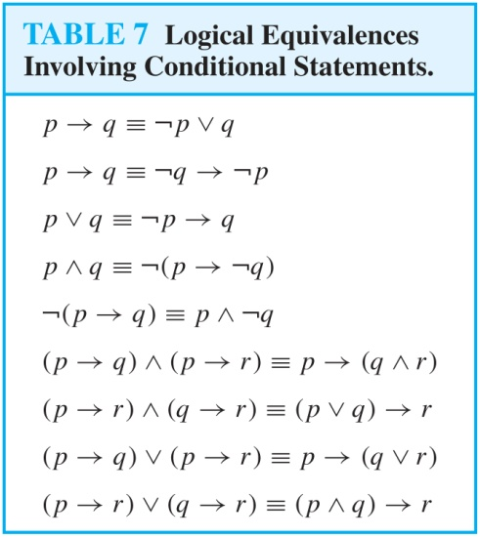
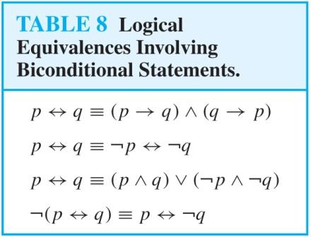
More Logical Equivalences

Slide 9
Conjunctive Normal Form (optional)
A compound proposition is in Conjunctive Normal Form (CNF) if it is a conjunction of disjunctions.
Every proposition can be put in an equivalent CNF.
Conjunctive Normal Form (CNF) can be obtained by eliminating implications, moving negation inwards and using the distributive and associative laws.
Important in resolution theorem proving used in artificial Intelligence (AI).
A compound proposition can be put in conjunctive normal form through repeated application of the logical equivalences covered earlier.
Conjunctive Normal Form 合取范式

Slide 10
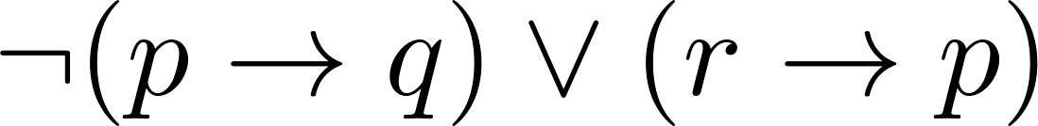
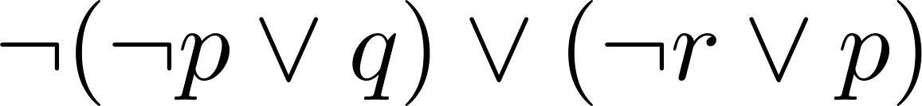
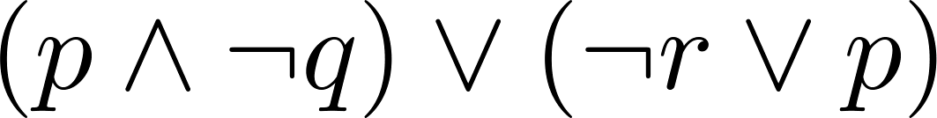
Conjunctive Normal Form (optional)
Example: Put the following into CNF:
Solution:
Eliminate implication signs:
Move negation inwards; eliminate double negation:
Convert to CNF using associative/distributive laws

Slide 11
Propositional Satisfiability
A compound proposition is satisfiable if there is an assignment of truth values to its variables that make it true. When no such assignments exist, the compound proposition is unsatisfiable.
A compound proposition is unsatisfiable if and only if its negation is a tautology.
satisfiable 可满足的
unsatisfiable 不可满足的

Slide 12
Questions on Propositional Satisfiability
Example: Determine the satisfiability of the following compound propositions:
Solution: Satisfiable. Assign T to p, q, and r.
Solution: Satisfiable. Assign T to p and F to q.
Solution: Not satisfiable. Check each possible assignment of truth values to the propositional variables and none will make the proposition true.

Slide 13
Notation
Needed for the next example.

Slide 14
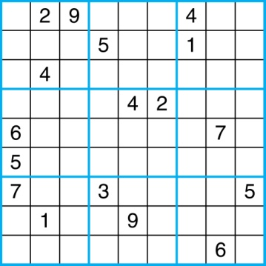
Sudoku
A Sudoku puzzle is represented by a 9×9 grid made up of nine 3×3 subgrids, known as blocks. Some of the 81 cells of the puzzle are assigned one of the numbers 1,2, …, 9.
The puzzle is solved by assigning numbers to each blank cell so that every row, column and block contains each of the nine possible numbers.
Example

Slide 15
Encoding as a Satisfiability Problem
Let p(i,j,n) denote the proposition that is true when the number n is in the cell in the ith row and the jth column.
There are 9×9 × 9 = 729 such propositions.
In the sample puzzle p(5,1,6) is true, but p(5,j,6) is false for j = 2,3,…9

Slide 16
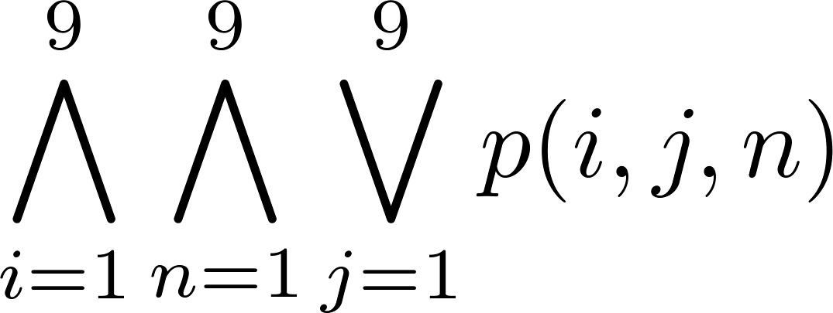
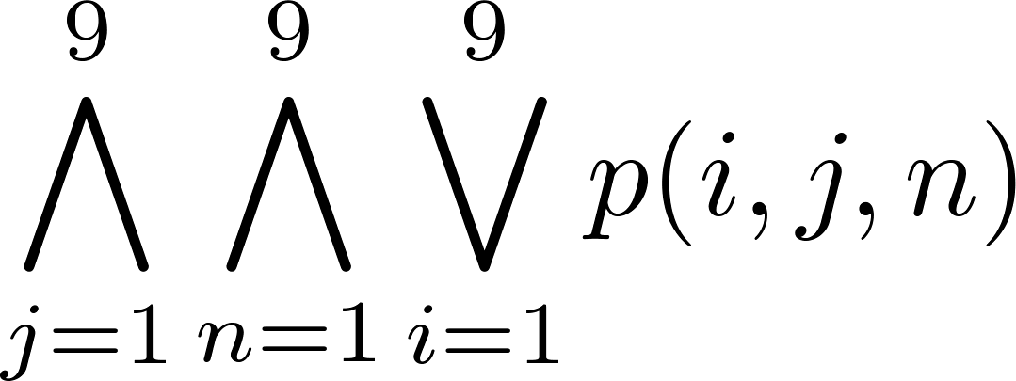
Encoding (cont)
For each cell with a given value, assert p(i,j,n), when the cell in row i and column j has the given value.
Assert that every row contains every number.
Assert that every column contains every number.

Slide 17
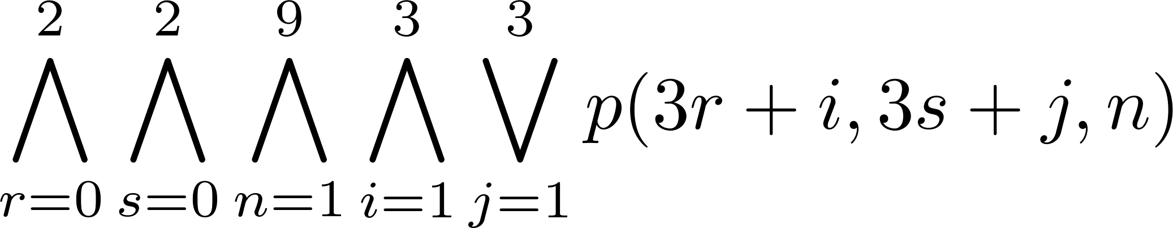
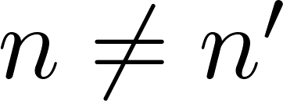
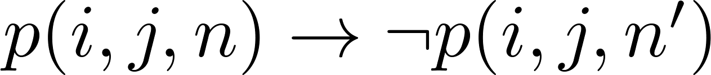
Encoding (cont)
Assert that each of the 3 x 3 blocks contain every number.
(this is tricky - ideas from chapter 4 help)
Assert that no cell contains more than one number. Take the conjunction over all values of n, n’, i, and j, where each variable ranges from 1 to 9 and ,
of

Slide 18
Solving Satisfiability Problems
To solve a Sudoku puzzle, we need to find an assignment of truth values to the 729 variables of the form p(i,j,n) that makes the conjunction of the assertions true. Those variables that are assigned T yield a solution to the puzzle.
A truth table can always be used to determine the satisfiability of a compound proposition. But this is too complex even for modern computers for large problems.
There has been much work on developing efficient methods for solving satisfiability problems as many practical problems can be translated into satisfiability problems.

Slide 19
Summary
Predicate Logic (First-Order Logic (FOL), Predicate Calculus)
The Language of Quantifiers
Logical Equivalences
Nested Quantifiers
Translation from Predicate Logic to English
Translation from English to Predicate Logic
Predicate Logic 谓词逻辑
First-Order Logic 一阶逻辑
Predicate Calculus 谓词演算

Slide 20
Predicates and Quantifiers
Section 1.4

Slide 21
Section Summary
Predicates
Variables
Quantifiers
Universal Quantifier
Existential Quantifier
Negating Quantifiers
De Morgan’s Laws for Quantifiers
Translating English to Logic
Logic Programming (optional)

Slide 22
Propositional Logic Not Enough
If we have:
“All men are mortal.”
“Socrates is a man.”
Does it follow that “Socrates is mortal?”
Can’t be represented in propositional logic. Need a language that talks about objects, their properties, and their relations.
Later we’ll see how to draw inferences.

Slide 23
Introducing Predicate Logic
Predicate logic uses the following new features:
Variables: x, y, z
Predicates: P(x), M(x)
Quantifiers (to be covered in a few slides):
Propositional functions are a generalization of propositions.
They contain variables and a predicate, e.g., P(x)
Variables can be replaced by elements from their domain.
Quantifiers 量词
Propositional functions 命题函数
domain 域

Slide 24
Propositional Functions
Propositional functions become propositions (and have truth values) when their variables are each replaced by a value from the domain (or bound by a quantifier, as we will see later).
The statement P(x) is said to be the value of the propositional function P at x.
For example, let P(x) denote “x > 0” and the domain be the integers. Then:
P(-3) is false.
P(0) is false.
P(3) is true.
Often the domain is denoted by U. So in this example U is the integers.

Slide 25
Examples of Propositional Functions
Let “x + y = z” be denoted by R(x, y, z) and U (for all three variables) be the integers. Find these truth values:
R(2,-1,5)
Solution: F
R(3,4,7)
Solution: T
R(x, 3, z)
Solution: Not a Proposition
Now let “x - y = z” be denoted by Q(x, y, z), with U as the integers. Find these truth values:
Q(2,-1,3)
Solution: T
Q(3,4,7)
Solution: F
Q(x, 3, z)
Solution: Not a Proposition

Slide 26
Compound Expressions
Connectives from propositional logic carry over to predicate logic.
If P(x) denotes “x > 0,” find these truth values:
P(3) ∨ P(-1) Solution: T
P(3) ∧ P(-1) Solution: F
P(3) → P(-1) Solution: F
P(3) → ¬P(-1) Solution: T
Expressions with variables are not propositions and therefore do not have truth values. For example,
P(3) ∧ P(y)
P(x) → P(y)
When used with quantifiers (to be introduced next), these expressions (propositional functions) become propositions.

Slide 27
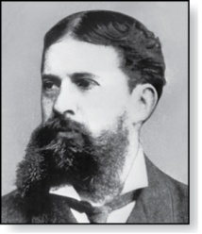
Quantifiers
Charles Peirce (1839-1914)
We need quantifiers to express the meaning of English words including all and some:
“All men are Mortal.”
“Some cats do not have fur.”
The two most important quantifiers are:
Universal Quantifier, “For all,” symbol: ∀
Existential Quantifier, “There exists,” symbol: ∃
We write as in ∀x P(x) and ∃x P(x).
∀x P(x) asserts P(x) is true for every x in the domain.
∃x P(x) asserts P(x) is true for some x in the domain.
The quantifiers are said to bind the variable x in these expressions.
Universal Quantifier 全称量词
Existential Quantifier 存在量词

Slide 28
Universal Quantifier
∀x P(x) is read as “For all x, P(x)” or “For every x, P(x)”
Examples:
If P(x) denotes “x > 0” and U is the integers, then ∀x P(x) is false.
If P(x) denotes “x > 0” and U is the positive integers, then ∀x P(x) is true.
If P(x) denotes “x is even” and U is the integers, then ∀ x P(x) is false.

Slide 29
Existential Quantifier
∃x P(x) is read as “For some x, P(x)”, or as “There is an x such that P(x),” or “For at least one x, P(x).”
Examples:
If P(x) denotes “x > 0” and U is the integers, then ∃x P(x) is true. It is also true if U is the positive integers.
If P(x) denotes “x < 0” and U is the positive integers, then ∃x P(x) is false.
If P(x) denotes “x is even” and U is the integers, then ∃x P(x) is true.

Slide 30
Uniqueness Quantifier (optional)
∃!x P(x) means that P(x) is true for one and only one x in the universe of discourse.
This is commonly expressed in English in the following equivalent ways:
“There is a unique x such that P(x).”
“There is one and only one x such that P(x)”
Examples:
If P(x) denotes “x + 1 = 0” and U is the integers, then ∃!x P(x) is true.
But if P(x) denotes “x > 0,” then ∃!x P(x) is false.
The uniqueness quantifier is not really needed as the restriction that there is a unique x such that P(x) can be expressed as:
∃x (P(x) ∧∀y (P(y) → y =x))

Slide 31
Thinking about Quantifiers
When the domain of discourse is finite, we can think of quantification as looping through the elements of the domain.
To evaluate ∀x P(x) loop through all x in the domain.
If at every step P(x) is true, then ∀x P(x) is true.
If at a step P(x) is false, then ∀x P(x) is false and the loop terminates.
To evaluate ∃x P(x) loop through all x in the domain.
If at some step, P(x) is true, then ∃x P(x) is true and the loop terminates.
If the loop ends without finding an x for which P(x) is true, then ∃x P(x) is false.
Even if the domains are infinite, we can still think of the quantifiers this fashion, but the loops will not terminate in some cases.

Slide 32
Properties of Quantifiers
The truth value of ∃x P(x) and ∀ x P(x) depend on both the propositional function P(x) and on the domain U.
Examples:
If U is the positive integers and P(x) is the statement “x < 2”, then ∃x P(x) is true, but ∀ x P(x) is false.
If U is the negative integers and P(x) is the statement “x < 2”, then both ∃x P(x) and ∀ x P(x) are true.
If U consists of 3, 4, and 5, and P(x) is the statement “x > 2”, then both ∃x P(x) and ∀ x P(x) are true. But if P(x) is the statement “x < 2”, then both ∃x P(x) and ∀ x P(x) are false.

Slide 33
Precedence of Quantifiers
The quantifiers ∀ and ∃ have higher precedence than all the logical operators.
For example, ∀x P(x) ∨ Q(x) means (∀x P(x))∨ Q(x)
∀x (P(x) ∨ Q(x)) means something different.
Unfortunately, often people write ∀x P(x) ∨ Q(x) when they mean ∀ x (P(x) ∨ Q(x)).

Slide 34
Translating from English to Logic
Example 1: Translate the following sentence into predicate logic: “Every student in this class has taken a course in Java.”
Solution:
First decide on the domain U.
Solution 1: If U is all students in this class, define a propositional function J(x) denoting “x has taken a course in Java” and translate as ∀x J(x).
Solution 2: But if U is all people, also define a propositional function S(x) denoting “x is a student in this class” and translate as ∀x (S(x)→ J(x)).
∀x (S(x) ∧ J(x)) is not correct. What does it mean?

Slide 35
Translating from English to Logic
Example 2: Translate the following sentence into predicate logic: “Some student in this class has taken a course in Java.”
Solution:
First decide on the domain U.
Solution 1: If U is all students in this class, translate as
∃x J(x)
Solution 2: But if U is all people, then translate as ∃x (S(x) ∧ J(x))
∃x (S(x)→ J(x)) is not correct. What does it mean?

Slide 36
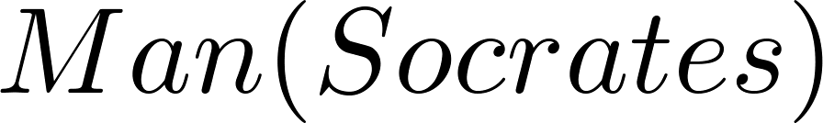
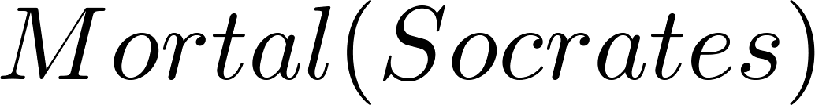
Returning to the Socrates Example
Introduce the propositional functions Man(x) denoting “x is a man” and Mortal(x) denoting “x is mortal.” Specify the domain as all people.
The two premises are:
The conclusion is:
Later we will show how to prove that the conclusion follows from the premises.

Slide 37
Equivalences in Predicate Logic
Statements involving predicates and quantifiers are logically equivalent if and only if they have the same truth value
for every predicate substituted into these statements and
for every domain of discourse used for the variables in the expressions.
The notation S ≡T indicates that S and T are logically equivalent.
Example: ∀x ¬¬S(x) ≡ ∀x S(x)

Slide 38
Thinking about Quantifiers as Conjunctions and Disjunctions
If the domain is finite, a universally quantified proposition is equivalent to a conjunction of propositions without quantifiers and an existentially quantified proposition is equivalent to a disjunction of propositions without quantifiers.
If U consists of the integers 1,2, and 3:
Even if the domains are infinite, you can still think of the quantifiers in this fashion, but the equivalent expressions without quantifiers will be infinitely long.

Slide 39
Negating Quantified Expressions
Consider ∀x J(x)
“Every student in your class has taken a course in Java.”
Here J(x) is “x has taken a course in Java” and
the domain is students in your class.
Negating the original statement gives “It is not the case that every student in your class has taken Java.” This implies that “There is a student in your class who has not taken Java.”
Symbolically ¬∀x J(x) and ∃x ¬J(x) are equivalent

Slide 40
Negating Quantified Expressions (continued)
Now Consider ∃ x J(x)
“There is a student in this class who has taken a course in Java.”
Where J(x) is “x has taken a course in Java.”
Negating the original statement gives “It is not the case that there is a student in this class who has taken Java.” This implies that “Every student in this class has not taken Java”
Symbolically ¬∃ x J(x) and ∀ x ¬J(x) are equivalent

Slide 41
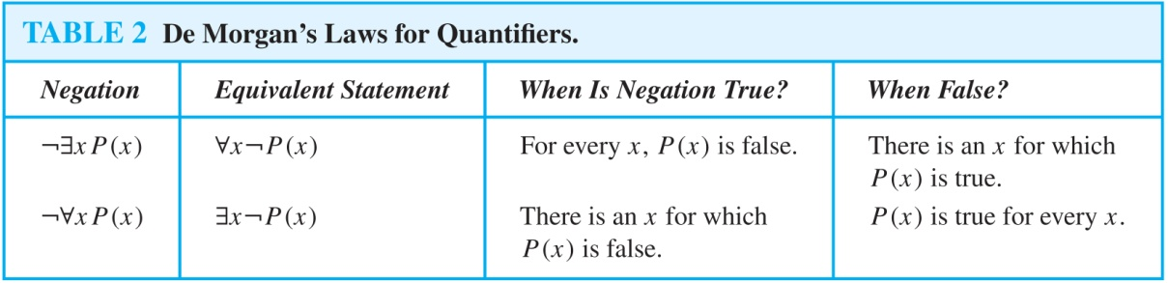
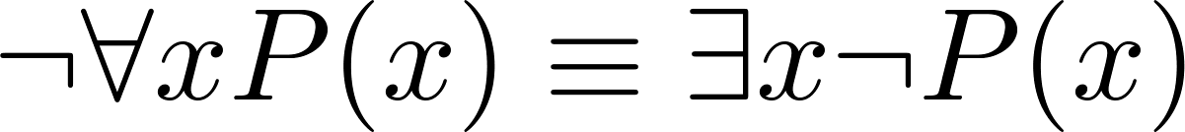
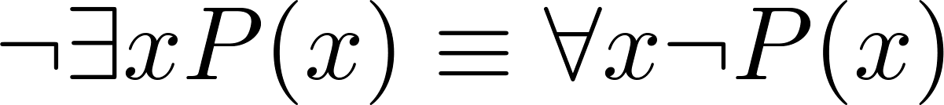
De Morgan’s Laws for Quantifiers
The rules for negating quantifiers are:
The reasoning in the table shows that:
These are important. You will use these.

Slide 42
Translation from English to Logic
Examples:
“Some student in this class has visited Mexico.”
Solution: Let M(x) denote “x has visited Mexico” and S(x) denote “x is a student in this class,” and U be all people.
∃x (S(x) ∧ M(x))
“Every student in this class has visited Canada or Mexico.”
Solution: Add C(x) denoting “x has visited Canada.”
∀x (S(x)→ (M(x)∨C(x)))

Slide 43
Some Fun with Translating from English into Logical Expressions
U = {fleegles, snurds, thingamabobs}
F(x): x is a fleegle
S(x): x is a snurd
T(x): x is a thingamabob
Translate “Everything is a fleegle”
Solution: ∀x F(x)

Slide 44
Translation (cont)
U = {fleegles, snurds, thingamabobs}
F(x): x is a fleegle
S(x): x is a snurd
T(x): x is a thingamabob
“Nothing is a snurd.”
Solution: ¬∃x S(x) What is this equivalent to?
Solution: ∀x ¬ S(x)

Slide 45
Translation (cont)
U = {fleegles, snurds, thingamabobs}
F(x): x is a fleegle
S(x): x is a snurd
T(x): x is a thingamabob
“All fleegles are snurds.”
Solution: ∀x (F(x)→ S(x))

Slide 46
Translation (cont)
U = {fleegles, snurds, thingamabobs}
F(x): x is a fleegle
S(x): x is a snurd
T(x): x is a thingamabob
“Some fleegles are thingamabobs.”
Solution: ∃x (F(x) ∧ T(x))

Slide 47
Translation (cont)
U = {fleegles, snurds, thingamabobs}
F(x): x is a fleegle
S(x): x is a snurd
T(x): x is a thingamabob
“No snurd is a thingamabob.”
Solution: ¬∃x (S(x) ∧ T(x)) What is this equivalent to?
Solution: ∀x (¬S(x) ∨ ¬T(x))

Slide 48
Translation (cont)
U = {fleegles, snurds, thingamabobs}
F(x): x is a fleegle
S(x): x is a snurd
T(x): x is a thingamabob
“If any fleegle is a snurd then it is also a thingamabob.”
Solution: ∀x ((F(x) ∧ S(x))→ T(x))

Slide 49
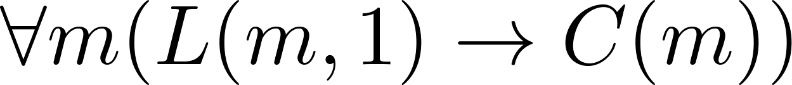
System Specification Example
Predicate logic is used for specifying properties that systems must satisfy.
For example, translate into predicate logic:
“Every mail message larger than one megabyte will be compressed.”
“If a user is active, at least one network link will be available.”
Decide on predicates and domains (left implicit here) for the variables:
Let L(m, y) be “Mail message m is larger than y megabytes.”
Let C(m) denote “Mail message m will be compressed.”
Let A(u) represent “User u is active.”
Let S(n, x) represent “Network link n is state x.
Now we have:
System Specification 系统规范

Slide 50
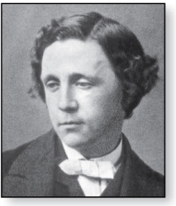
Lewis Carroll Example
Charles Lutwidge Dodgson
(AKA Lewis Caroll)
(1832-1898)
The first two are called premises and the third is called the conclusion.
“All lions are fierce.”
“Some lions do not drink coffee.”
“Some fierce creatures do not drink coffee.”
Here is one way to translate these statements to predicate logic. Let P(x), Q(x), and R(x) be the propositional functions “x is a lion,” “x is fierce,” and “x drinks coffee,” respectively.
∀x (P(x)→ Q(x))
∃x (P(x) ∧ ¬R(x))
∃x (Q(x) ∧ ¬R(x))
Later we will see how to prove that the conclusion follows from the premises.

Slide 51
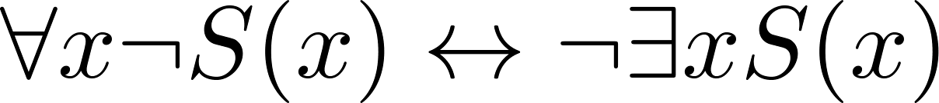
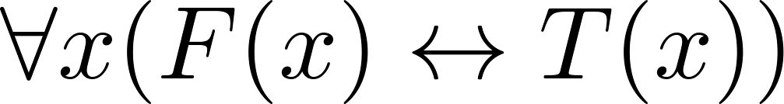
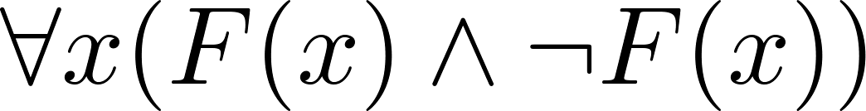
Some Predicate Calculus Definitions (optional)
An assertion involving predicates and quantifiers is valid if it is true
for all domains
every propositional function substituted for the predicates in the assertion.
Example:
An assertion involving predicates is satisfiable if it is true
for some domains
some propositional functions that can be substituted for the predicates in the assertion.
Otherwise it is unsatisfiable.
Example: not valid but satisfiable
Example: unsatisfiable
valid 有效的
satisfiable 可满足的
unsatisfiable 不可满足的

Slide 52
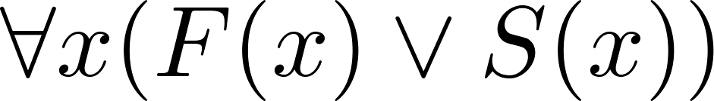
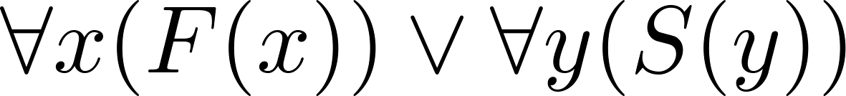
More Predicate Calculus Definitions (optional)
The scope of a quantifier is the part of an assertion in which variables are bound by the quantifier.
Example: x has wide scope
Example: x has narrow scope

Slide 53
Logic Programming (optional)
Prolog (from Programming in Logic) is a programming language developed in the 1970s by researchers in artificial intelligence (AI).
Prolog programs include Prolog facts and Prolog rules.
As an example of a set of Prolog facts consider the following:
instructor(chan, math273).
instructor(patel, ee222).
instructor(grossman, cs301).
enrolled(kevin, math273).
enrolled(juana, ee222).
enrolled(juana, cs301).
enrolled(kiko, math273).
enrolled(kiko, cs301).
Here the predicates instructor(p,c) and enrolled(s,c) represent that professor p is the instructor of course c and that student s is enrolled in course c.

Slide 54
Logic Programming (cont)
In Prolog, names beginning with an uppercase letter are variables.
If we have apredicate teaches(p,s) representing “professor p teaches student s,” we can write the rule:
teaches(P,S) :- instructor(P,C), enrolled(S,C).
This Prolog rule can be viewed as equivalent to the following statement in logic (using our conventions for logical statements).
∀p ∀c ∀s(I(p,c) ∧ E(s,c)) → T(p,s))

Slide 55
Logic Programming (cont)
Prolog programs are loaded into a Prolog interpreter. The interpreter receives queries and returns answers using the Prolog program.
For example, using our program, the following query may be given:
?enrolled(kevin,math273).
Prolog produces the response:
yes
Note that the ? is the prompt given by the Prolog interpreter indicating that it is ready to receive a query.

Slide 56
Logic Programming (cont)
The query:
?enrolled(X,math273).
produces the response:
X = kevin;
X = kiko;
no
The query:
?teaches(X,juana).
produces the response:
X = patel;
X = grossman;
no
The Prolog interpreter tries to find an instantiation for X. It does so and returns X = kevin. Then the user types the ; indicating a request for another answer. When Prolog is unable to find another answer it returns no.

Slide 57
Logic Programming (cont)
The query:
?teaches(chan,X).
produces the response:
X = kevin;
X = kiko;
no
A number of very good Prolog texts are available. Learn Prolog Now! is one such text with a free online version at http://www.learnprolognow.org/
There is much more to Prolog and to the entire field of logic programming.

Slide 58
Nested Quantifiers
Section 1.4

Slide 59
Section Summary
Nested Quantifiers
Order of Quantifiers
Translating from Nested Quantifiers into English
Translating Mathematical Statements into Statements involving Nested Quantifiers.
Translated English Sentences into Logical Expressions.
Negating Nested Quantifiers.

Slide 60
Nested Quantifiers
Nested quantifiers are often necessary to express the meaning of sentences in English as well as important concepts in computer science and mathematics.
Example: “Every real number has an inverse” is
∀x ∃y(x + y = 0)
where the domains of x and y are the real numbers.
We can also think of nested propositional functions:
∀x ∃y(x + y = 0) can be viewed as ∀x Q(x) where Q(x) is ∃y P(x, y) where P(x, y) is (x + y = 0)

Slide 61
Thinking of Nested Quantification
Nested Loops
To see if ∀x∀yP (x,y) is true, loop through the values of x :
At each step, loop through the values for y.
If for some pair of x andy, P(x,y) is false, then ∀x ∀yP(x,y) is false and both the outer and inner loop terminate.
∀x ∀y P(x,y) is true if the outer loop ends after stepping through each x.
To see if ∀x ∃yP(x,y) is true, loop through the values of x:
At each step, loop through the values for y.
The inner loop ends when a pair x and y is found such that P(x, y) is true.
If no y is found such that P(x, y) is true the outer loop terminates as ∀x ∃yP(x,y) has been shown to be false.
∀x ∃y P(x,y) is true if the outer loop ends after stepping through each x.
If the domains of the variables are infinite, then this process can not actually be carried out.

Slide 62
Order of Quantifiers
Examples:
Let P(x,y) be the statement “x + y = y + x.” Assume that U is the real numbers. Then ∀x ∀yP(x,y) and ∀y ∀xP(x,y) have the same truth value.
Let Q(x,y) be the statement “x + y = 0.” Assume that U is the real numbers. Then ∀x ∃yQ(x,y) is true, but ∃y ∀xQ(x,y) is false.

Slide 63
Questions on Order of Quantifiers
Example 1: Let U be the real numbers,
Define P(x,y) : x ∙ y = 0
What is the truth value of the following:
∀x∀yP(x,y)
Answer: False
∀x∃yP(x,y)
Answer: True
∃x∀y P(x,y)
Answer: True
∃x ∃ y P(x,y)
Answer: True

Slide 64
Questions on Order of Quantifiers
Example 2: Let U be the real numbers,
Define P(x,y) : x / y = 1
What is the truth value of the following:
∀x∀yP(x,y)
Answer: False
∀x∃yP(x,y)
Answer: False
∃x∀y P(x,y)
Answer: False
∃x ∃ y P(x,y)
Answer: True

Slide 65
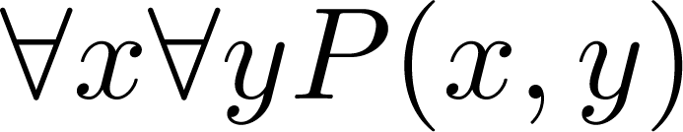
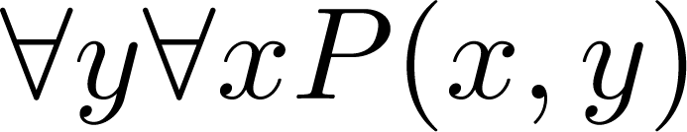
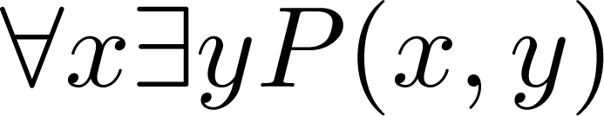
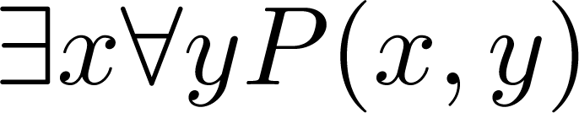
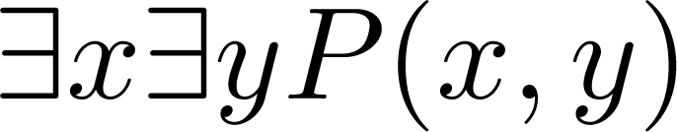
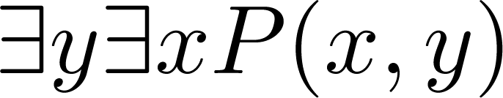
Quantifications of Two Variables
Statement | When True? | When False
 | P(x,y) is true for every pair x,y. | There is a pair x, y for which P(x,y) is false.
 | For every x there is a y for which P(x,y) is true. | There is an x such that P(x,y) is false for every y.
 | There is an x for which P(x,y) is true for every y. | For every x there is a y for which P(x,y) is false.
 | There is a pair x, y for which P(x,y) is true. | P(x,y) is false for every pair x,y

Slide 66
Translating Nested Quantifiers into English
Example 1: Translate the statement
∀x (C(x )∨ ∃y (C(y ) ∧ F(x, y)))
where C(x) is “x has a computer,” and F(x,y) is “x and y are friends,” and the domain for both x and y consists of all students in your school.
Solution: Every student in your school has a computer or has a friend who has a computer.
Example 2: Translate the statement
∃x∀y ∀z ((F(x, y)∧ F(x,z) ∧ (y ≠z))→¬F(y,z))
Solution: There is a student none of whose friends are also friends with each other.

Slide 67
Translating Mathematical Statements into Predicate Logic
Example : Translate “The sum of two positive integers is always positive” into a logical expression.
Solution:
Rewrite the statement to make the implied quantifiers and domains explicit:
“For every two integers, if these integers are both positive, then the sum of these integers is positive.”
Introduce the variables x and y, and specify the domain, to obtain:
“For all positive integers x and y, x + y is positive.”
The result is:
∀x ∀ y ((x > 0)∧ (y > 0)→ (x + y > 0))
where the domain of both variables consists of all integers

Slide 68
Translating English into Logical Expressions Example
Example: Use quantifiers to express the statement “There is a woman who has taken a flight on every airline in the world.”
Solution:
Let P(w,f) be “w has taken f ” and Q(f,a) be “f is a flight on a .”
The domain of w is all women, the domain of f is all flights, and the domain of a is all airlines.
Then the statement can be expressed as:
∃w ∀a ∃f (P(w,f ) ∧ Q(f,a))

