Slide 1
Bayes’ Theorem
Section 7.3

Slide 2
Section Summary
Bayes’ Theorem
Generalized Bayes’ Theorem
Bayesian Spam Filters
A.I. Applications (optional, not currently included in the overheads)

Slide 3
Motivation for Bayes’ Theorem
Bayes’ theorem allows us to use probability to answer questions such as the following:
Given that someone tests positive for having a particular disease, what is the probability that they actually do have the disease?
Given that someone tests negative for the disease, what is the probability, that in fact they do have the disease?
Bayes’ theorem has applications to medicine, law, artificial intelligence, engineering, and many diverse other areas.

Slide 4
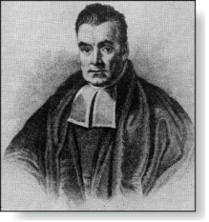
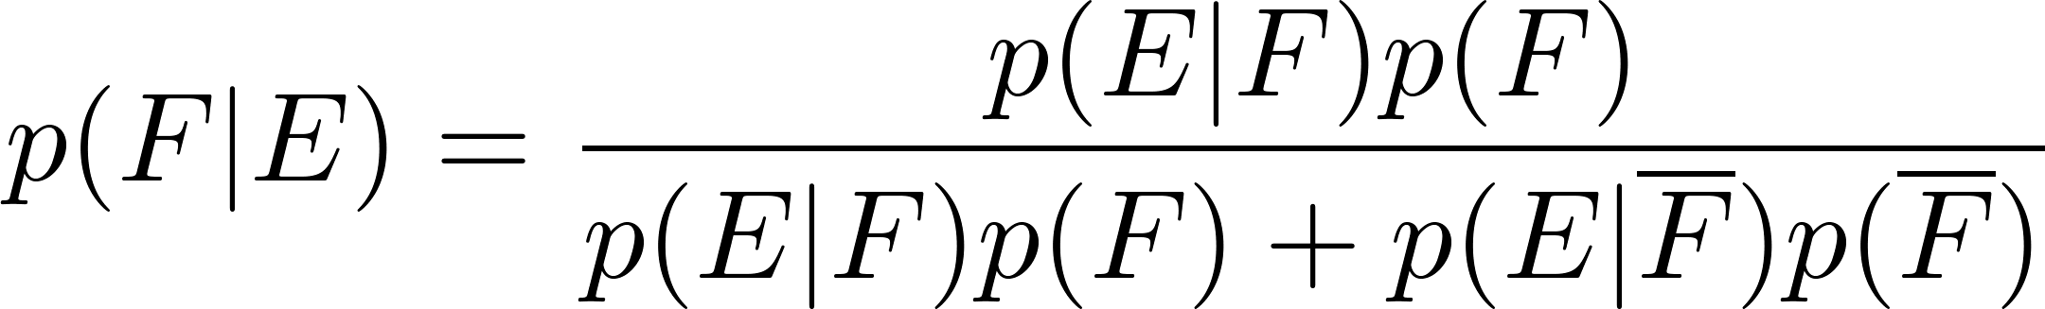
Bayes’ Theorem
Thomas Bayes
(1702-1761)
Bayes’ Theorem: Suppose that E and F are events from a sample space S such that p(E)≠ 0 and p(F) ≠ 0. Then:
Example: We have two boxes. The first box contains two green balls and seven red balls. The second contains four green balls and three red balls. Bob selects one of the boxes at random. Then he selects a ball from that box at random. If he has a red ball, what is the probability that he selected a ball from the first box.
Let E be the event that Bob has chosen a red ball and F be the event that Bob has chosen the first box.
By Bayes’ theorem the probability that Bob has picked the first box is:

Slide 5
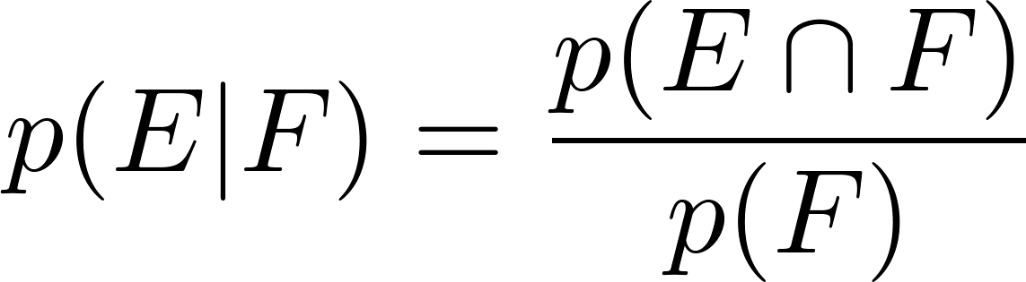
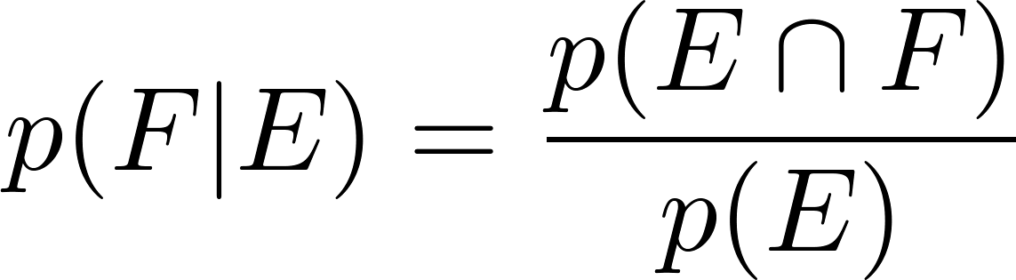
Derivation of Bayes’ Theorem
Recall the definition of the conditional probability p(E|F):
From this definition, it follows that:
,
continued →

Slide 6
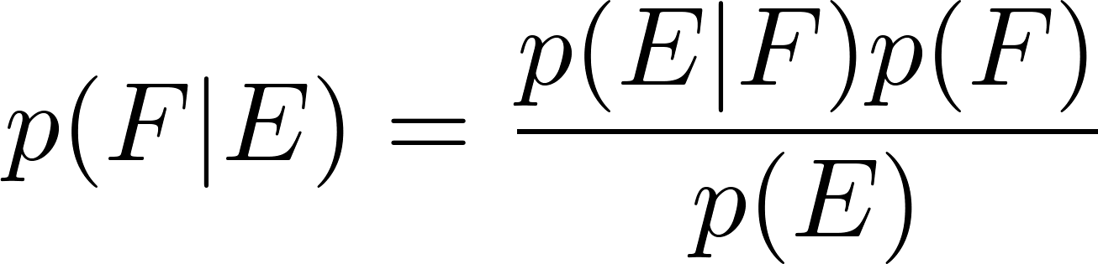
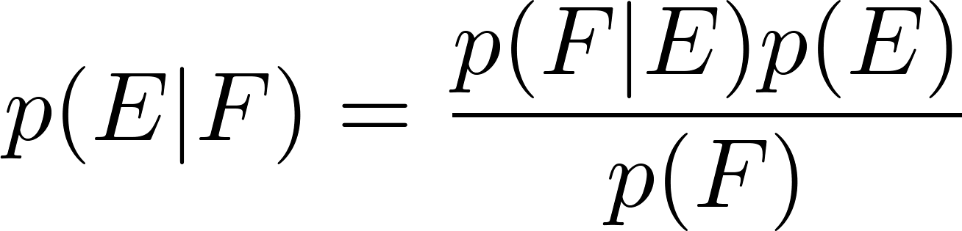
Derivation of Bayes’ Theorem
On the last slide we showed that
,
Equating the two formulas for p(E F) shows that
Solving for p(E|F) and for p(F|E) tells us that
,
continued →

Slide 7
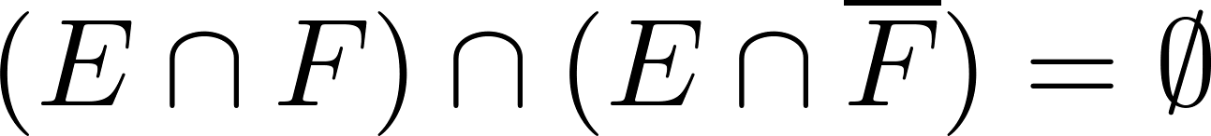
Derivation of Bayes’ Theorem
On the last slide we showed that:
Note that
since
because
and
By the definition of conditional probability,
Hence,

Slide 8
Applying Bayes’ Theorem
Example: Suppose that one person in 100,000 has a particular disease. There is a test for the disease that gives a positive result 99% of the time when given to someone with the disease. When given to someone without the disease, 99.5% of the time it gives a negative result. Find
the probability that a person who test positive has the disease.
the probability that a person who test negative does not have the disease.
Should someone who tests positive be worried?

Slide 9

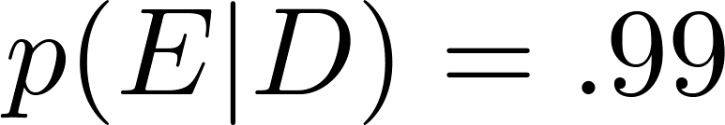

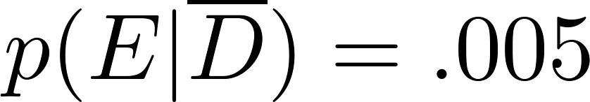
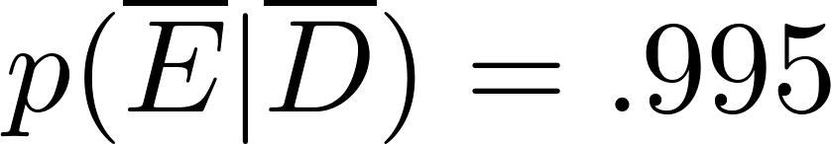
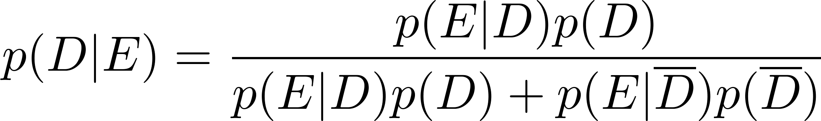
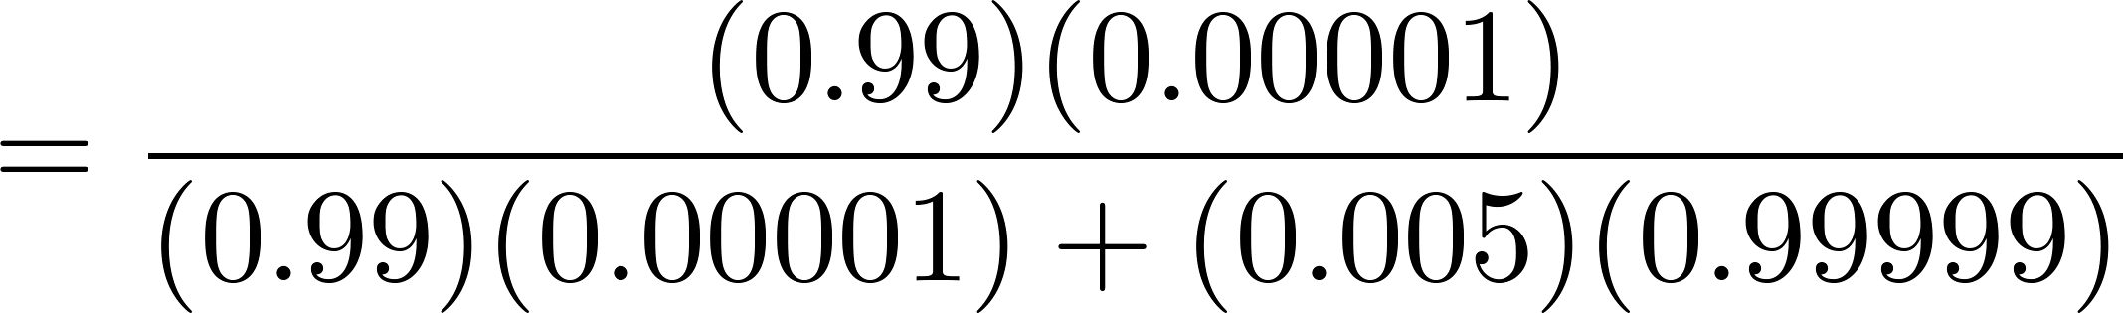

Applying Bayes’ Theorem
Solution: Let D be the event that the person has the disease, and E be the event that this person tests positive. We need to compute p(D|E) from p(D), p(E|D), p( E | ), p( ).
Can you use this formula to explain why the resulting probability is surprisingly small?
So, don’t worry too much, if your test for this disease comes back positive.

Slide 10
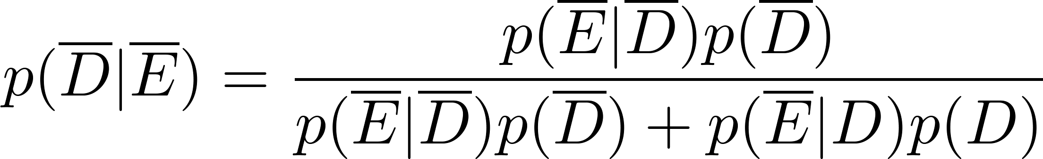
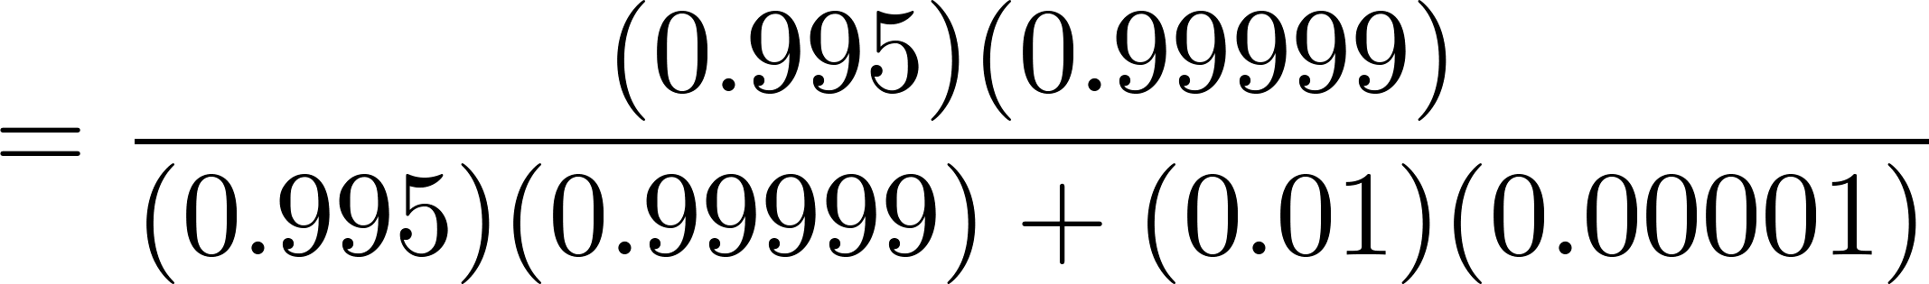
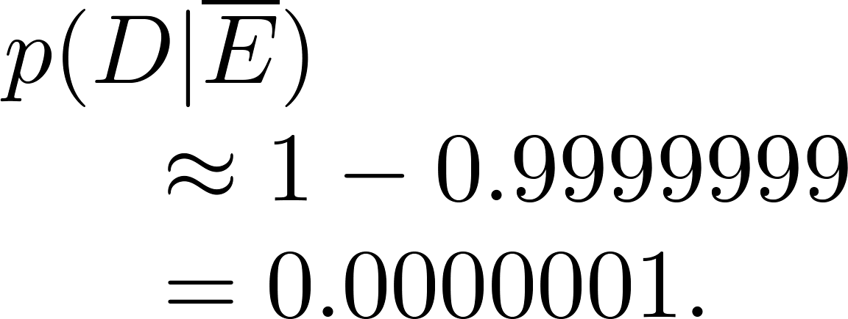

Applying Bayes’ Theorem
What if the result is negative?
So, it is extremely unlikely you have the disease if you test negative.
So, the probability you have the disease if you test negative is

Slide 11
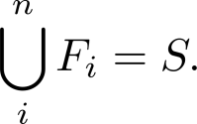
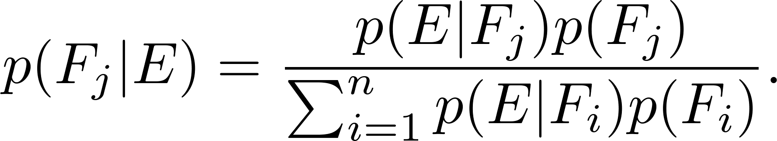
Generalized Bayes’ Theorem
Generalized Bayes’ Theorem: Suppose that E is an event from a sample space S and that F₁, F₂, …, F_{n} are mutually exclusive events such that
Assume that p(E) ≠ 0 for i = 1, 2, …, n. Then
Exercise 17 asks for the proof.

Slide 12
Bayesian Spam Filters
How do we develop a tool for determining whether an email is likely to be spam?
If we have an initial set B of spam messages and set G of non-spam messages. We can use this information along with Bayes’ law to predict the probability that a new email message is spam.
We look at a particular word w, and count the number of times that it occurs in B and in G; n_{B}(w) and n_{G}(w).
Estimated probability that a spam message contains w is: p(w) = n_{B}(w)/|B|
Estimated probability that a message that is not spam contains w is: q(w) = n_{G}(w)/|G|
continued →

Slide 13
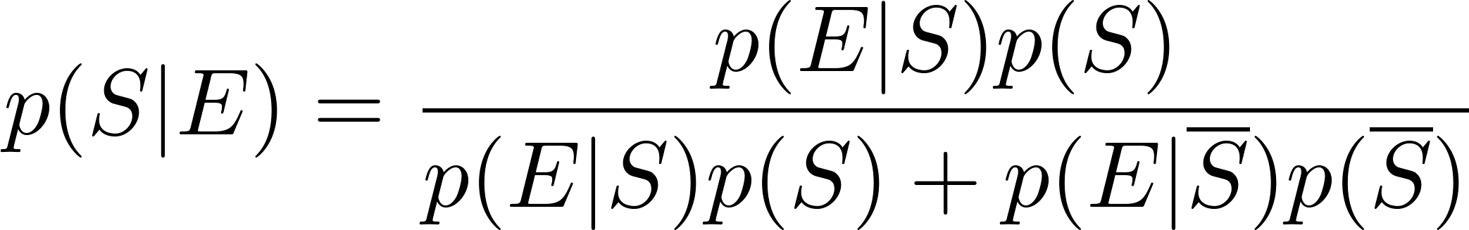
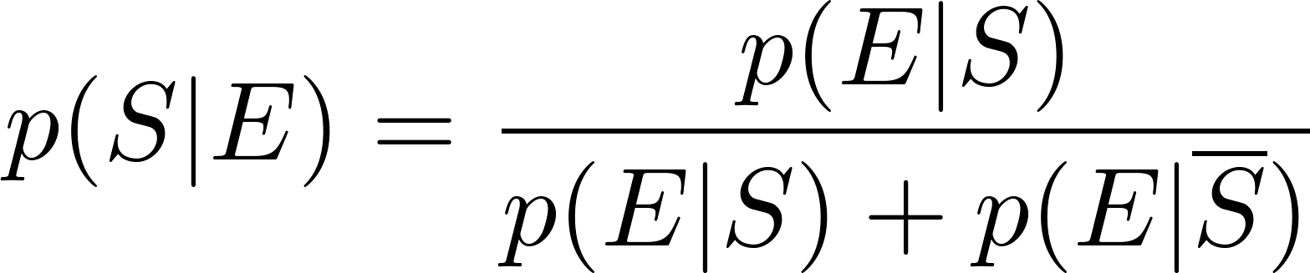
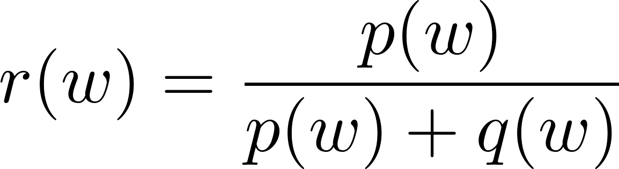
Bayesian Spam Filters
Let S be the event that the message is spam, and E be the event that the message contains the word w.
Using Bayes’ Rule,
Assuming that it is equally likely that an arbitrary message is spam and is not spam; i.e., p(S) = ½.
Note: If we have data on the frequency of spam messages, we can obtain a better estimate for p(s).
(See Exercise 22.)
Using our empirical estimates of
p(E | S) and
p(E |‾S).
r(w) estimates the probability that the message is spam. We can class the message as spam if r(w) is above a threshold.

Slide 14
Bayesian Spam Filters
Example: We find that the word “Rolex” occurs in 250 out of 2000 spam messages and occurs in 5 out of 1000 non-spam messages. Estimate the probability that an incoming message is spam. Suppose our threshold for rejecting the email is 0.9.
Solution: p(Rolex) = 250/2000 =.0125 and q(Rolex) = 5/1000 = 0.005.
We class the message as spam and reject the email!

Slide 15
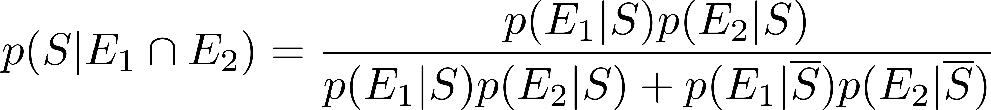
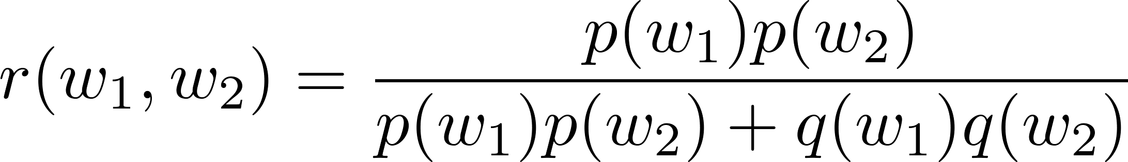
Bayesian Spam Filters using Multiple Words
Accuracy can be improved by considering more than one word as evidence.
Consider the case where E₁ and E₂ denote the events that the message contains the words w₁ and w₂ respectively.
We make the simplifying assumption that the events are independent. And again we assume that p(S) = ½.

Slide 16
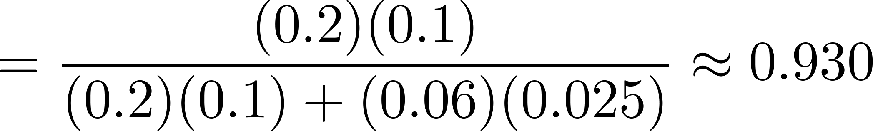
Bayesian Spam Filters using Multiple Words
Example: We have 2000 spam messages and 1000 non-spam messages. The word “stock” occurs 400 times in the spam messages and 60 times in the non-spam. The word “undervalued” occurs in 200 spam messages and 25 non-spam.
Solution: p(stock) = 400/2000 = .2, q(stock) = 60/1000=.06,
p(undervalued) = 200/2000 = .1, q(undervalued) = 25/1000 = .025
If our threshold is .9, we class the message as spam and reject it.

Slide 17
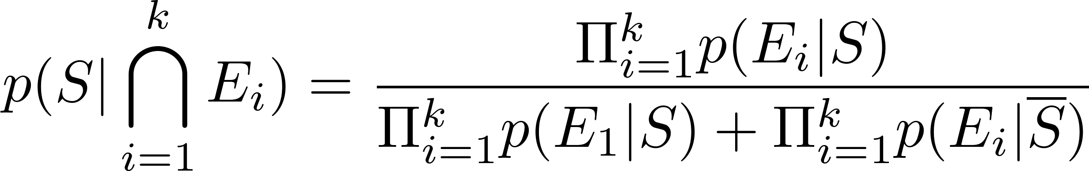
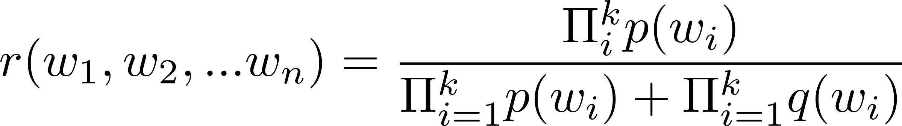
Bayesian Spam Filters using Multiple Words
In general, the more words we consider, the more accurate the spam filter. With the independence assumption if we consider k words:
We can further improve the filter by considering pairs of words as a single block or certain types of strings.

Slide 18
Expected Value and Variance
Section 7.4

Slide 19
Section Summary
Expected Value
Linearity of Expectations
Average-Case Computational Complexity
Geometric Distribution
Independent Random Variables
Variance
Chebyshev’s Inequality

Slide 20
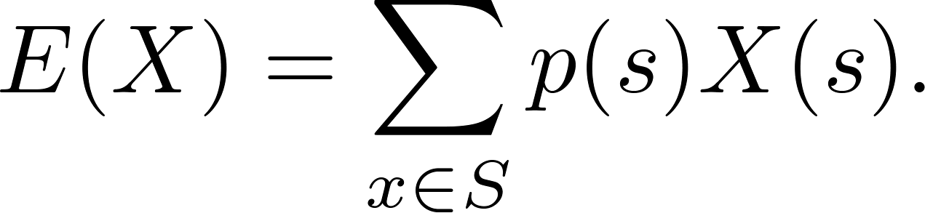
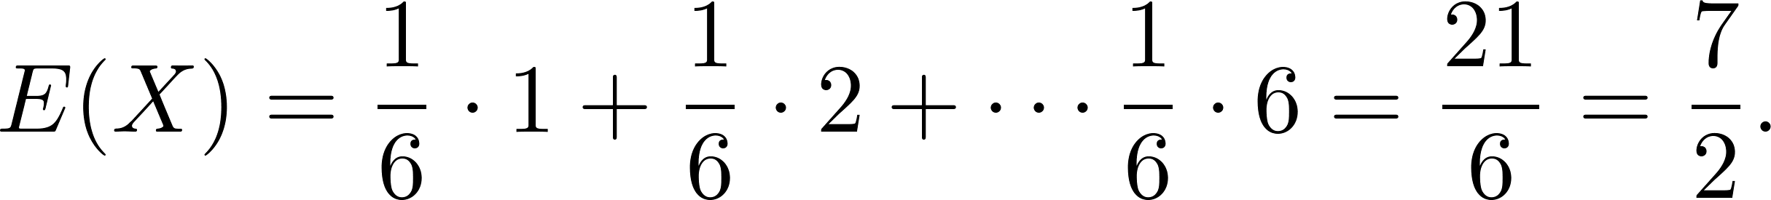
Expected Value
Definition: The expected value (or expectation or mean) of the random variable X(s) on the sample space S is equal to
Example-Expected Value of a Die: Let X be the number that comes up when a fair die is rolled. What is the expected value of X?
Solution: The random variable X takes the values 1, 2, 3, 4, 5, or 6. Each has probability 1/6. It follows that

Slide 21
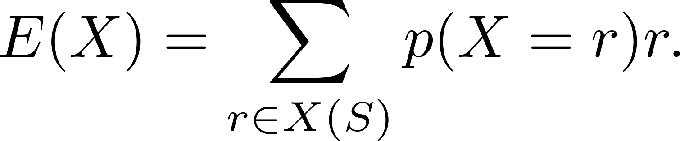
Expected Value
Theorem 1: If X is a random variable and p(X = r) is the probability that X = r, so that
then
Proof: Suppose that X is a random variable with range X(S) and let p(X = r) be the probability that X takes the value r. Consequently, p(X = r) is the sum of the probabilities of the outcomes s such that X(s) = r. Hence,

Slide 22
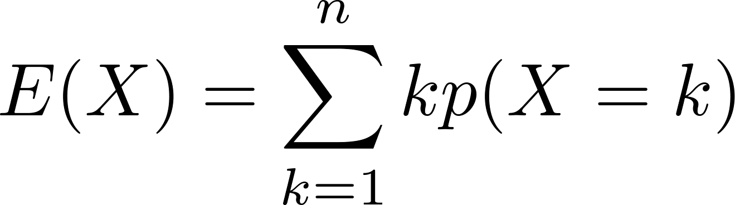
Expected Value
Theorem 2: The expected number of successes when n mutually independent Bernoulli trials are performed, where, the probability of success on each trial, p = np.
Proof: Let X be the random variable equal to the number of success in n trials. By Theorem 2 of section 7.2, p(X = k) = C(n,k)p^{k}q^{n−k}. Hence,
by Theorem 1
continued →

Slide 23
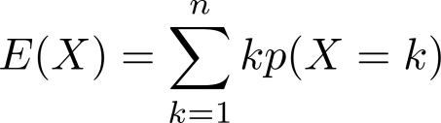
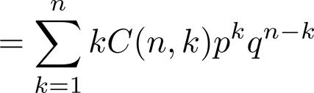
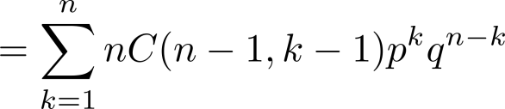
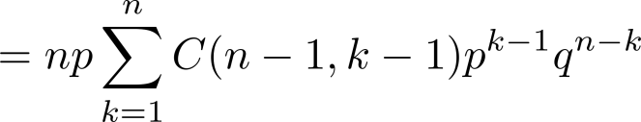
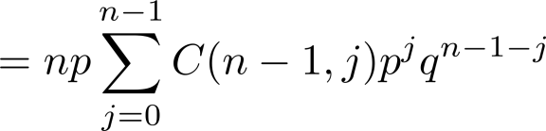

Expected Value
from previous page
by Theorem 2 in Section 7.2
by Exercise 21 in Section 6.4
factoring np from each term
shifting index of summation with j = k − 1
by the binomial theom
because p + q = 1
We see that the expected number of successes in n mutually independent Bernoulli trials is np.

Slide 24
Linearity of Expectations
The following theorem tells us that expected values are linear. For example, the expected value of the sum of random variables is the sum of their expected values.
Theorem 3: If X_{i}, i = 1, 2, …,n with n a positive integer, are random variables on S, and if a and b are real numbers, then
(i) E(X₁ + X₂ + …. + X_{n}) = E(X₁ )+ E(X₂) + …. + E(X_{n})
(ii) E(aX + b) = aE(X) + b.
see the text for the proof

Slide 25
Linearity of Expectations
Expected Value in the Hatcheck Problem: A new employee started a job checking hats, but forgot to put the claim check numbers on the hats. So, the n customers just receive a random hat from those remaining. What is the expected number of hat returned correctly?
Solution: Let X be the random variable that equals the number of people who receive the correct hat. Note that X = X₁ + X₂ + ∙∙∙ + X_{n},
where X_{i} = 1 if the ith person receives the hat and X_{i} = 0 otherwise.
Because it is equally likely that the checker returns any of the hats to the ith person, it follows that the probability that the ith person receives the correct hat is 1/n. Consequently (by Theorem 1), for all I
E(X_{i}) = 1 ∙p(X_{i} = 1) + 0 ∙p(X_{i} = 0) = 1 ∙ 1/n + 0 = 1/n .
By the linearity of expectations (Theorem 3), it follows that:
E(X )= E(X₁) + E(X₂) + ∙∙∙ + E(X_{n}) = n ∙ 1/n – 1.
Consequently, the average number of people who receive the correct hat is exactly 1. ( Surprisingly, this answer remains the same no matter how many people have checked their hats!)

Slide 26
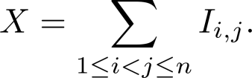

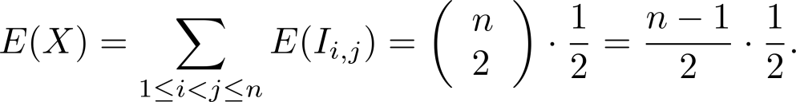
Linearity of Expectations
Expected Number of Inversions in a Permutation: The ordered pair (i,j) is an inversion in a permutation of the first n positive integers if i < j, but j precedes i in the permutation.
Example: There are six inversions in the permutation of 3,5, 1, 4, 2
(1, 3), (1, 5), (2, 3), (2, 4), (2, 5), (4, 5).
Find the average number of inversions in a random permutation of the first n integers.
Solution: Let I_{i,j} be the random variable on the set of all permutations of the first n positive integers with I_{i,j} = 1 if (i,j) is an inversion of the permutation and I_{i,j} = 0 otherwise. If X is the random variable equal to the number of inversions in the permutation, then
Since it is equally likely for i to precede j in a randomly chosen permutation as it is for j to precede i, we have: E(I_{i,j}) = 1 ∙p(I_{i ,j} = 1) + 0 ∙p(I_{i,j} = 0) = 1 ∙ 1/2 + 0 = ½, for all (i,j) .
Because there are pairs i and j with 1 ≤ i < j ≤ n, by the linearity of expectations (Theorem 3), we have:
Consequently, it follows that there is an average of n(n −1)/4 inversions in a random permutation of the first n positive integers.

Slide 27
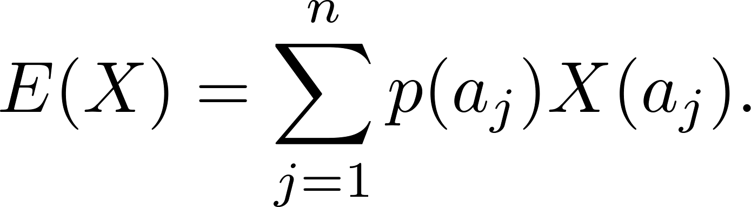
Average-Case Computational Complexity
The average-case computational complexity
of an algorithm can be found by computing the
expected value of a random variable.
Let the sample space of an experiment be the set of possible inputs a_{j}, j = 1, 2, …,n, and let the random variable X be the assignment to a_{j} of the number of operations used by the algorithm when given a_{j} as input.
Assign a probability p(a_{j}) to each possible input value a_{j}.
The expected value of X is the average-case computational complexity of the algorithm.

Slide 28
Average-Case Complexity of Linear Search
What is the average-case complexity of linear search (described in Chapter 3) if the probability that x is in the list is p and it is equally likely that x is any of the n elements of the list?
procedure linear search(x: integer, a₁, a₂, …,a_{n}: distinct integers)
i := 1
while (i ≤ n and x ≠ a_{i})
i := i + 1
if i ≤ n then location := i
else location := 0
return location{location is the subscript of the term that equals x, or is 0 if x is not found}
continued →

Slide 29
Average-Case Complexity of Linear Search
Solution: There are n + 1 possible types of input: one type for each of the n numbers on the list and one additional type for the numbers not on the list.
Recall that:
2i + 1 comparisons are needed if x equals the ith element of the list.
2n + 2 comparisons are used if x is not on the list.
The probability that x equals a_{i} is p/n and the probability that x is not in the list is q = 1− p. The average-case case computational complexity of the linear search algorithm is:
E = 3p/n + 5p/n + … + (2n + 1)p/n + (2n + 2)q
= (p/n)( 3 + 5 + …. + (2n + 1)) + (2n + 2)q
= (p/n)((n + 1)² − 1) + (2n + 2)q (Example 2 from Section 5.1)
= p(n + 2) + (2n + 2)q.
When x is guaranteed to be in the list, p = 1, q = 0, so that E = n + 2.
When p is ½ and q = ½, then E = (n + 2)/2 + n + 1 = (3n + 4) /2.
When p is ¾ and q = ¼ then E = (n + 2)/4 + (n + 1)/2 = (5n + 8) /4.
When x is guaranteed not to be in the list, p = 0 and q = 1, then E = 2n + 2.

Slide 30
Average-Case Complexity of Insertion Sort
What is the average number of comparisons used by insertion sort from Chapter 3) to sort n distinct elements?
procedure insertion sort
(a₁,…,a_{n}: reals with n ≥ 2)
for j := 2 to n
i := 1
while a_{j} > a_{i}
i := i + 1
m := a_{j}
for k := 0 to j − i − 1
a_{j-k} := a_{j-k-1}
a_{i} := m
{Now a₁,…,a_{n} is in increasing order}
At step i for i = 2, ….,n, insertion sort inserts the ith element in the original list into the correct position in the sorted list of the first i -1 elements.
continued →

Slide 31
Average-Case Complexity of Insertion Sort
Solution: Let X be the random variable equal to the number of comparisons used by insertion sort to sort a list of a₁, a₂, …., a_{n} distinct elements. E(X) is the average number of comparisons.
Let X_{i} be the random variable equal to the number of comparisons used to insert a_{i} into the proper position after the first i −1 elements a₁, a₂, …., a_{i-1} have been sorted.
Since X = X₂ + X₃ + ∙∙∙ + X_{n},
E(X) = E(X₂ + X₃ + ∙∙∙ + X_{n}) = E(X₂) + E(X₃) + ∙∙∙ + E(X_{n}).
To find E(X_{i}) for i = 2,3,…,n, let p_{j}(k) be the probability that the largest of the first j elements in the list occurs at the kth position, that is, max(a₁, a₂, …., a_{j} ) = a_{k}, where 1 ≤ k ≤ j.
Assume uniform distribution; p_{j}(k) = 1/j .
Then X_{i}(k) = k.
continued →

Slide 32
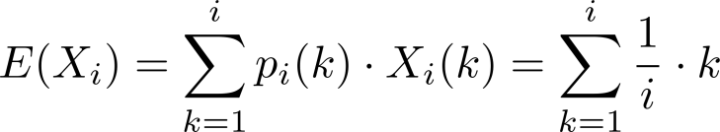
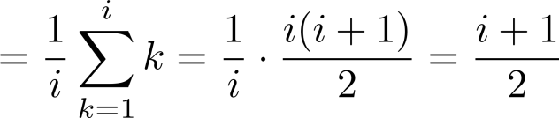
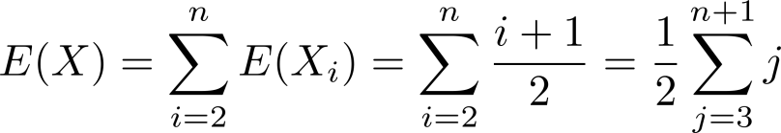
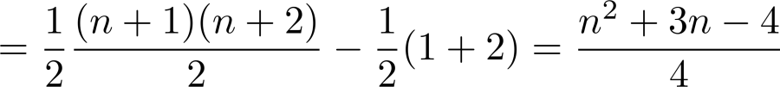

Average-Case Complexity of Insertion Sort
Since a_{i} could be inserted into any of the first i positions
It follows that
Hence, the average-case complexity is .

Slide 33
The Geometric Distribution
Definition 2: A random variable X has geometric distribution with parameter p if p(X = k) = (1 − p)^{k-1}p for k = 1,2,3,…, where p is a real number with 0 ≤ p ≤ 1.
Theorem 4: If the random variable X has the geometric distribution with parameter p, then E(X) = 1/p.
Example: Suppose the probability that a coin comes up tails is p. What is the expected number of flips until this coin comes up tails?
The sample space is {T, HT, HHT, HHHT, HHHHT, …}.
Let X be the random variable equal to the number of flips in an element of the sample space; X(T) = 1, X(HT) = 2, X(HHT) = 3, etc.
By Theorem 4, E(X) = 1/p.
see text for full details

Slide 34
Independent Random Variables
Definition 3: The random variables X and Y on a sample space S are independent if
p(X = r₁ and Y = r₂) = p(X = r₁)∙ p(Y = r₂).
Theorem 5: If X and Y are independent variables on a sample space S, then E(XY) = E(X)E(Y).
see text for the proof

Slide 35
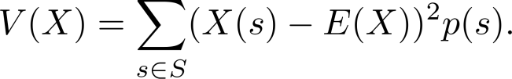

Variance
Deviation: The deviation of X at s ∊ S is X(s) − E(X), the difference between the value of X and the mean of X.
Definition 4: Let X be a random variable on the sample space S. The variance of X, denoted by V(X) is
That is V(X) is the weighted average of the square of the deviation of X. The standard deviation of X, denoted by σ(X) is defined to be
Theorem 6: If X is a random variable on a sample space S, then V(X) = E(X²) − E(X)².
Corollary 1: If X is a random variable on a sample space S and E(X) = μ , then V(X) = E((X −μ)²).
see text for the proof
see text for the proof.

Slide 36
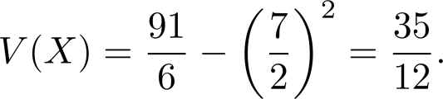
Variance
Example: What is the variance of the random variable X, where X(t) = 1 if a Bernoulli trial is a success and X(t) = 0 if it is a failure, where p is the probability of success and q is the probability of failure?
Solution: Because X takes only the values 0 and 1, it follows that X²(t) = X(t). Hence,
Variance of the Value of a Die: What is the variance of a random variable X, where X is the number that comes up when a fair die is rolled?
Solution: We have V(X) = E(X²) − E(X)² . In an earlier example, we saw that E(X) = 7/2. Note that
E(X²) = 1/6(1² + 2² + 3² +4² + 5² + 6²) = 91/6.
We conclude that
V(X) = E(X²) − E(X)² = p − p² = p(1 − p) = pq.

Slide 37
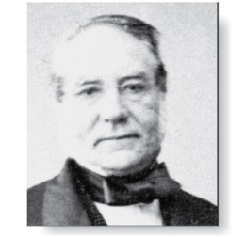
Variance
Irenée-Jules Bienaymé
(1796-1878)
Bienaymé‘s Formula: If X and Y are two independent random variables on a sample space S, then V(X + Y) = V(X) + V(Y). Furthermore, if X_{i}, i = 1,2, …,n, with n a positive integer, are pairwise independent random variables on S, then
V(X₁ + X₂ + ∙∙∙ + X_{n}) = V(X₁) + V(X₂) + ∙∙∙ + V(X_{n}).
Example: Find the variance of the number of successes when n independent Bernoulli trials are performed, where on each trial, p is the probability of success and q is the probability of failure.
Solution: Let X_{i} be the random variable with X_{i} ((t₁, t₂, …., t_{n})) = 1 if trial t_{i} is a success and X_{i} ((t₁, t₂, …., t_{n})) = 0 if it is a failure. Let X = X₂ + X₃ + …. X_{n}. Then X counts the number of successes in the n trials.
By Bienaymé ‘s Formula, it follows that V(X)= V(X₁) + V(X₂) + ∙∙∙ + V(X_{n}).
By the previous example ,V(X_{i}) = pq for i = 1,2, …,n.
Hence, V(X) = npq.
see text for the proof

Slide 38
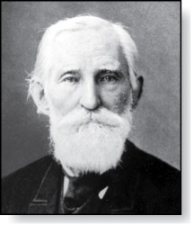
Chebyshev’s Inequality
Pafnuty Lvovich Chebyshev
(1821-1894)
Chebyschev’s Inequality: Let X be a random variable on a sample space S with probability function p. If r is a positive real number, then
p(|X(s) − E(X)| ≥ r ) ≤ V(X)/r².
Example: Suppose that X is a random variable that counts the number of tails when a fair coin is tossed n times. Note that X is the number of successes when n independent Bernoulli trials, each with probability of success ½ are done. Hence, (by Theorem 2) E(X) = n/2 and (by Example 18) V(X) = n/4.
By Chebyschev’s inequality with r = √n,
p(|X(s) − n/2 | ≥ √n ) ≤ (n/4 )(√n )² = ¼.
This means that the probability that the number of tails that come up on n tosses deviates from the mean , n/2, by more than √n is no larger than ¼.
see text for the proof

