Slide 1
Advanced Counting Techniques
Chapter 8
With Question/Answer Animations
Copyright © McGraw-Hill Education. All rights reserved. No reproduction or distribution without the prior written consent of McGraw-Hill Education.

Slide 2
Chapter Summary
Applications of Recurrence Relations
Solving Linear Recurrence Relations
Homogeneous Recurrence Relations
Nonhomogeneous Recurrence Relations
Divide-and-Conquer Algorithms and Recurrence Relations
Inclusion-Exclusion
Recurrence 递推关系
Linear 线性
Homogeneous 齐次
Nonhomogeneous 非齐次
Inclusion-Exclusion 包含互斥
Divide-and-Conquer 分治

Slide 3
Divide-and-Conquer Algorithms and Recurrence Relations
Section 8.3

Slide 4
Section Summary
Divide-and-Conquer Algorithms and Recurrence Relations
Examples
Binary Search
Merge Sort
Fast Multiplication of Integers
Master Theorem
Closest Pair of Points (not covered yet in these slides)
Binary二分的
Merge合并
Multiplication操纵

Slide 5
Divide-and-Conquer Algorithmic Paradigm
Definition: A divide-and-conquer algorithm works by first dividing a problem into one or more instances of the same problem of smaller size and then conquering the problem using the solutions of the smaller problems to find a solution of the original problem.
Examples:
Binary search, covered in Chapters 3 and 5: It works by comparing the element to be located to the middle element. The original list is then split into two lists and the search continues recursively in the appropriate sublist.
Merge sort, covered in Chapter 5: A list is split into two approximately equal sized sublists, each recursively sorted by merge sort. Sorting is done by successively merging pairs of lists.
Instance 实例
Conquer 求解
Notes:
概念
两个例子：二分搜索，归并排序

Slide 6
Divide-and-Conquer Recurrence Relations
Suppose that a recursive algorithm divides a problem of size n into a subproblems.
Assume each subproblem is of size n/b.
Suppose g(n) extra operations are needed in the conquer step.
Then f(n) represents the number of operations to solve a problem of size n satisisfies the following recurrence relation:
f(n) = af(n/b) + g(n)
This is called a divide-and-conquer recurrence relation.
Notes:
定义，注意几个不同部分

Slide 7
Example: Binary Search
Binary search reduces the search for an element in a sequence of size n to the search in a sequence of size n/2. Two comparisons are needed to implement this reduction;
one to decide whether to search the upper or lower half of the sequence and
the other to determine if the sequence has elements.
Hence, if f(n) is the number of comparisons required to search for an element in a sequence of size n, then
when n is even.
f(n) = f(n/2) + 2
https://fhfirehuo.github.io/Attacking-Java-Rookie/Chapter03/BinarySearch.html
Notes:
注意：二分查找不一定要数组是有序的

Slide 8
Example: Merge Sort
The merge sort algorithm splits a list of n (assuming n is even) items to be sorted into two lists with n/2 items. It uses fewer than n comparisons to merge the two sorted lists.
Hence, the number of comparisons required to sort a sequence of size n, is no more than than M(n) where
M(n) = 2M(n/2) + n.
https://www.runoob.com/w3cnote/merge-sort.html
Notes:
第二个例子，归并排序
大家学过归并排序吗？

Slide 9
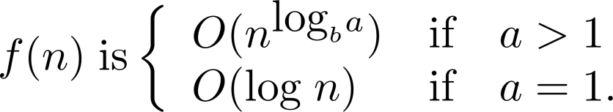
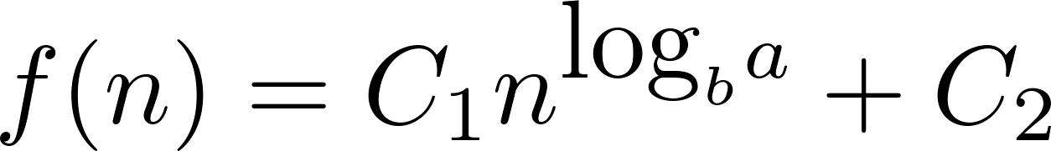
Estimating the Size of Divide-and-Conquer Functions
Theorem 1: Let f be an increasing function that satisfies the recurrence relation
f(n) = af(n/b) + cn^{d}
whenever n is divisible by b, where a≥ 1, b is an integer greater than 1, and c is a positive real number. Then
Furthermore, when n = b^{k} and a ≠1, where k is a positive integer,
where C₁ = f(1) + c/(a−1) and C₂ = −c/(a−1).
Divisible 可整除
Notes:
看材料，板书

Slide 10
Complexity of Binary Search
Binary Search Example: Give a big-O estimate for the number of comparisons used by a binary search.
Solution: Since the number of comparisons used by binary search is f(n) = f(n/2) + 2 where n is even, by Theorem 1, it follows that f(n) is O(log n).
Notes:
有了这个之后呢，我们就可以分析不同算法的复杂度了

Slide 11
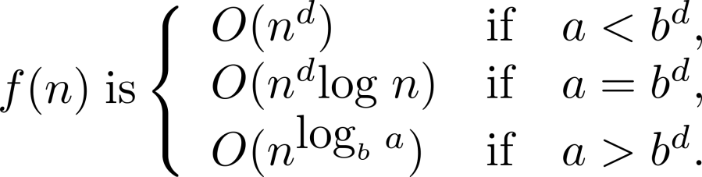
Estimating the Size of Divide-and-conquer Functions (continued)
Theorem 2. Master Theorem: Let f be an increasing function that satisfies the recurrence relation
f(n) = af(n/b) + cn^{d}
whenever n = b^{k}, where k is a positive integer greater than 1, and c and d are real numbers with c positive and d nonnegative. Then
Notes:
n = b^{k}的特殊情况

Slide 12
Complexity of Merge Sort
Merge Sort Example: Give a big-O estimate for the number of comparisons used by merge sort.
Solution: Since the number of comparisons used by merge sort to sort a list of n elements is less than M(n) where M(n) = 2M(n/2) + n, by the master theorem M(n) is O(n log n).
Notes:
继续分析归并排序

Slide 13
Inclusion-Exclusion
Section 8.5

Slide 14
Section Summary
The Principle of Inclusion-Exclusion
Examples
Principle 规则

Slide 15
Principle of Inclusion-Exclusion
In Section 2.2, we developed the following formula for the number of elements in the union of two finite sets:
We will generalize this formula to finite sets of any size.
Notes:
基于第二章的结果，拓展

Slide 16
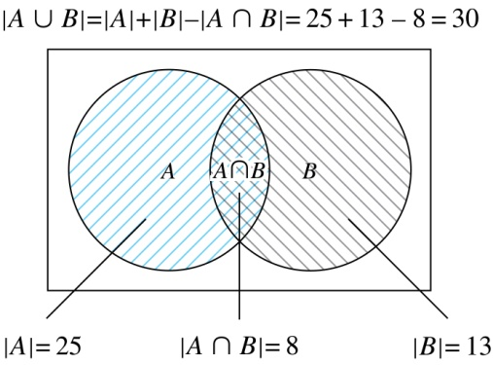
Two Finite Sets
Example: In a discrete mathematics class every student is a major in computer science or mathematics or both. The number of students having computer science as a major (possibly along with mathematics) is 25; the number of students having mathematics as a major (possibly along with computer science) is 13; and the number of students majoring in both computer science and mathematics is 8. How many students are in the class?
Solution: |A∪B| = |A| + |B| −|A∩B|
= 25 + 13 −8 = 30
Notes:
读题目

Slide 17

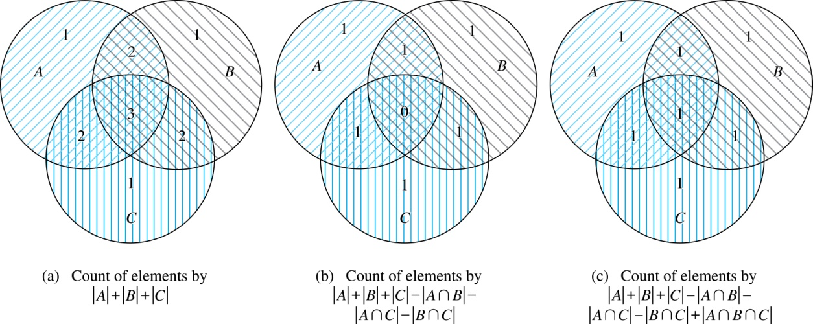
Three Finite Sets
Notes:
以这个图示为例，按照顺序

Slide 18
Three Finite Sets Continued
Example: A total of 1232 students have taken a course in Spanish, 879 have taken a course in French, and 114 have taken a course in Russian. Further, 103 have taken courses in both Spanish and French, 23 have taken courses in both Spanish and Russian, and 14 have taken courses in both French and Russian. If 2092 students have taken a course in at least one of Spanish French and Russian, how many students have taken a course in all 3 languages.
Solution: Let S be the set of students who have taken a course in Spanish, F the set of students who have taken a course in French, and R the set of students who have taken a course in Russian. Then, we have
|S| = 1232, |F| = 879, |R| = 114, |S∩F| = 103, |S∩R| = 23, |F∩R| = 14, and |S∪F∪R| = 23.
Using the equation
|S∪F∪R| = |S|+ |F|+ |R| − |S∩F| − |S∩R| − |F∩R| + |S∩F∩R|,
we obtain 2092 = 1232 + 879 + 114 −103 −23 −14 + |S∩F∩R|.
Solving for |S∩F∩R| yields 7.
Notes:
我们先来看一下题目

Slide 19
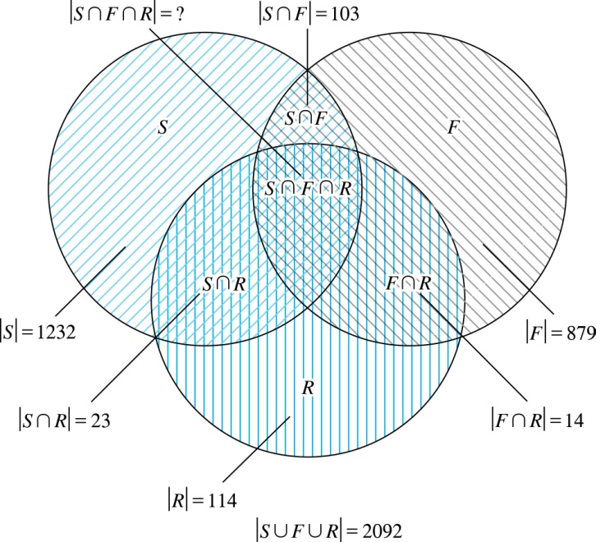
Illustration of Three Finite Set Example
Notes:
通过刚才的图示来理解

Slide 20

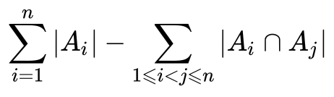
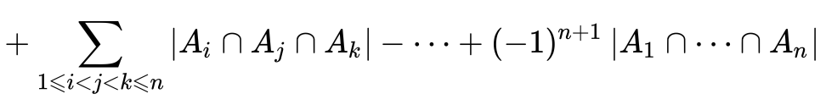
The Principle of Inclusion-Exclusion
Theorem 1. The Principle of Inclusion-Exclusion: Let A₁, A₂, …, A_{n} be finite sets. Then:
Notes:
下面，我们把这个定理拓展到无限多个集合
正负号，取决于n

Slide 21
The Principle of Inclusion-Exclusion (continued)
Proof: An element in the union is counted exactly once in the right-hand side of the equation. Consider an element a that is a member of r of the sets A₁,…., A_{n} where 1≤ r ≤ n.
It is counted C(r,1) times by Σ|A_{i}|
It is counted C(r,2) times by Σ|A_{i} ⋂A_{j}|
In general, it is counted C(r,m) times by the summation of m of the sets A_{i}.
right-hand side 左手边，数学中常用语
Notes:
句子意思是 是 各种集合的共有部分——r中的一个
统计元素在r中出现的次数

Slide 22
The Principle of Inclusion-Exclusion (cont)
Thus the element is counted exactly
C(r,1) − C(r,2) + C(r,3) − ⋯ + (−1)^{r+1} C(r,r)
times by the right hand side of the equation.
By Corollary 2 of Section 6.4 and Binomial Theorem, we have
C(r,0) − C(r,1) + C(r,2) − ⋯ + (−1)^{r} C(r,r) = 0.
Hence,
1 = C(r,0) = C(r,1) − C(r,2) + ⋯ + (−1)^{r+1} C(r,r).
Notes:
Corollary 2 of Section 6.4板书

Slide 23
Binomial Theorem
Binomial Theorem: Let x and y be variables, and n a nonnegative integer. Then:

