Slide 1


《离散数学》
Chapter 11：Trees（I）
王晓黎 2025年12月17日

Slide 2
Outline
Introduction to Trees
Tree Traversal
Spanning Trees
Minimum Spanning Trees

Slide 3
Introduction to Trees
Introduction to Trees
Rooted Trees
Trees as Models
Properties of Trees

Slide 4
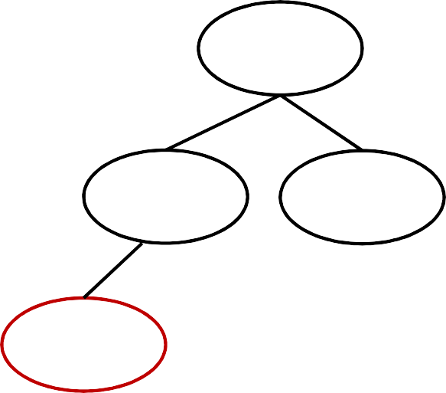
A Motivated Example
Type in “buy apple to eat” using the search engine
buy apple to eat
Apples are so expensive, so why do so many people still buy them? Apples are so expensive this year, they're even pricier than meat.
food
phone
fluit
meat
Apple
Huawei
apple

Slide 5
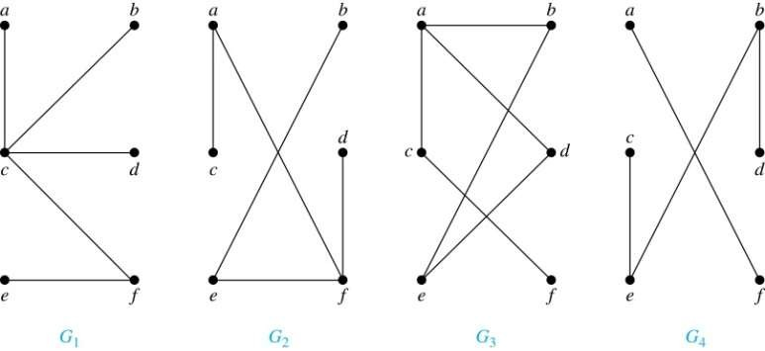
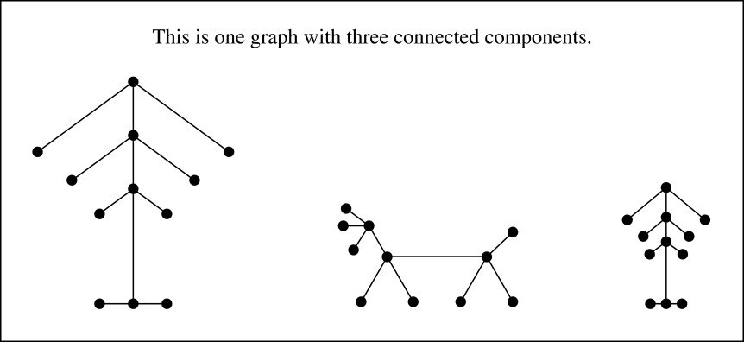
Trees
Definition: A tree (树) is a connected undirected graph with no simple circuits.
Example: Which of these graphs are trees?
Solution: G₁ and G₂ are trees - both are connected and have no simple circuits.
Because e, b, a, d, e is a simple circuit, G₃ is not a tree. G₄ is not a tree because it
is not connected.
Definition: A forest (森林) is a graph that has
no simple circuit, but is not connected. Each of the connected components in a forest is a tree.

Slide 6

Trees (continued)
Theorem: An undirected graph is a tree if and only if there is a unique simple path between any two of its vertices.
Proof: Assume that T is a tree. Then T is connected with no simple circuits. Hence, if x and y are distinct vertices of T, there is a simple path between them (by Theorem 1 of Section 10.4). This path must be unique - for if there were a second path, there would be a simple circuit in T. Hence, there is a unique simple path between any two vertices of a tree.
Now assume that there is a unique simple path between any two vertices of a graph T. Then T is connected because there is a path between any two of its vertices. Furthermore, T can have no simple circuits since if there were a simple circuit, there would be two paths between some two vertices.
Hence, a graph with a unique simple path between any two vertices is a tree.

Slide 7
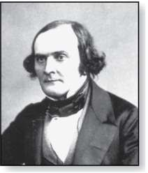
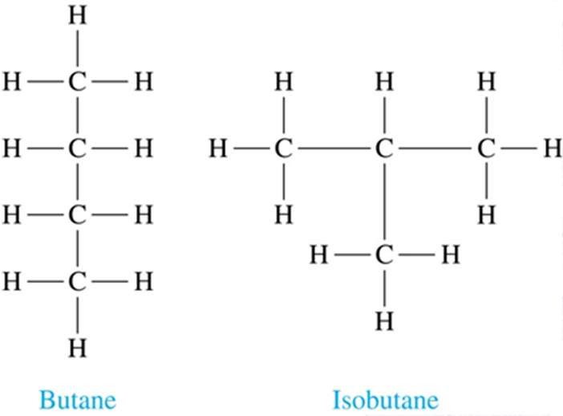
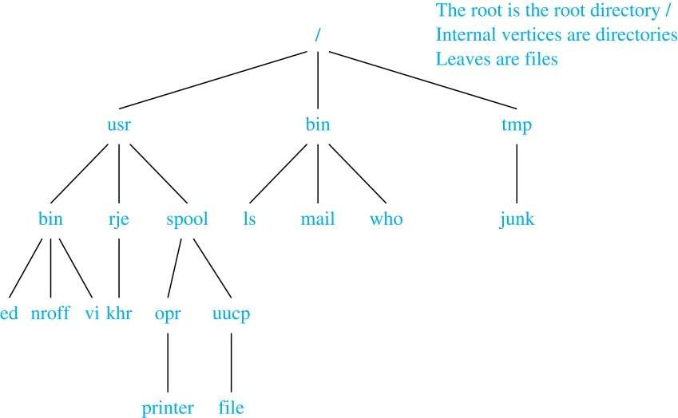
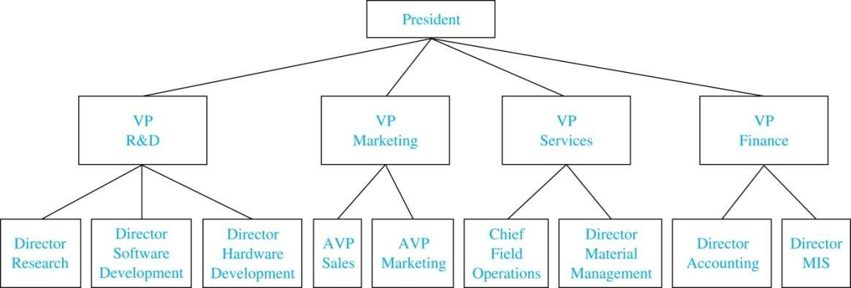
Trees as Models
Arthur Cayley (1821-1895)
Trees are used as models in computer science, chemistry, geology, botany, psychology, and many other areas
Trees were introduced by the mathematician Cayley in 1857 in his work counting the number of isomers of saturated hydrocarbons. The two isomers of butane are shown at the right
The organization of a computer file system into directories, subdirectories, and files is naturally represented as a tree
Trees are used to represent the structure of organizations

Slide 8
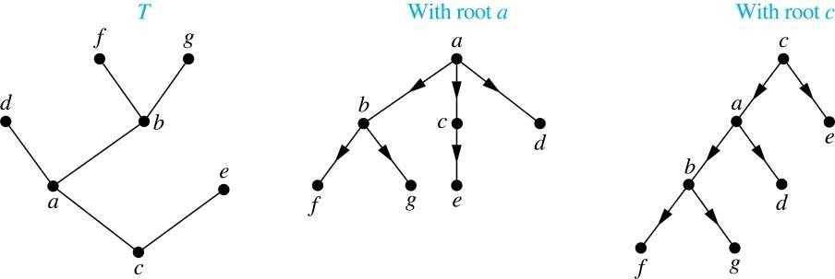
Rooted Trees
Definition: A rooted tree (有根树) is a tree in which one vertex has been designated as the root and every edge is directed away from the root.
An unrooted tree is converted into different rooted trees when different vertices are chosen as the root.

Slide 9
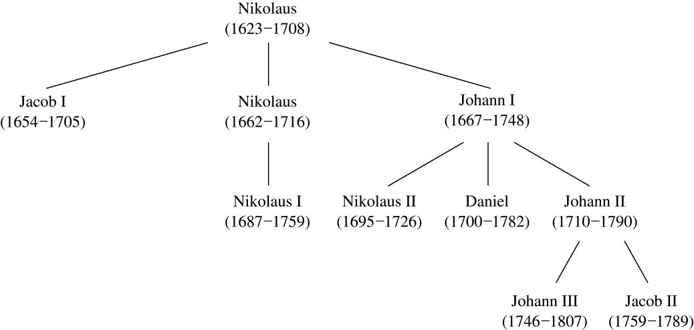
Rooted Tree Terminology
Terminology for rooted trees is a mix from botany and genealogy
(such as the Bernoulli family of mathematicians)
If v is a vertex of a rooted tree other than the root, the parent of v is the unique vertex u such that there is a directed edge from u to v. When u is a parent of v, v is called a child of u. Vertices with the same parent are called siblings.
The ancestors of a vertex are the vertices in the path from the root to this vertex, excluding the vertex itself and including the root. The descendants of a vertex v are those vertices that have v as an ancestor.
A vertex of a rooted tree with no children is called a leaf. Vertices that have children are called
internal vertices.
If a is a vertex in a tree, the subtree with a as its root is the subgraph of the tree consisting of a and its descendants and all edges incident to these descendants.

Slide 10
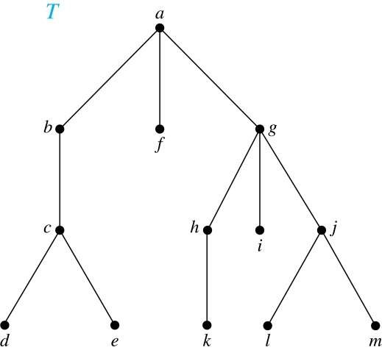
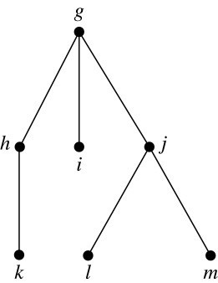
Terminology for Rooted Trees
Example: In the rooted tree T (with root a):
Find the parent of c, the children of g, the siblings of h, the ancestors of e, and the descendants of b.
Find all internal vertices and all leaves.
What is the subtree rooted at g?
Solution:
The parent of c is b. The children of g are h, i, and j.
The siblings of h are i and j. The ancestors of e are c, b, and a. The descendants of b are c, d, and e.
The internal vertices are a, b, c, g, h, and j. The leaves are d, e, f, i, k, l, and m.
We display the subtree rooted at g.

Slide 11
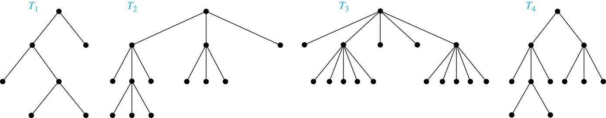
m-ary Rooted Trees
Definition: A rooted tree is called an m-ary tree if every internal vertex has no
more than m children. The tree is called a full m-ary tree if every internal vertex has exactly m children. An m-ary tree with m=2 is called a binary tree.
Example: Are the following rooted trees full m-ary trees for some positive integer m?
Solution:
T₁ is a full binary tree because each of its internal vertices has two children. T₂ is a full 3-ary tree because each of its internal vertices has three children. In T₃ each internal vertex has five children, so T₃ is a full 5-ary tree.
T₄ is not a full m-ary tree for any m because some of its internal vertices have two children and others
have three children.
11

Slide 12
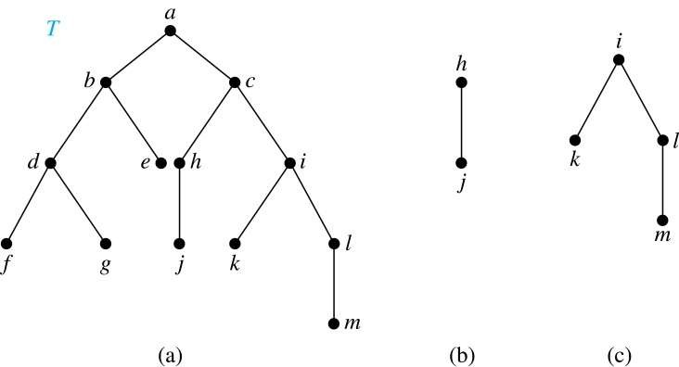
Ordered Rooted Trees
Definition: An ordered rooted tree (有序根树) is a rooted tree where the children of each internal vertex are ordered.
We draw ordered rooted trees so that the children of each internal vertex are shown in order from left to right.
Definition: A binary tree (二叉树) is an ordered rooted tree where each internal vertex has at most two children. If an internal vertex of a binary tree has two children, the first is called the left child and the second the right child. The tree rooted at the left child of a vertex is called the left subtree of this vertex, and that rooted at the right child of a vertex is called the right subtree of this vertex.
Example: Consider the binary tree T.
What are the left and right children of d?
What are the left and right subtrees of c?
Solution:
The left child of d is f and the right child is g.
The left and right subtrees of c are displayed in
(b) and (c).
12

Slide 13
Properties of Trees
Theorem 2: A tree with n vertices has n−1 edges.
Proof (by mathematical induction):
BASIS STEP: When n=1, a tree with one vertex has no edges. Hence, the theorem holds when n=1.
INDUCTIVE STEP: Assume that every tree with k vertices has k−1 edges.
Suppose that a tree T has k+1 vertices and that v is a leaf of T. Let w be the parent of v. Removing the vertex v and the edge connecting w to v produces a tree T′ with k vertices. By the inductive hypothesis, T′ has k−1 edges. Because T has one more edge than T′, we see that T has k edges. This completes the inductive step.

Slide 14

Counting Vertices in Full m-Ary Trees
Theorem 3: A full m-ary tree with i internal vertices has n = mi + 1 vertices.
Proof : Every vertex, except the root, is the child of an internal vertex. Because each of the i internal vertices has m children, there are mi vertices in the tree other than the root. Hence, the tree contains n = mi
+ 1 vertices.

Slide 15
Counting Vertices in Full m-Ary Trees (continued)
Theorem 4: A full m-ary tree with
(i) n vertices has i = (n − 1)/m internal vertices and l = [(m − 1)n + 1]/m leaves,
proofs of parts
(ii) and (iii) are left as take-home assignments
(ii)
i internal vertices has n = mi + 1 vertices and l = (m − 1)i + 1 leaves,
(iii)
l leaves has n = (ml − 1)/(m − 1) vertices and i = (l − 1)/ (m − 1)
internal vertices.
Proof (of part i): Solving for i in n = mi + 1 (from Theorem 3) gives i
= (n − 1)/m. Since each vertex is either a leaf or an internal vertex, n
= l + i. By solving for l and using the formula for i, we see that
l = n − i = n − (n − 1)/m = [(m − 1)n + 1]/m .

Slide 16
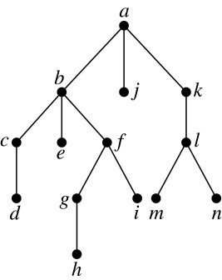
Level of vertices and height of trees
When working with trees, we often want to have rooted trees where the subtrees at each vertex contain paths of approximately the same length
To make this idea precise we need some definitions:
  The level of a vertex in a rooted tree is the length of the unique path from the root to this vertex
  The height of a rooted tree is the maximum of the levels of the vertices
Example:
Find the level of each vertex in the tree to the right.
What is the height of the tree?
Solution:
  The root a is at level 0. Vertices b, j, and k are at level 1.
Vertices c, e, f, and l are at level 2. Vertices d, g, i, m, and n are at level 3. Vertex h is at level 4.
  The height is 4, since 4 is the largest level of any vertex.

Slide 17
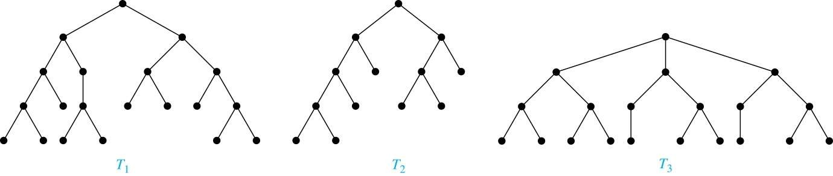
Balanced m-Ary Trees
Definition: A rooted m-ary tree of height h is balanced if all leaves are at levels h or h−1.
Example: Which of the rooted trees shown below is balanced?
Solution: T₁ and T₃ are balanced, but T₂ is not because it has leaves at levels 2, 3, and 4.

Slide 18
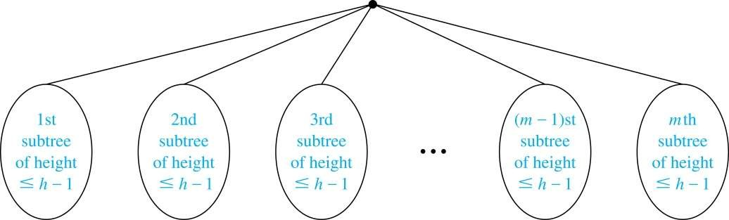

The Bound for the Number of Leaves in an m-Ary Tree
Theorem 5: There are at most m^{h} leaves in an m-ary tree of height h.
Proof (by mathematical induction on height):
BASIS STEP: Consider an m-ary trees of height 1. The tree consists of a root and no more than m
children, all leaves. Hence, there are no more than m¹ = m leaves in an m-ary tree of height 1.
INDUCTIVE STEP: Assume the result is true for all m-ary trees of height < h. Let T be an m-ary tree of
height h. The leaves of T are the leaves of the subtrees of T we get when we delete the edges from the root to each of the vertices of level 1.
Each of these subtrees has height ≤ h−1. By the inductive hypothesis, each of these subtrees has at most m^{h−1} leaves. Since there are at most m such subtees, there are at most m⋅m^{h−1} = m^{h} leaves in the tree.

Slide 19
Tree Traversal
Traversal Algorithms
Infix, Prefix, and Postfix Notation

Slide 20
Tree Traversal
Procedures for systematically visiting every vertex of an ordered tree are called traversals (遍历)
The three most commonly used traversals are preorder traversal (前 序遍历), inorder traversal (中序遍历), and postorder traversal (后序 遍历)

Slide 21
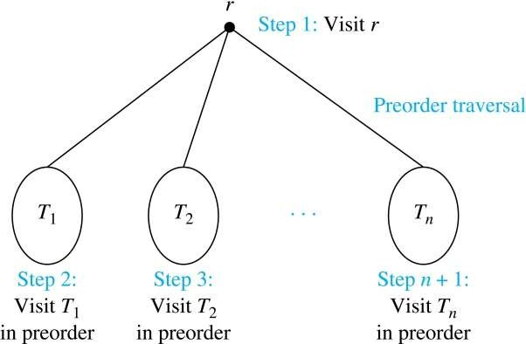
Preorder Traversal
Definition: Let T be an ordered rooted tree with root r. If T consists only of r, then r is the preorder traversal of T. Otherwise, suppose that T₁, T₂, …, T_{n} are the subtrees of r from left to right in T. The preorder traversal begins by visiting r, and continues by traversing T₁ in preorder, then T₂ in preorder, and so on, until T_{n} is traversed in preorder.

Slide 22
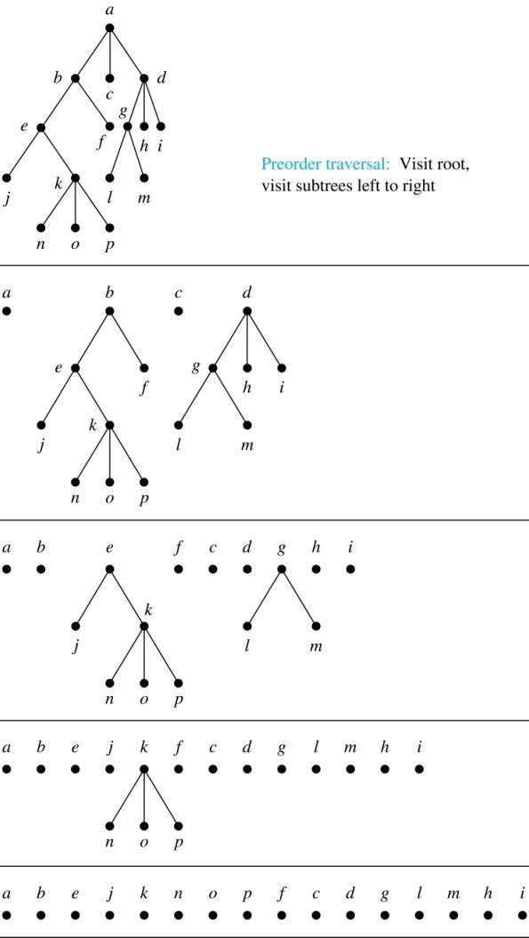
Preorder Traversal (continued)
procedure preorder (T: ordered rooted tree)
r := root of T
list r
for each child c of r from left to right T(c) := subtree with c as root preorder(T(c))

Slide 23
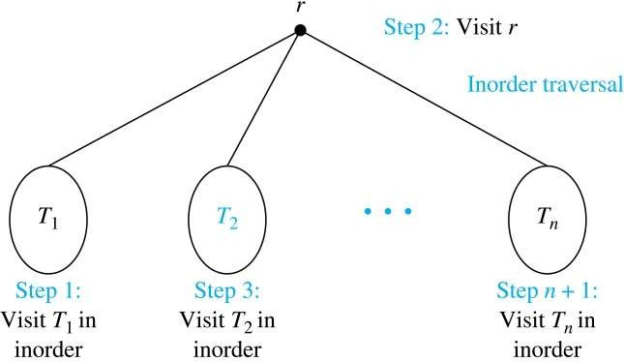
Inorder Traversal
Definition: Let T be an ordered rooted tree with root r. If T consists only of r, then r is the inorder traversal of T. Otherwise, suppose that T₁, T₂, …, T_{n} are the subtrees of r from left to right in T. The inorder traversal begins by traversing T₁ in inorder, then visiting r, and continues by traversing T₂ in inorder, and so on, until T_{n} is traversed in inorder.

Slide 24
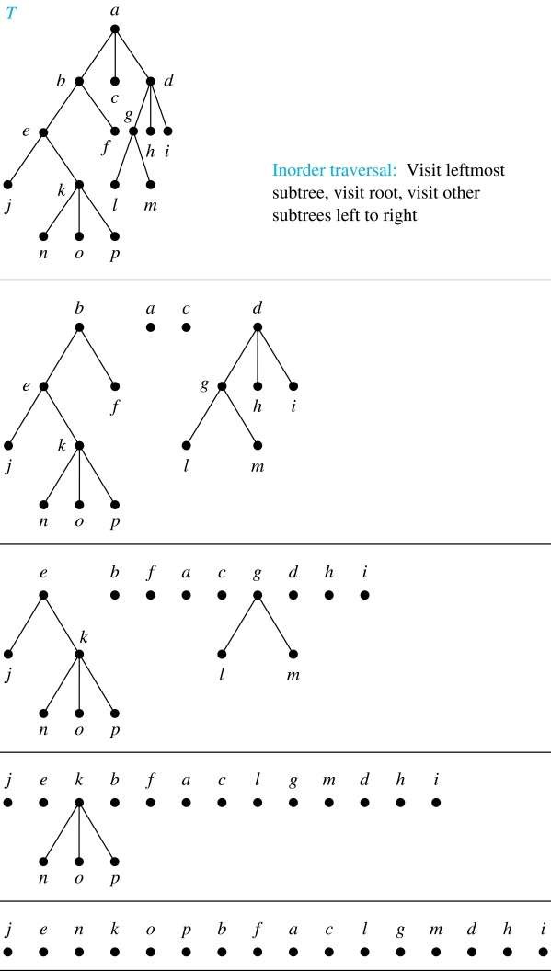
Inorder Traversal (continued)
procedure inorder (T: ordered rooted tree)
r := root of T
if r is a leaf then list r
else
l := first child of r from left to right
T(l) := subtree with l as its root
inorder(T(l)) list(r)
for each child c of r from left to right T(c) := subtree with c as root inorder(T(c))

Slide 25
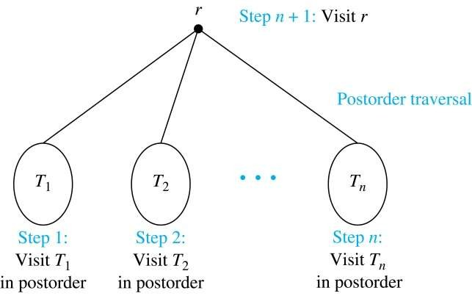
Postorder Traversal
Definition: Let T be an ordered rooted tree with root r. If T consists only of r, then r is the postorder traversal of T. Otherwise, suppose that T₁, T₂, …, T_{n} are the subtrees of r from left to right in T. The postorder traversal begins by traversing T₁ in postorder, then T₂ in postorder, and so on, after T_{n} is traversed in postorder, r is visited.

Slide 26
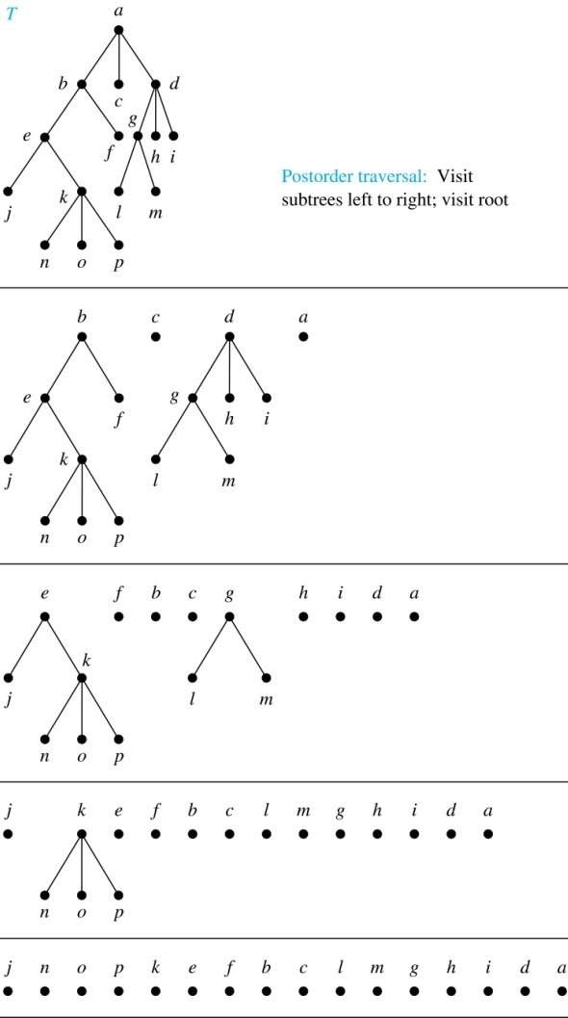
Postorder Traversal (continued)
procedure postordered (T: ordered rooted tree)
r := root of T
for each child c of r from left to right
T(c) := subtree with c as root postorder(T(c))
list r

Slide 27
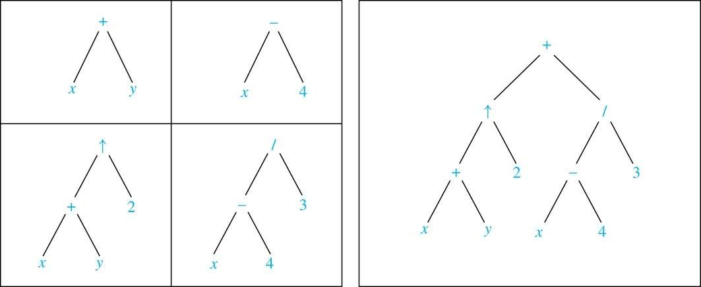
Expression Trees
Complex expressions can be represented using ordered rooted trees
Consider the expression ((x + y) ↑ 2 ) + ((x − 4)/3)
A binary tree for the expression can be built from the bottom up, as is illustrated here

Slide 28
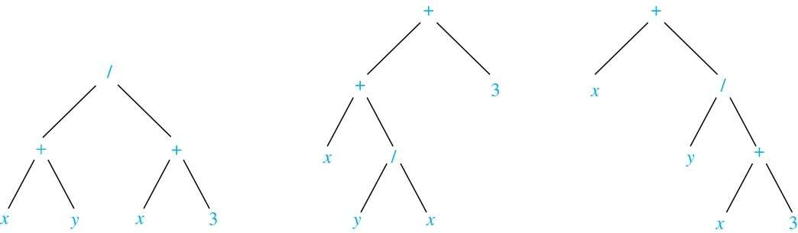
Infix Notation
An inorder traversal of the tree representing an expression produces the original expression when parentheses are included except for unary operations, which now immediately follow their operands
We illustrate why parentheses are needed with an example that displays three trees all yield the same infix representation (中缀表示)

Slide 29
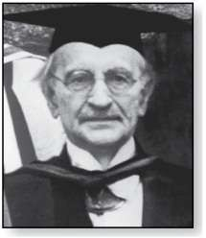
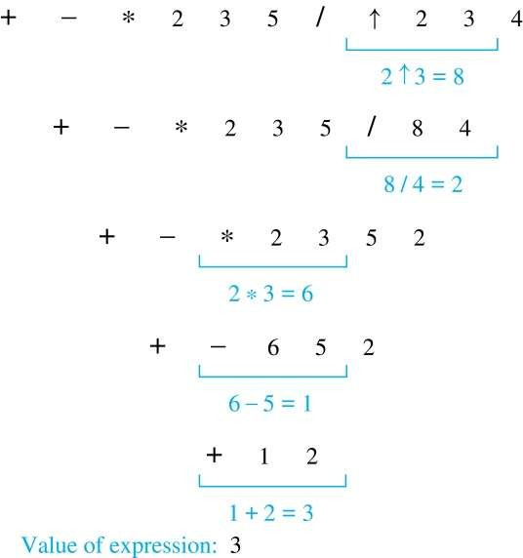
Prefix Notation
When we traverse the rooted tree representation of an
Jan Łukasiewicz (1878-1956)
expression in preorder, we obtain the prefix form (前缀
形式) of the expression. Expressions in prefix form are _{Example: We show the steps}
said to be in Polish notation (波兰记法), named after the Polish logician Jan Łukasiewicz
Operators precede their operands in the prefix form of an expression. Parentheses are not needed as the representation is unambiguous
The prefix form of ((x + y) ↑ 2 ) + ((x − 4)/3) is
+ ↑ + x y 2 / − x 4 3
Prefix expressions are evaluated by working from right to left. When we encounter an operator, we perform the corresponding operation with the two operations to the right
used to evaluate a particular prefix expression:

Slide 30
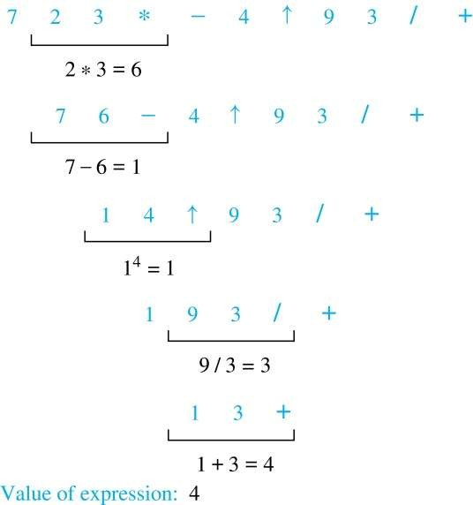
Postfix Notation
We obtain the postfix form (后缀形式) of an expression by traversing its binary trees in postorder. Expressions written in postfix form are said to be in reverse Polish notation (逆波 兰记法)
Parentheses are not needed as the postfix form is unambiguous
Example: We show the steps used to evaluate a particular postfix expression.
The postfix form of ((x + y) ↑ 2 ) + ((x − 4)/3) is
x y + 2 ↑ x 4 − 3 / +
A binary operator follows its two operands. So, to evaluate an expression one works from left to right, carrying out an operation represented by an operator on its preceding operands

Slide 31
Q&A

