Slide 1


《离散数学》
Chapter 11：Trees（II）
王晓黎 2025年12月19日

Slide 2
Outline
Introduction to Trees
Tree Traversal
Spanning Trees (生成树)
Minimum Spanning Trees (最小生成树)
2

Slide 3
Spanning Trees
Spanning Trees
Depth-First Search
Breadth-First Search
Depth-First Search in Directed Graphs

Slide 4
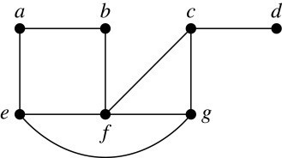
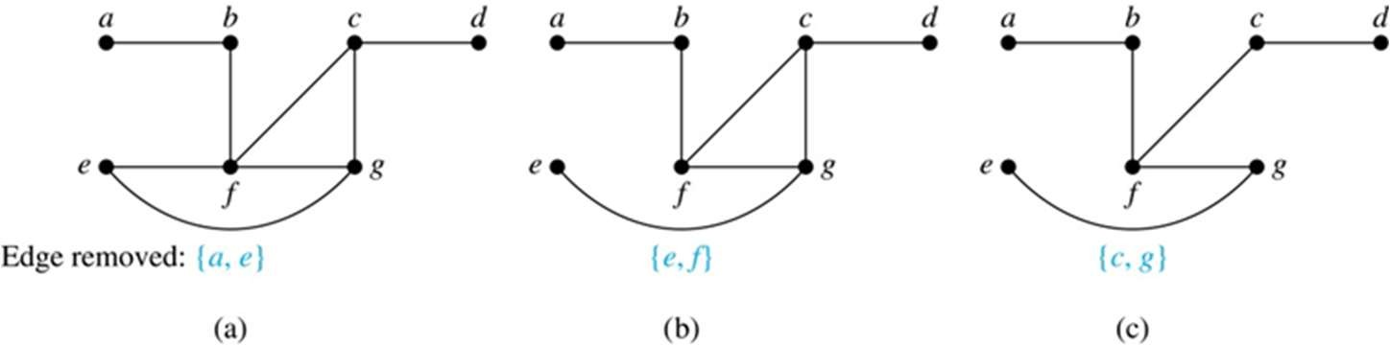
Spanning Trees
Definition: Let G be a simple graph. A spanning tree of G is a subgraph of G that is a tree containing every vertex of G.
Example: Find the spanning tree of this simple graph:
Solution: The graph is connected, but is not a tree because it contains simple circuits. Remove the edge {a, e}. Now one simple circuit is gone, but the remaining subgraph still has a simple circuit. Remove the edge {e, f} and then the edge {c, g} to produce a simple graph with no simple circuits. It is a spanning tree, because it contains every vertex of the original graph.

Slide 5
Spanning Trees (continued)
Theorem: A simple graph is connected if and only if it has a spanning tree.
Proof: Suppose that a simple graph G has a spanning tree T. T contains every vertex of G and there is a path in T between any two of its vertices. Because T is a subgraph of G, there is a path in G between any two of its vertices. Hence, G is connected.
Now suppose that G is connected. If G is not a tree, it contains a simple circuit. Remove an edge from one of the simple circuits. The resulting subgraph is still connected because any vertices connected via a path containing the removed edge are still connected via a path with the remaining part of the simple circuit. Continue in this fashion until there are no more simple circuits. A tree is produced because the graph remains connected as edges are removed. The resulting tree is a spanning tree because it contains every vertex of G.

Slide 6
Depth-First Search
To use depth-first search to build a spanning tree for a connected simple graph first arbitrarily choose a vertex of the graph as the root
  Form a path starting at this vertex by successively adding vertices and edges, where each new edge is incident with the last vertex in the path and a vertex not already in the path. Continue adding vertices and edges to this path as long as possible
  If the path goes through all vertices of the graph, the tree consisting of this path is a spanning tree
  Otherwise, move back to the next to the last vertex in the path, and if possible, form a new path starting at this vertex and passing through vertices not already visited. If this cannot be done, move back another vertex in the path
  Repeat this procedure until all vertices are included in the spanning tree

Slide 7
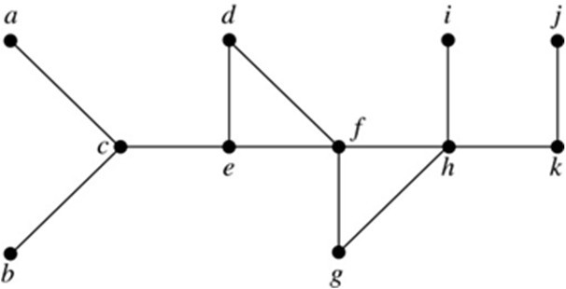
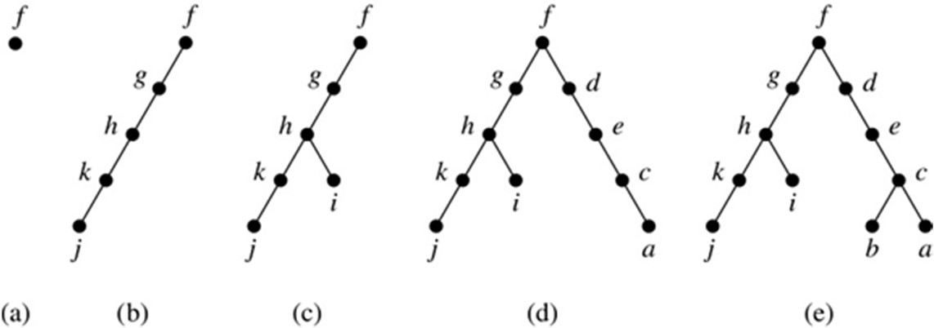
Depth-First Search (continued)
Example: Use depth-first search to find a spanning tree of this graph.
Solution: We start arbitrarily with vertex f. We build a path by successively adding an edge that connects the last vertex added to the path and a vertex not already in the path, as long as this is possible. The result is a path that connects f, g, h, k, and j. Next, we return to k, but find no new vertices to add. So, we return to h and add the path with one edge that connects h and i. We next return to f, and add the path connecting f, d, e, c, and a.
Finally, we return to c and add the path connecting c and b. We now stop because all vertices have been added.

Slide 8
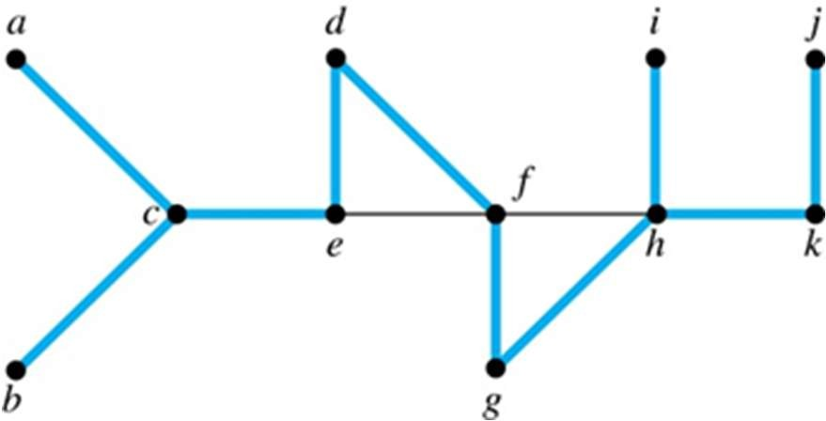
Depth-First Search (continued)
The edges selected by depth-first search of a graph are called tree edges. All other edges of the graph must connect a vertex to an ancestor or descendant of the vertex in the graph. These are called back edges
In this figure, the tree edges are shown with heavy blue lines. The two thin black edges are back edges

Slide 9
Depth-First Search Algorithm
We now use pseudocode to specify depth-first search. In this recursive algorithm, after adding an edge connecting a vertex v to the vertex w, we finish exploring w before we return to v to continue exploring from v
procedure DFS(G: connected graph with vertices v₁, v₂, …, v_{n})
T := tree consisting only of the vertex v₁ visit(v₁)
procedure visit(v: vertex of G)
for each vertex w adjacent to v and not yet in T
add vertex w and edge {v,w} to T visit(w)

Slide 10
Breadth-First Search
We can construct a spanning tree using breadth-first search. We first arbitrarily choose a root from the vertices of the graph
  Then we add all of the edges incident to this vertex and the other endpoint of each of these edges. We say that these are the vertices at level 1
  For each vertex added at the previous level, we add each edge incident to this vertex, as long as it does not produce a simple circuit. The new vertices we find are the vertices at the next level
  We continue in this manner until all the vertices have been added and we have a spanning tree

Slide 11
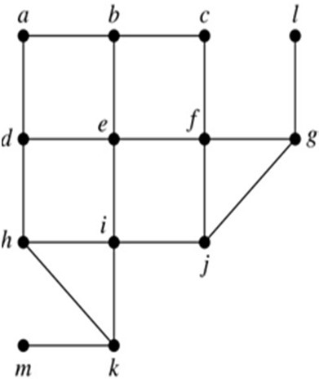
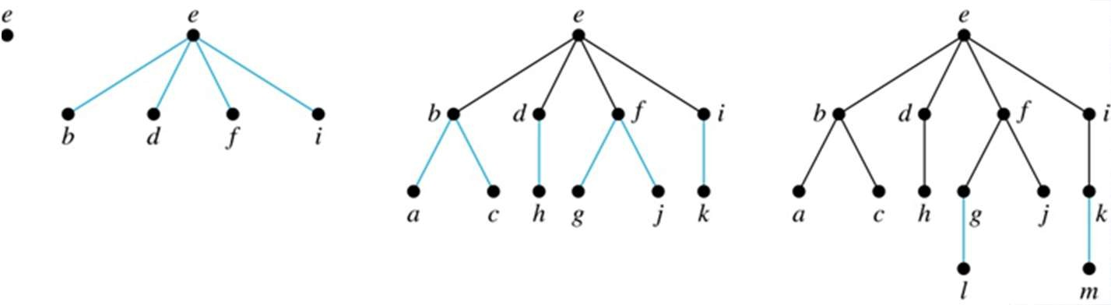
Breadth-First Search (continued)
Example: Use breadth-first search to find a spanning tree for this graph.
Solution: We arbitrarily choose vertex e as the root. We then add the edges from e to b, d, f, and i. These four vertices make up level 1 in the tree. Next, we add the edges from b to a and c, the edges from d to h, the edges from f to j and g, and the edge from i to k. The endpoints of these edges not at level 1 are at level 2. Next, add edges from these vertices to adjacent vertices not already in the graph. So, we add edges from g to l and from k to
m. We see that level 3 is made up of the vertices l and m. This is the last level because
there are no new vertices to find.

Slide 12
Breadth-First Search Algorithm
We now use pseudocode to describe breadth-first search
procedure BFS(G: connected graph with vertices v₁, v₂, …, v_{n}) T := tree consisting only of the vertex v₁
L := empty list visit(v₁)
put v₁ in the list L of unprocessed vertices
while L is not empty
remove the first vertex, v, from L
for each neighbor w of v
if w is not in L and not in T then
add w to the end of the list L
add w and edge {v,w} to T

Slide 13
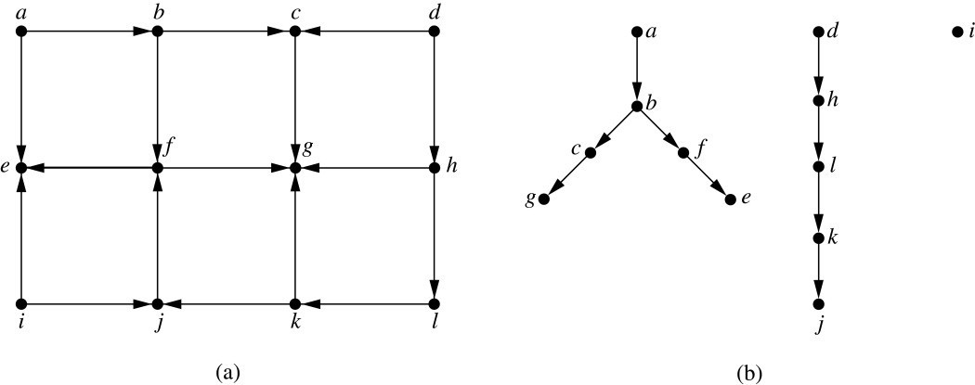
Depth-First Search in Directed Graphs
Both depth-first search and breadth-first search can be easily modified to run on a directed graph. But the result is not necessarily a spanning tree, but rather a spanning forest
Example: For the graph in (a), if we begin at vertex a, depth-first search adds the path connecting a, b, c, and g. At g, we are blocked, so we return to
c. Next, we add the path connecting f
to e. Next, we return to a and find that we cannot add a new path. So, we begin another tree with d as its root.
We find that this new tree consists of the path connecting the vertices d, h, l, k, and j. Finally, we add a new tree, which only contains i, its root.

Slide 14
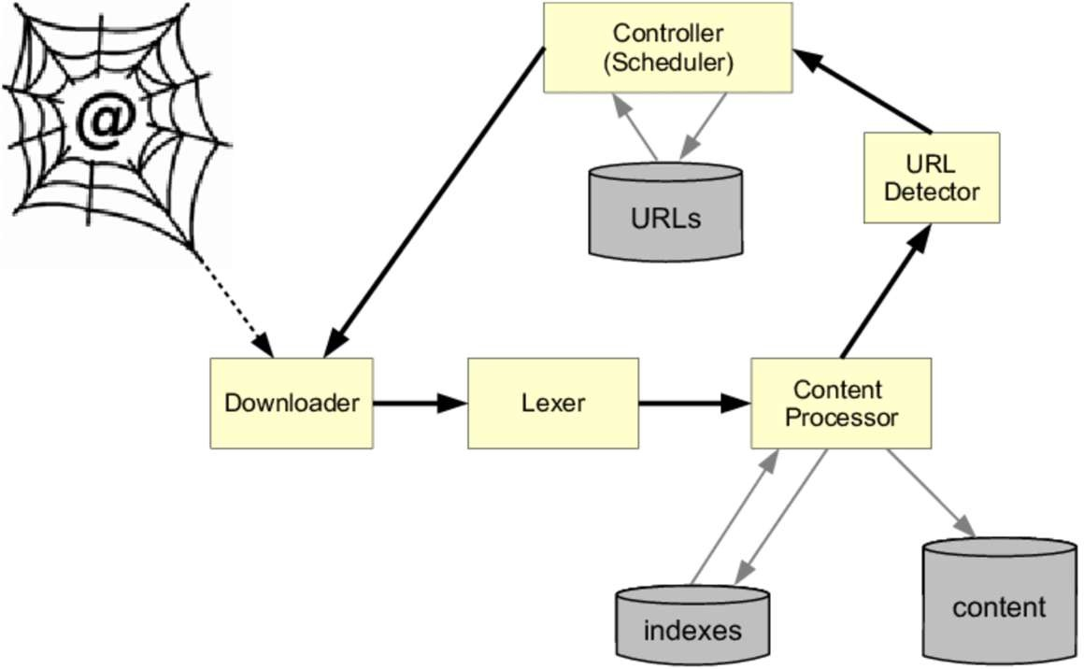
Applications: Google Search Engines
To index websites, search engines such as Google systematically explore the web starting at known sites. The programs that do this exploration are known as Web spiders
  A web spider is a computer program that’s used to search and automatically index website content

Slide 15
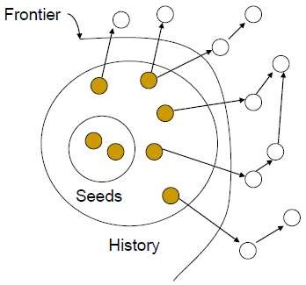
Applications: Google Search Engines
How does a web spider search and automatically index website content?
  Start from a seed set: a list of URLs to visit, denoted by U
    Visit hyperlinks in the pages and add them to crawl frontier
    Depth first search or breadth first search
Crawling approach:
(1) Get next URL u from U
(2) Download the webpage of u
URL Frontier: contains URLs yet to be fetched
– URLs from the frontier are recursively visited according to a set of policies
U

Slide 16
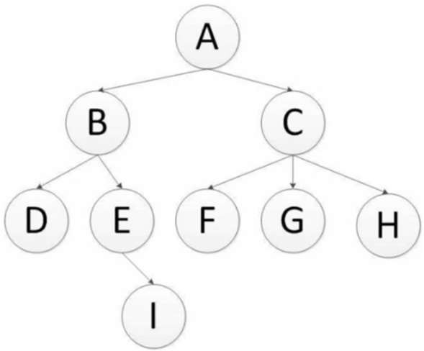
Applications: Google Search Engines (Continued)
Depth-first search
  Start from the initial page, follow one link after another until the path ends, then move on to another starting page and continue tracking the links
Breadth-first search
  Directly insert each first-level link found on the downloaded web page at the end of the URL queue to be crawled
Depth-first crawling order：
A-B-D-E-I-C-F-G-H
Breadth-first crawling order：
A-B-C-D-E-F-G-H-I

Slide 17
Minimum Spanning Trees
Minimum Spanning Trees
Algorithms for Minimum Spanning Trees

Slide 18
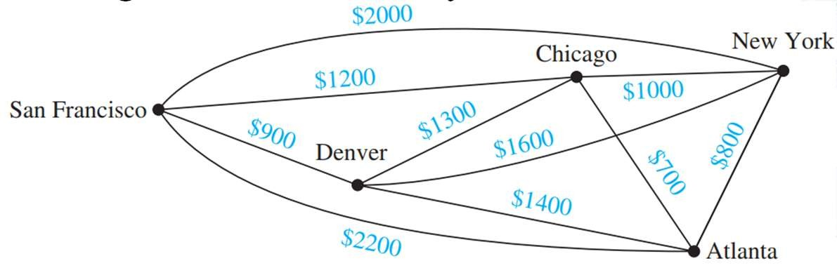
Minimum Spanning Trees
Definition: Graphs that have a number assigned to each edge are called weighted graphs.
Example: A company plans to build a communications network connecting its five computer centers. Vertices represent computer centers, edges represent possible leased lines, and the weights on edges are the monthly lease rates of the lines represented by the edges.
Which links should be made to ensure that there is a path between any two computer centers so that the total cost of the network is minimized?
Solution: We can solve this problem by finding a spanning tree so that the sum of the weights of the edges of the tree is minimized. Such a spanning tree is called a minimum spanning tree.

Slide 19

Minimum Spanning Trees
Definition: A minimum spanning tree in a connected weighted graph is a spanning tree that has the smallest possible sum of weights of its edges.
Example: Design a minimum-cost communications network connecting all the computers represented by the graph?
Solution: How about using brute force?

Slide 20
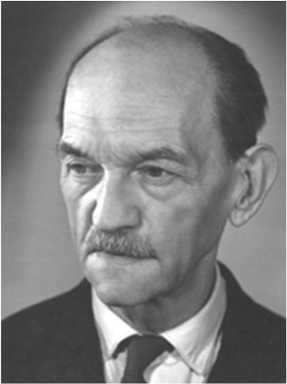
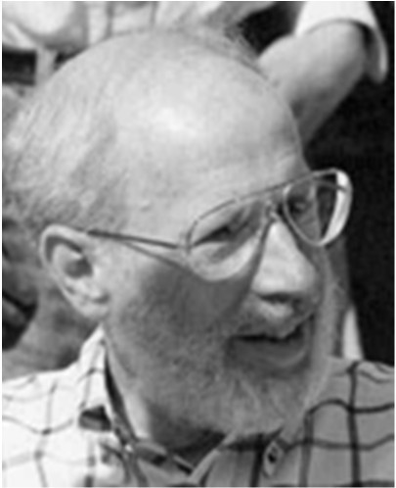
Algorithms for Finding Minimum Spanning Trees
Recall: In Section 3.1 a greedy algorithm is a procedure that makes an optimal choice at each of its steps. Optimizing at each step does not guarantee that the optimal overall solution is produced. However, the two algorithms presented in this section for constructing minimum spanning trees are greedy algorithms that do produce optimal solutions.
The first algorithm was discovered by Vojtěch Jarník in 1930
The second algorithm was discovered by Joseph Kruskal in 1956
Vojtěch Jarník (1897-1970)
Joseph Kruskal (1928-2010)

Slide 21
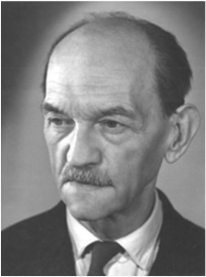
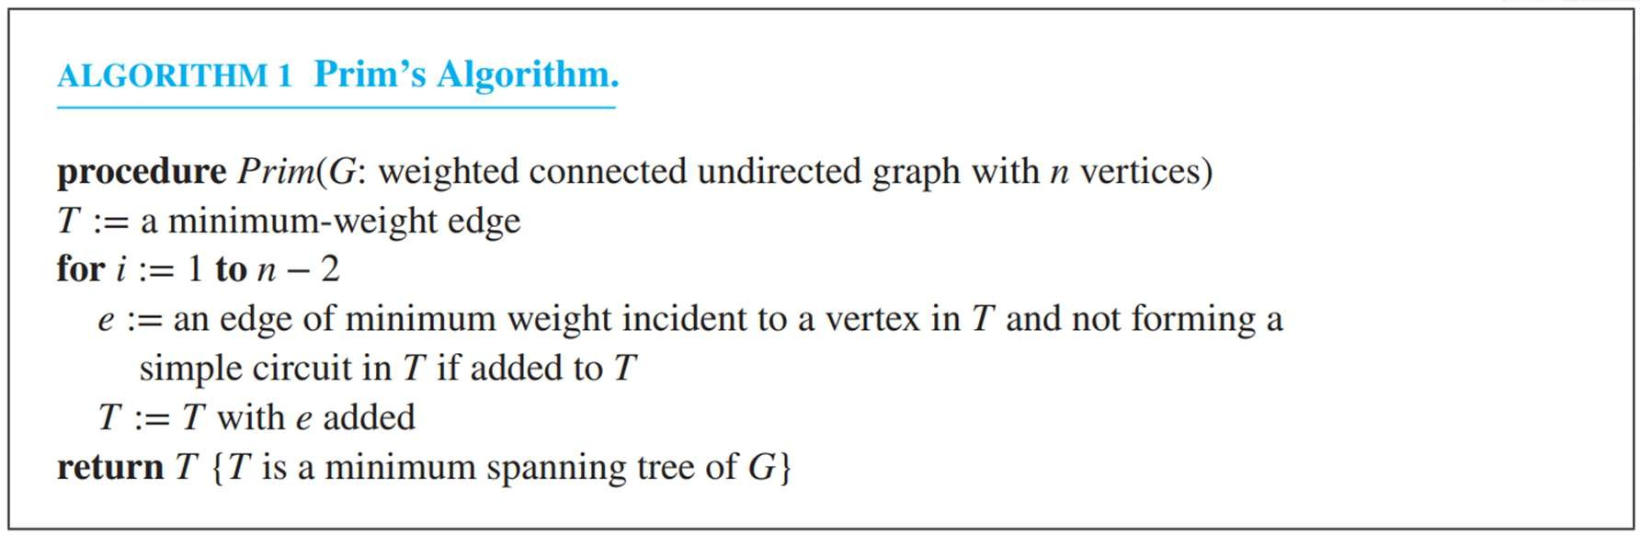
Prim’s algorithm
Vojtěch Jarník (1897-1970)
Suppose the graph has n edges,
Begin by choosing any edge with smallest weight, putting it into the spanning tree
Successively add to the tree edges of minimum weight that are incident to a vertex already in the tree, never forming a simple circuit with those edges already in the tree
Stop when n-1 edges have been added
21

Slide 22

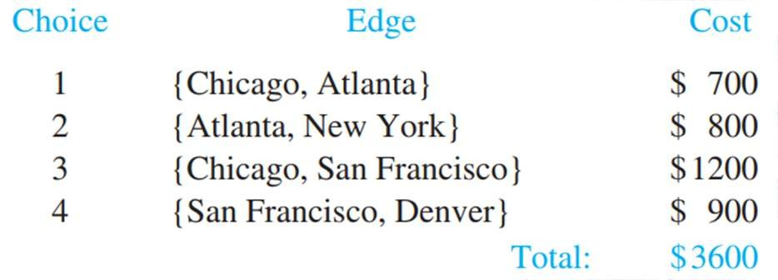
Prim’s algorithm
Example: Use Prim’s algorithm to design a minimum-cost communications network connecting all the computers represented by the graph
Solution: We solve this problem by finding a minimum spanning tree in the graph. Prim’s algorithm is carried out by choosing an initial edge of minimum weight and successively adding edges of minimum weight that are incident to a vertex in the tree and that do not form simple circuits. The edges in color show a minimum spanning tree produced by Prim’s algorithm, with the choice made at each step displayed.
22

Slide 23
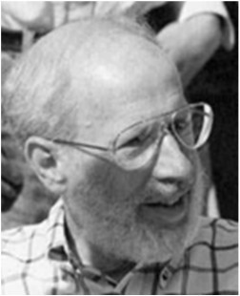
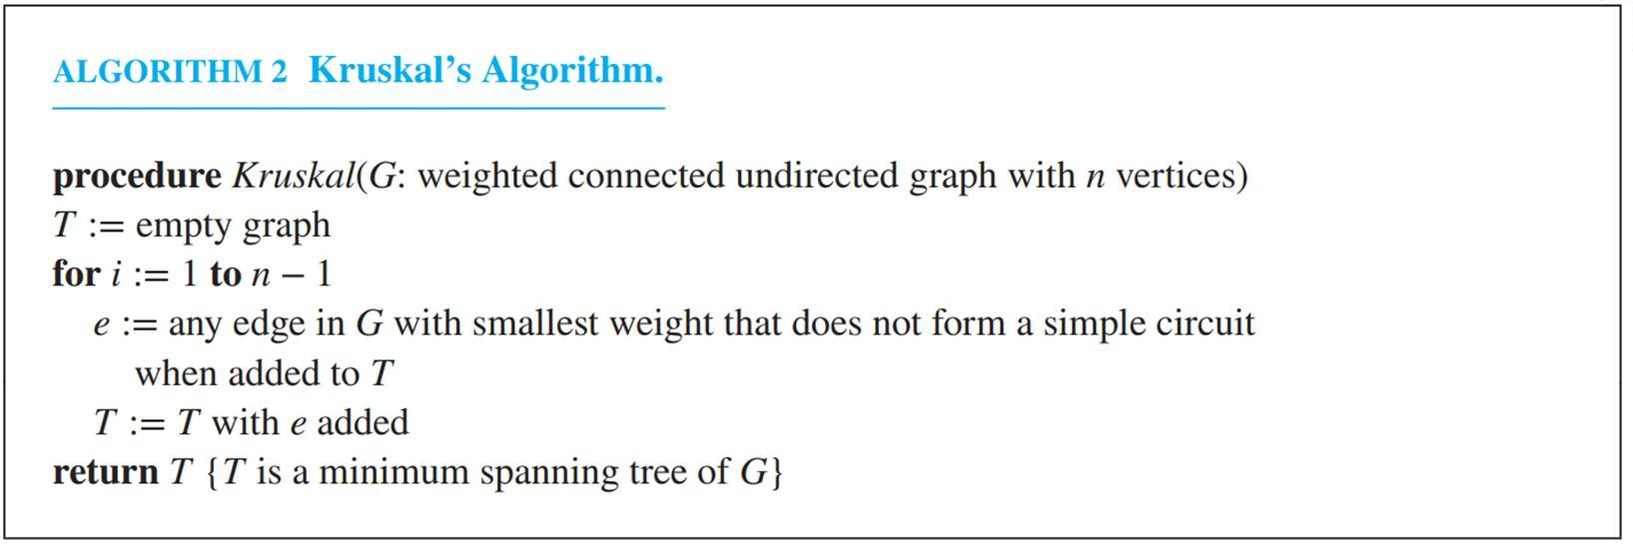
Kruskal’s algorithm
Joseph Kruskal (1928-2010)
Suppose the graph has n edges,
Begin by choosing an edge in the graph with minimum weight, putting it into the spanning tree
Successively add edges with minimum weight that do not form a simple circuit with those edges already chosen
Stop after n-1 edges have been selected
23

Slide 24
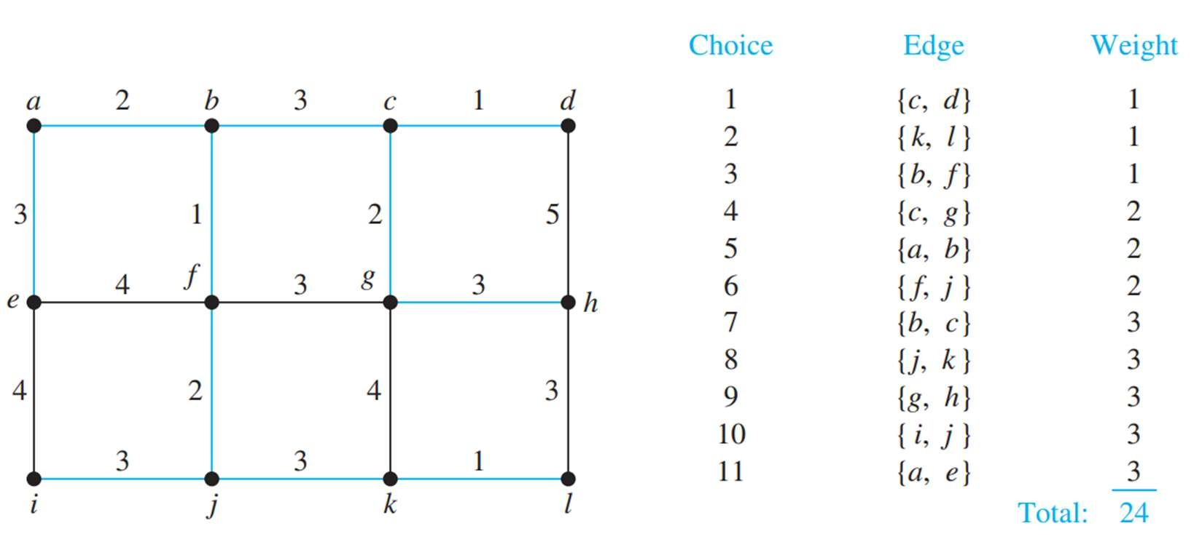
Kruskal’s algorithm
Example: Use Kruskal’s algorithm to find a minimum spanning tree in the weighted graph
24

Slide 25
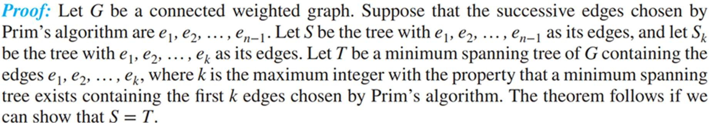
Proof for Prim’s algorithm
25

Slide 26
Q&A

